Slide 1
Calculus I for MGMT – Preliminaries
Exponential & Logarithmic Expressions
Mathematics for Management
Supplementary Electronic Materials
Preliminaries
  Numbers & Inequalities
  Exponential & Logarithmic Expressions
  The Cartesian Coordinate System
  Factorizing Polynomials &
  Solving Systems of Equations

Slide 2
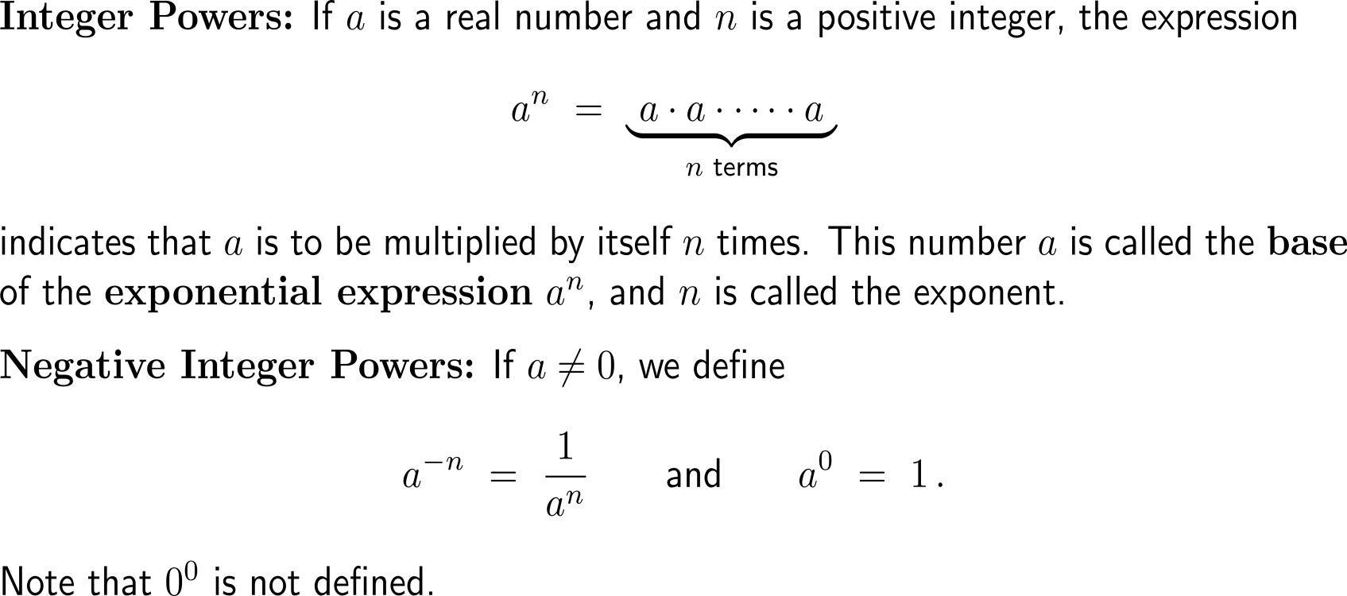
There are four types of exponential expressions: (i) integer powers,
(ii) negative integer powers , …

Slide 3
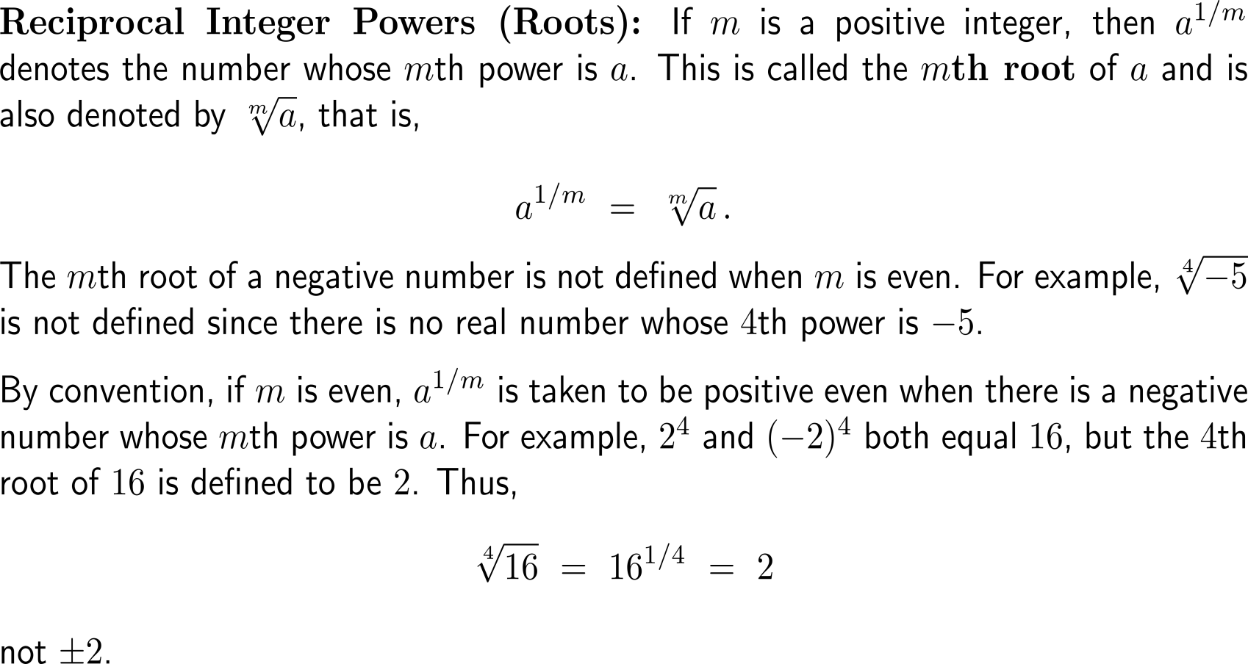
… (iii) reciprocal integer powers or roots, …

Slide 4
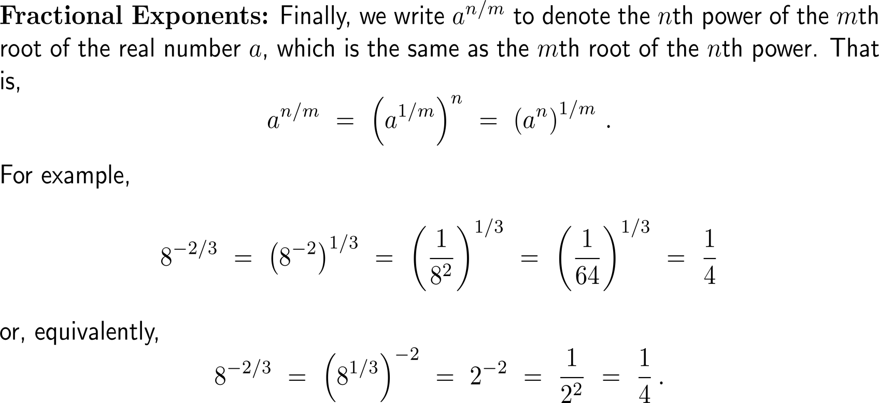
… and (iv) powers with fractional exponents

Slide 5
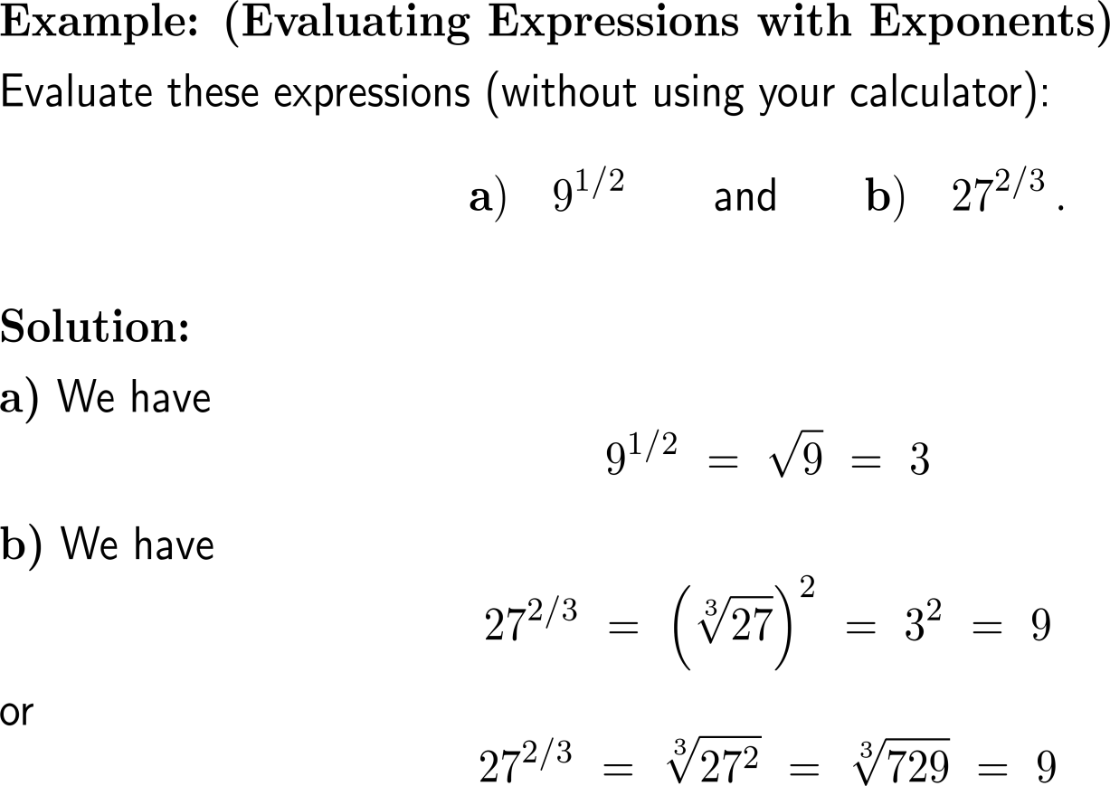
Example:
Evaluating expressions with exponents

Slide 6
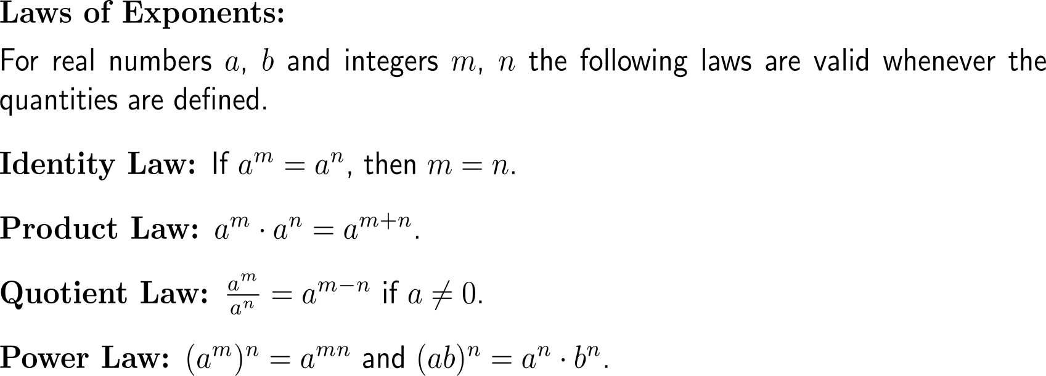
Exponents obey a set of laws that are very useful to find shortcuts during computations

Slide 7
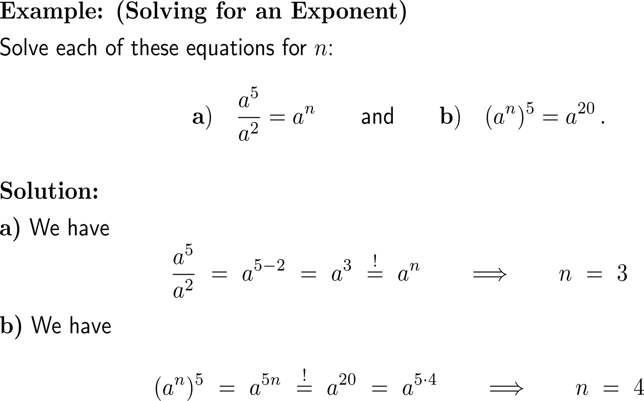
Example:
Solving for an exponent

Slide 8
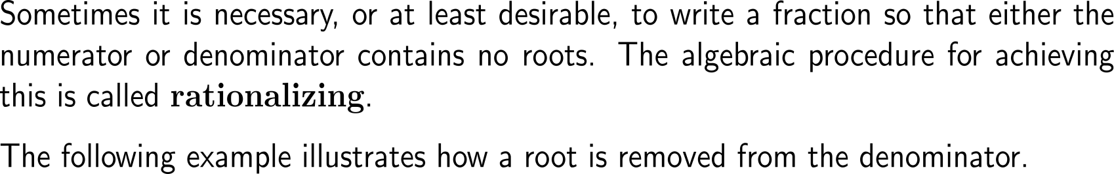
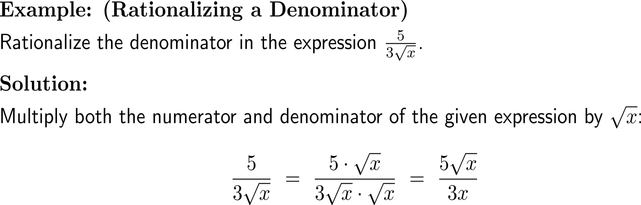
Rationalizing allows to write a fraction such that either the numerator or the denominator contains no roots

Slide 9
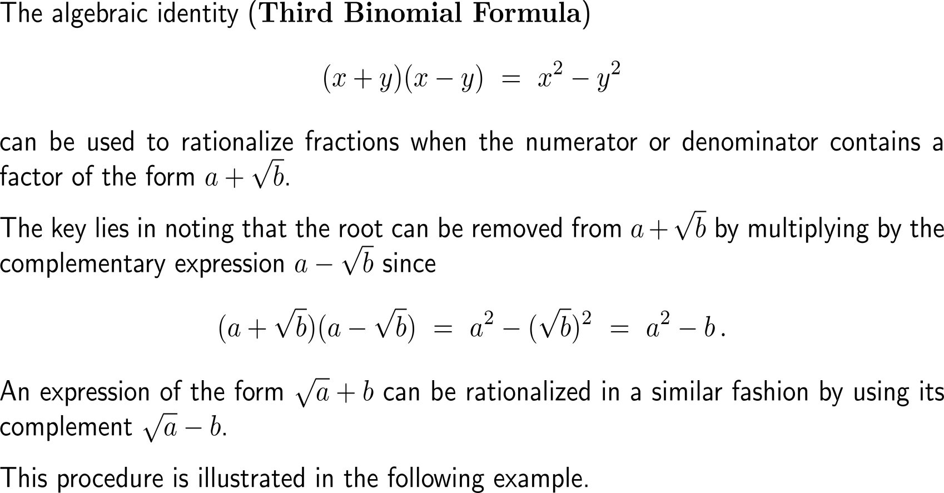
A key tool for rationalizing is the Third Binomial Formula

Slide 10
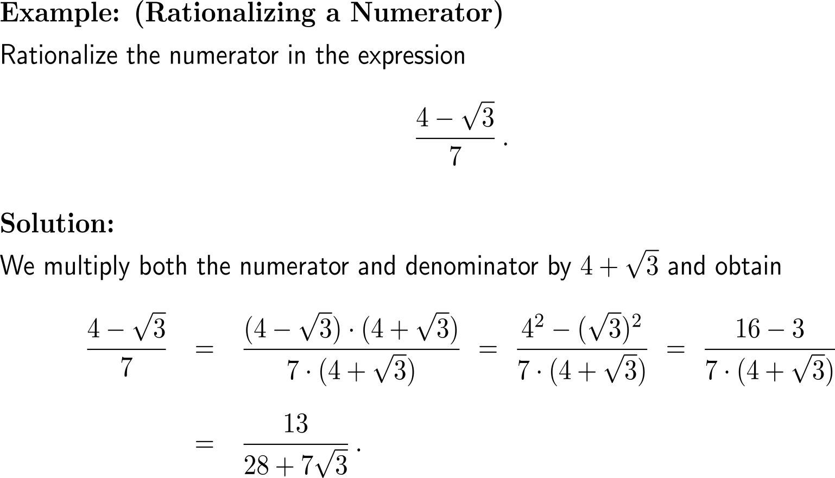
Example:
Rationalizing a numerator

Slide 11
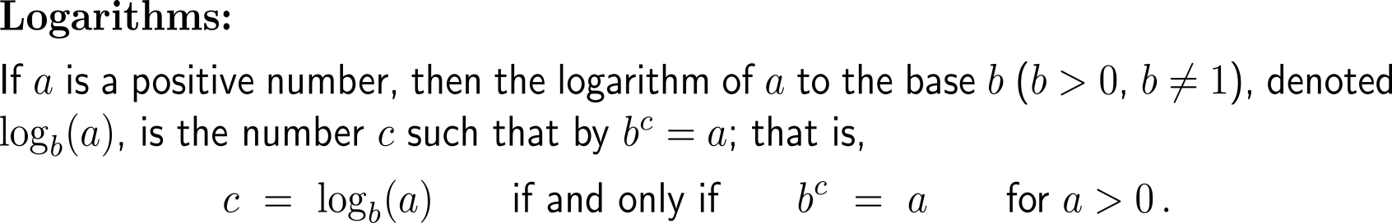
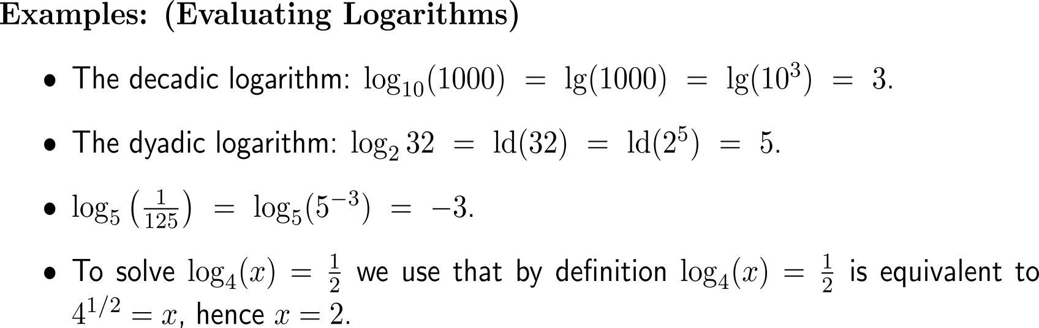
Logarithms return the exponent to a given base

Slide 12
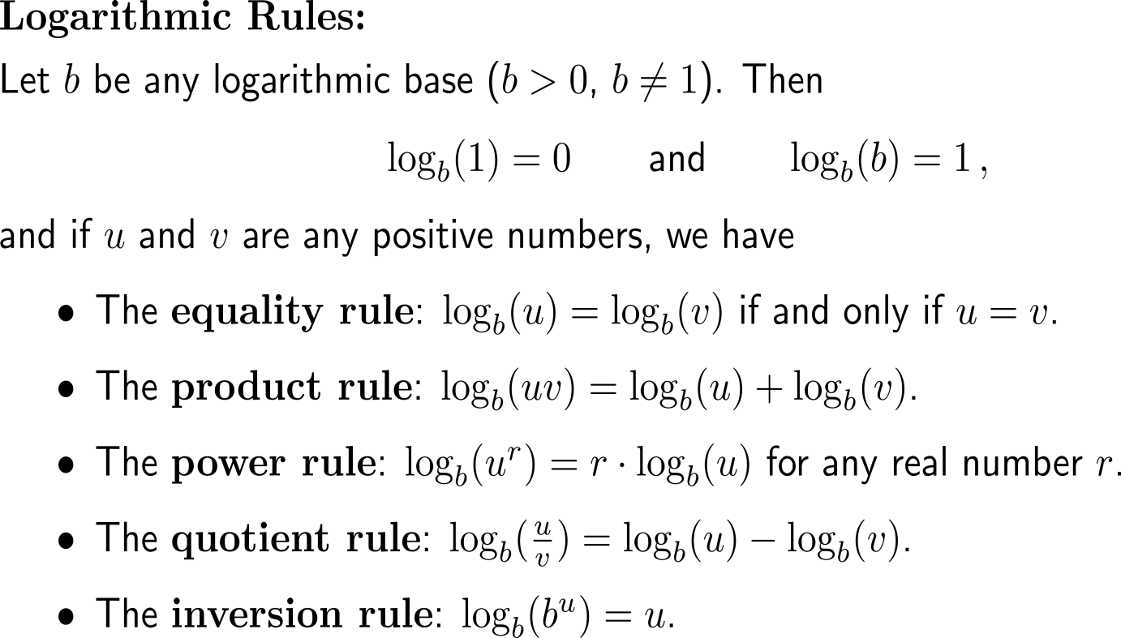
The computation rules for logarithms resemble those for exponents

Slide 13
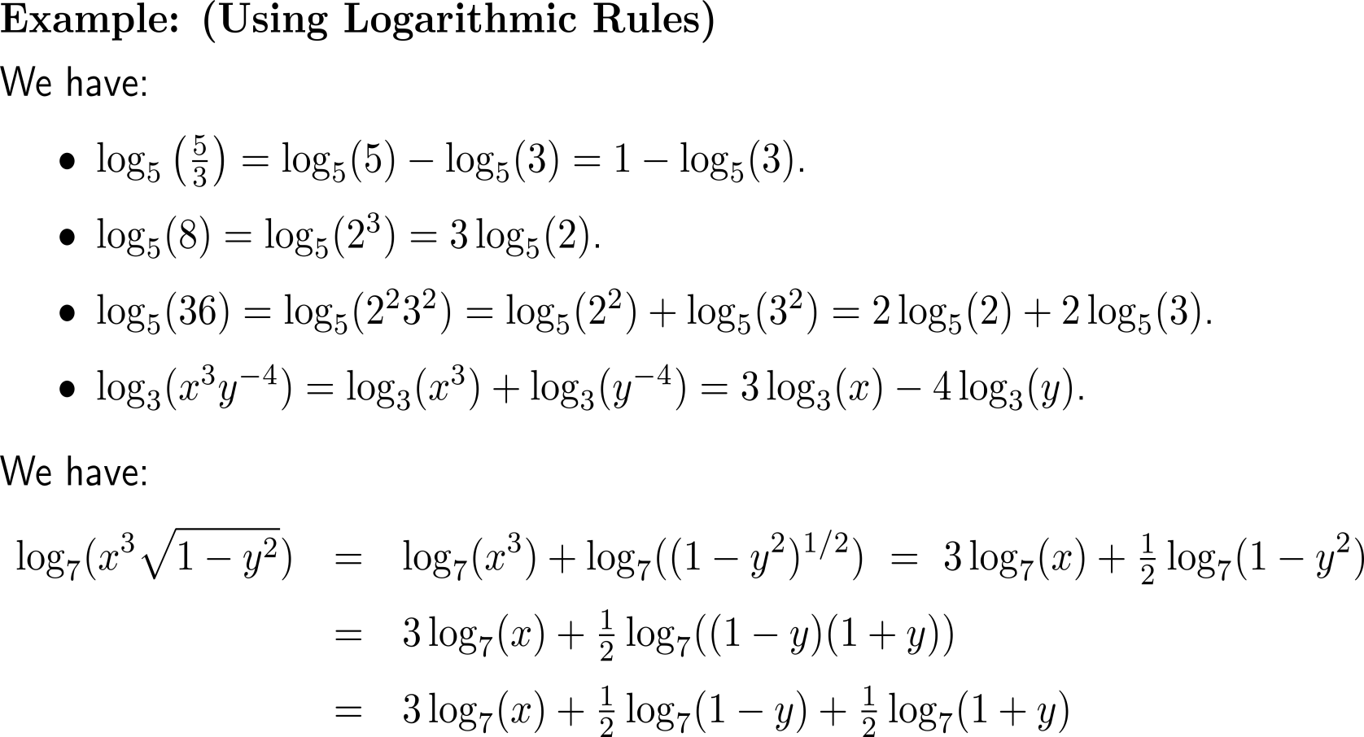
Examples:
Using logarithmic rules

Slide 14
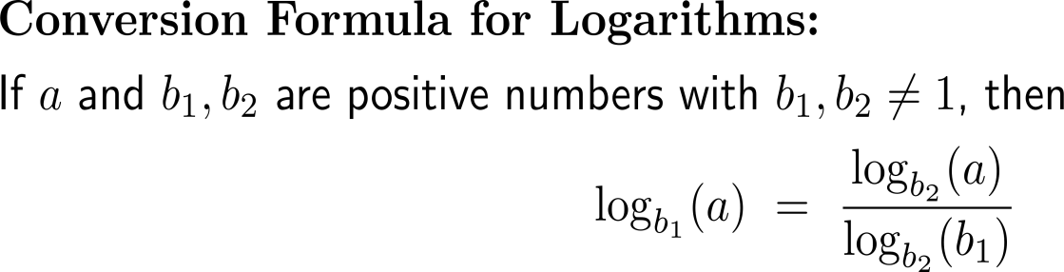
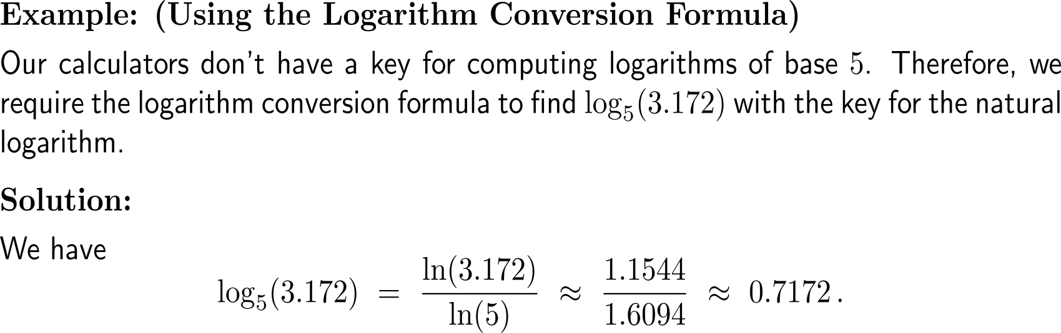
Logarithms of one base can be converted into logarithms of another base

Slide 15
Calculus I for Management

