Slide 1
Calculus I for MGMT – Preliminaries
The Cartesian Coordinate System
Mathematics for Management
Supplementary Electronic Materials
Preliminaries
  Numbers & Inequalities
  Exponential & Logarithmic Expressions
  The Cartesian Coordinate System
  Factorizing Polynomials &
  Solving Systems of Equations

Slide 2
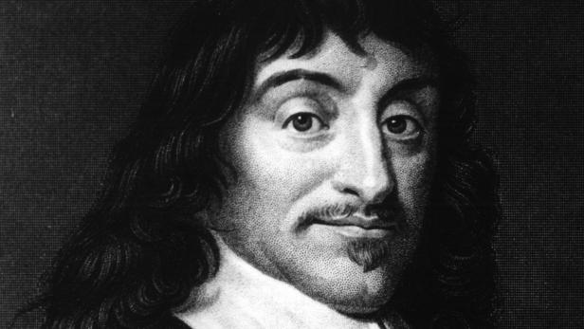
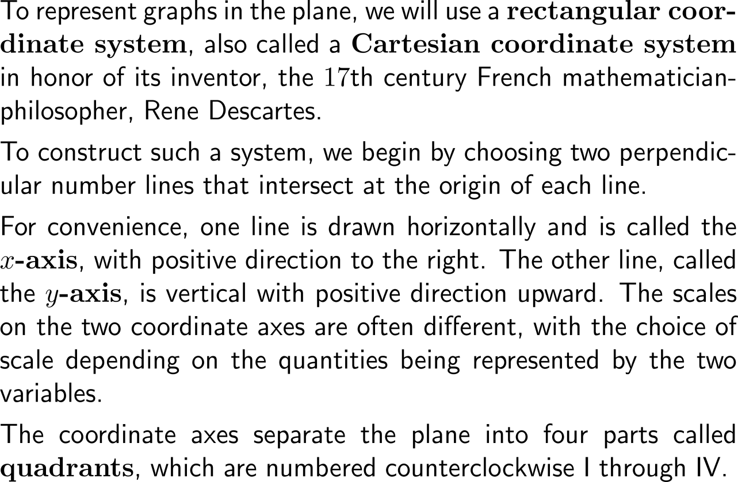
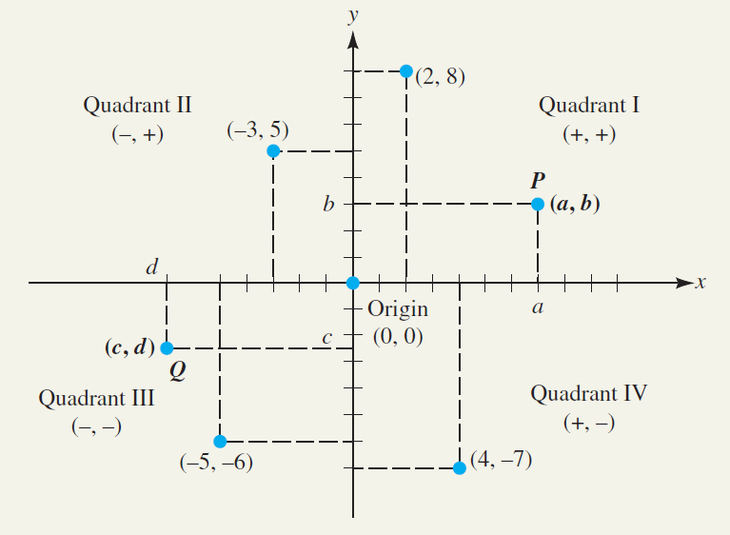
To represent and uniquely address points in a plane, we use a Cartesian coordinate system (1/ 2)
René Descartes
(31.03.1596 – 11.02.1650)

Slide 3
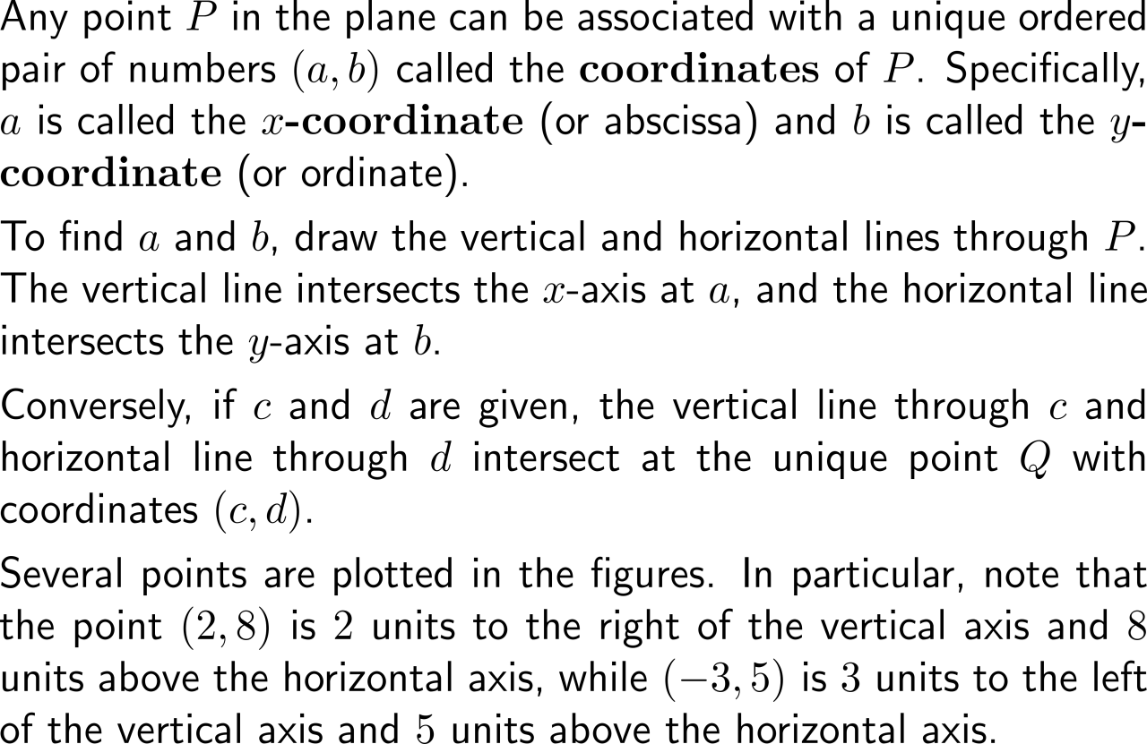
To represent and uniquely address points in a plane, we use a Cartesian coordinate system (2/ 2)

Slide 4
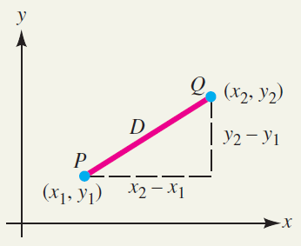
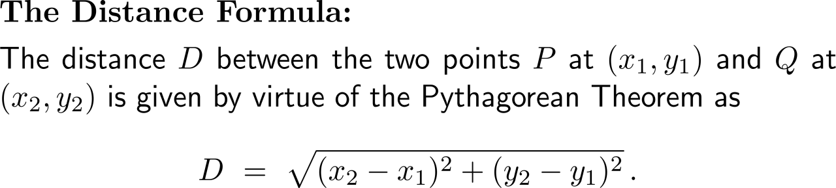
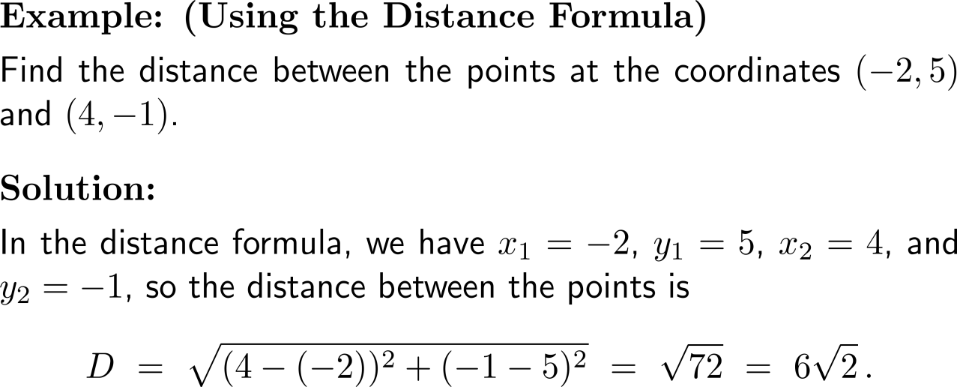
The distance between two points in the plane is provided by means of the Pythagorean Theorem

Slide 5
Example:
Specific diagrams in microeconomics
Price-Quantity-Diagram
Payoff-Diagram
Utility-Diagram
price
payoff for player B
utility of player B
payoff space
utility space
demand curve
quantity
payoff for player A
utility of player A
For instance, the price-quantity-space is represented as Cartesian product, and every pair (price, quantity) is an element of this space. Specific elements – those that are realized in a special situation – can form a specific curve, in this case a demand curve.
Analogous situations hold for gains/ payoffs or utilities.

Slide 6
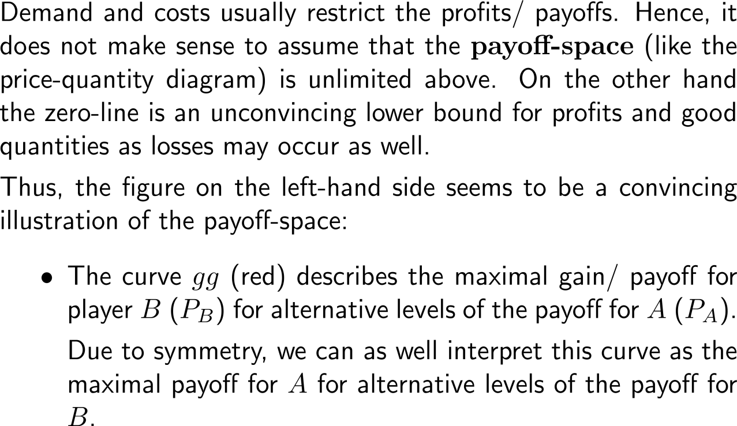
How can we make sense of and illustrate the payoff-space? (1/ 2)
payoff for player B (P_{B})
G
g
payoff space
P_{B}*
P_{A}*
45°
g
G
payoff for player A (P_{A})

Slide 7
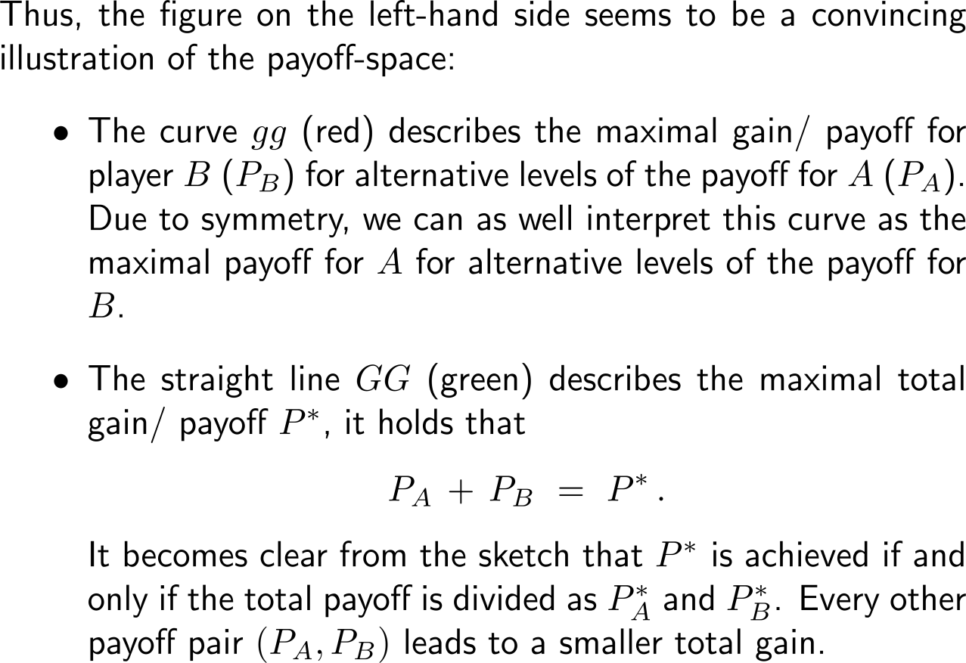
How can we make sense of and illustrate the payoff-space? (2/ 2)
payoff for player B (P_{B})
G
g
payoff space
P_{B}*
P_{A}*
45°
g
G
payoff for player A (P_{A})

Slide 8
Calculus I for Management

