Slide 1
Calculus I for MGMT – Functions & Graphs
Functional Models
Mathematics for Management
Supplementary Electronic Materials
Functions & Graphs
  Functions
  The Graph of a Function
  Lines & Linear Functions
  Functional Models

Slide 2
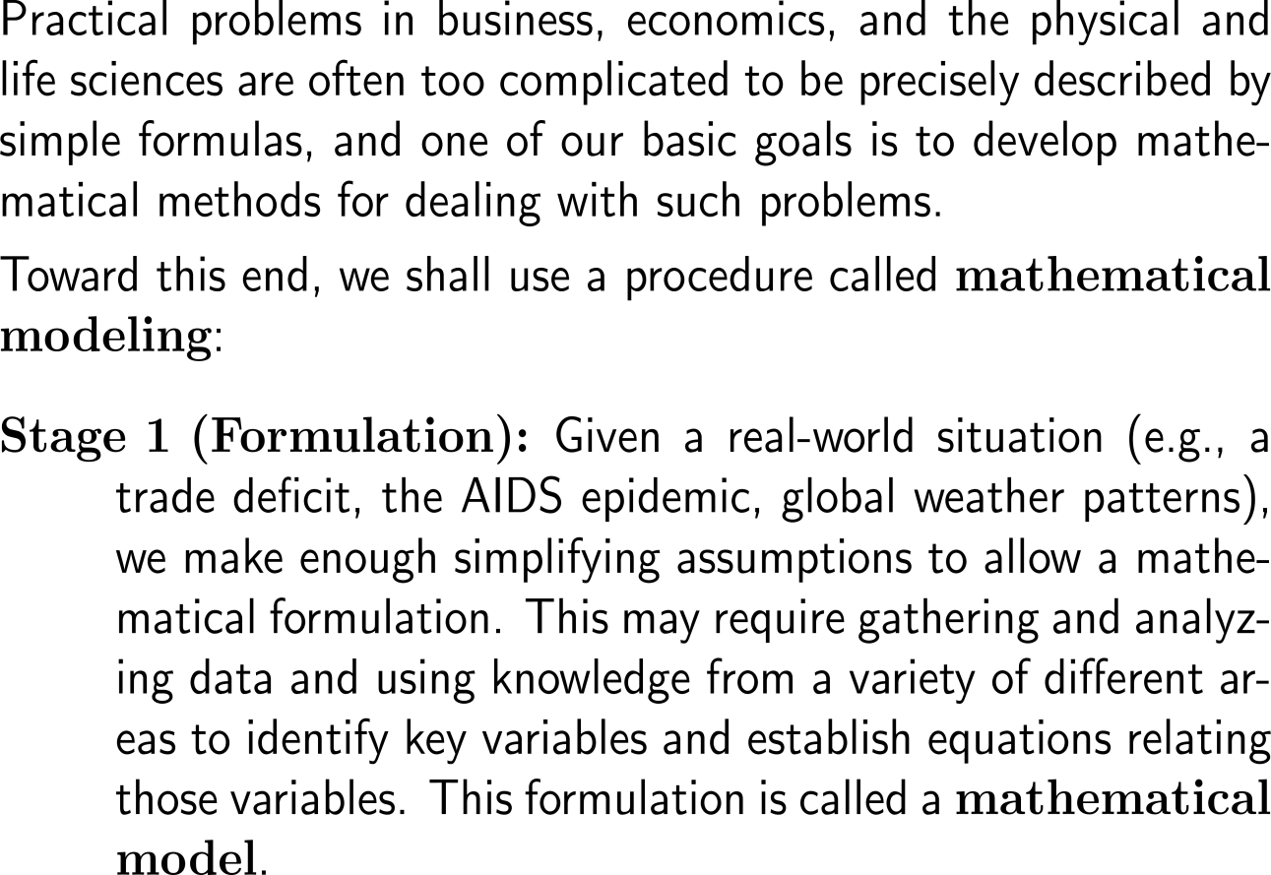
Mathematical modeling covers the process of solving a real-world situation by means of mathematical methods (1/ 3)
Economic
Problem
Formulation
Adjustments
Math. Model
Testing
Analysis
Simulation
Solution
Predictions
Inter-pretation
Communication

Slide 3
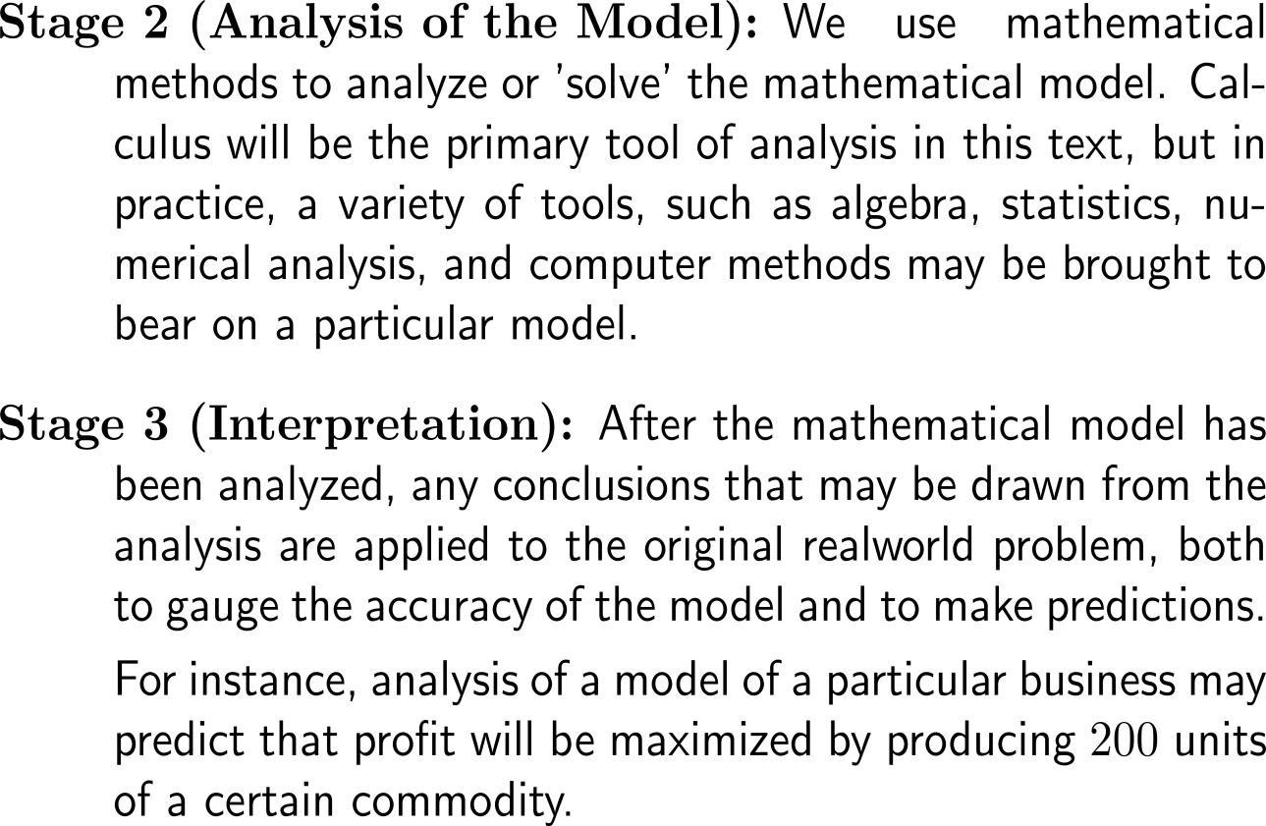
Mathematical modeling covers the process of solving a real-world situation by means of mathematical methods (2/ 3)
Economic
Problem
Formulation
Adjustments
Math. Model
Testing
Analysis
Simulation
Solution
Predictions
Inter-pretation
Communication

Slide 4
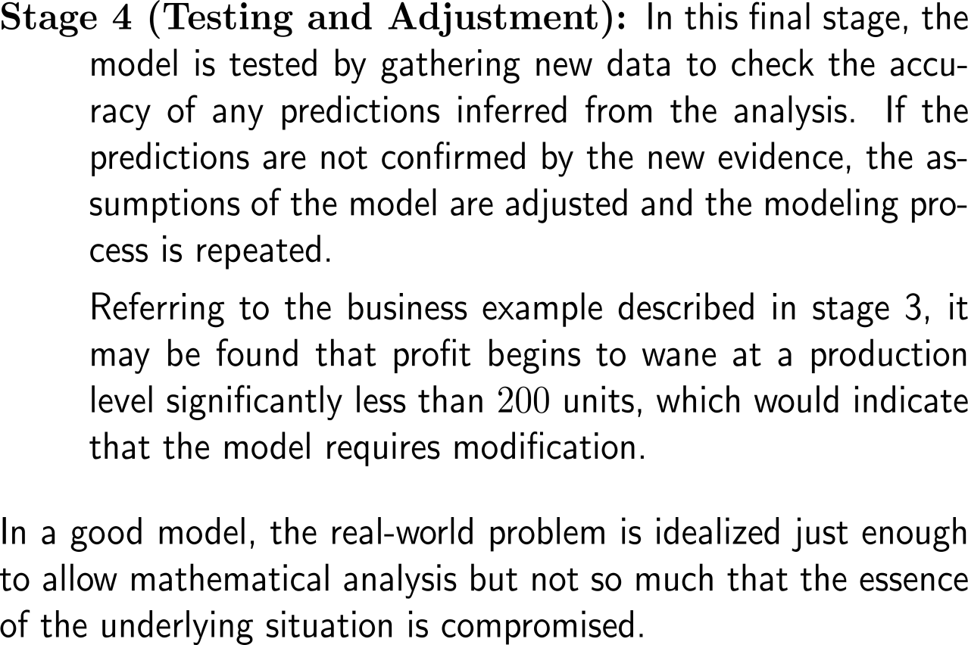
Mathematical modeling covers the process of solving a real-world situation by means of mathematical methods (3/ 3)
Economic
Problem
Formulation
Adjustments
Math. Model
Testing
Analysis
Simulation
Solution
Predictions
Inter-pretation
Communication

Slide 5
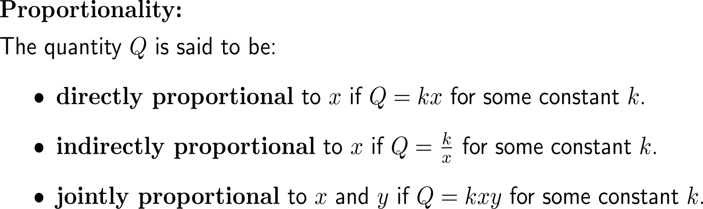
Two varying quantities are said to be in a relation of proportionality if their product or ratio yields a constant

Slide 6
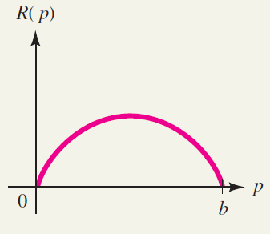
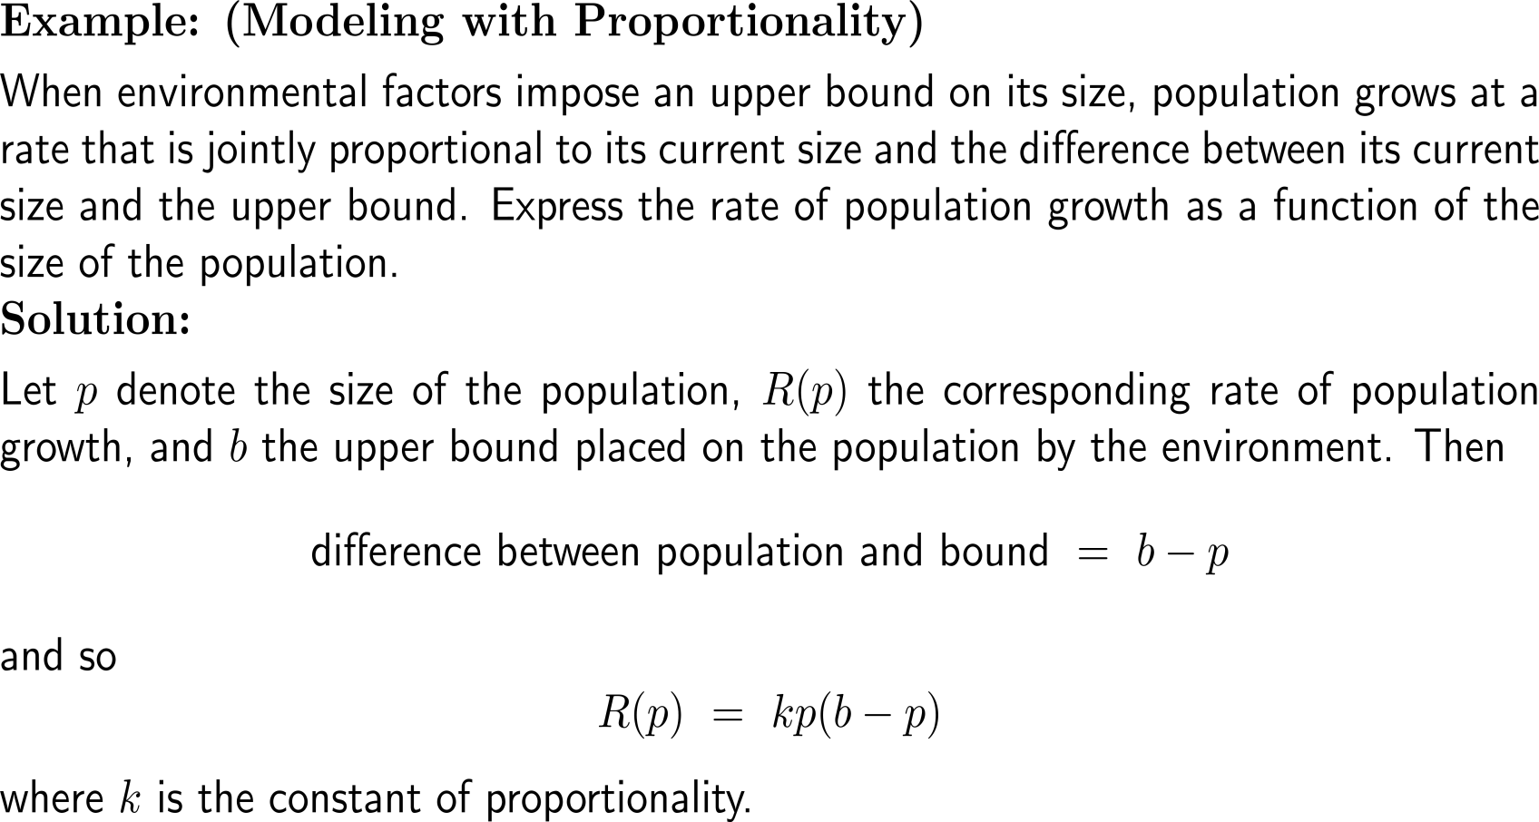
Example:
Modeling with Proportionality
The rate of bounded population growth:
R(p) = kp(b – p).

Slide 7
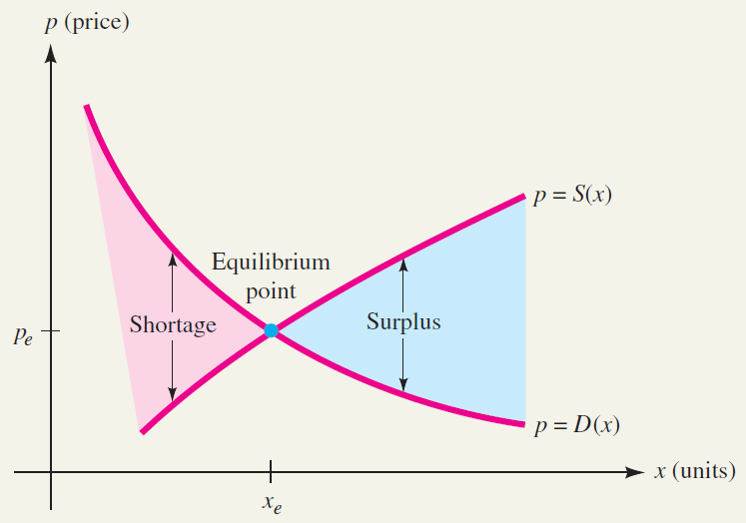
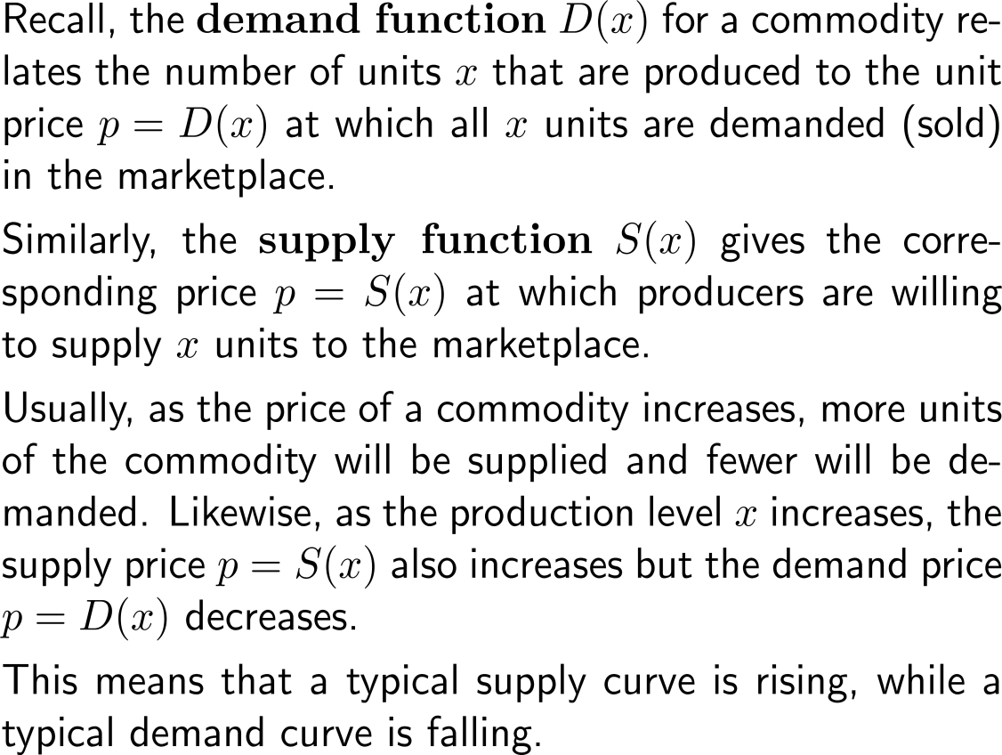
Market equilibrium: in a competitive market environment, supply tends to equal demand (1/ 2)
Market Equilibrium
Market equilibrium occurs when supply equals demand

Slide 8
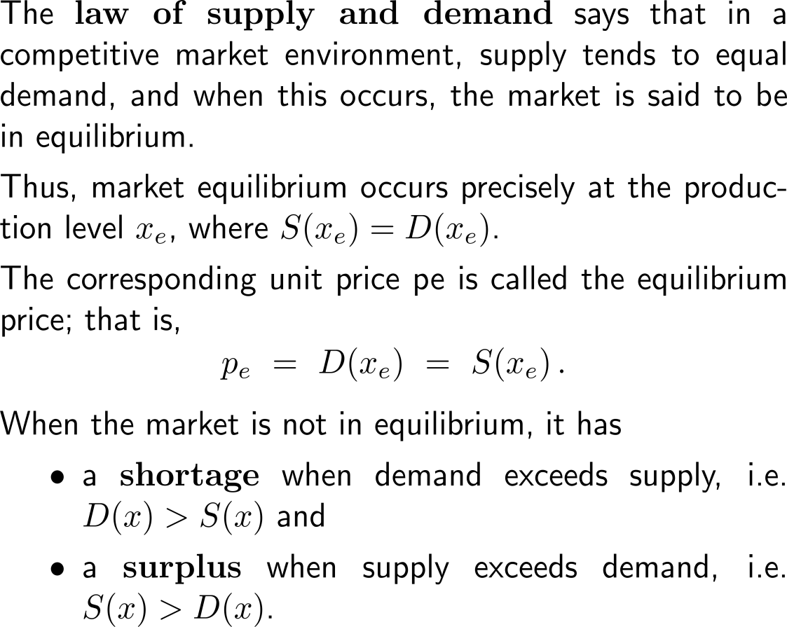
Market equilibrium: in a competitive market environment, supply tends to equal demand (2/ 2)
Market Equilibrium
Market equilibrium occurs when supply equals demand

Slide 9
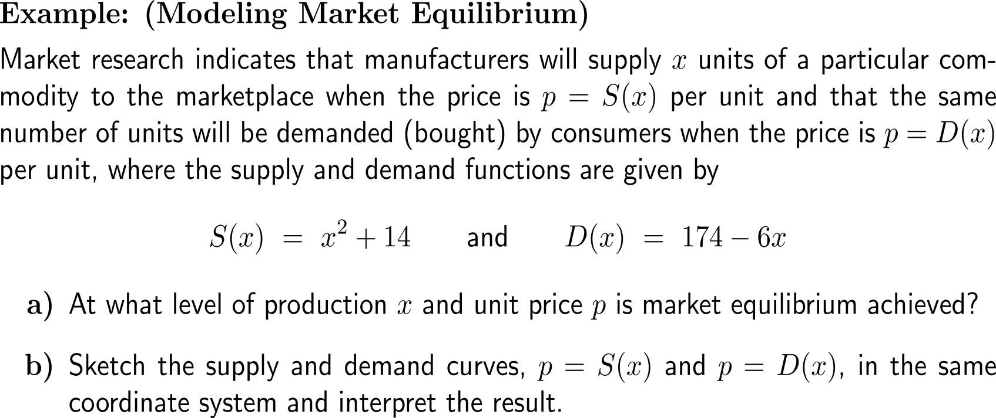
Example:
Modeling market equilibrium

Slide 10
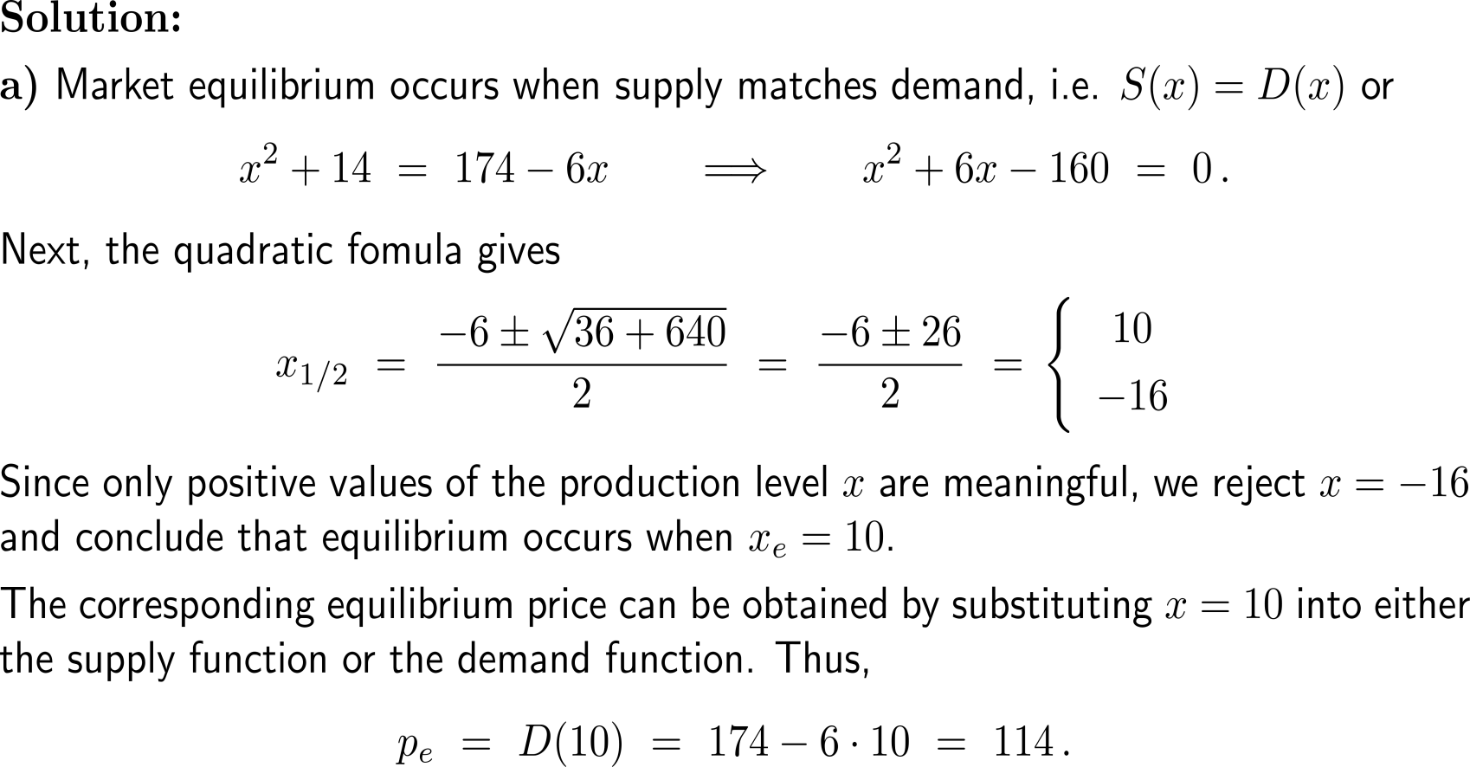
Example:
Modeling market equilibrium

Slide 11
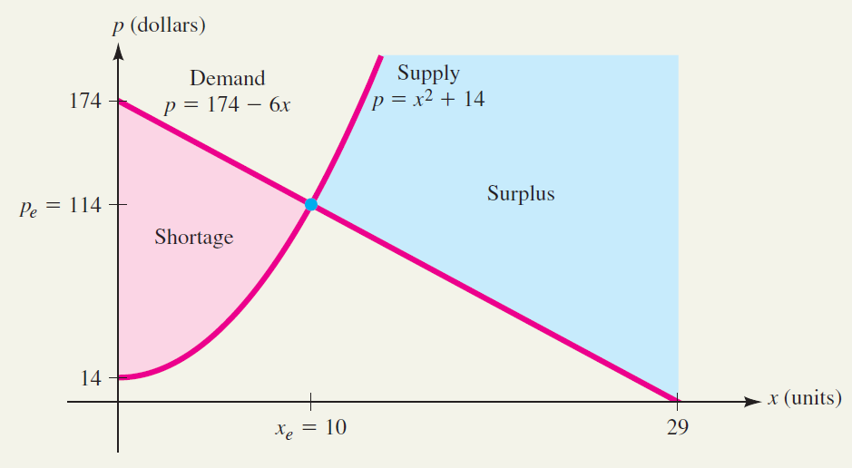
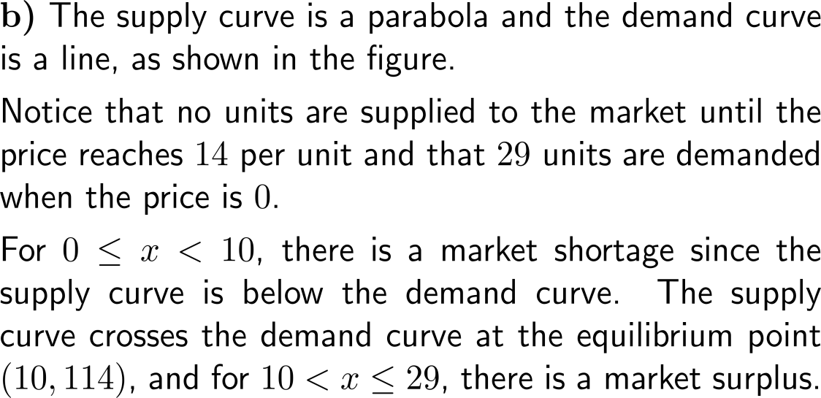
Example:
Modeling market equilibrium
Supply, demand, and equilibrium point for our example

Slide 12
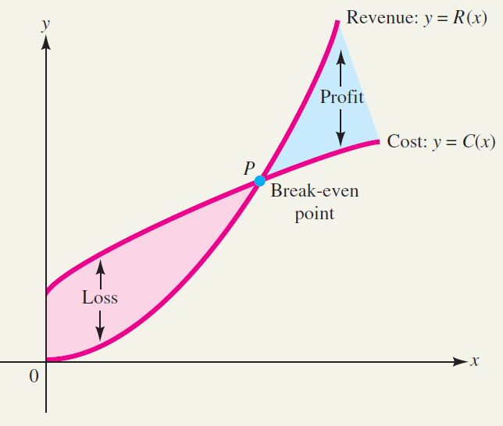
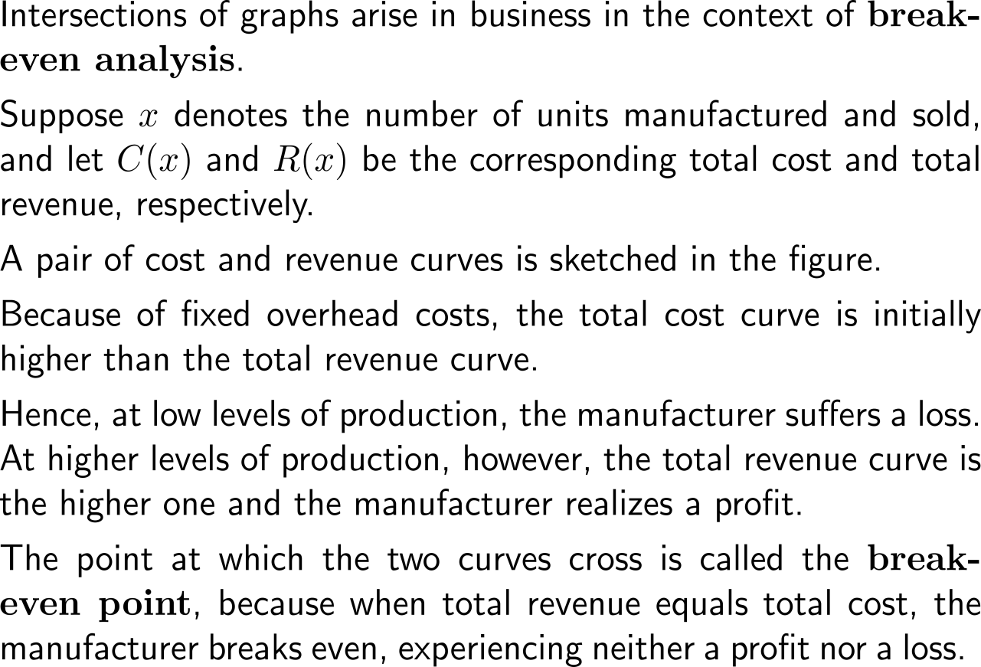
Break-even analysis: revenue (over) compensates costs
Cost and revenue curves, with a break-even point at P

Slide 13

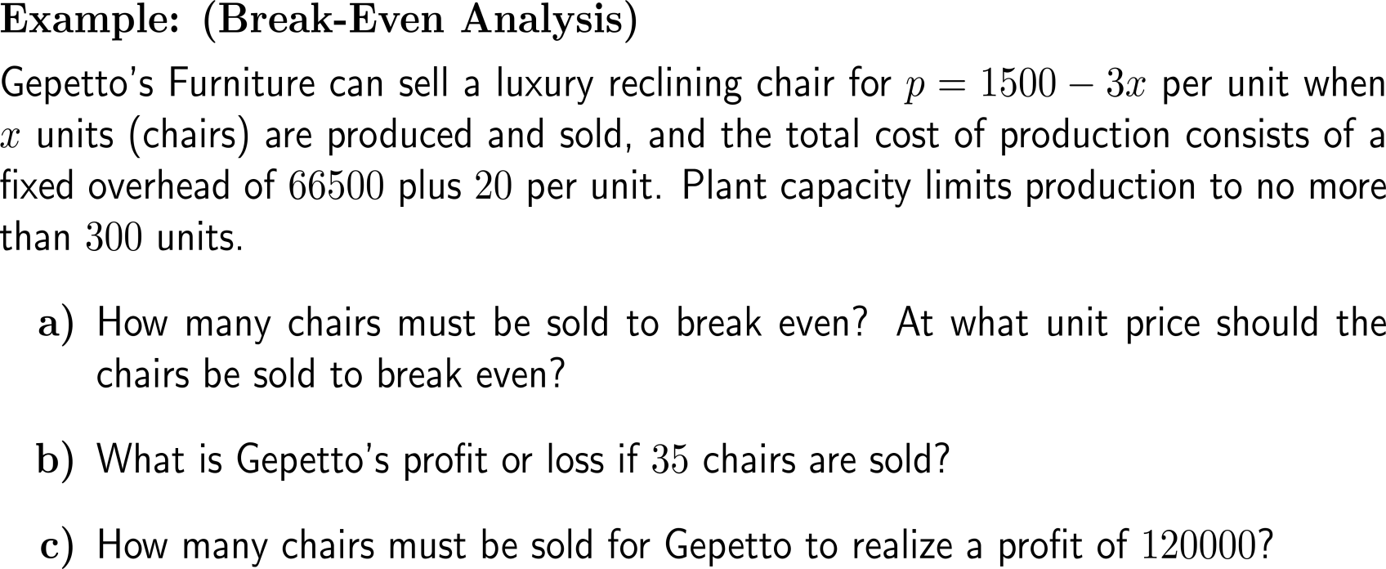

Example:
Break-Even analysis

Slide 14
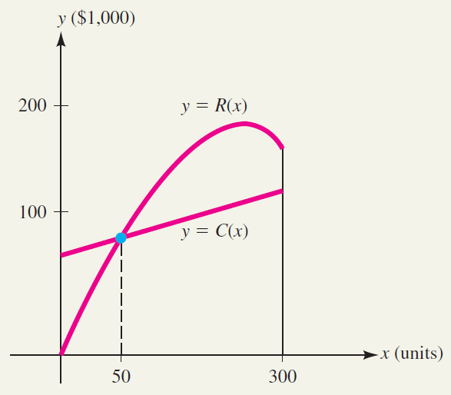

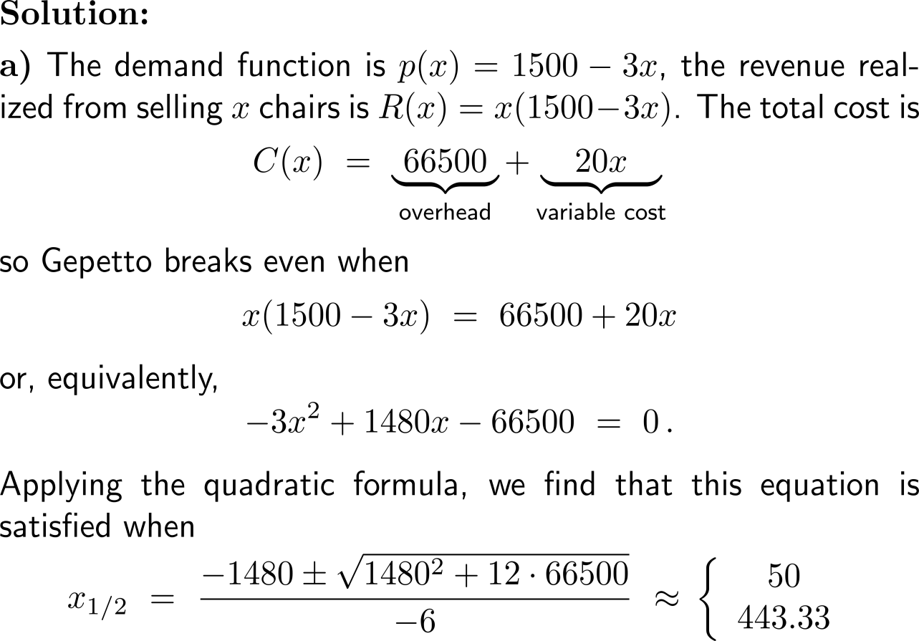
Example:
Break-Even analysis

Slide 15
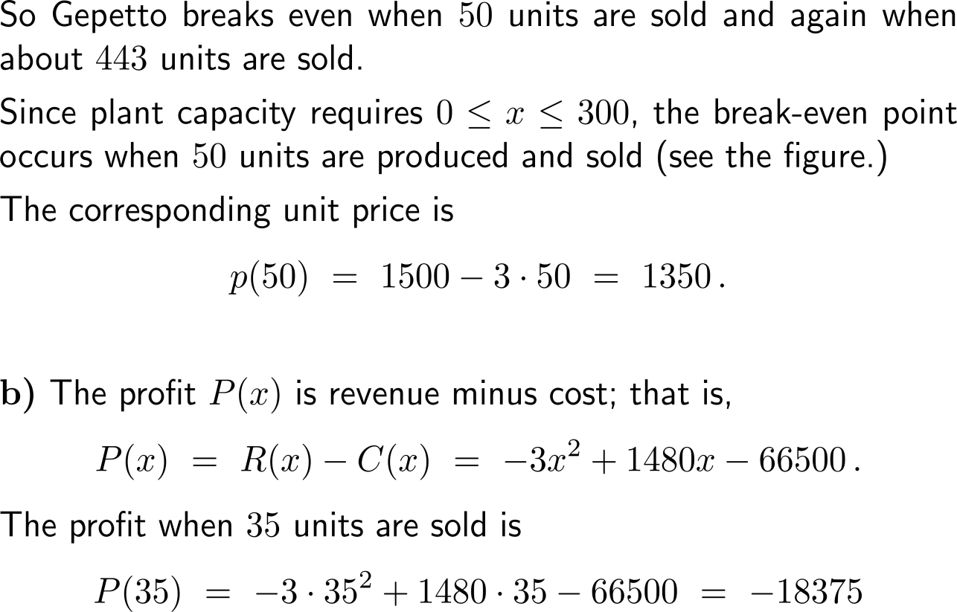
Example:
Break-Even analysis

Slide 16
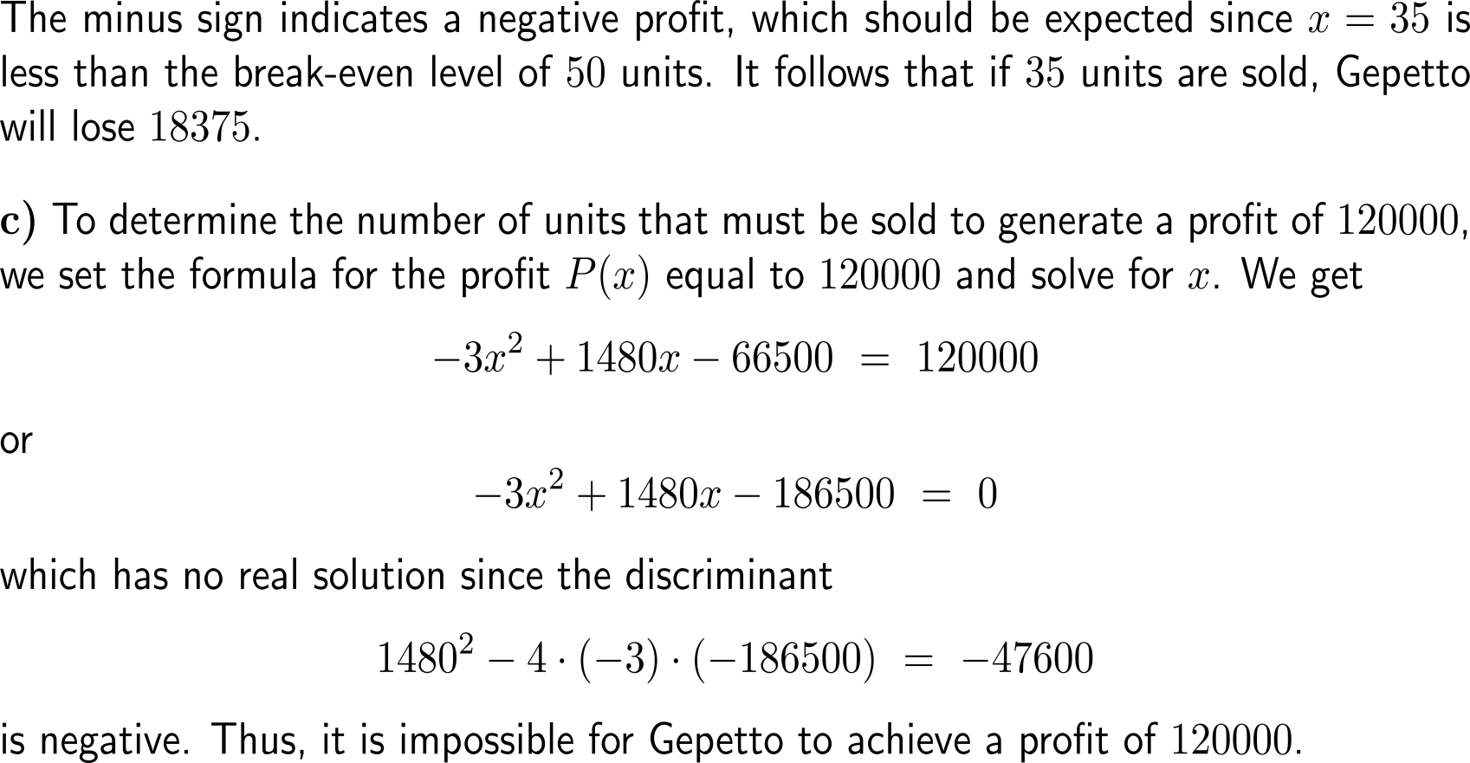
Example:
Break-Even analysis

Slide 17

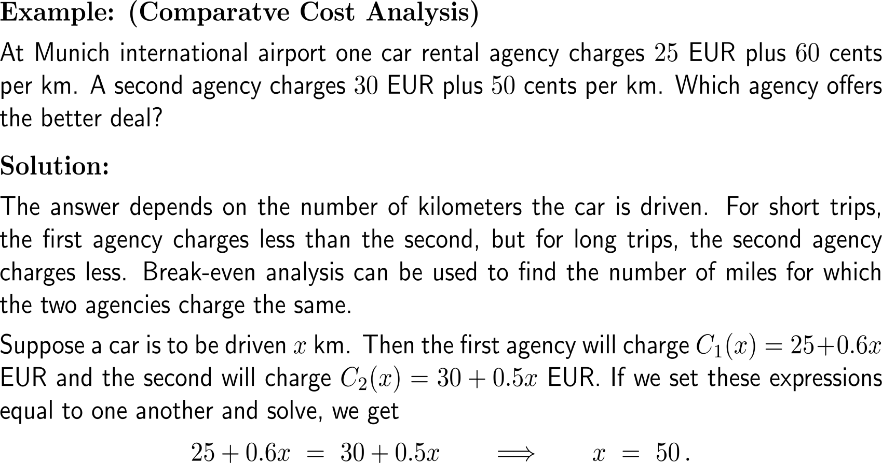
Example:
Comparative cost analysis

Slide 18
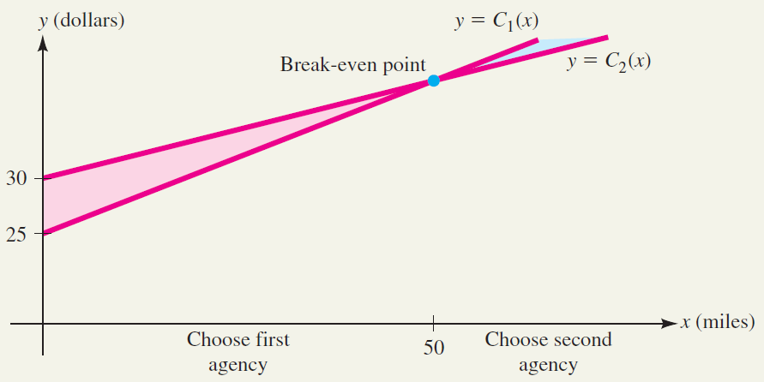
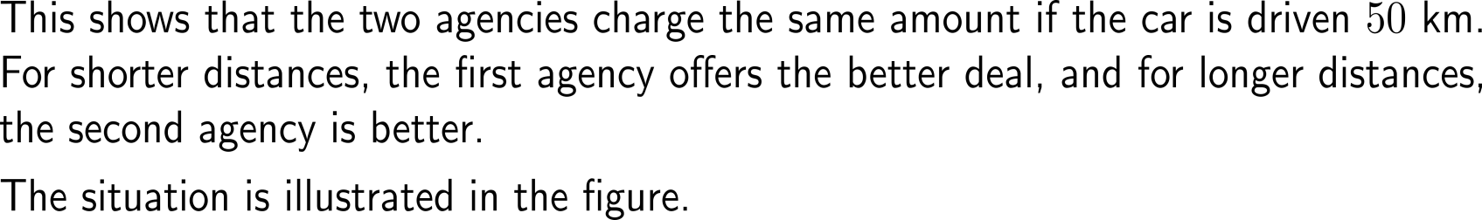
Example:
Comparative cost analysis

Slide 19
Calculus I for Management

