Slide 1
Calculus I for MGMT – Derivatives & Techniques of Differentiation
The Derivative
Mathematics for Management
Supplementary Electronic Materials
Derivatives & Techniques
of Differentiation
The Derivative
  Introductory Techniques
  of Differentiation

Slide 2
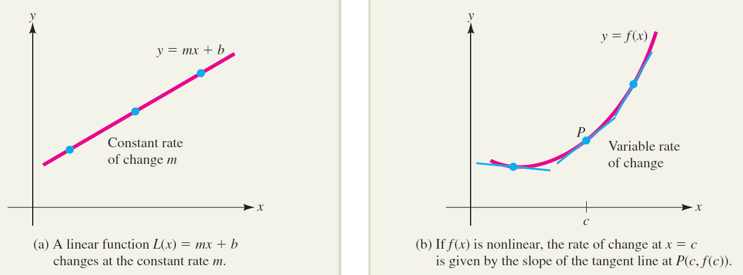
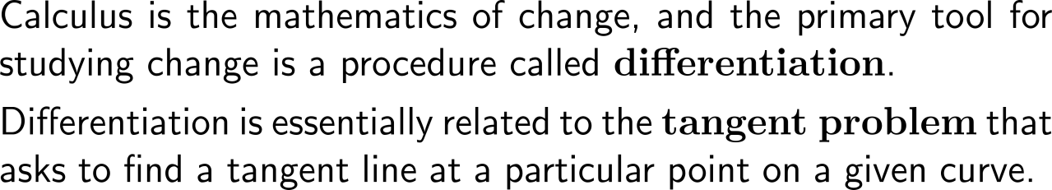
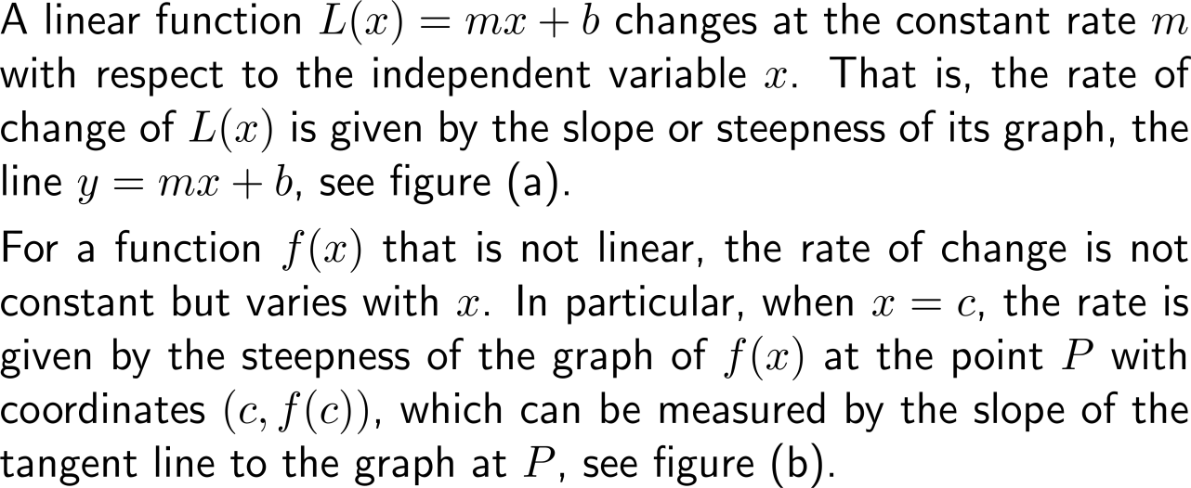
Calculus is the mathematics of change, and the primary tool for studying change is a procedure called differentiation

Slide 3
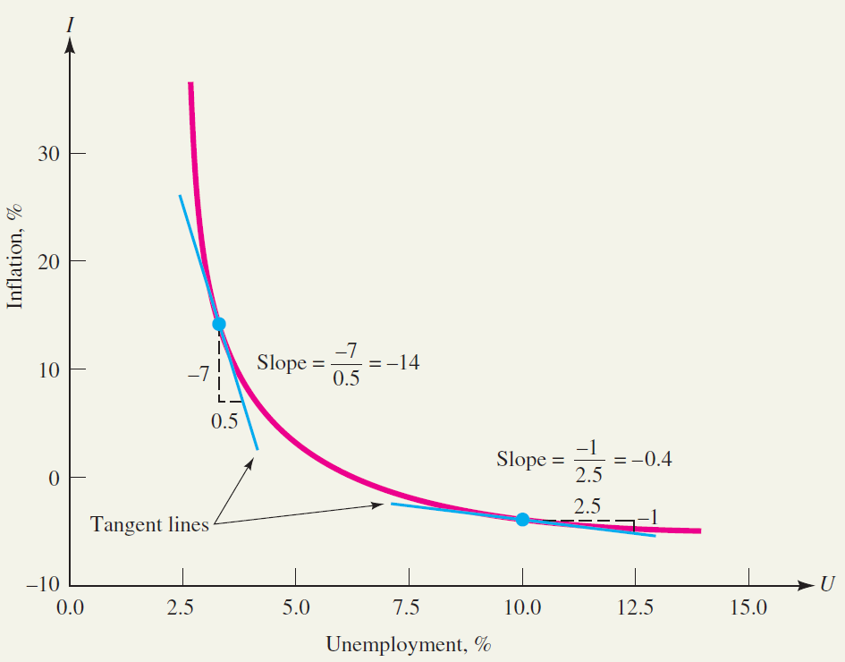
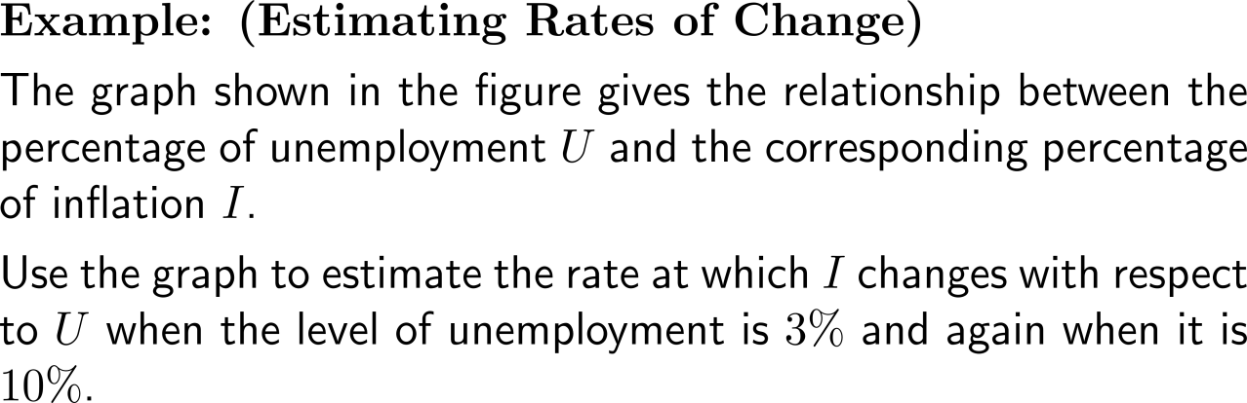
Example:
Estimating rates of change
Inflation as a function of unemployment
Source: Adapted from Robert Eisner, The Misunderstood Economy: What Counts and How to Count It, Boston, MA: Harvard Business School Press, 1994, p. 173.

Slide 4
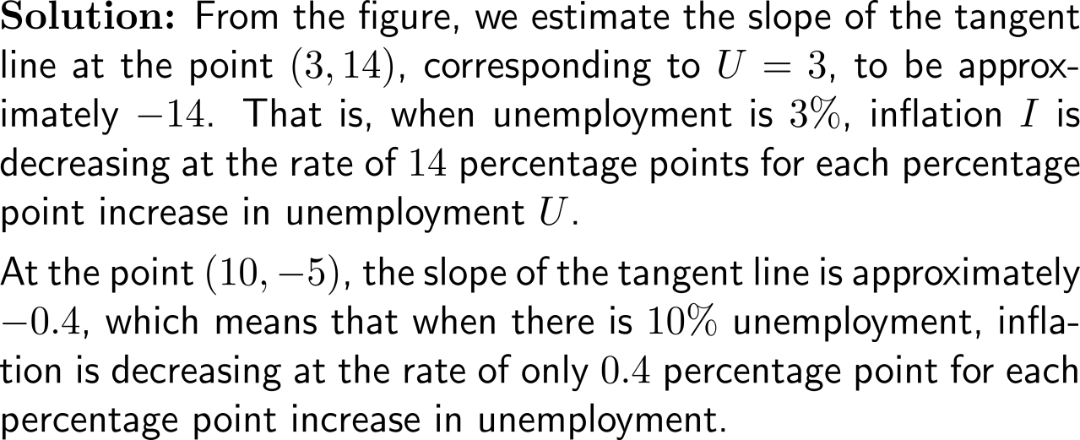
Example:
Estimating rates of change
Inflation as a function of unemployment
Source: Adapted from Robert Eisner, The Misunderstood Economy: What Counts and How to Count It, Boston, MA: Harvard Business School Press, 1994, p. 173.

Slide 5
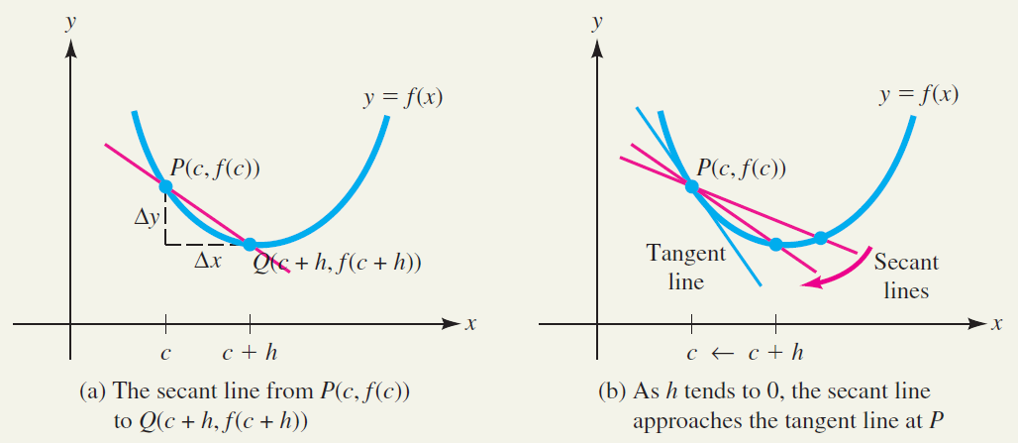
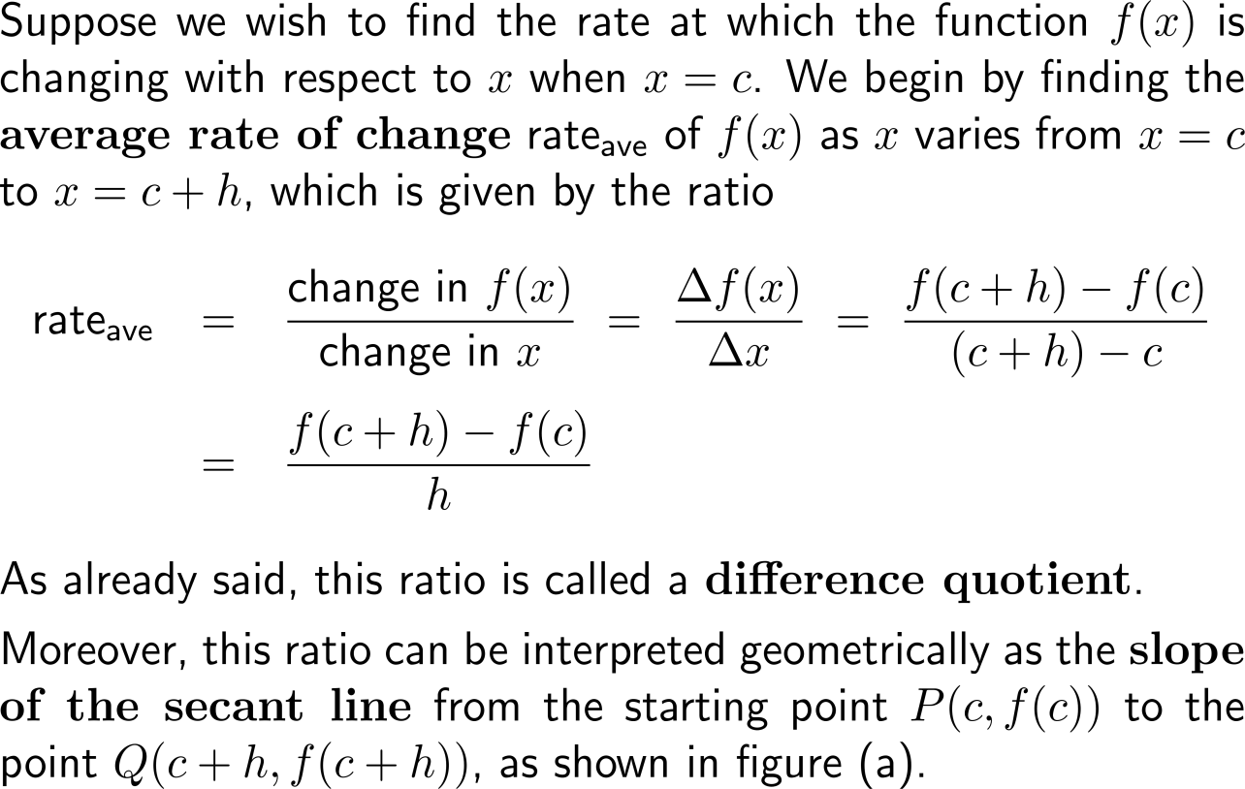
The difference quotient (average rate of change) gives the slope of a secant line …

Slide 6
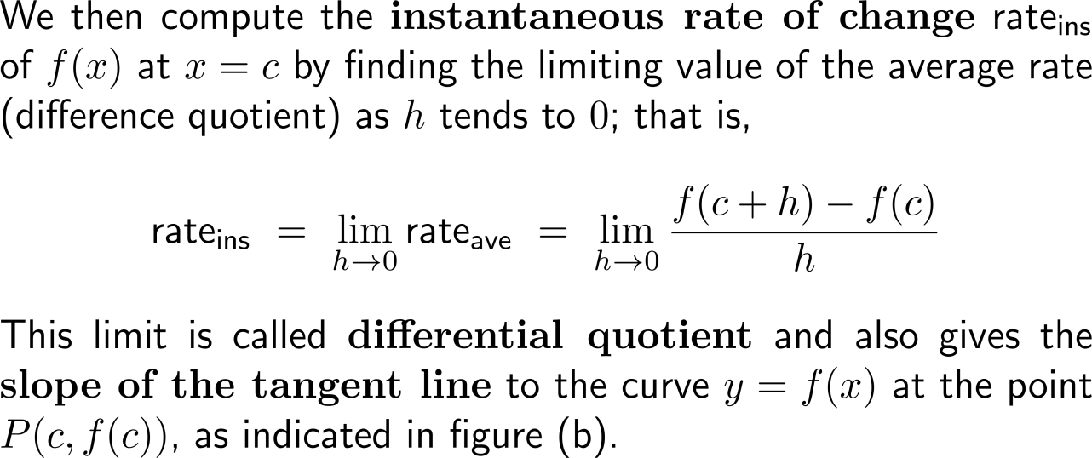
… and its limit – the differential quotient (instantaneous rate of change) – the slope of the corresponding tangent line

Slide 7
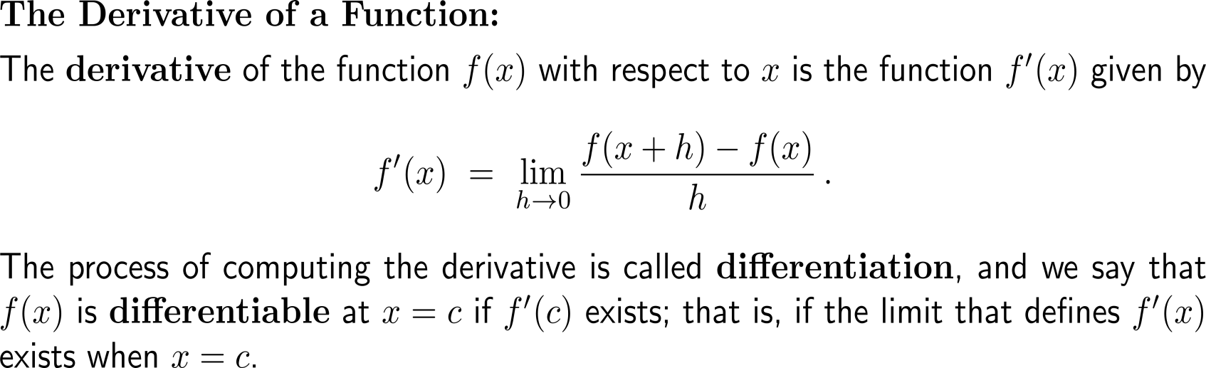
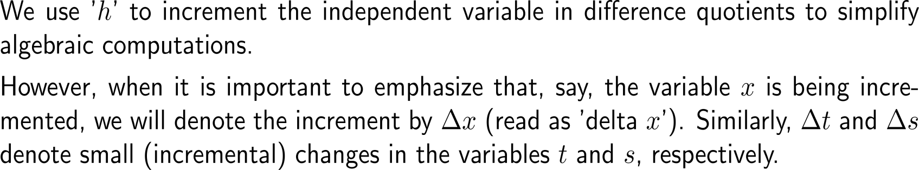
The derivate of a function at a point is given by the corresponding differential quotient

Slide 8
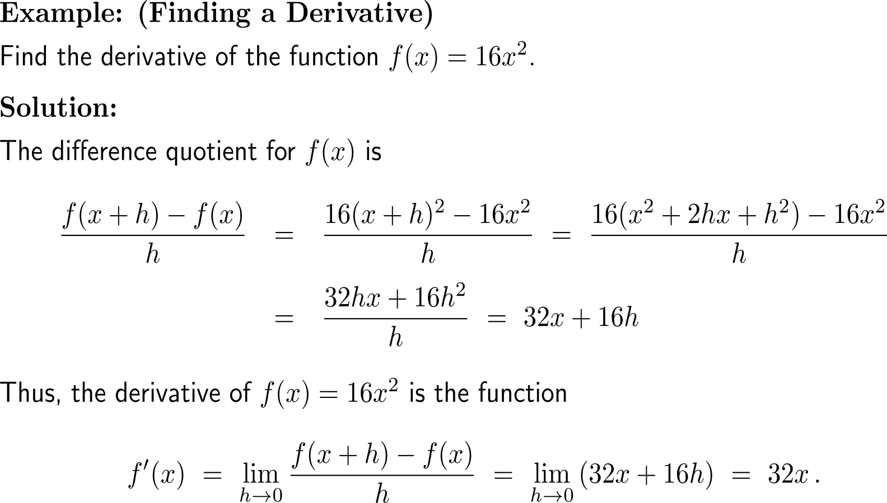
Example:
Finding a derivative

Slide 9
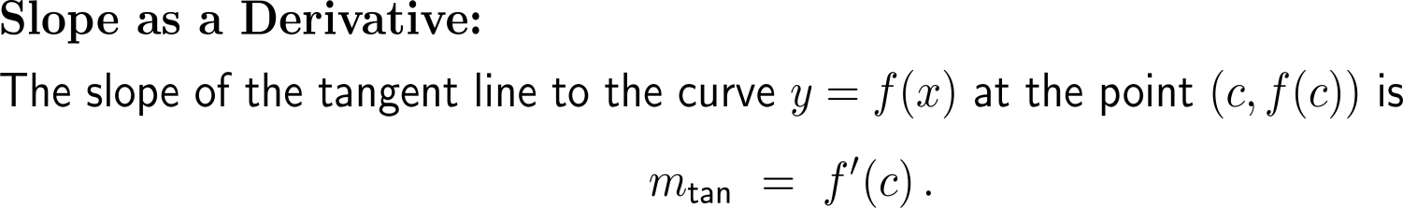
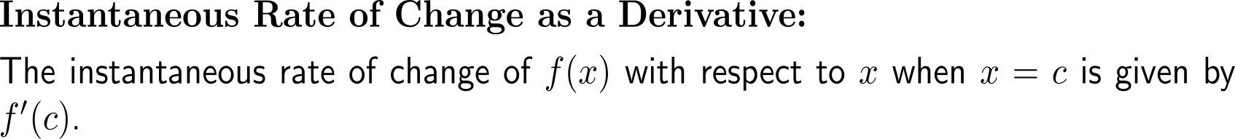
Let us summarize our observations about rates of change and slope in terms of the derivative notation

Slide 10
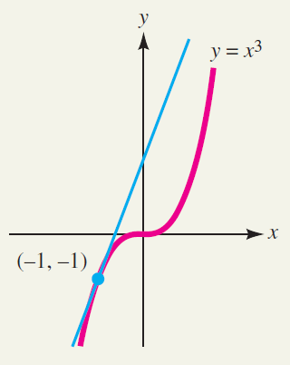
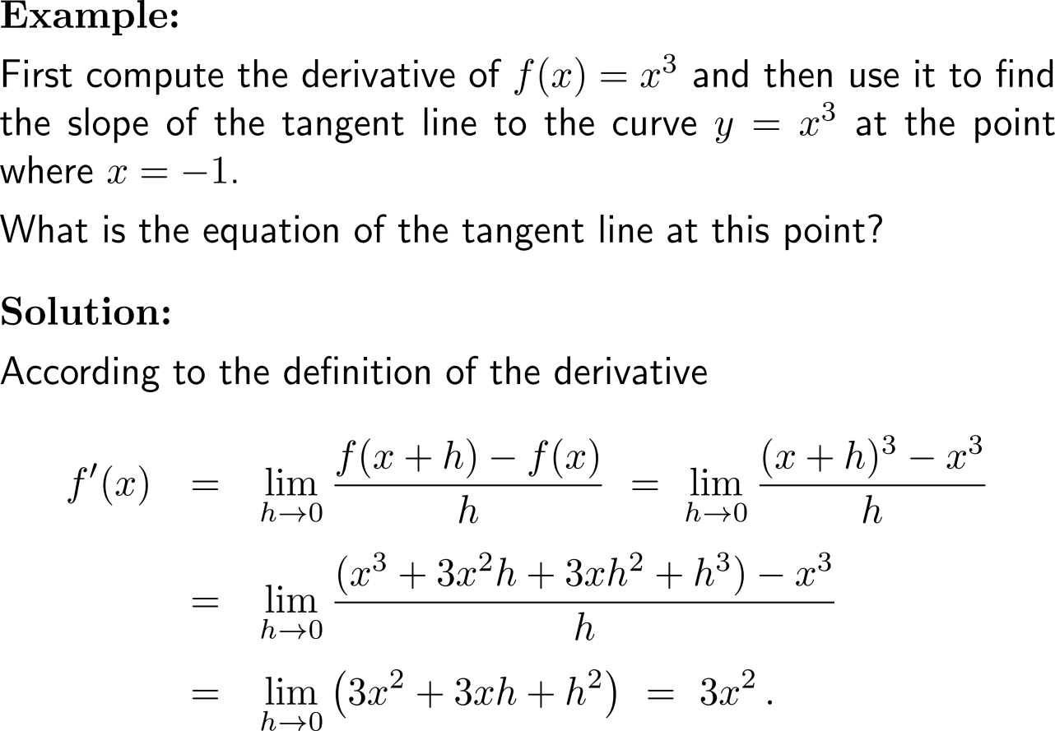
Example:
Using a derivative to find the slope of a tangent

Slide 11
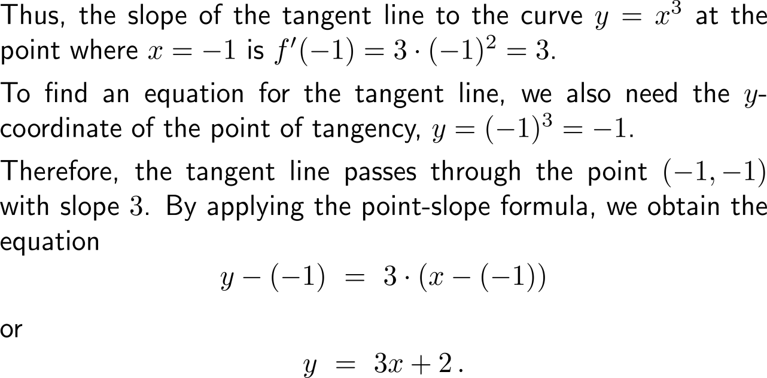
Example:
Using a derivative to find the slope of a tangent

Slide 12
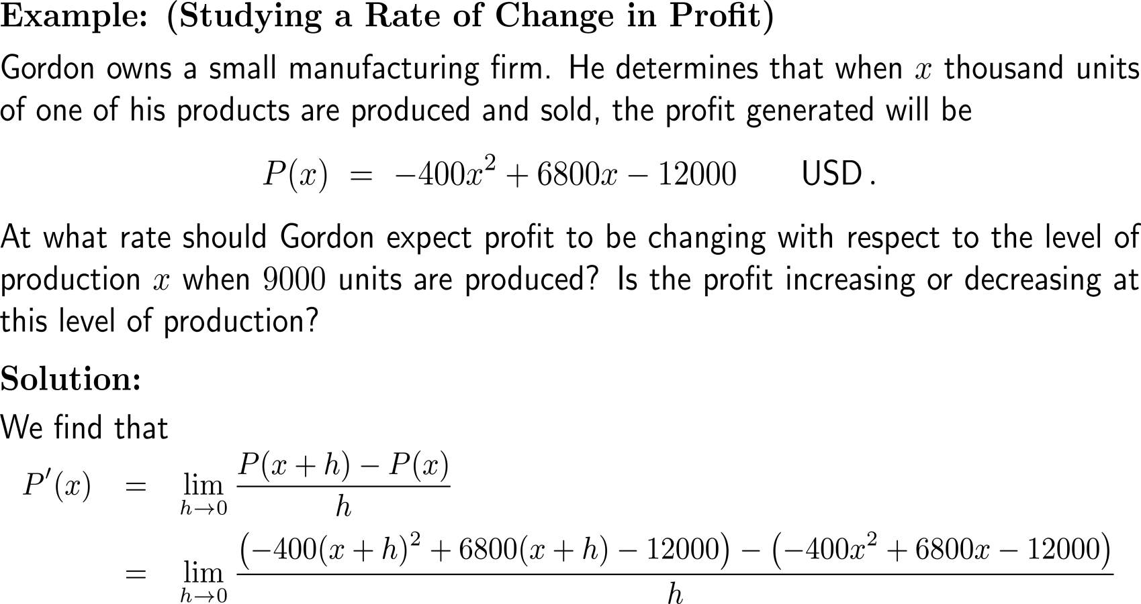
Example:
Studying a Rate of Change in Profit

Slide 13
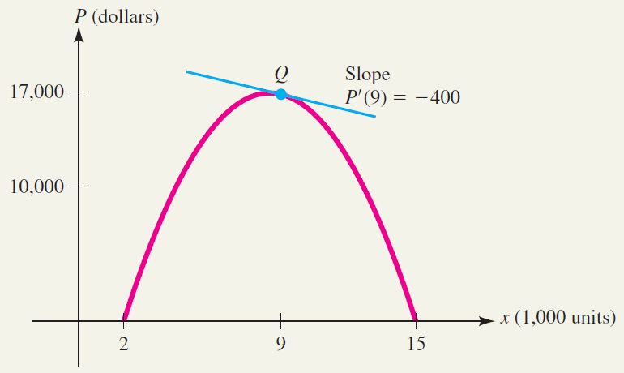
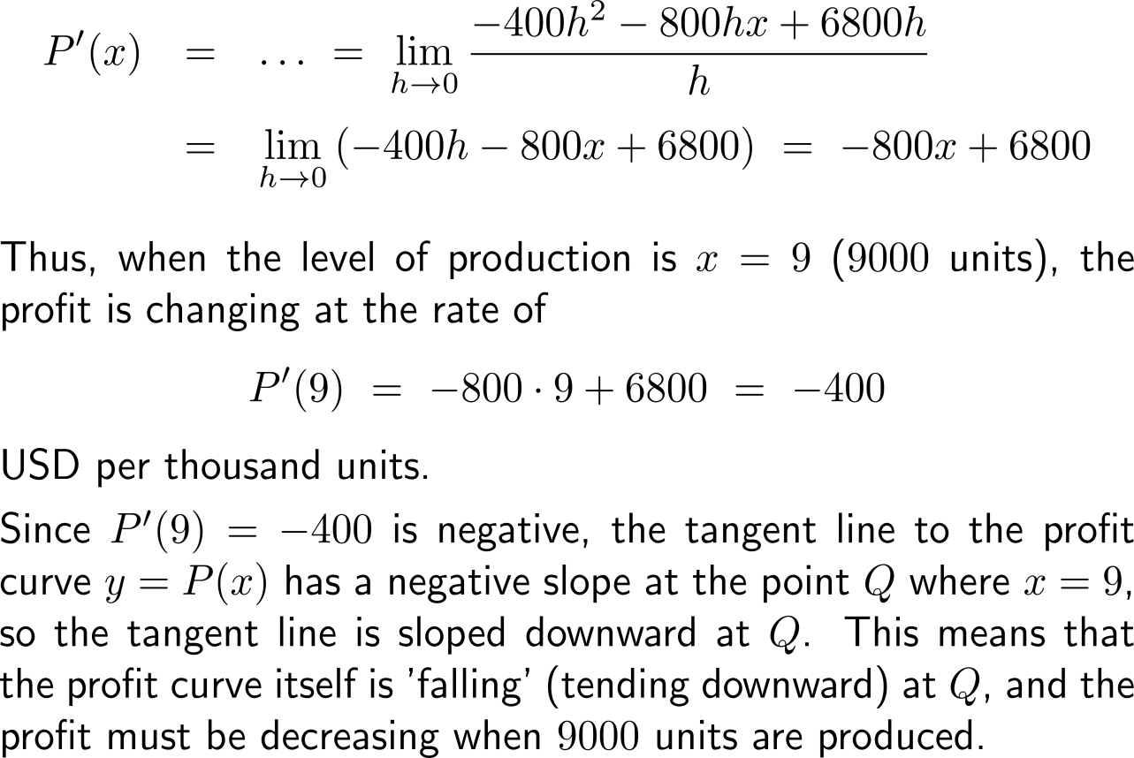
Example:
Studying a Rate of Change in Profit

Slide 14
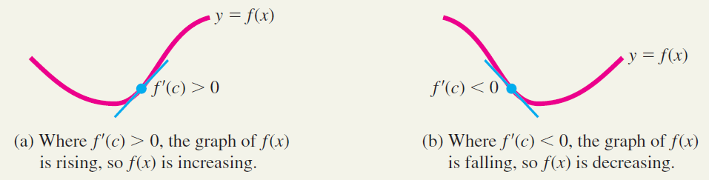
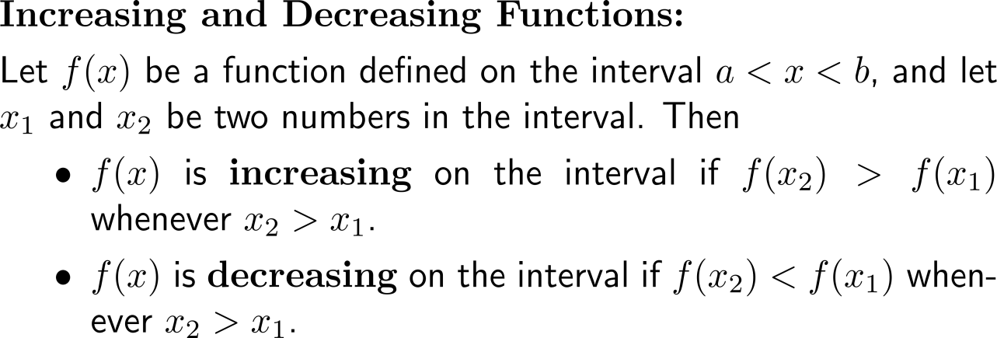
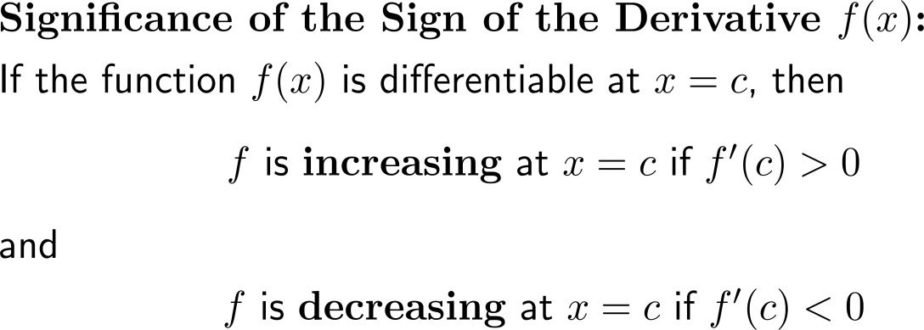
The sign of a derivative indicates if the graph of a function is increasing or decreasing at the corresponding point

Slide 15
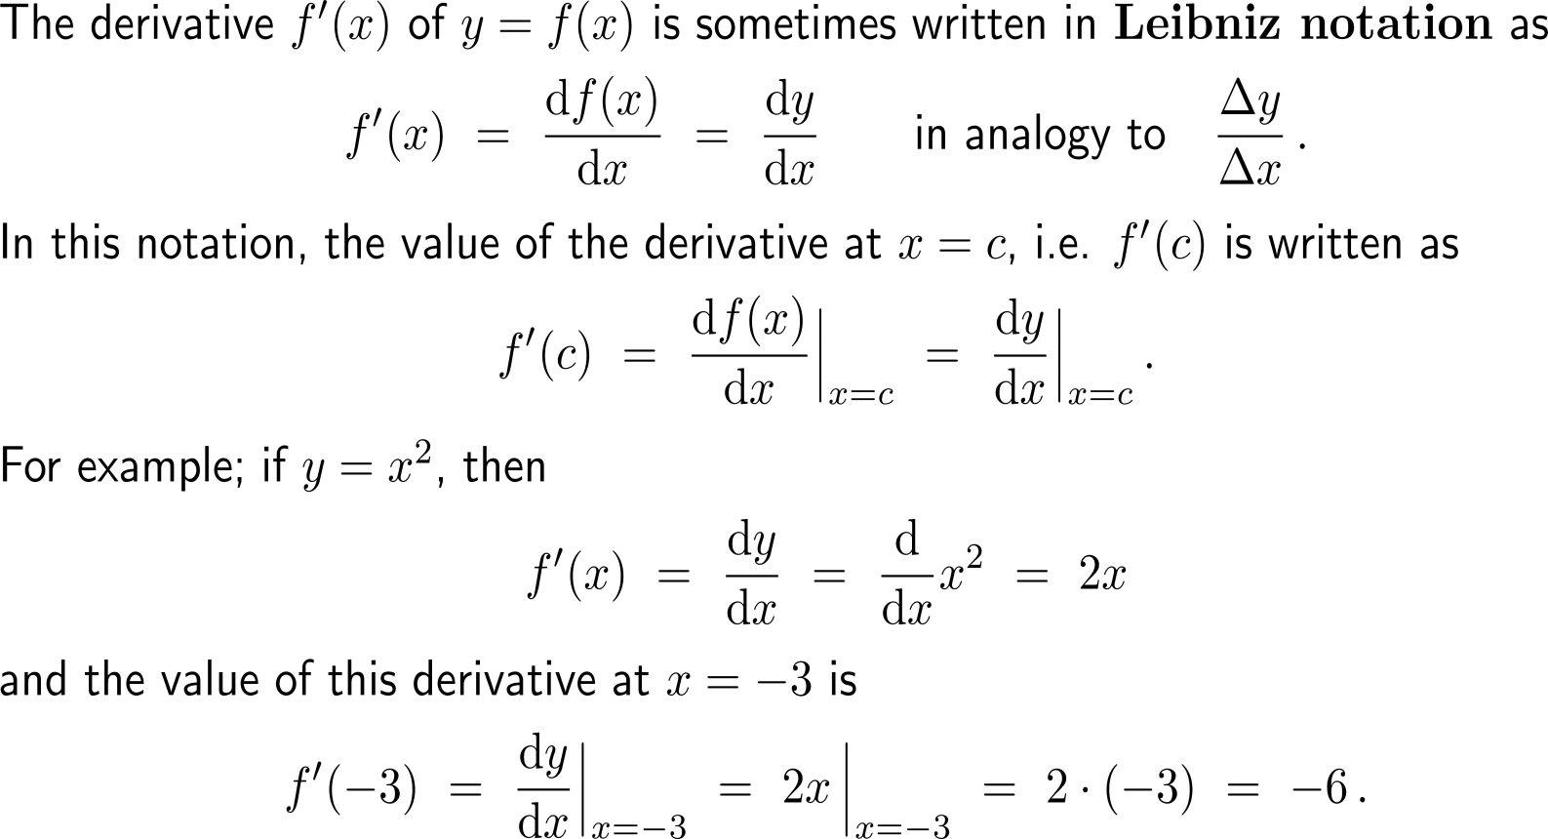
The Leibniz notation is an alternative way of writing derivatives and will be handy for denoting higher-order derivatives

Slide 16
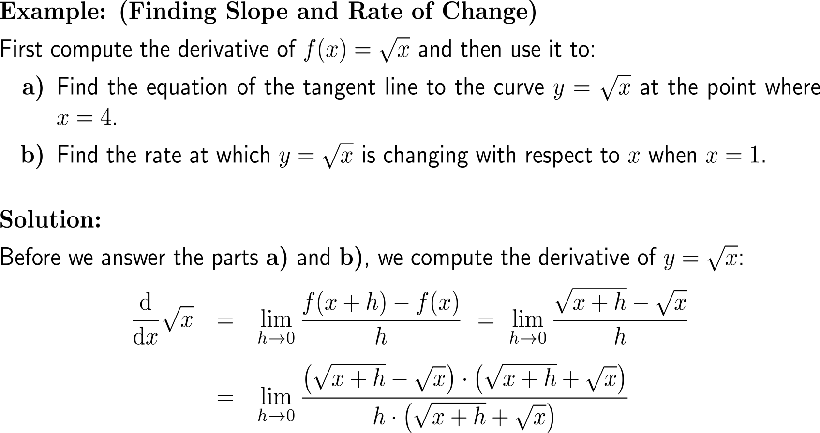
Example:
Finding slope and rate of change

Slide 17
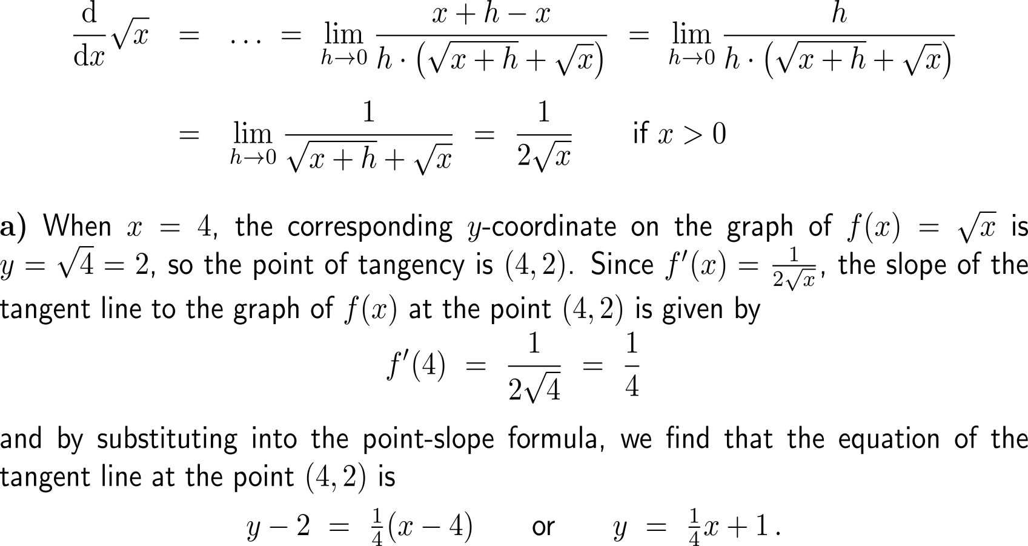
Example:
Finding slope and rate of change

Slide 18
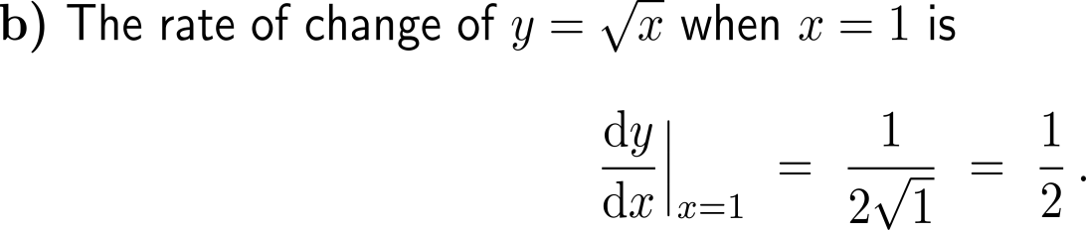
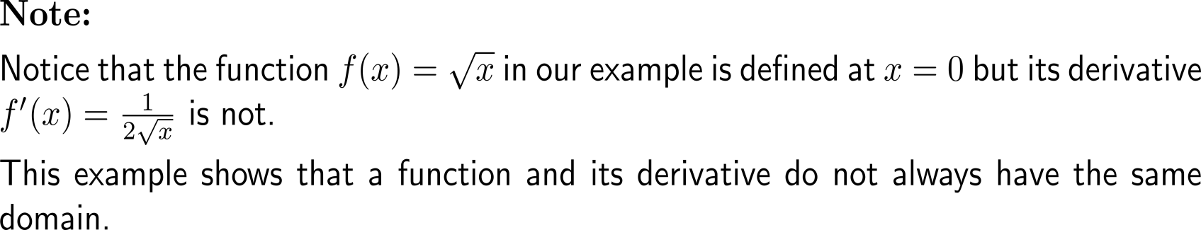
Example:
Finding slope and rate of change

Slide 19
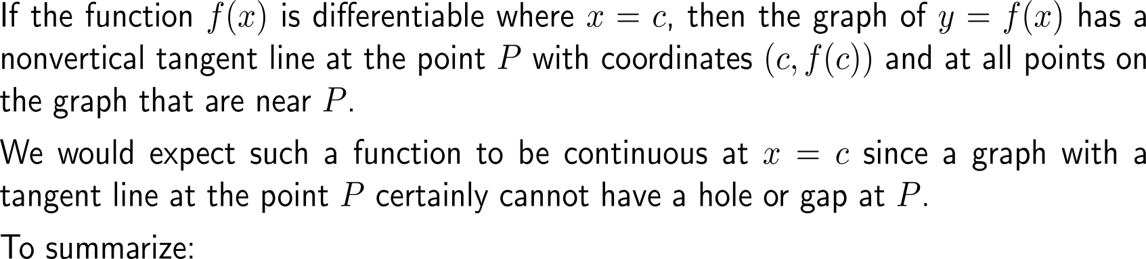
A differentiable function is continuous at all points at which it is differentiable

Slide 20
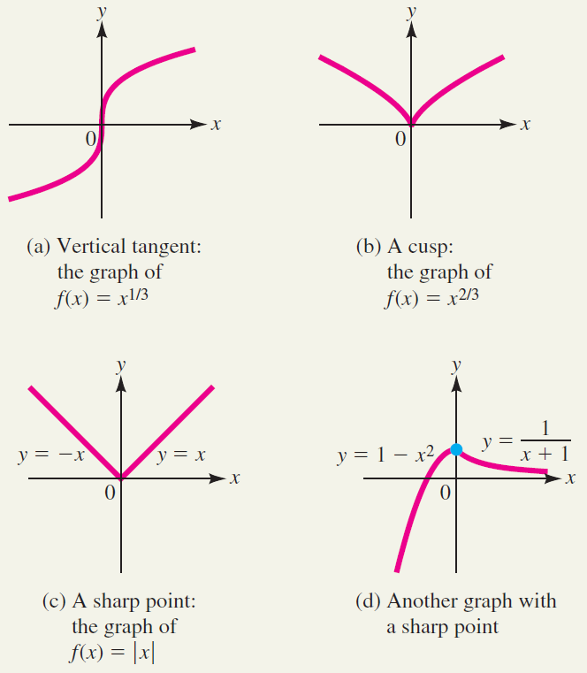
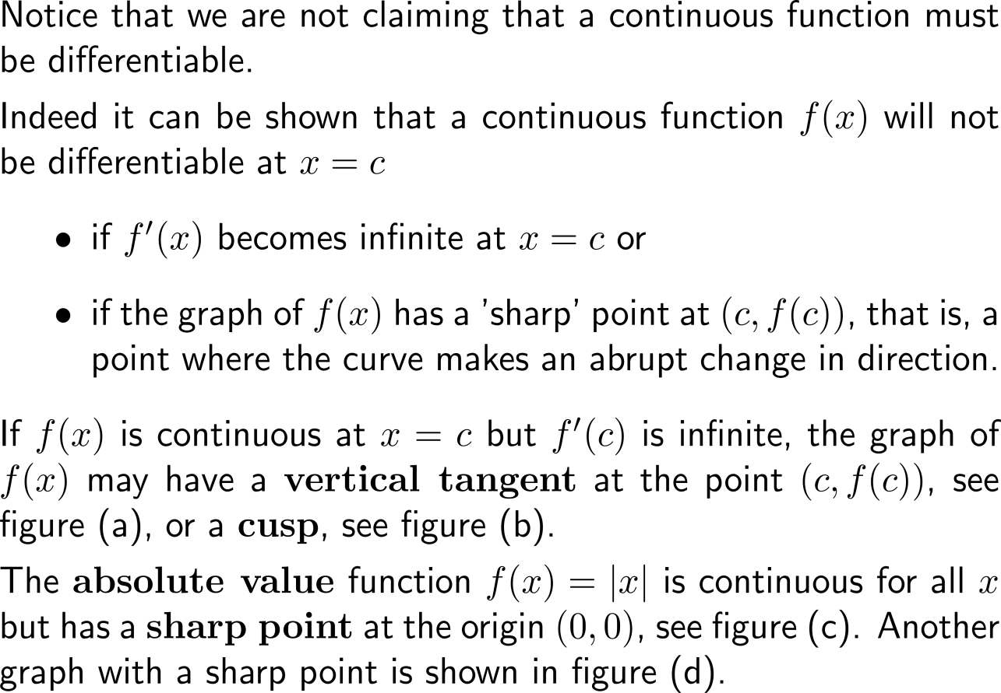
Though, continuity is not enough to ensure differentiability – there are functions that are continuous at a point but not differentiable there

Slide 21
Calculus I for Management

