Slide 1
Calculus I for MGMT – Advanced Differentiation Rules
The Product & Quotient Rule
Mathematics for Management
Supplementary Electronic Materials
Advanced
Differentiation Rules
  The Derivative of
  Exponential Functions
  Higher-Order Derivatives
  The Product & Quotient Rule
  Derivatives of
  Trigonometric Functions

Slide 2
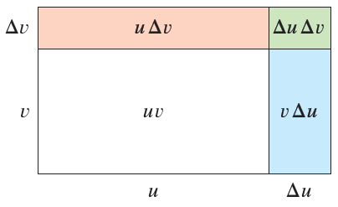
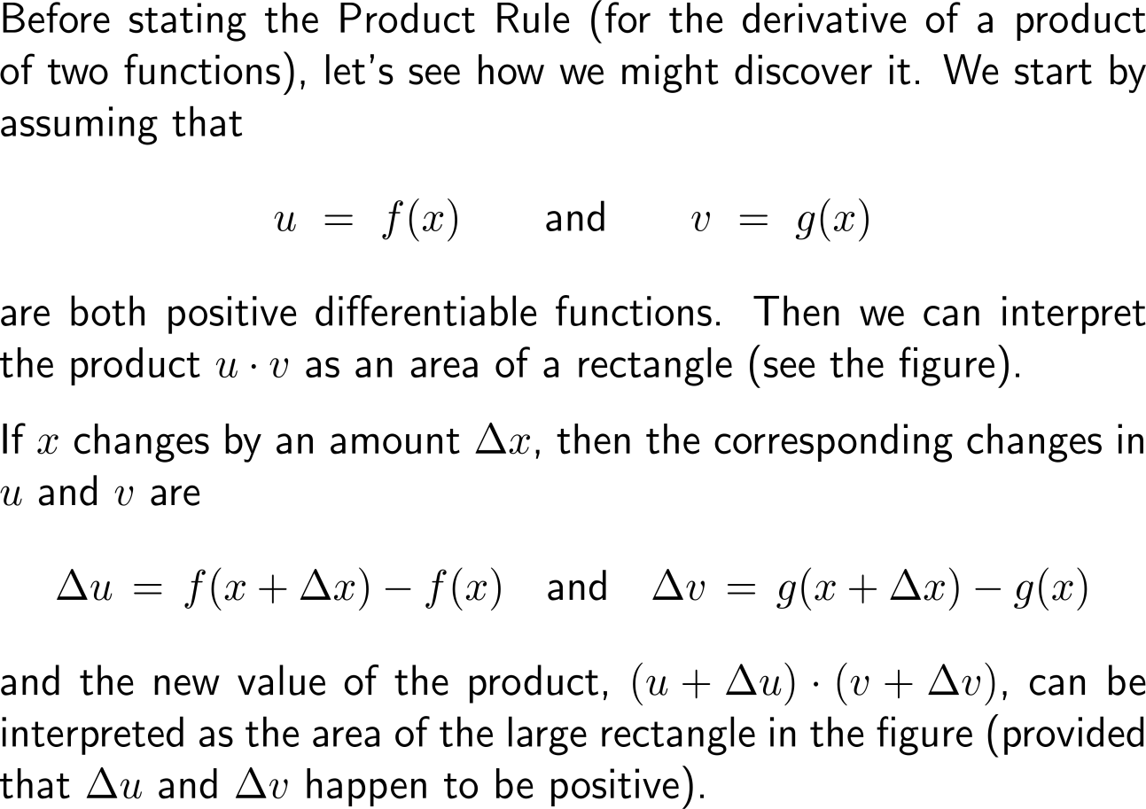
Motivation of the product rule – What is the derivative of a product of differentiable functions? (1/ 3)

Slide 3
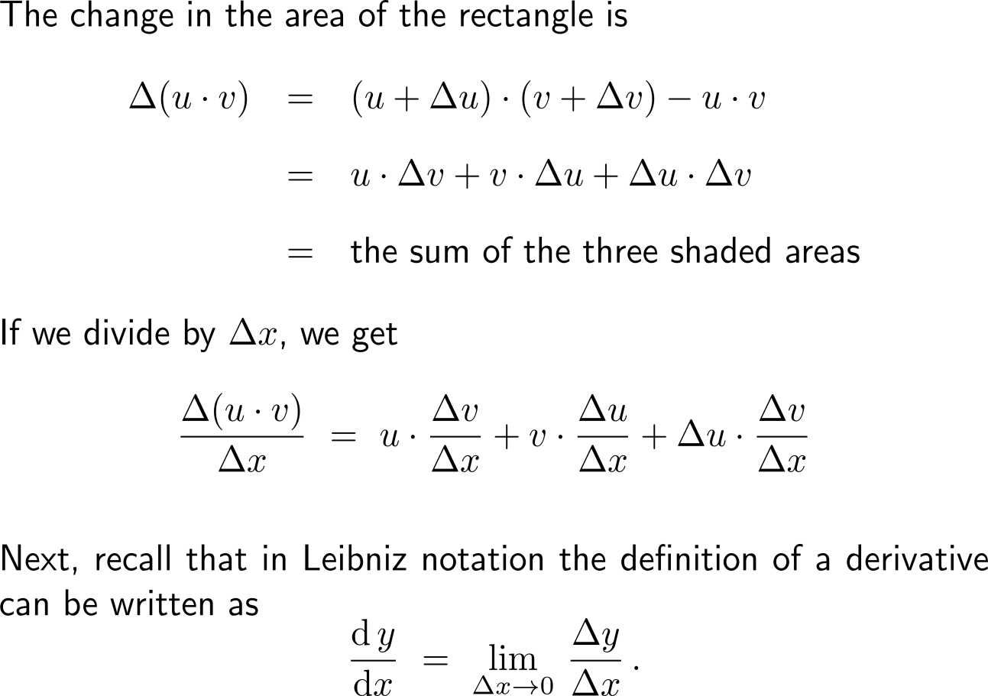
Motivation of the product rule – What is the derivative of a product of differentiable functions? (2/ 3)

Slide 4
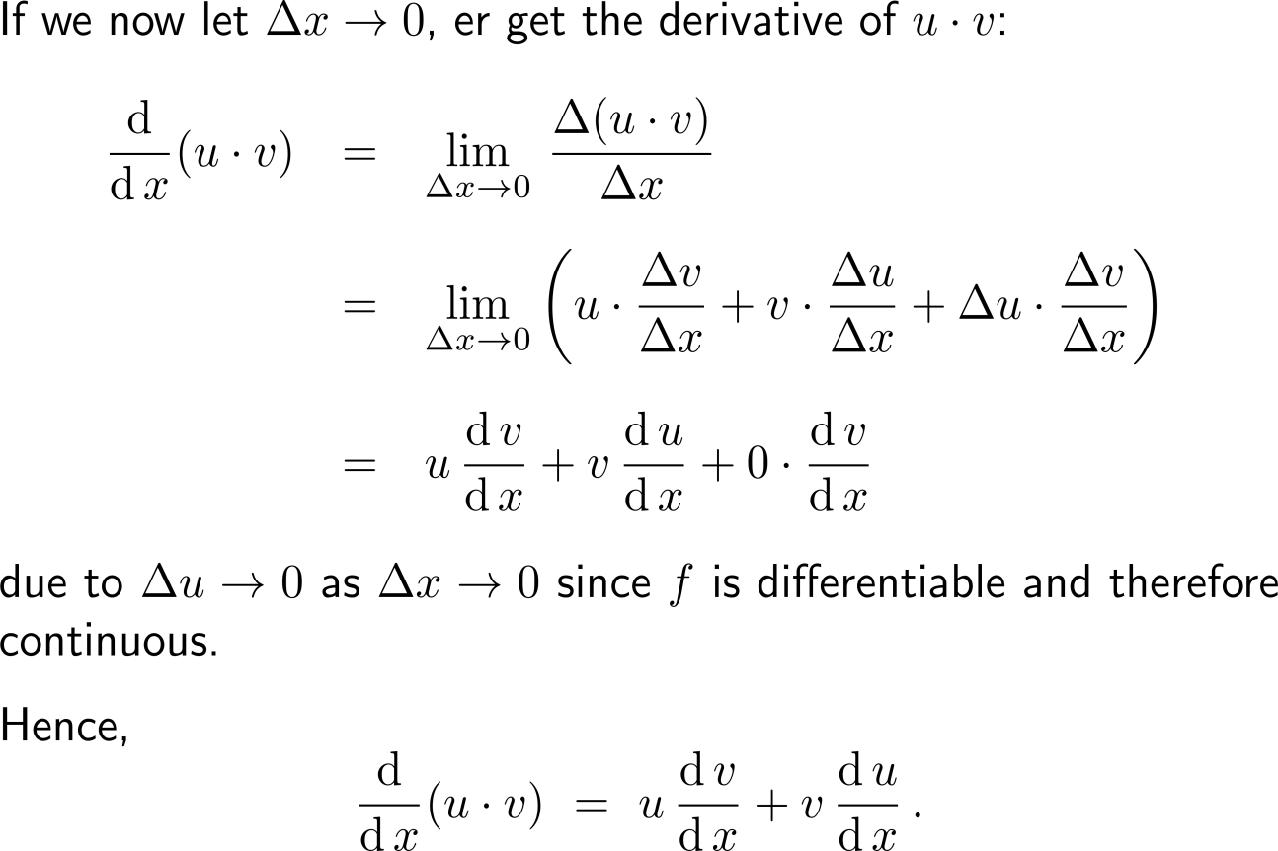
Motivation of the product rule – What is the derivative of a product of differentiable functions? (3/ 3)

Slide 5
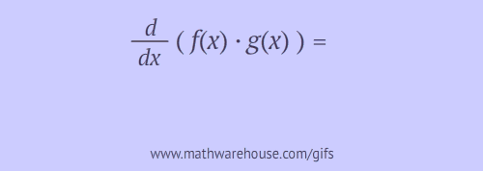
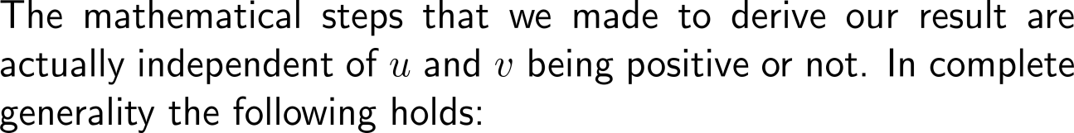
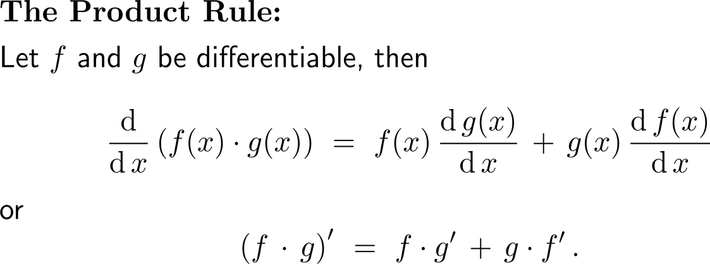
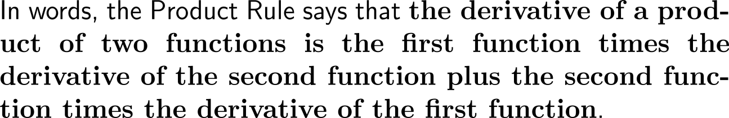
The Product Rule

Slide 6
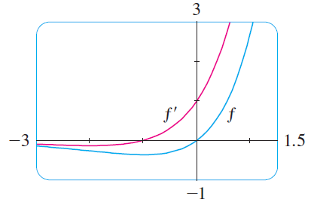
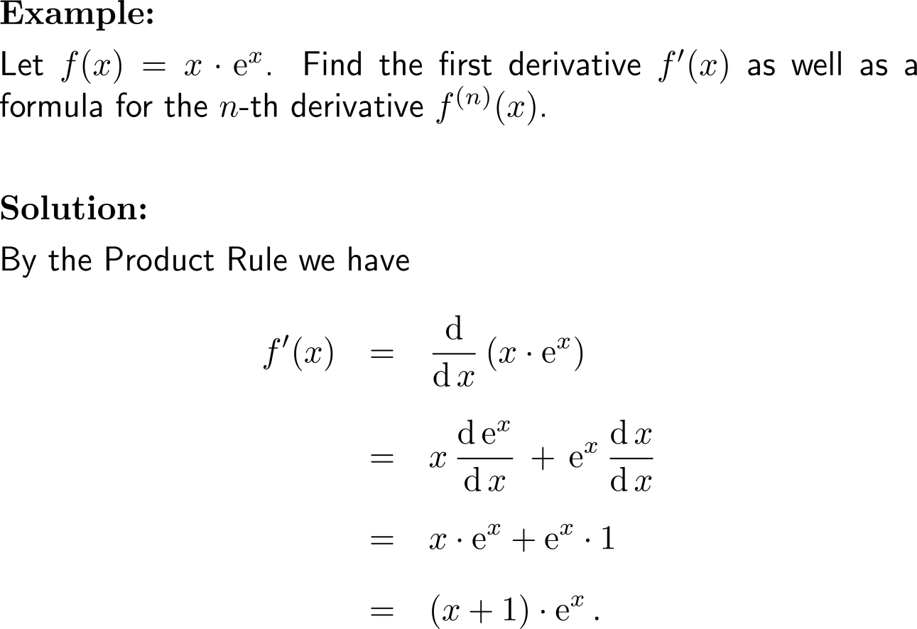
Example:
Application of the Product Rule
change in the inclination behavior

Slide 7
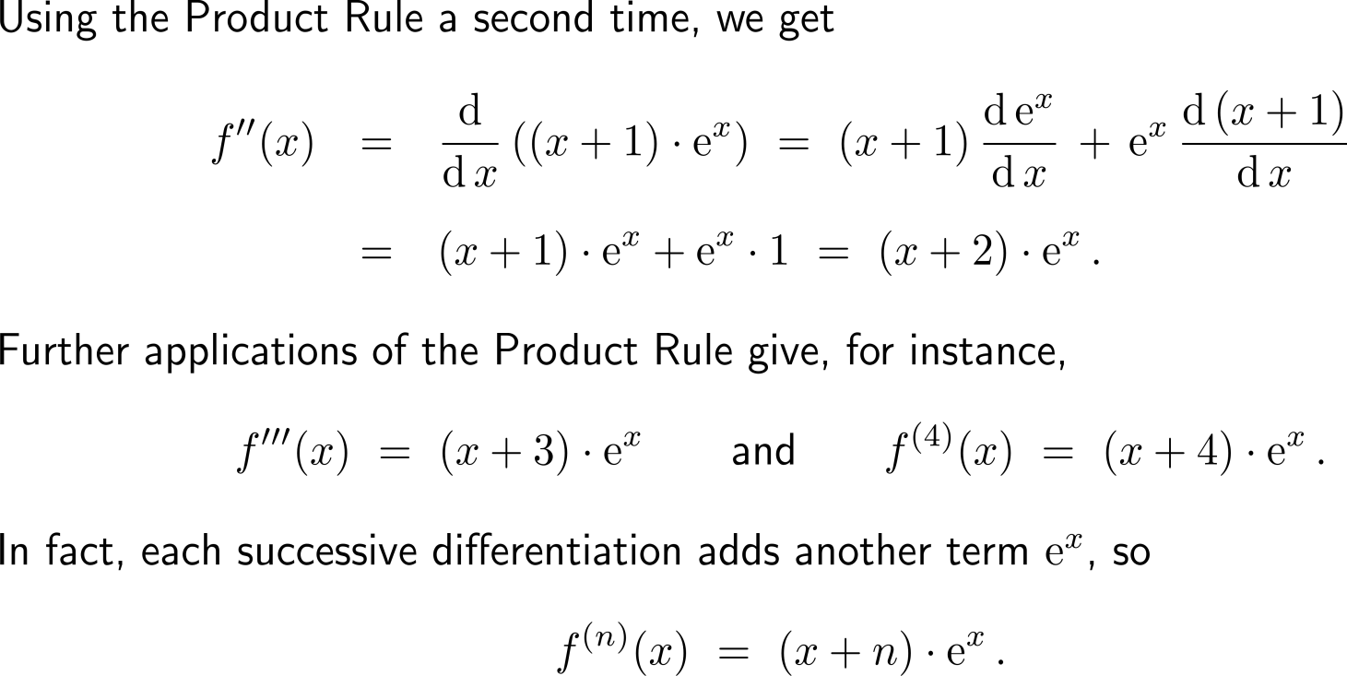
Example:
Application of the Product Rule

Slide 8
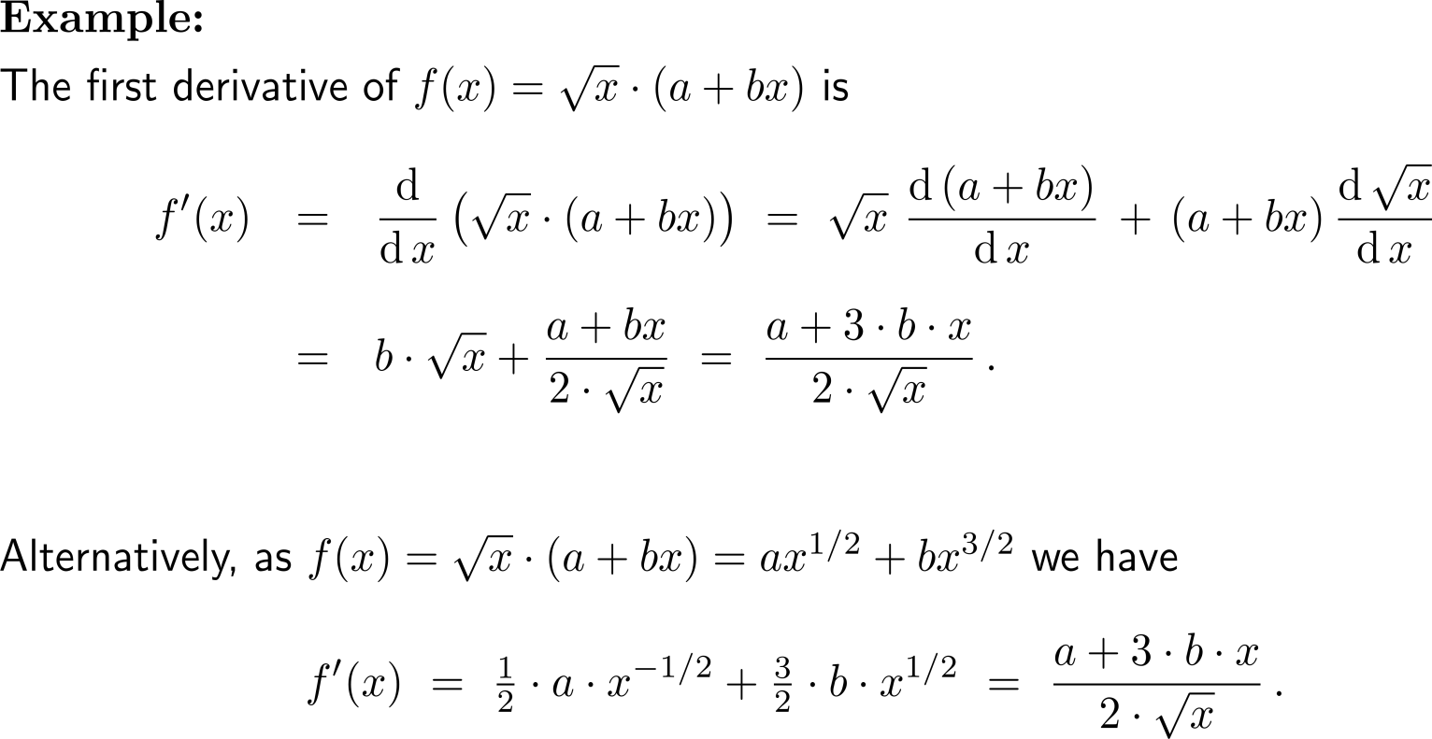
Example:
Application of the Product Rule

Slide 9
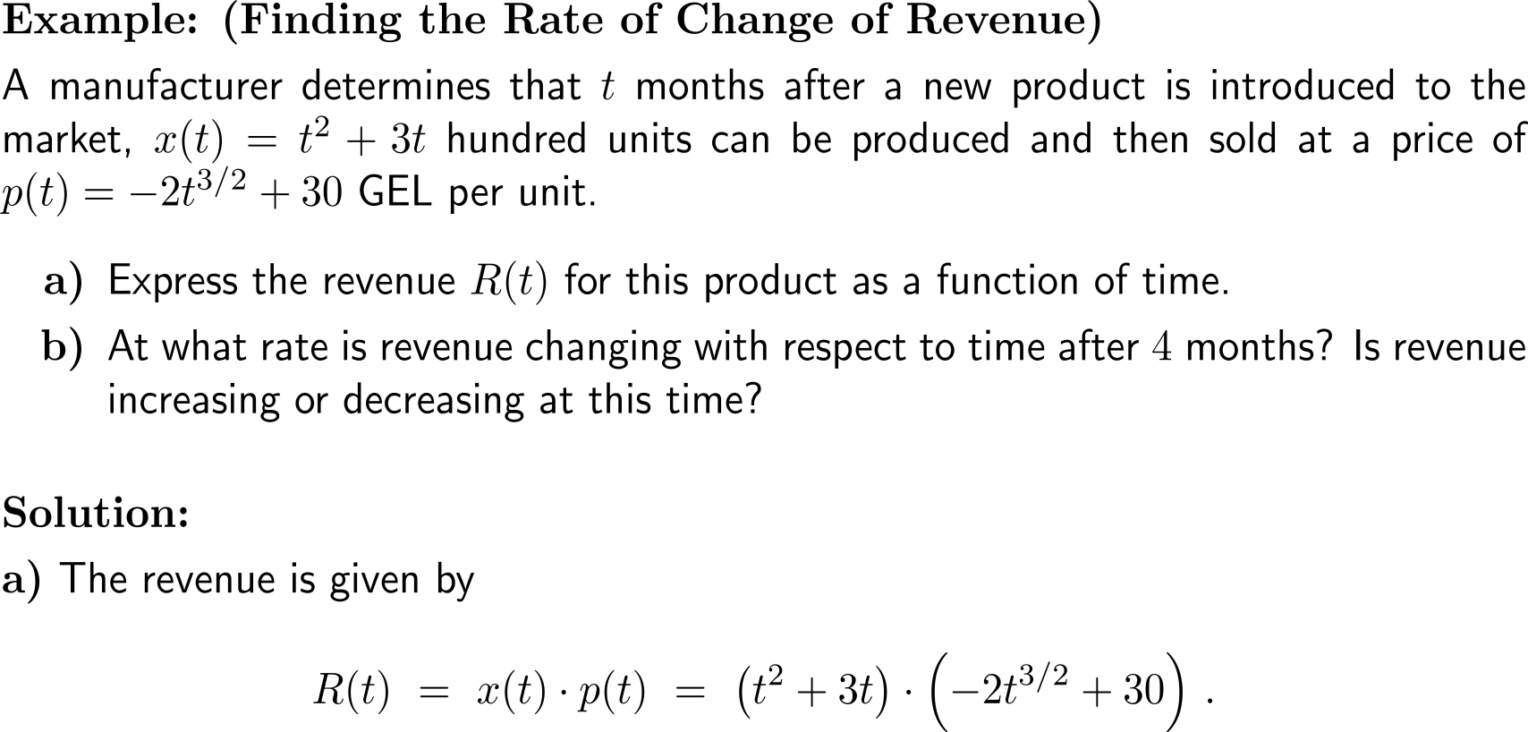
Example:
Finding the rate of change of revenue

Slide 10
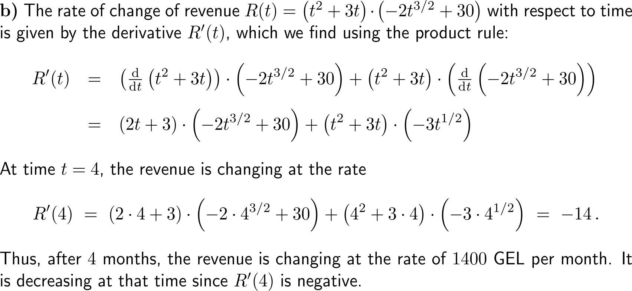
Example:
Finding the rate of change of revenue

Slide 11
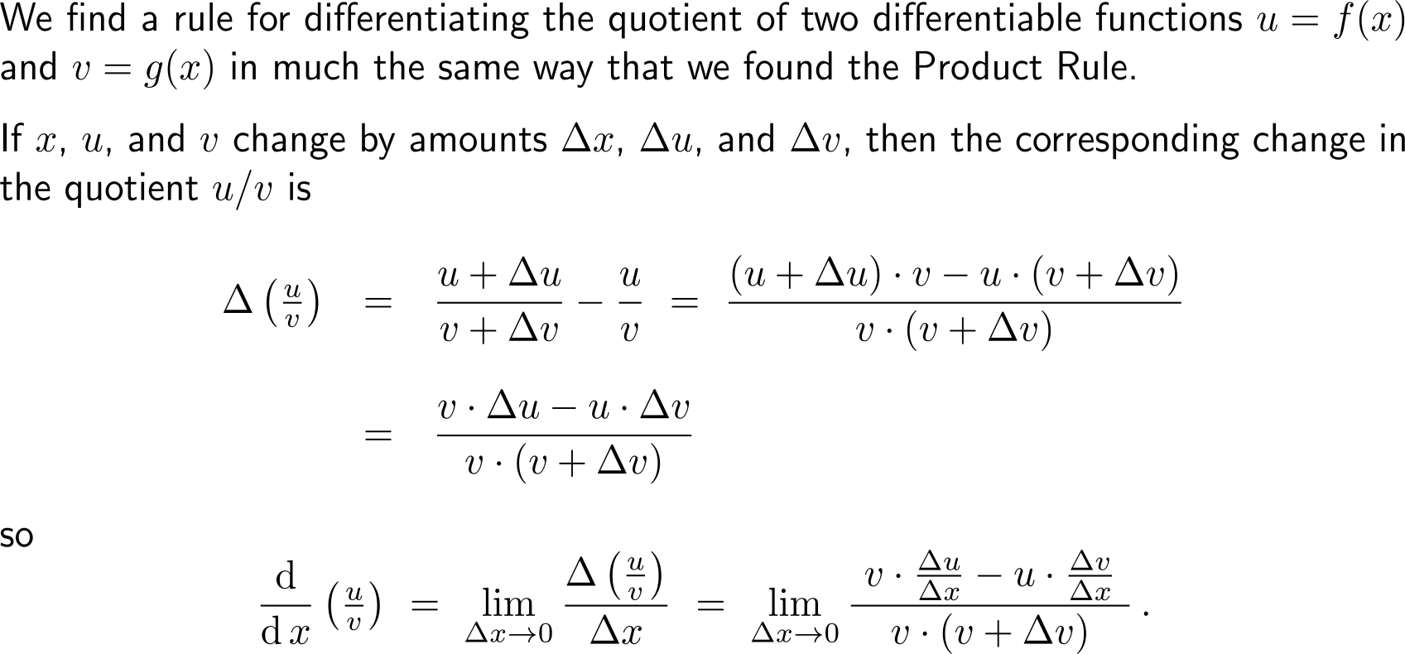
Motivation of the quotient rule – What is the derivative of a quotient of differentiable functions? (1/ 2)

Slide 12
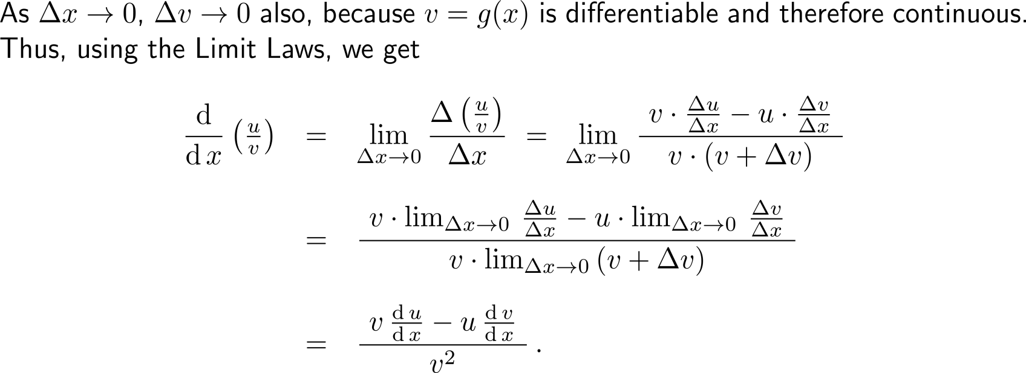
Motivation of the quotient rule – What is the derivative of a quotient of differentiable functions? (2/ 2)

Slide 13
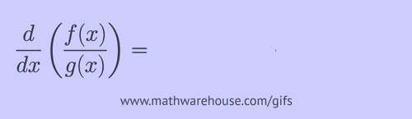
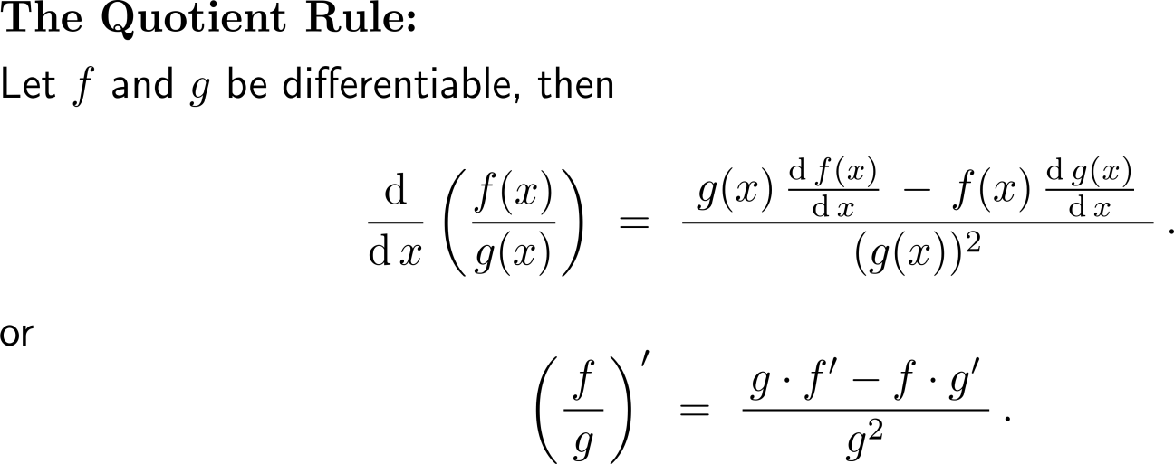
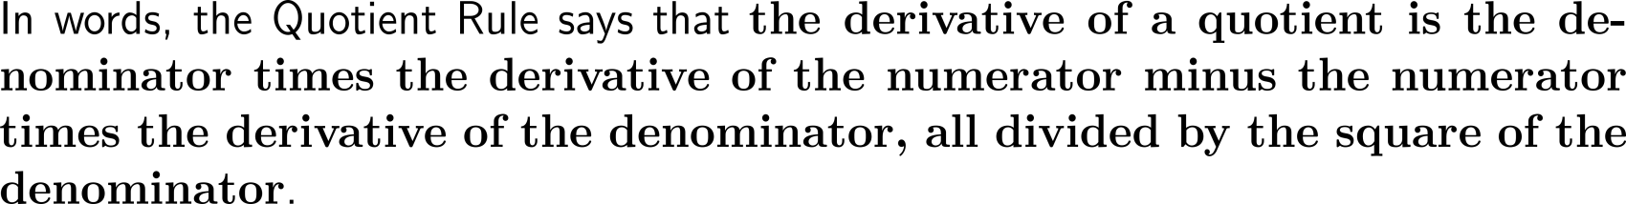
The Quotient Rule

Slide 14
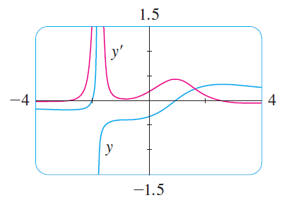
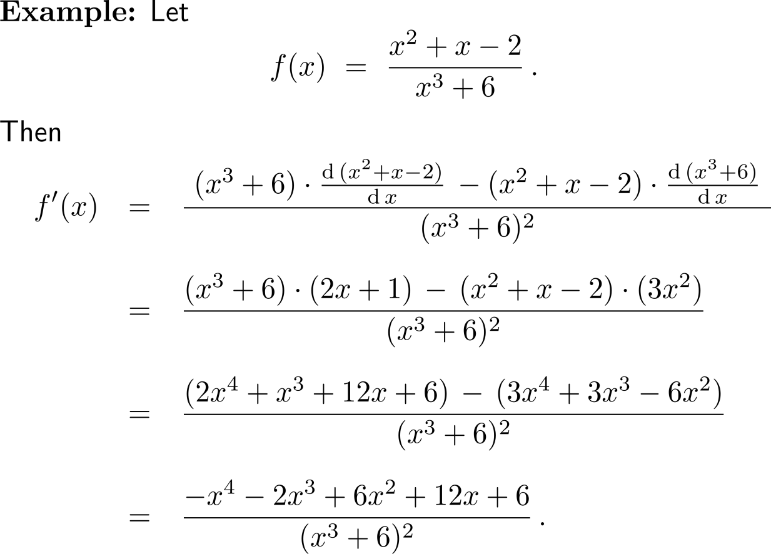
Example:
Application of the Quotient Rule
Notice,
when y grows rapidly (near -2), then y’ is large, and
when y grows slowly, then y’ is near 0

Slide 15
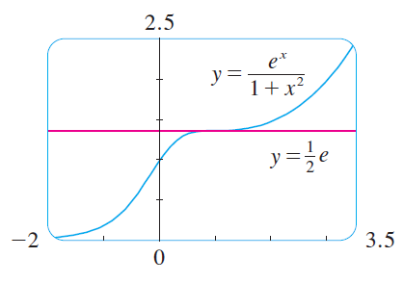
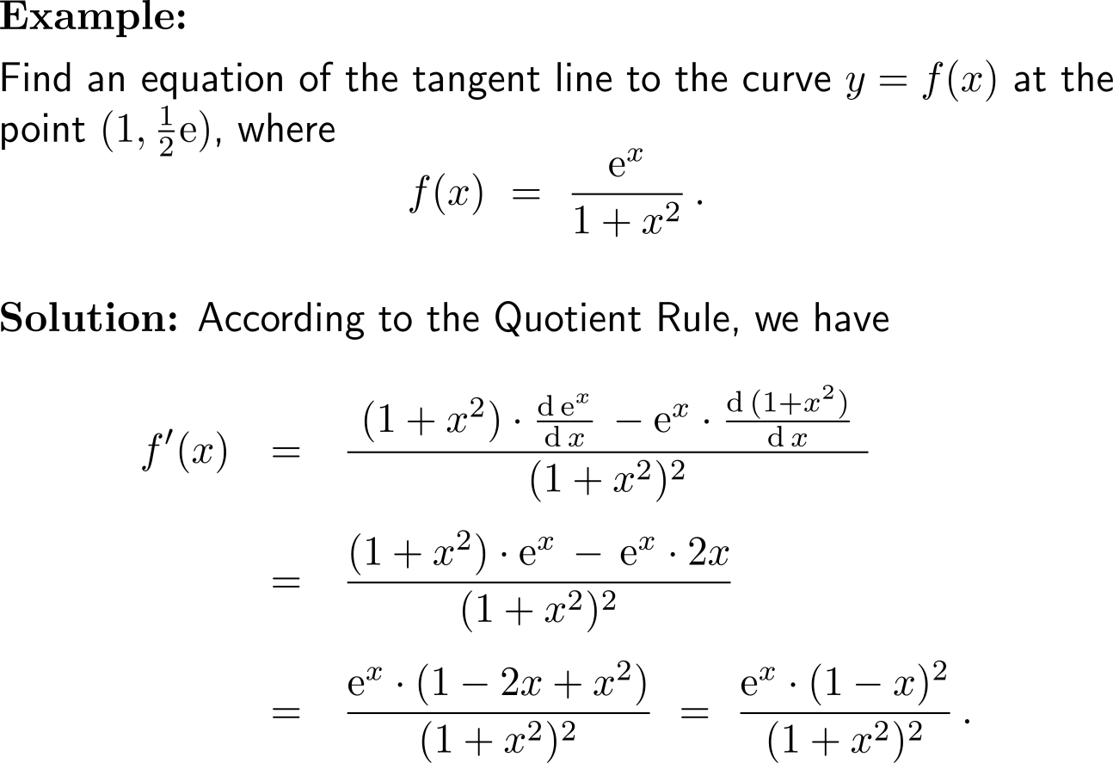
Example:
Application of the Quotient Rule

Slide 16
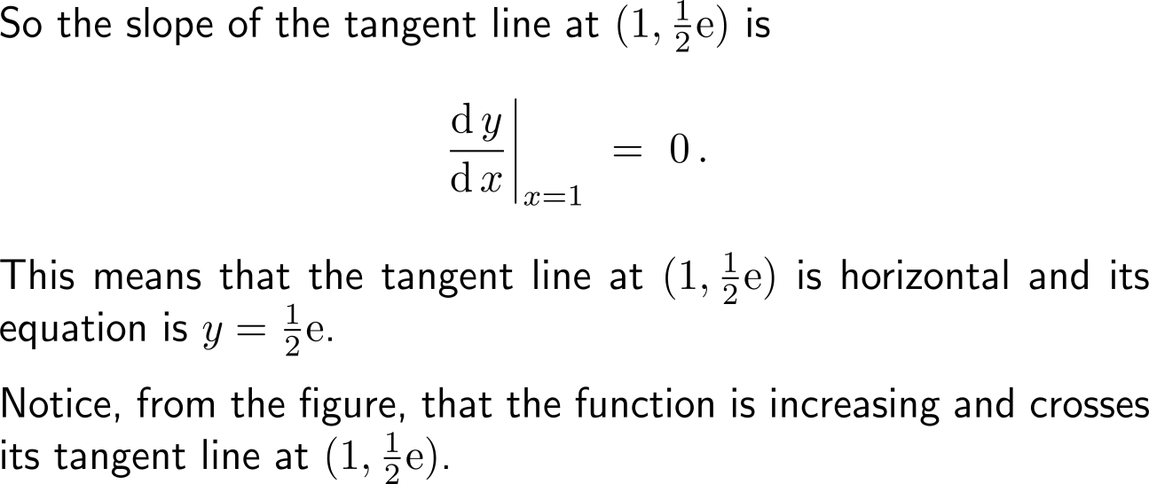
Example:
Application of the Quotient Rule

Slide 17
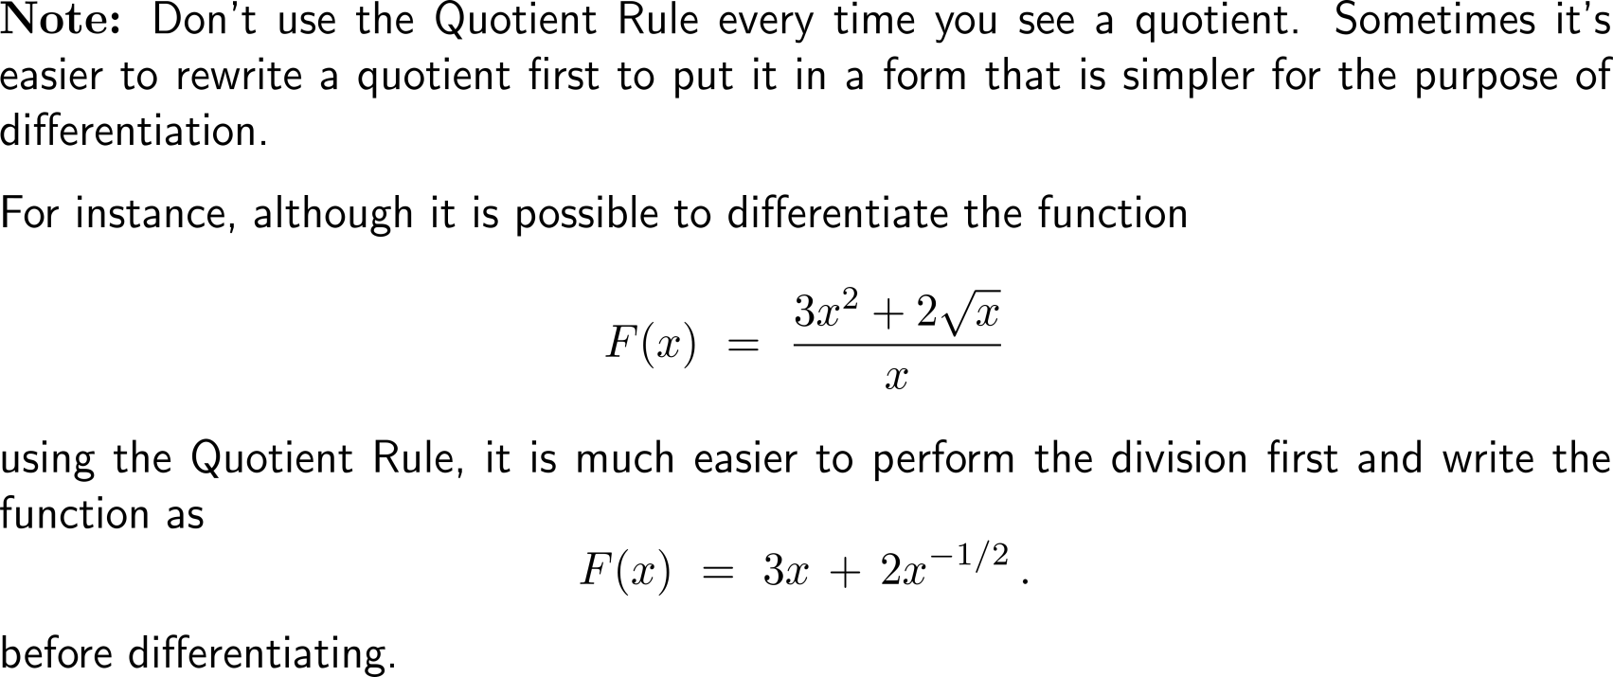
Don’t use the Quotient Rule every time you see a quotient

Slide 18
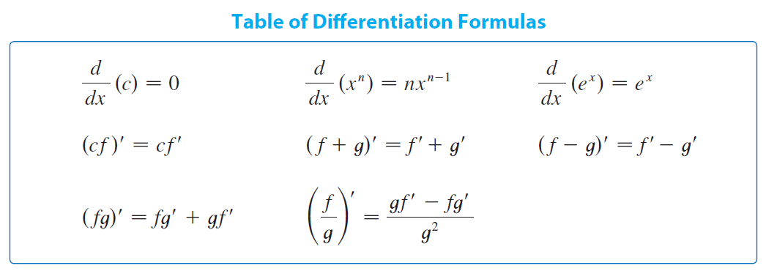
We summarize the differentiation formulas we have learned so far as follows

Slide 19
Calculus I for Management

