Slide 1
Calculus I for MGMT – Applications of Differentiation
Linear Approximation
Mathematics for Management
Supplementary Electronic Materials
Applications of
Differentiation
  The Chain Rule
  Implicit Differentiation
  Linear Approximation
  L’Hospital’s Rules & Indeterminate Forms

Slide 2
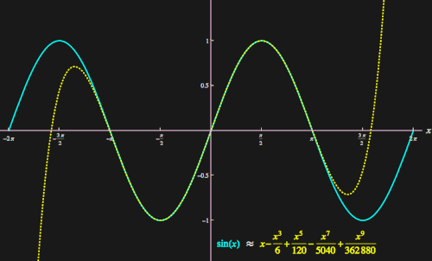
Approximation plays a key role in mathematics and its applications
We have already seen that a tangent line can be used to locally understand the behavior of a function (linear approximation) near a point a.
Taking further information into account, like second, third, … order derivatives the approximation becomes more accurate for a wider range of numbers about the point of expansion a.
This procedure even allows us later to write certain functions as infinite power-series.
The major question in this context are that of the
quality of the approximation and
range on which we trust the approximation.
Next, we discuss some aspects of these two questions for linear approximations.
Example: successive polynomial approximation of the sine function at 0
animation

Slide 3
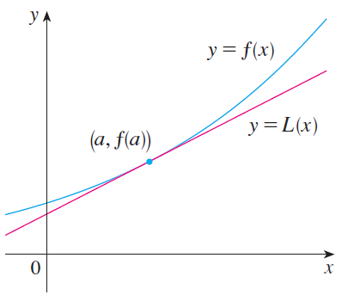
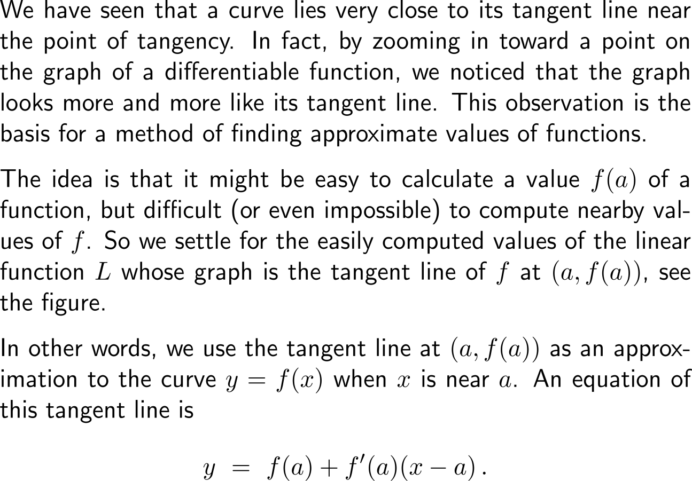
By zooming in toward a point on the graph of a differentiable function, we already noticed that the graph looks more and more like its tangent line …

Slide 4
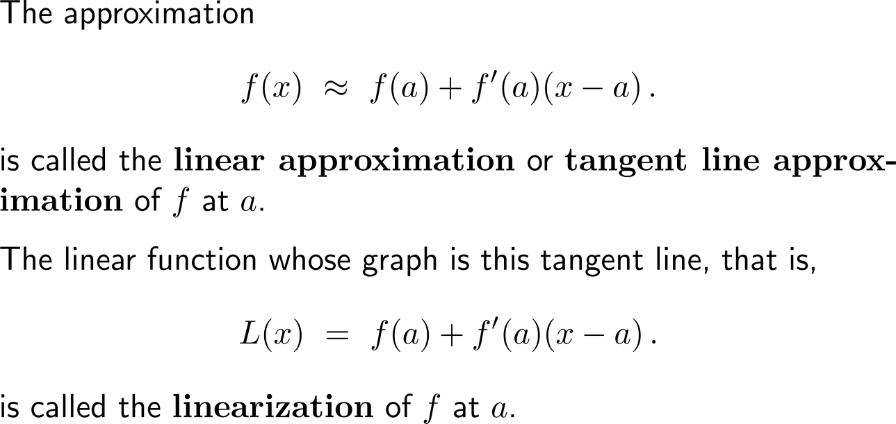
… this gives rise to the (local) approximation of a function by its linearization

Slide 5
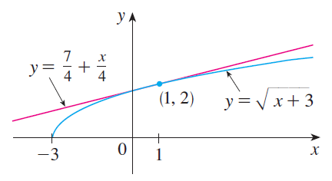
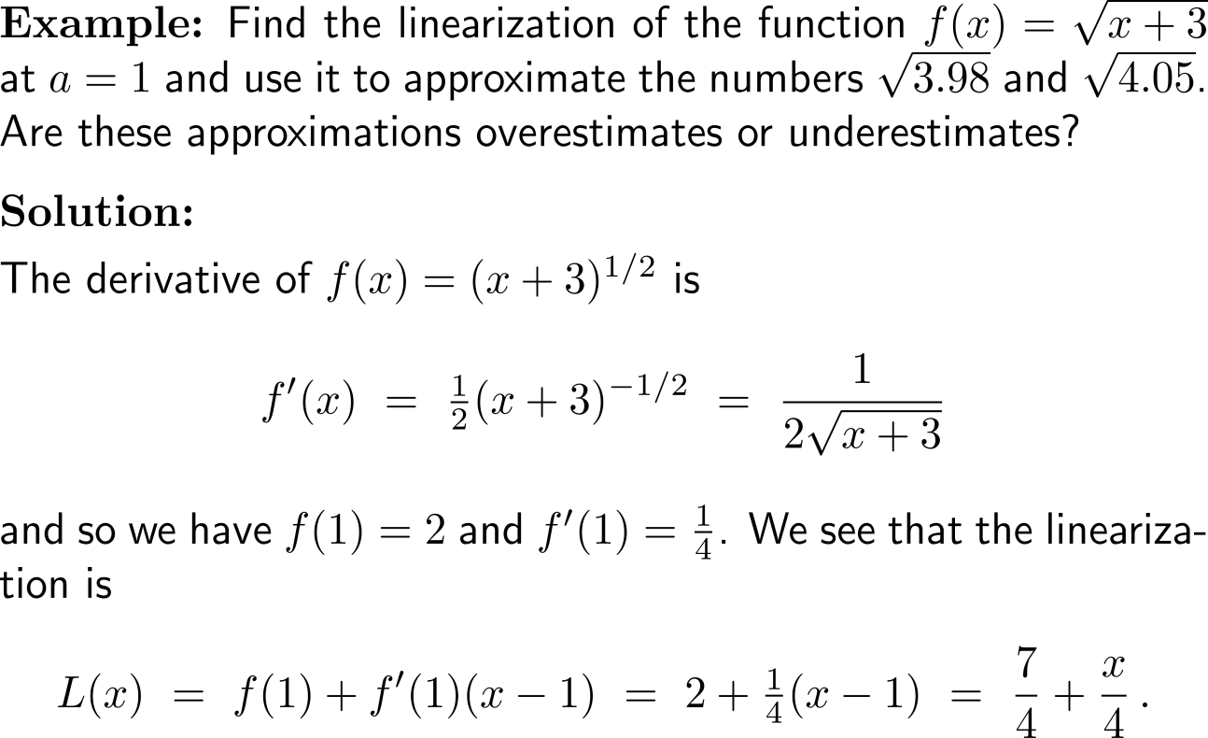
Example:
Linear approximation

Slide 6
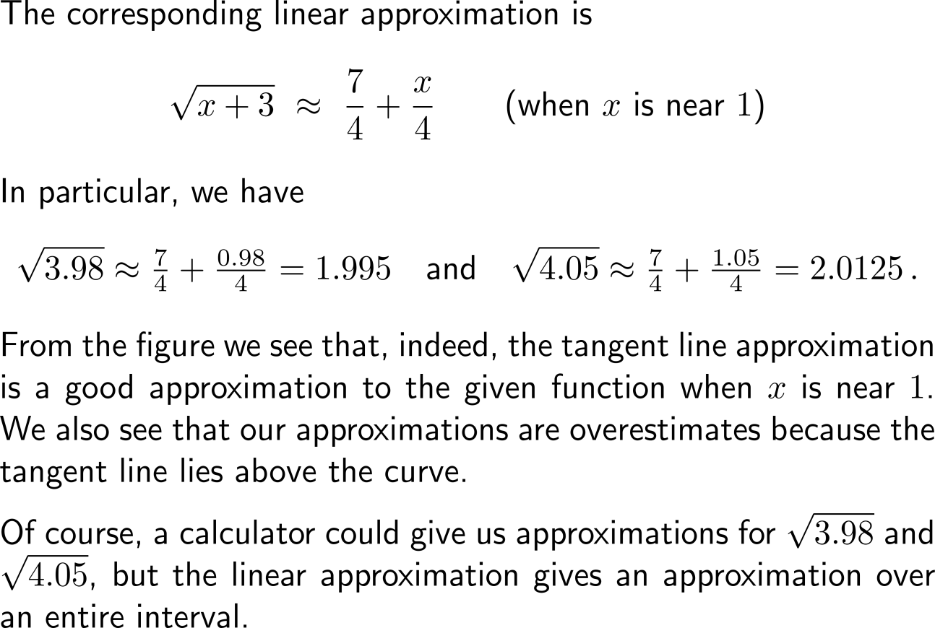
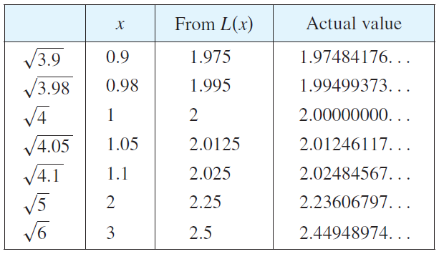
Example:
Linear approximation

Slide 7
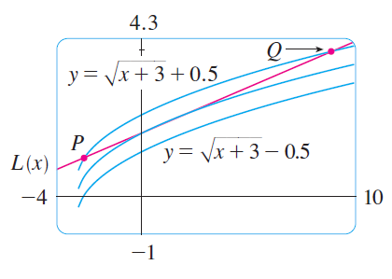
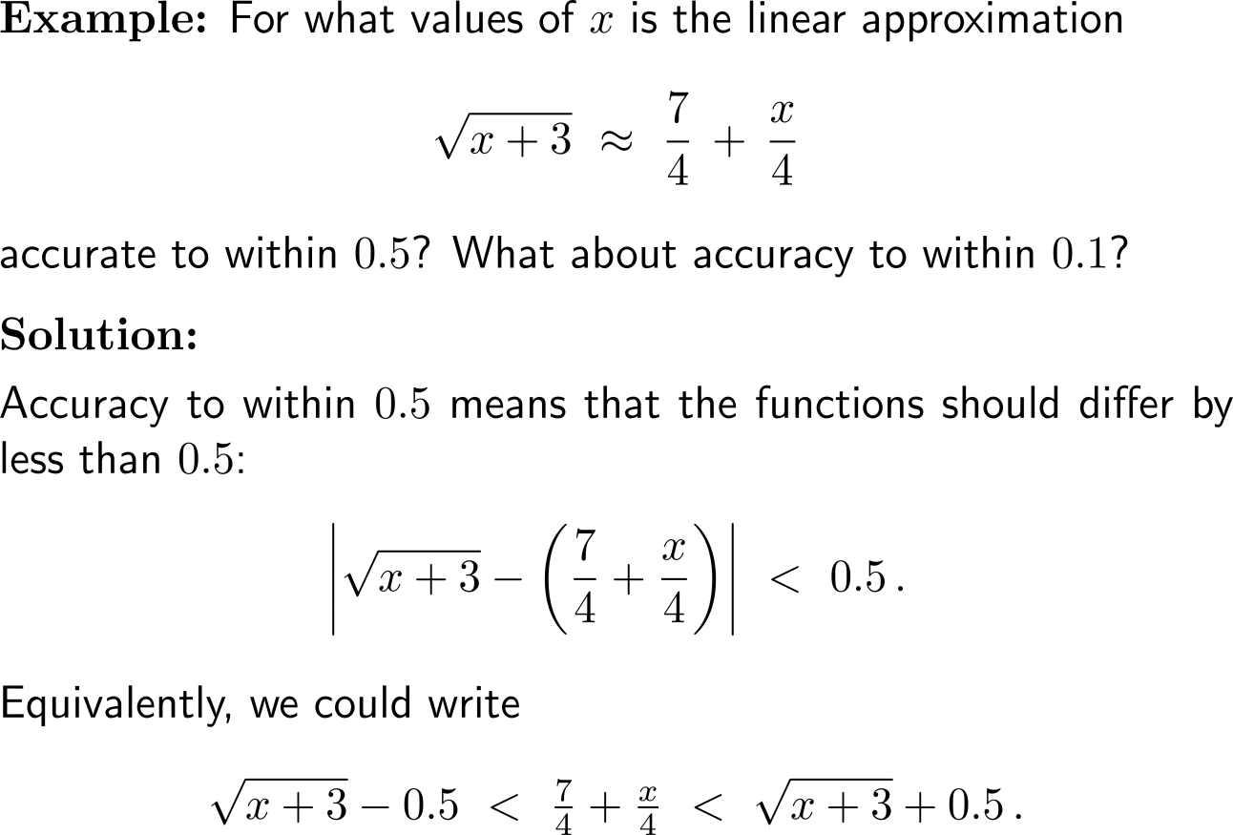
Example:
Linear approximation

Slide 8
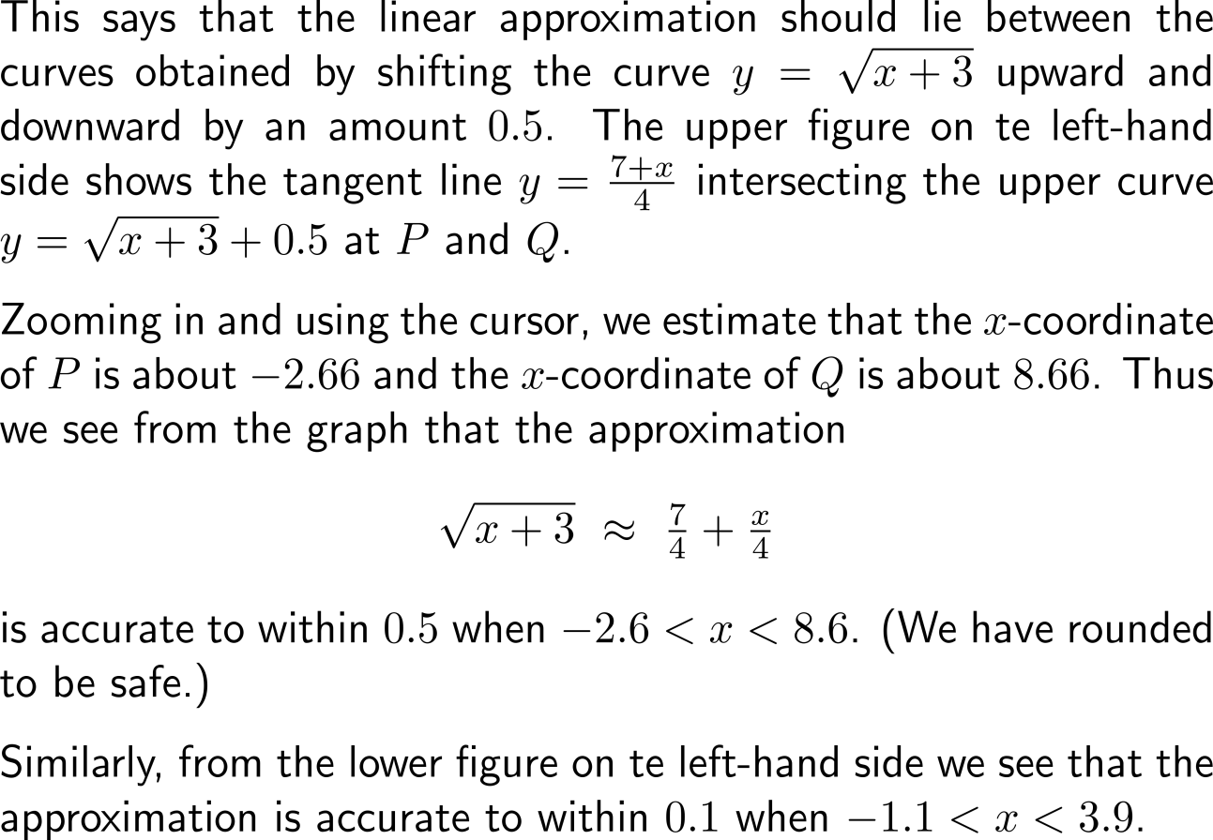
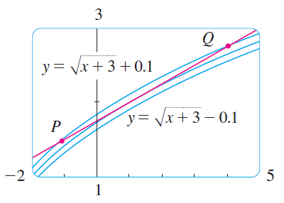
Example:
Linear approximation

Slide 9
Calculus I for Management

