Slide 1
Calculus I for MGMT – Exponential & Logarithmic Functions I
Recap: Exp. & Log. Functions – incl. Inverse Functions
Mathematics for Management
Supplementary Electronic Materials
Exponential & Logarithmic Functions I
Recap: Exp. & Log. Functions – incl. Inverse Functions
  Hyperbolic Sine &
  Hyperbolic Cosine
  Continuous Compounding

Slide 2
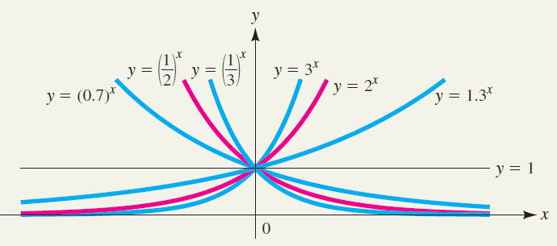
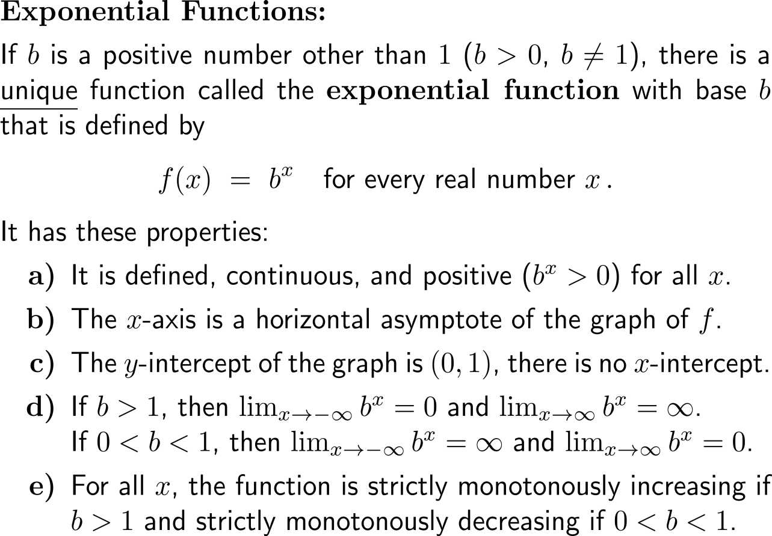
Recap:
You already know exponential functions and their properties

Slide 3
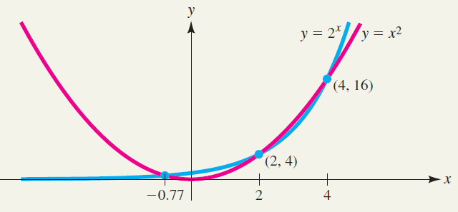
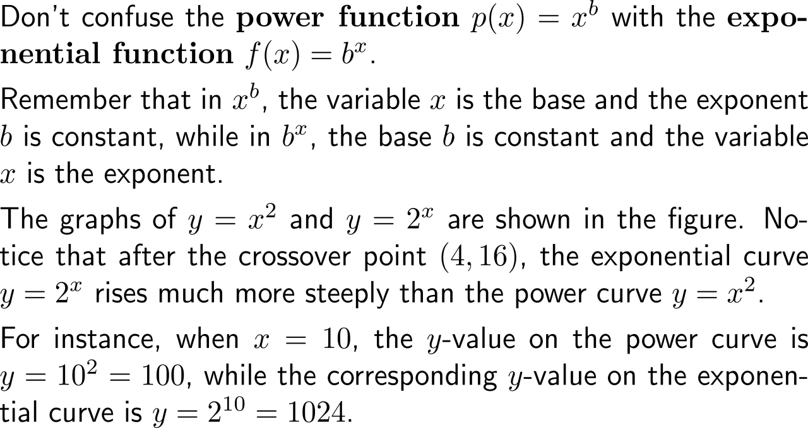
Recap:
Exponential functions grow faster than power functions

Slide 4
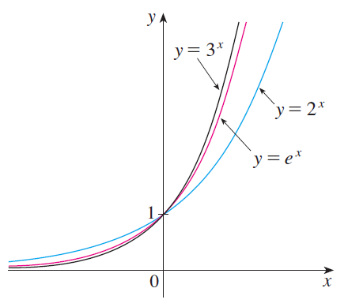
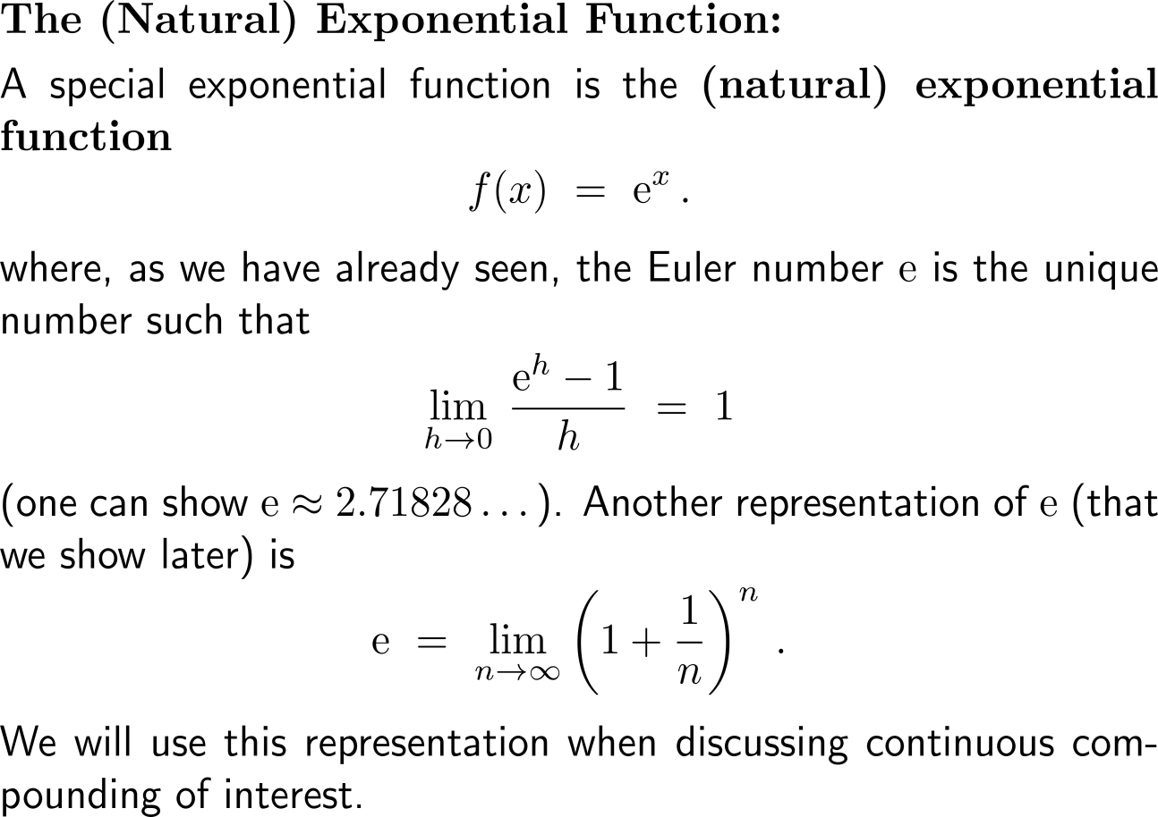
Recap:
The (natural) exponential function

Slide 5
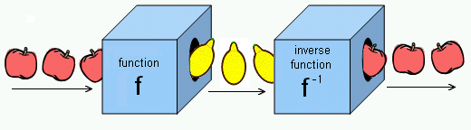
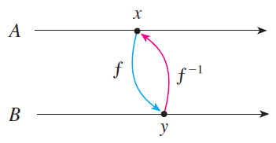
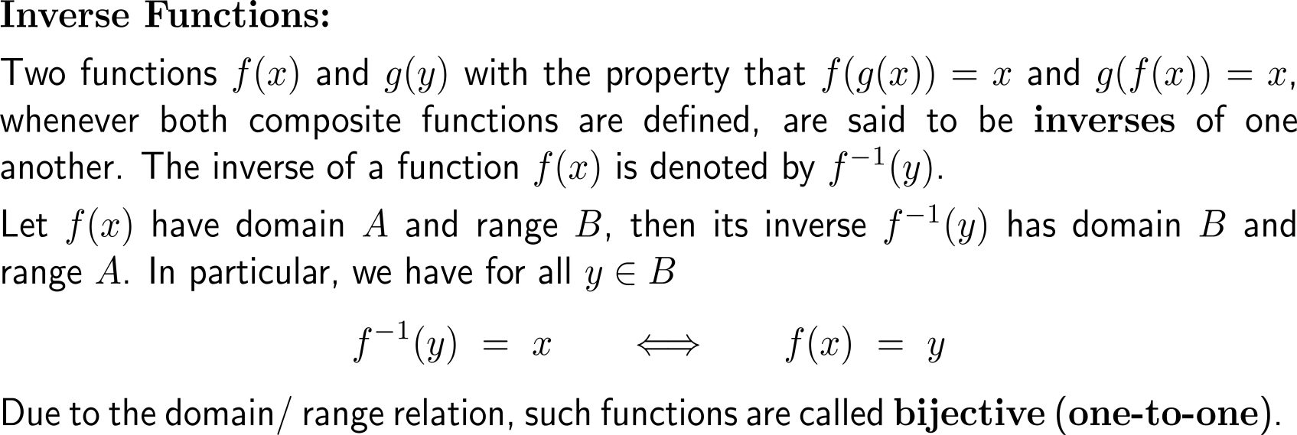
Composition of a bijective function with its (uniquely defined) inverse function gives the identity function on the domain

Slide 6
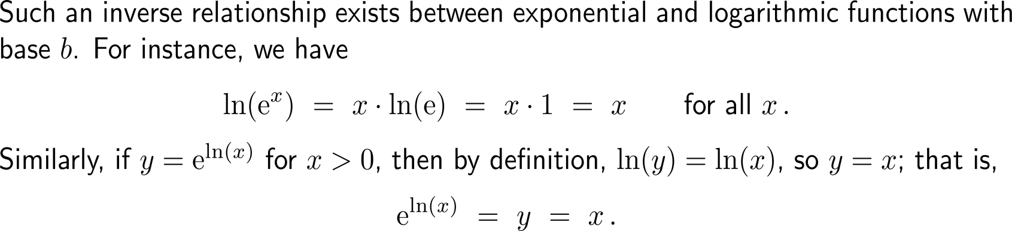
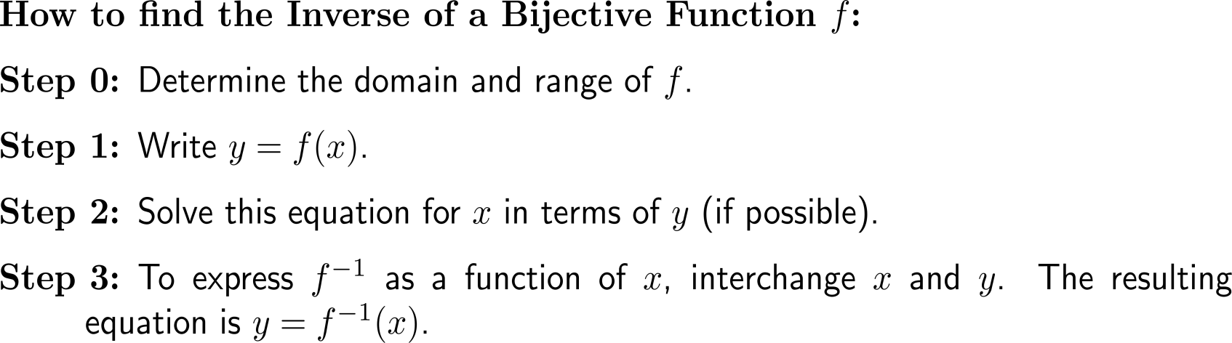
In all standard cases the inverse function is determined by means of algebraic manipulations

Slide 7
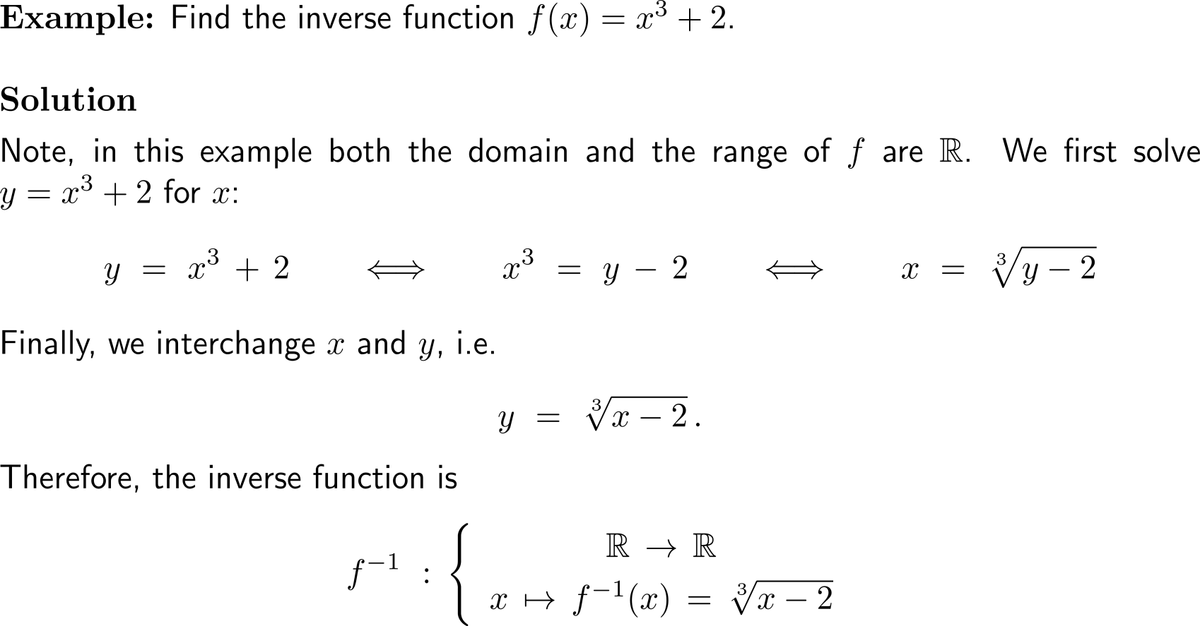
Example:
Finding the inverse of a function

Slide 8
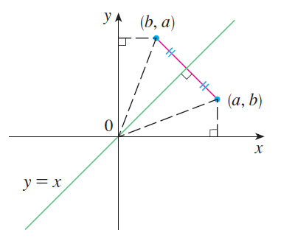
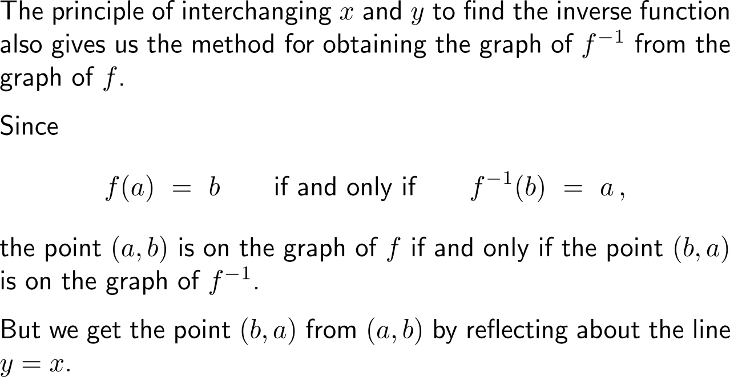
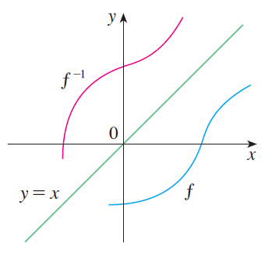
Geometrically, the graph of the inverse function is obtained by reflecting the graph of the function about the line y = x

Slide 9
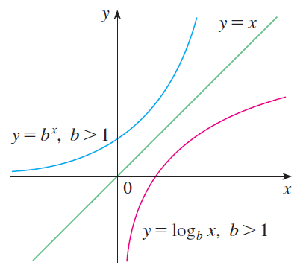
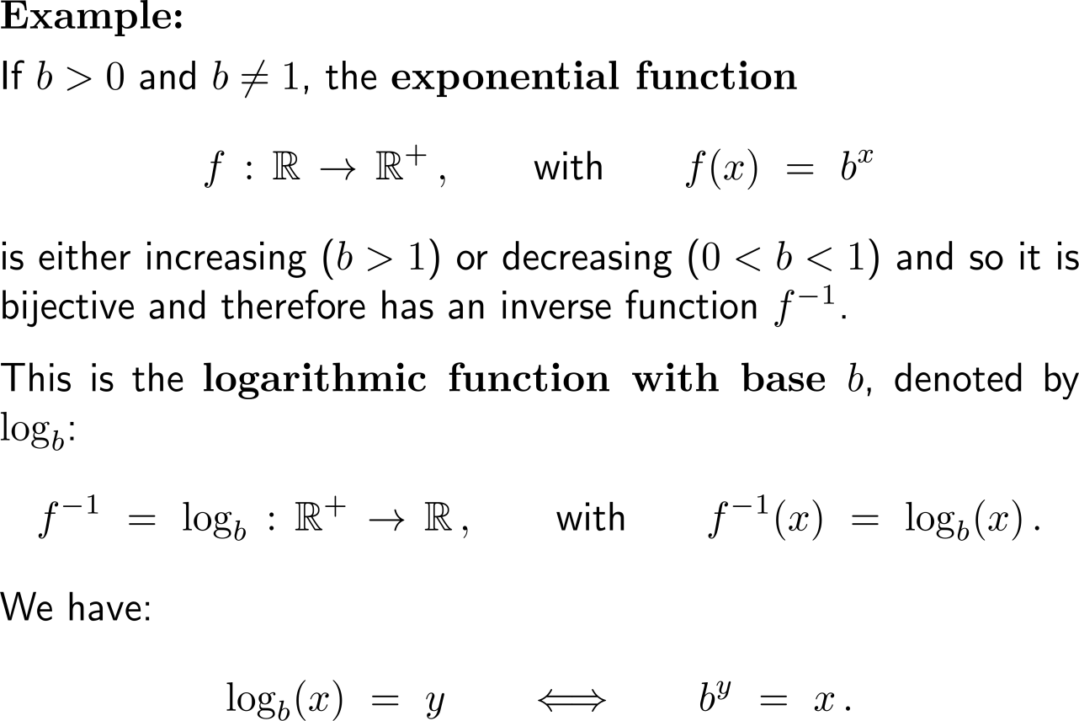
Example:
Exponential function and logarithmic function

Slide 10
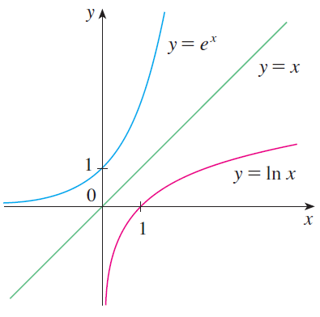
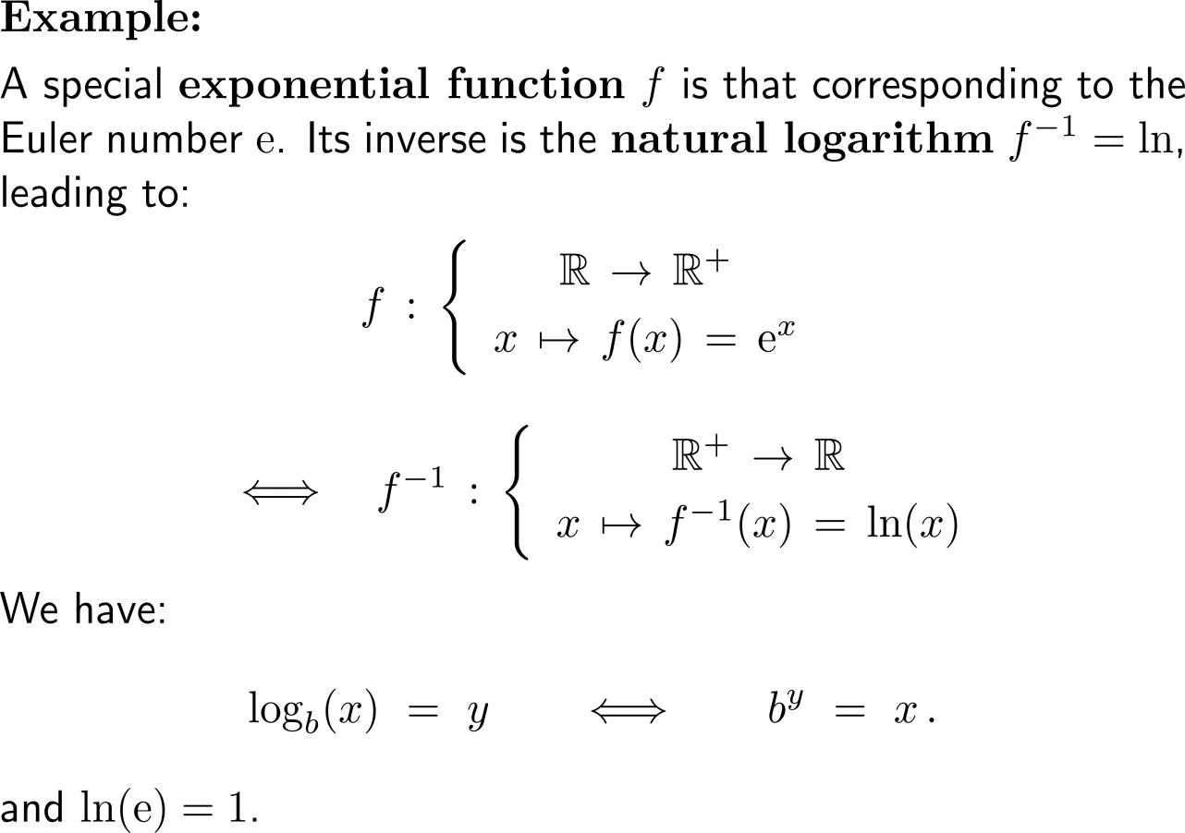
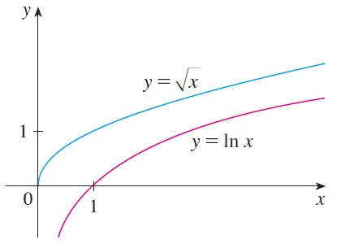
Example:
Exponential function and the natural logarithm

Slide 11
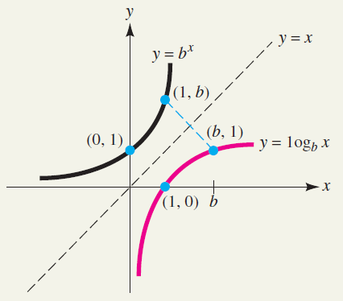
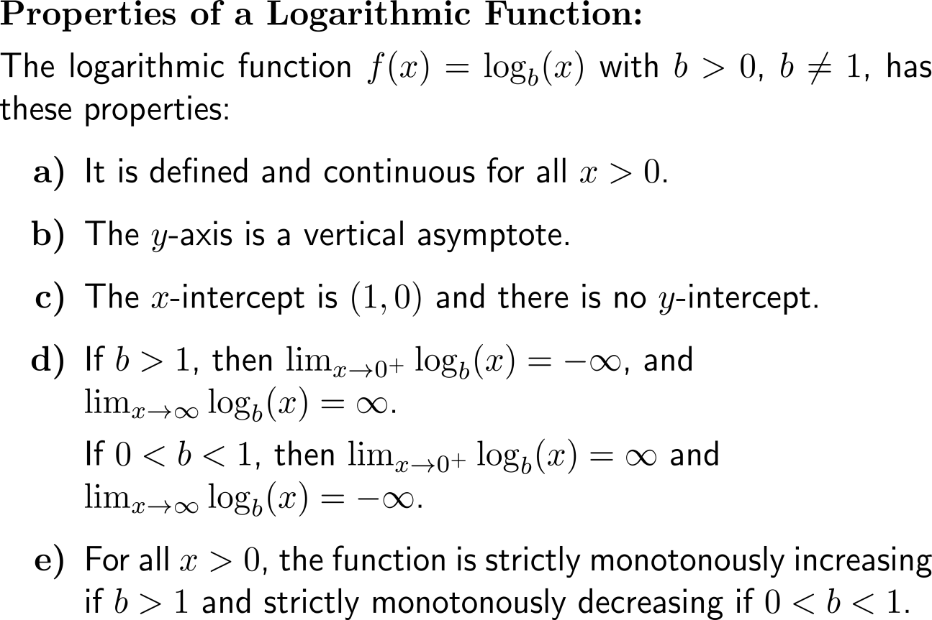
The properties of logarithmic functions follow from the mirroring of those of exponential functions

Slide 12
Calculus I for Management

