Slide 1
Calculus I for MGMT – Exponential & Logarithmic Functions I
Hyperbolic Sine & Hyperbolic Cosine
Mathematics for Management
Supplementary Electronic Materials
Exponential & Logarithmic Functions I
  Recap: Exp. & Log. Functions – incl. Inverse Functions
  Hyperbolic Sine &
  Hyperbolic Cosine
  Continuous Compounding

Slide 2
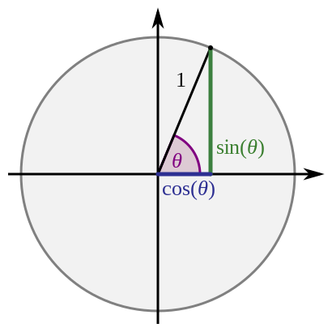
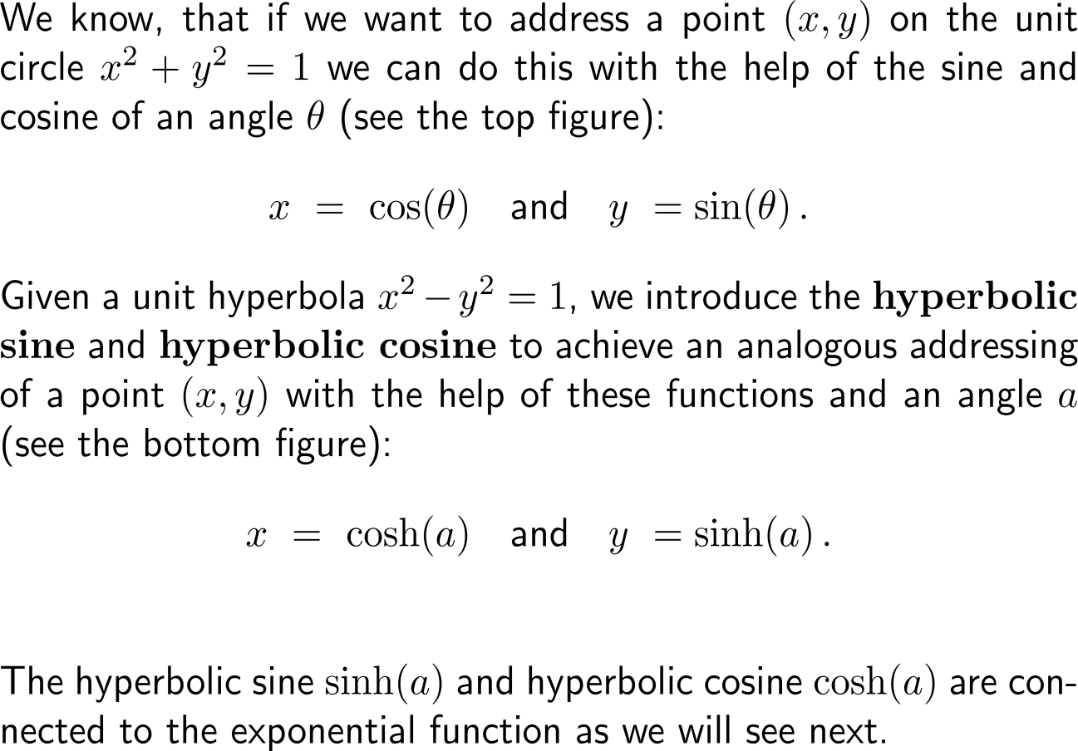
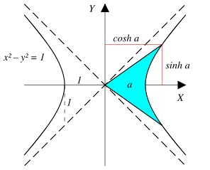
Analogous to the trigonometric functions that are dine fined for the unit circle we define the hyperbolic functions for the unit hyperbola

Slide 3
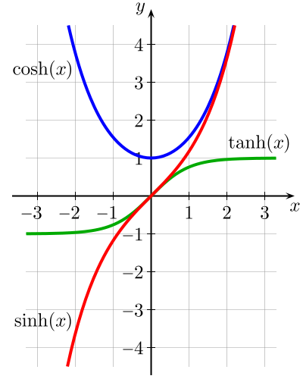
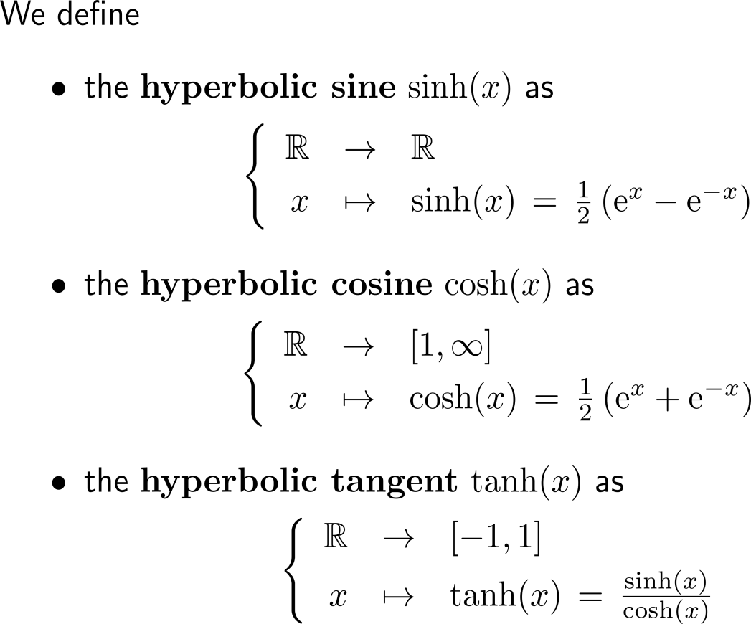
These hyperbolic functions are given in terms of the sum/ difference of two exponential functions

Slide 4
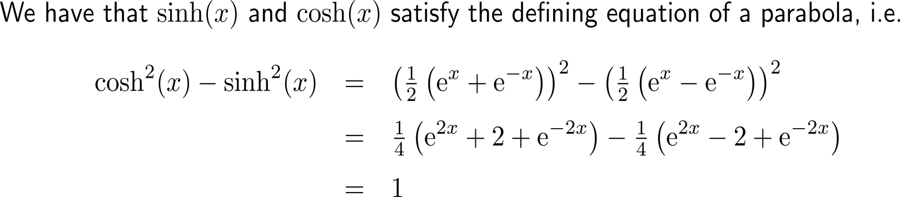
It is easily checked that the hyperbolic sine and hyperbolic cosine satisfy the defining equation of a hyperbola for all elements of their domain

Slide 5
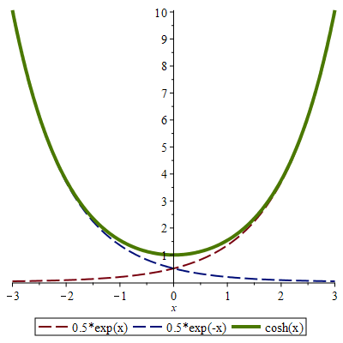
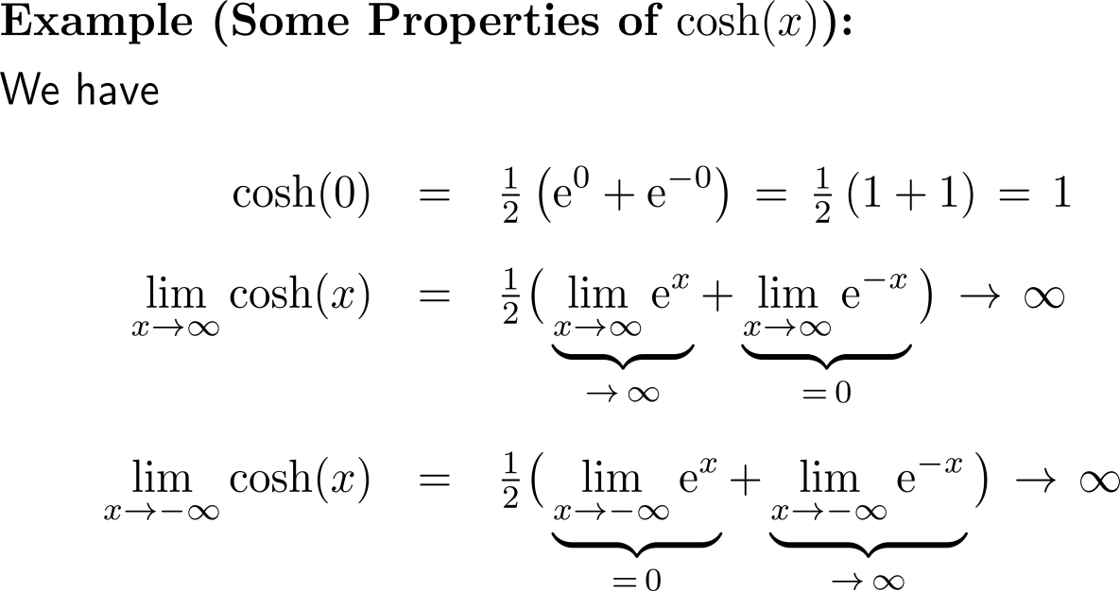
Example:
Properties of the hyperbolic cosine

Slide 6
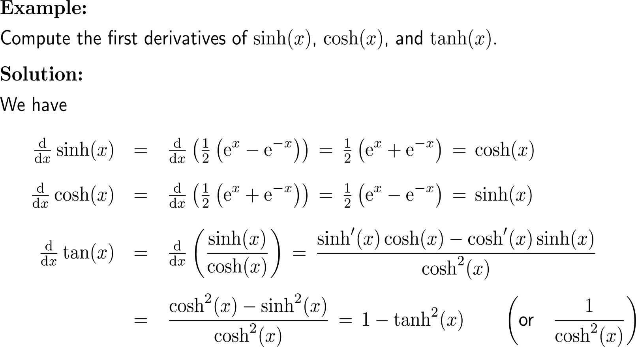
Example:
Derivatives of the hyperbolic functions

Slide 7
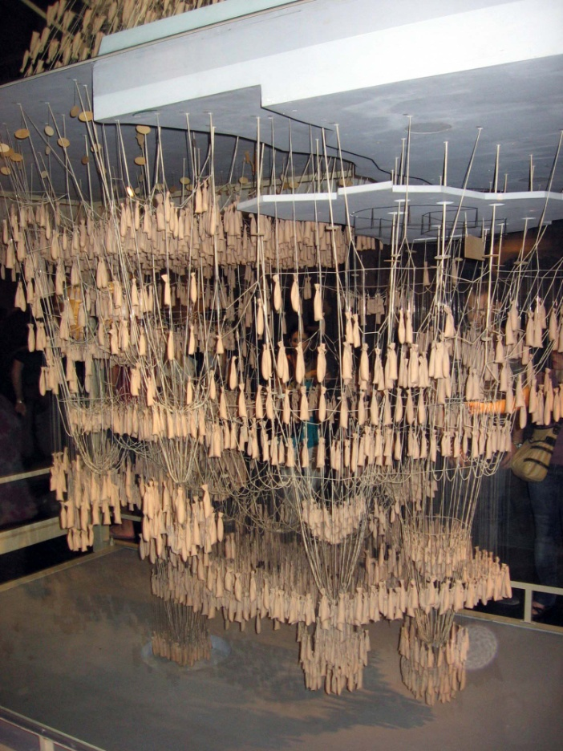
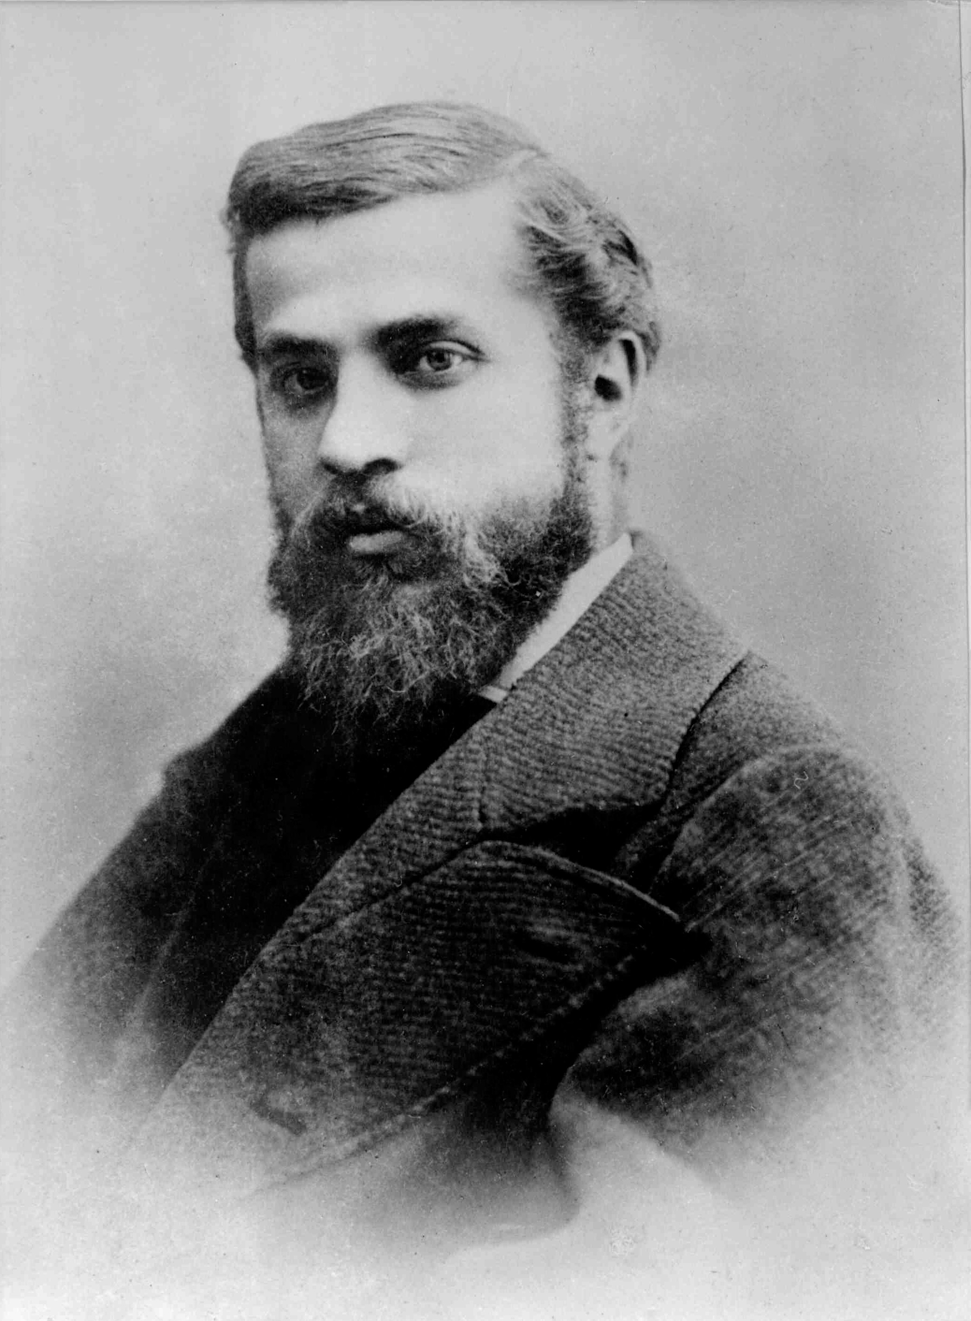

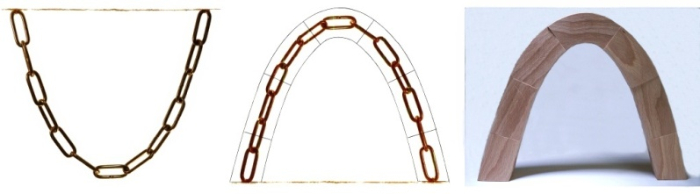
The hyperbolic cosine describes the behavior of a chain under gravitation; a statically very interesting behavior exploited e.g. by Antoni Gaudi
Antoni Gaudí i Cornet
(1852 – 1926)

Slide 8
Calculus I for Management

