Slide 1
Calculus I for MGMT – Exponential & Logarithmic Functions I
Continuous Compounding
Mathematics for Management
Supplementary Electronic Materials
Exponential & Logarithmic Functions I
  Recap: Exp. & Log. Functions – incl. Inverse Functions
  Hyperbolic Sine &
  Hyperbolic Cosine
  Continuous Compounding

Slide 2
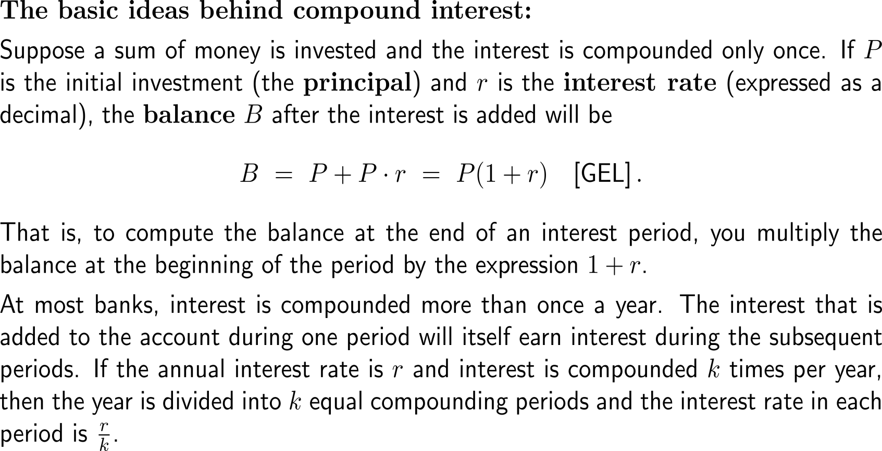
Motivating the formula for continuous compounding of interest (1/ 4)
Continuous Compounding of Interest

Slide 3
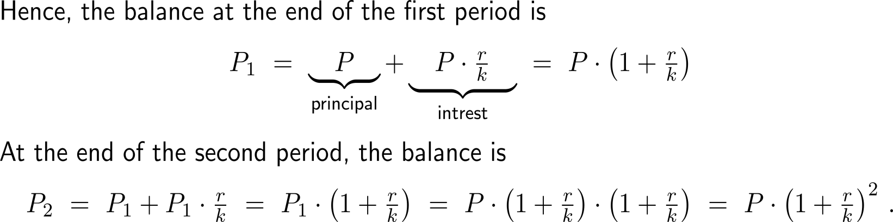
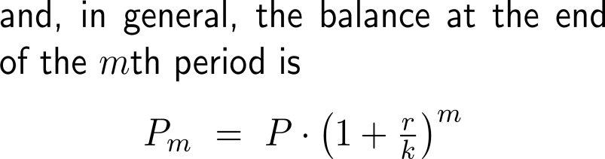
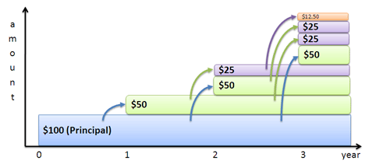
Motivating the formula for continuous compounding of interest (2/ 4)

Slide 4
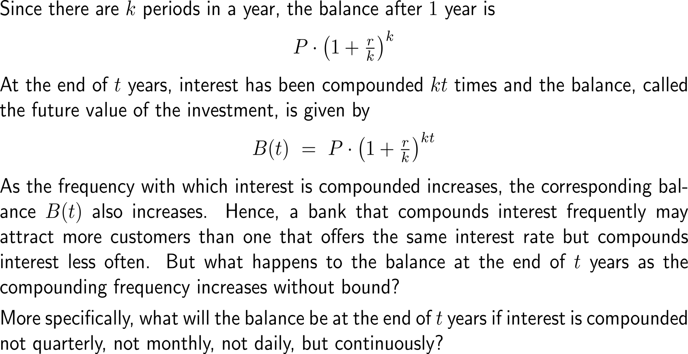
Motivating the formula for continuous compounding of interest (3/ 4)

Slide 5
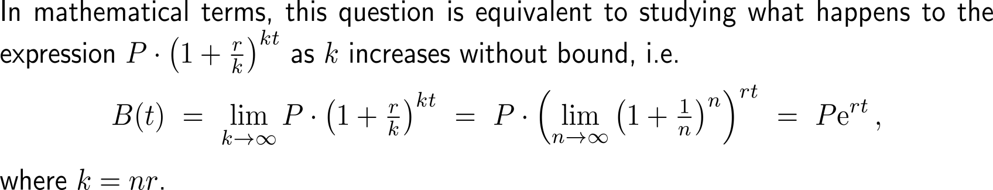
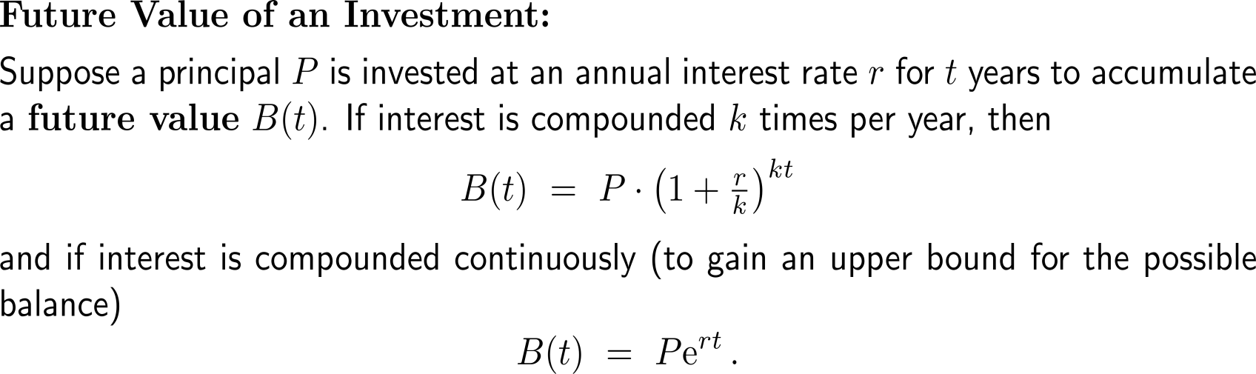
Motivating the formula for continuous compounding of interest (4/ 4)

Slide 6
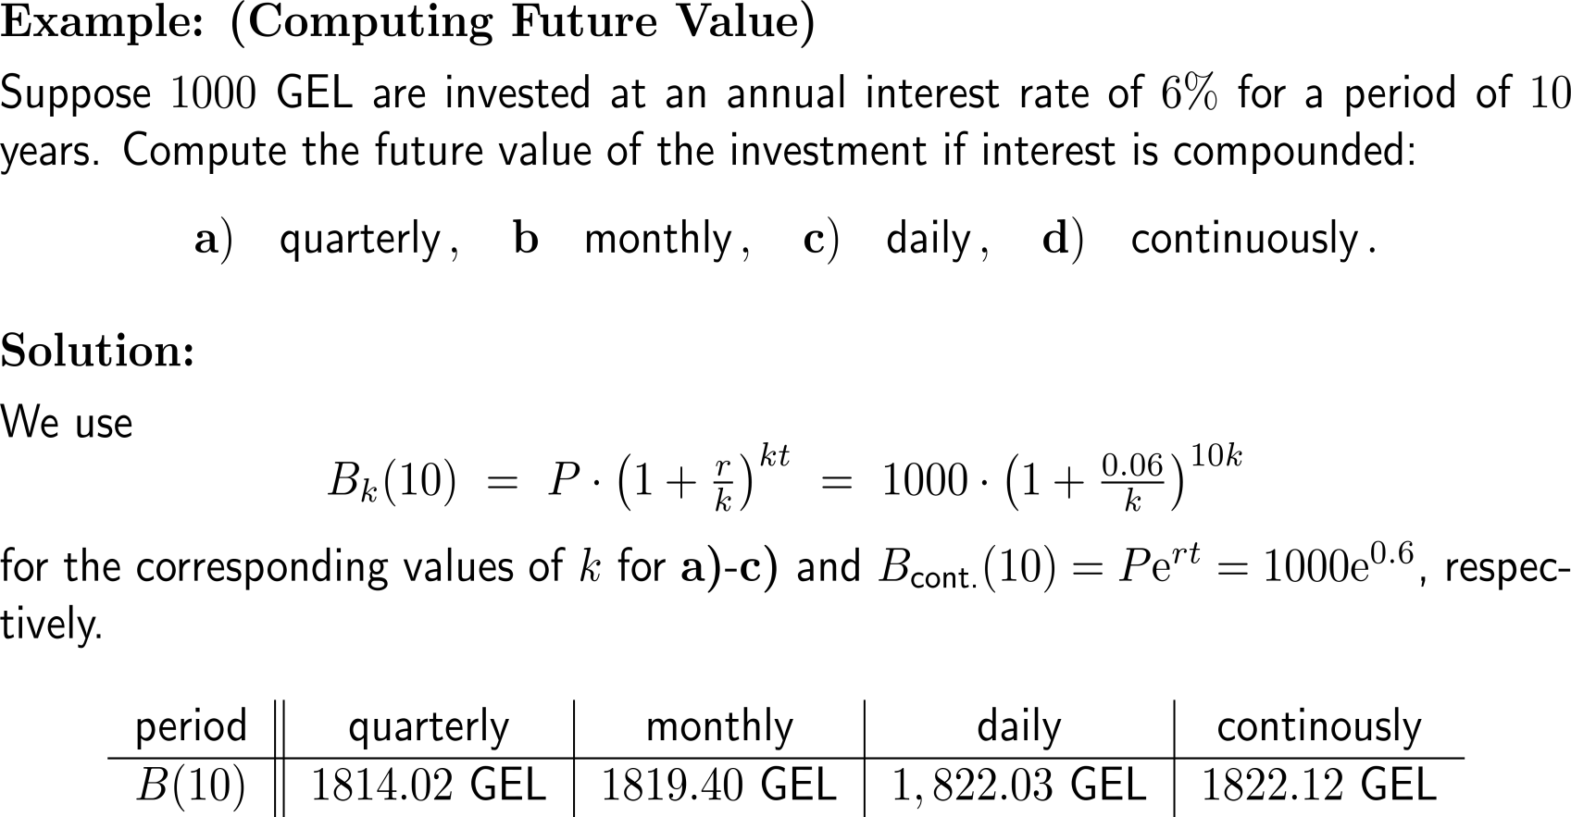
Example:
Computing future value

Slide 7
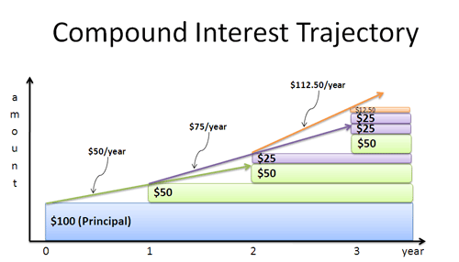
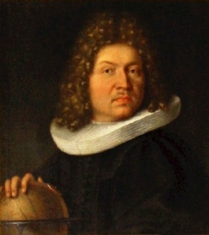
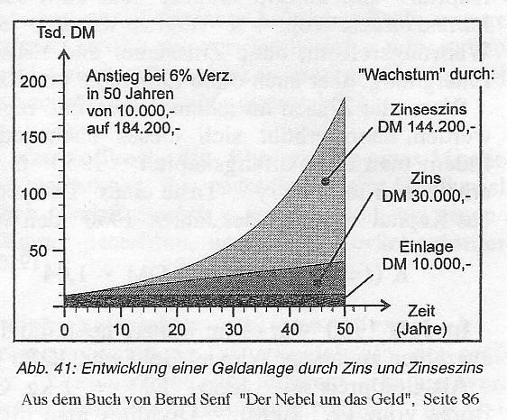
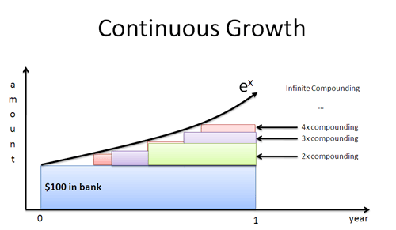
Continuous compounding as the limit case for infinitely many compounding events
Jacob Bernoulli (1655 - 1705)

Slide 8
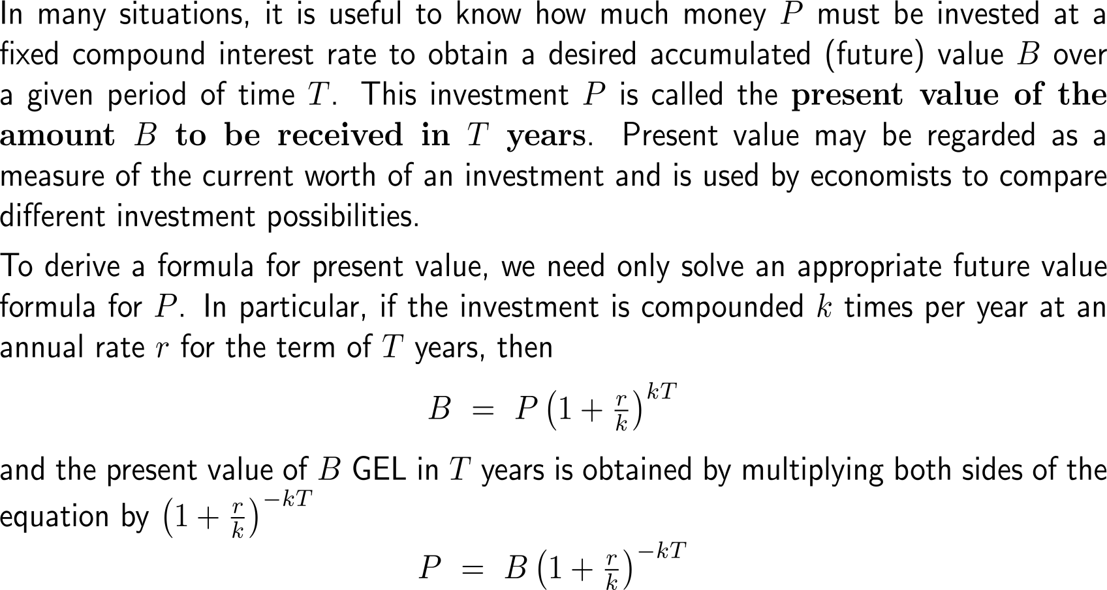
Motivating the formula for present vale (1/ 2)
Present
Value

Slide 9
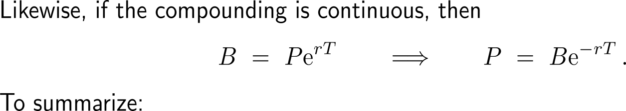
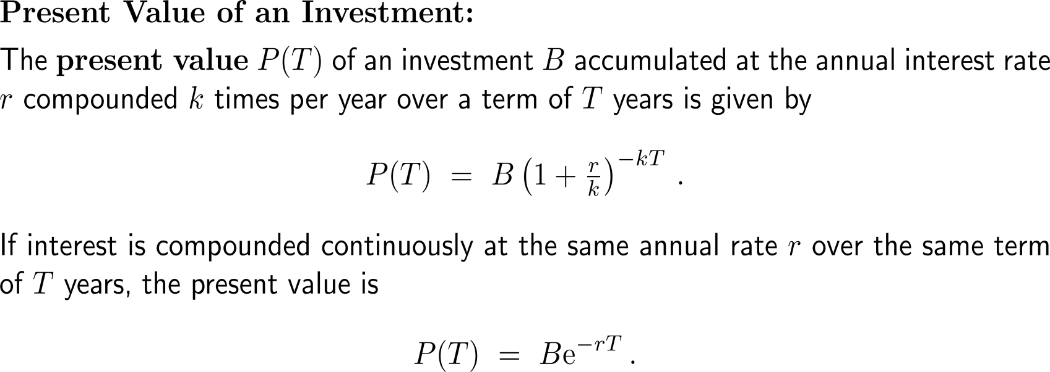
Motivating the formula for present vale (2/ 2)

Slide 10
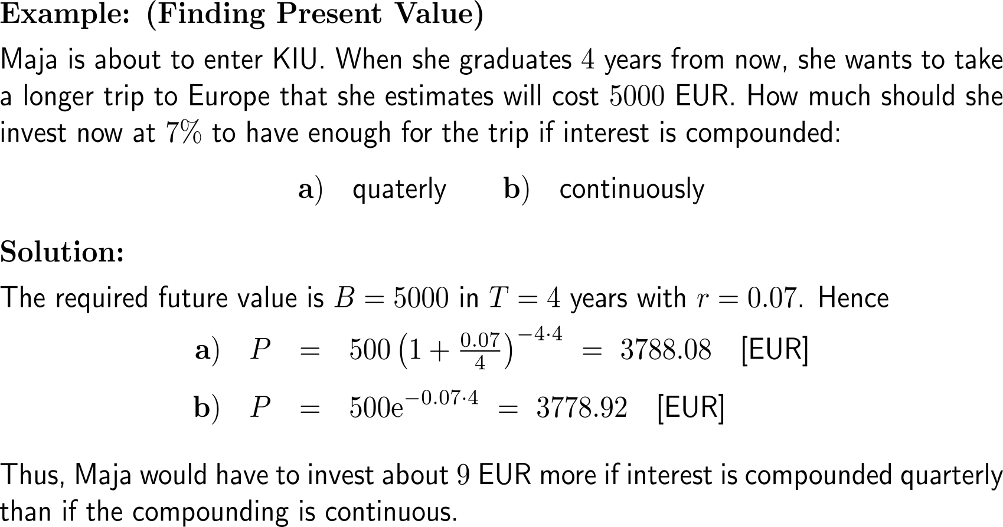
Example:
Finding present value

Slide 11
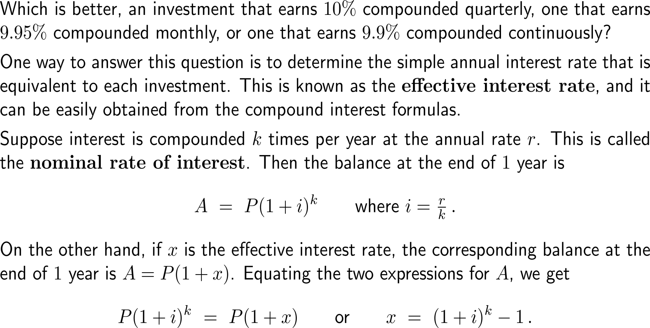
Motivating the formula for effective interest rates (1/ 2)
Effective Interest Rate

Slide 12
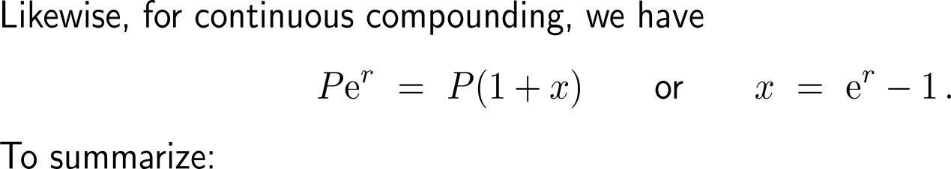
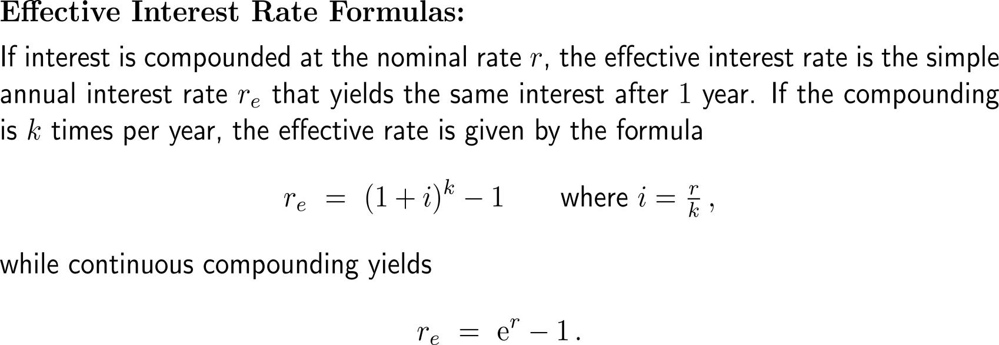
Motivating the formula for effective interest rates (2/ 2)

Slide 13
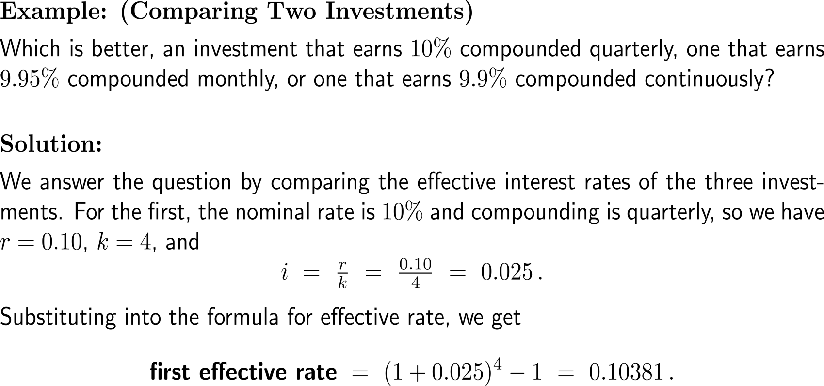
Example:
Comparing two investments

Slide 14
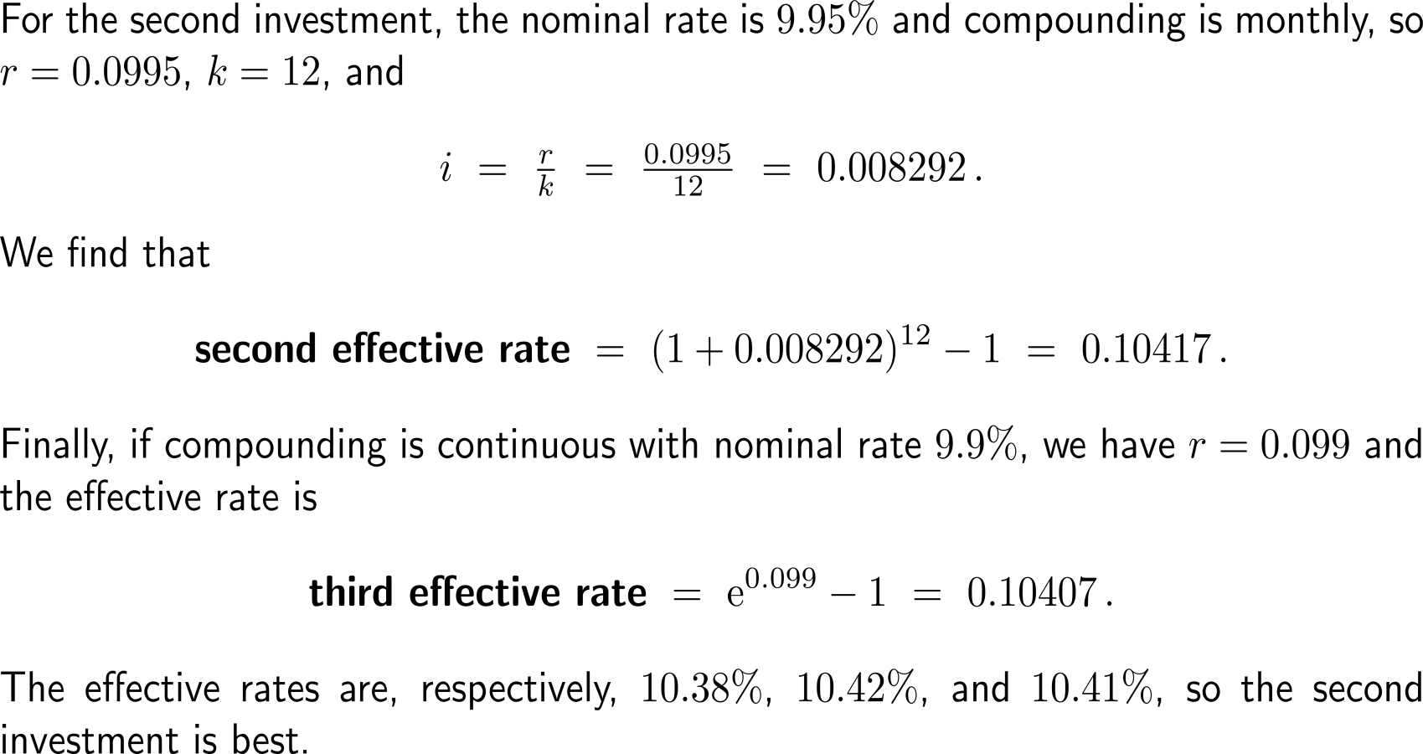
Example:
Comparing two investments

Slide 15
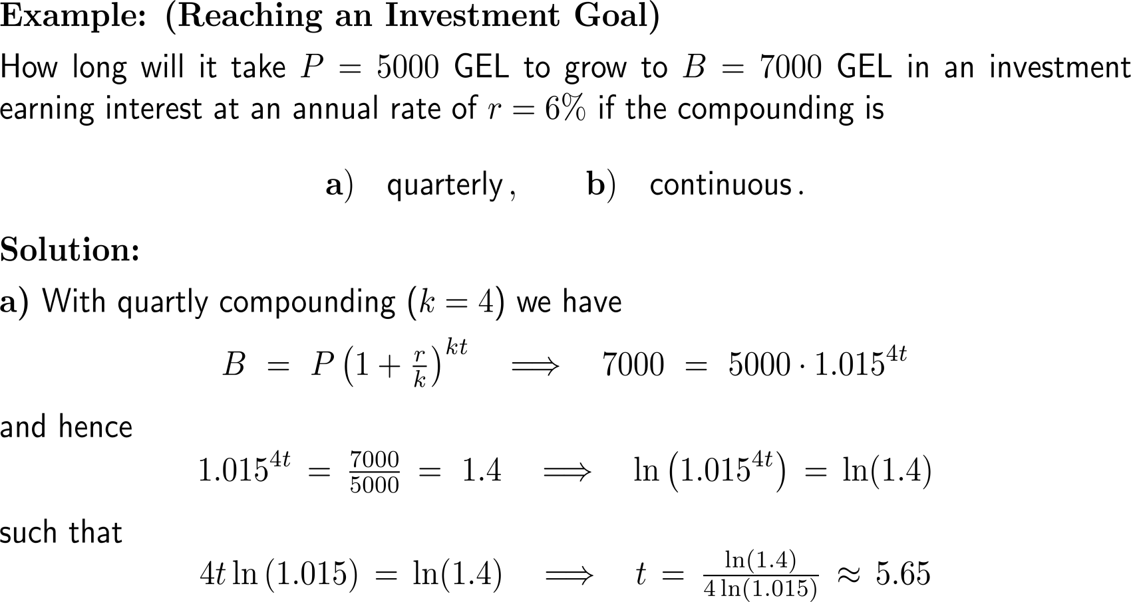
Example:
Reaching an investment goal
Logarithms in Compounding Applications

Slide 16
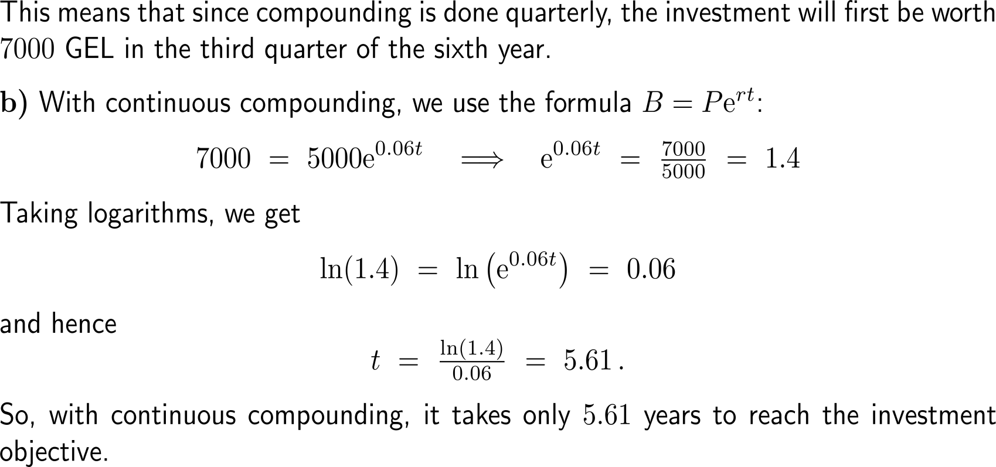
Example:
Reaching an investment goal

Slide 17
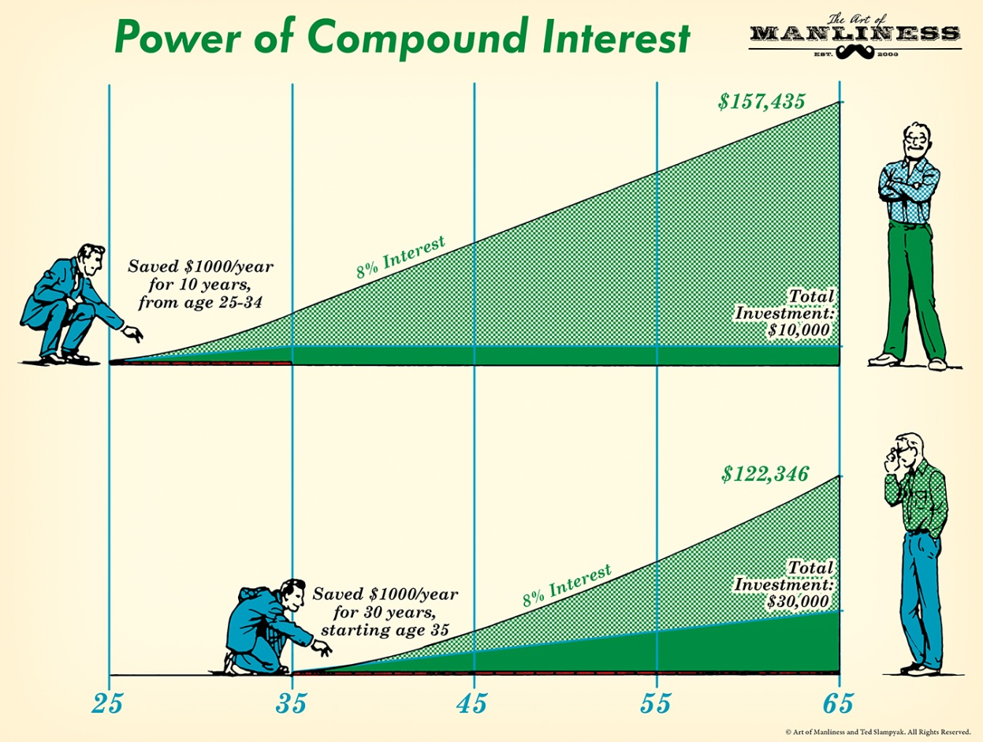
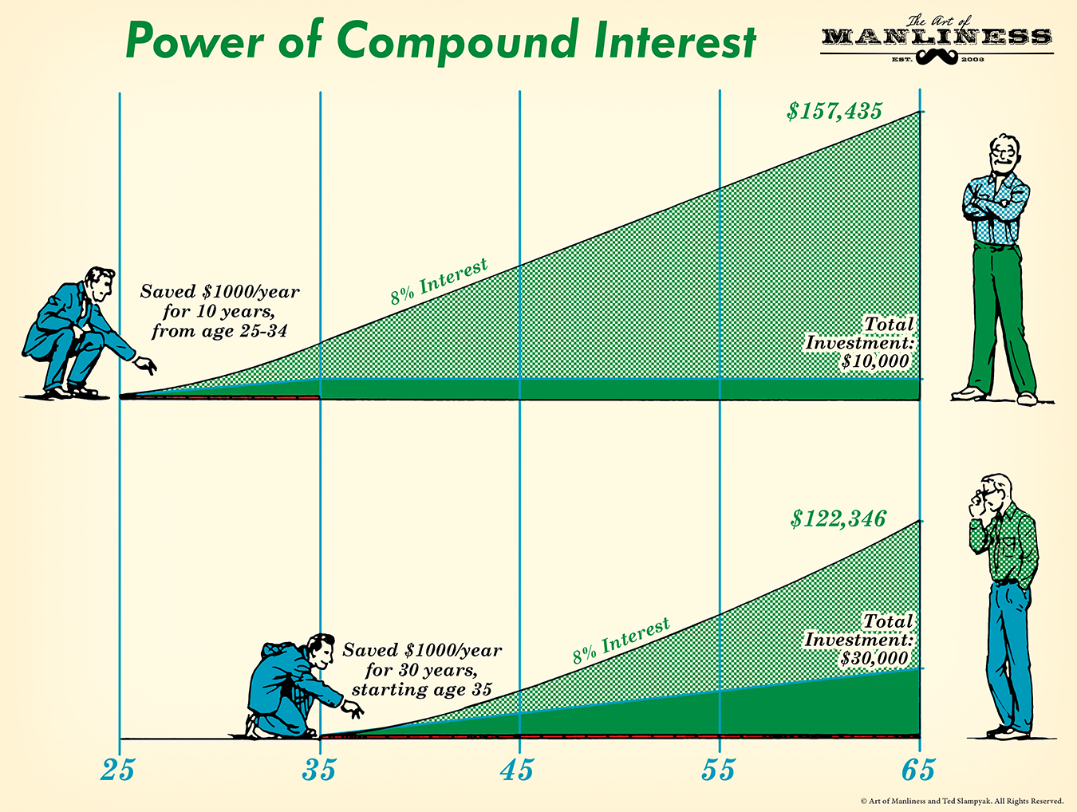
Example:
Continuously Compounded Interest
What do you think about this cartoon?
Is this investment strategy feasible?

Slide 18
Calculus I for Management

