Slide 1
Calculus I for Management
Exponential & Logarithmic Functions
week 7
Lecture
  Recap: Exponential & logarithmic functions – incl. inverse functions
  Hyperbolic sine and cosine: sinh(x) & cosh(x)
  Continuous compounding

Slide 2
Topics
  Recap: Exponential & Logarithmic Functions
  Hyperbolic Sine and Cosine: sinh(x) & cosh(x)
  Continuous Compounding

Slide 3
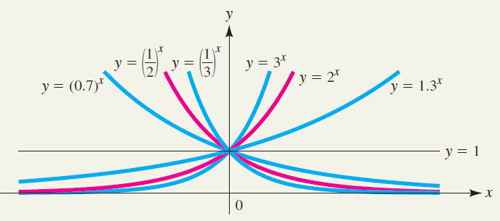
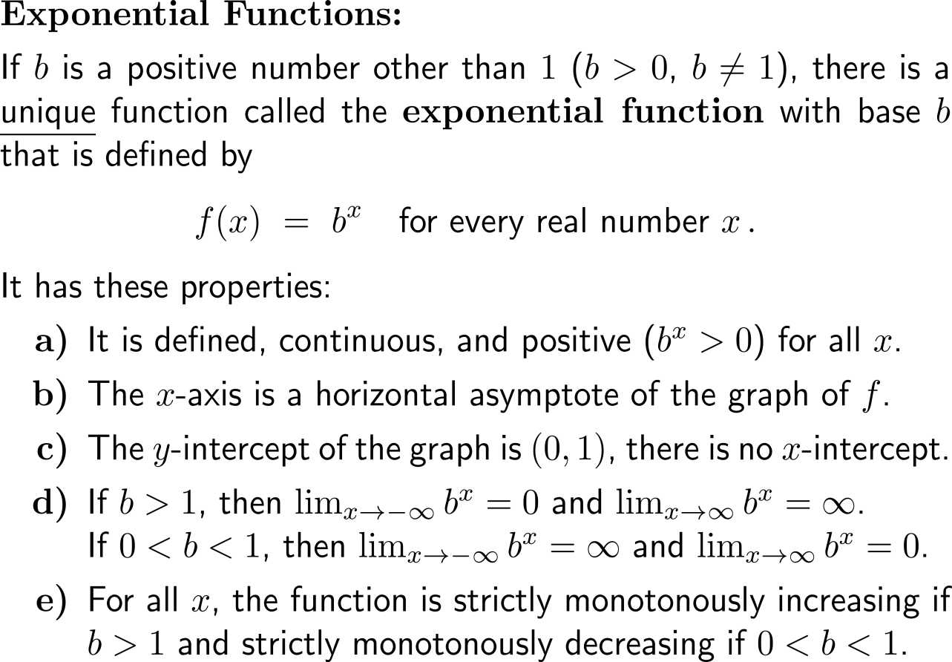
Recap:
You already know exponential functions and their properties

Slide 4
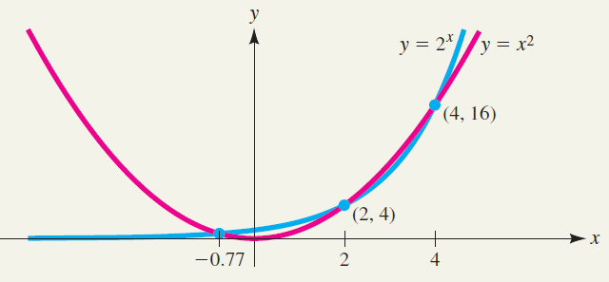
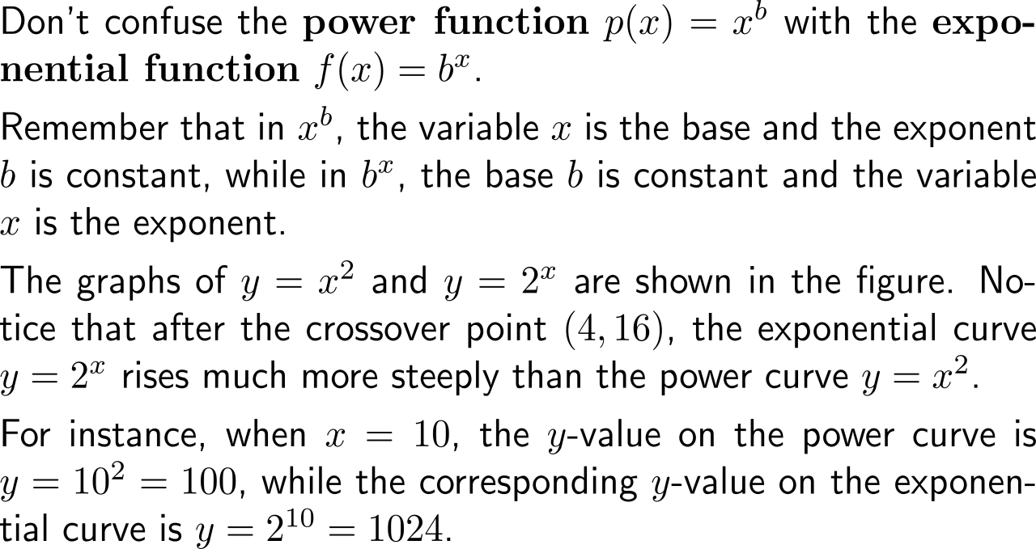
Recap:
Exponential functions grow faster than power functions

Slide 5
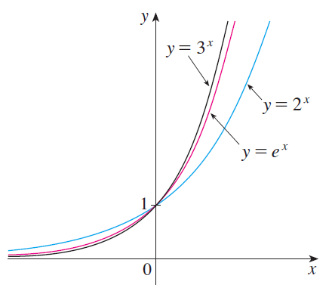
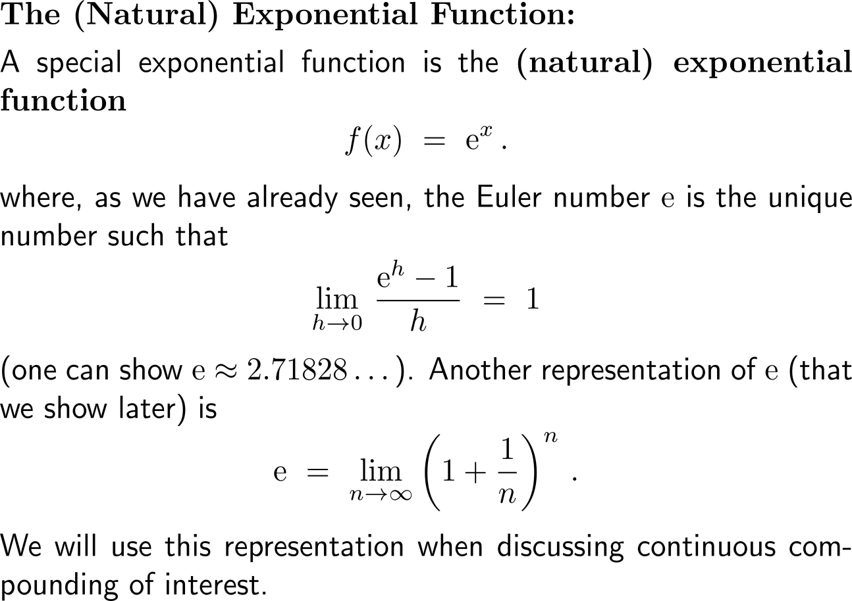
Recap:
The (natural) exponential function

Slide 6
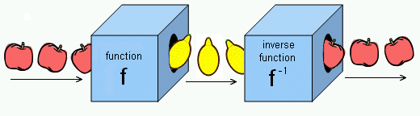
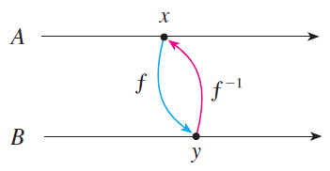
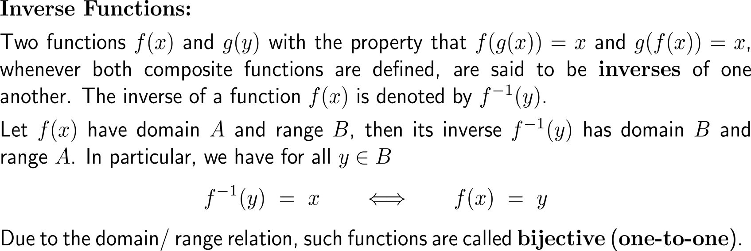
Composition of a bijective function with its (uniquely defined) inverse function gives the identity function on the domain

Slide 7
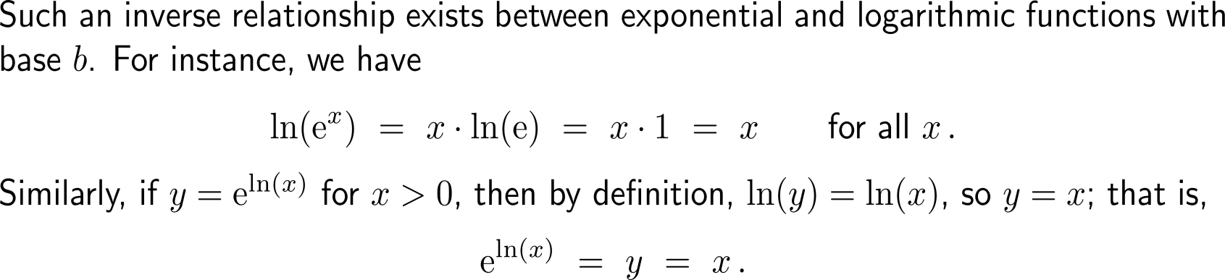
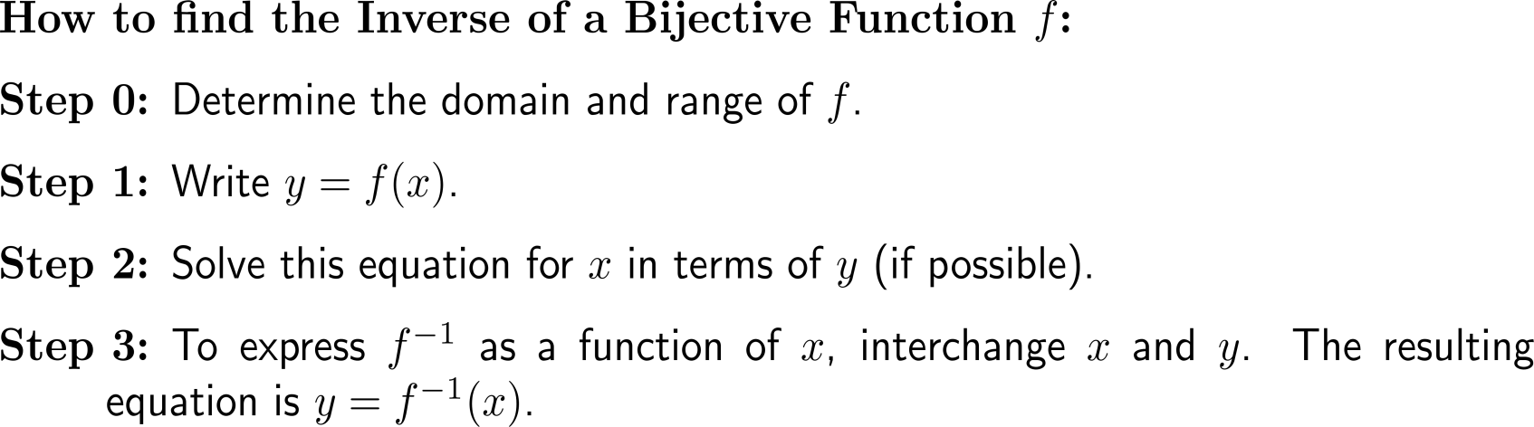
In all standard cases the inverse function is determined by means of algebraic manipulations

Slide 8
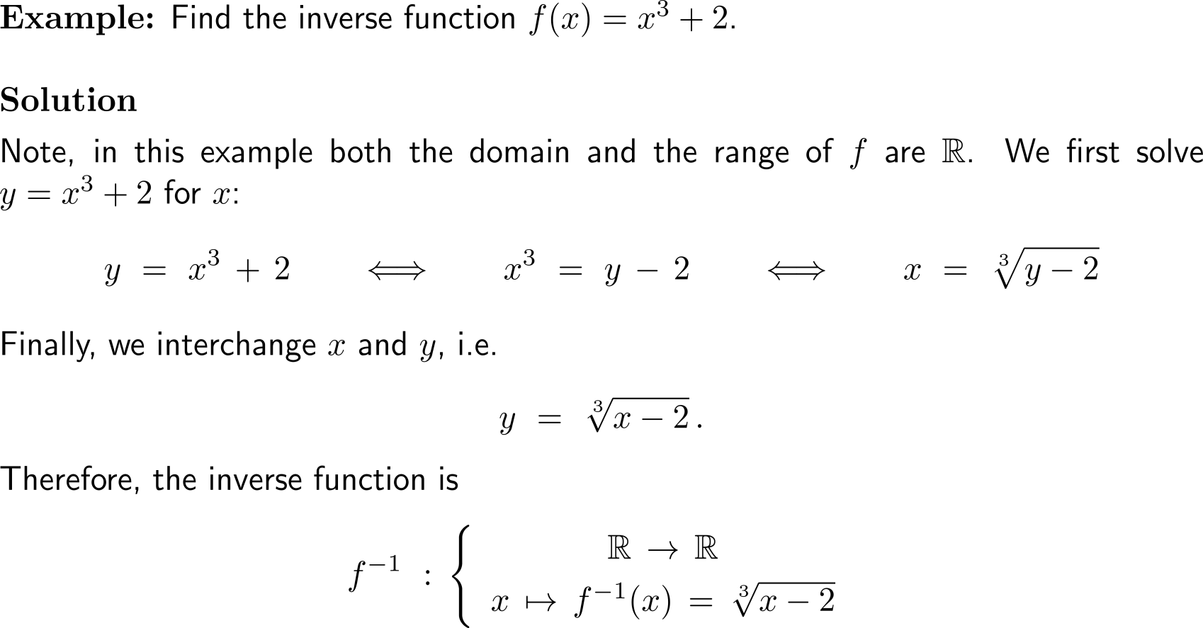
Example:
Finding the inverse of a function

Slide 9
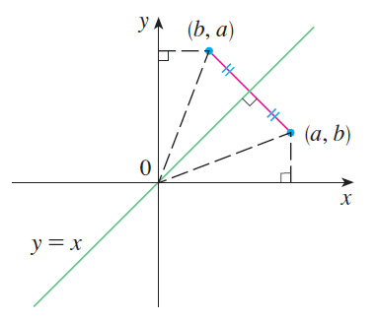
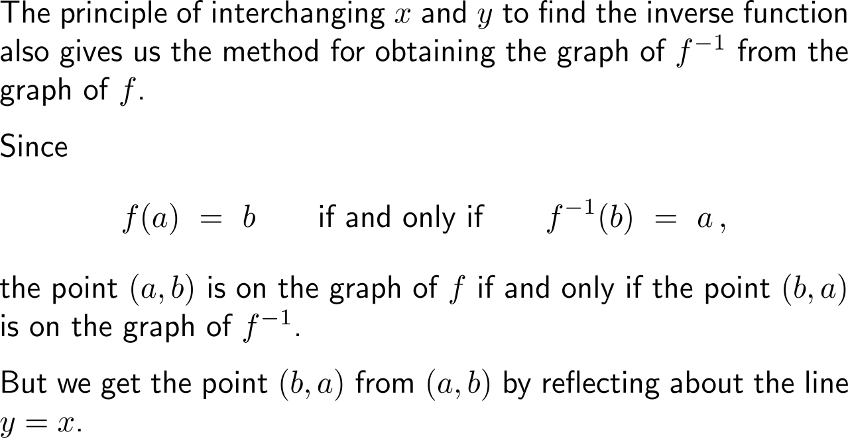
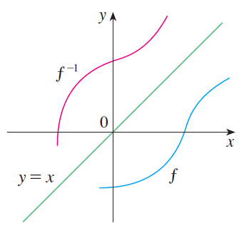
Geometrically, the graph of the inverse function is obtained by reflecting the graph of the function about the line y = x

Slide 10
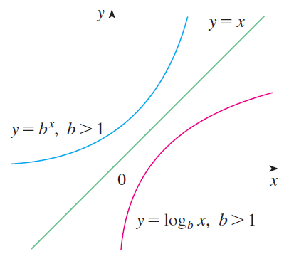
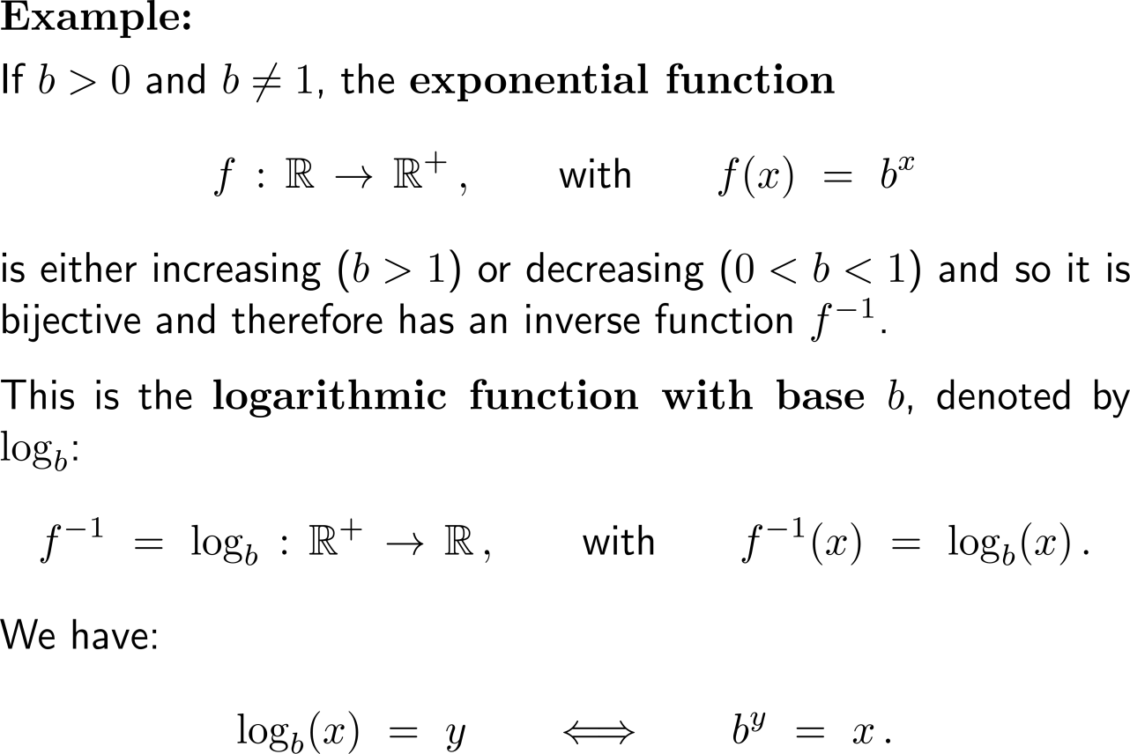
Example:
Exponential function and logarithmic function

Slide 11
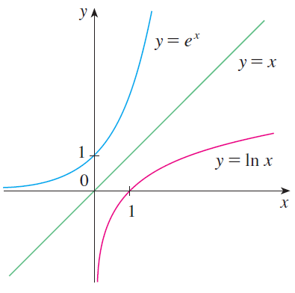
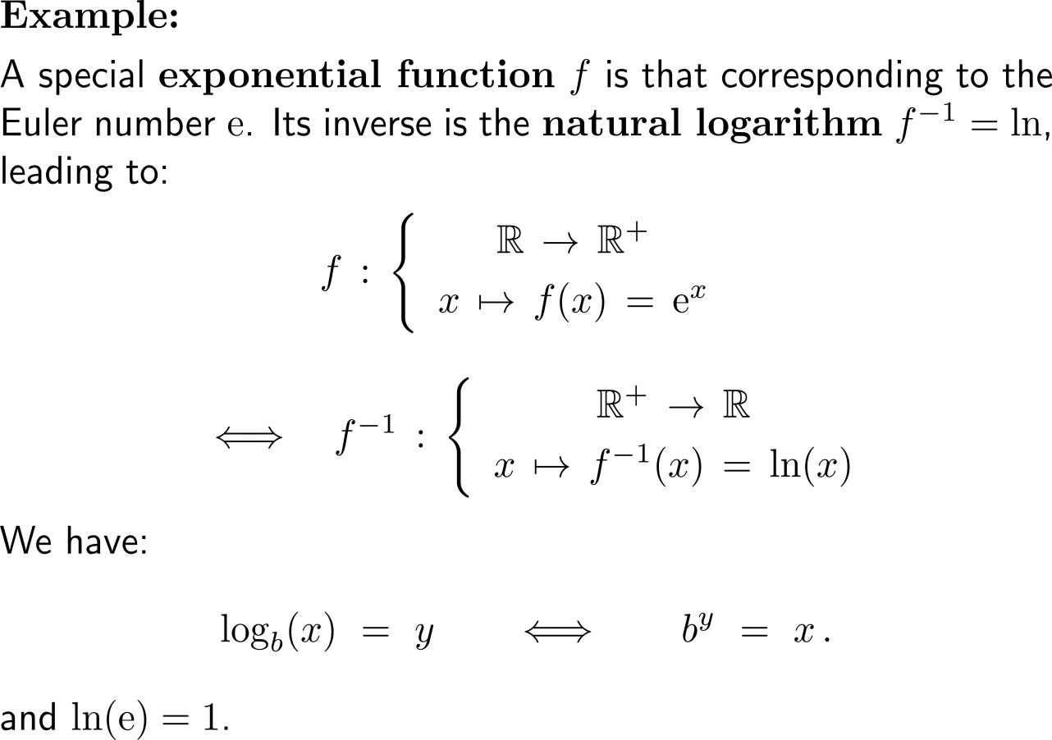
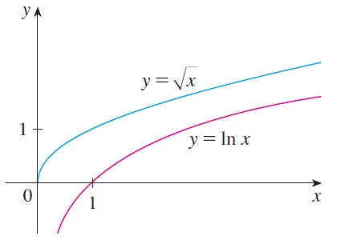
Example:
Exponential function and the natural logarithm

Slide 12
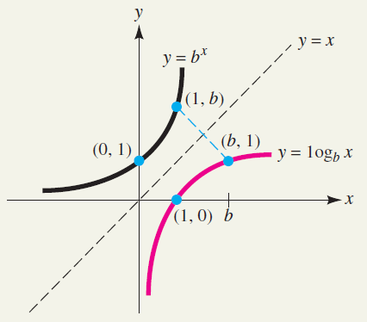
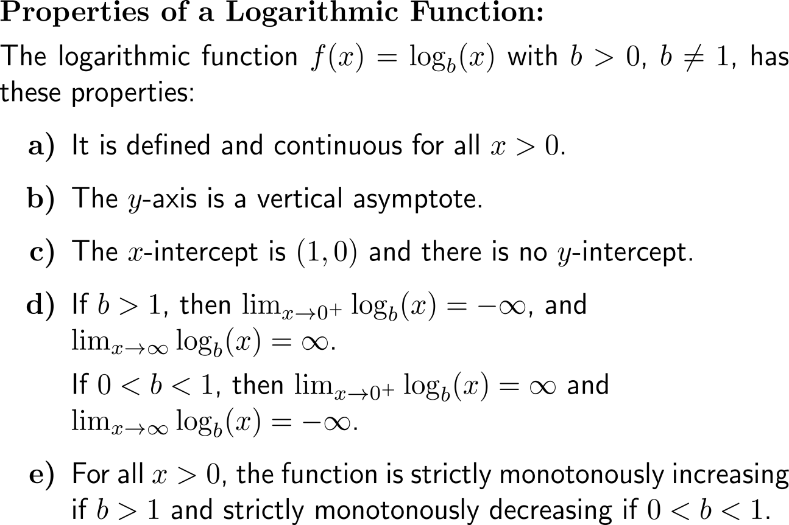
The properties of logarithmic functions follow from the mirroring of those of exponential functions

Slide 13
Topics
  Recap: Exponential & Logarithmic Functions
  Hyperbolic Sine and Cosine: sinh(x) & cosh(x)
  Continuous Compounding

Slide 14
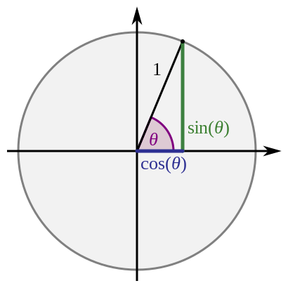
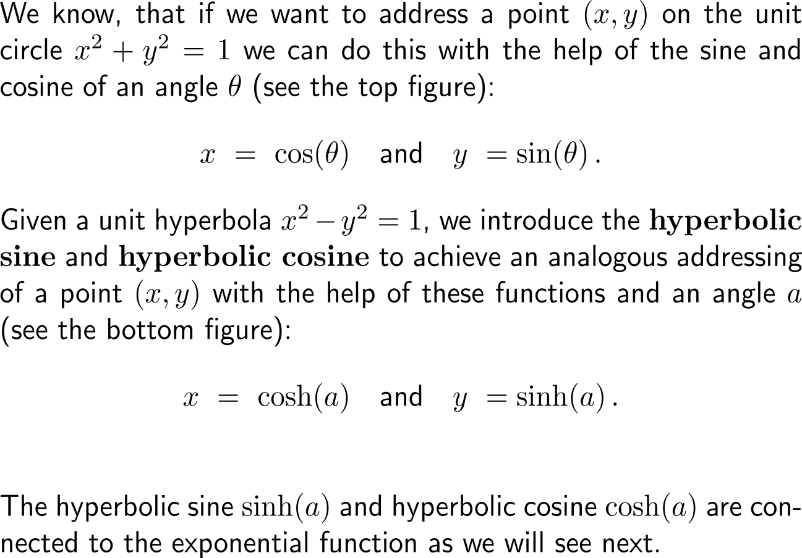
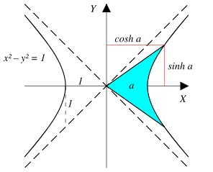
Analogous to the trigonometric functions that are dine fined for the unit circle we define the hyperbolic functions for the unit hyperbola

Slide 15
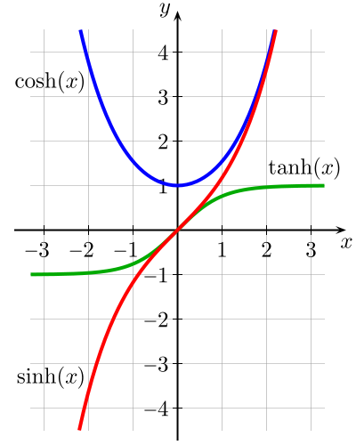
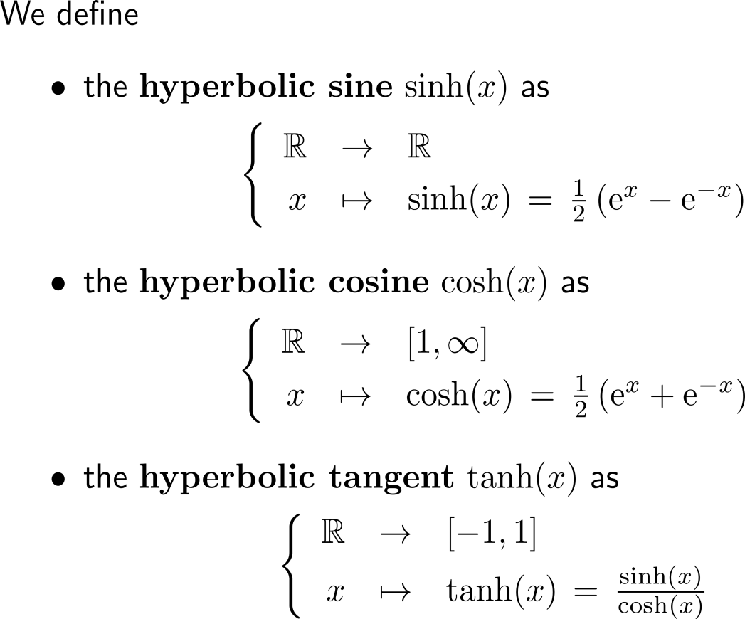
These hyperbolic functions are given in terms of the sum/ difference of two exponential functions

Slide 16
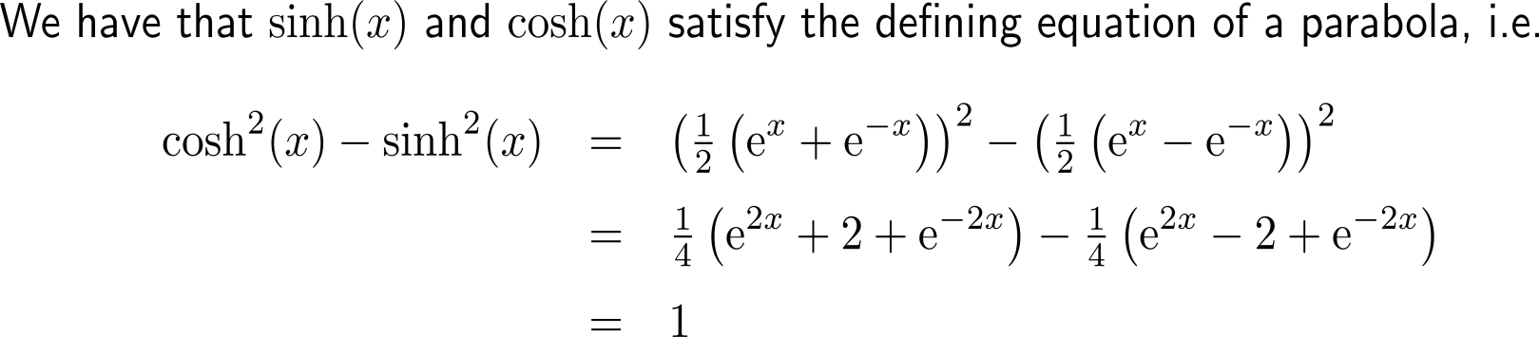
It is easily checked that the hyperbolic sine and hyperbolic cosine satisfy the defining equation of a hyperbola for all elements of their domain

Slide 17
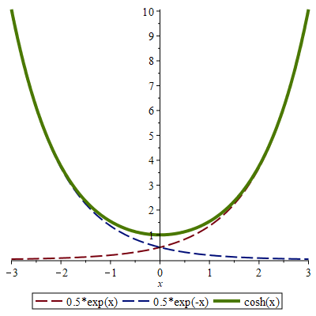
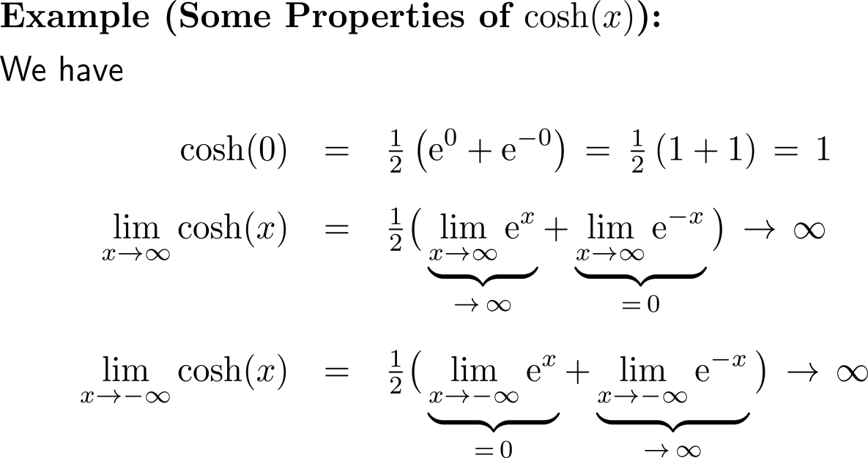
Example:
Properties of the hyperbolic cosine

Slide 18
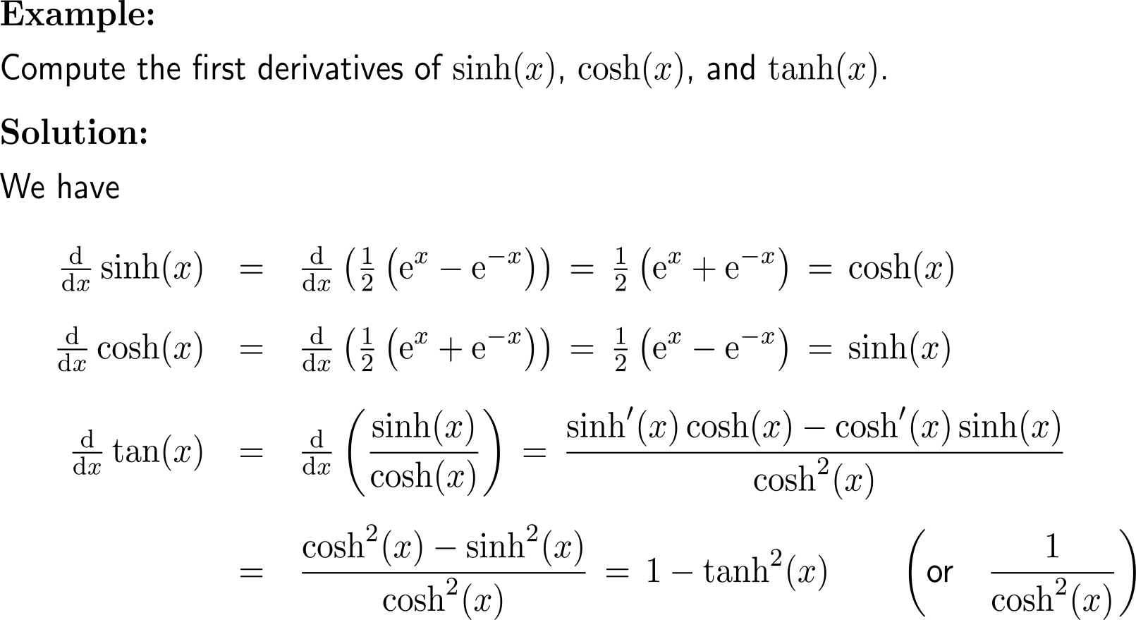
Example:
Derivatives of the hyperbolic functions

Slide 19
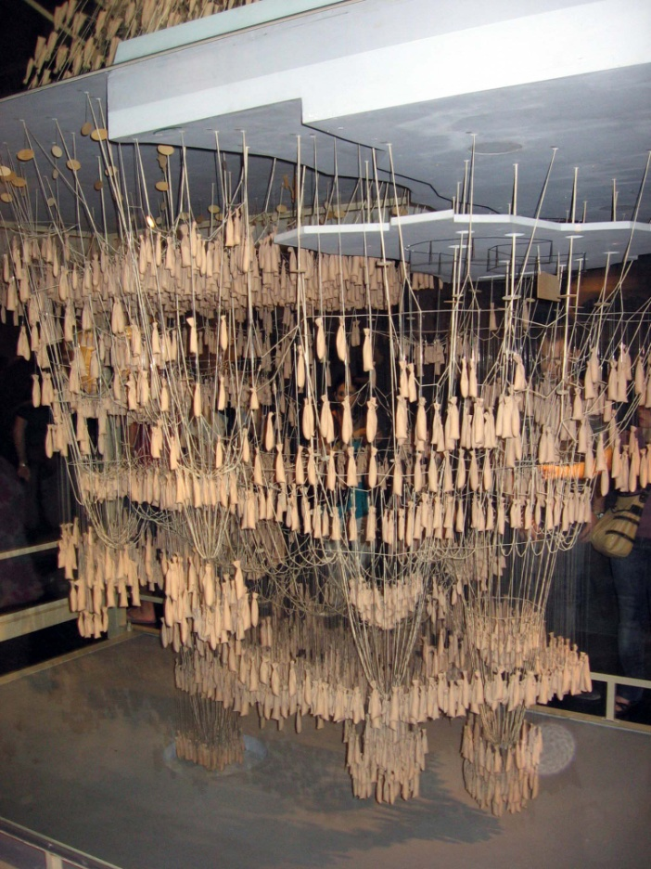
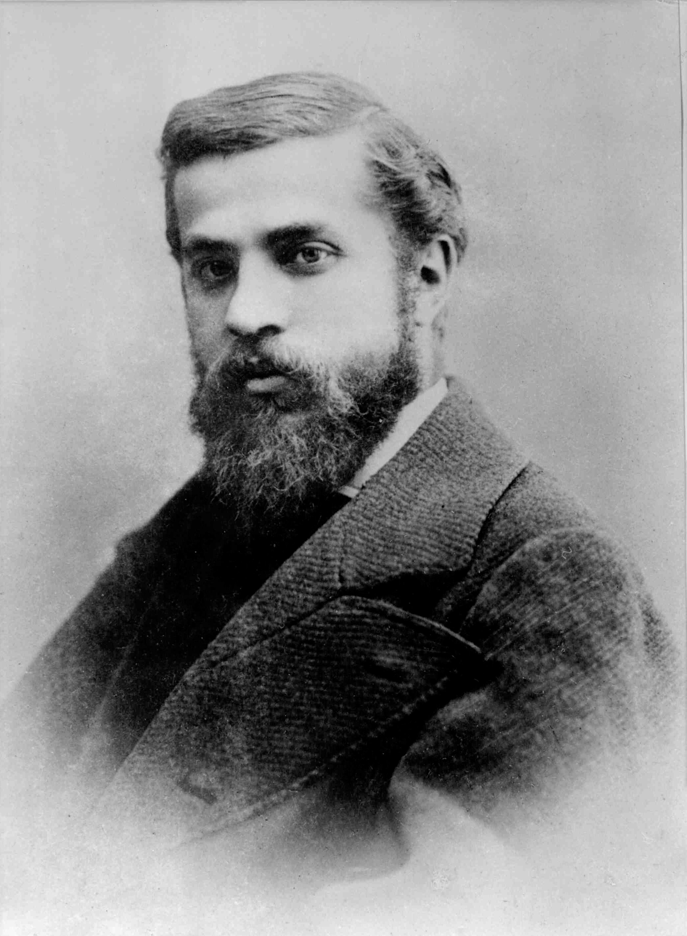
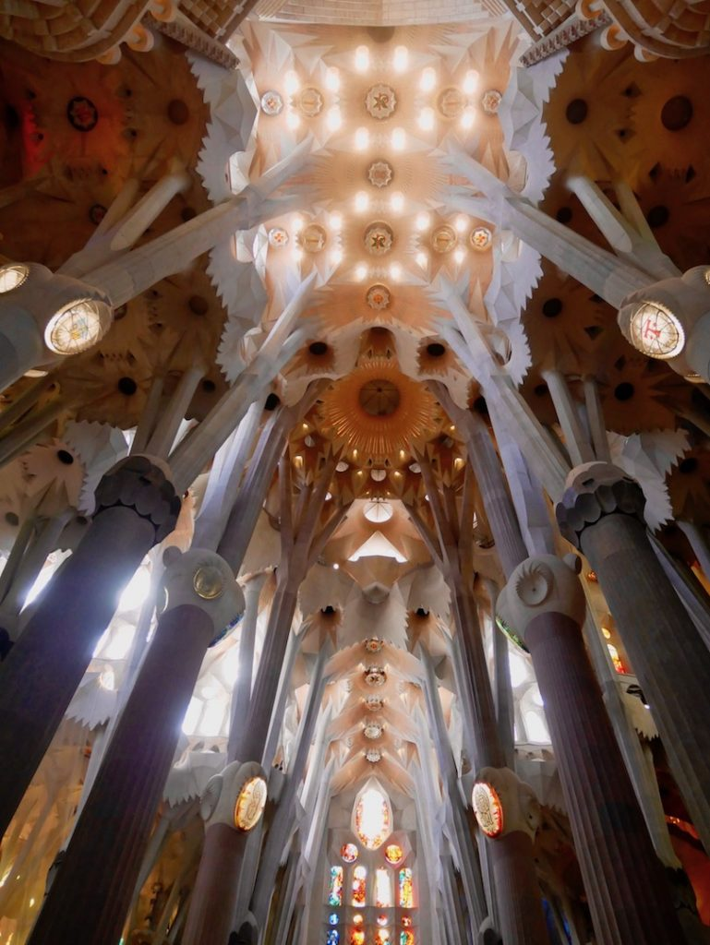
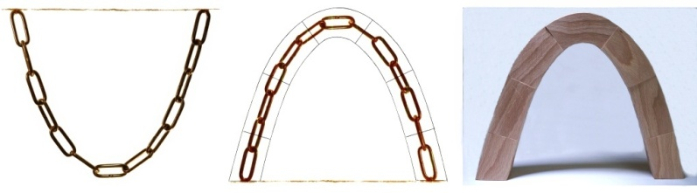
The hyperbolic cosine describes the behavior of a chain under gravitation; a statically very interesting behavior exploited e.g. by Antoni Gaudi
Antoni Gaudí i Cornet
(1852 – 1926)

Slide 20
Topics
  Recap: Exponential & Logarithmic Functions
  Hyperbolic Sine and Cosine: sinh(x) & cosh(x)
  Continuous Compounding

Slide 21
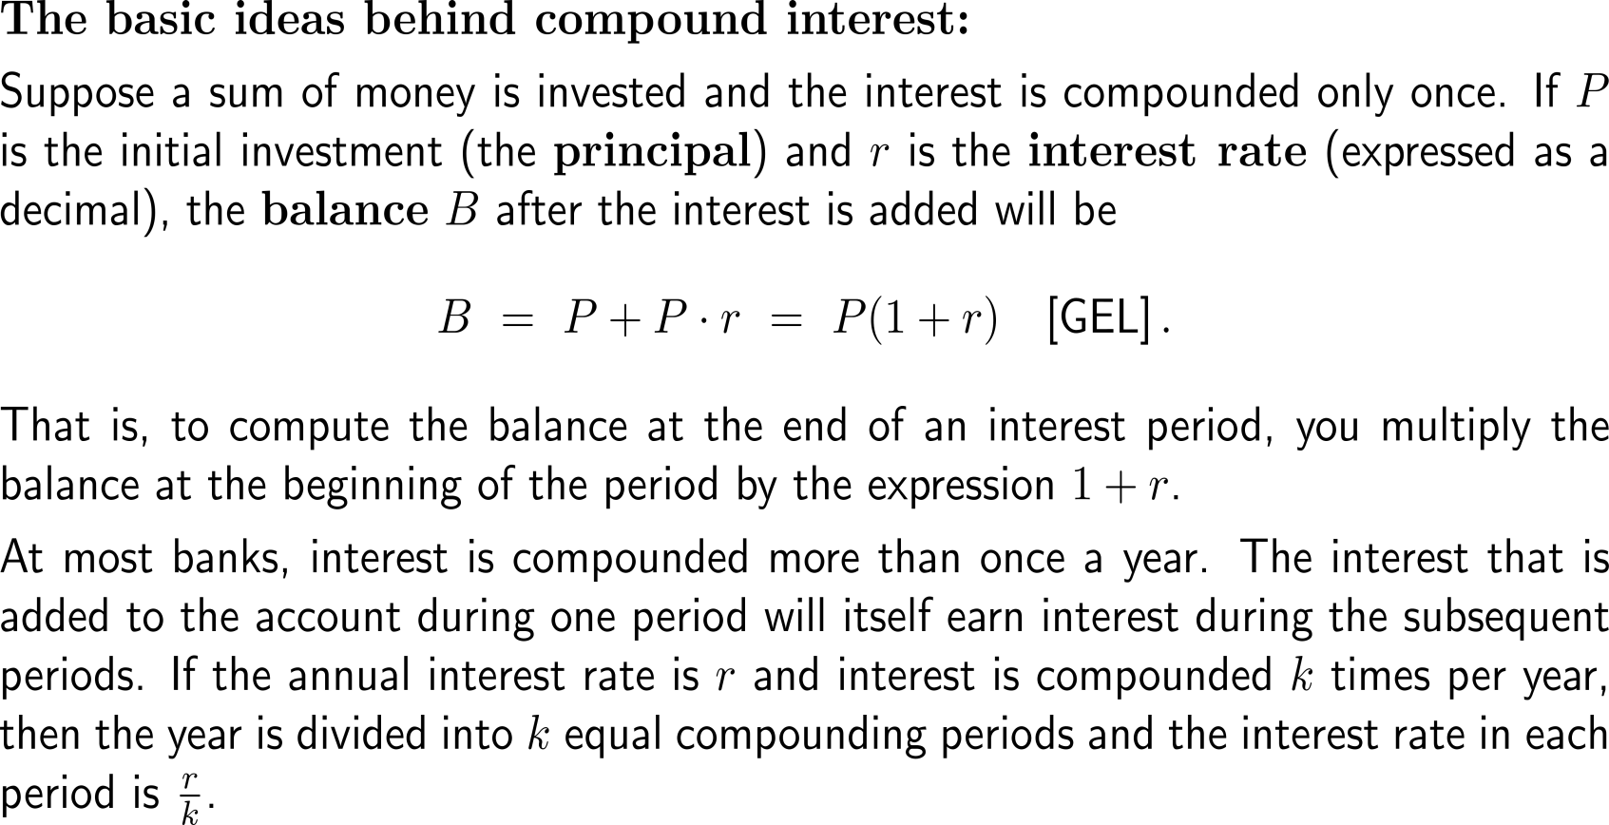
Motivating the formula for continuous compounding of interest (1/ 4)
Continuous Compounding of Interest

Slide 22
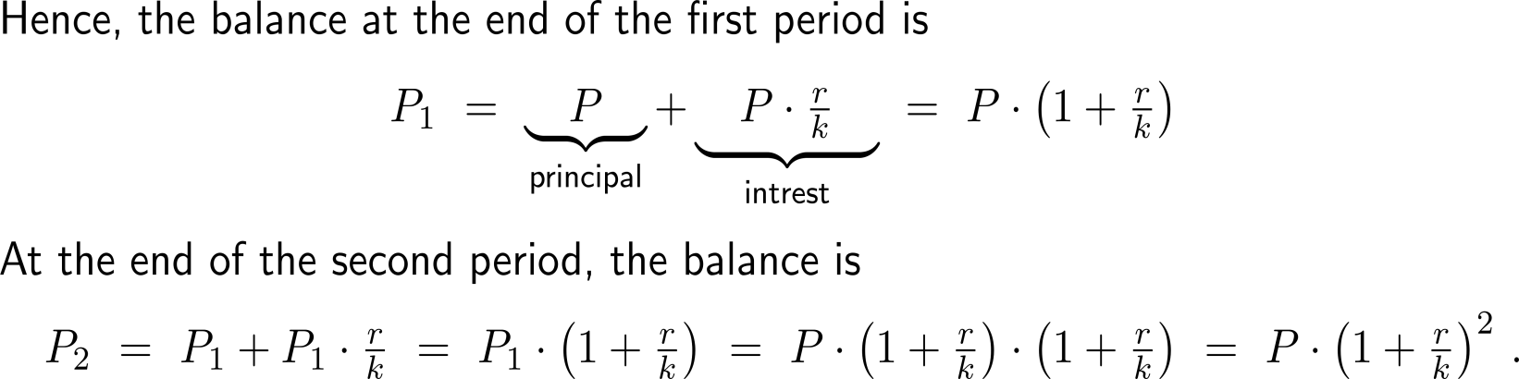
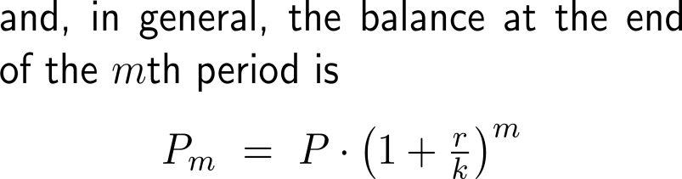
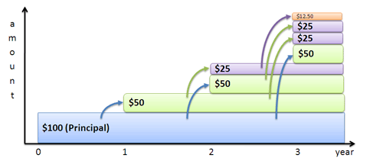
Motivating the formula for continuous compounding of interest (2/ 4)

Slide 23
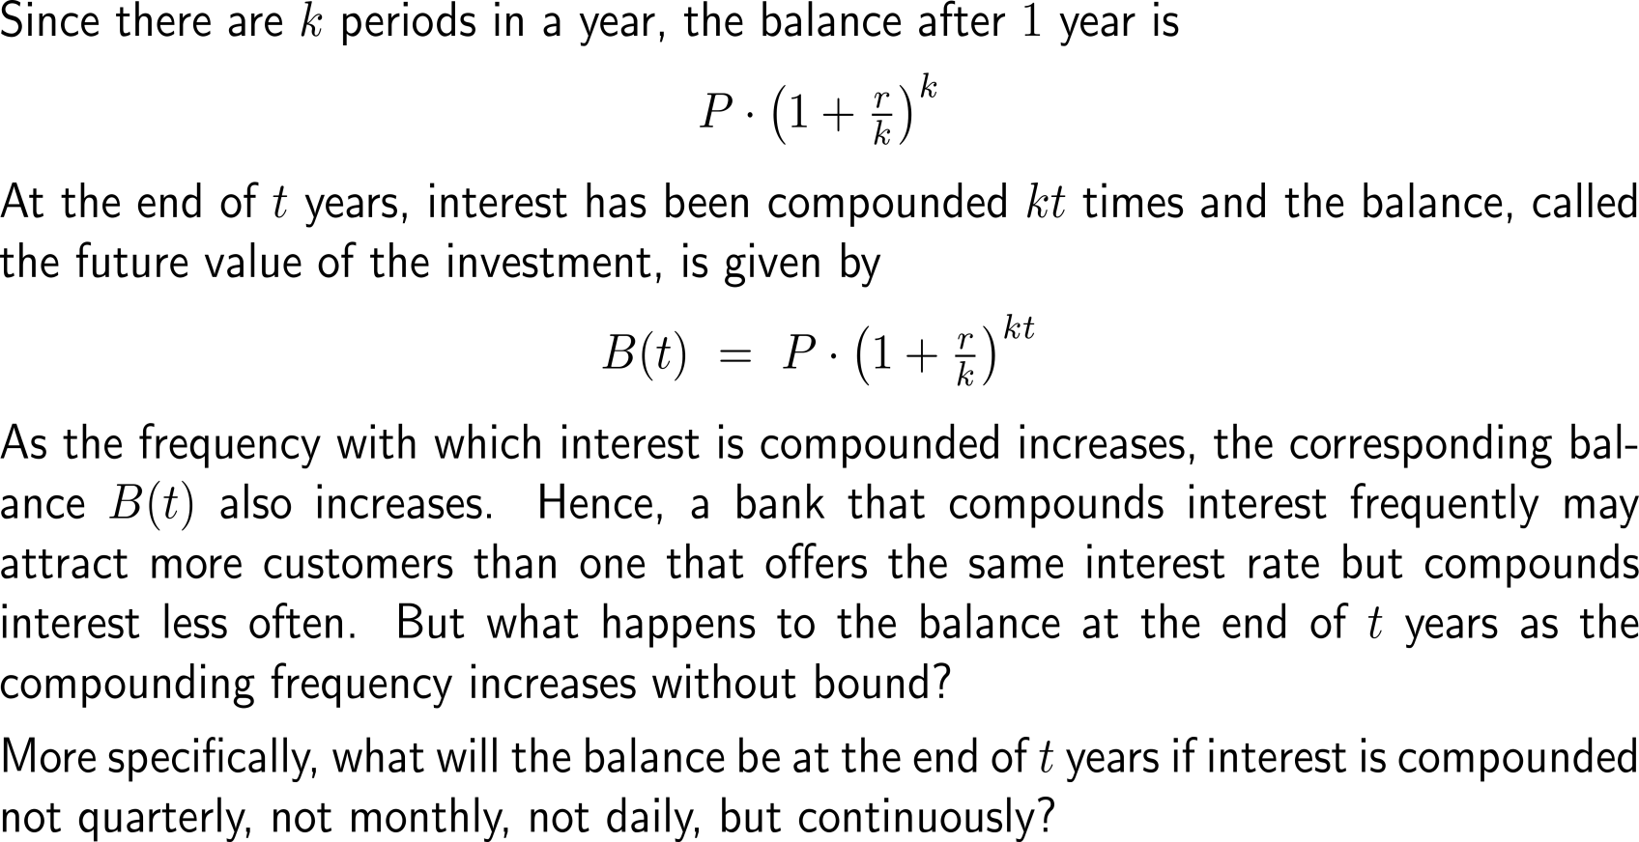
Motivating the formula for continuous compounding of interest (3/ 4)

Slide 24
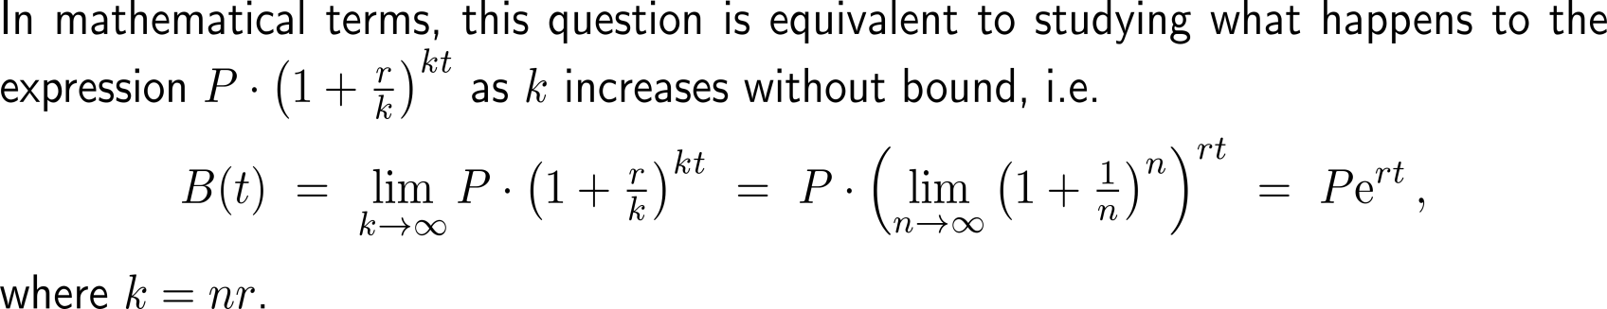
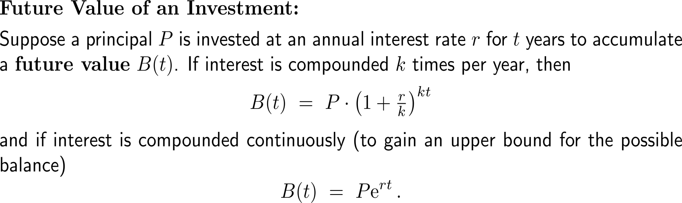
Motivating the formula for continuous compounding of interest (4/ 4)

Slide 25
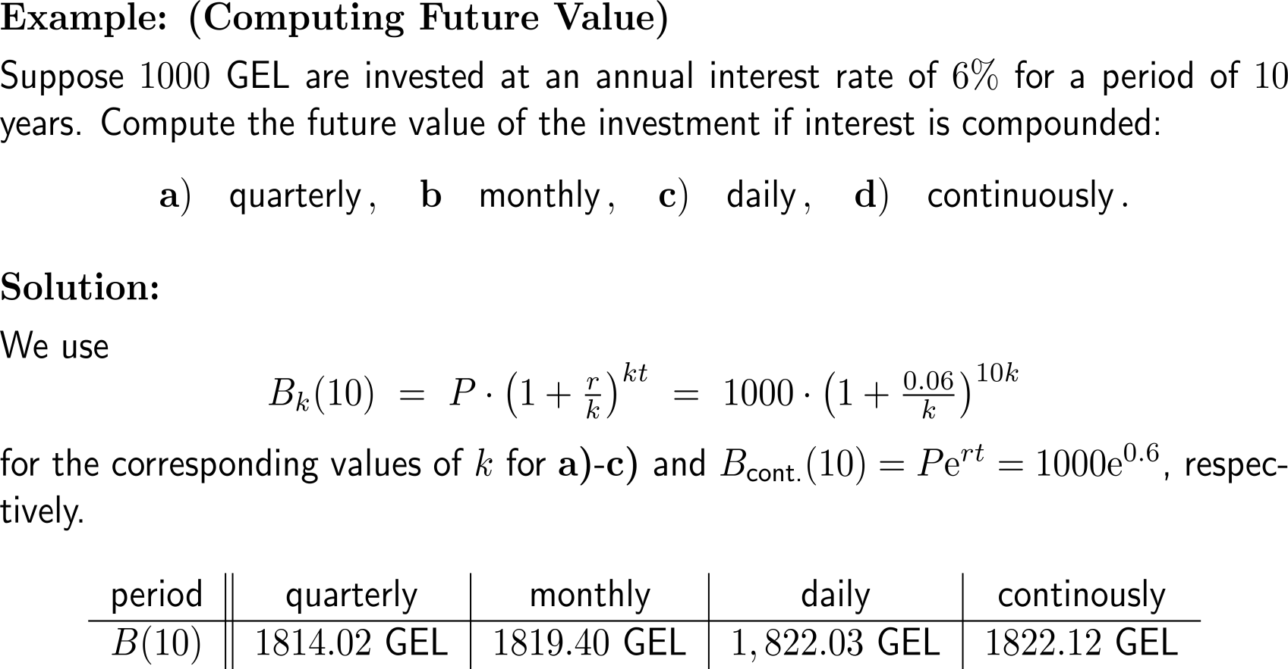
Example:
Computing future value

Slide 26
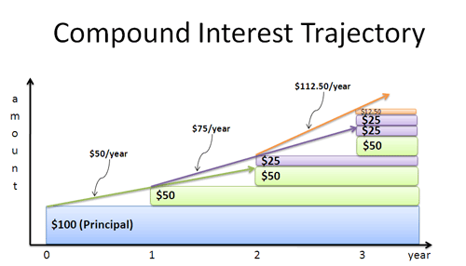
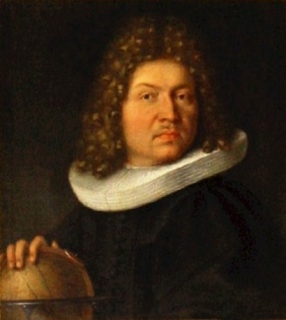
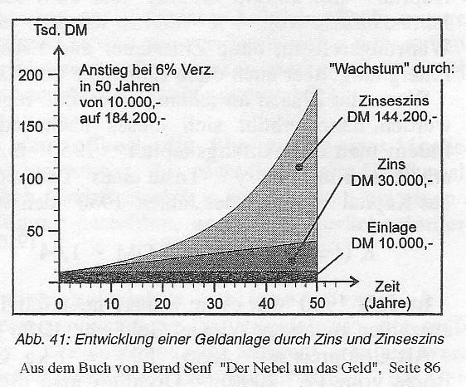
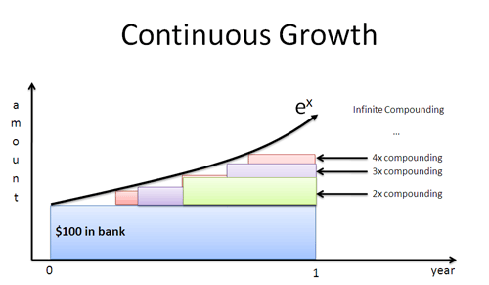
Continuous compounding as the limit case for infinitely many compounding events
Jacob Bernoulli (1655 - 1705)

Slide 27
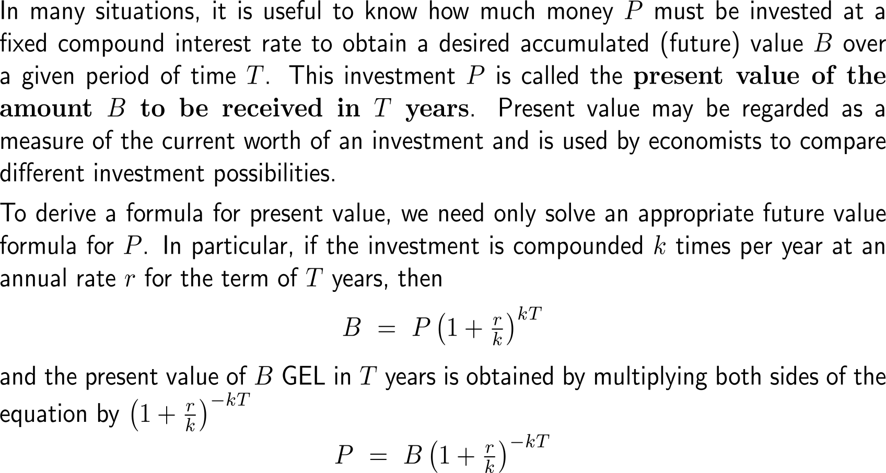
Motivating the formula for present vale (1/ 2)
Present
Value

Slide 28
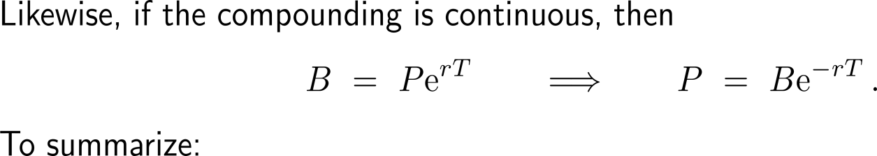
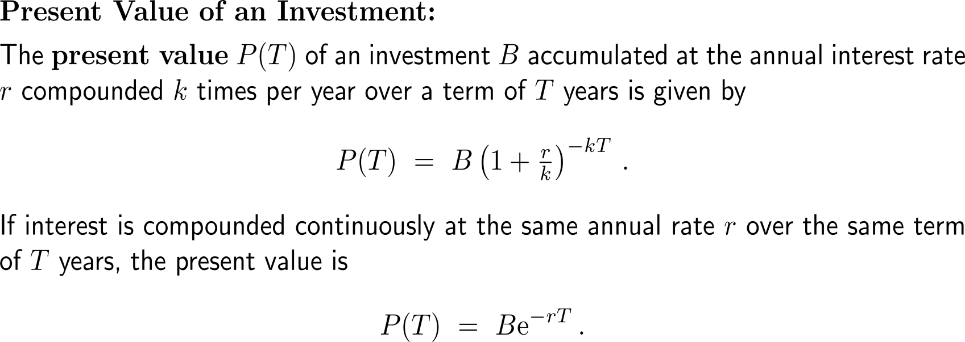
Motivating the formula for present vale (2/ 2)

Slide 29

Example:
Finding present value

Slide 30

Motivating the formula for effective interest rates (1/ 2)
Effective Interest Rate

Slide 31


Motivating the formula for effective interest rates (2/ 2)

Slide 32

Example:
Comparing two investments

Slide 33

Example:
Comparing two investments

Slide 34

Example:
Reaching an investment goal
Logarithms in Compounding Applications

Slide 35

Example:
Reaching an investment goal

Slide 36


Example:
Continuously Compounded Interest
What do you think about this cartoon?
Is this investment strategy feasible?

Slide 37


Further Worked-Out Exercises:
Calculus I for Management
Topics
  Continuous compounding

Slide 38


Exercise:
Finding doubling time for an investment
10 minutes
self/ group work
please, upload your solutions to the chat

Slide 39


Exercise:
Finding doubling time for an investment

Slide 40


Exercise:
Computing an interest rate
10 minutes
self/ group work
please, upload your solutions to the chat

Slide 41


An application of exponential growth/ decay is given by the efficiency with which an individual performs a task and the amount of training time (1/ 2)

Slide 42

An application of exponential growth/ decay is given by the efficiency with which an individual performs a task and the amount of training time (2/ 2)

Slide 43


Exercise:
Examining a Learning Model

Slide 44

Exercise:
Examining a Learning Model

Slide 45

Exercise:
Studying the progress of an epidemic

Slide 46


Exercise:
Studying the progress of an epidemic

Slide 47

Exercise:
Studying the progress of an epidemic

Slide 48
Calculus I for Management

