Slide 1
Calculus I for MGMT – Exp. & Log. Functions II and Marginal Analysis
Exponential Models
Mathematics for Management
Supplementary Electronic Materials
Exp. & Log. Functions II and
Marginal Analysis
  Differentiation of
  Exp. & Log. Functions
  Exponential Models
  Marginal Analysis & Approx. using Increments
  Related Rates

Slide 2
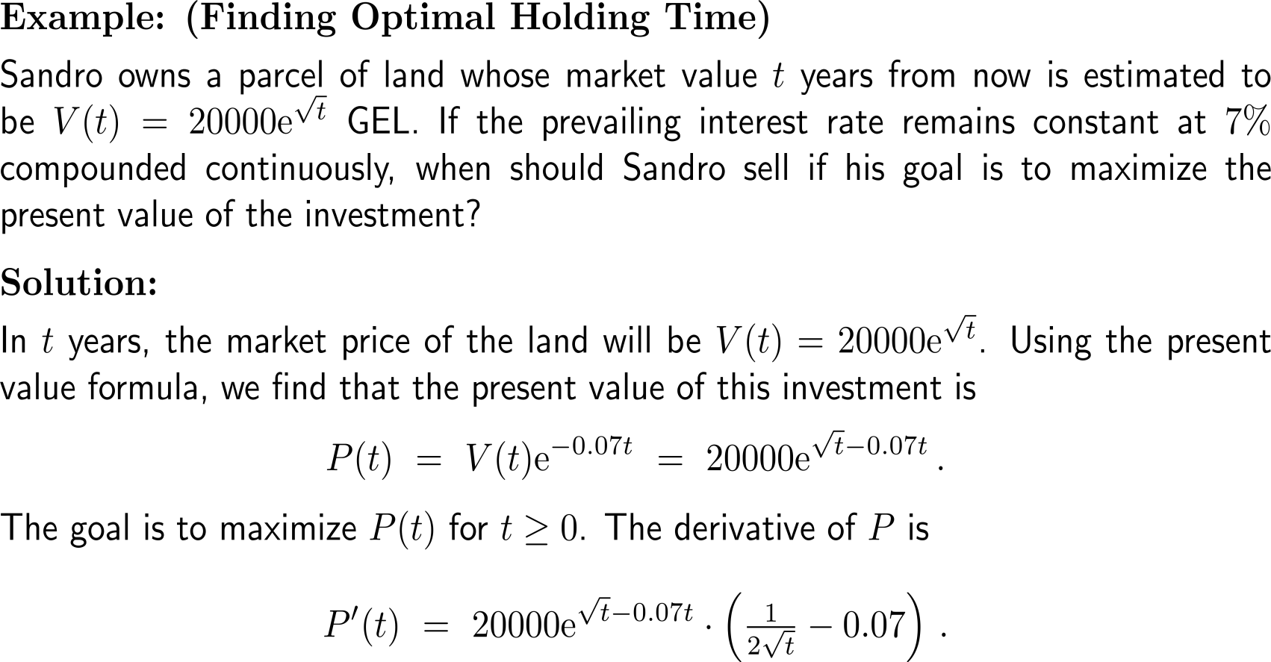
Example:
Finding optimal holding time

Slide 3
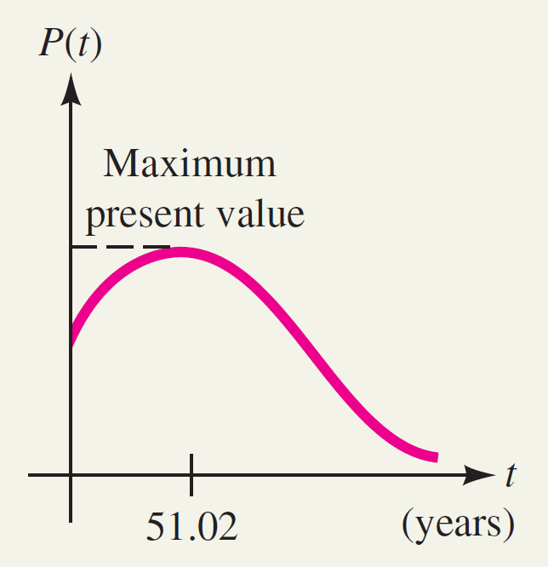
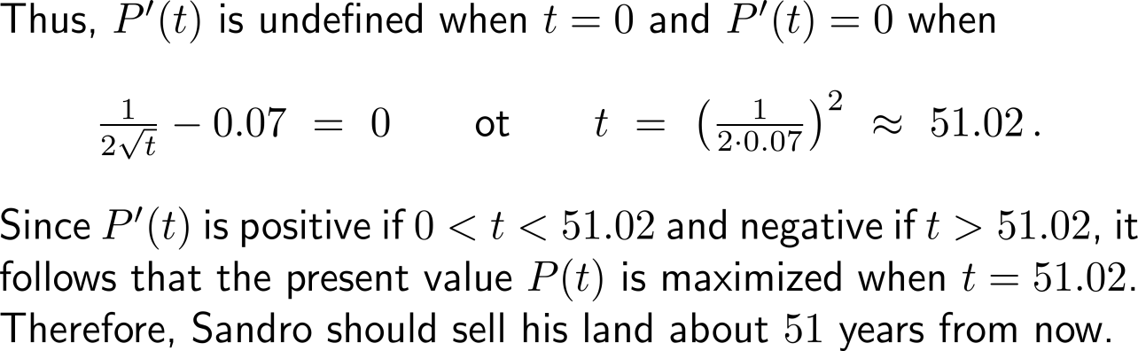
Example:
Finding optimal holding time

Slide 4
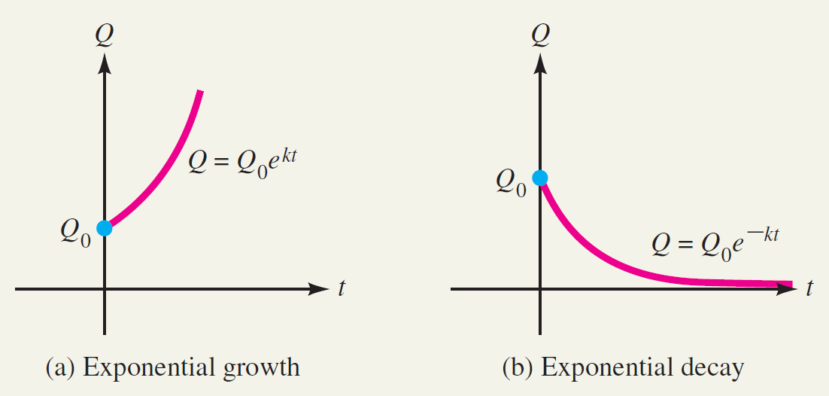
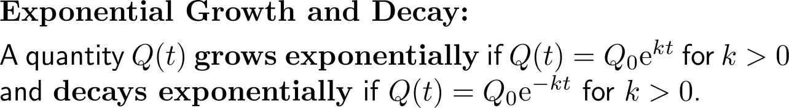
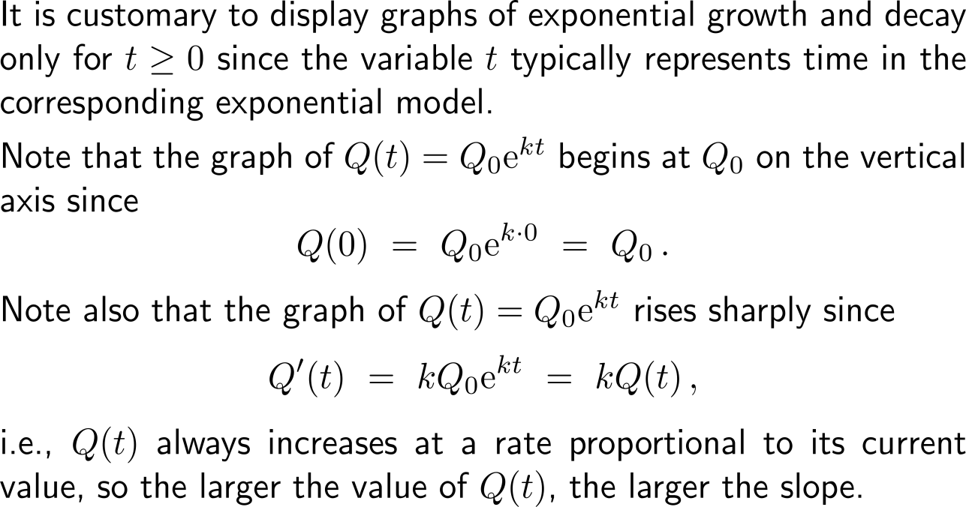
Exponential growth/ decay is characterizes by an increase/ decrease rate that is always proportional to the current value

Slide 5
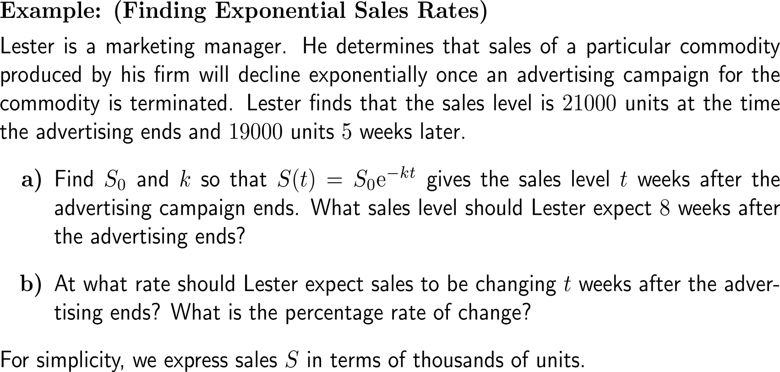
Example:
Finding exponential sales rates

Slide 6
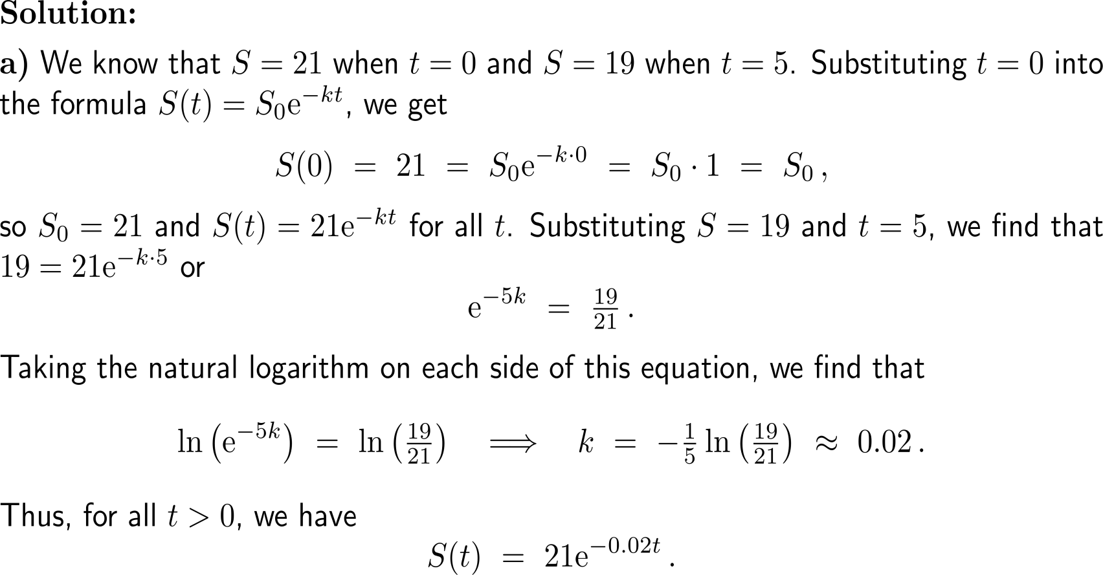
Example:
Finding exponential sales rates

Slide 7
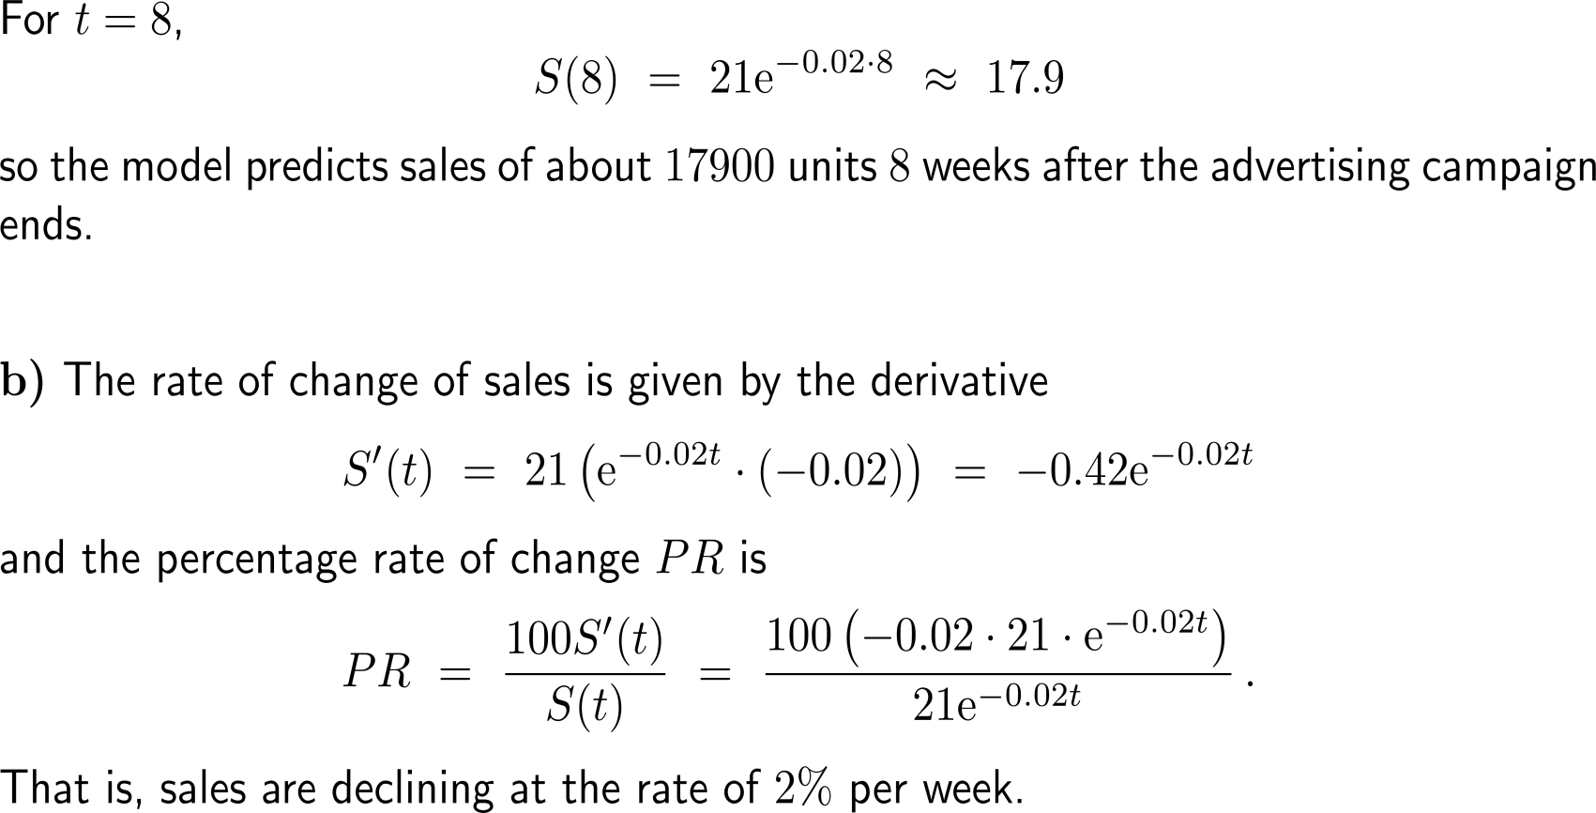
Example:
Finding exponential sales rates

Slide 8
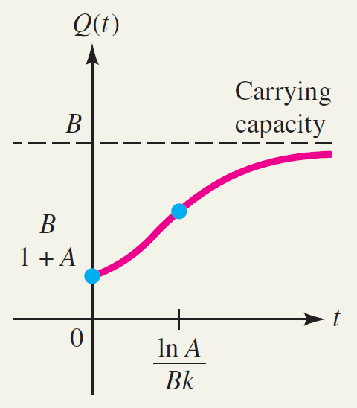
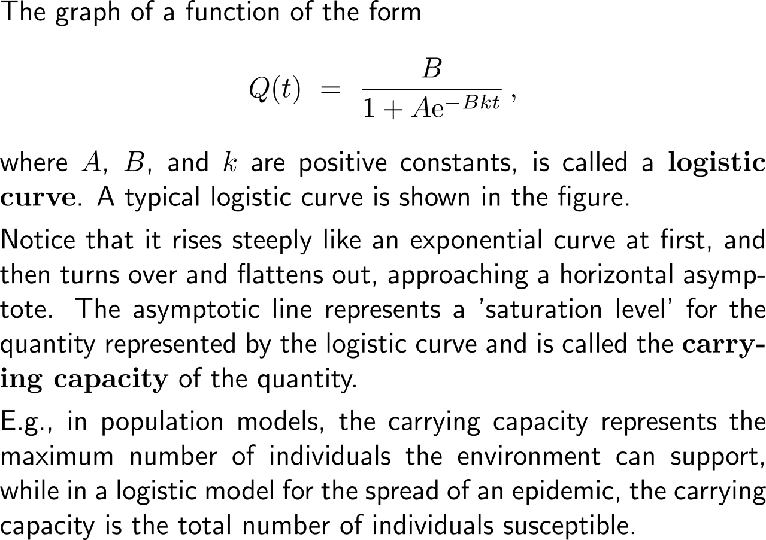
Logistic growth resembles an strictly increasing growth that is bounded by a capacity such that the rate of growth damps with increasing time (1/ 4)

Slide 9
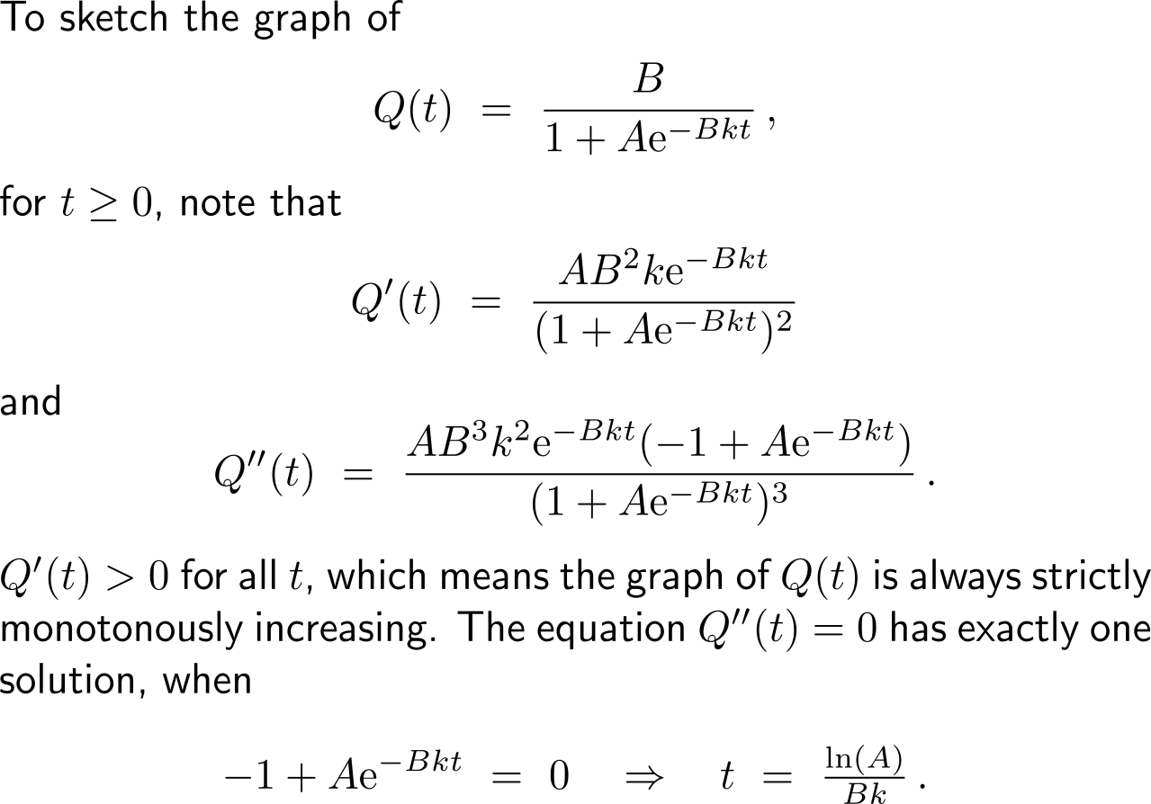
Logistic growth resembles an strictly increasing growth that is bounded by a capacity such that the rate of growth damps with increasing time (2/ 4)

Slide 10
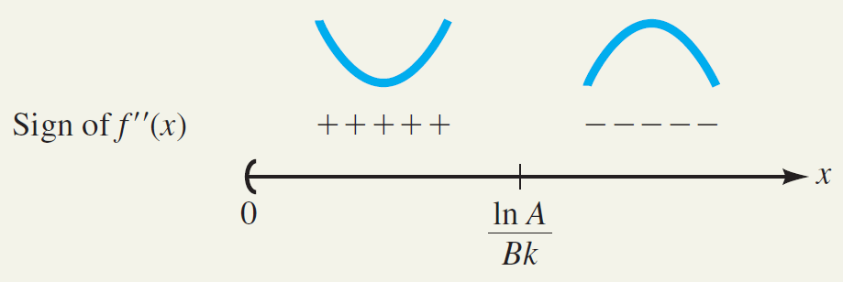
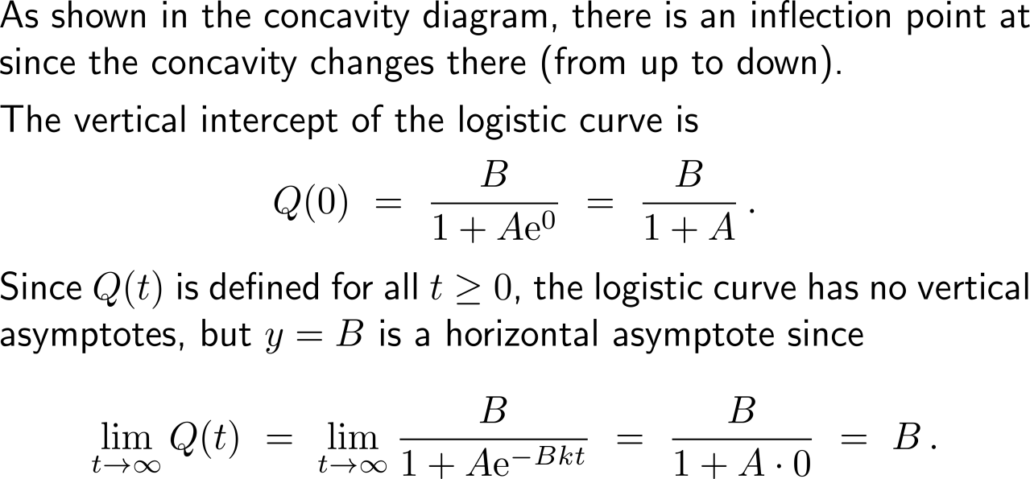
Logistic growth resembles an strictly increasing growth that is bounded by a capacity such that the rate of growth damps with increasing time (3/ 4)

Slide 11
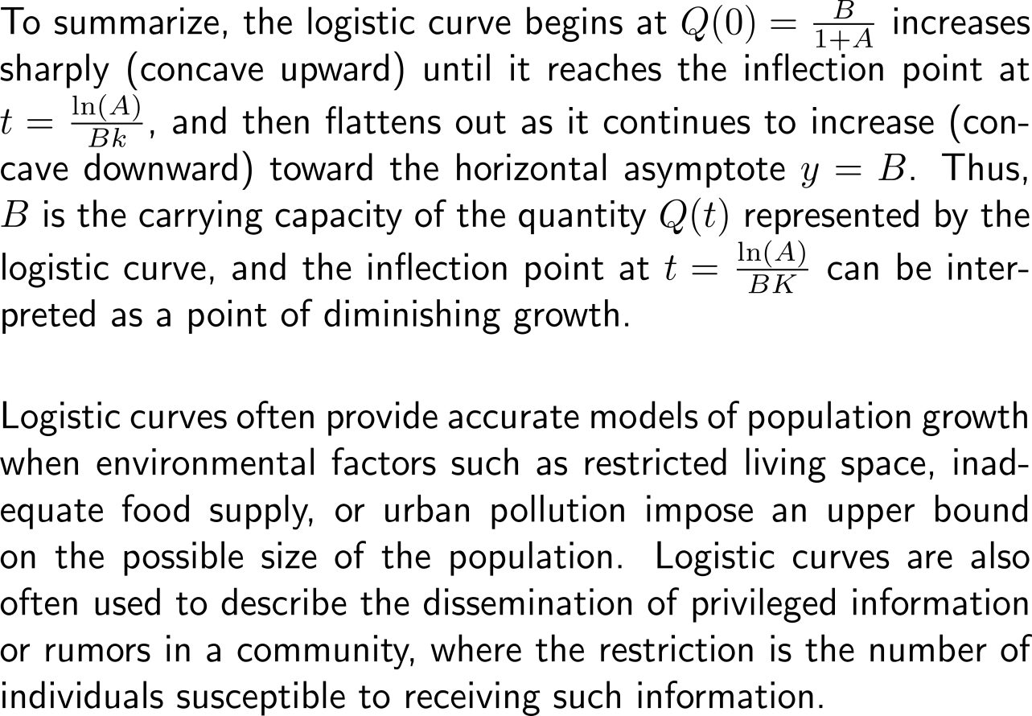
Logistic growth resembles an strictly increasing growth that is bounded by a capacity such that the rate of growth damps with increasing time (4/ 4)

Slide 12
Calculus I for Management

