Slide 1
Calculus I for MGMT – Exp. & Log. Functions II and Marginal Analysis
Marginal Analysis & Approximation using Increments
Mathematics for Management
Supplementary Electronic Materials
Exp. & Log. Functions II and
Marginal Analysis
  Differentiation of
  Exp. & Log. Functions
  Exponential Models
  Marginal Analysis & Approx. using Increments
  Related Rates

Slide 2
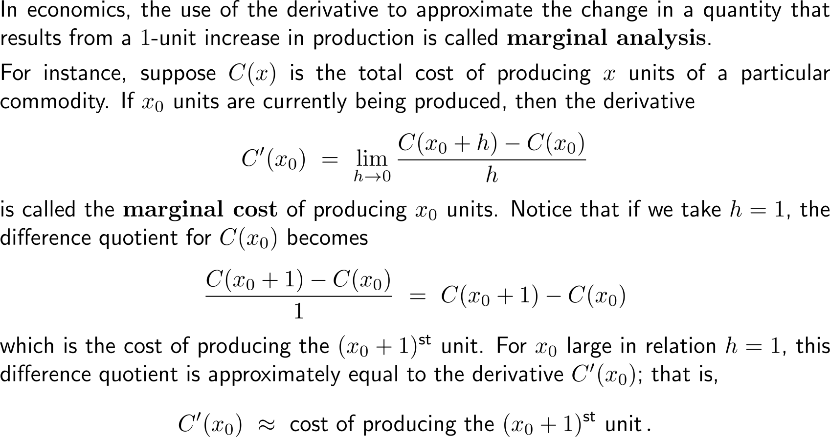
Marginal analysis studies the change in a quantity that results from a 1-unit increase in this quantity (1/ 3)

Slide 3
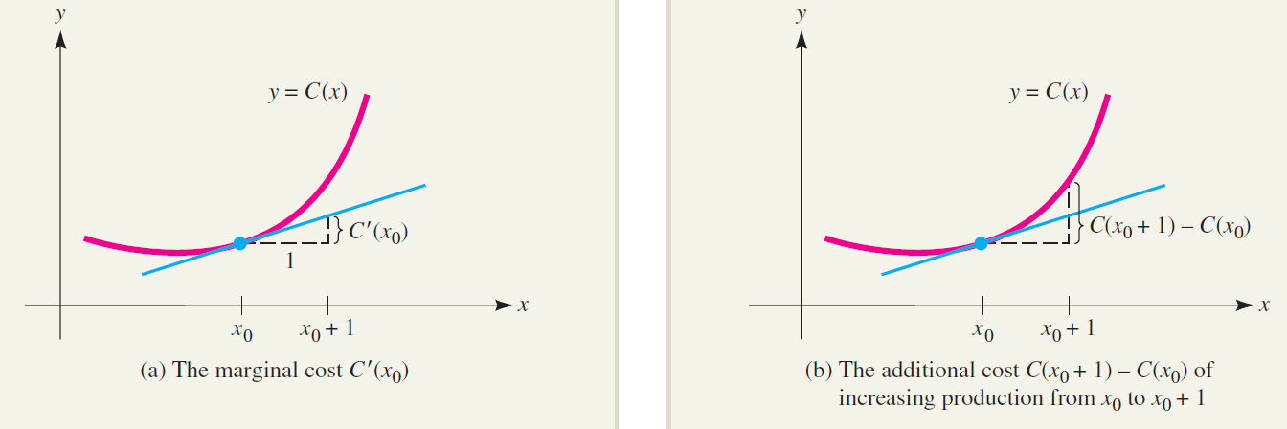
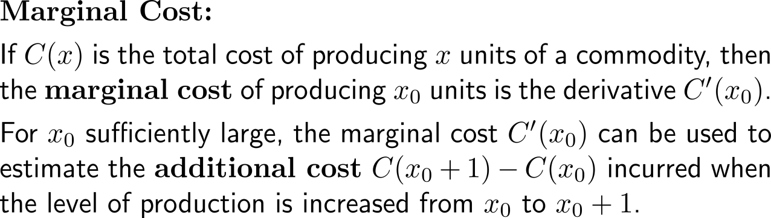
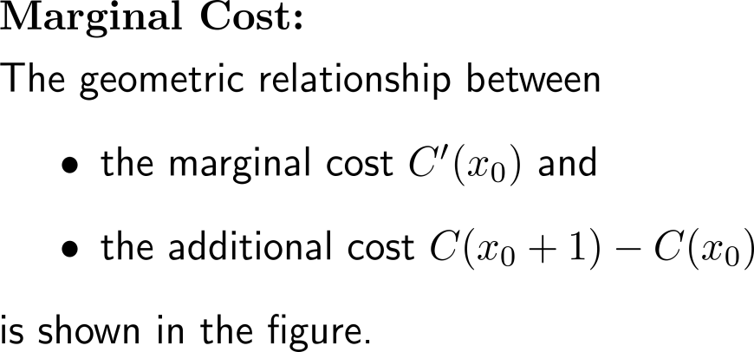
Marginal analysis studies the change in a quantity that results from a 1-unit increase in this quantity (2/ 3)

Slide 4
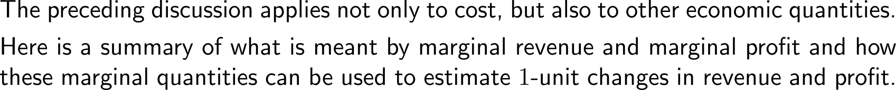
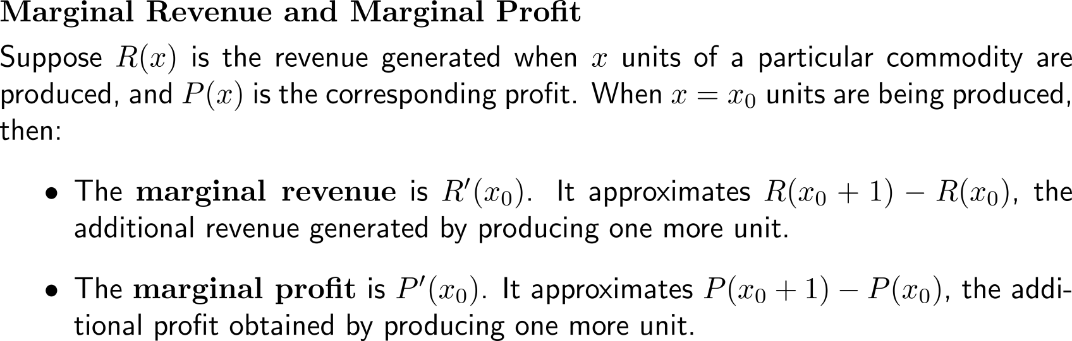
Marginal analysis studies the change in a quantity that results from a 1-unit increase in this quantity (3/ 3)

Slide 5

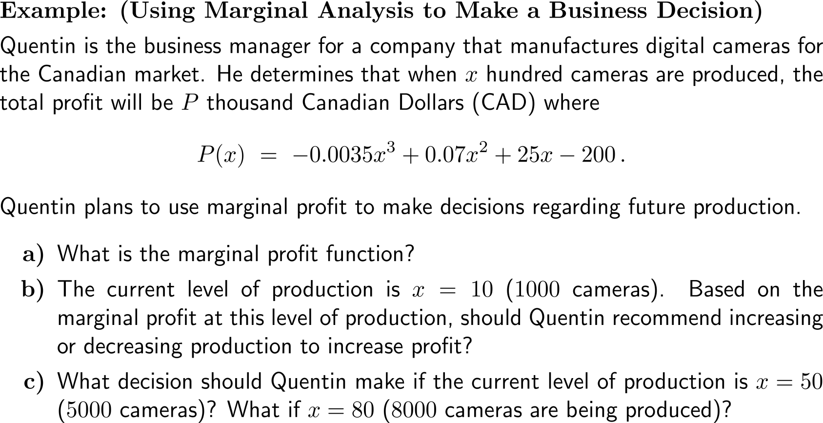
Example:
Using Marginal Analysis to make a business decision

Slide 6
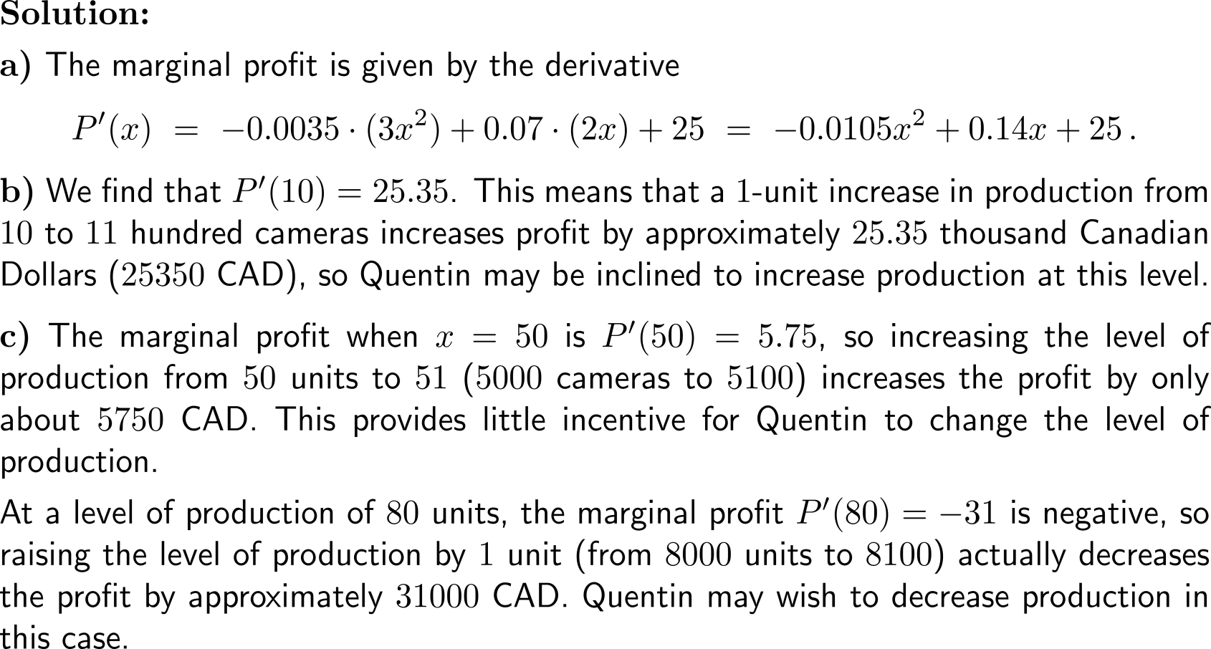
Example:
Using Marginal Analysis to make a business decision

Slide 7
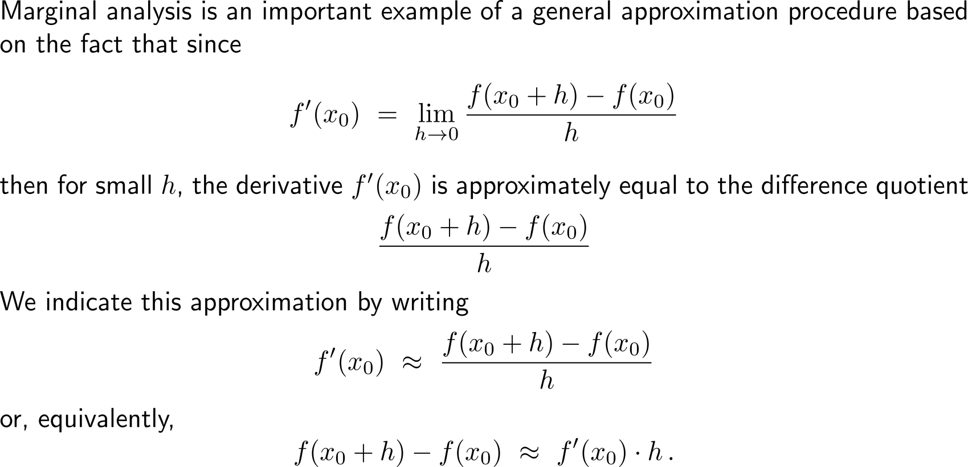
Marginal analysis can be viewed as an application of our just discussed topic of linear approximation (1/ 2)

Slide 8
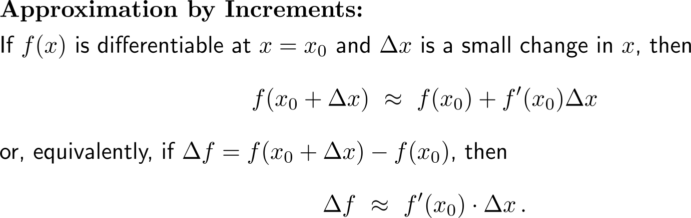
Marginal analysis can be viewed as an application of our just discussed topic of linear approximation (2/ 2)

Slide 9
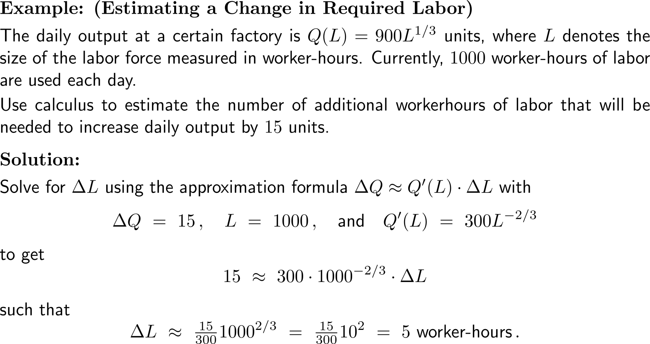
Example:
Estimating a change in required labor

Slide 10
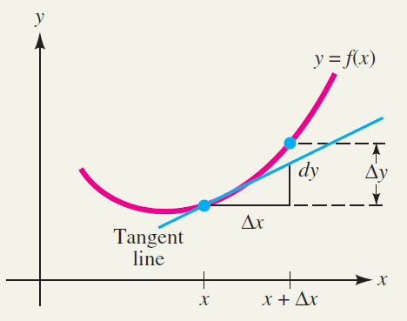
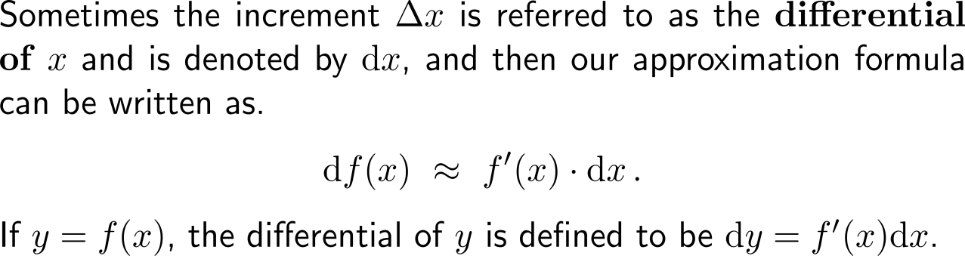
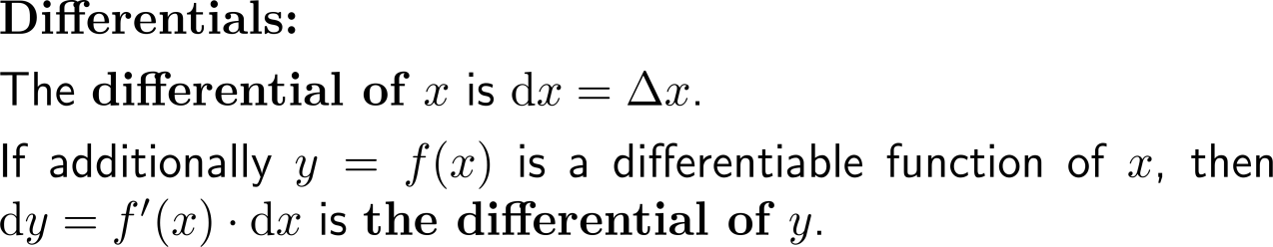
From the notational point of view, increments are sometimes referred to as differentials (1/ 2)

Slide 11
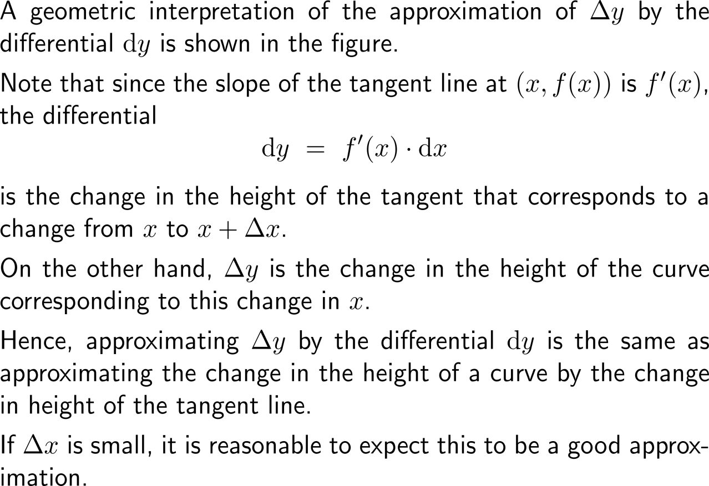
From the notational point of view, increments are sometimes referred to as differentials (2/ 2)

Slide 12
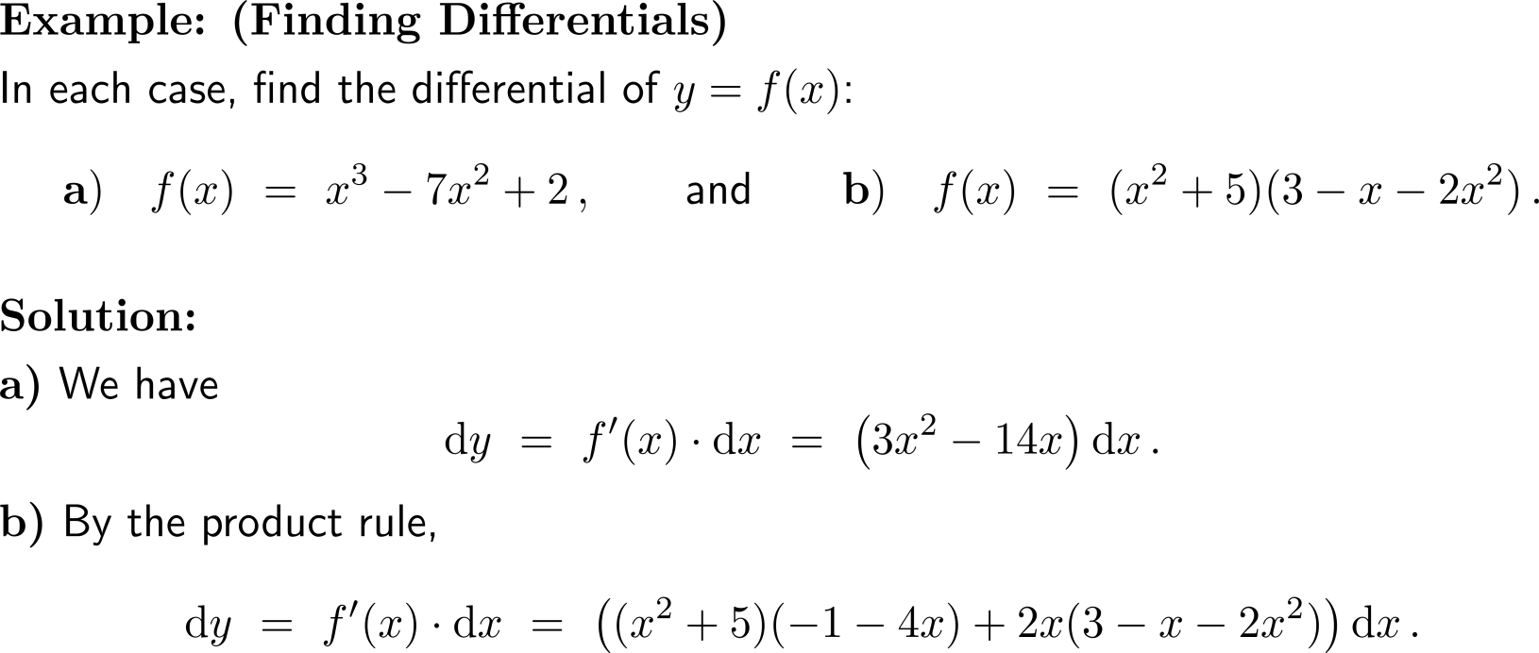
Example:
Finding differentials

Slide 13
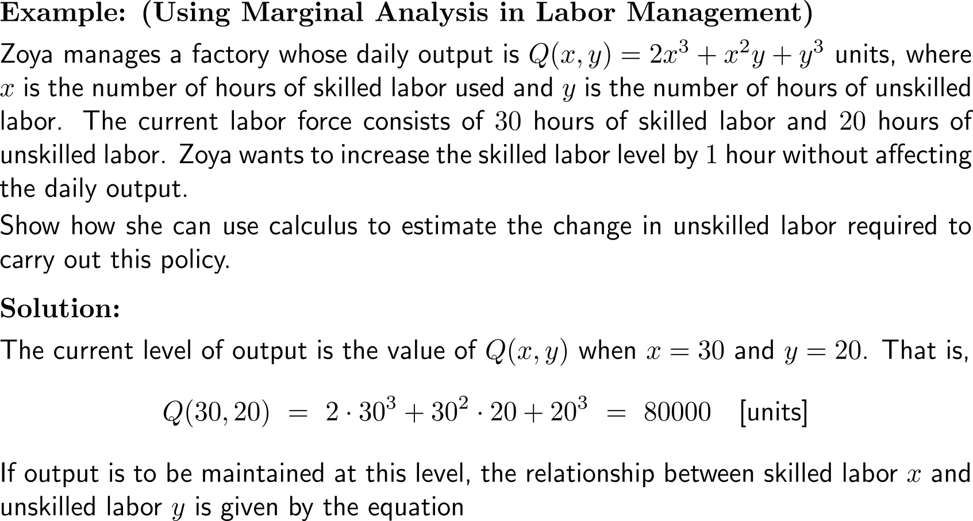
Example:
Using Marginal Analysis in labor management

Slide 14
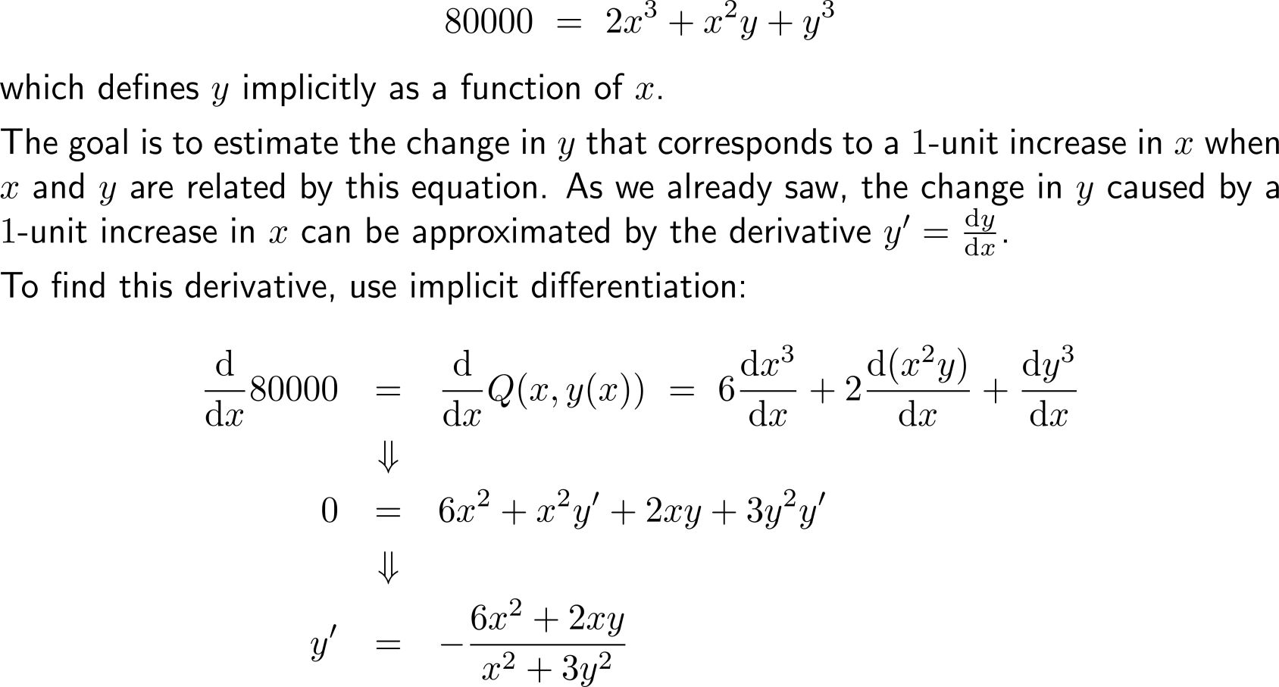
Example:
Using Marginal Analysis in labor management

Slide 15
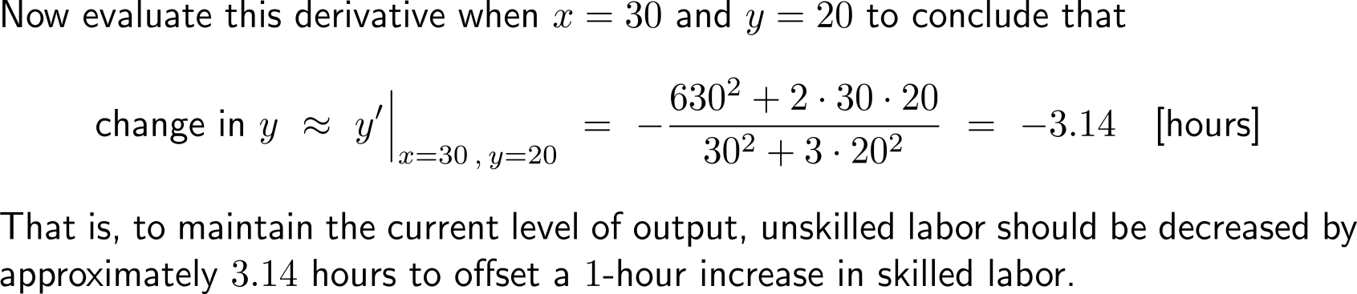
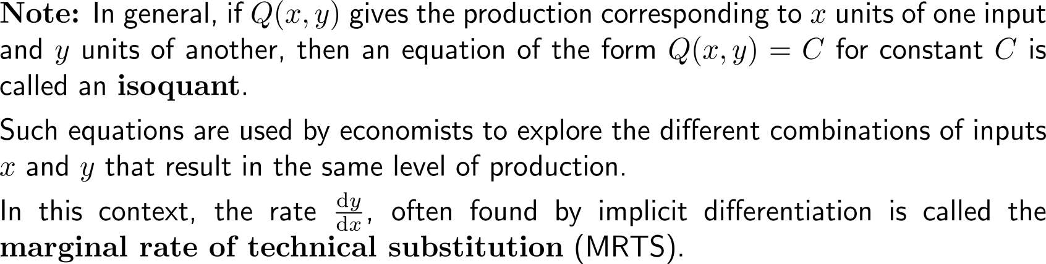
Example:
Using Marginal Analysis in labor management

Slide 16
Calculus I for Management

