Slide 1
Calculus I for MGMT – Exp. & Log. Functions II and Marginal Analysis
Related Rates
Mathematics for Management
Supplementary Electronic Materials
Exp. & Log. Functions II and
Marginal Analysis
  Differentiation of
  Exp. & Log. Functions
  Exponential Models
  Marginal Analysis & Approx. using Increments
  Related Rates

Slide 2
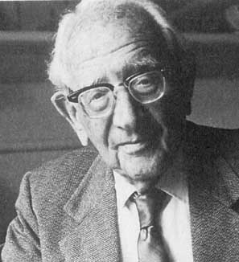


Problem solving strategies combine unstructured creativity with structured formalism to find and document solutions
assign names to variables
determine what is known and what is unknown
develop the steps of how to come from the known to the unknown
understand
the problem
develop a
plan
Georg Pólya
13. 12. 1887 – 7. 9. 1985
review your
solution
execute the plan

Slide 3
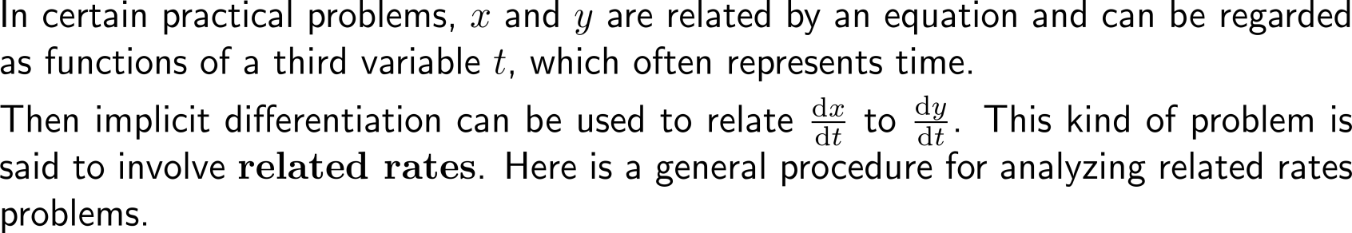
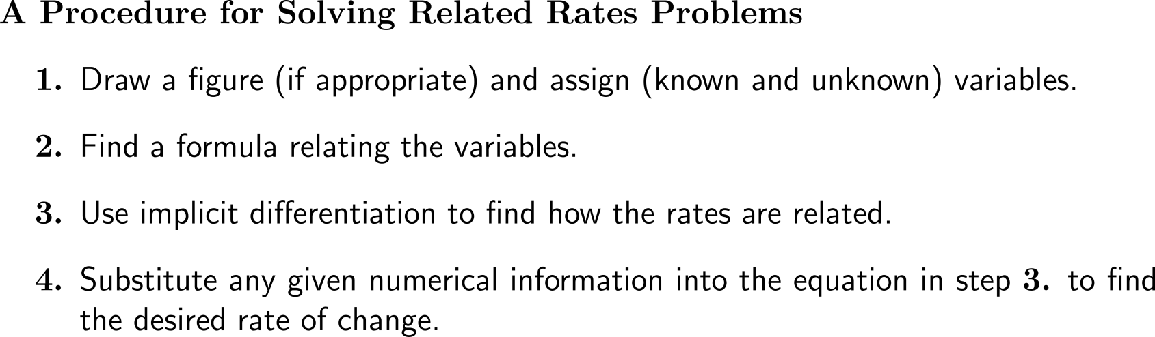
In practical problems it often arises that quantities and their rates depend on each other such that one has to solve ‘related rates problems’

Slide 4
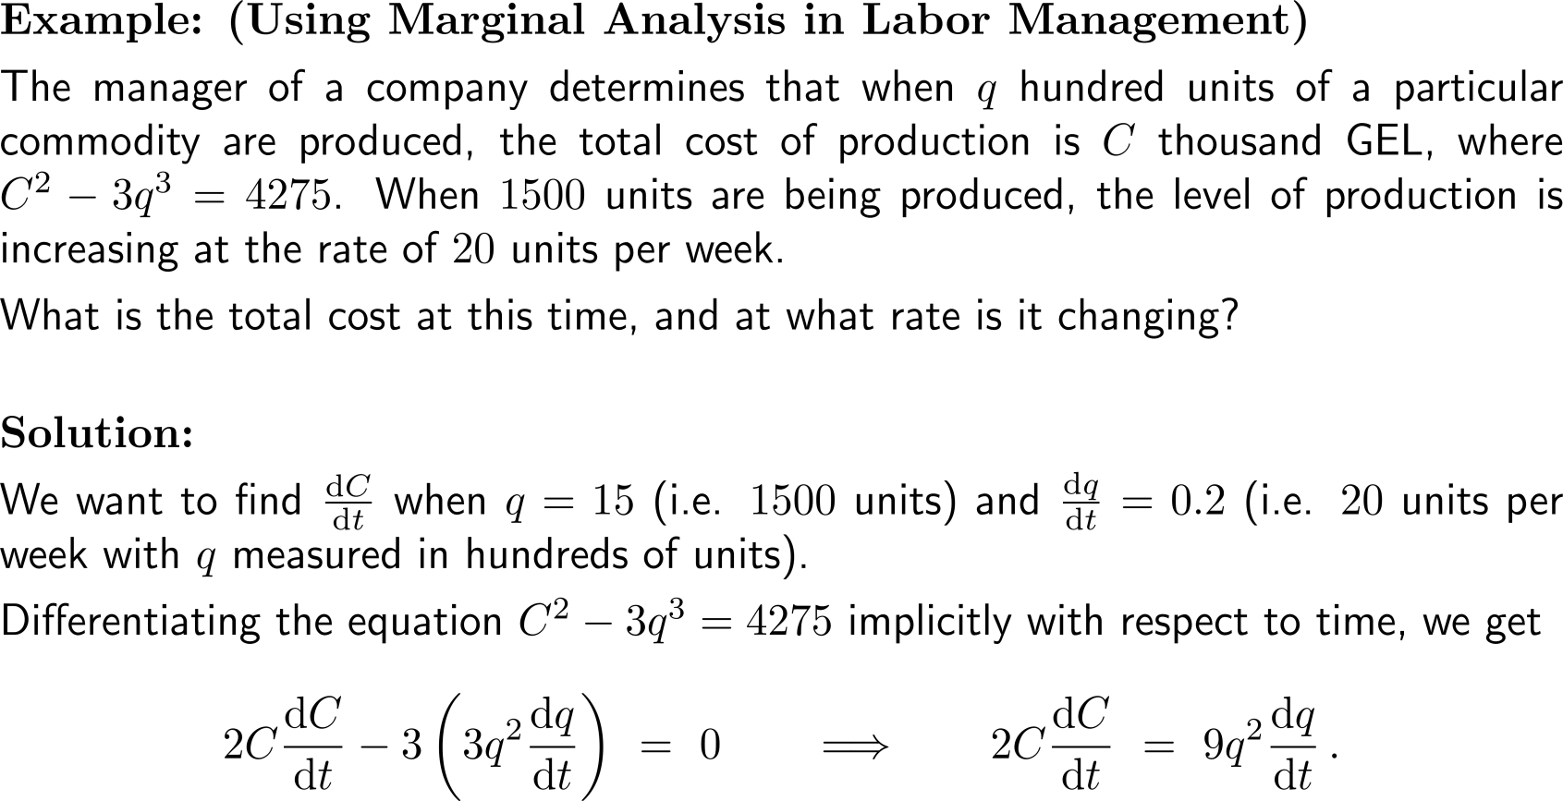
Example:
Finding a related rate of cost

Slide 5
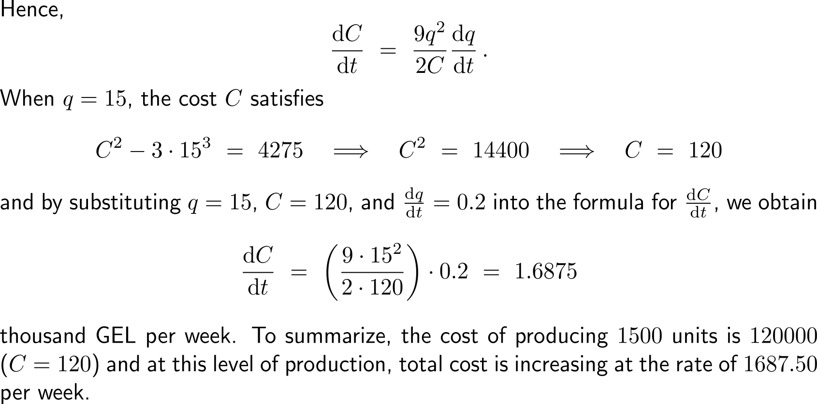
Example:
Finding a related rate of cost

Slide 6
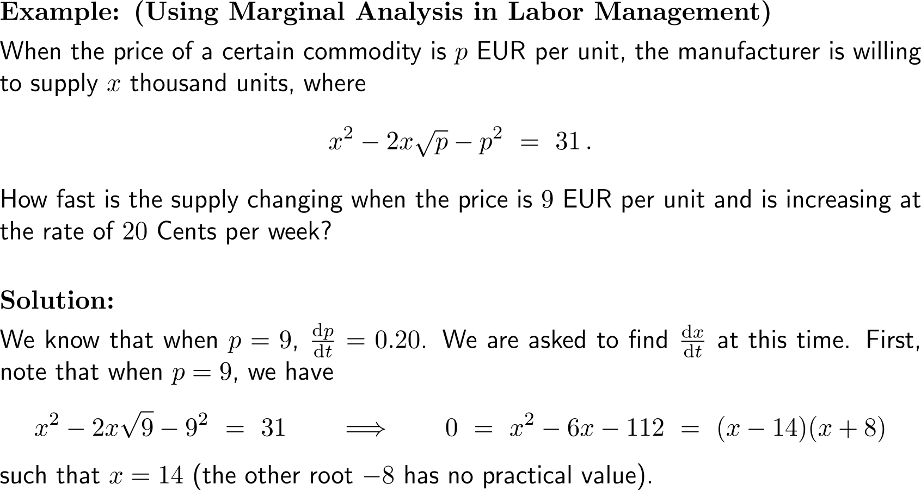
Example:
Using related rates to study supply

Slide 7
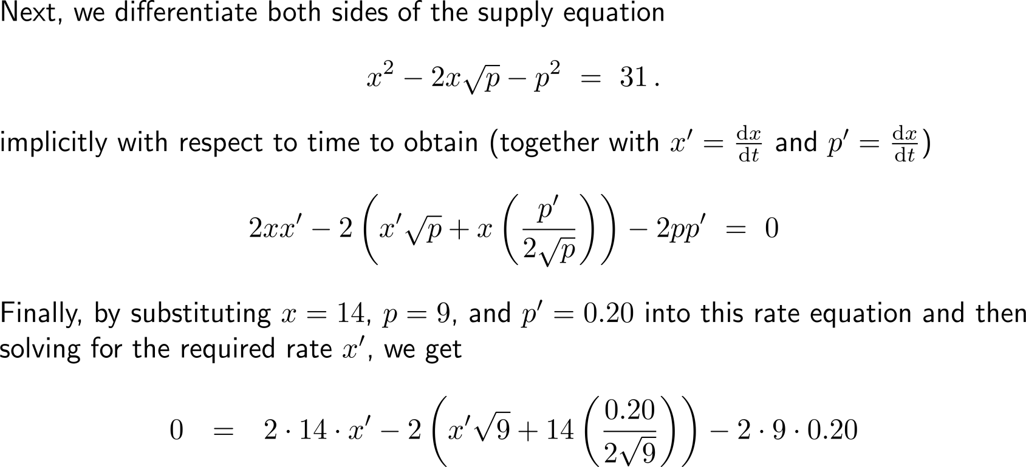
Example:
Using related rates to study supply

Slide 8
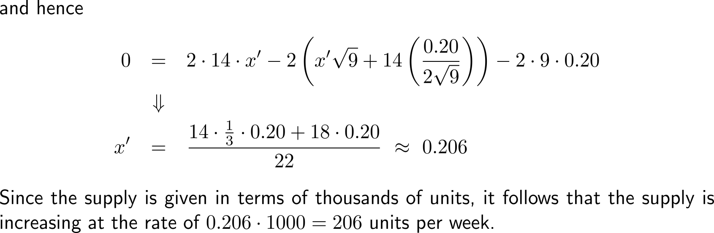
Example:
Using related rates to study supply

Slide 9
Calculus I for Management

