Slide 1
Calculus I for Management
Exponential & Logarithmic Functions – Part II
and
Marginal Analysis
week 8
Lecture
  Differentiation of exp. & log. functions
  Exponential models
  Marginal analysis & approximations using increments
  Related rates

Slide 2
Topics
  Differentiation of Exponential & Logarithmic Functions
  Exponential Models
  Marginal Analysis & Approximations Using Increments
  Related Rates

Slide 3
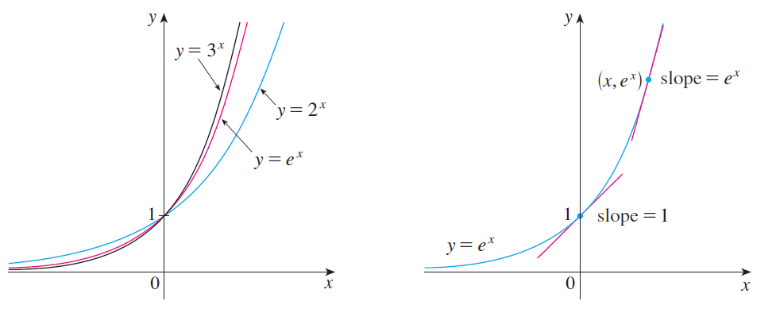
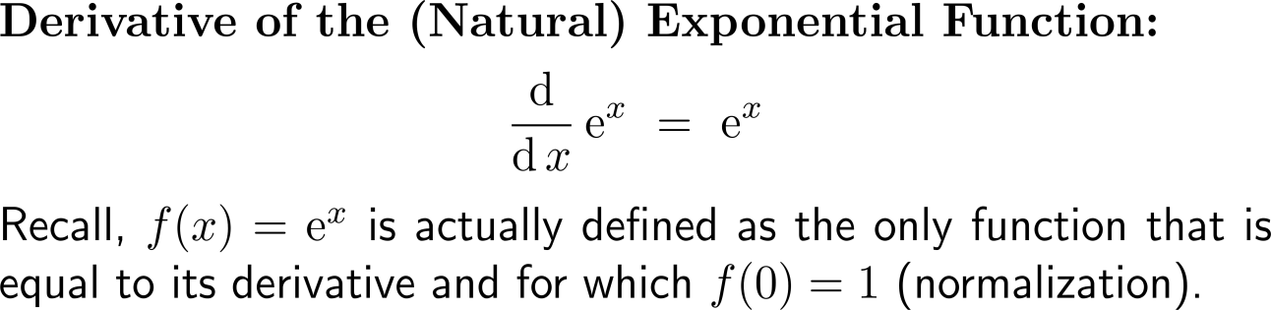
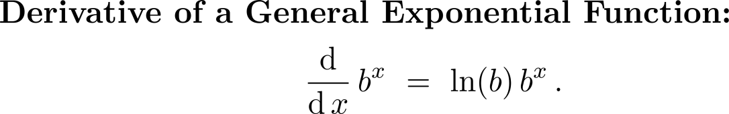
Recap: the natural exponential function with base e is the only non-constant function whose derivative is equal to the function itself

Slide 4
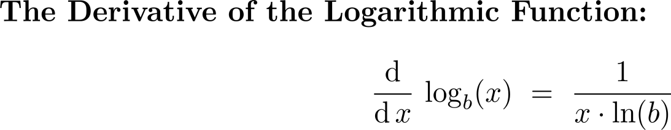
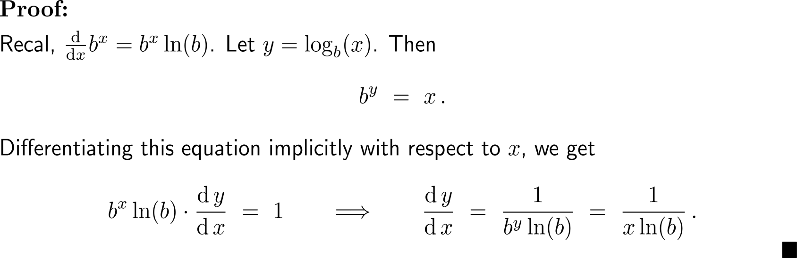
Next, let us use implicit differentiation to find the derivatives of logarithmic functions …

Slide 5
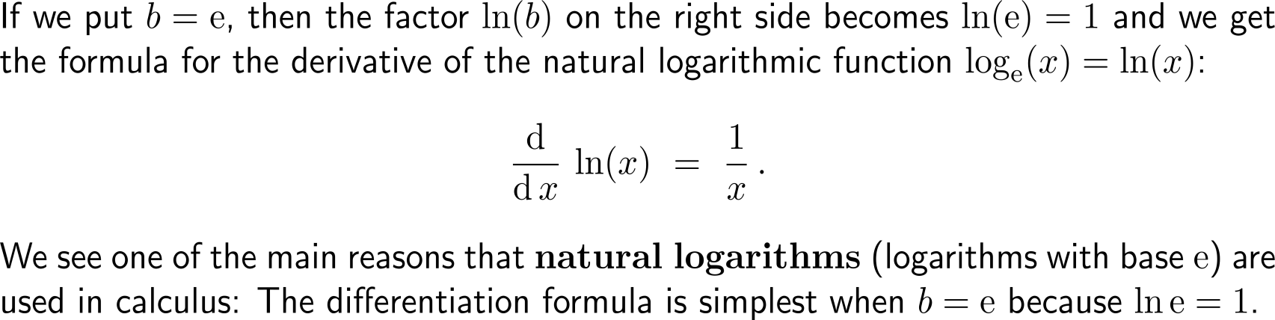
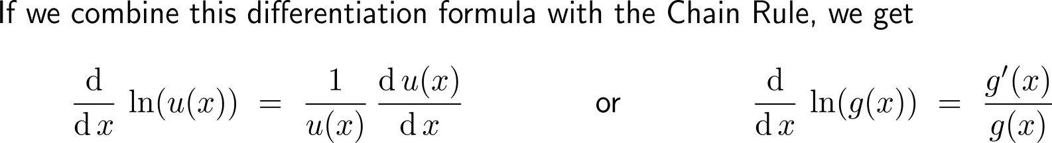
… and, in particular, the natural logarithmic function

Slide 6
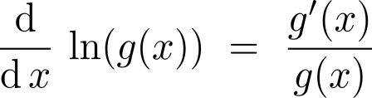
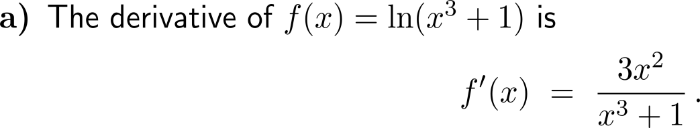
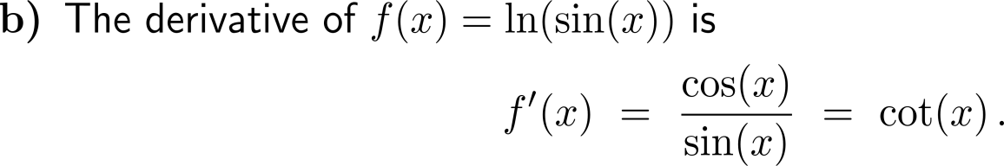
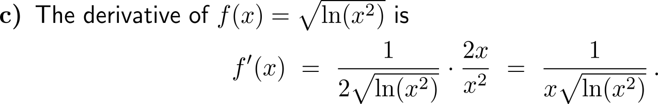
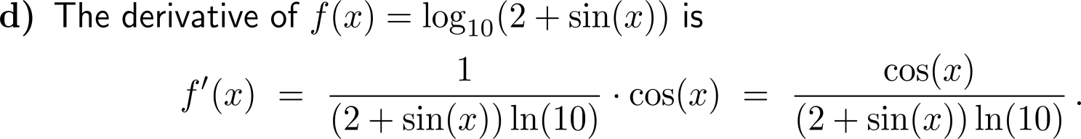
Example:
Application of the differentiation rule for the natural logarithm

Slide 7
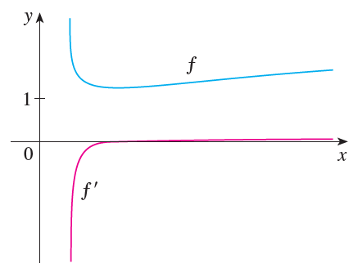
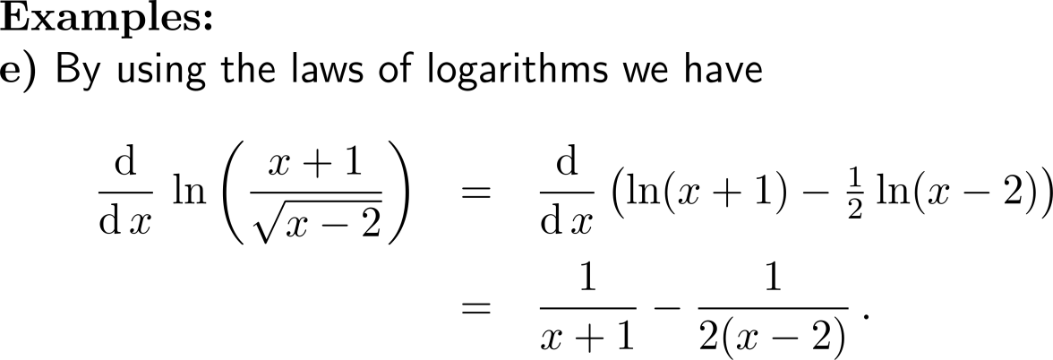
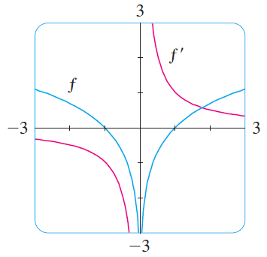
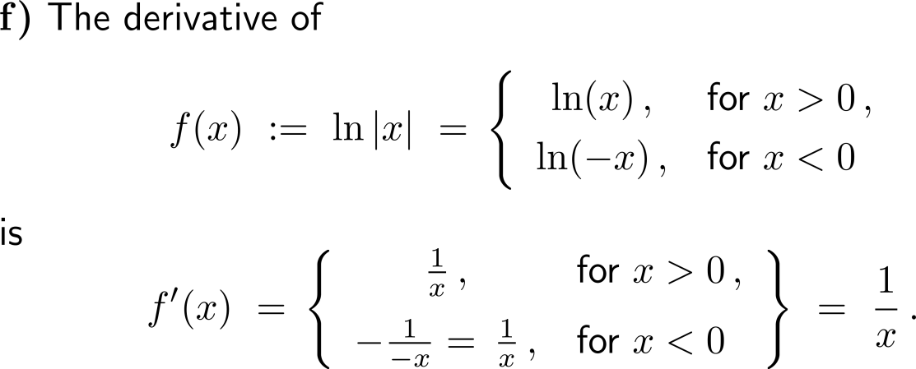
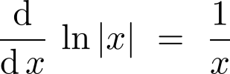
Example:
Application of the differentiation rule for the natural logarithm

Slide 8
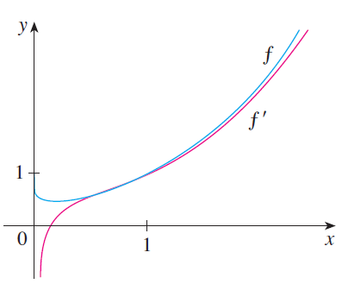
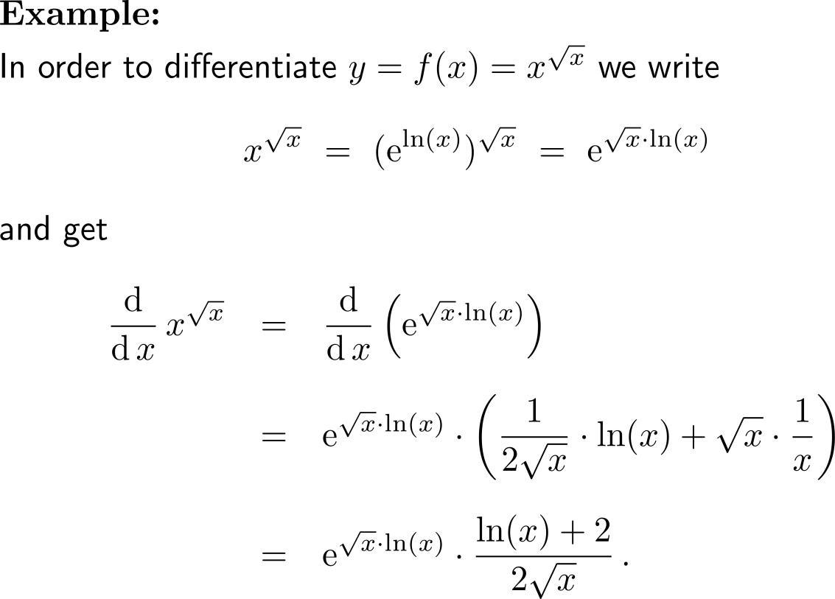
Example:
Derivative of natural exponential and logarithmic functions

Slide 9
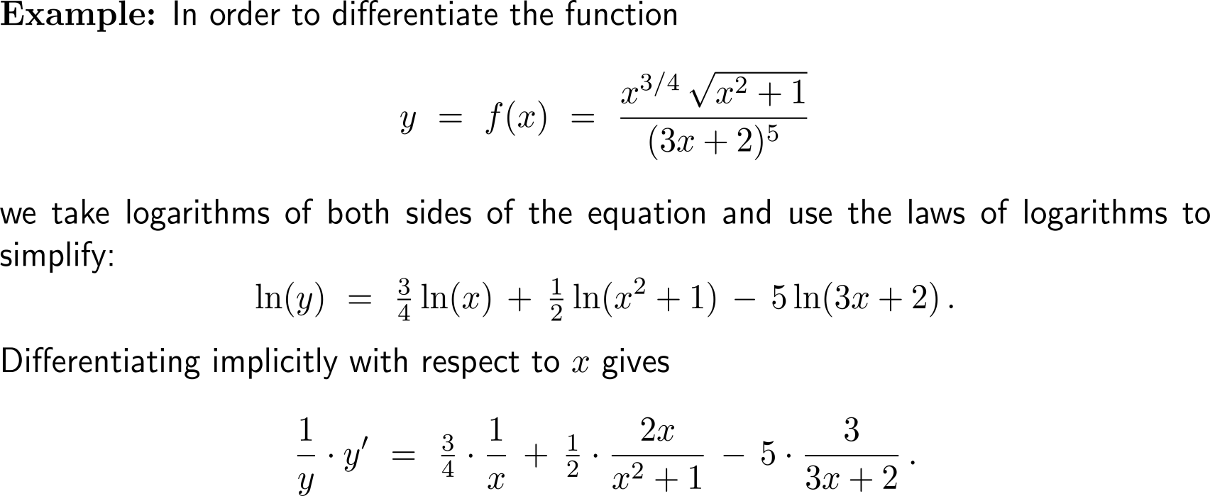
The calculation of derivatives of complicated functions involving products, quotients, or powers can often be simplified by taking logarithms (1/ 3)

Slide 10
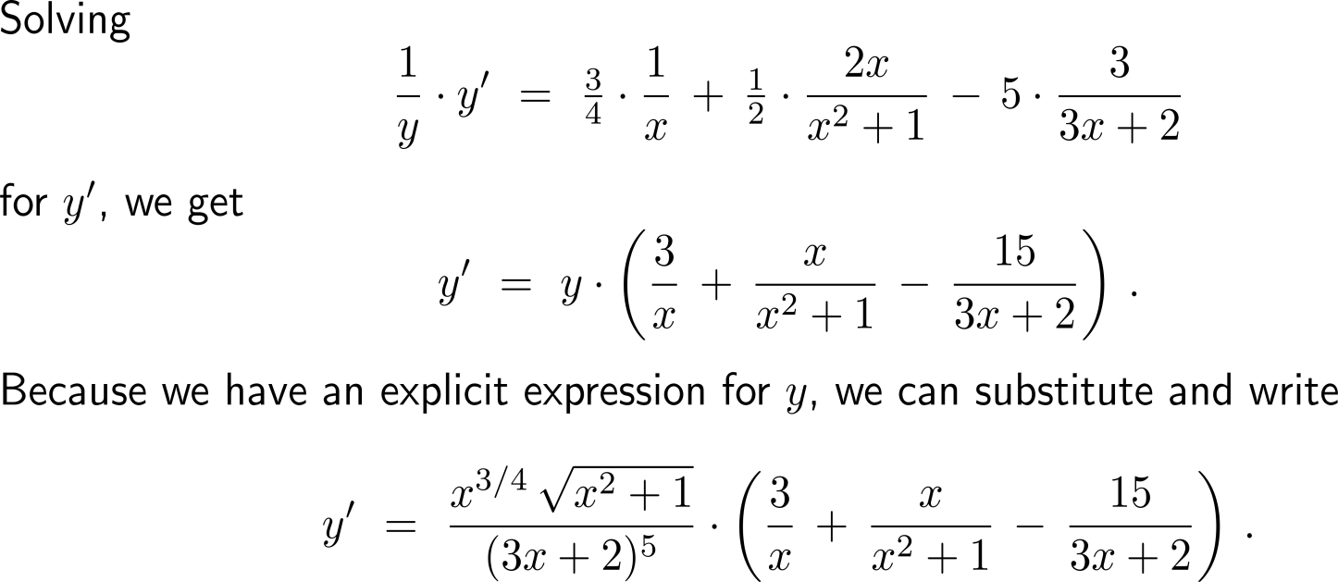
The calculation of derivatives of complicated functions involving products, quotients, or powers can often be simplified by taking logarithms (2/ 3)

Slide 11
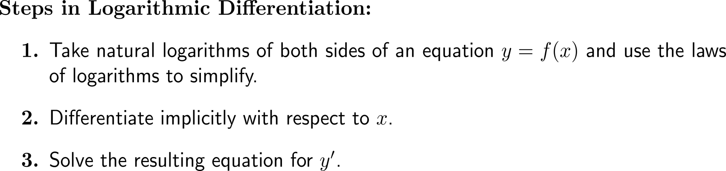
The calculation of derivatives of complicated functions involving products, quotients, or powers can often be simplified by taking logarithms (3/ 3)

Slide 12
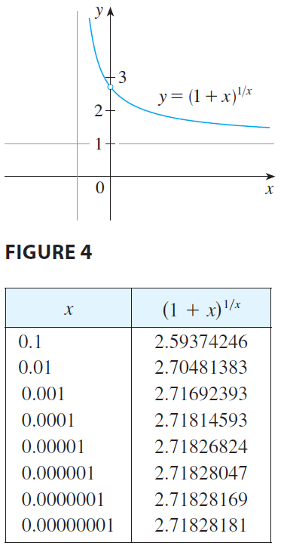
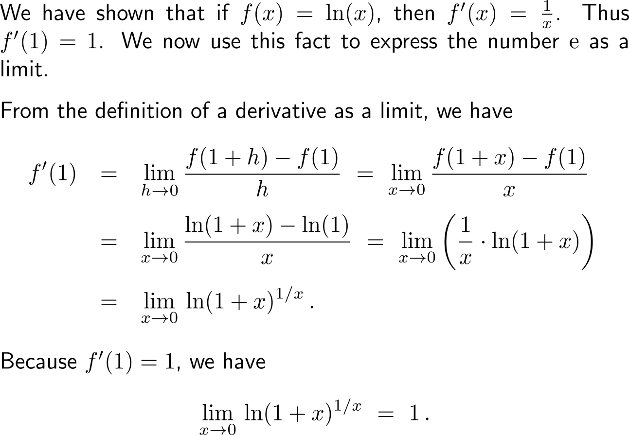
The Euler-number e as a limit (1/ 2)

Slide 13
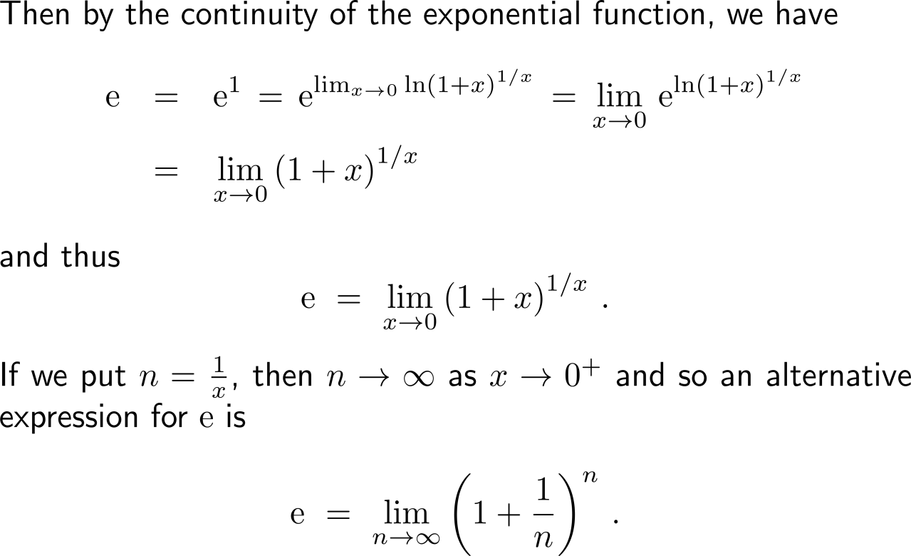
The Euler-number e as a limit (2/ 2)

Slide 14
Topics
  Differentiation of Exponential & Logarithmic Functions
  Exponential Models
  Marginal Analysis & Approximations Using Increments
  Related Rates

Slide 15
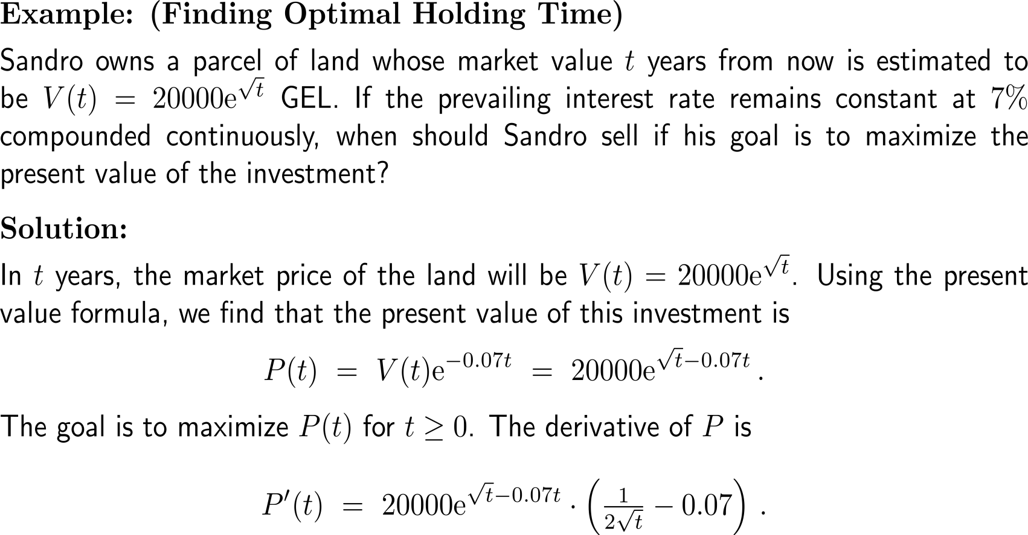
Example:
Finding optimal holding time

Slide 16
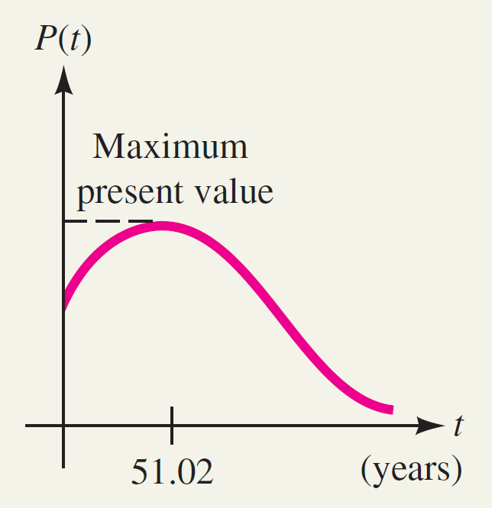
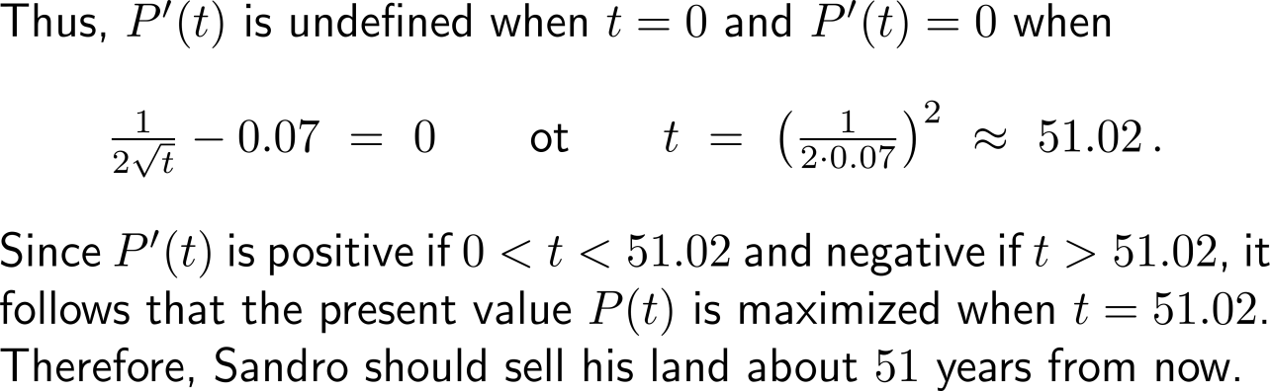
Example:
Finding optimal holding time

Slide 17
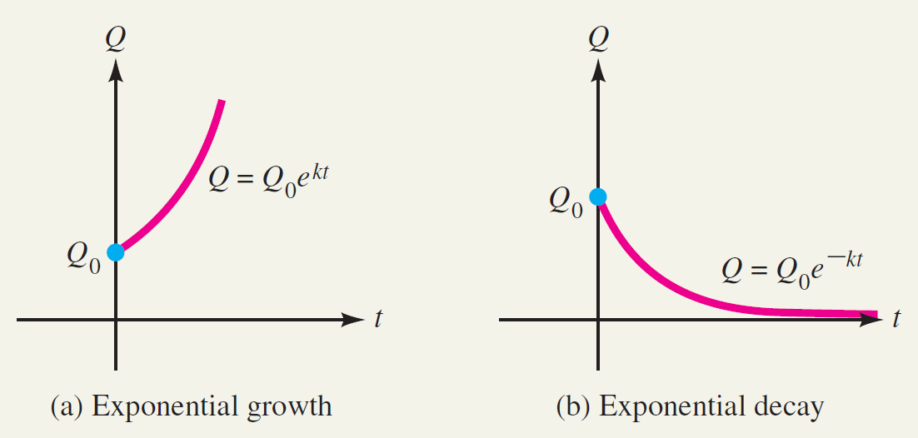
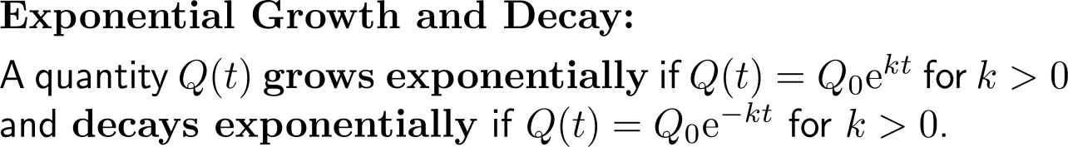
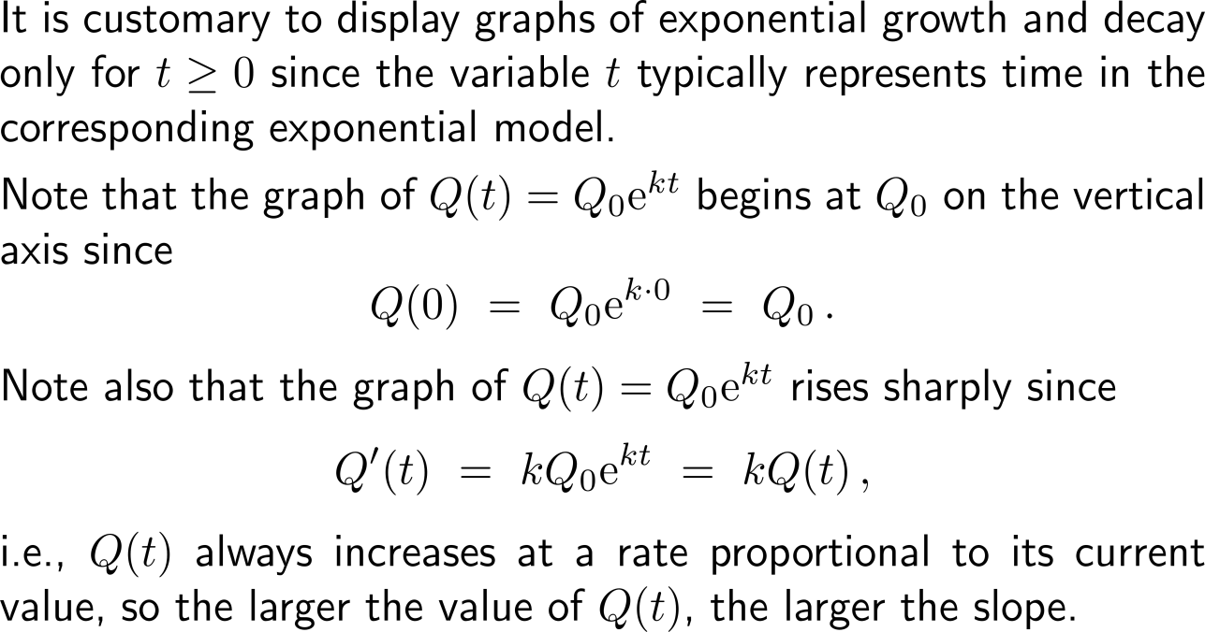
Exponential growth/ decay is characterizes by an increase/ decrease rate that is always proportional to the current value

Slide 18
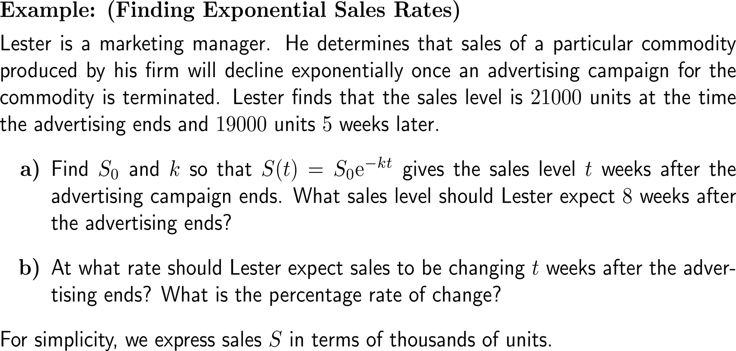
Example:
Finding exponential sales rates

Slide 19
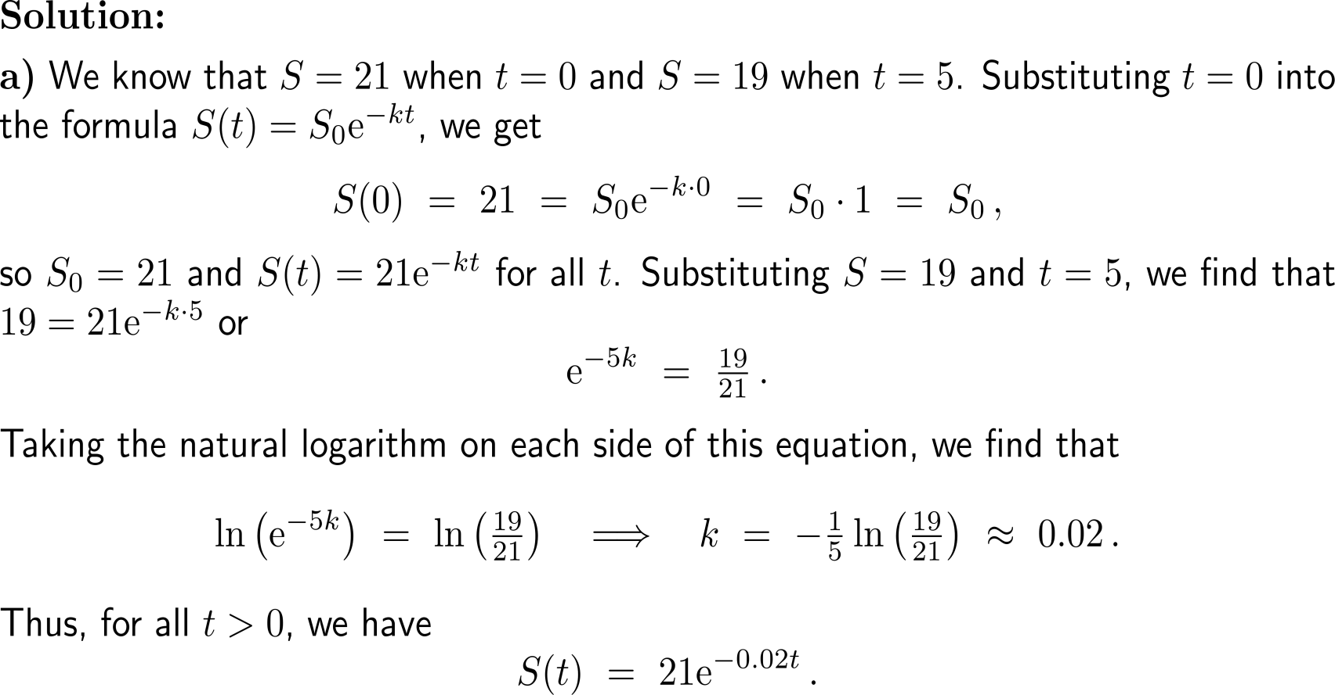
Example:
Finding exponential sales rates

Slide 20
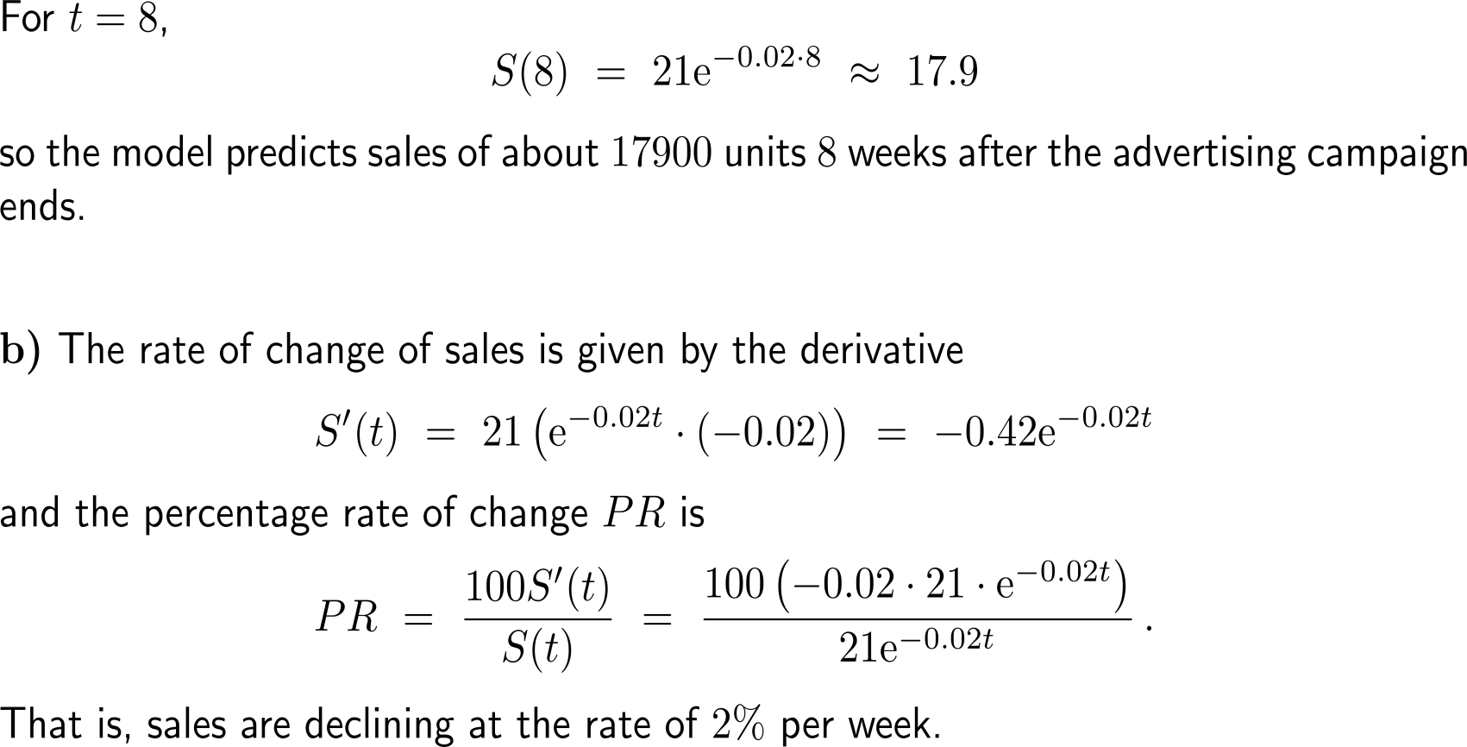
Example:
Finding exponential sales rates

Slide 21
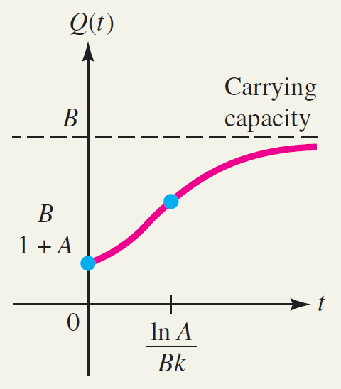
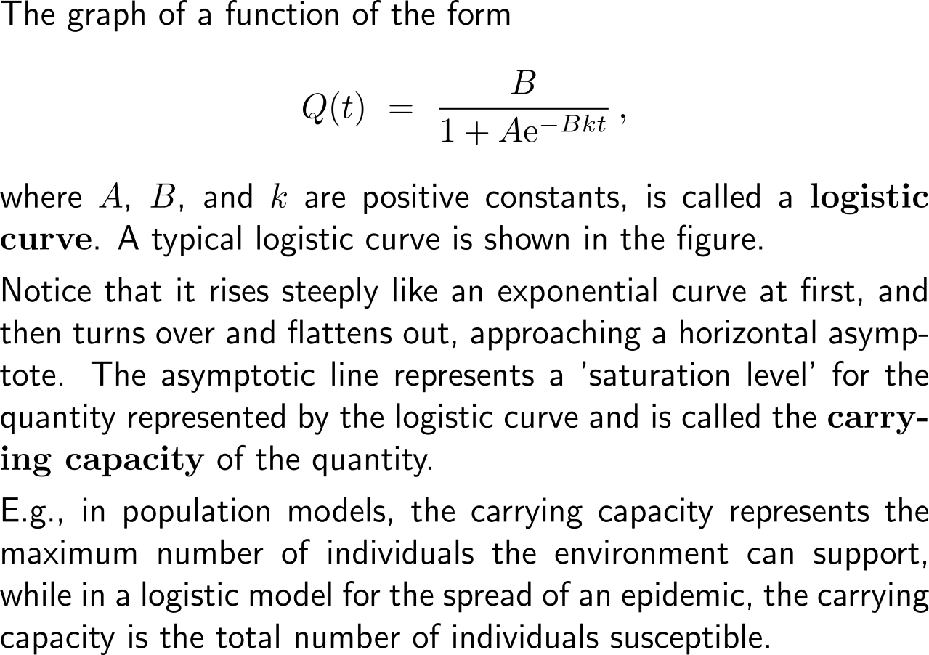
Logistic growth resembles an strictly increasing growth that is bounded by a capacity such that the rate of growth damps with increasing time (1/ 4)

Slide 22
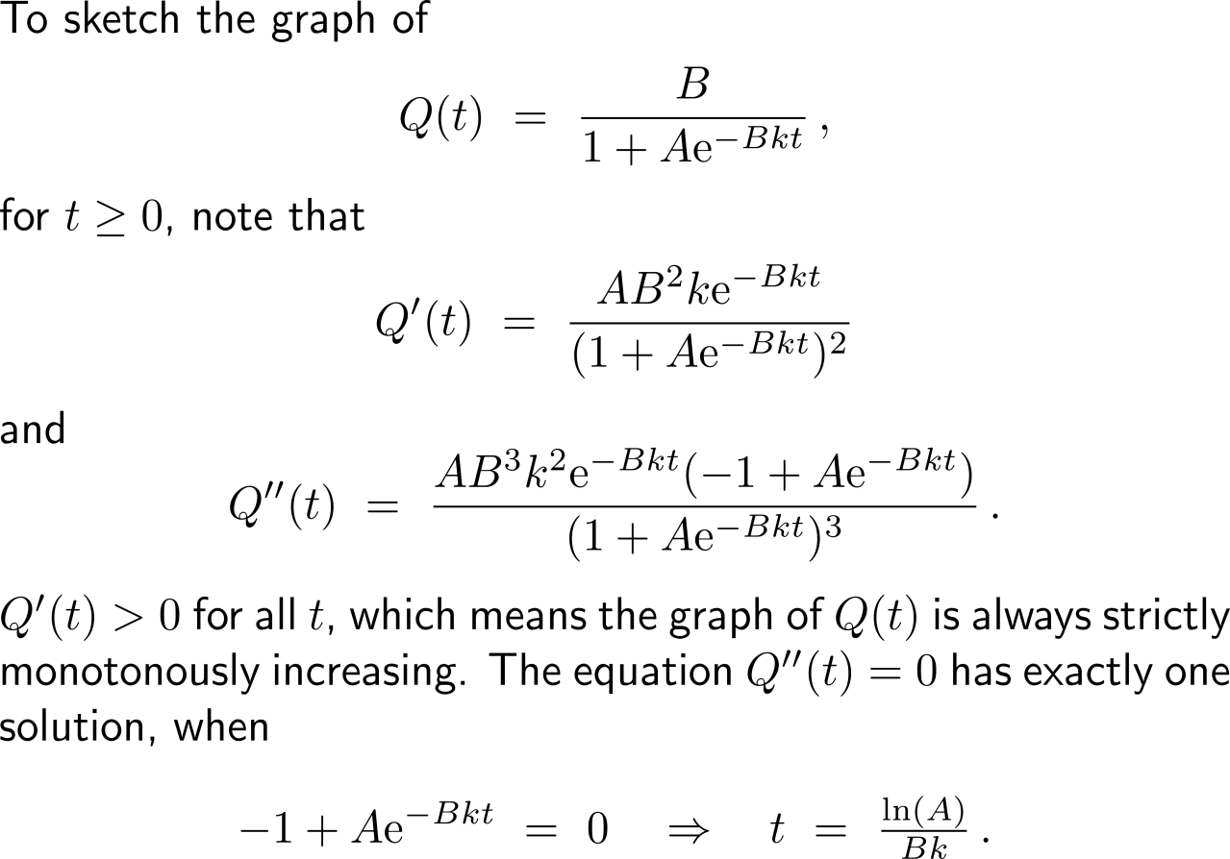
Logistic growth resembles an strictly increasing growth that is bounded by a capacity such that the rate of growth damps with increasing time (2/ 4)

Slide 23
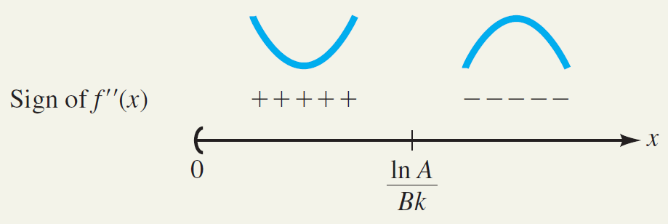
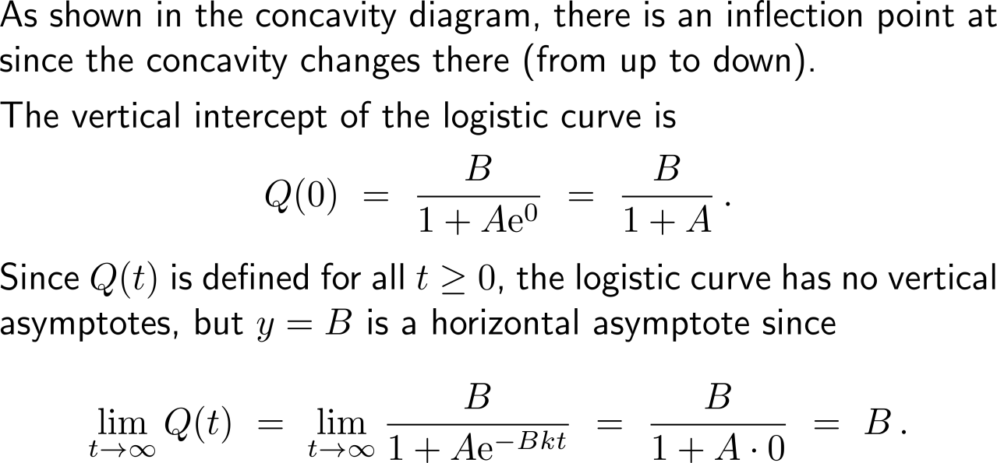
Logistic growth resembles an strictly increasing growth that is bounded by a capacity such that the rate of growth damps with increasing time (3/ 4)

Slide 24
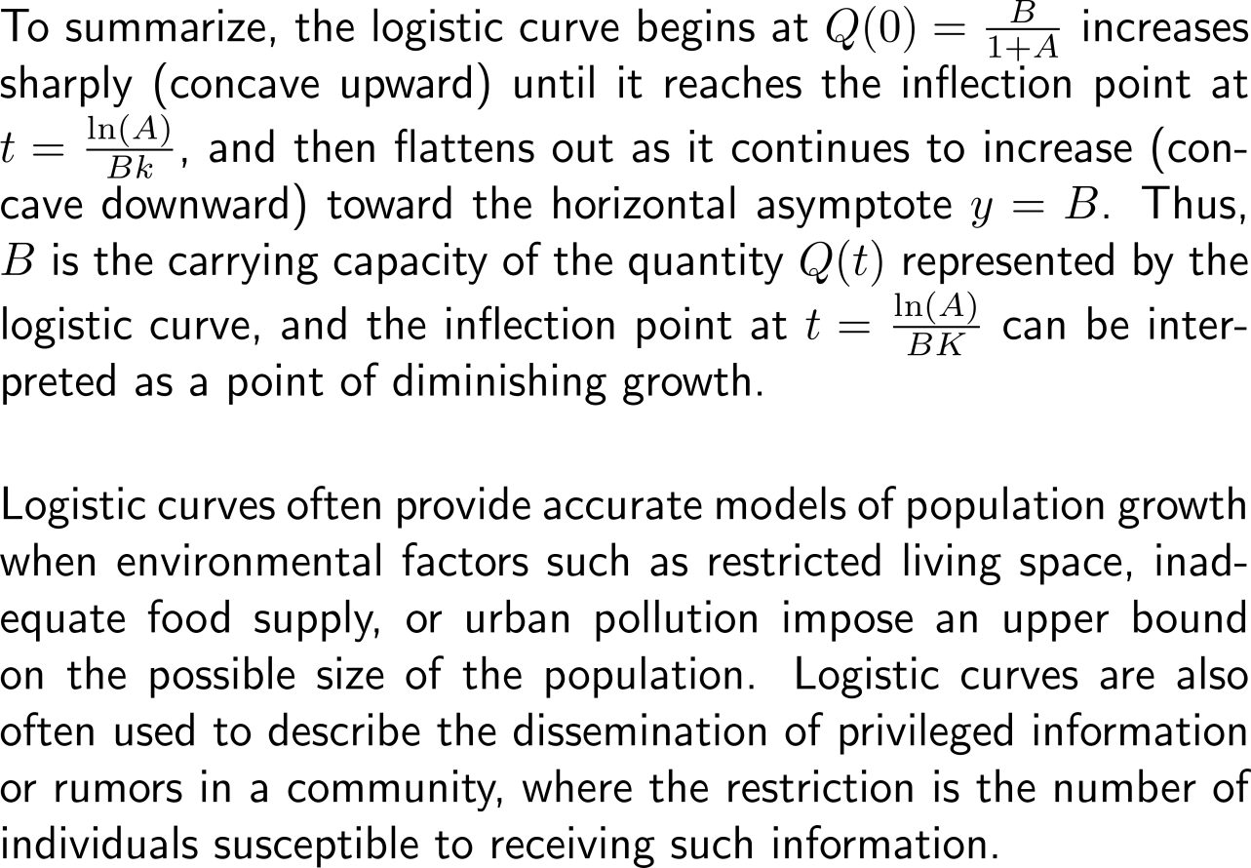
Logistic growth resembles an strictly increasing growth that is bounded by a capacity such that the rate of growth damps with increasing time (4/ 4)

Slide 25
Topics
  Differentiation of Exponential & Logarithmic Functions
  Exponential Models
  Marginal Analysis & Approximations Using Increments
  Related Rates

Slide 26
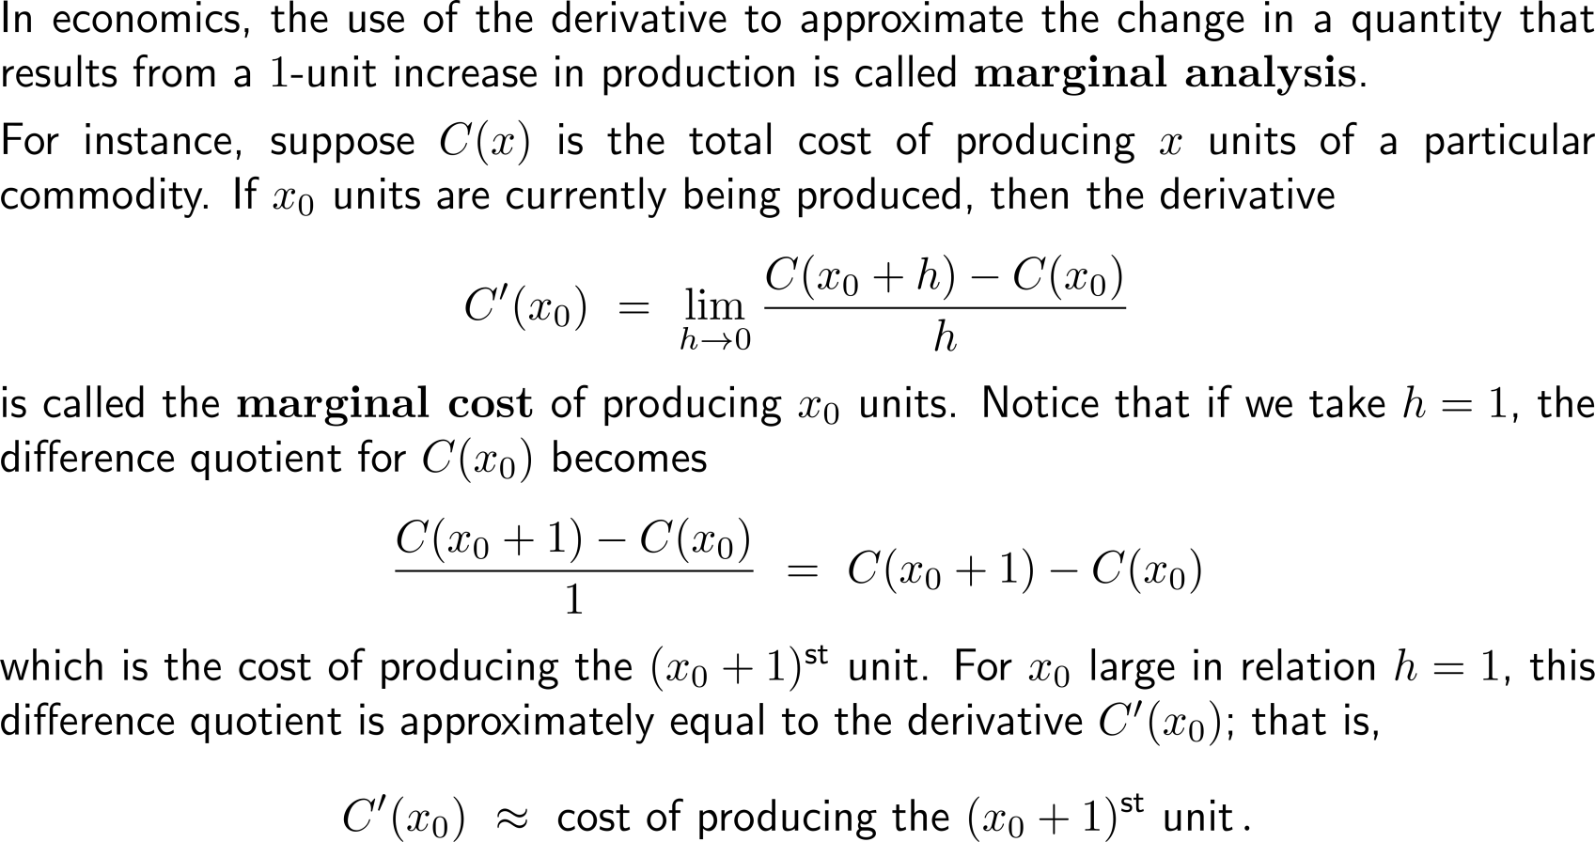
Marginal analysis studies the change in a quantity that results from a 1-unit increase in this quantity (1/ 3)

Slide 27
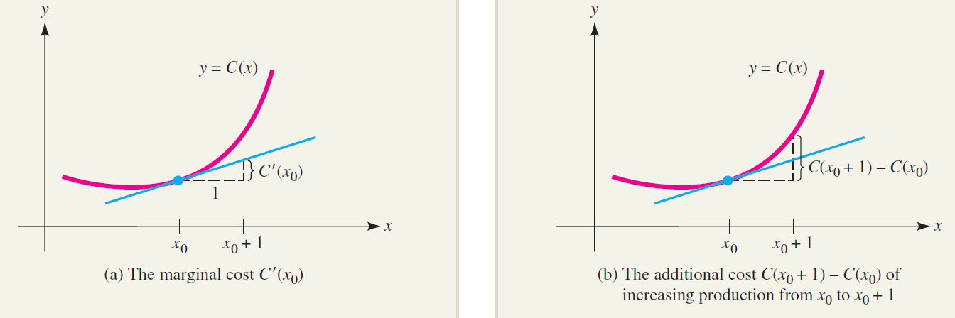
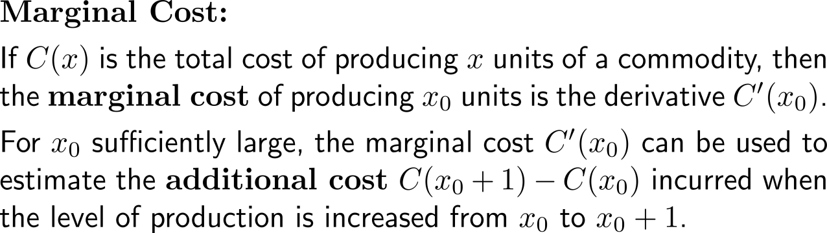
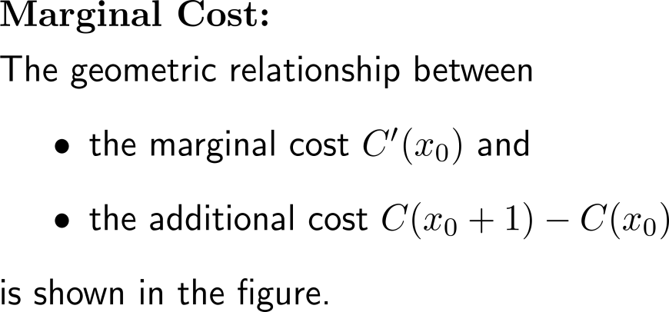
Marginal analysis studies the change in a quantity that results from a 1-unit increase in this quantity (2/ 3)

Slide 28
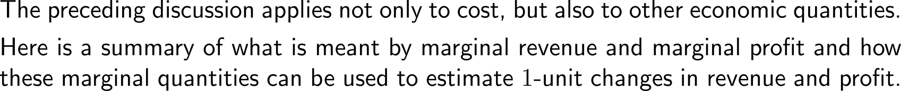
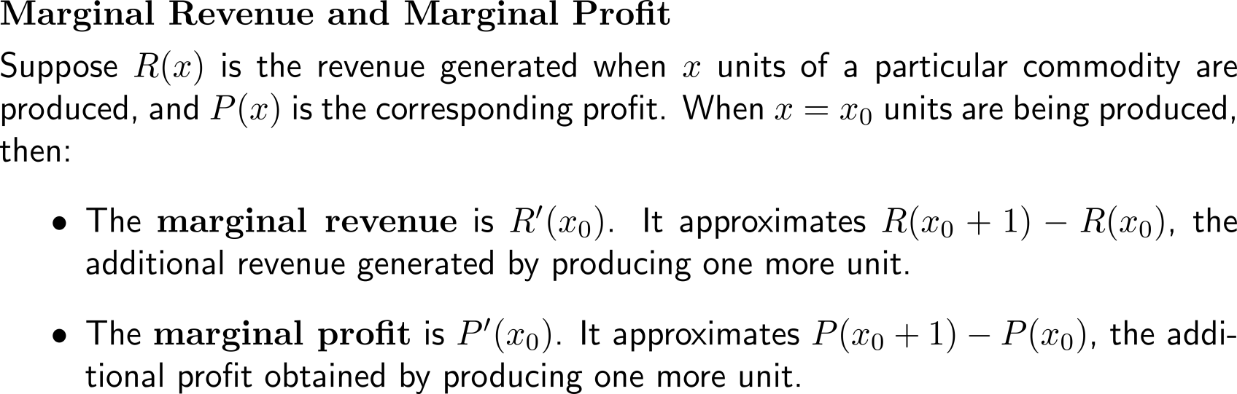
Marginal analysis studies the change in a quantity that results from a 1-unit increase in this quantity (3/ 3)

Slide 29

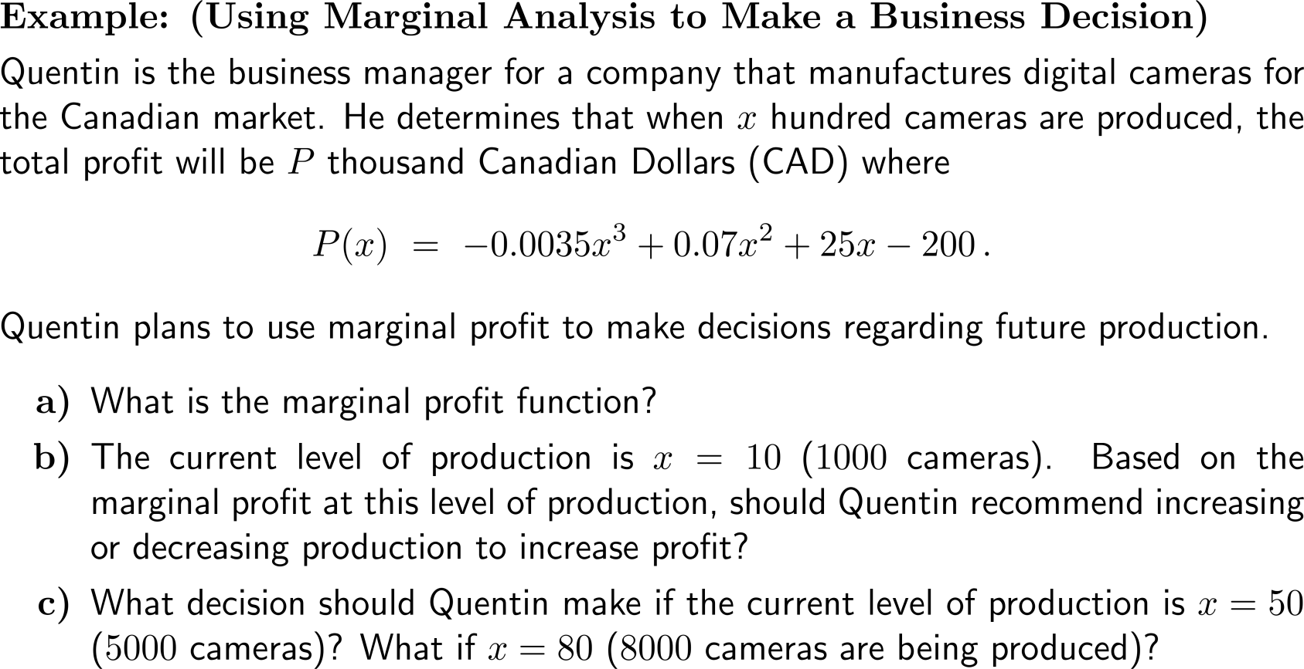
Example:
Using Marginal Analysis to make a business decision

Slide 30
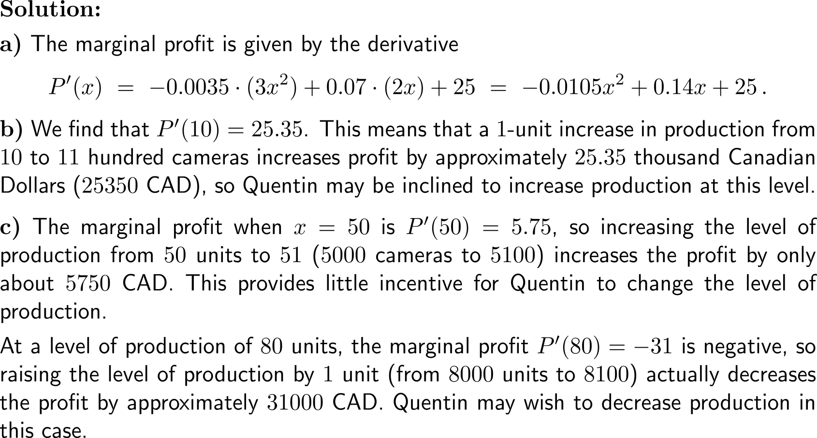
Example:
Using Marginal Analysis to make a business decision

Slide 31
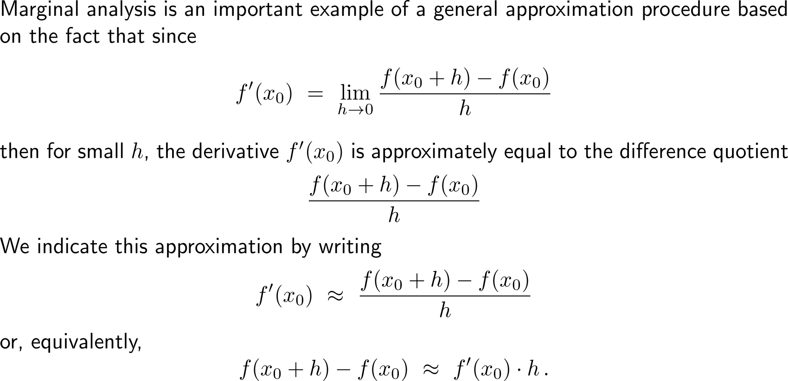
Marginal analysis can be viewed as an application of our just discussed topic of linear approximation (1/ 2)

Slide 32
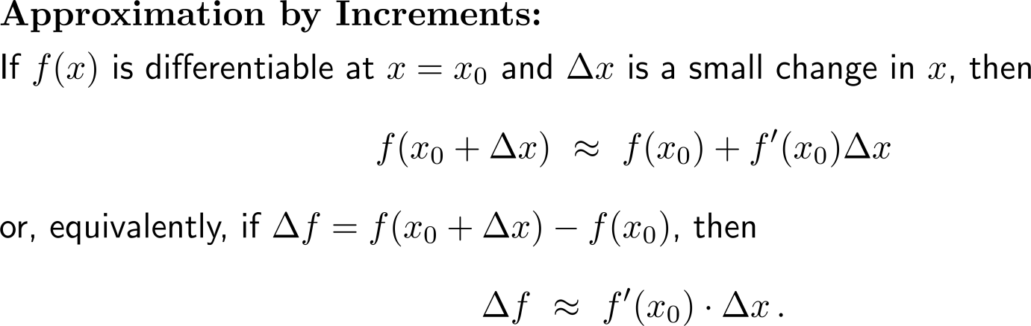
Marginal analysis can be viewed as an application of our just discussed topic of linear approximation (2/ 2)

Slide 33

Example:
Estimating a change in required labor

Slide 34



From the notational point of view, increments are sometimes referred to as differentials (1/ 2)

Slide 35

From the notational point of view, increments are sometimes referred to as differentials (2/ 2)

Slide 36

Example:
Finding differentials

Slide 37

Example:
Using Marginal Analysis in labor management

Slide 38

Example:
Using Marginal Analysis in labor management

Slide 39


Example:
Using Marginal Analysis in labor management

Slide 40
Topics
  Differentiation of Exponential & Logarithmic Functions
  Exponential Models
  Marginal Analysis & Approximations Using Increments
  Related Rates

Slide 41



Problem solving strategies combine unstructured creativity with structured formalism to find and document solutions
assign names to variables
determine what is known and what is unknown
develop the steps of how to come from the known to the unknown
understand
the problem
develop a
plan
Georg Pólya
13. 12. 1887 – 7. 9. 1985
review your
solution
execute the plan

Slide 42


In practical problems it often arises that quantities and their rates depend on each other such that one has to solve ‘related rates problems’

Slide 43

Example:
Finding a related rate of cost

Slide 44

Example:
Finding a related rate of cost

Slide 45

Example:
Using related rates to study supply

Slide 46

Example:
Using related rates to study supply

Slide 47

Example:
Using related rates to study supply

Slide 48


Further Worked-Out Exercises:
Calculus I for Management
Topics
  Differentiation of Exponential & Logarithmic Functions
  Exponential Models
  Marginal Analysis
  Related Rates

Slide 49


Exercise

Slide 50

Exercise

Slide 51

Exercise

Slide 52


Exercise:
Population Growth

Slide 53

Exercise:
Population Growth

Slide 54

Example:
Population Growth
https://www.worldometers.info/world-population/
The current world population is 7.8 billion as of October 2020 according to the most recent United Nations estimates elaborated by Worldometer. The term "World Population" refers to the human population (the total number of humans currently living) of the world.

Slide 55









Exercise:
Radioactive Decay
radium and its use in the early 20th century:

Slide 56

Exercise:
Radioactive Decay

Slide 57

Exercise:
Radioactive Decay

Slide 58

Exercise:
Studying marginal cost and marginal revenue

Slide 59

Exercise:
Studying marginal cost and marginal revenue

Slide 60

Exercise:
Studying marginal cost and marginal revenue

Slide 61


Exercise:
Estimating change in cost using a derivative

Slide 62

Exercise:
Related Rates

Slide 63

Exercise:
Related Rates

Slide 64

Exercise:
Related Rates

Slide 65



Exercise:
Related Rates

Slide 66

Exercise:
Related Rates

Slide 67


Exercise:
Related Rates

Slide 68
Calculus I for Management

