Slide 1
Calculus I for MGMT – Curves & Derivatives
Increasing/ Decreasing Functions & Relative Extrema
Mathematics for Management
Supplementary Electronic Materials
Connecting the Properties of Curves with Derivatives
Increasing/ Decreasing Functions & Relative Extrema
  Concavity and Points of Inflection
  Horizontal, Vertical & Slant Asymptotes

Slide 2
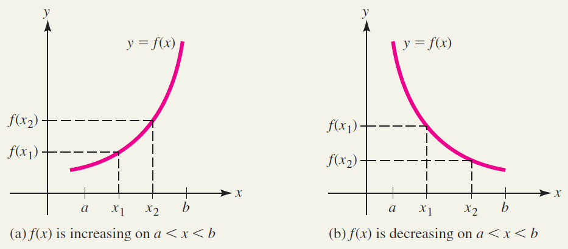
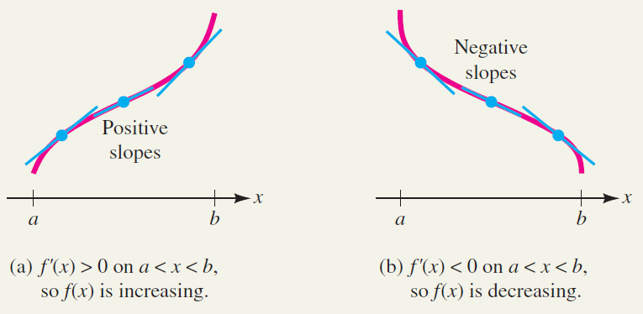
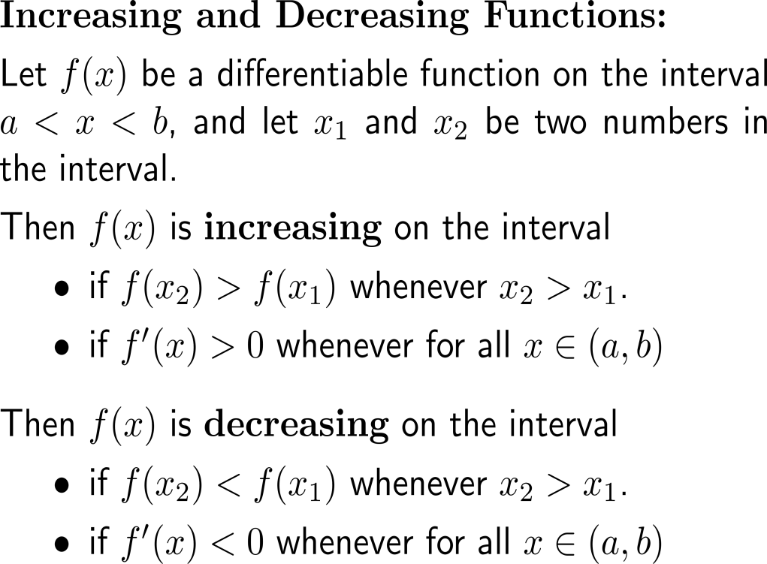
Recap:
Increasing and decreasing functions

Slide 3
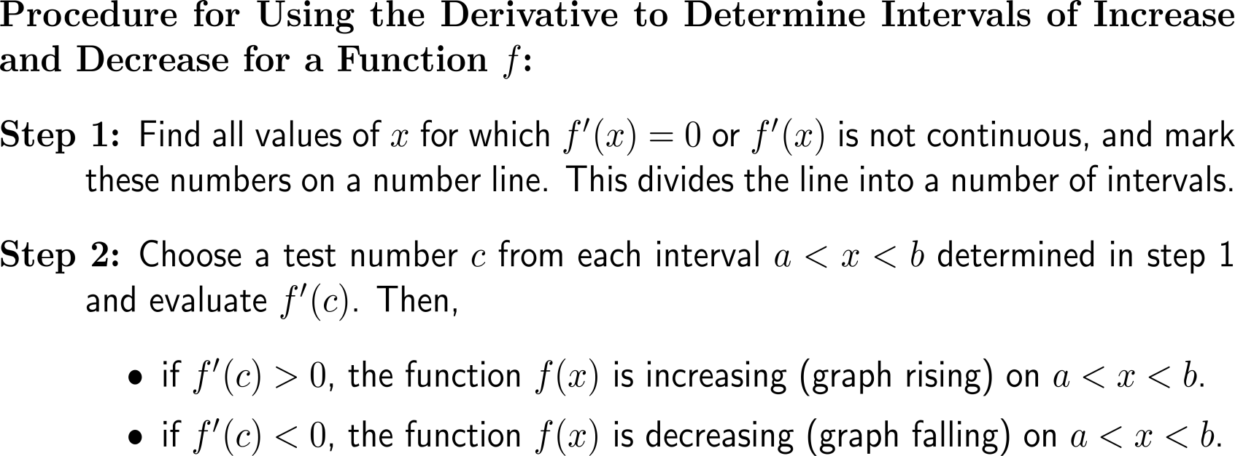
This leads to a hands-on procedure to use the derivative to determine intervals of increase and decease for a function

Slide 4
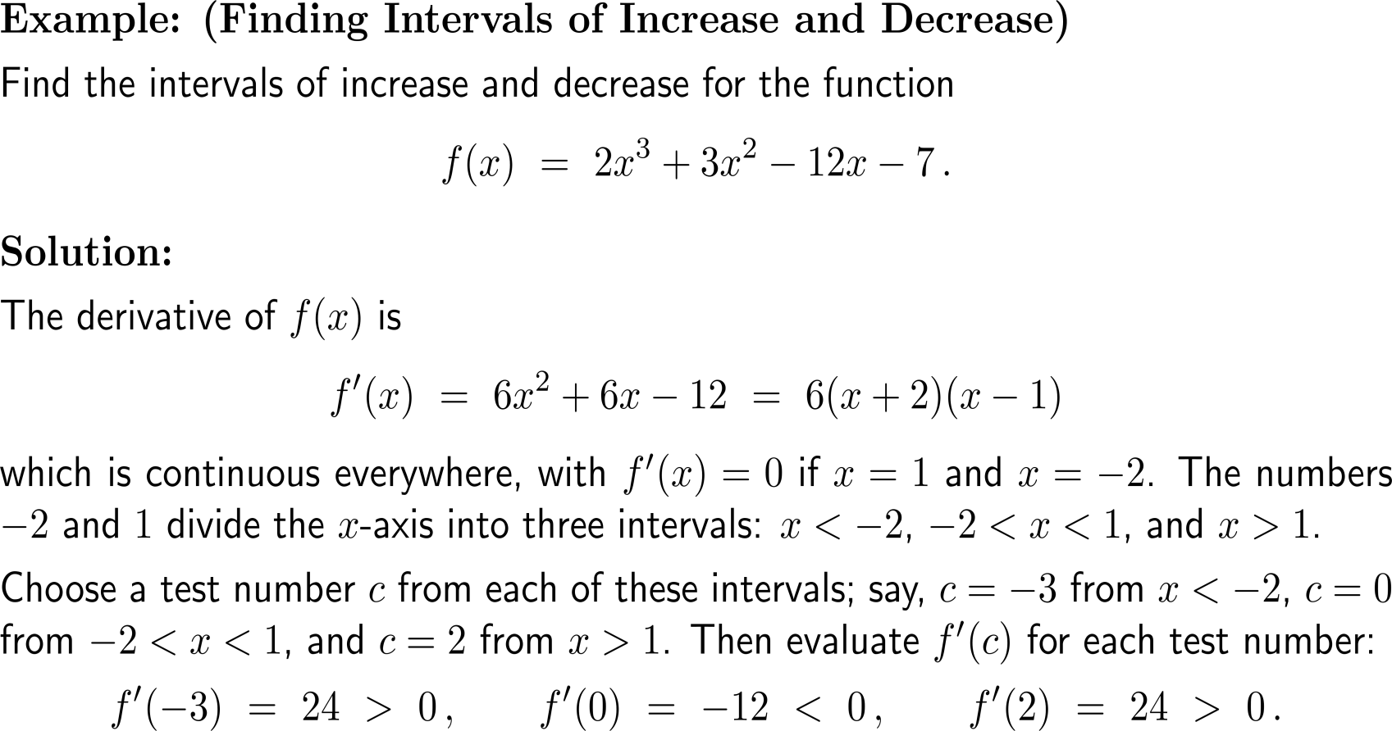
Example:
Finding intervals of increase and decrease

Slide 5
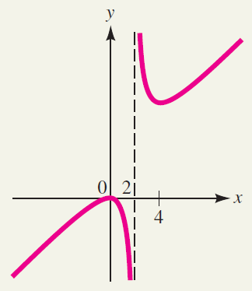
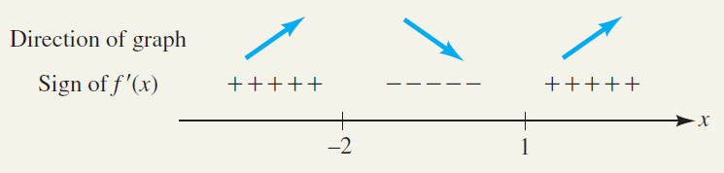
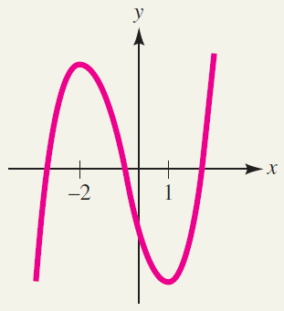
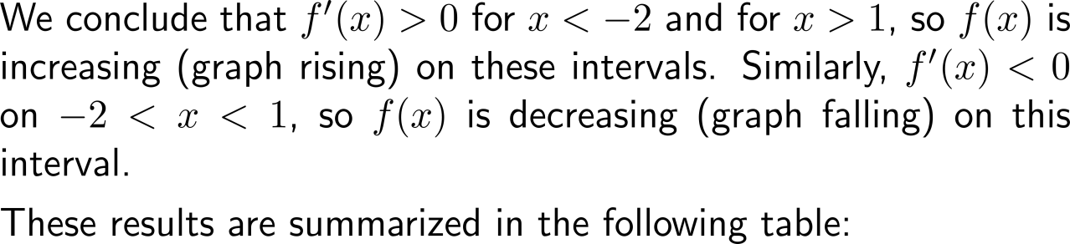
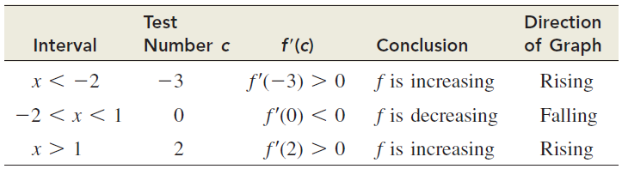
Example:
Finding intervals of increase and decrease

Slide 6
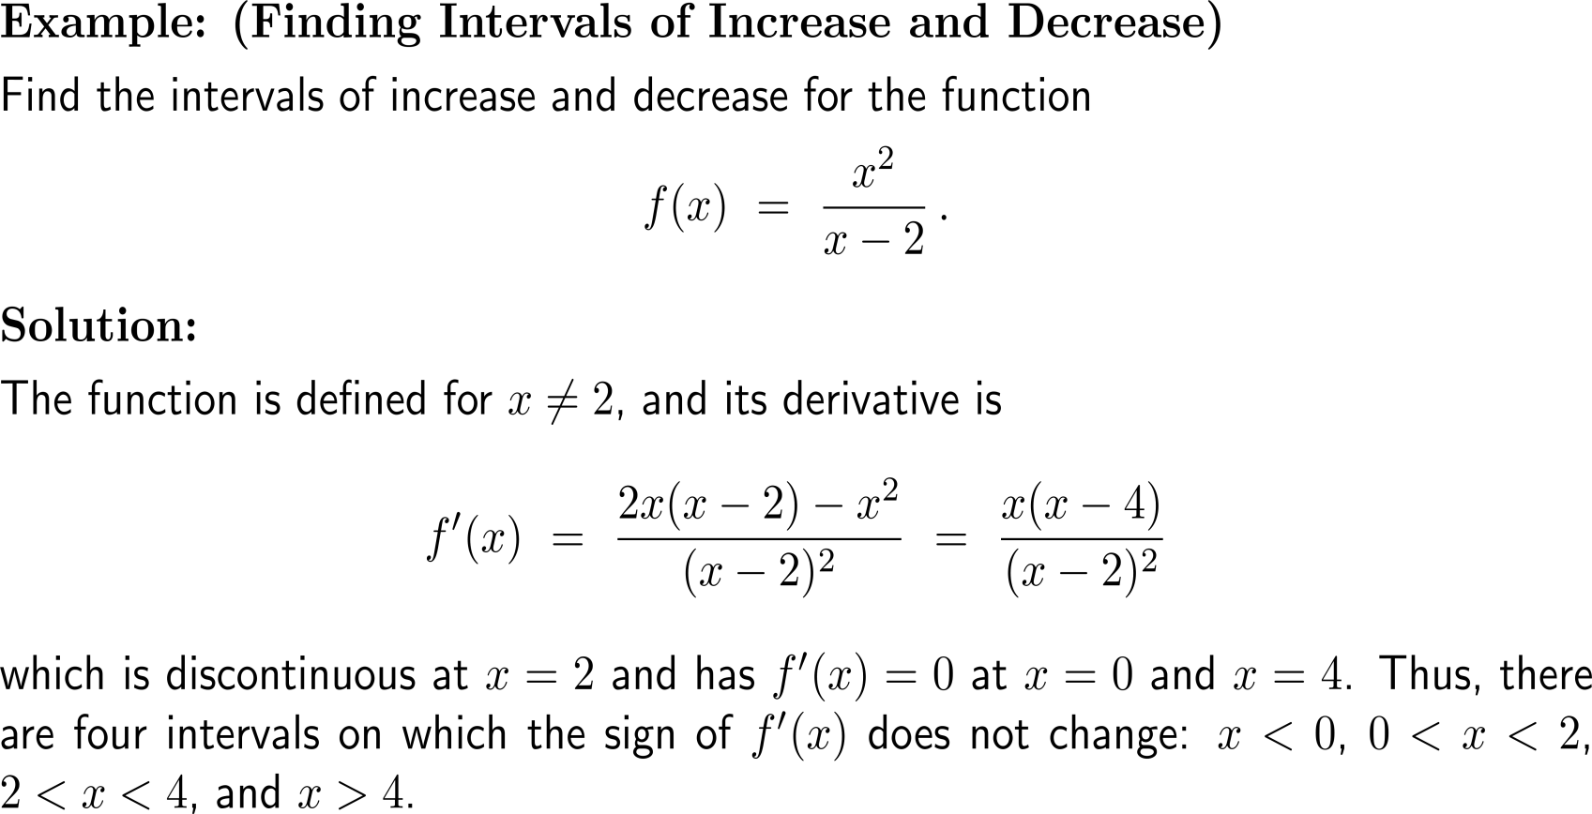
Example:
Finding intervals of increase and decrease

Slide 7
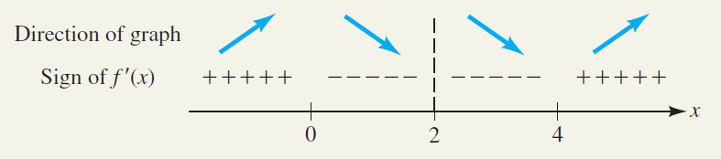
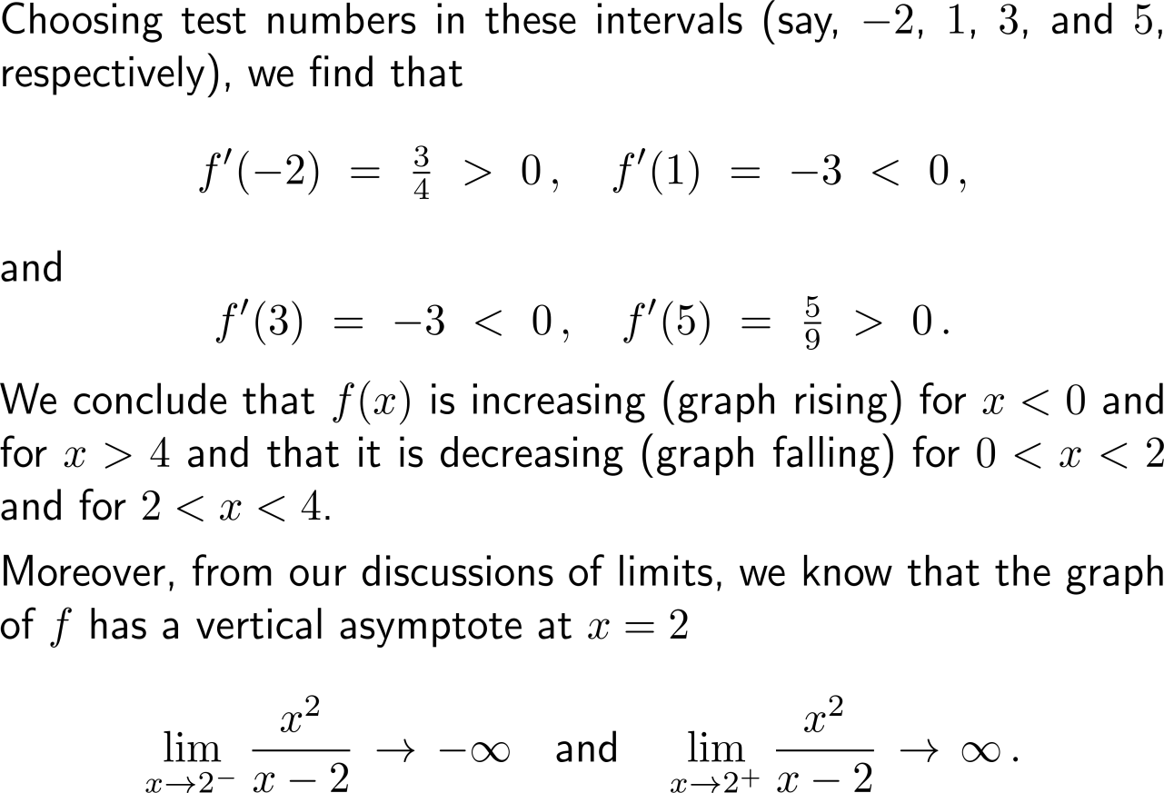
Example:
Finding intervals of increase and decrease

Slide 8
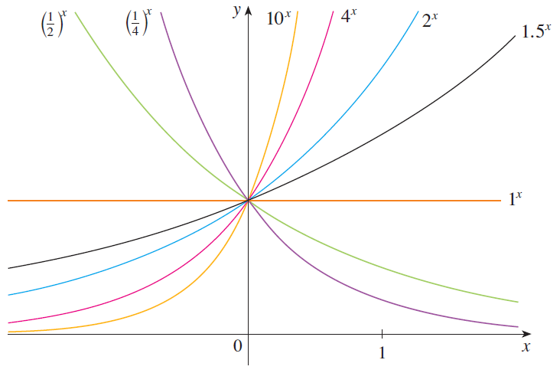
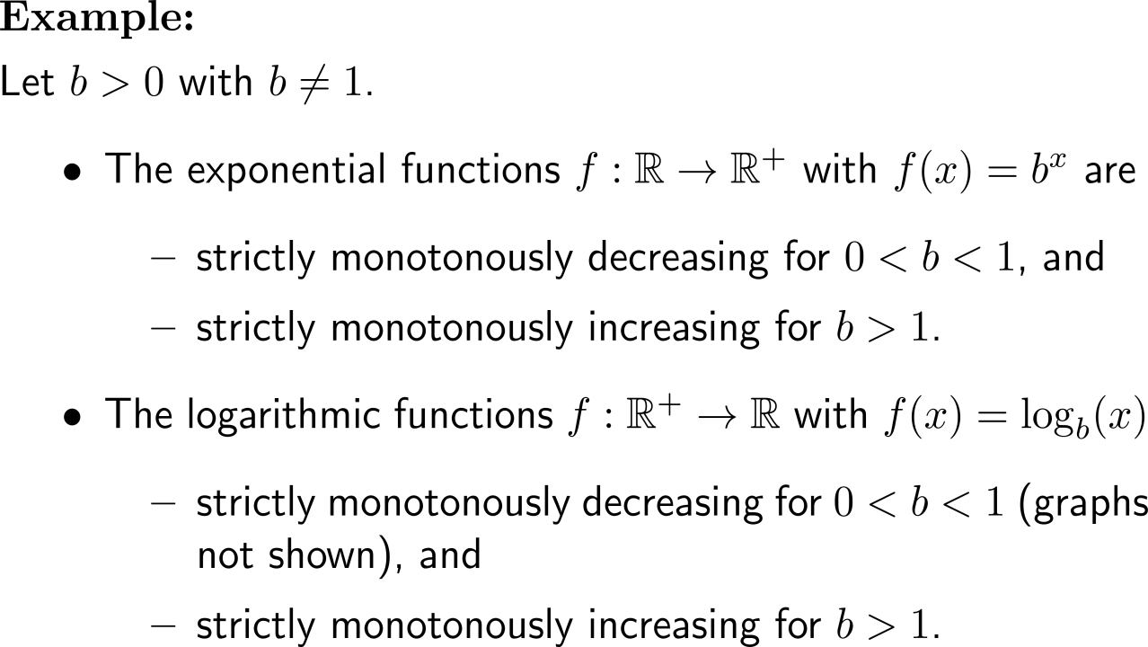
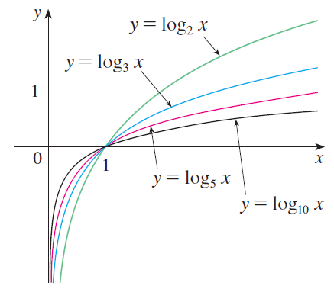
Example:
Exponential functions and logarithms

Slide 9
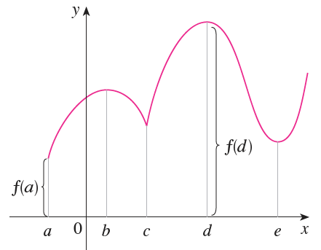
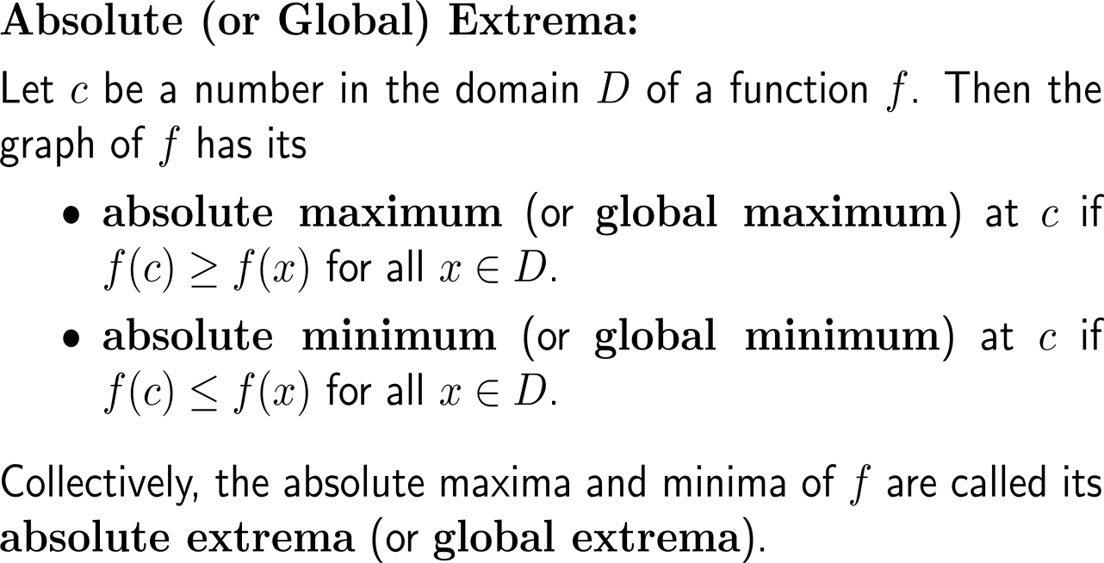
We distinguish between to types of extrema:
(i) absolute or global extrema …
absolute extremum

Slide 10
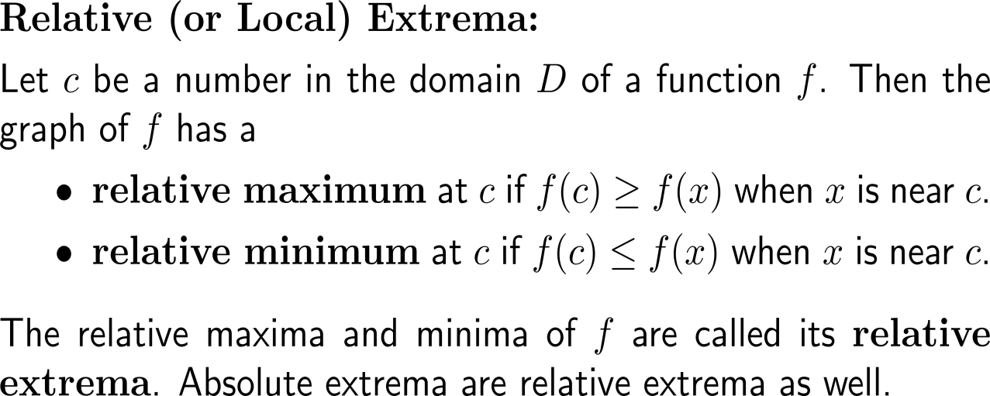
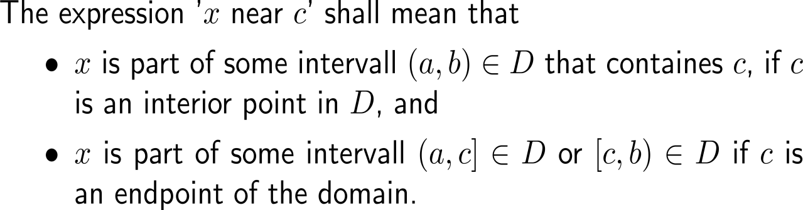
… and (ii) relative or local extrema
relative extremum
absolute extremum

Slide 11
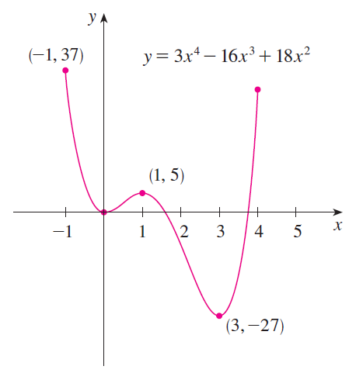
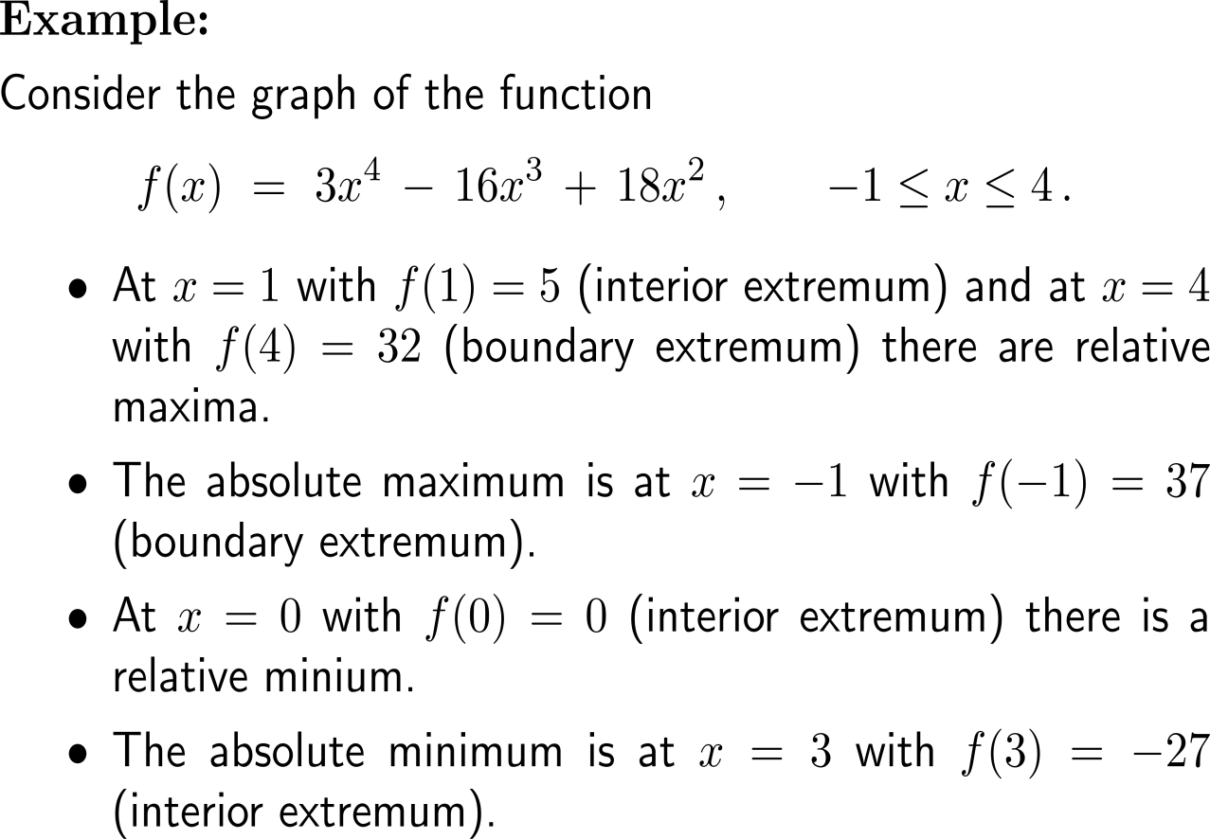
Example:
Relative and absolute extrema

Slide 12
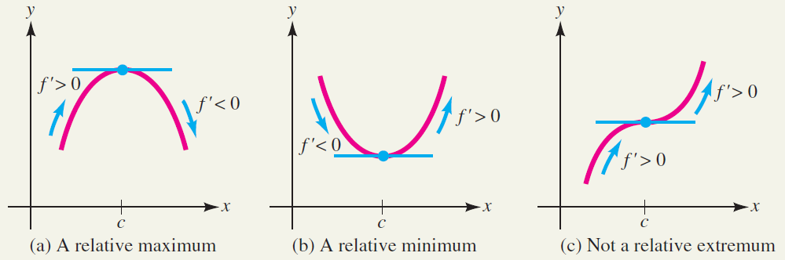
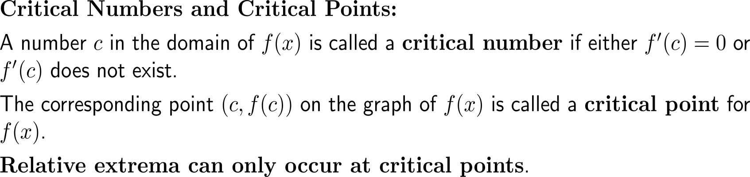
Relative extrema can only occur at critical points (1/ 2)
the differentiable
situation
c is a critical number if
f’(c) = 0 or
f’(c) does not exist

Slide 13
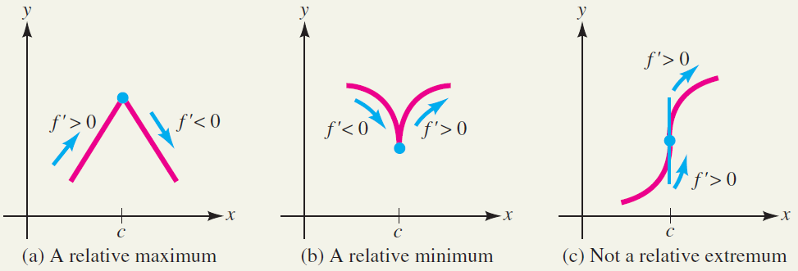
Relative extrema can only occur at critical points (2/ 2)
the non-differentiable
situation
c is a critical number if
f’(c) = 0 or
f’(c) does not exist

Slide 14
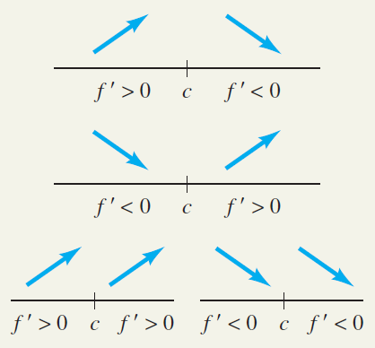
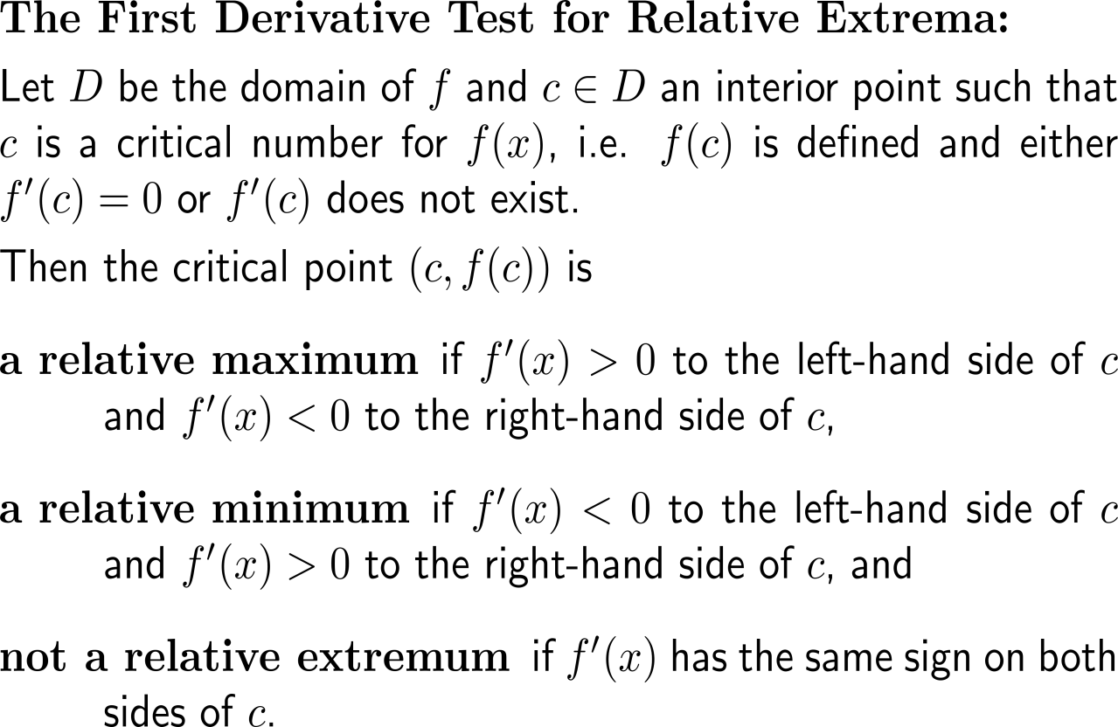
The type of sign change of the 1st derivative at a critical number determines the type of the relative extremum at the critical number
relative maximum
relative minimum
not a relative extremum

Slide 15
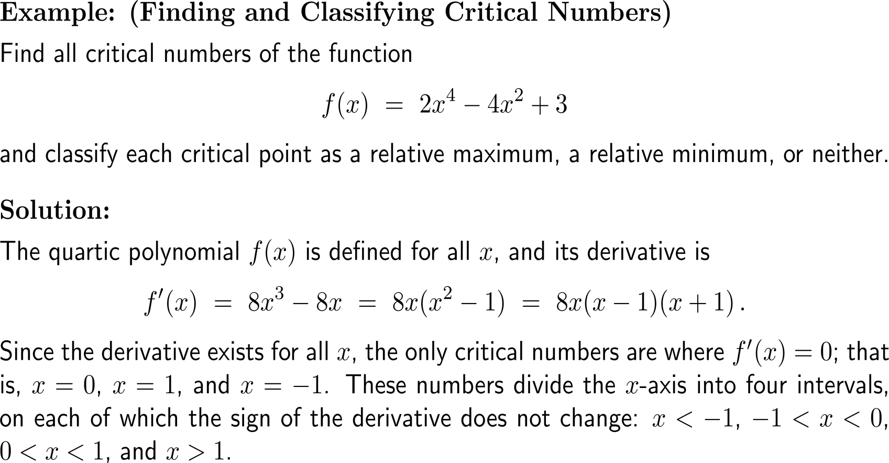
Example:
Finding and classifying critical numbers

Slide 16
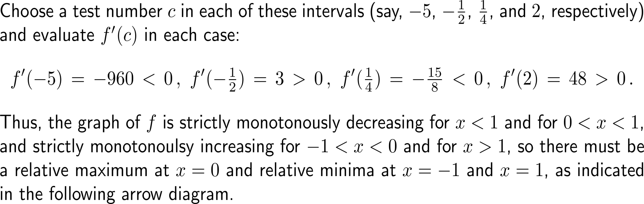
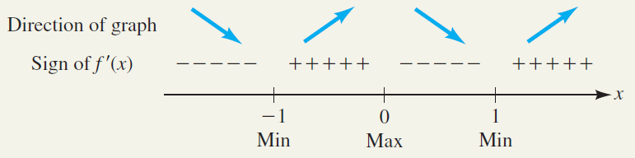
Example:
Finding and classifying critical numbers

Slide 17
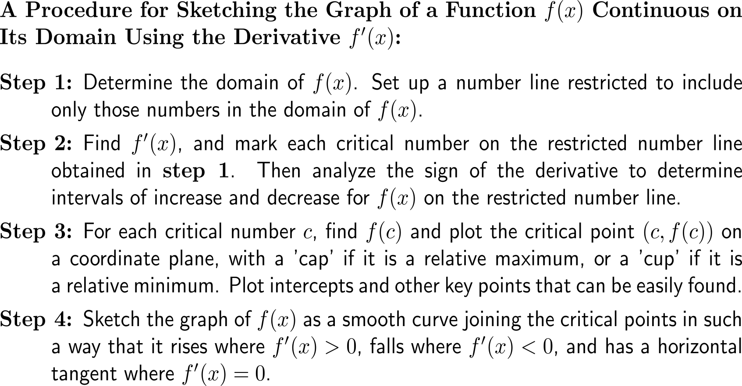
The 1st derivatives gives good information for sketching the graph of a function
‘cap’
‘cup’

Slide 18
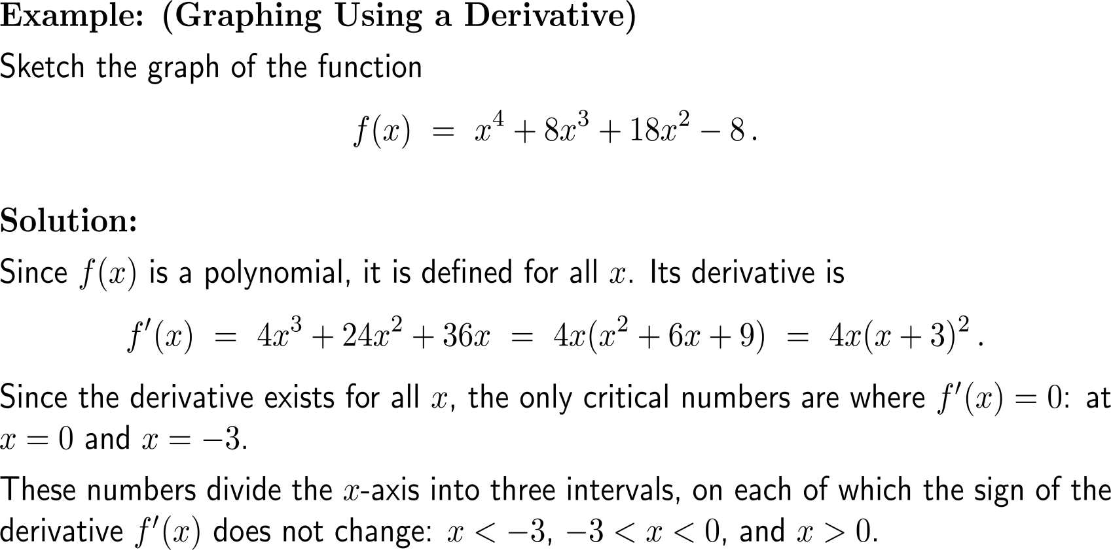
Example:
Graphing using a derivative

Slide 19
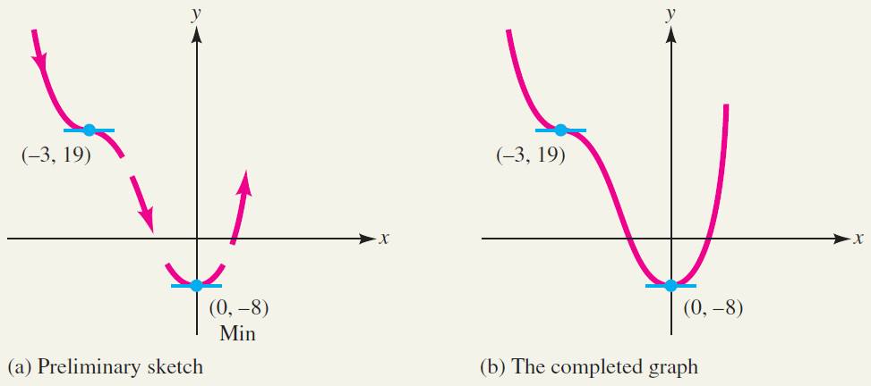
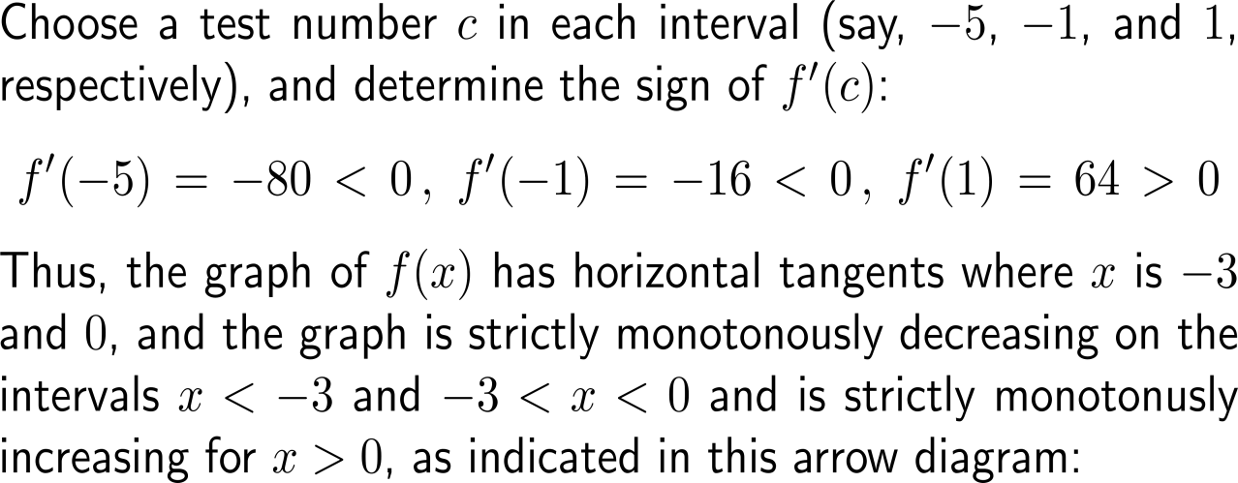
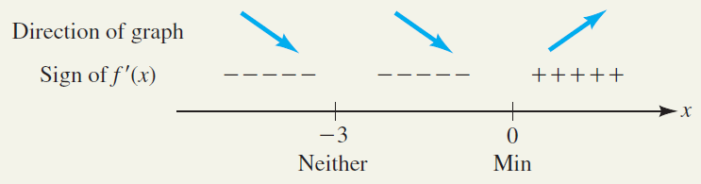
Example:
Graphing using a derivative

Slide 20

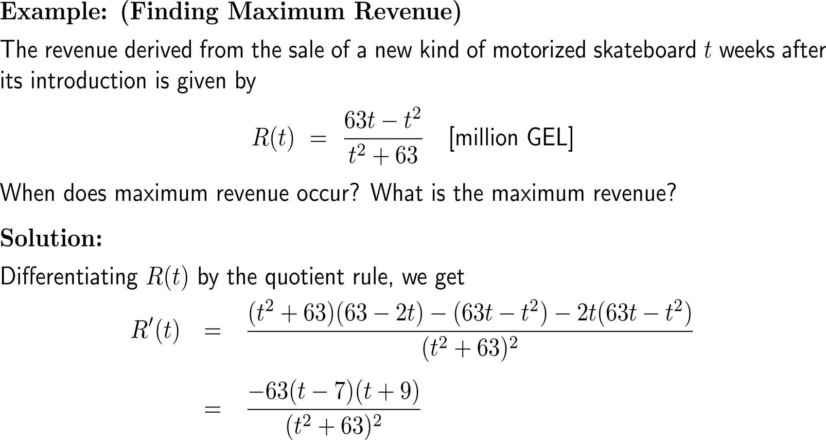
Example:
Finding maximum revenue

Slide 21
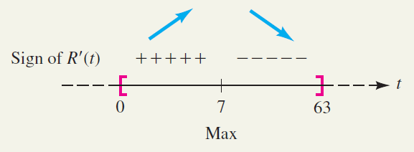
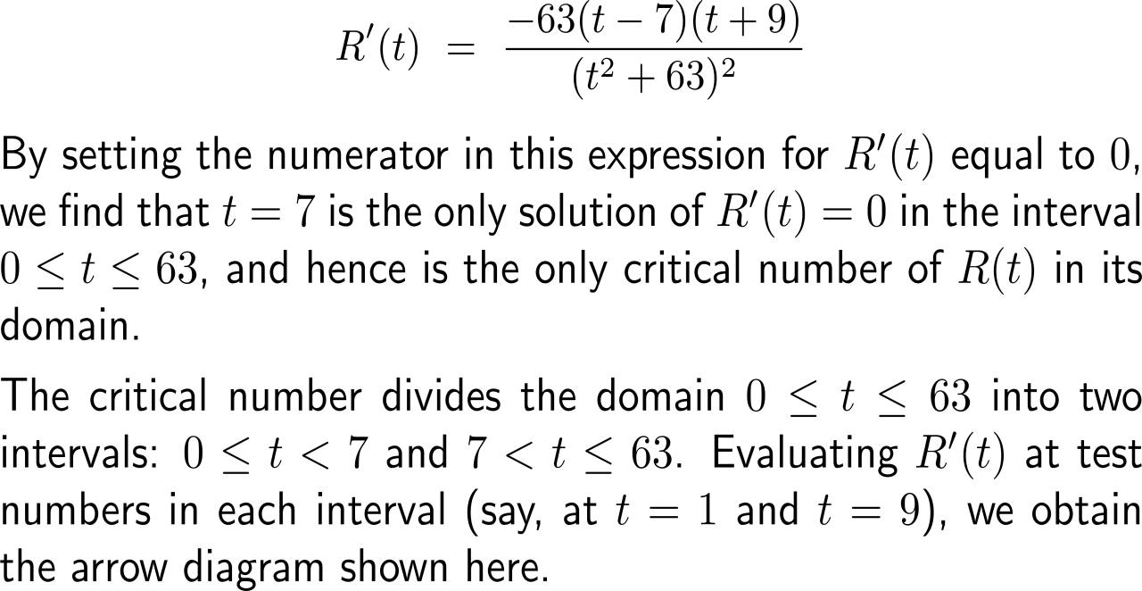

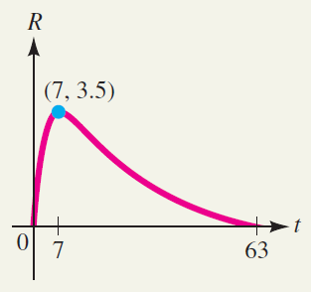
Example:
Finding maximum revenue

Slide 22
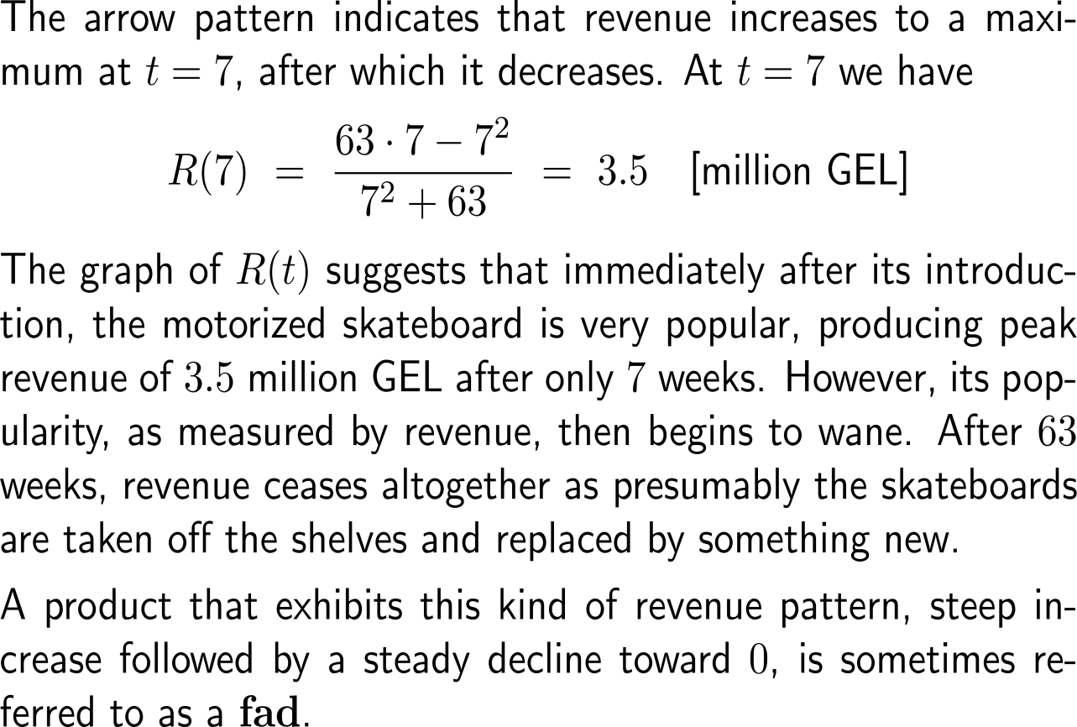
Example:
Finding maximum revenue

Slide 23
Calculus I for Management

