Slide 1
Calculus I for MGMT – Curves & Derivatives
Horizontal, Vertical & Slant Asymptotes
Mathematics for Management
Supplementary Electronic Materials
Connecting the Properties of Curves with Derivatives
  Increasing/ Decreasing Functions & Relative Extrema
  Concavity and Points of Inflection
  Horizontal, Vertical & Slant Asymptotes

Slide 2
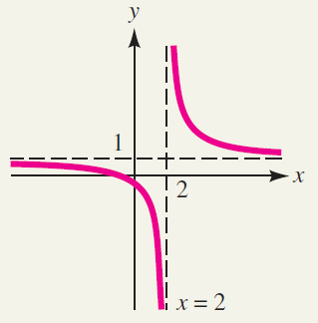
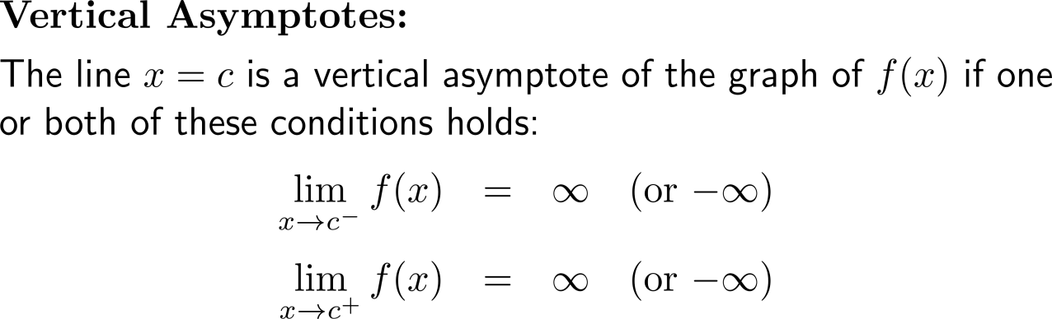
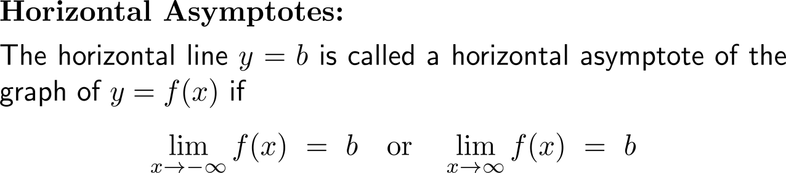

We already discussed vertical and horizontal asymptotes
vertical asymptote
horizontal
asymptote

Slide 3
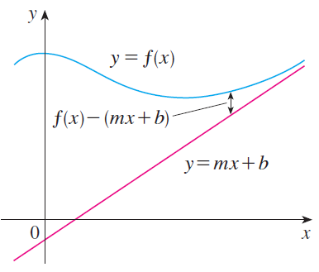
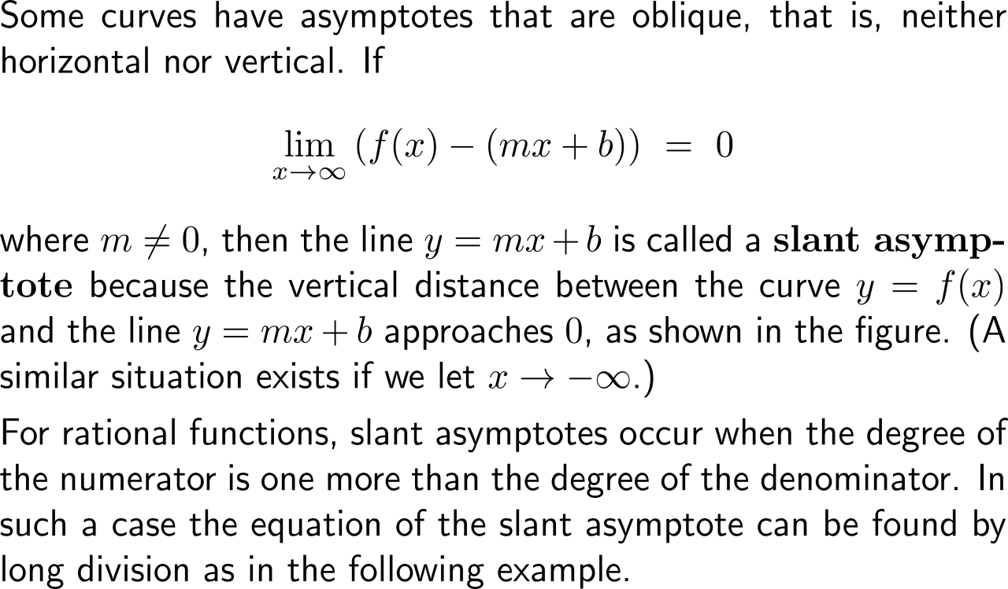
Besides horizontal and vertical asymptotes, slant asymptotes may occur in graphs and help to accurately sketch the behavior of a curve

Slide 4
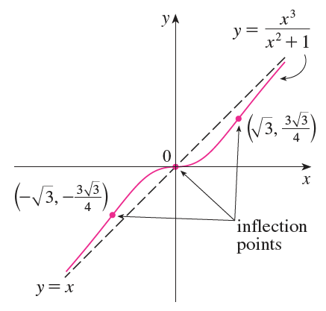
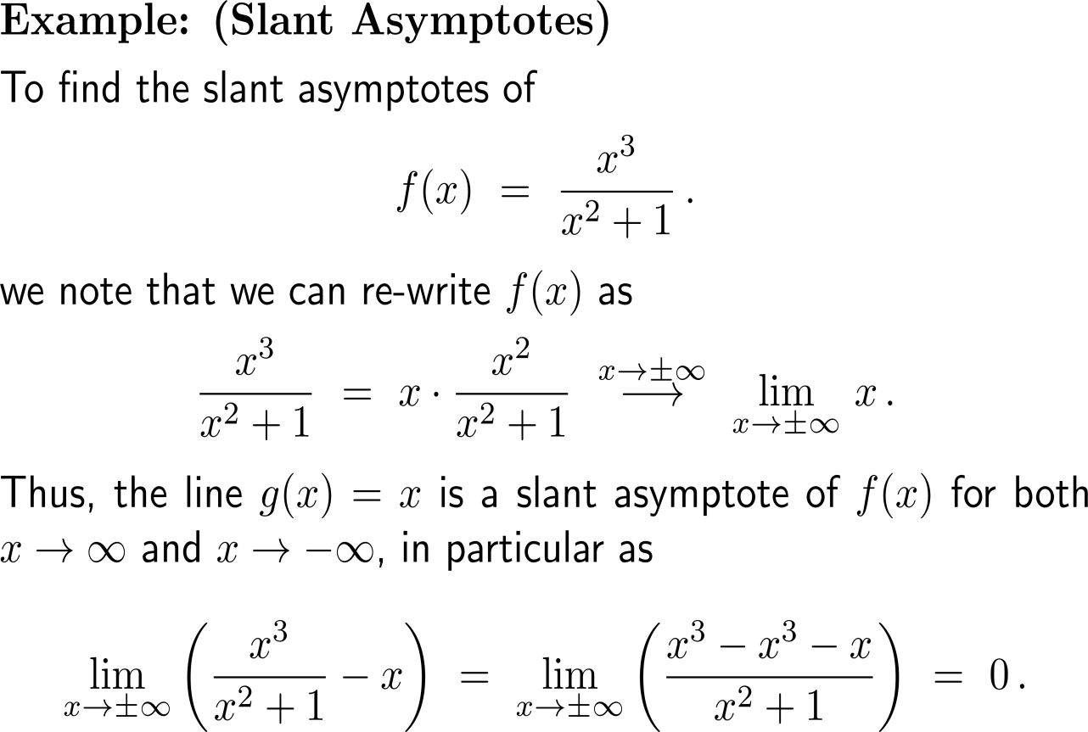
Example:
Finding slant asymptotes

Slide 5
Calculus I for Management

