Slide 1
Calculus I for MGMT – Curves & Optimization Curve Sketching & Optimization
Mathematics for Management
Supplementary Electronic Materials
Curve Sketching & Optimization
Summary of Curve Sketching
Optimization, Marginal Analysis & Elasticity

Slide 2
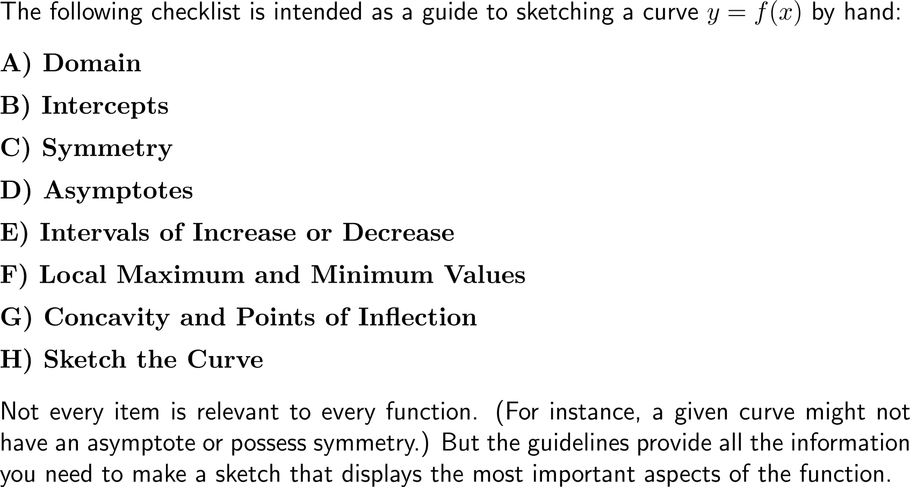
Sketching a curve can be systematically done by following a list of straightforward guidelines
A
B
C
H
D
G
F
E

Slide 3
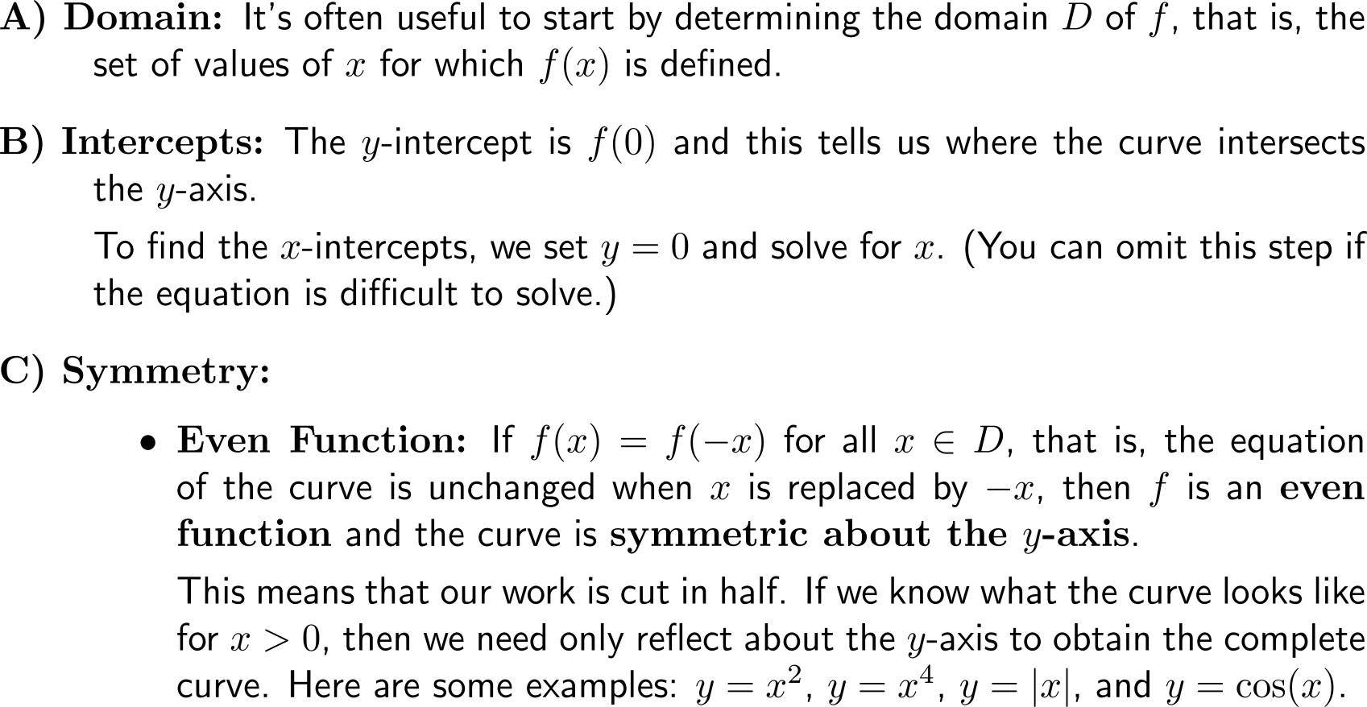
Curve sketching guidelines (1a/ 4)
A
B
C
H
D
G
F
E

Slide 4
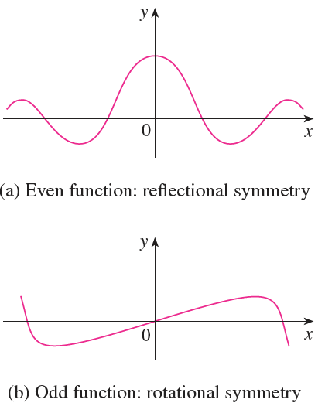
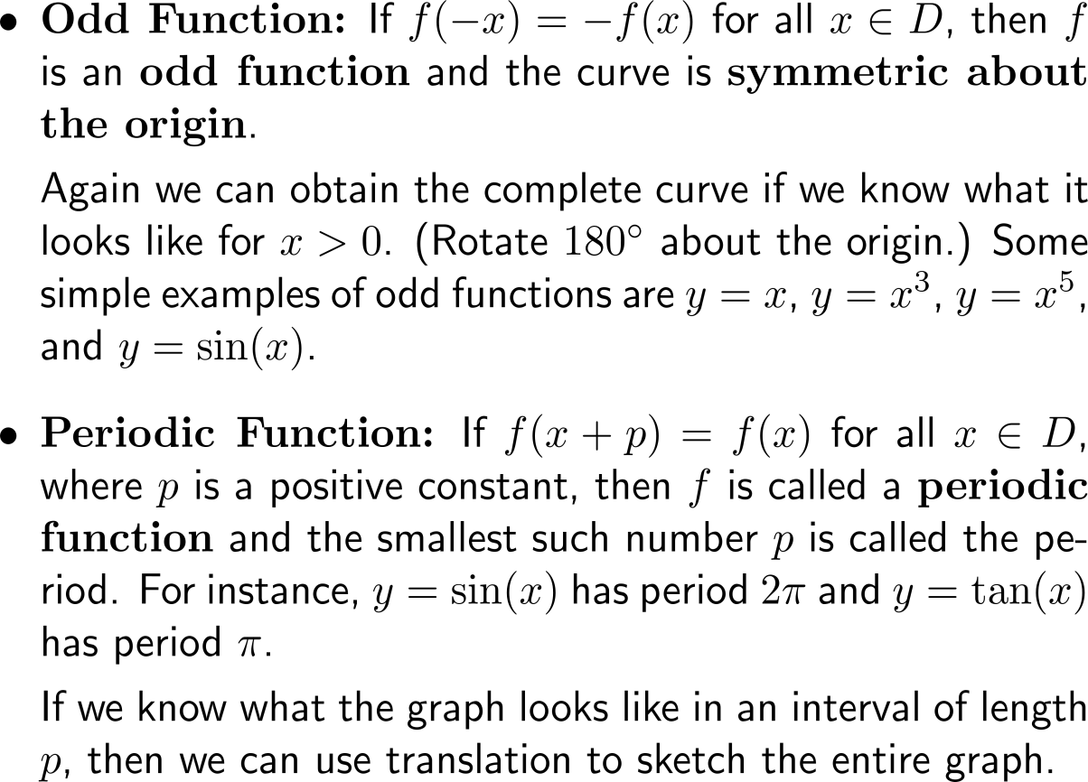
Curve sketching guidelines (1b/ 4)

Slide 5
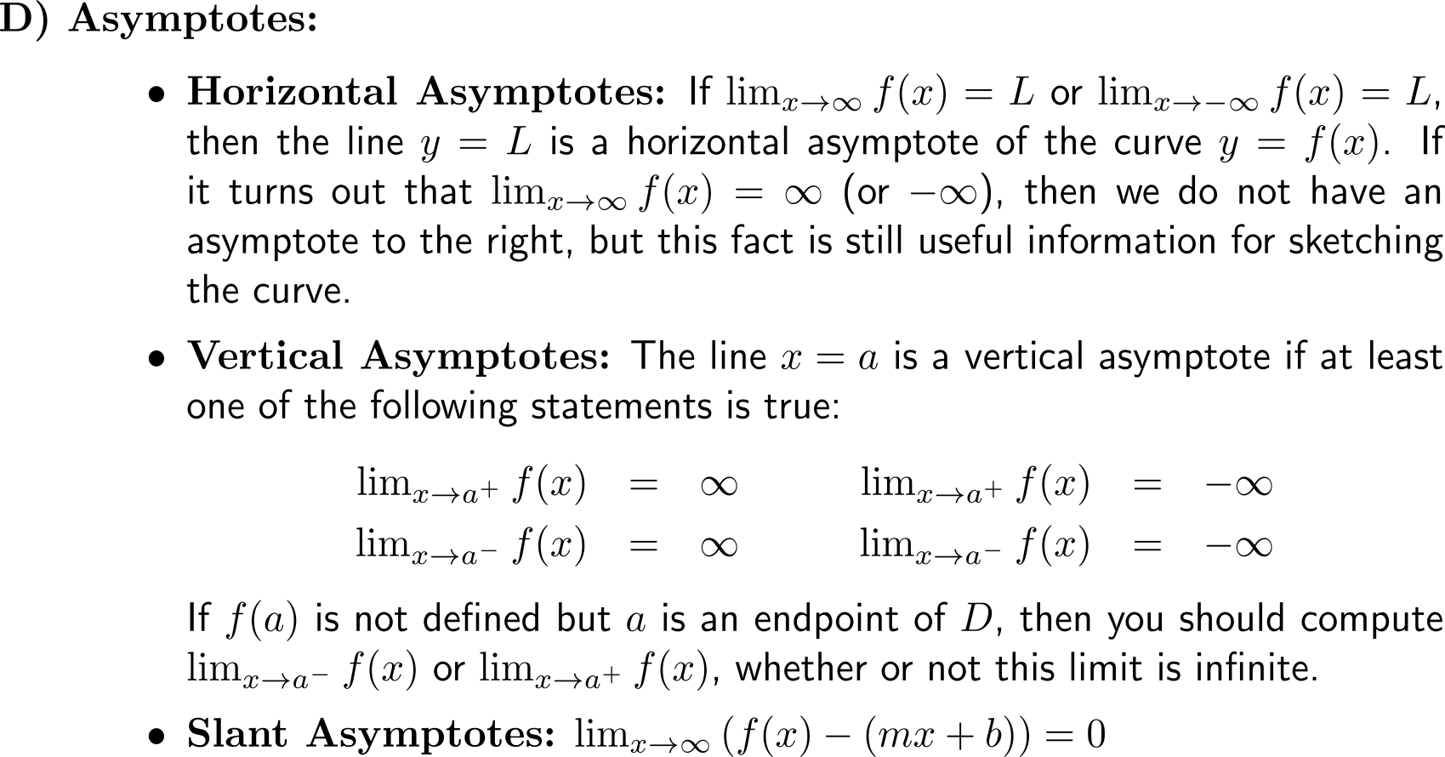
Curve sketching guidelines (2/ 4)
A
B
C
H
D
G
F
E

Slide 6
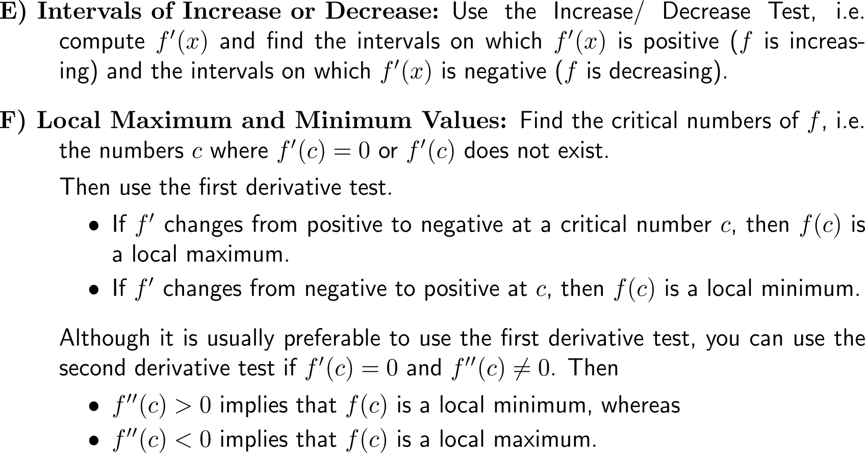
Curve sketching guidelines (3/ 4)
A
B
C
H
D
G
F
E

Slide 7
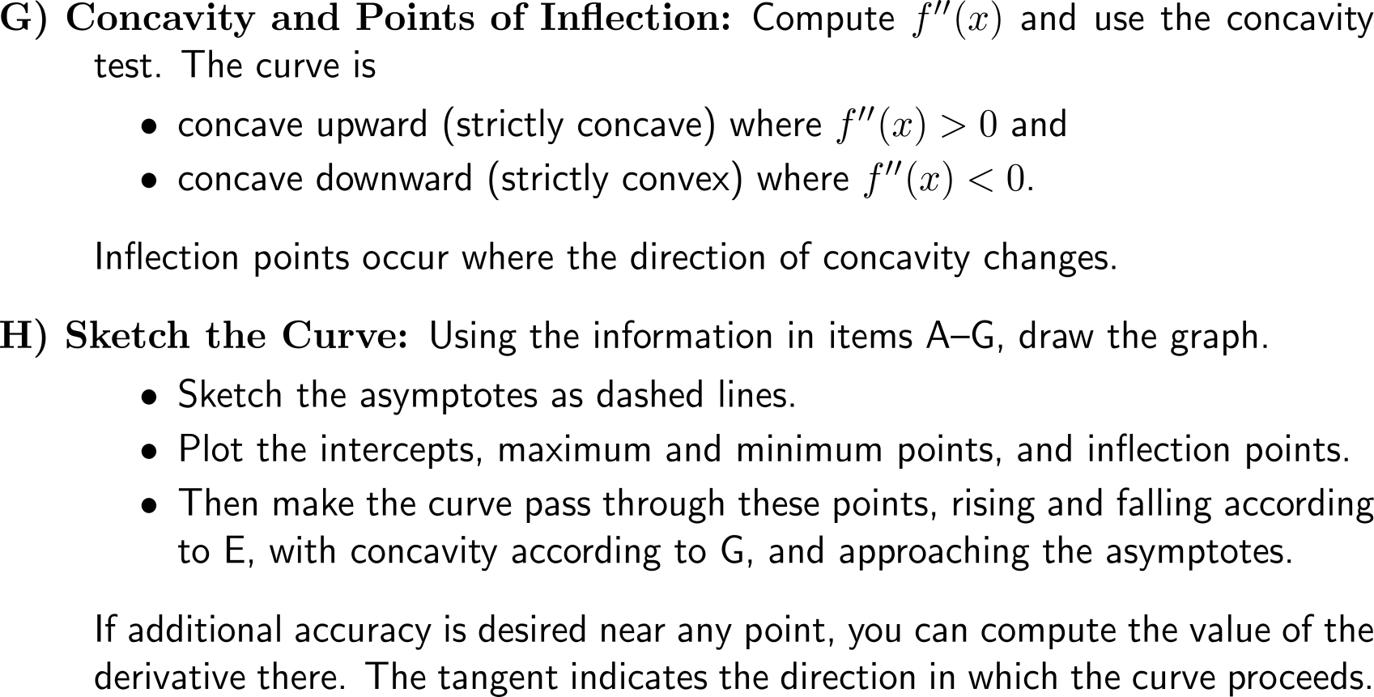
Curve sketching guidelines (4/ 4)
A
B
C
H
D
G
F
E

Slide 8
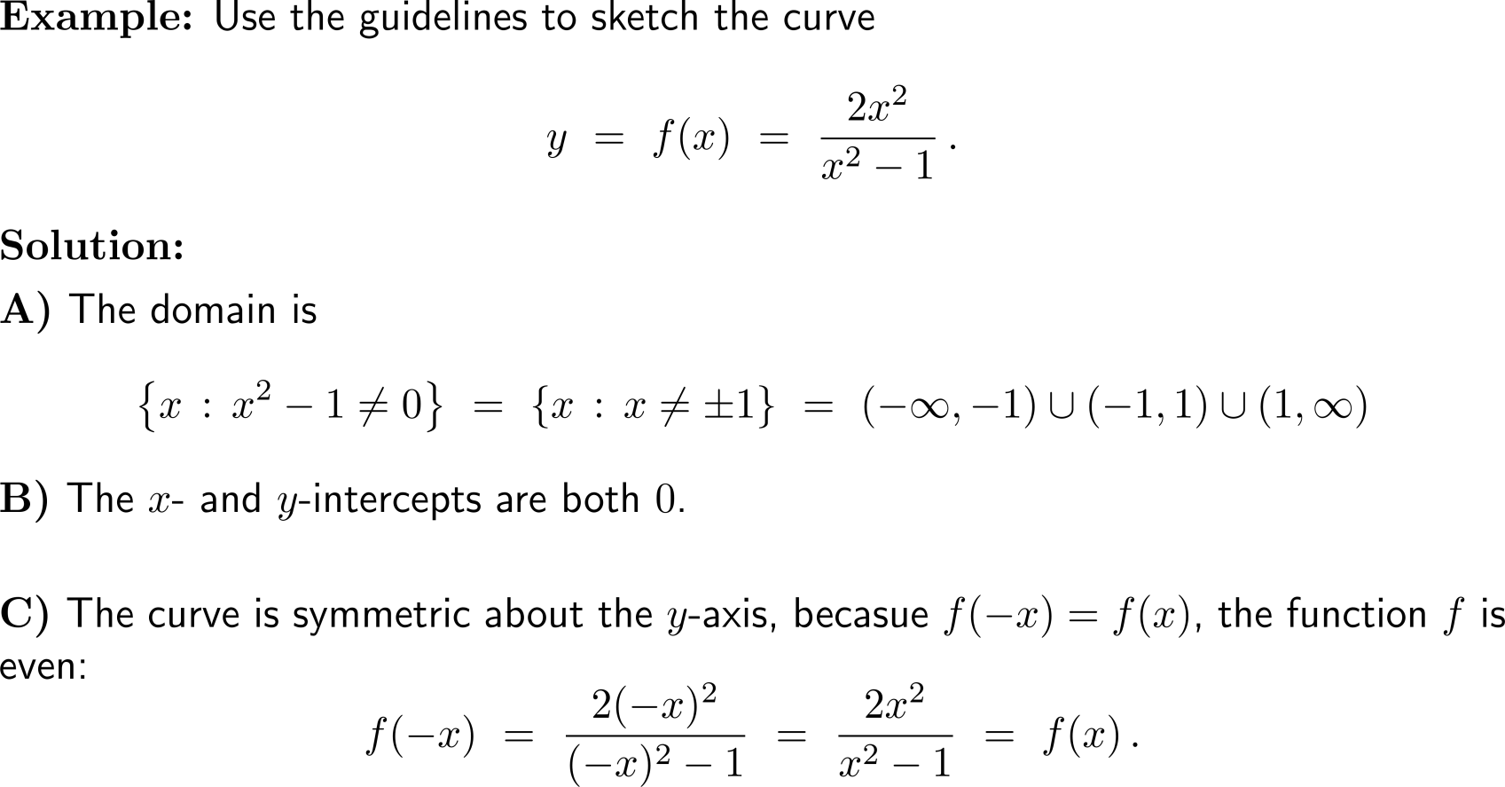
Example: Applying the guidelines of curve sketching
A
B
C

Slide 9
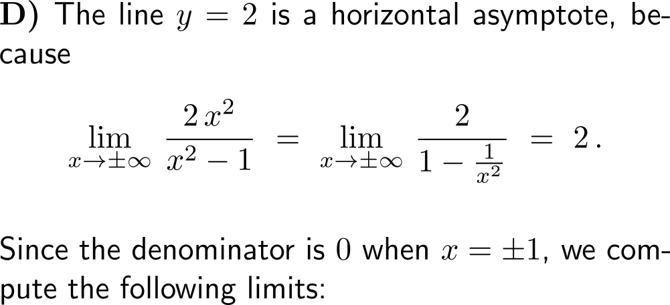
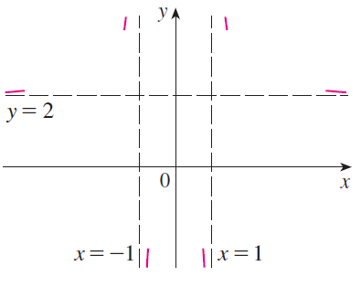
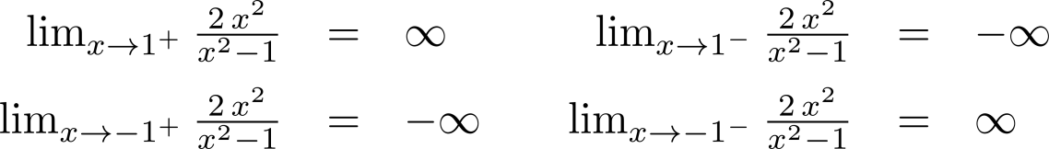

Example: Applying the guidelines of curve sketching
D

Slide 10
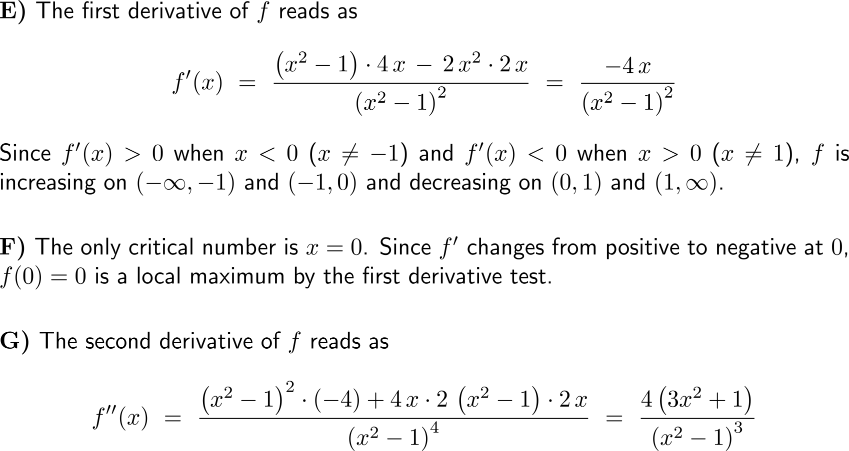
Example: Applying the guidelines of curve sketching
E
F
G

Slide 11
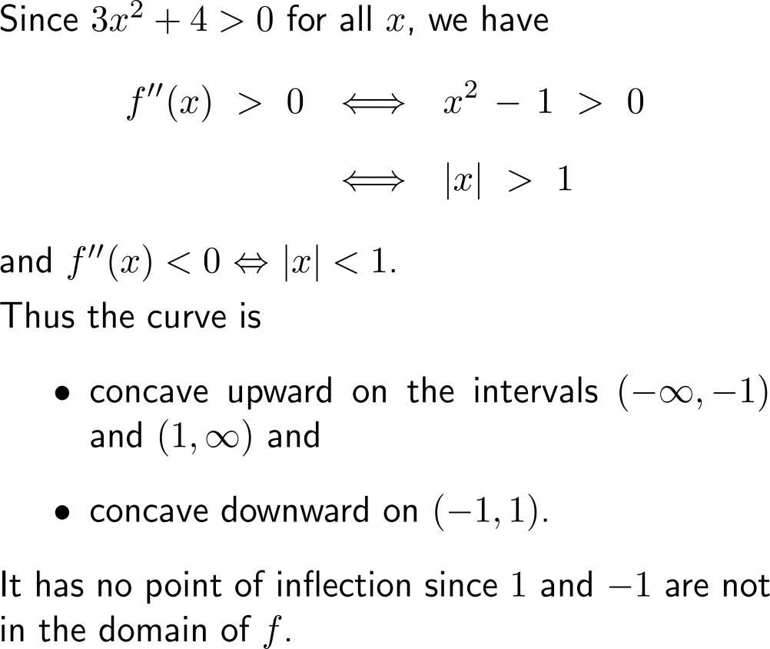
Example: Applying the guidelines of curve sketching
concave upward
concave upward
local maximum
concave downward

Slide 12
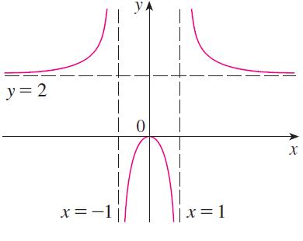
Example: Applying the guidelines of curve sketching
H

Slide 13
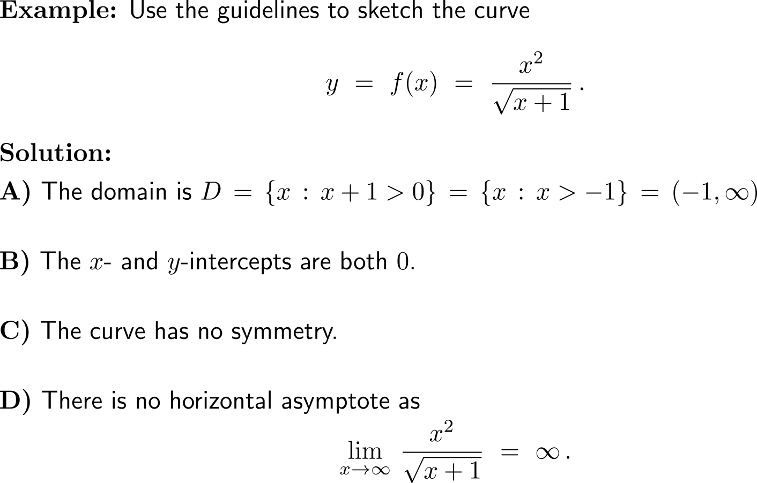
Example: Applying the guidelines of curve sketching
A
B
C
D

Slide 14
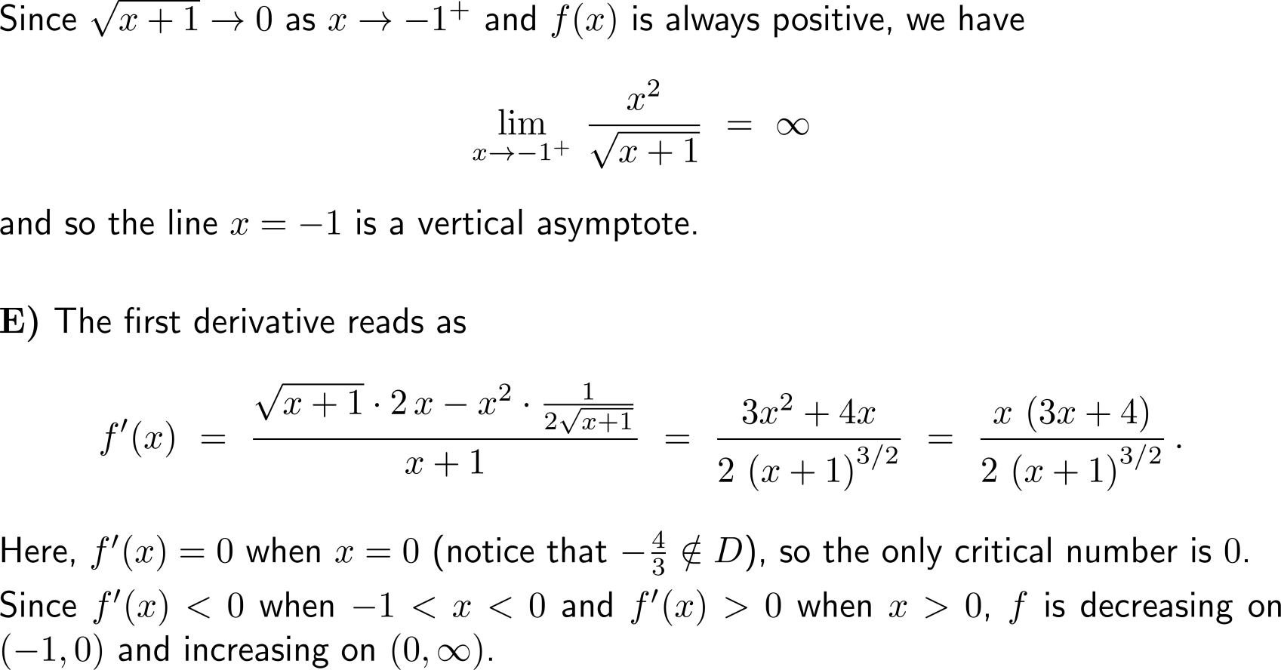
Example: Applying the guidelines of curve sketching
E

Slide 15
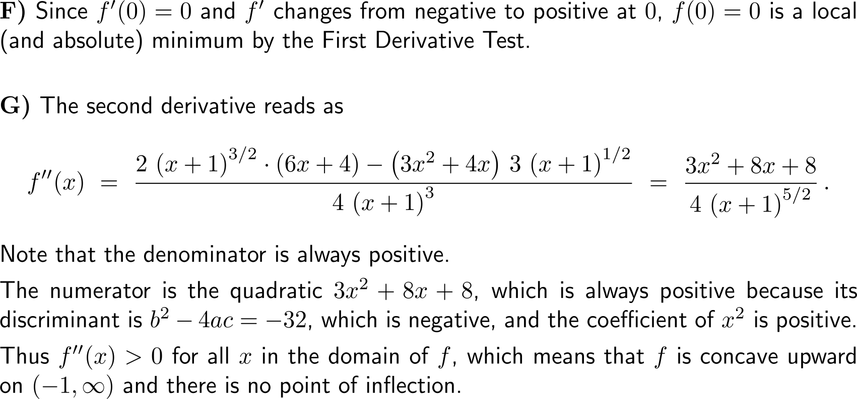
Example: Applying the guidelines of curve sketching
F
G

Slide 16
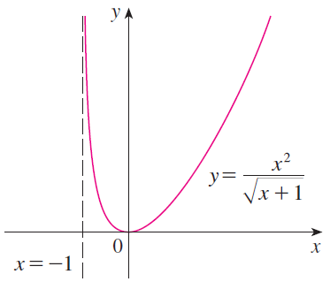
Example: Applying the guidelines of curve sketching
H

Slide 17
Calculus I for Management

