Slide 1
Calculus I for Management
Antiderivatives & Indefinite Integrals
week 11
Lecture
  Indefinite integration
  Integration yielding inverse trigonometric functions
  First rules of integration

Slide 2
Topics
  Indefinite Integration
  Integration yielding Inverse Trigonometric Functions
  First Rules of Integration

Slide 3
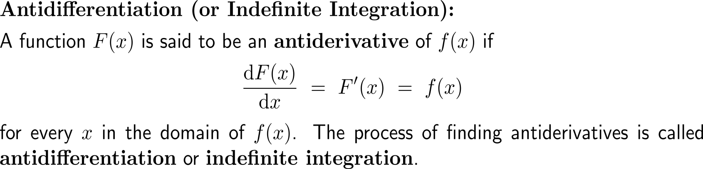
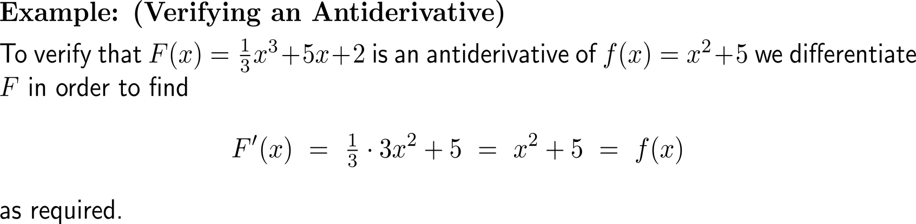
The antiderivative or indefinite integral of a function f(x) is a function F(x) such that F’(x) = f(x)

Slide 4
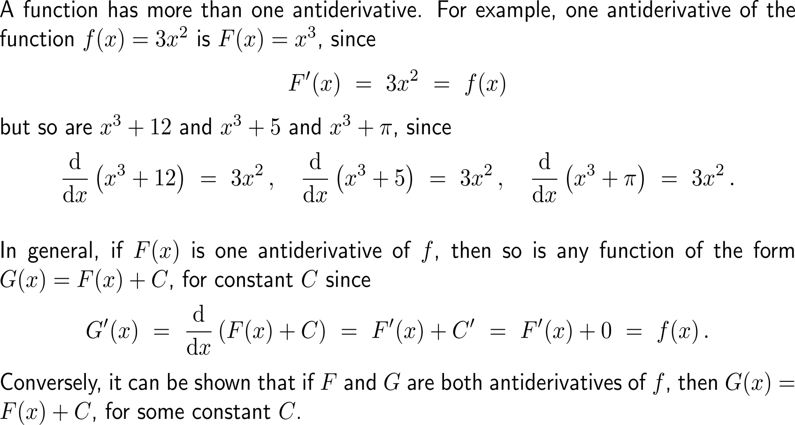
A function has a whole family of antiderivatives that differ by an additive constant from each other (1/ 3)

Slide 5
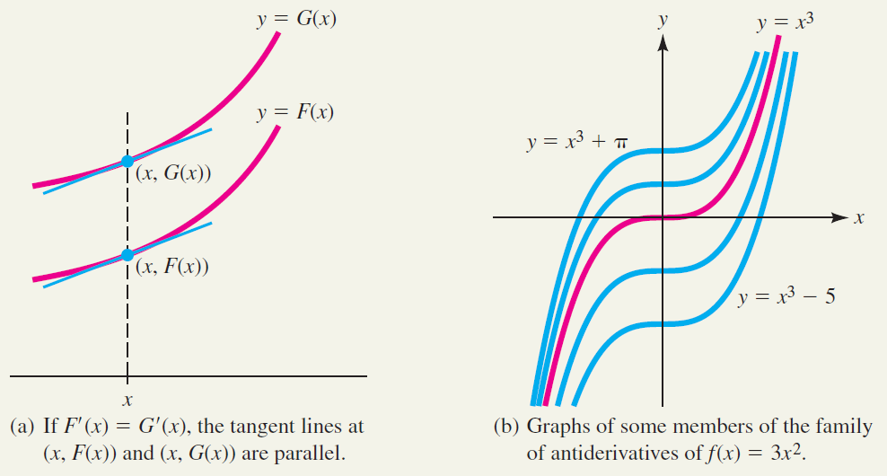
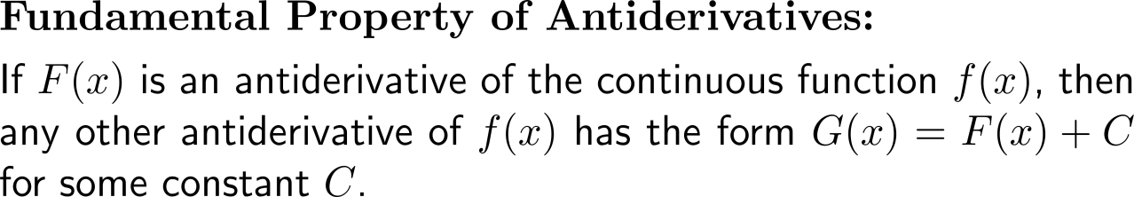
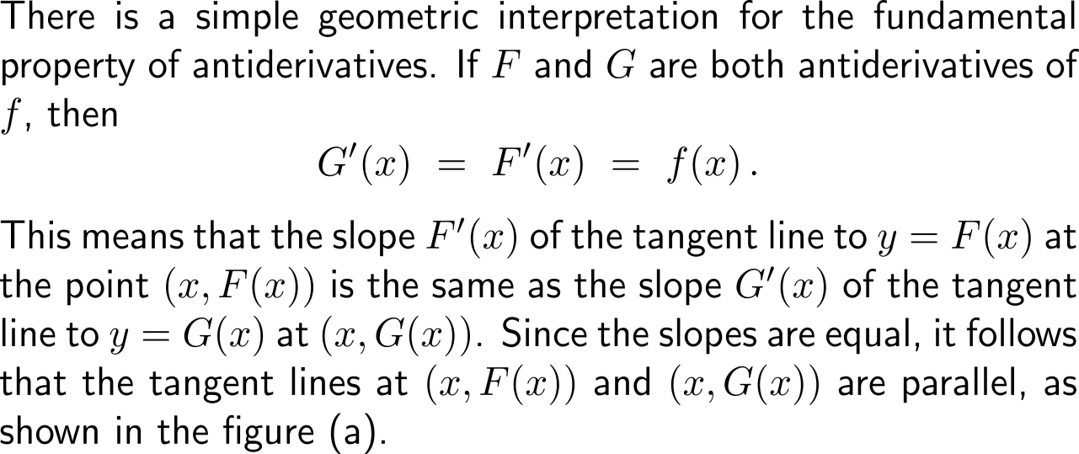
A function has a whole family of antiderivatives that differ by an additive constant from each other (2/ 3)

Slide 6
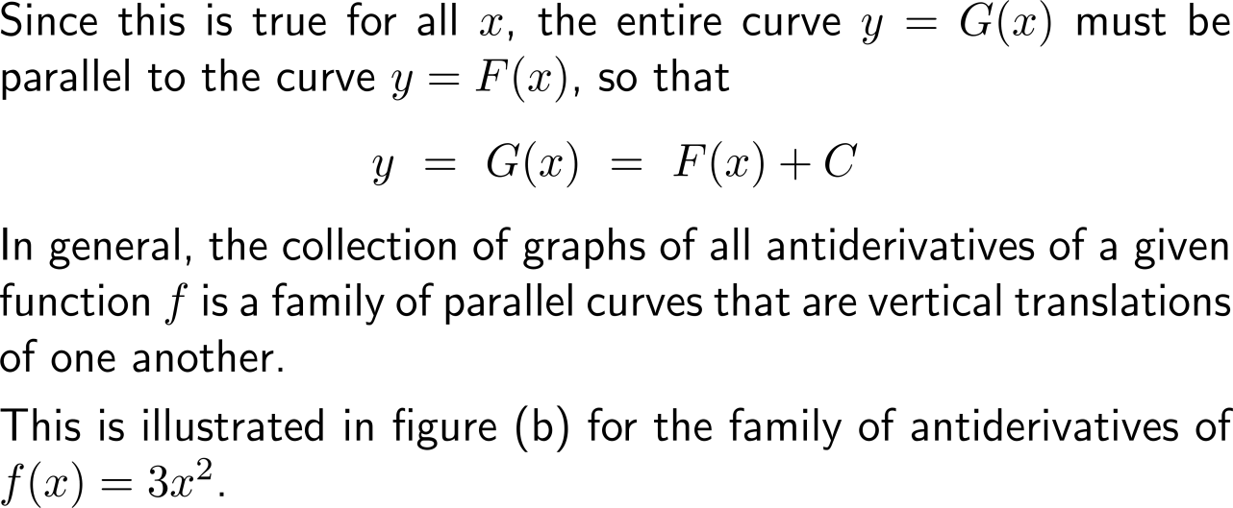
A function has a whole family of antiderivatives that differ by an additive constant from each other (3/ 3)

Slide 7
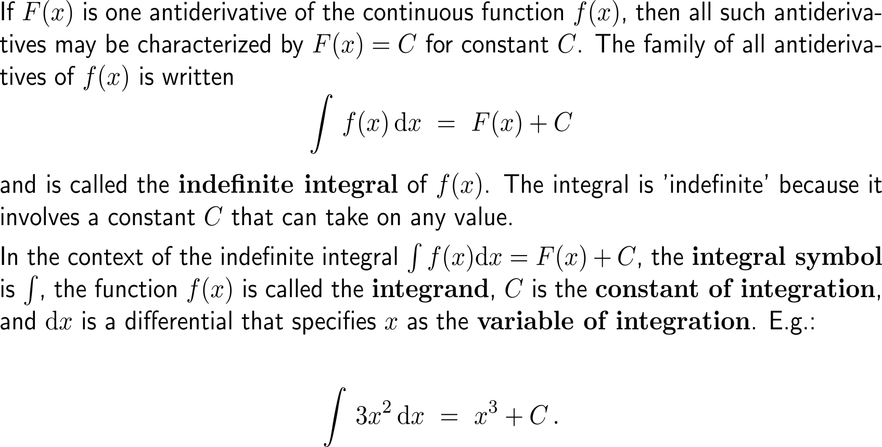
An indefinite integral consist of the integral symbol, an integrand, and the differential symbol dx indicating the variable x of integration
integrand
constant of integration
integral symbol
variable of integration

Slide 8
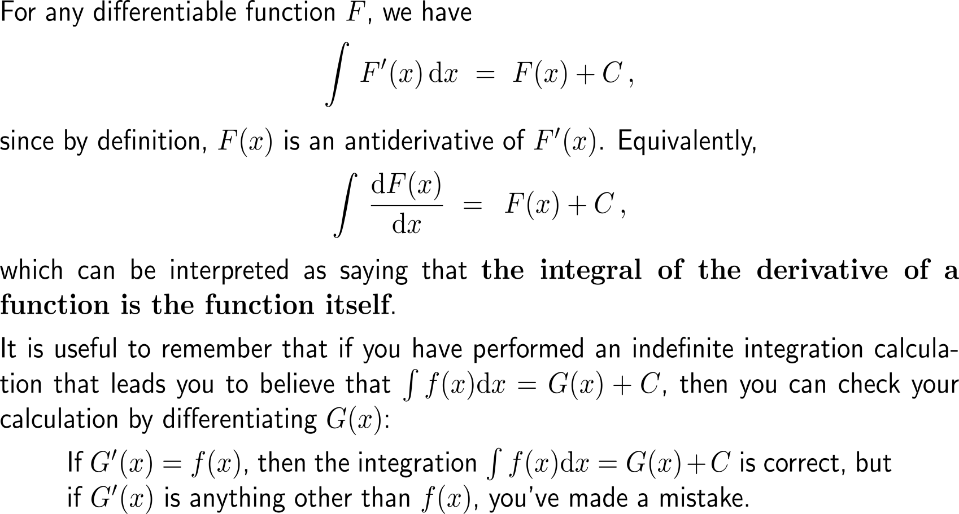
The integral of the derivative of a function is the function itself

Slide 9
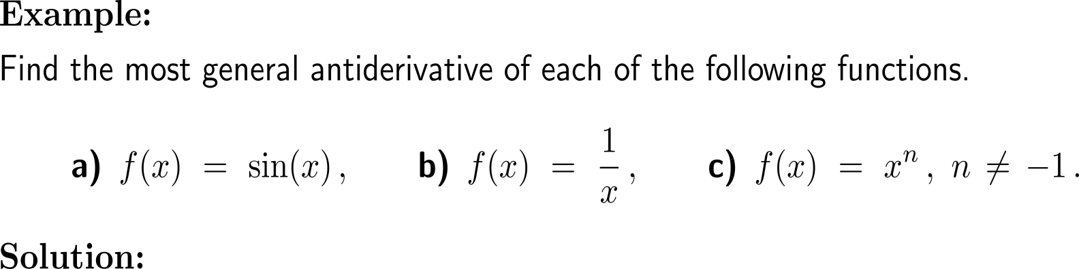
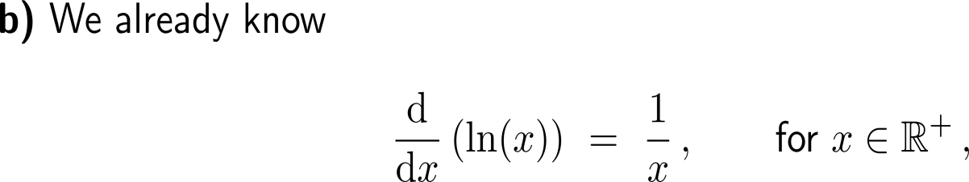
Example:
Determination of antiderivatives

Slide 10
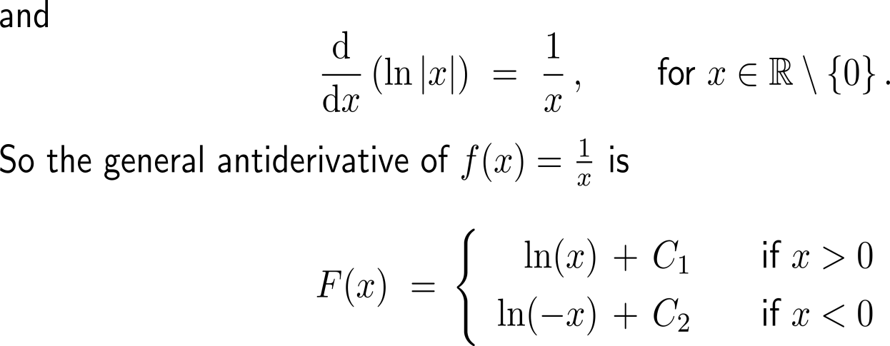
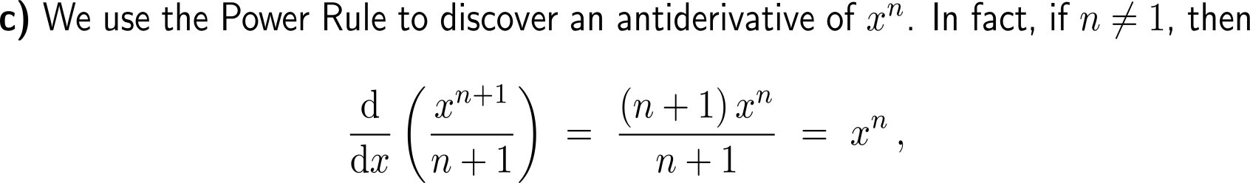
Example:
Determination of antiderivatives

Slide 11
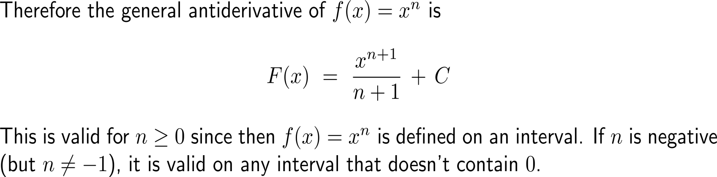
Example:
Determination of antiderivatives

Slide 12
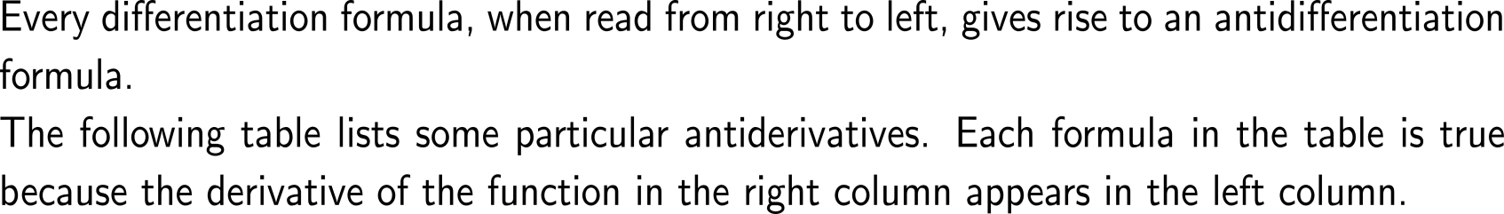
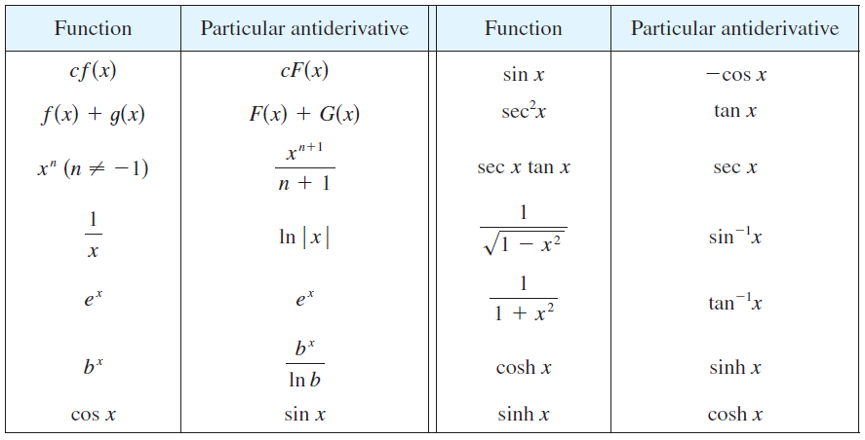

Every differentiation formula, when read from right to left, gives rise to an antidifferentiation formula
see
next section

Slide 13
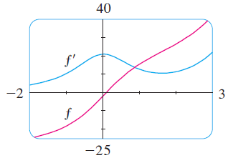
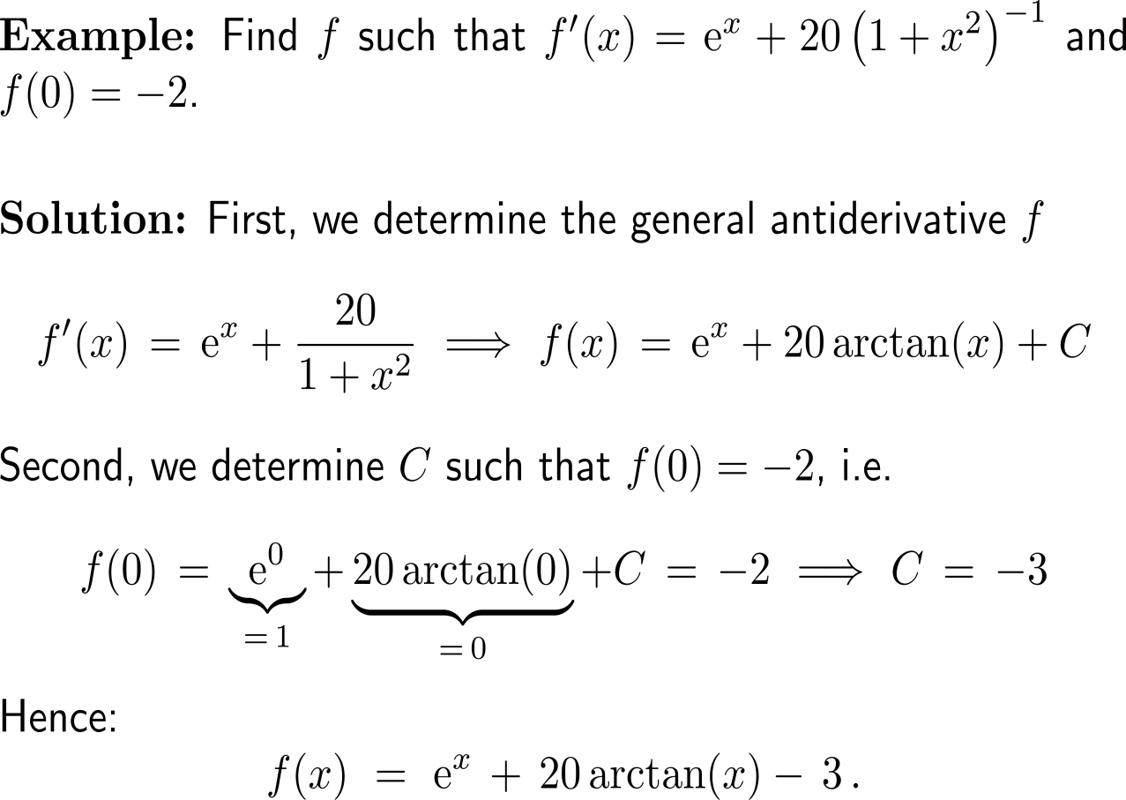
Example:
Determination of antiderivatives
Shown are the graphs of the function f’ and its antiderivative f.
Notice that f’(x) > 0, so f is always increasing. Also notice that when f has a maximum or minimum, f appears to have an inflection point.
So the graph serves as a check on our calculation.

Slide 14
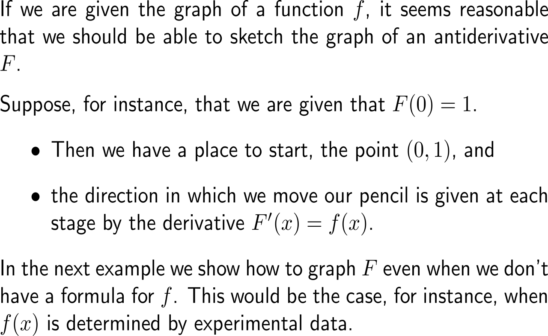
To round the discussion of antiderivatives, let us discuss the shape of the graph of an antiderivative, given the graph of the function
Shown are the graphs of the function f’ and its antiderivative f.
Notice that f’(x) > 0, so f is always increasing. Also notice that when f has a maximum or minimum, f appears to have an inflection point.
So the graph serves as a check on our calculation.

Slide 15
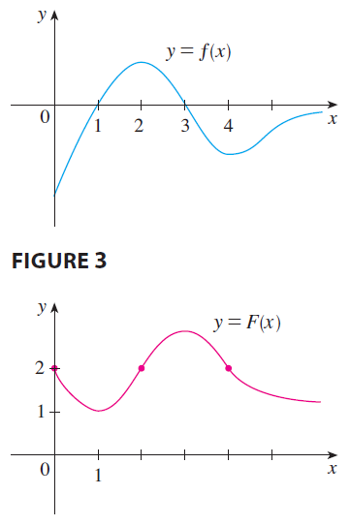
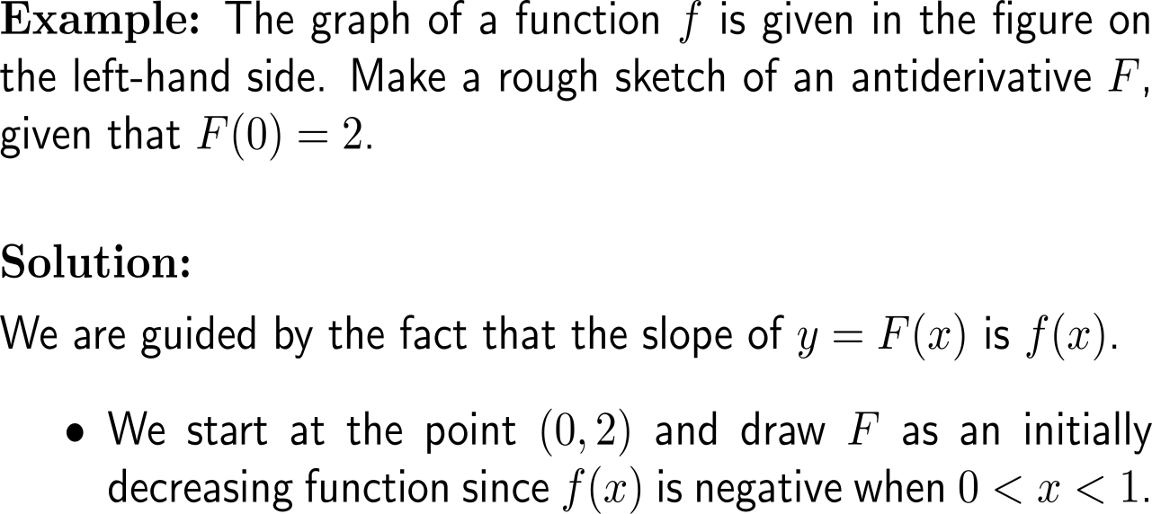
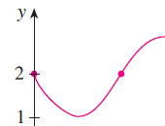
Example:
Determination of antiderivatives

Slide 16
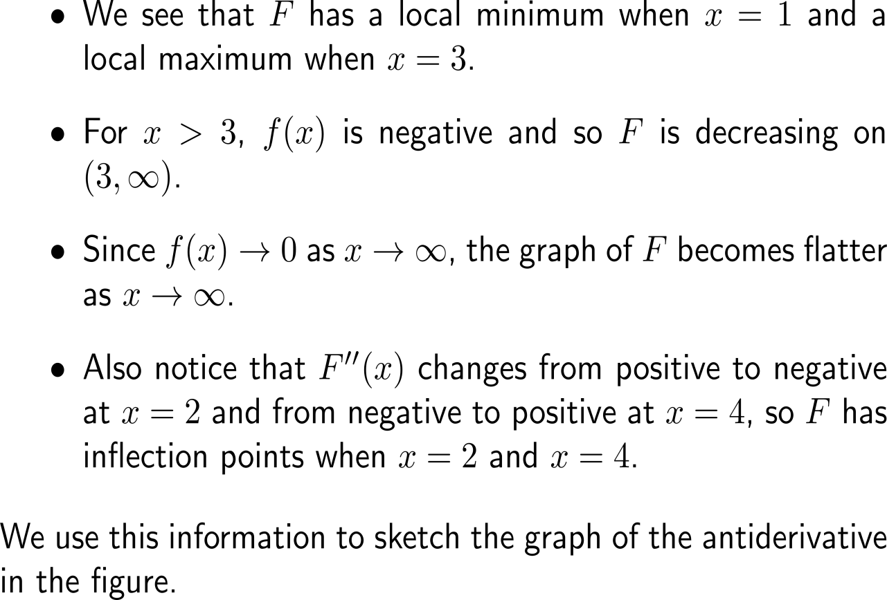
Example:
Determination of antiderivatives

Slide 17
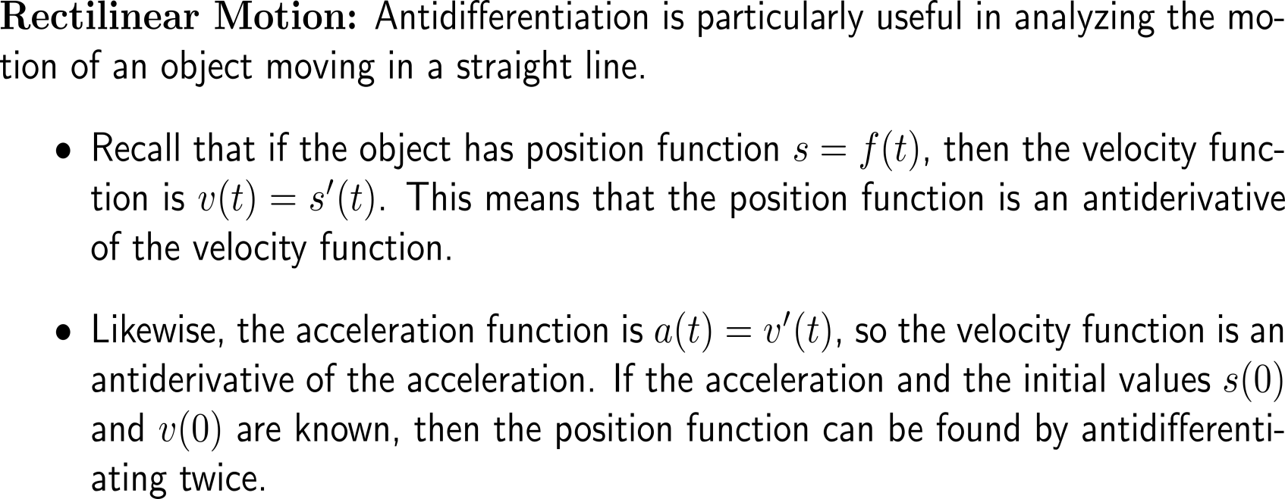
Antidifferentiation is particularly useful in analyzing the motion of an object moving in a straight line

Slide 18
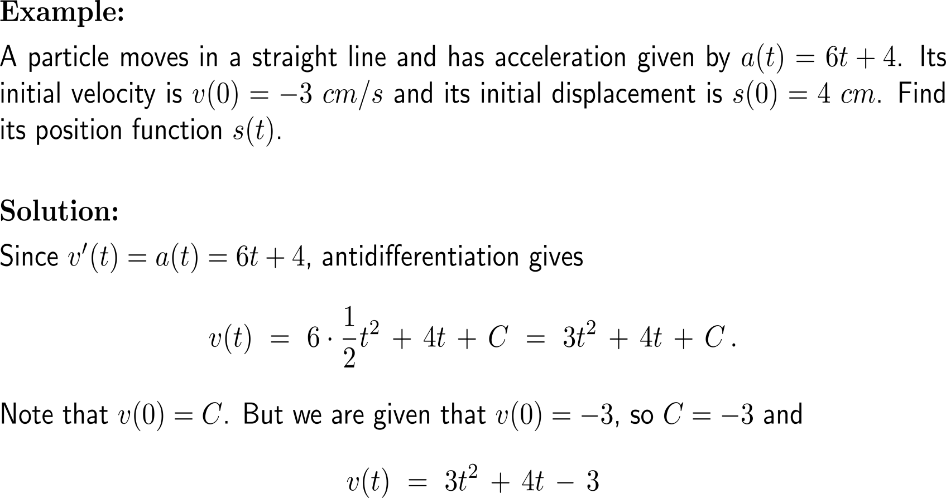
Example:
Antiderivatives and rectilinear motion

Slide 19
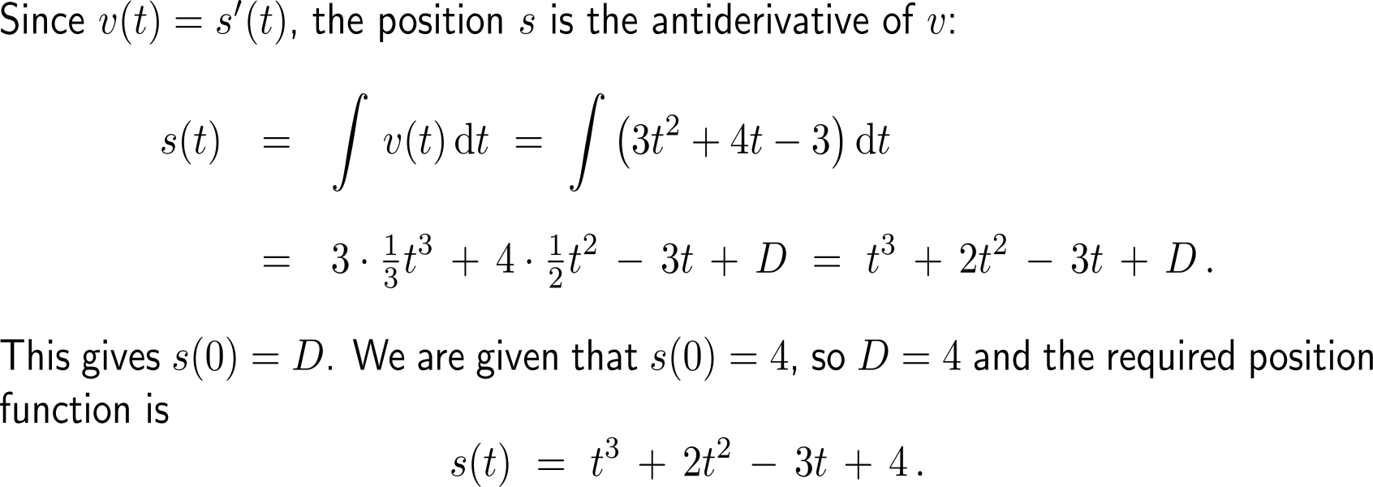
Example:
Antiderivatives and rectilinear motion

Slide 20
Topics
  Indefinite Integration
  Integration yielding Inverse Trigonometric Functions
  First Rules of Integration

Slide 21
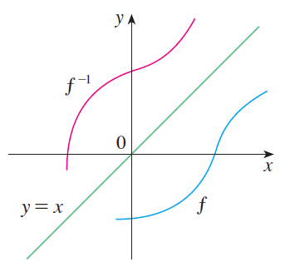
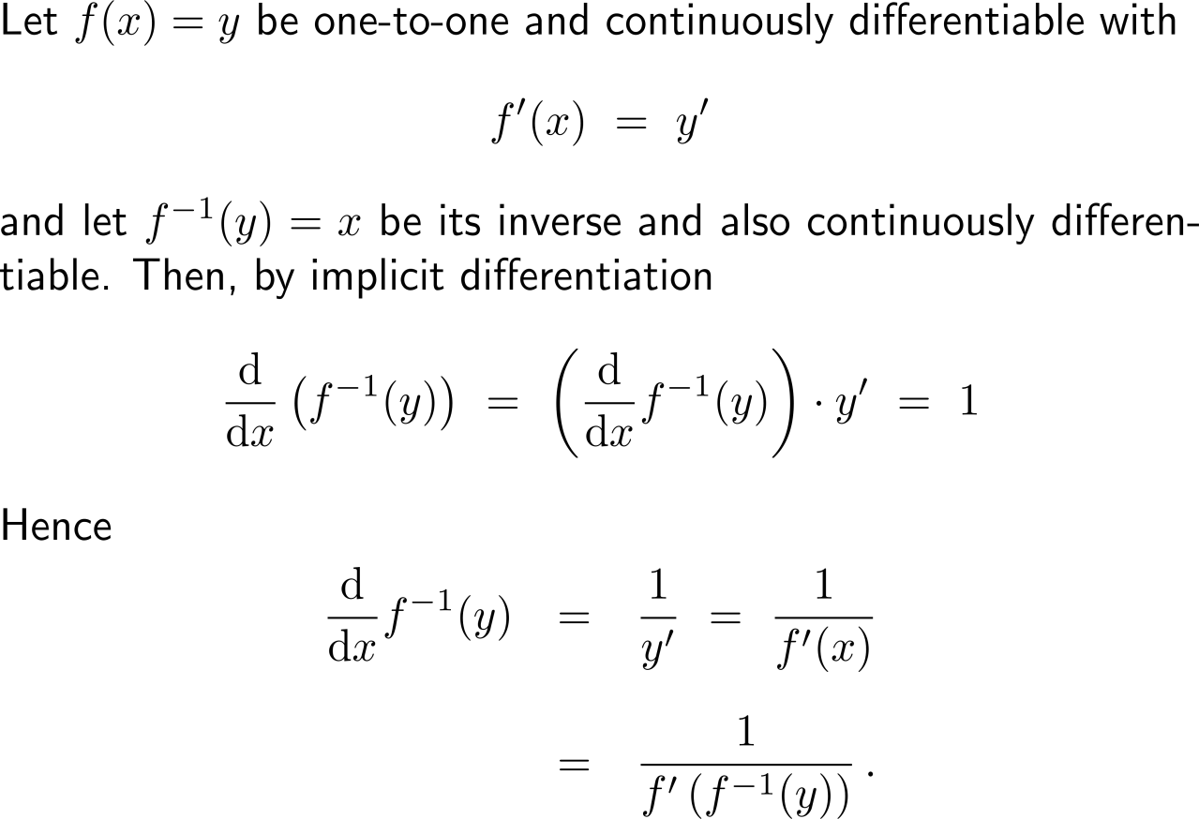
Recap:
Implicit differentiation of inverse functions

Slide 22
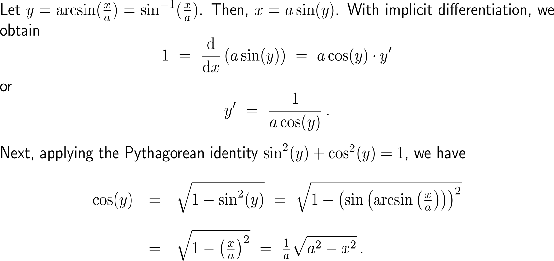
By determining the derivative of the inverse sine function …

Slide 23
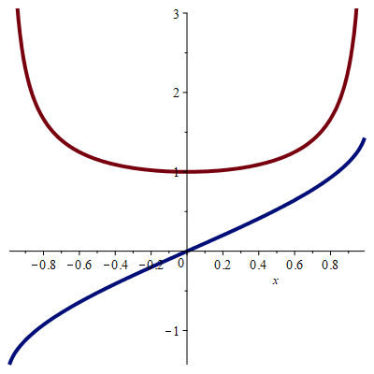

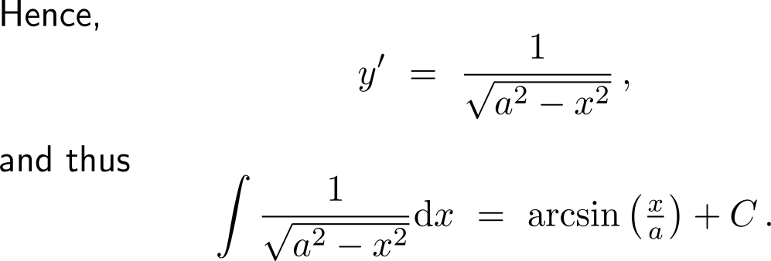
… we can apply this for integration

Slide 24
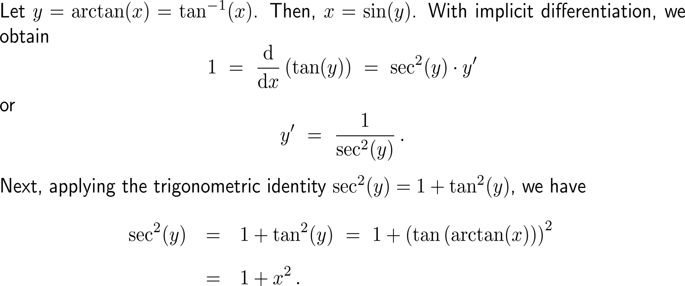
By determining the derivative of the inverse tangent function …

Slide 25
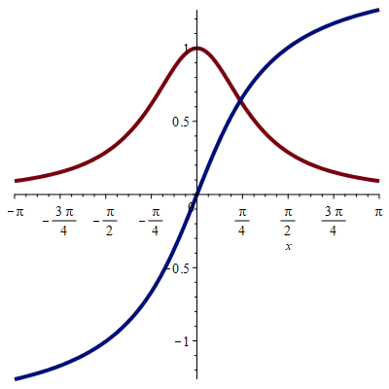
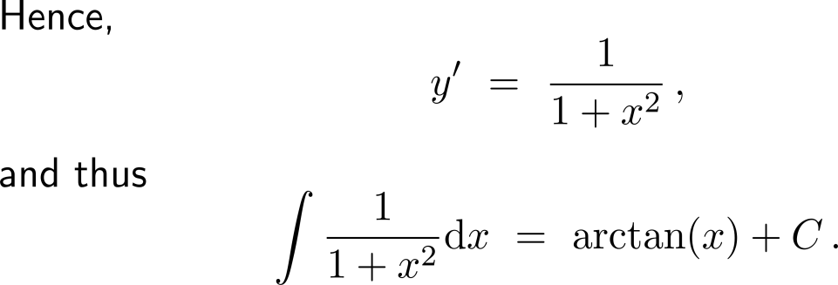

… we can apply this for integration

Slide 26
Topics
  Indefinite Integration
  Integration yielding Inverse Trigonometric Functions
  First Rules of Integration

Slide 27
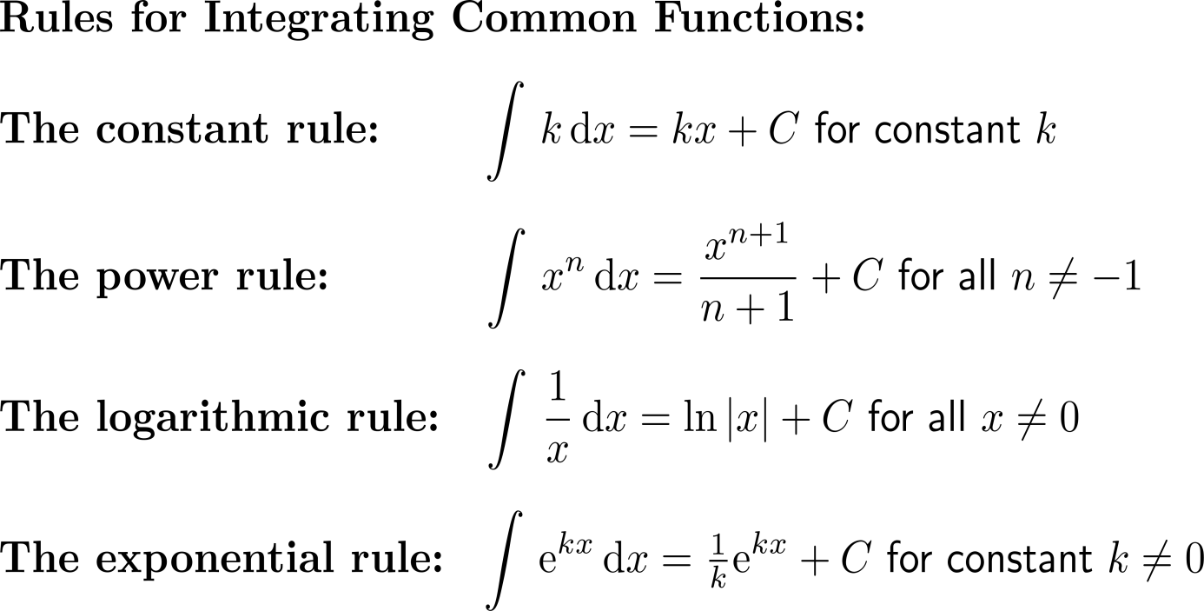
The relationship between differentiation and antidifferentiation enables us to establish integration rules by 'reversing' analogous differentiation rules

Slide 28
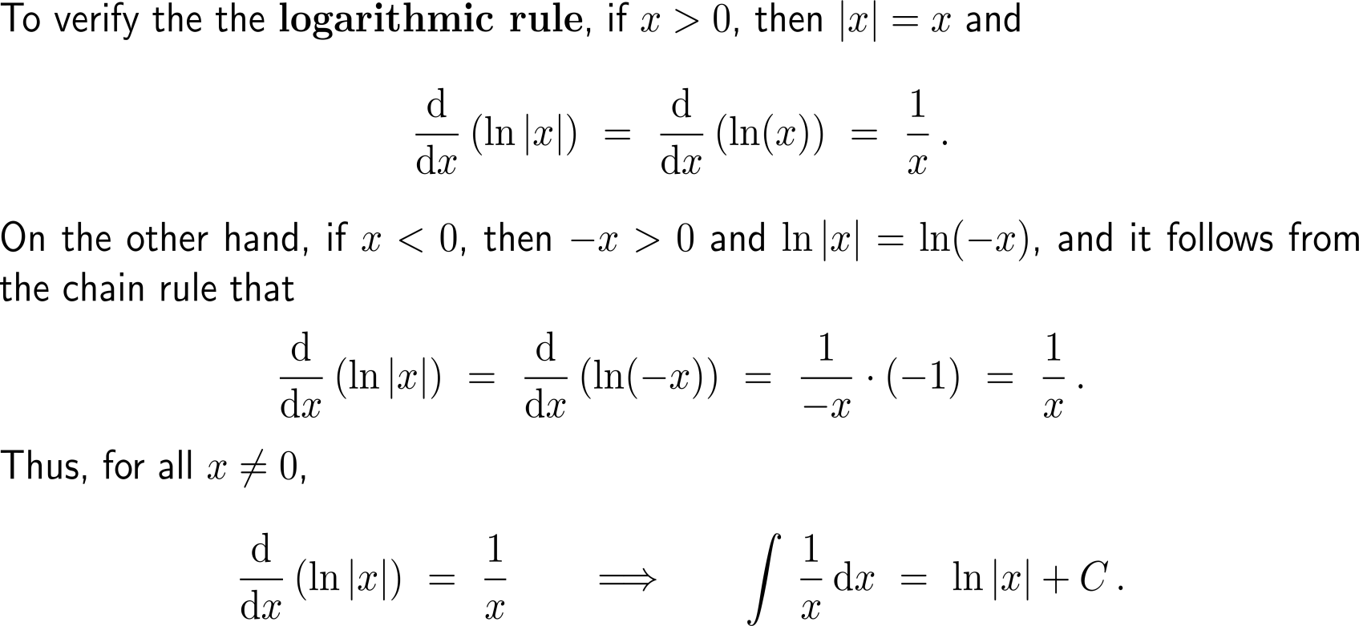
The verification of the logarithmic rule …

Slide 29
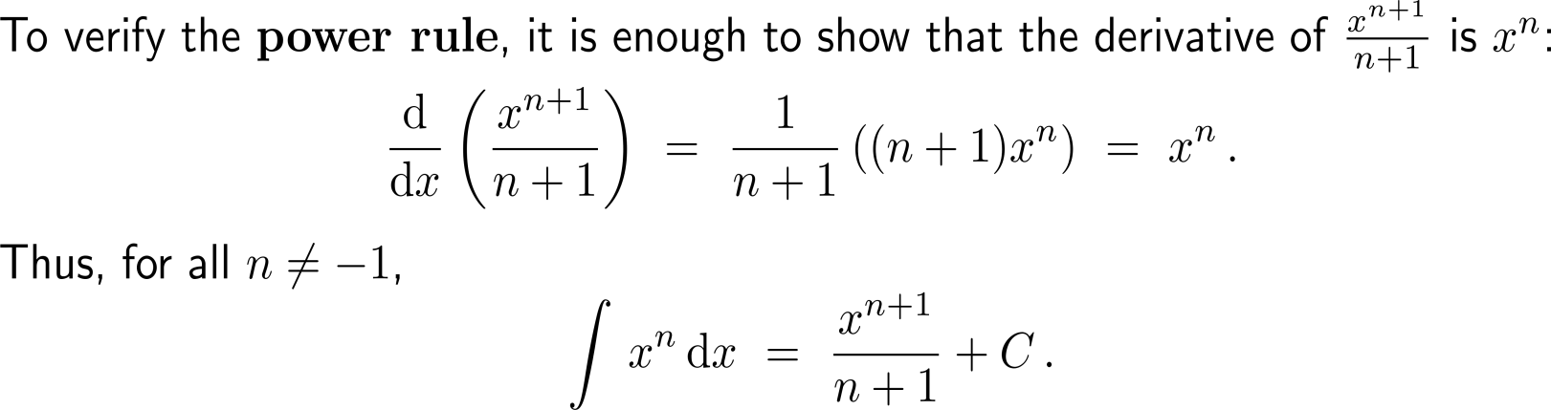
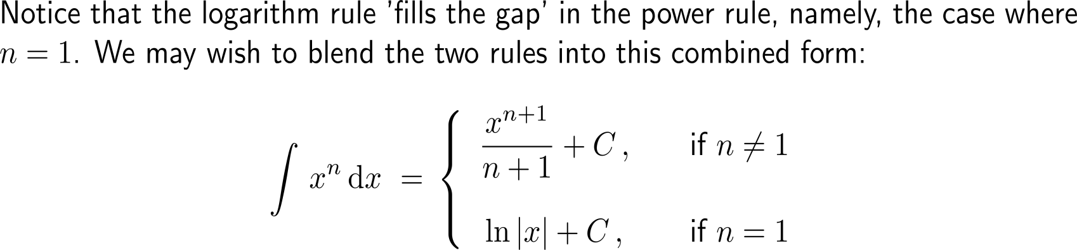
… and the power rule is straight forward

Slide 30
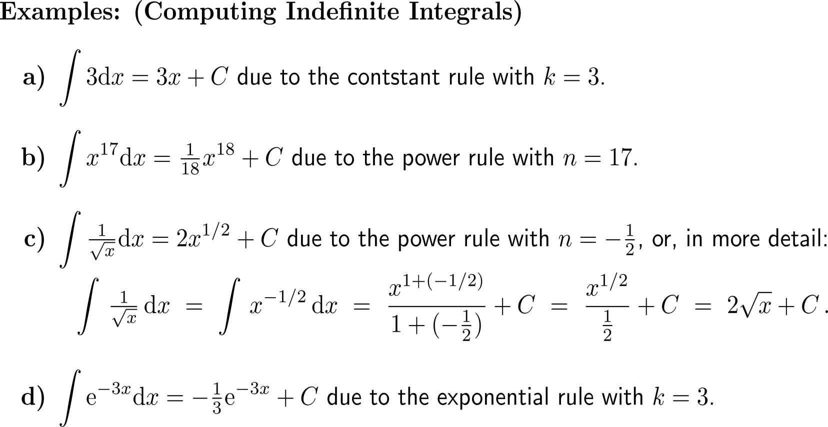
Examples:
Computing indefinite integrals

Slide 31
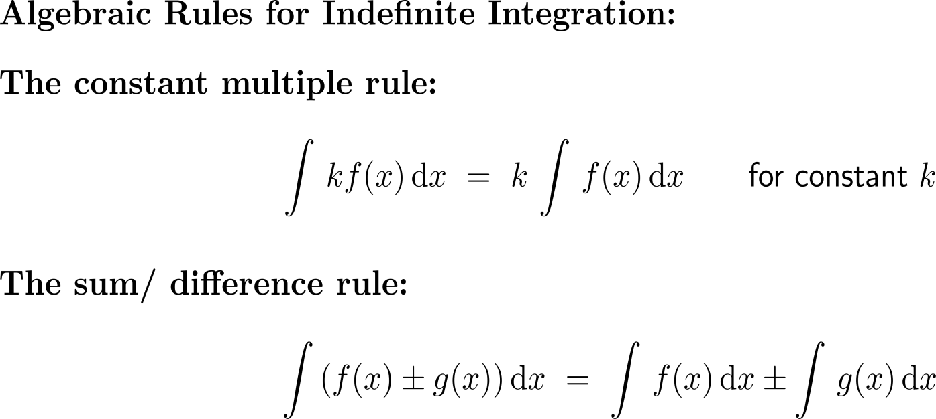
Algebraic rules for indefinite integrals allow the integration of a variety of combinations of functions

Slide 32
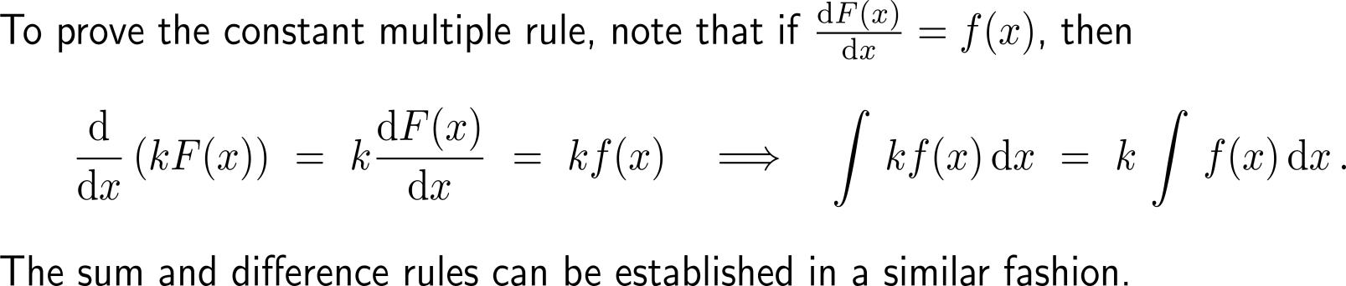
The algebraic rules for indefinite integrals are also easily verified

Slide 33
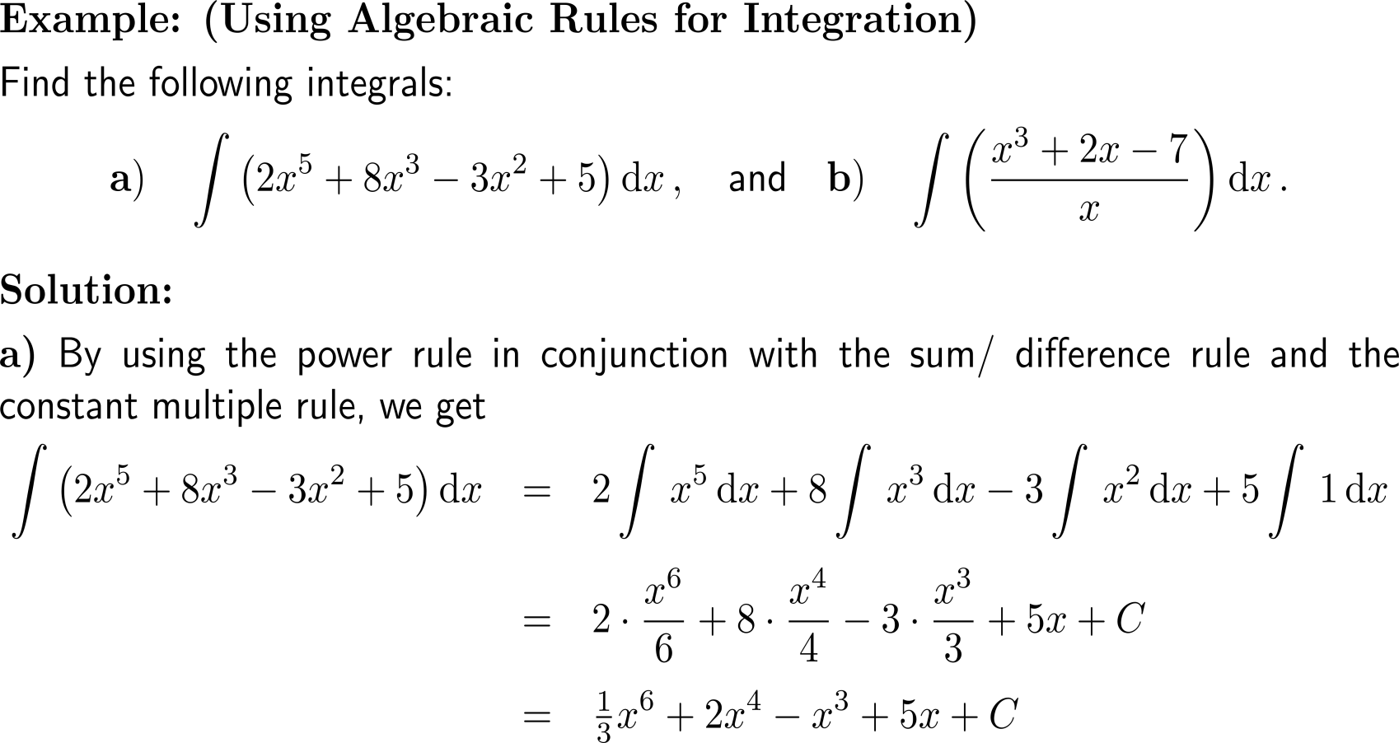
Example:
Using algebraic rules for integration

Slide 34
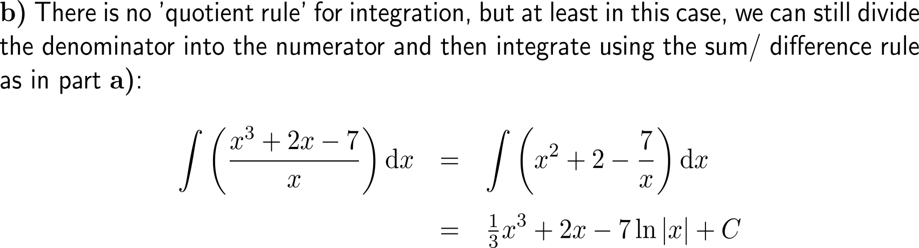
Example:
Using algebraic rules for integration

Slide 35
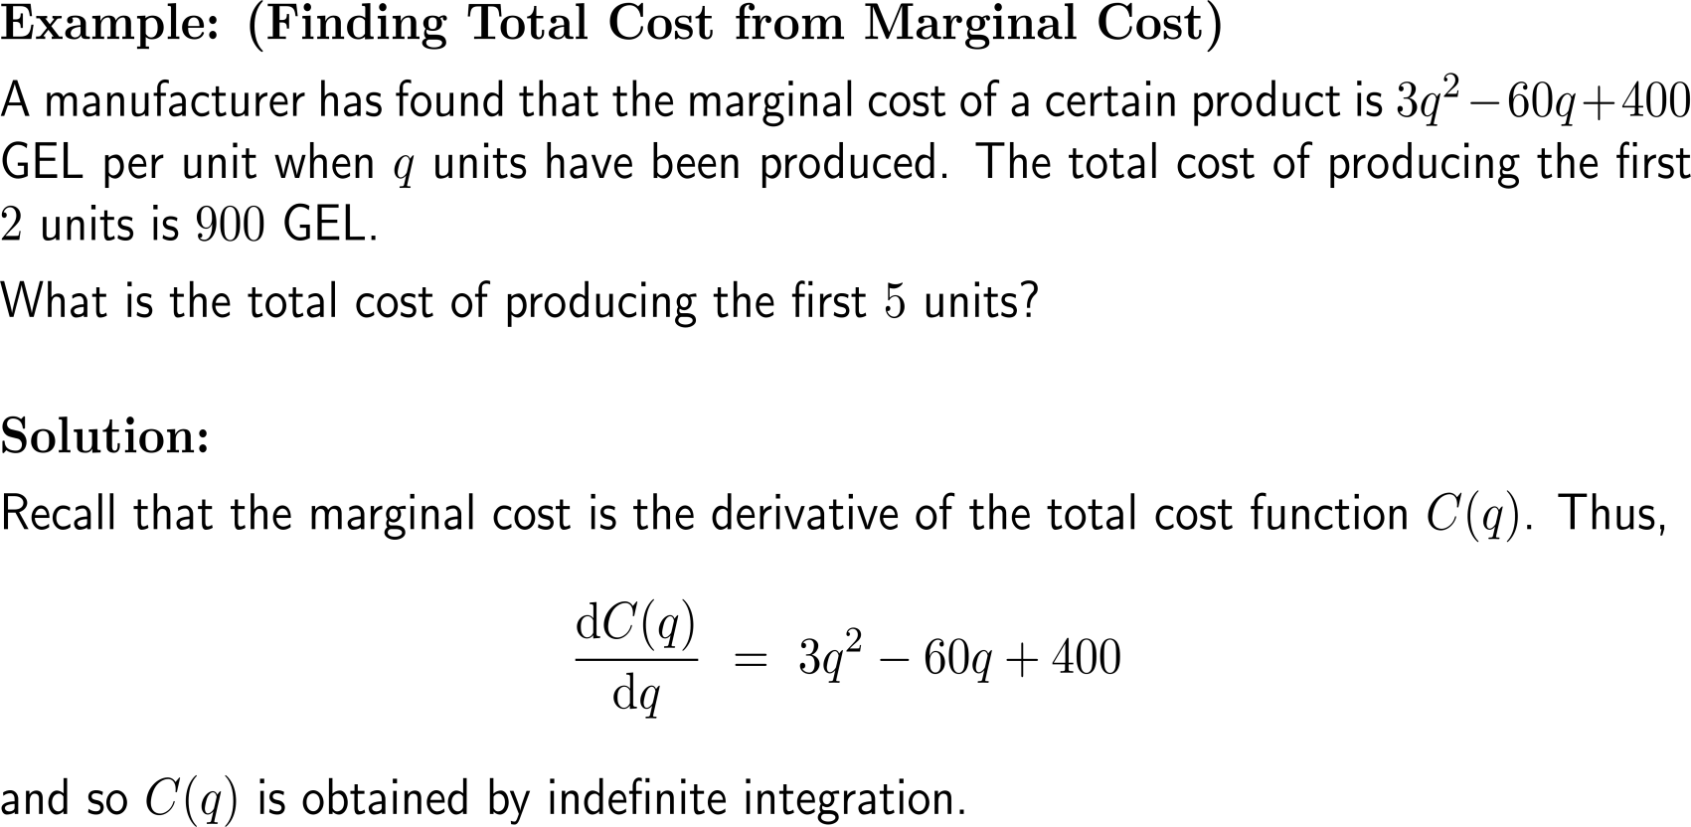
Example:
Finding total cost from marginal cost

Slide 36
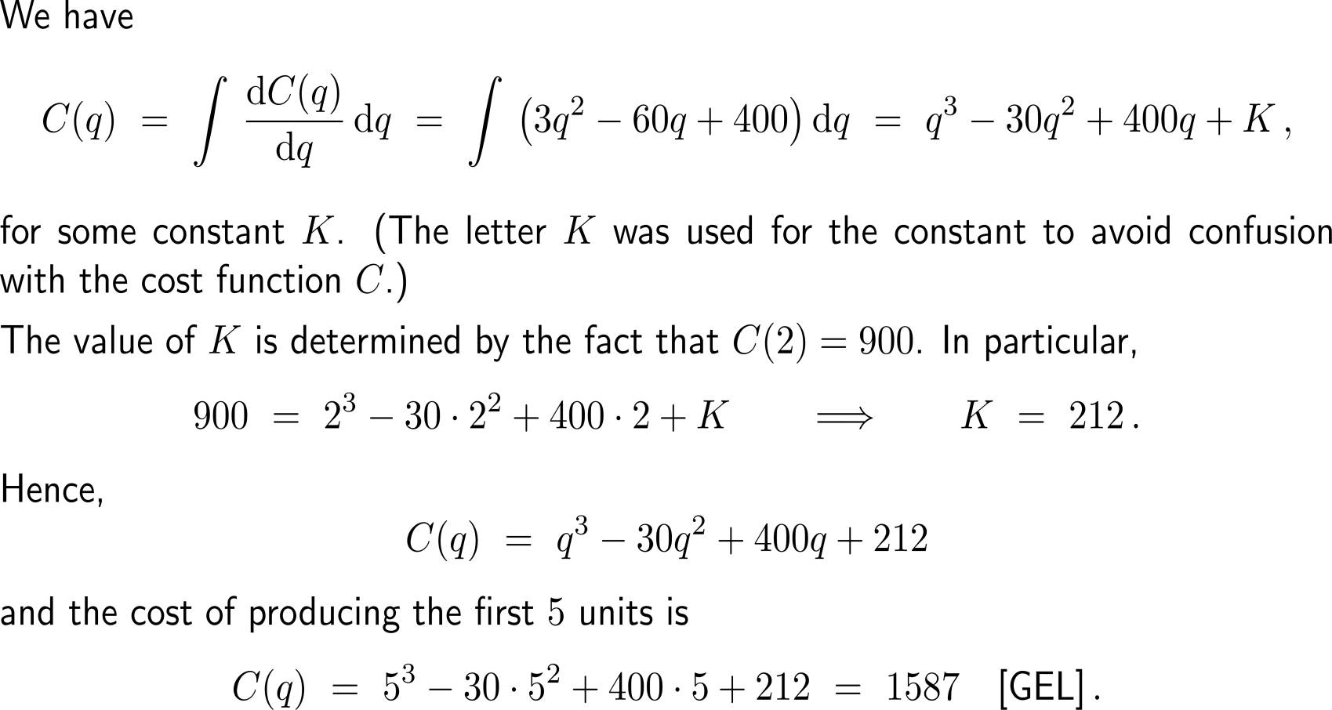
Example:
Finding total cost from marginal cost

Slide 37
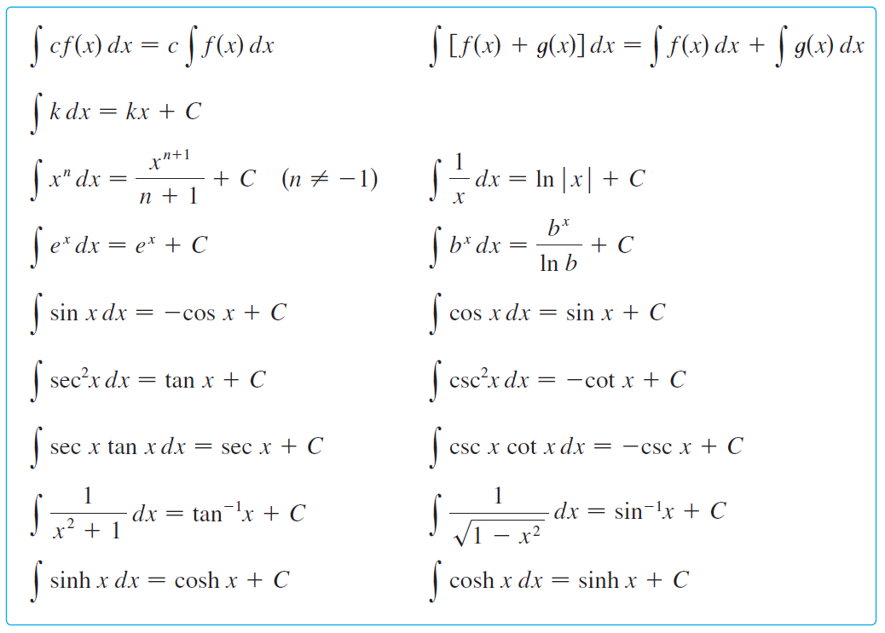
Table of indefinite integrals/ antidifferentiation formulas
(any formula can be verified by differentiating the function on the right)

Slide 38
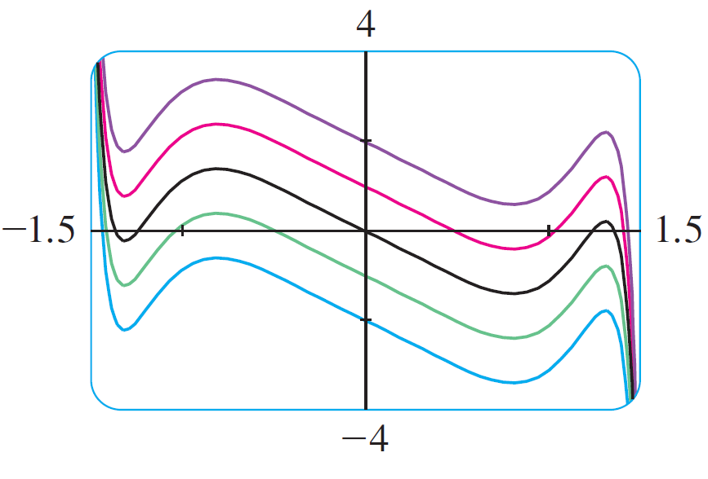
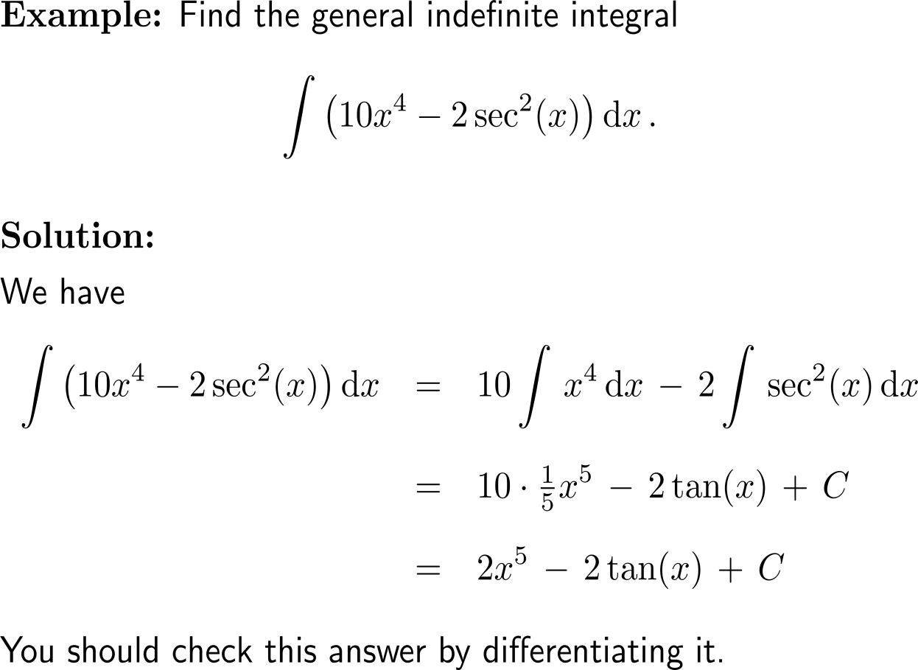
Example:
Indefinite integrals
The indefinite integral in the example
is graphed for several values of C.
Here the value of C is the y-intercept.

Slide 39
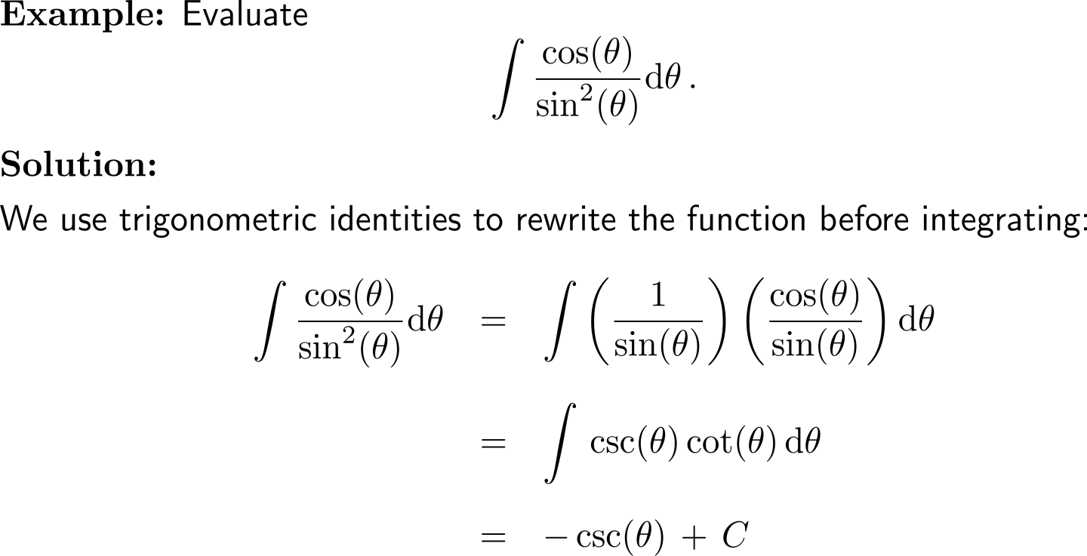
Example:
Indefinite integrals

Slide 40


Further Worked-Out Exercises:
Calculus I for Management
Topics
  Indefinite integration
  First rules of integration
  Techniques for finding indefinite integrals

Slide 41
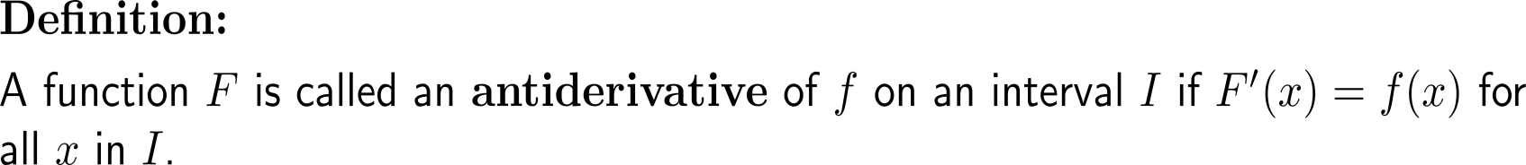

For a given function f an antiderivative F is a functions the derivative of which is f

Slide 42


Exercise
a)
b)

Slide 43

Exercise
10 minutes
self/ group work
c)
d)
please, upload your solutions to the chat

Slide 44



Exercise:
Finding a function from its slope function

Slide 45


Exercise:
Antiderivatives
10 minutes
self/ group work
please, upload your solutions to the chat

Slide 46

Exercise:
Antiderivatives

Slide 47



Exercise:
Antiderivatives
The Sørvágsvatn lake, Färöer island

Slide 48

Exercise:
Antiderivatives

Slide 49

Exercise:
Antiderivatives

Slide 50
Calculus I for Management

