Slide 1
Calculus I for MGMT – Integration
Integration by Parts
Mathematics for Management
Supplementary Electronic Materials
Preliminaries
Integration by Parts (of indefinite integrals)
  Definite Integration by Parts
  Repeated Application of Integration by Parts
  Using Integral Tables

Slide 2
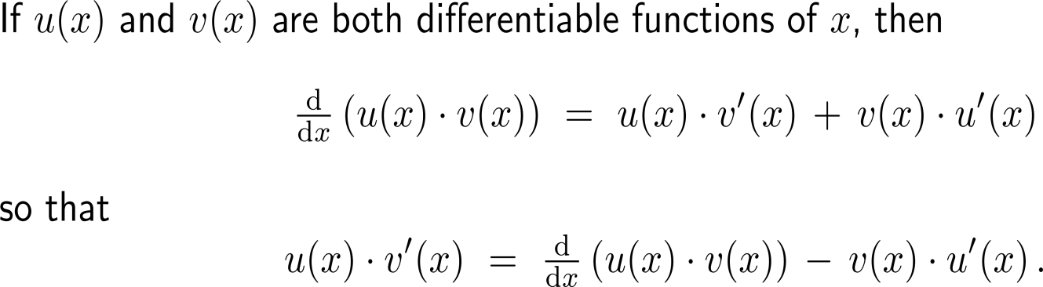
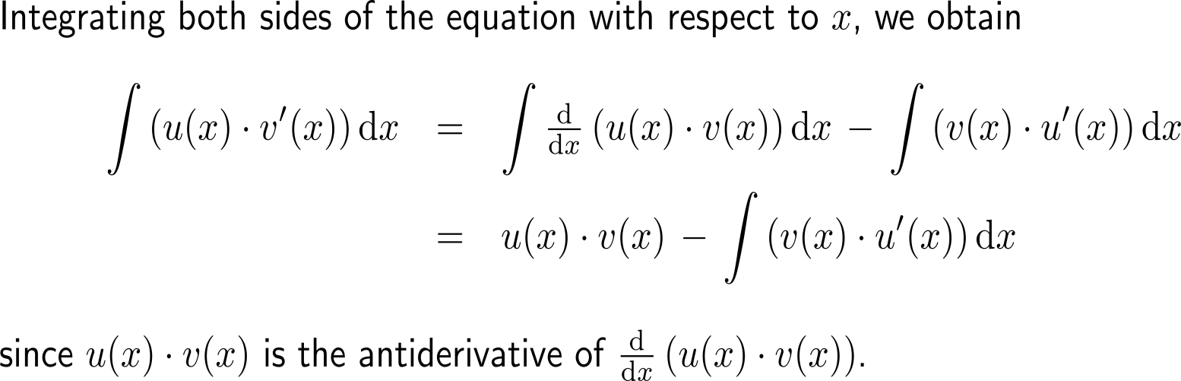
Integration by parts is a technique of integration based on the product rule for differentiation (1/ 3)

Slide 3
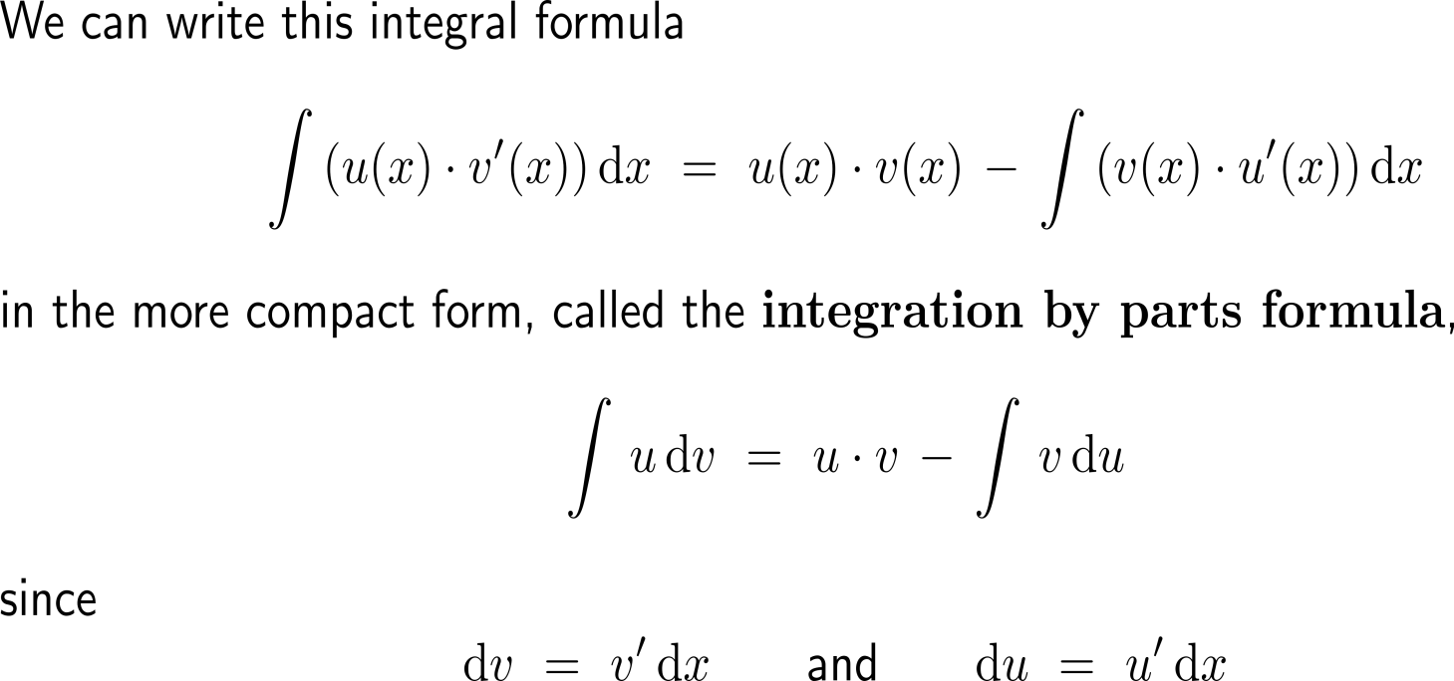
Integration by parts is a technique of integration based on the product rule for differentiation (2/ 3)

Slide 4
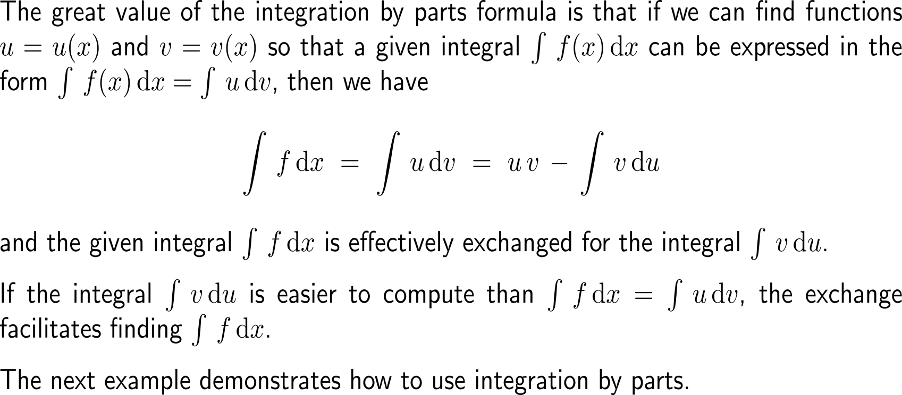
Integration by parts is a technique of integration based on the product rule for differentiation (3/ 3)

Slide 5

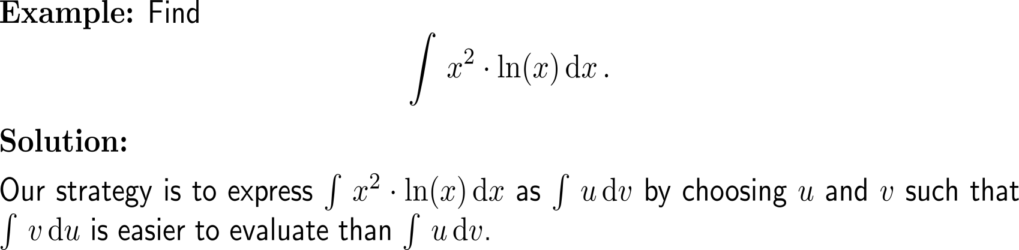
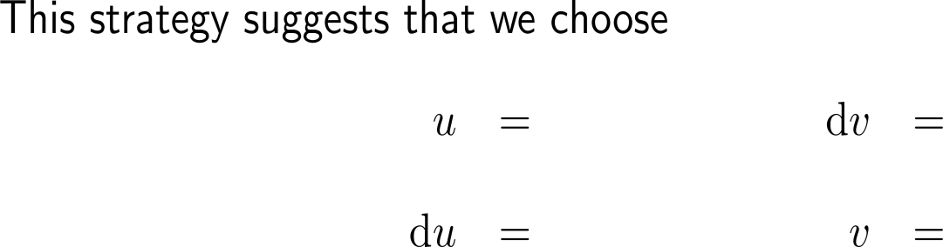




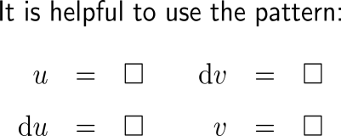
Example:
Application of integration by parts

Slide 6
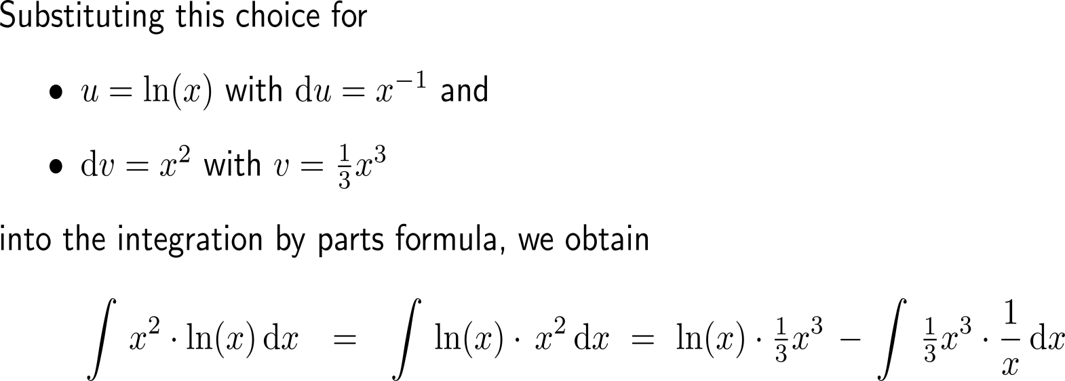
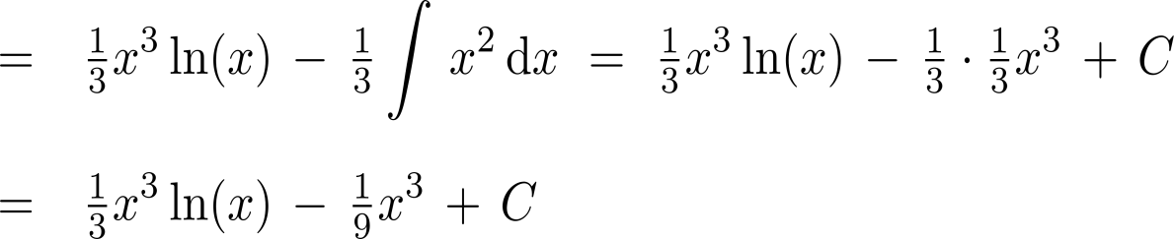
Example:
Application of integration by parts
u
dv
u
v
v
du

Slide 7
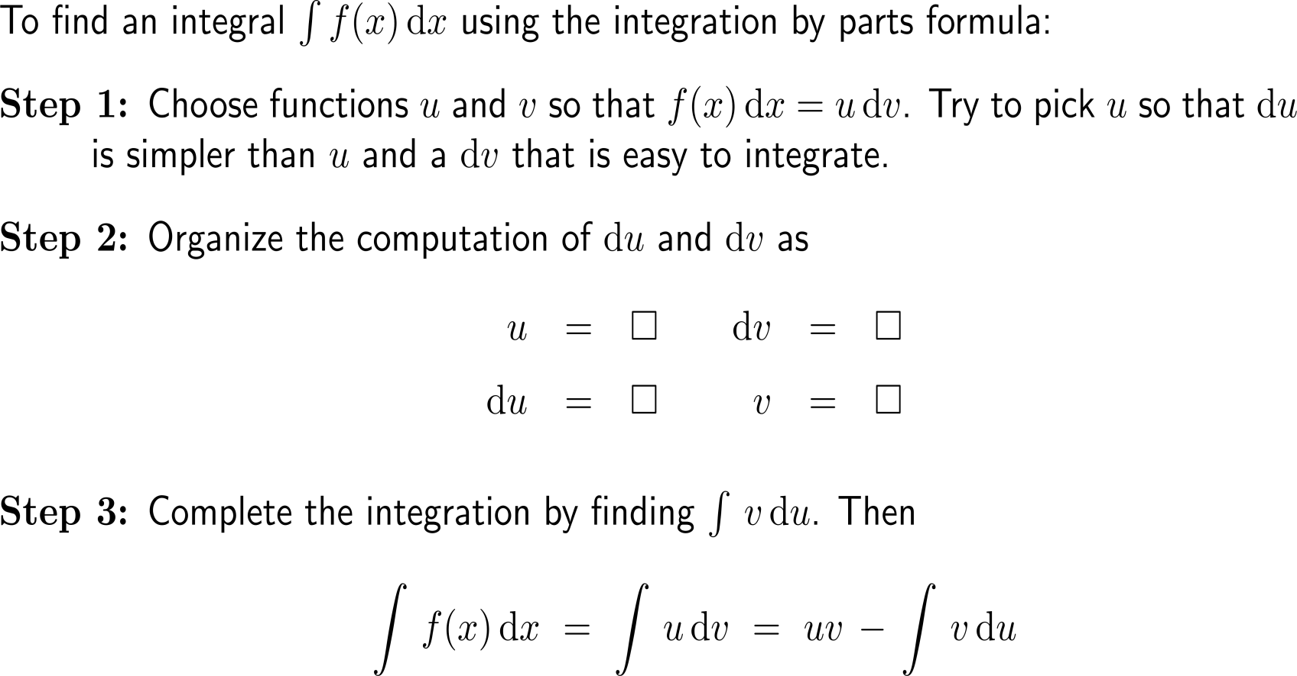
Let us summarize the integration by parts procedure as follows

Slide 8
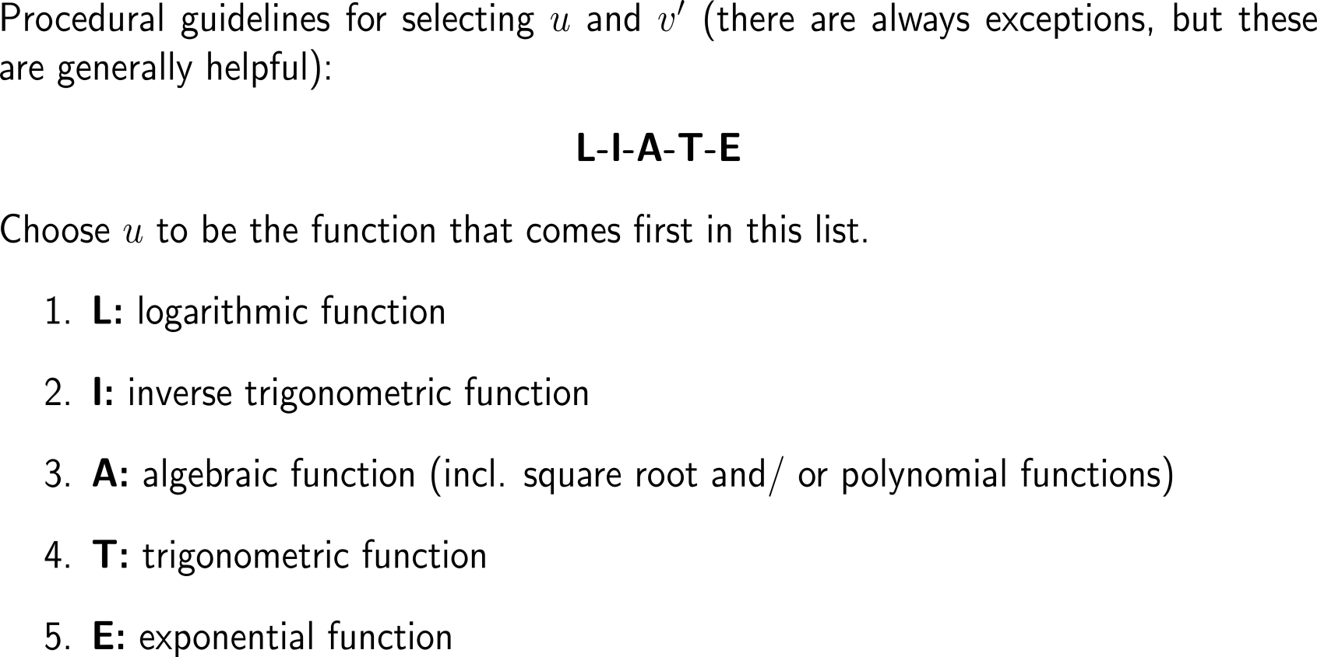
Some procedural rules of thumb for integration by parts

Slide 9
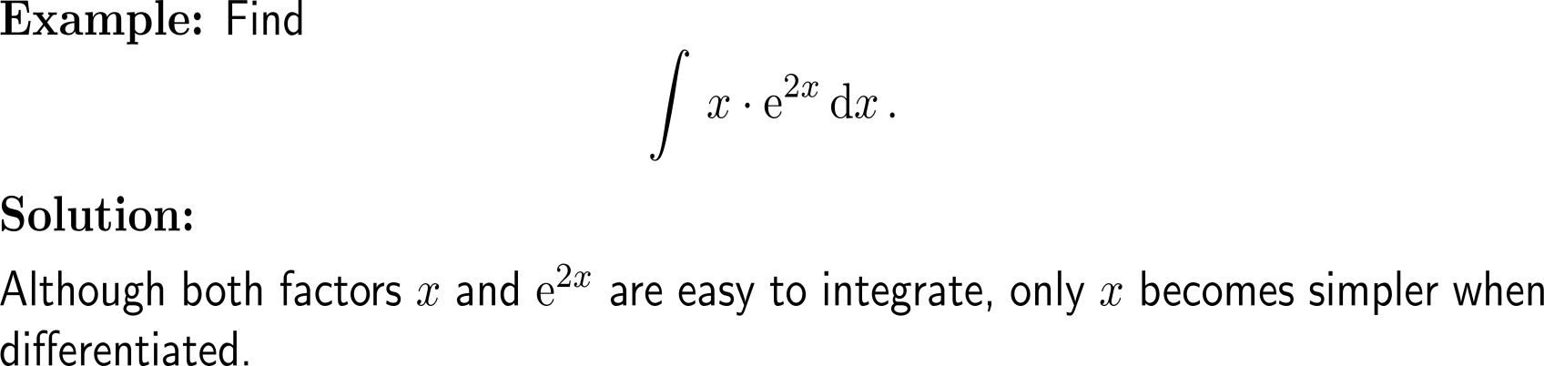
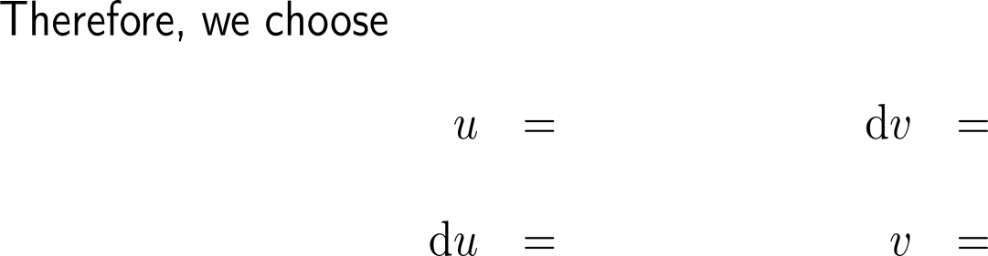



Example:
Application of integration by parts
L-I-A-T-E

Slide 10
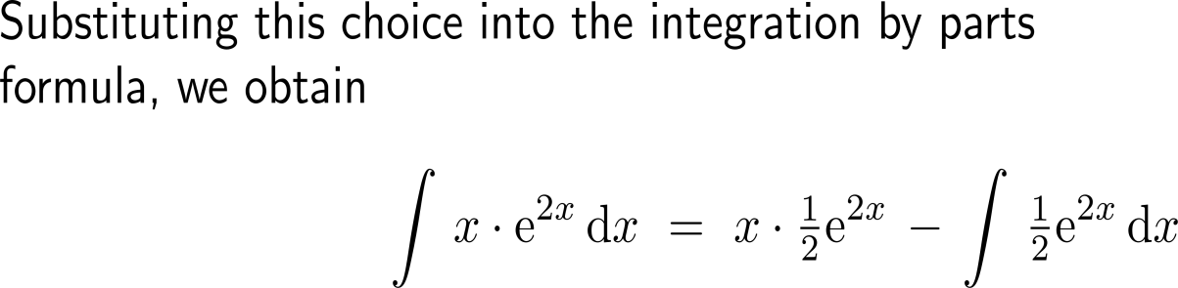
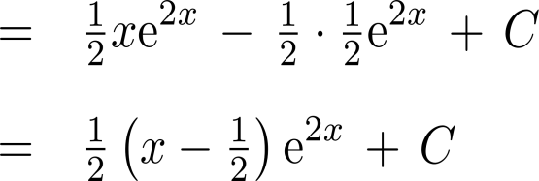
Example:
Application of integration by parts
u
dv
u
v
v
du

Slide 11
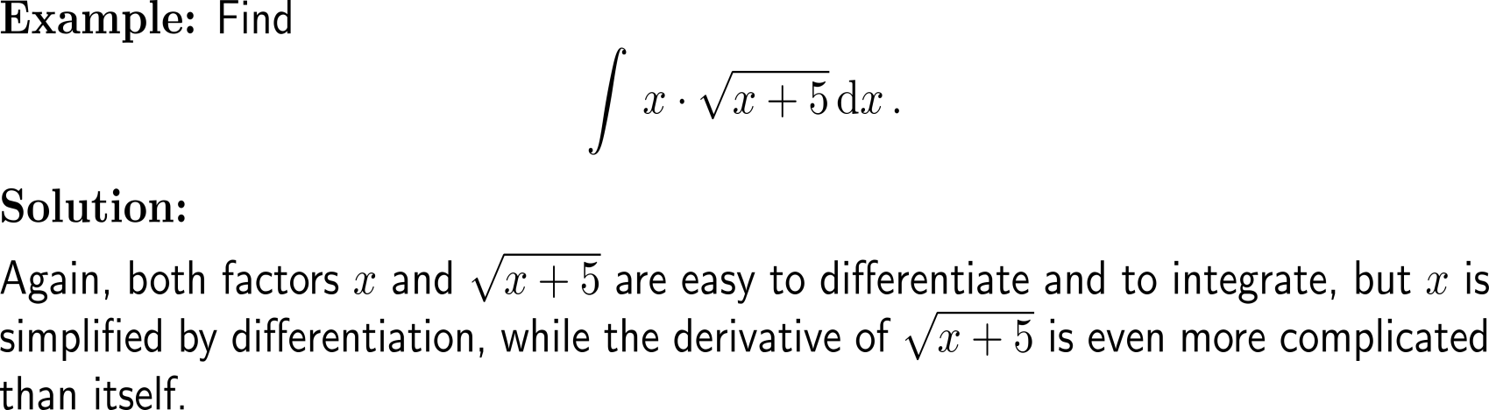


Example:
Application of integration by parts
L-I-A-T-E

Slide 12
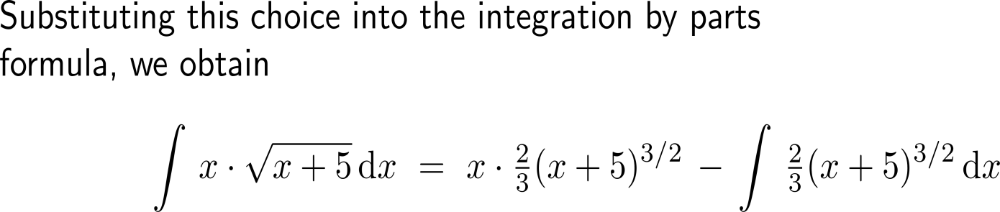
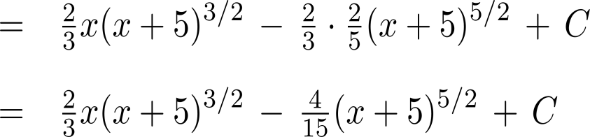
Example:
Application of integration by parts
u
dv
u
v
v
du

Slide 13
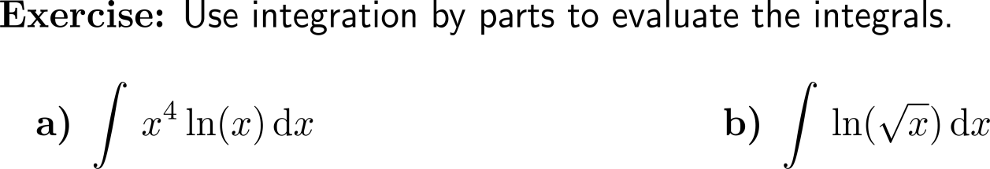
Now it’s your turn:
Please, try to solve these two questions on your own
Discussion
7 minutes
self/ group work
please, upload your solutions to the chat

Slide 14
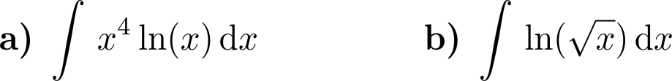
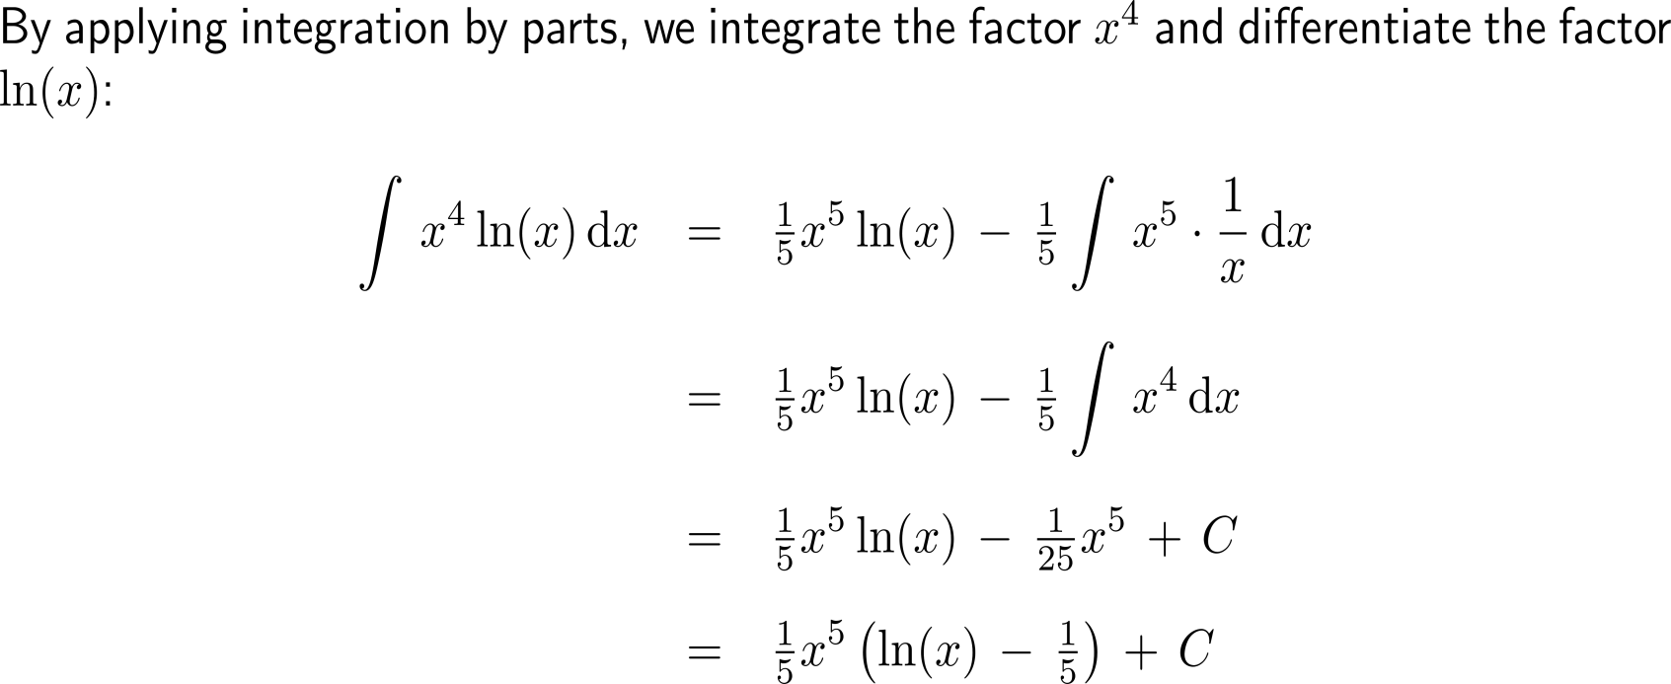
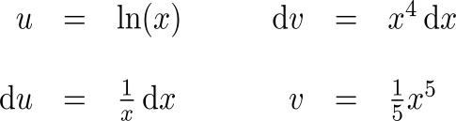
Now it’s your turn:
Solution
a)

Slide 15
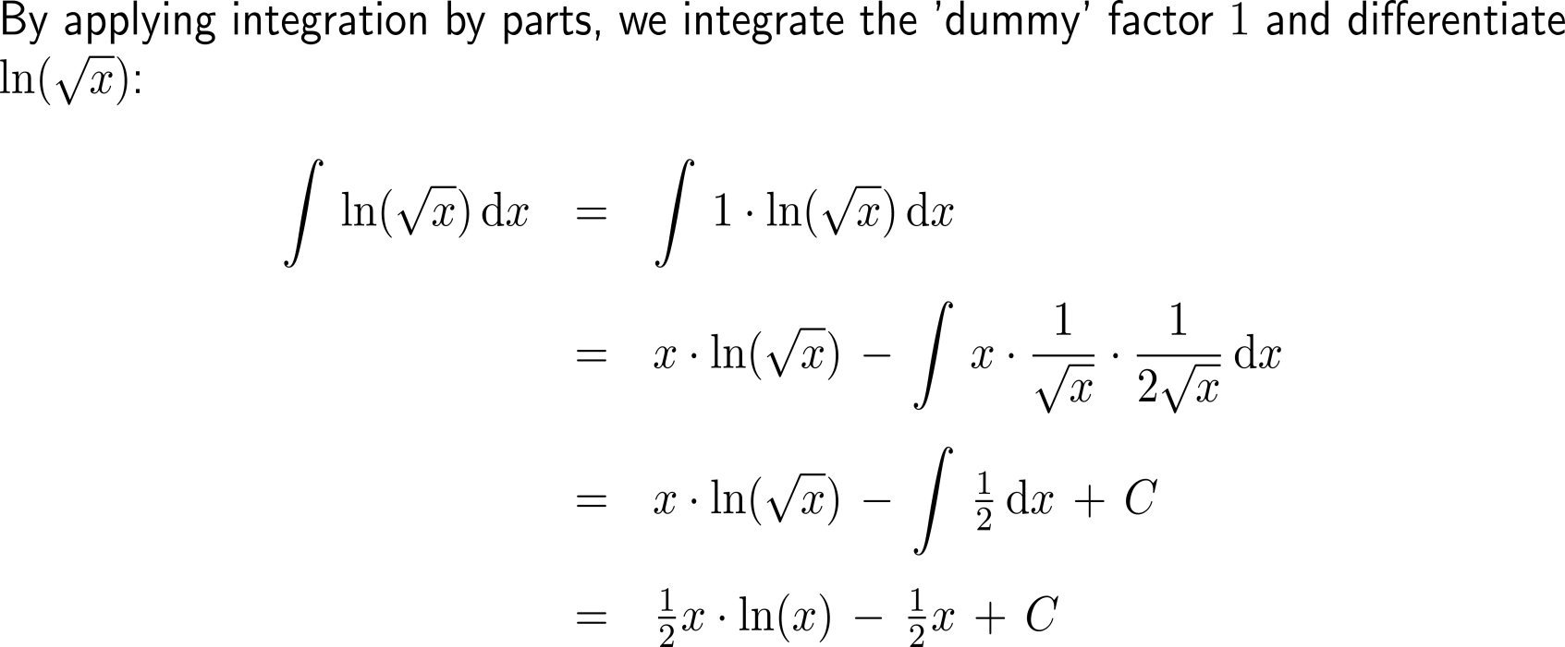
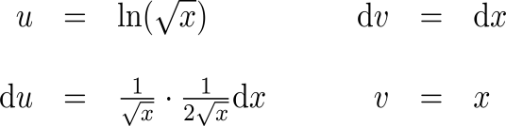
Now it’s your turn:
Solution
b)

Slide 16
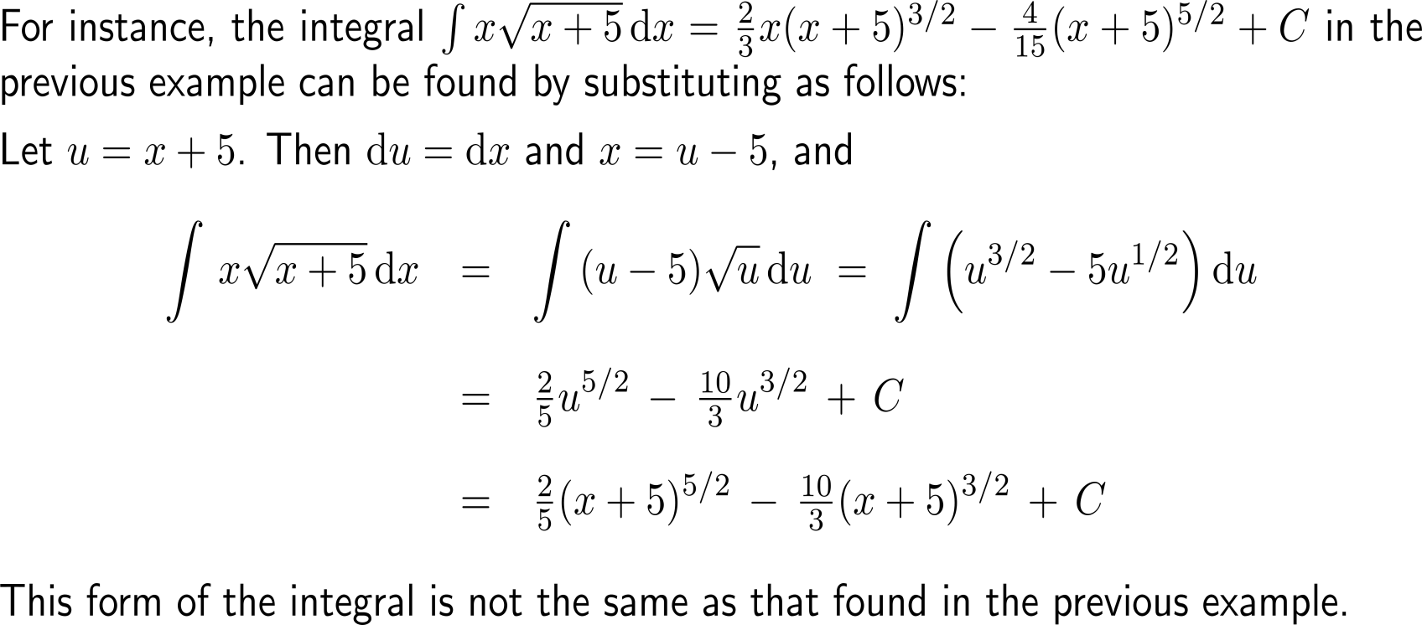
Note: some integrals can be evaluated by either substitution or integration by parts (1/ 2)

Slide 17
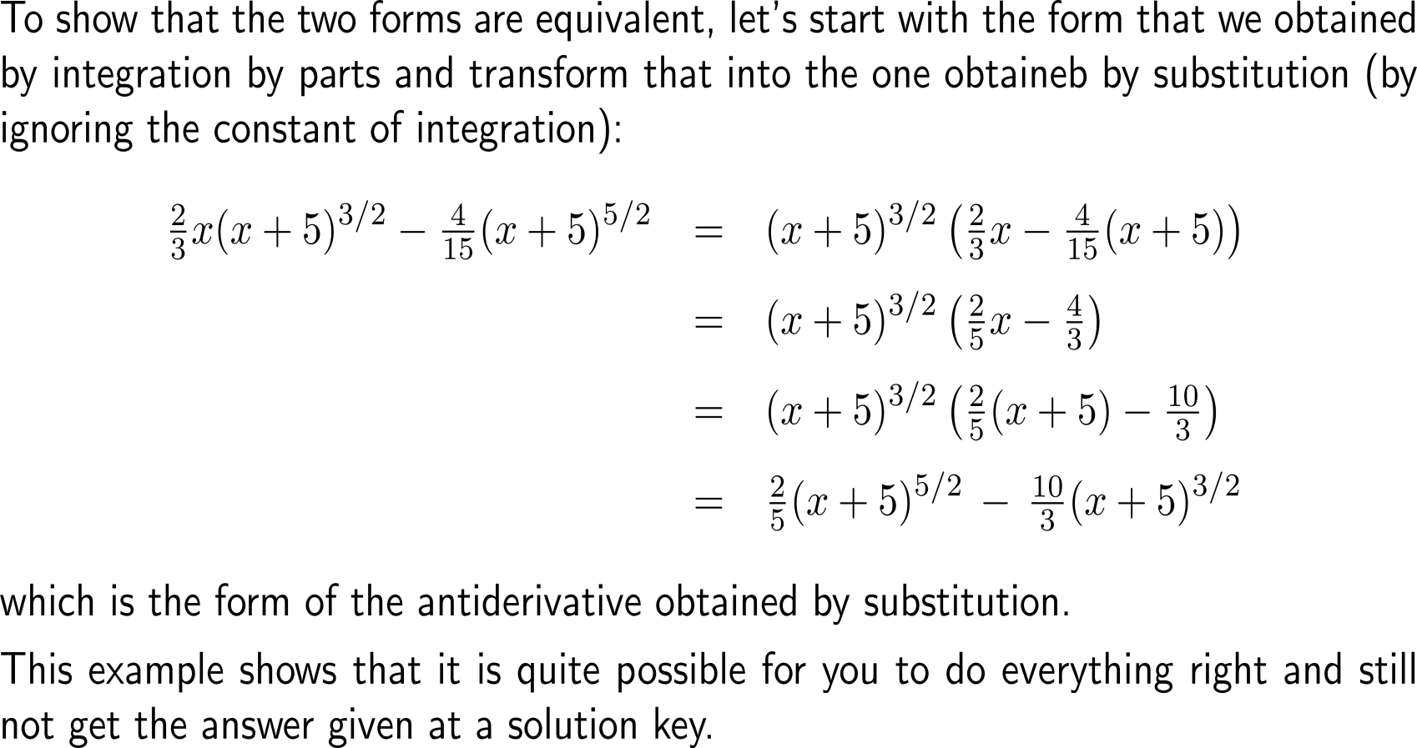
Note: some integrals can be evaluated by either substitution or integration by parts (2/ 2)

Slide 18
Calculus I for Management

