Slide 1
Calculus I for Management
Integration by Parts & Integral Tables
week 15
Lecture
  Integration by parts (of indefinite integrals)
  Definite integration by parts
  Repeated application of integration by parts
  Using integral tables

Slide 2
Topics
  Integration by Parts (of indefinite integrals)
  Definite Integration by Parts
  Repeated Application of Integration by Parts
  Using Integral Tables

Slide 3
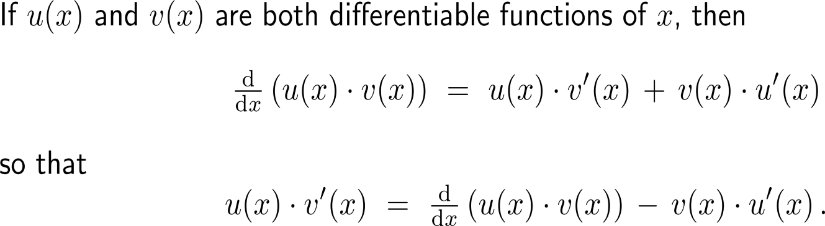
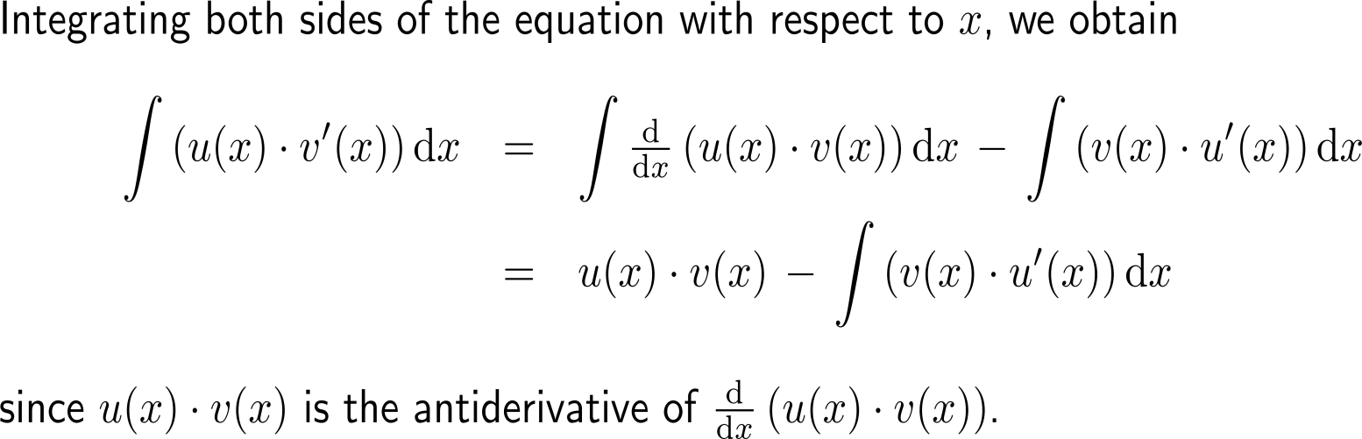
Integration by parts is a technique of integration based on the product rule for differentiation (1/ 3)

Slide 4
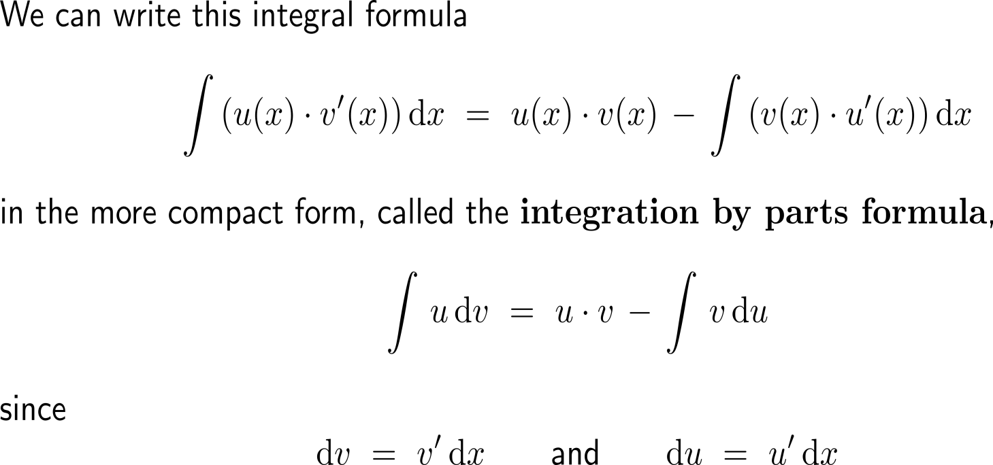
Integration by parts is a technique of integration based on the product rule for differentiation (2/ 3)

Slide 5
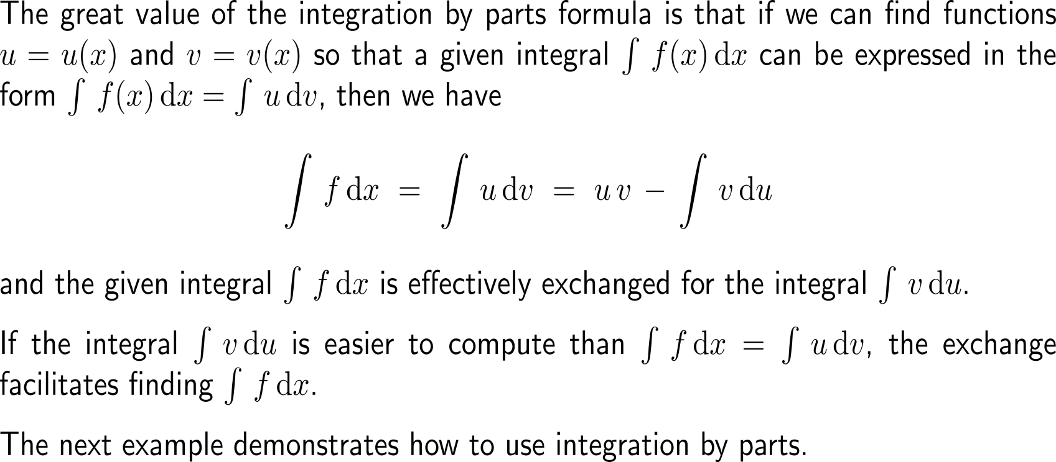
Integration by parts is a technique of integration based on the product rule for differentiation (3/ 3)

Slide 6

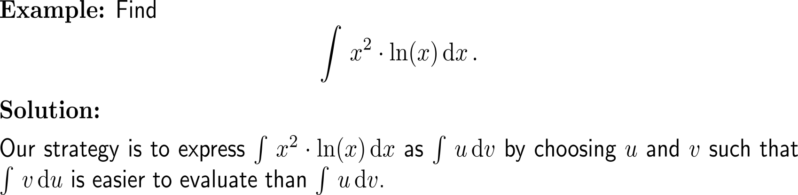
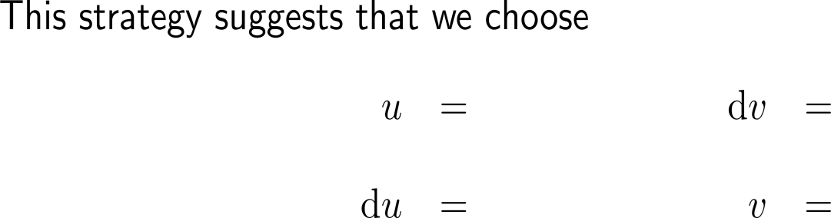




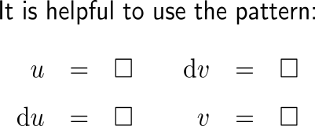
Example:
Application of integration by parts

Slide 7
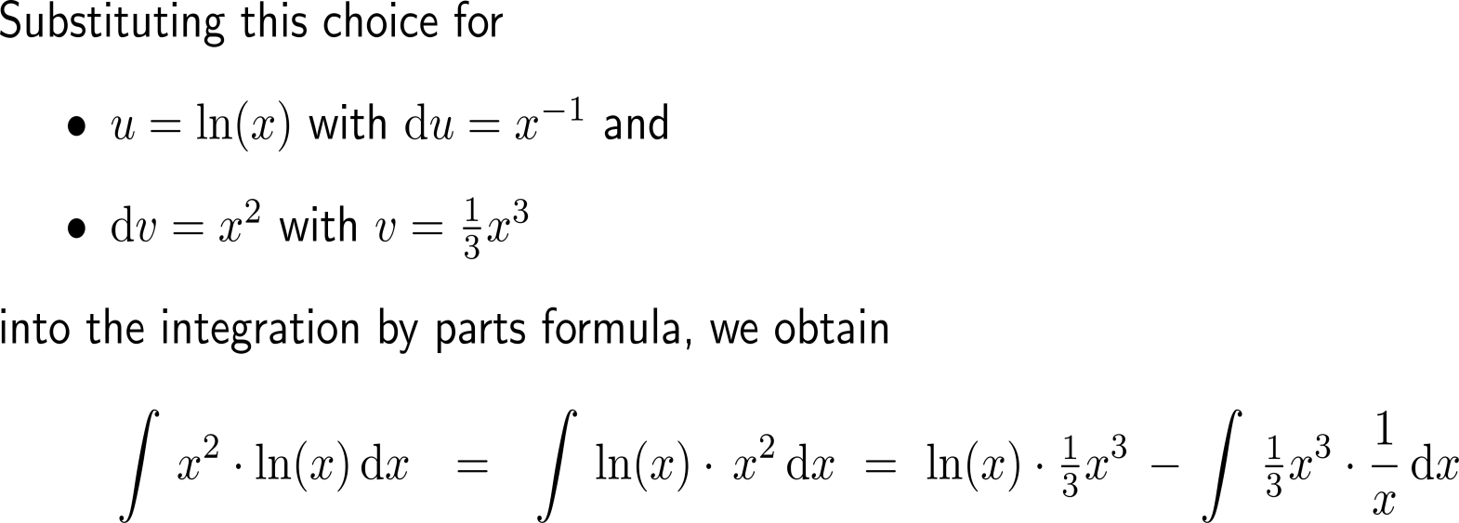
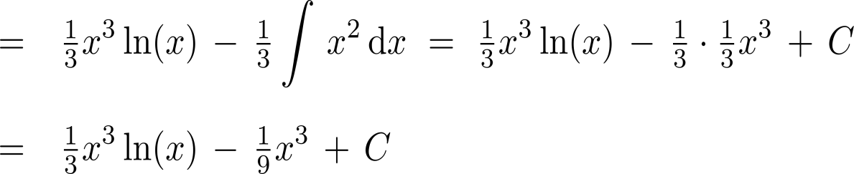
Example:
Application of integration by parts
u
dv
u
v
v
du

Slide 8
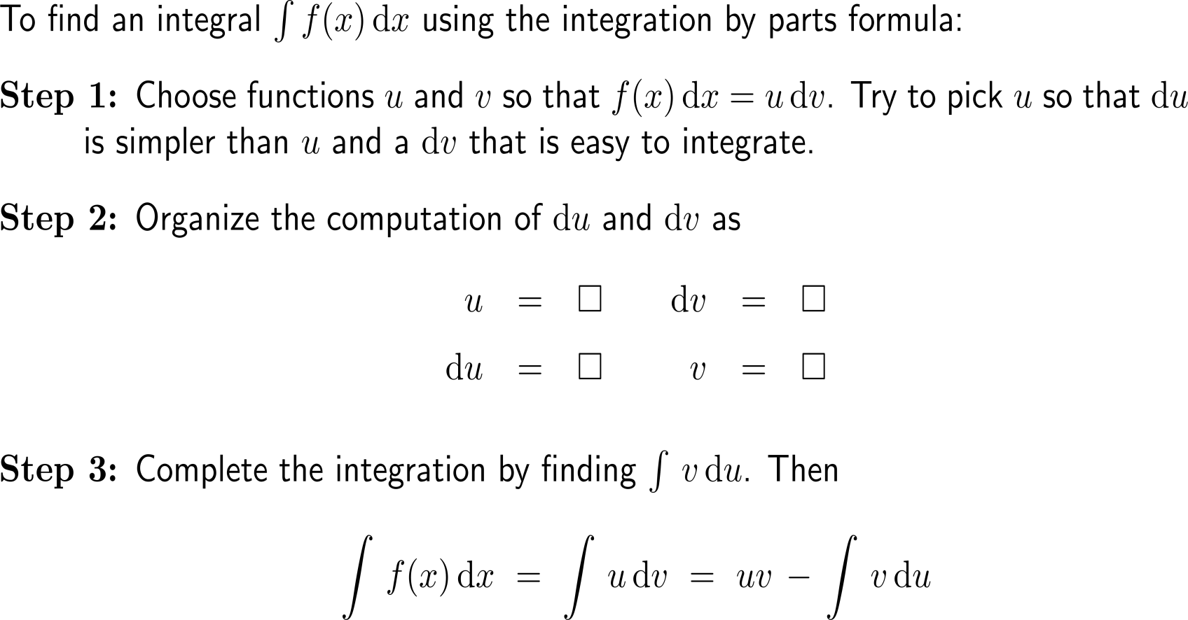
Let us summarize the integration by parts procedure as follows

Slide 9
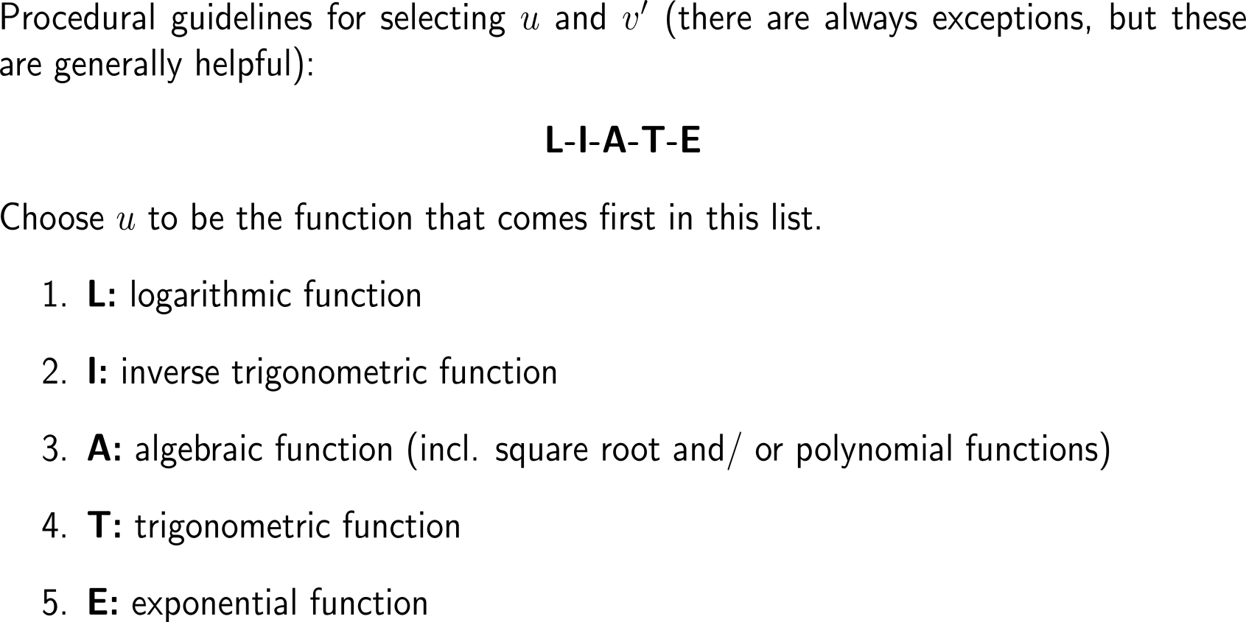
Some procedural rules of thumb for integration by parts

Slide 10
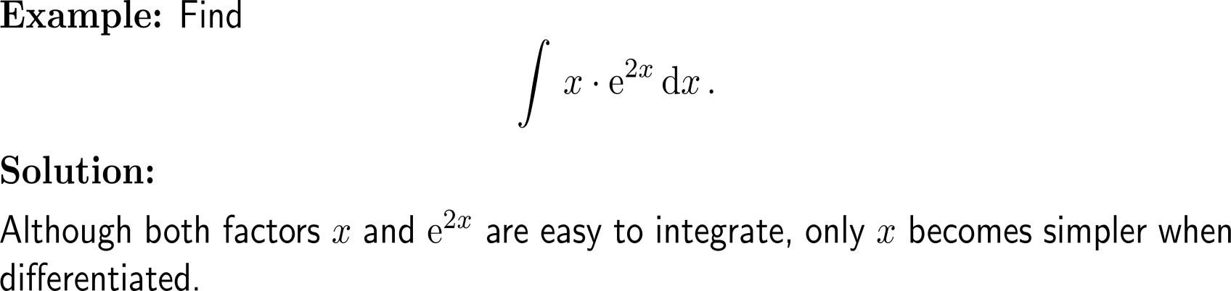
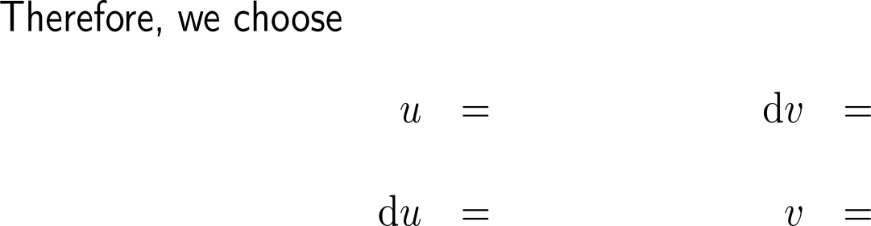



Example:
Application of integration by parts
L-I-A-T-E

Slide 11
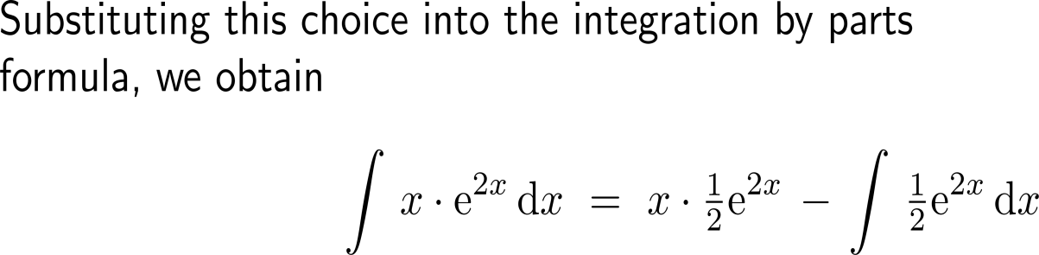
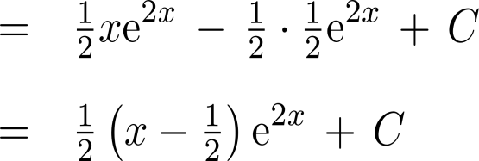
Example:
Application of integration by parts
u
dv
u
v
v
du

Slide 12
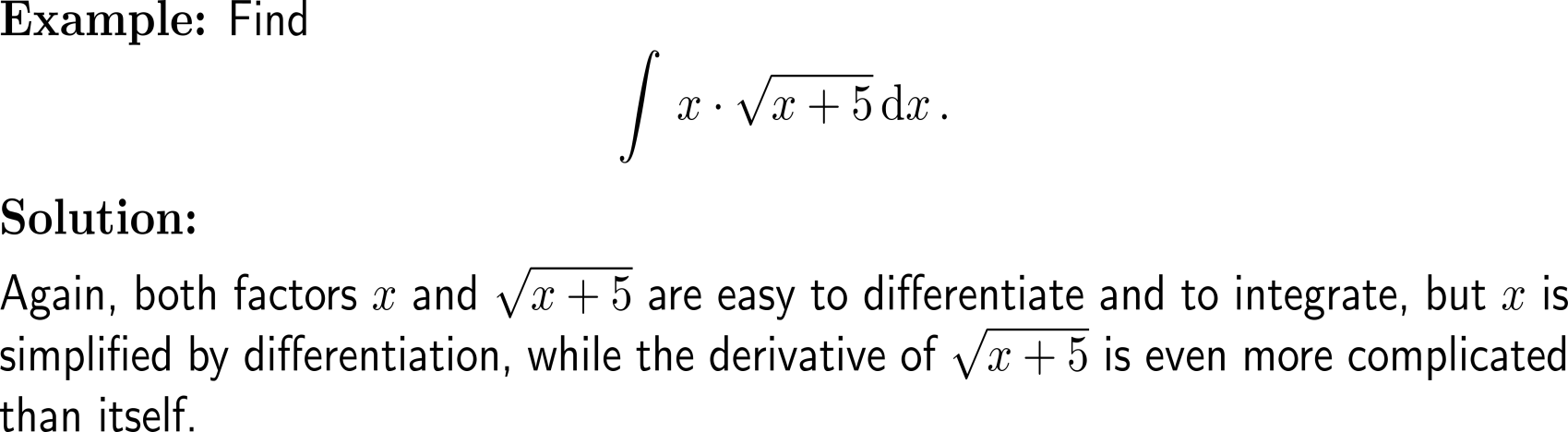


Example:
Application of integration by parts
L-I-A-T-E

Slide 13
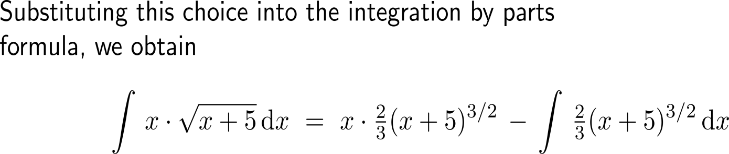
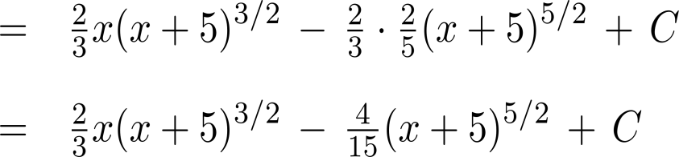
Example:
Application of integration by parts
u
dv
u
v
v
du

Slide 14
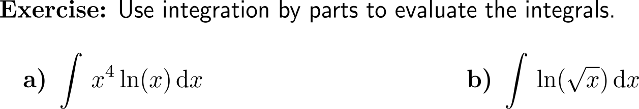
Now it’s your turn:
Please, try to solve these two questions on your own
Discussion
7 minutes
self/ group work
please, upload your solutions to the chat

Slide 15
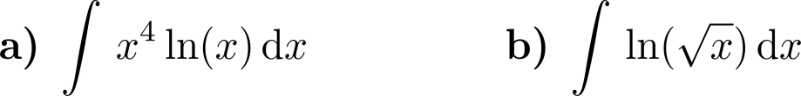
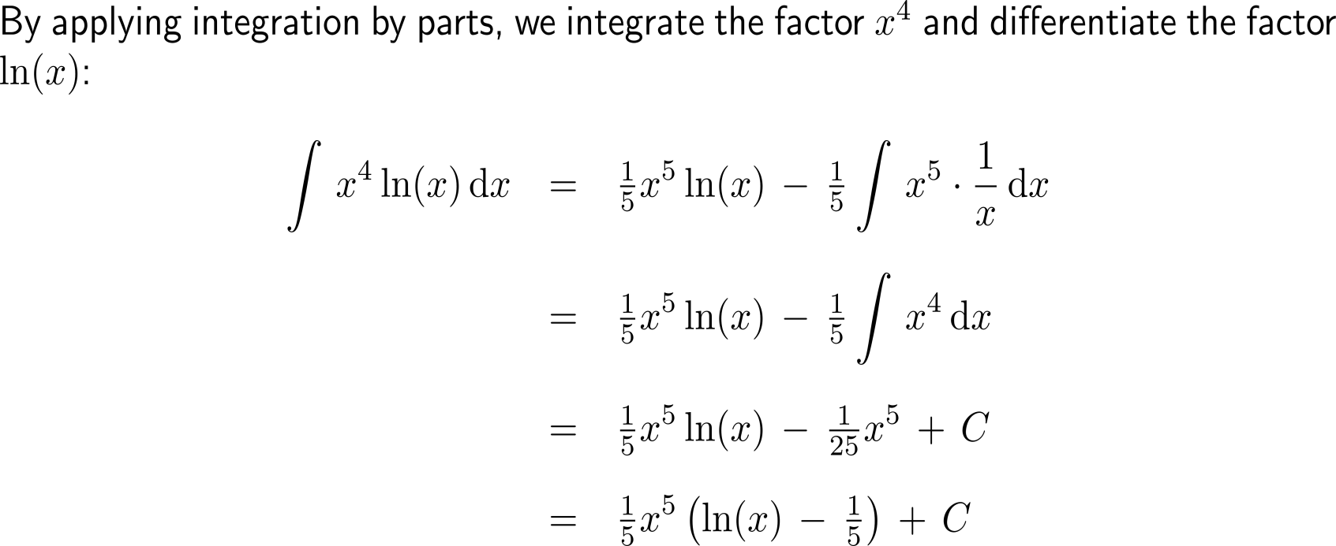
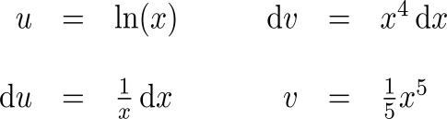
Now it’s your turn:
Solution
a)

Slide 16
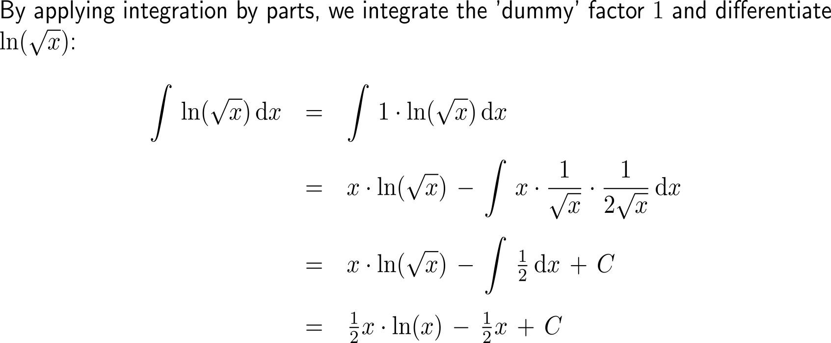
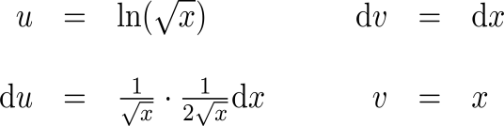
Now it’s your turn:
Solution
b)

Slide 17
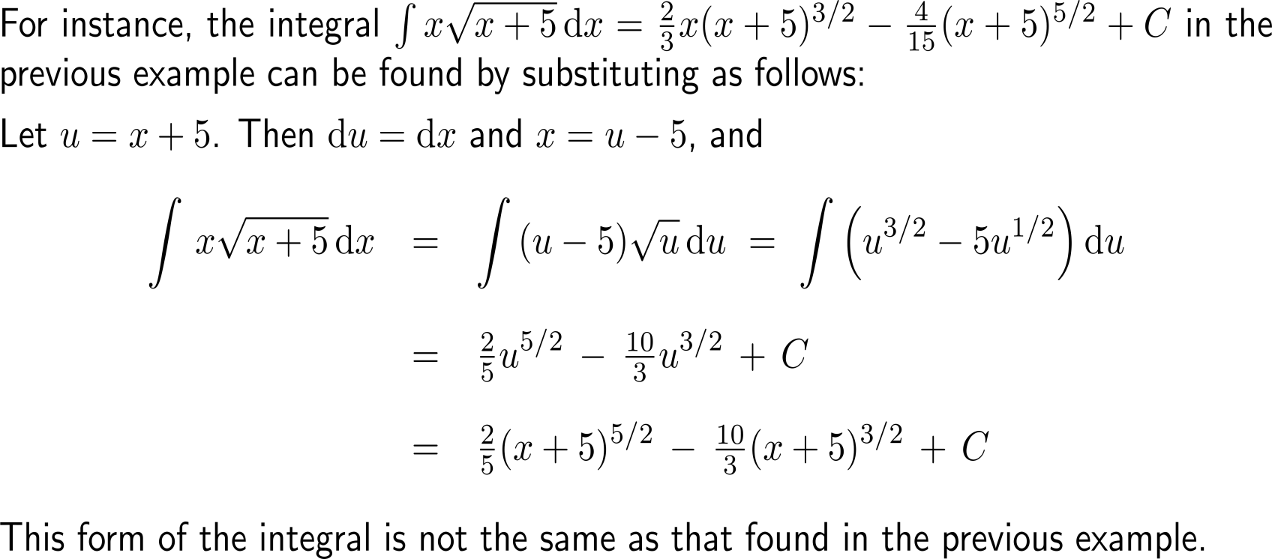
Note: some integrals can be evaluated by either substitution or integration by parts (1/ 2)

Slide 18
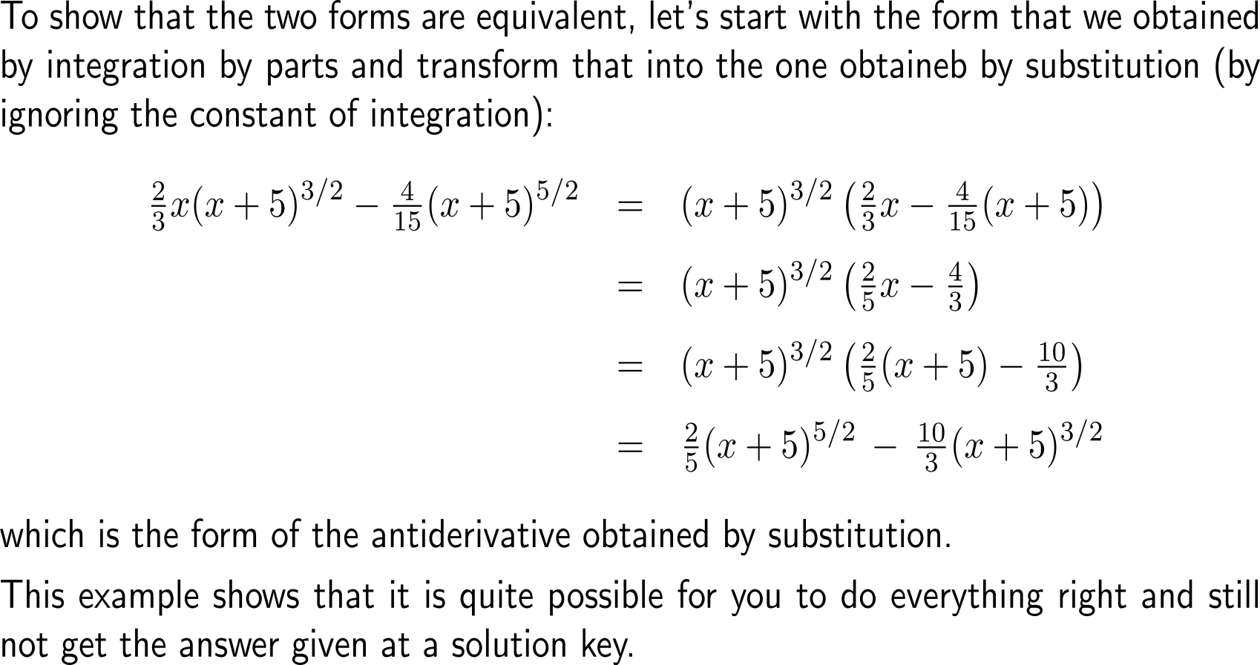
Note: some integrals can be evaluated by either substitution or integration by parts (2/ 2)

Slide 19
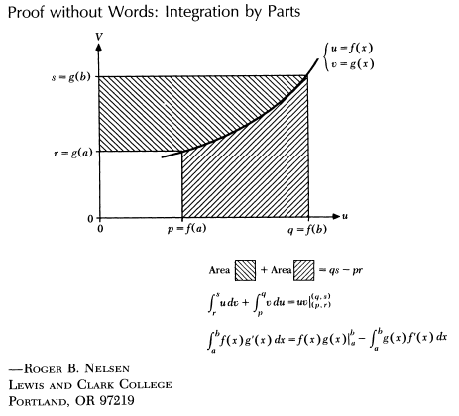
Topics
  Integration by Parts (of indefinite integrals)
  Definite Integration by Parts
  Repeated Application of Integration by Parts
  Using Integral Tables

Slide 20
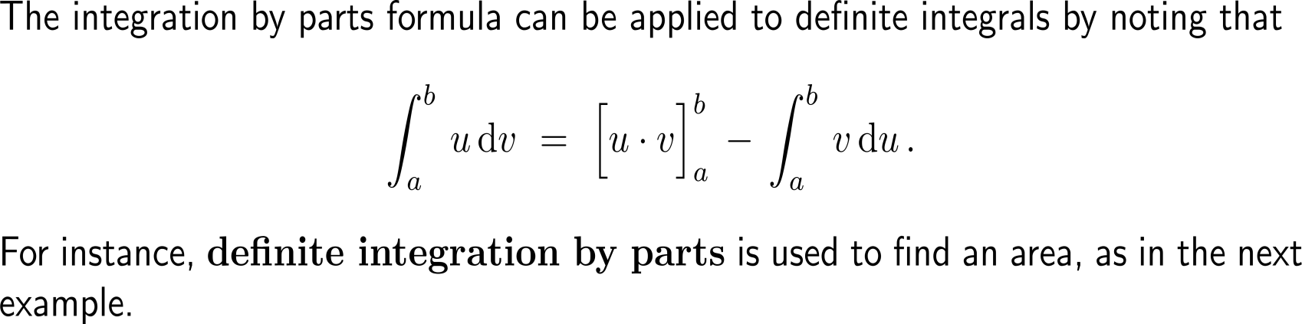
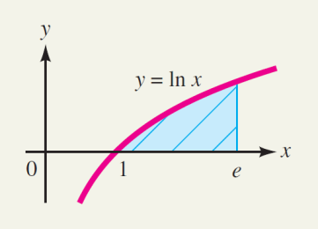
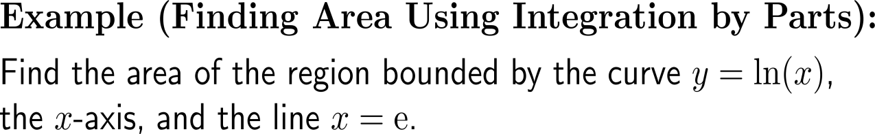
Definite integration by parts is used, for instance, to find an area

Slide 21

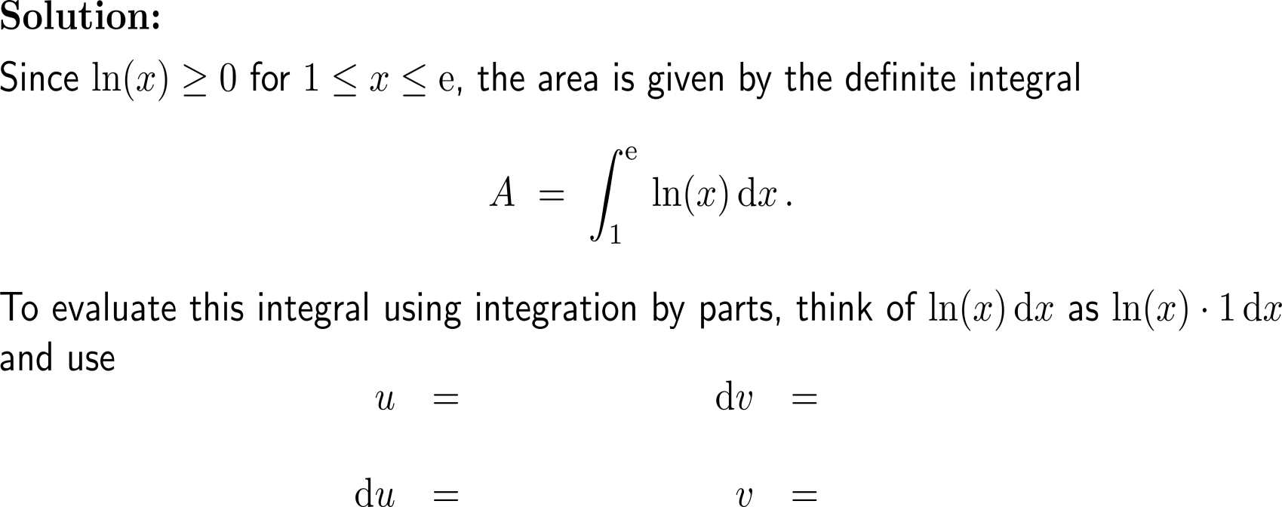



Example:
Application of definite integration by parts
L-I-A-T-E

Slide 22
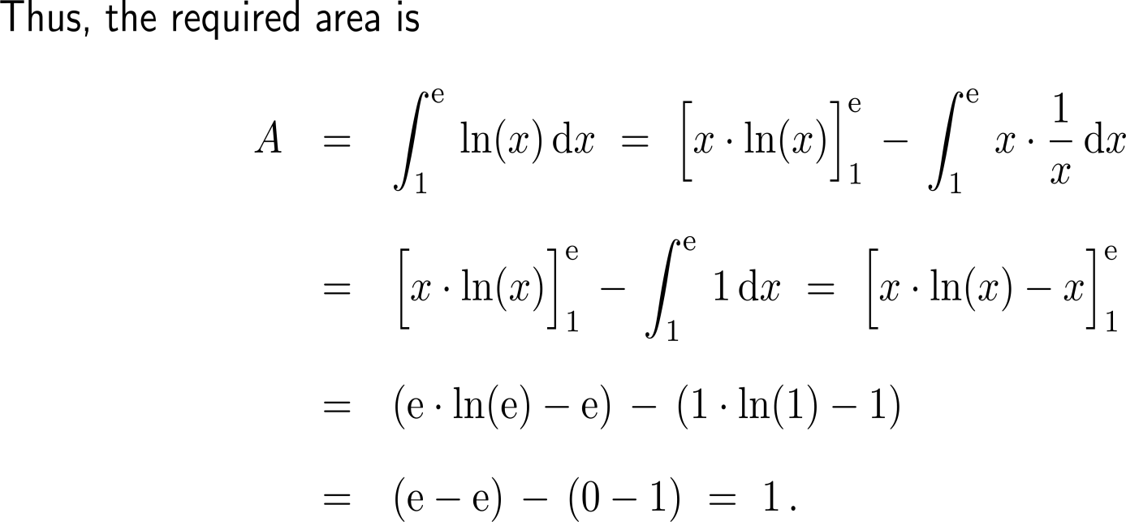
Example:
Application of definite integration by parts

Slide 23
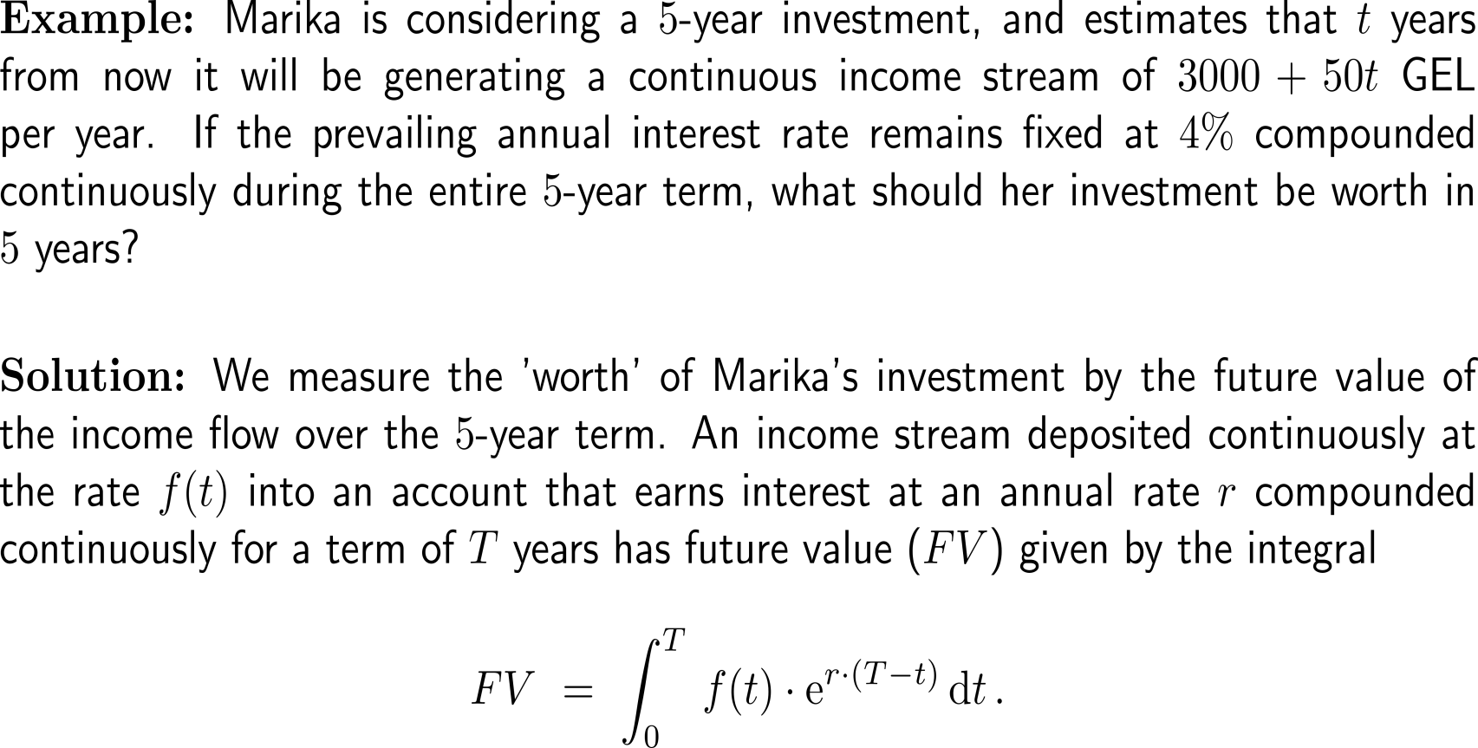
Example:
Calculating the future vale of an investment

Slide 24
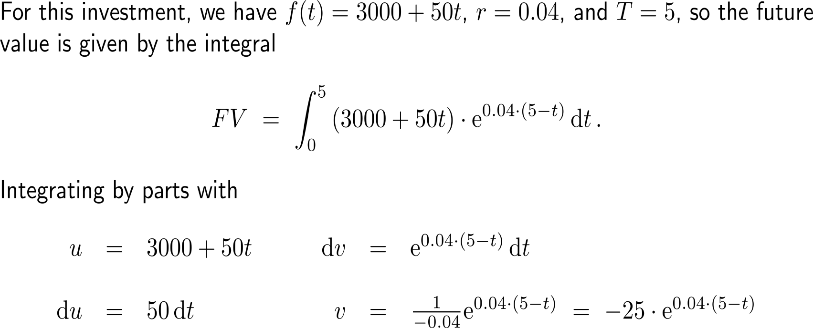
Example:
Calculating the future vale of an investment
L-I-A-T-E

Slide 25
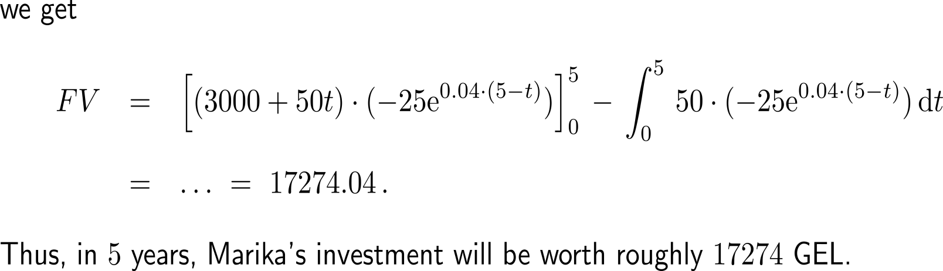
Example:
Calculating the future vale of an investment

Slide 26
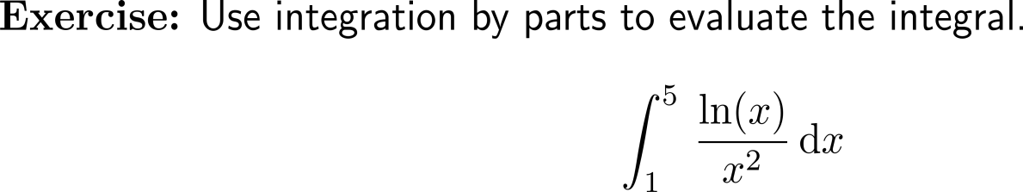
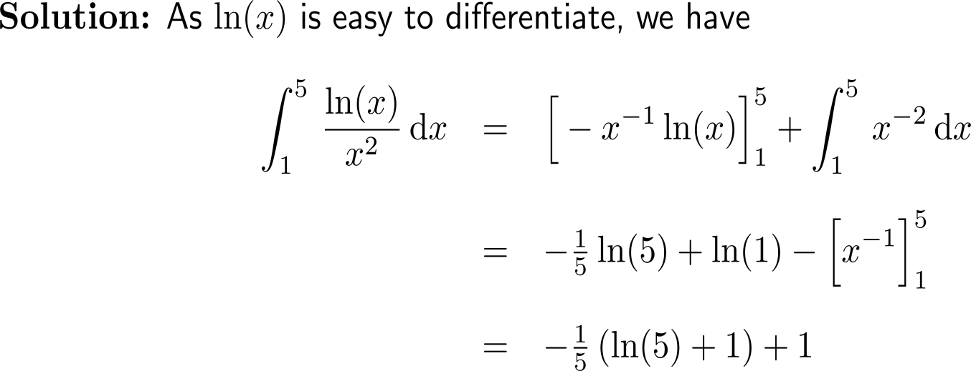
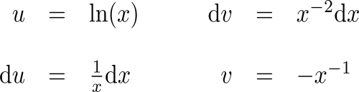
Now it’s your turn:
Please, try to solve this question on your own
Discussion
5 minutes
self/ group work
please, upload your solutions to the chat

Slide 27
Topics
  Integration by Parts (of indefinite integrals)
  Definite Integration by Parts
  Repeated Application of Integration by Parts
  Using Integral Tables

Slide 28
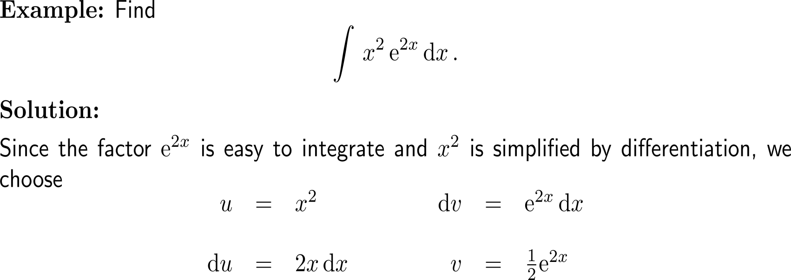
Example:
Integrating by parts twice

Slide 29
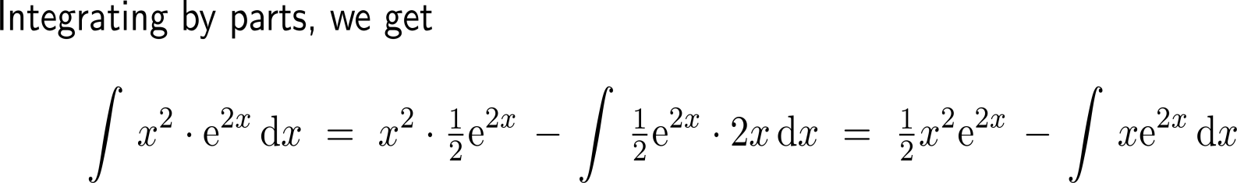
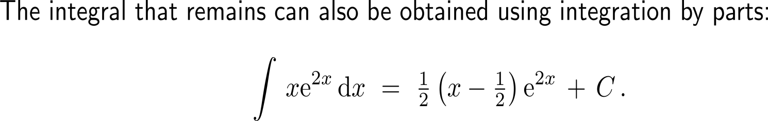
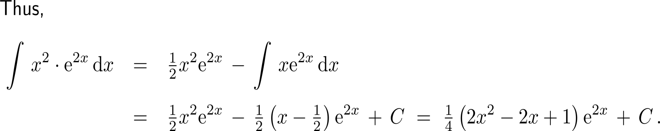
Example:
Integrating by parts twice

Slide 30
Topics
  Integration by Parts (of indefinite integrals)
  Definite Integration by Parts
  Repeated Application of Integration by Parts
  Using Integral Tables

Slide 31
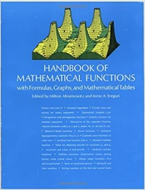
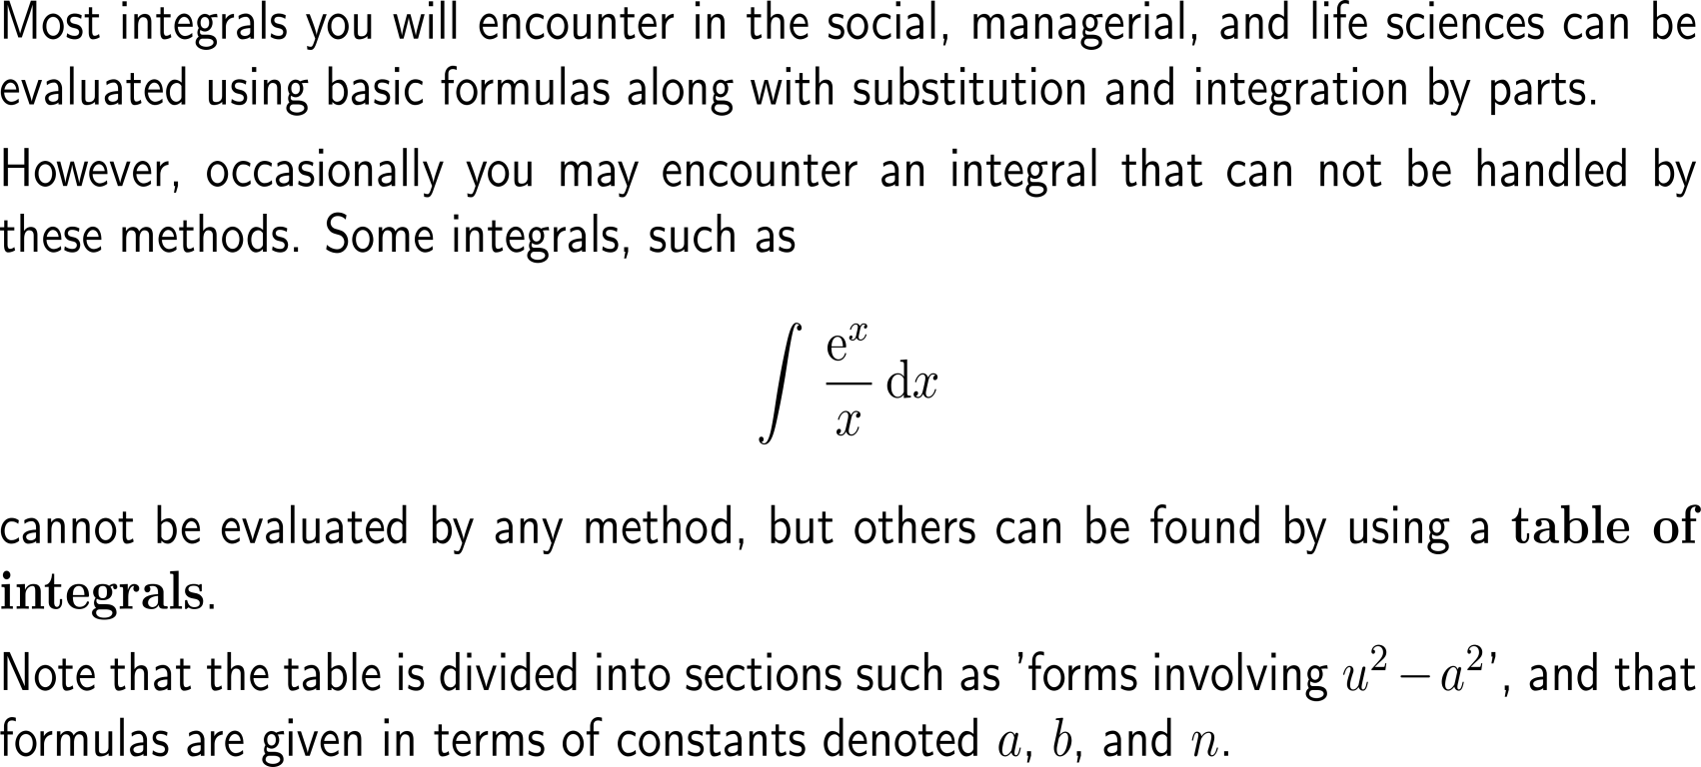

Using a table of integrals are often of great help to find the indefinite integrals of uncommon or complicated functions
online “tables”

Slide 32
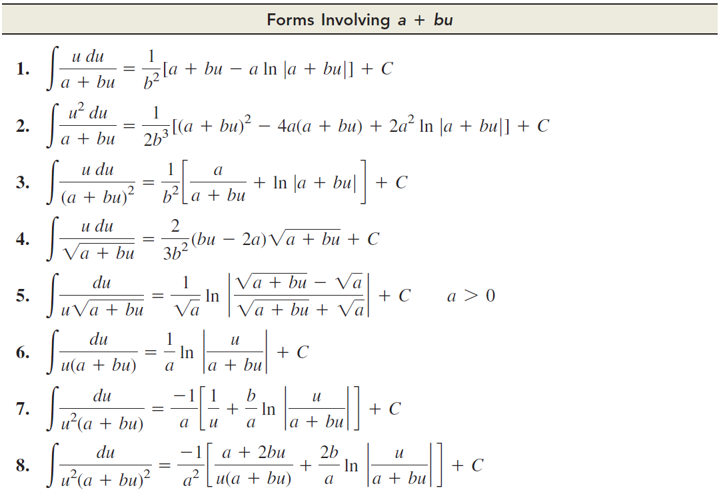
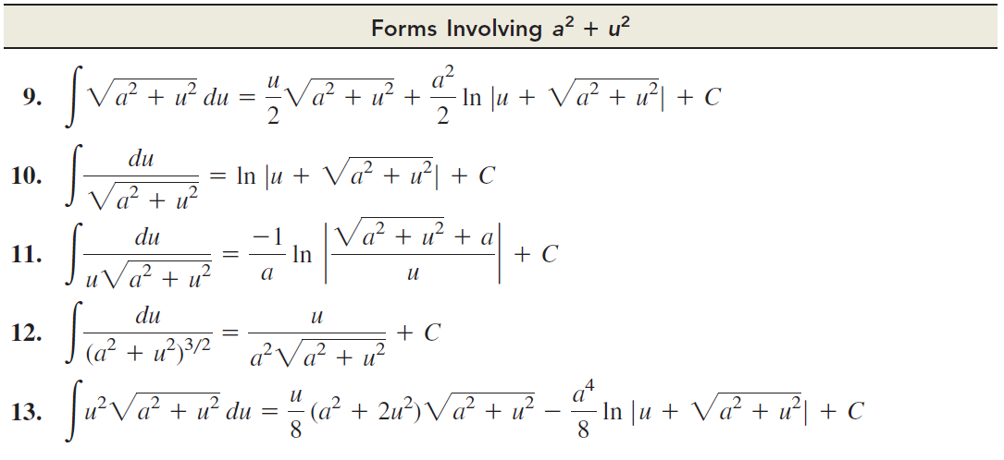
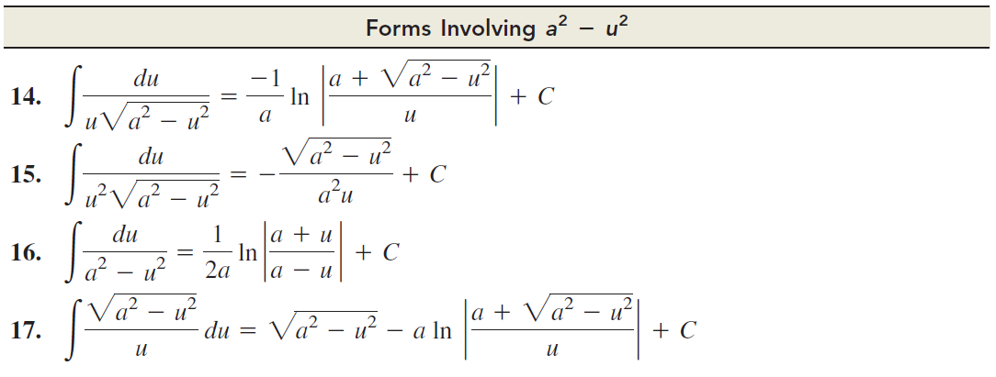
Important integral tables (1/ 2)

Slide 33
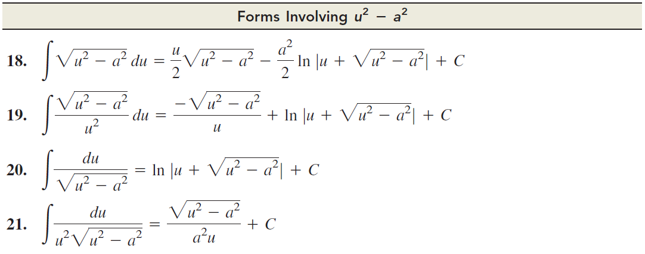
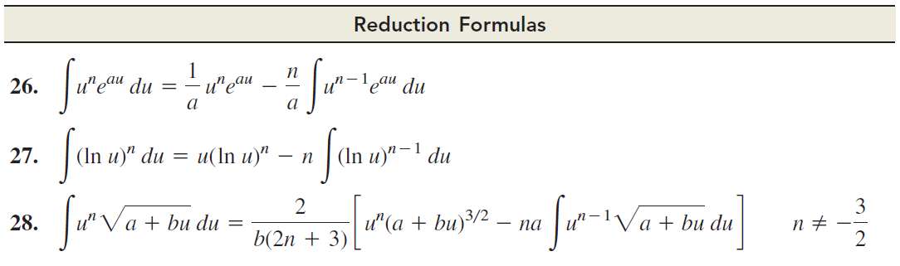
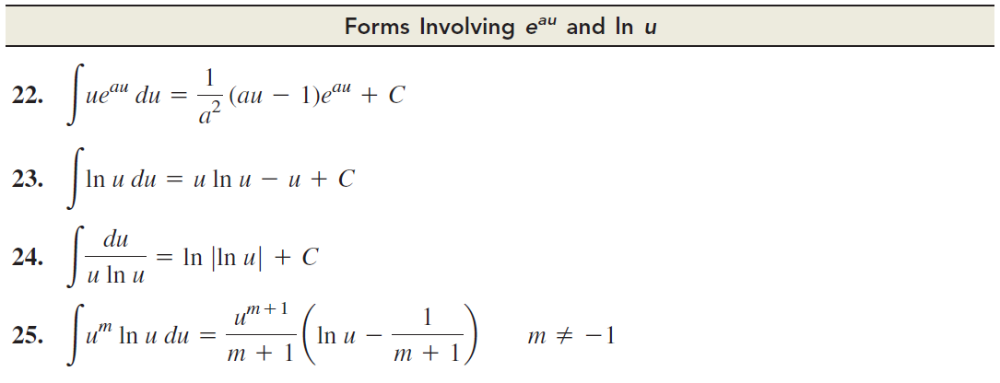
Important integral tables (2/ 2)

Slide 34


Example:
Using a table of integrals

Slide 35

Example:
An integral not in the table

Slide 36


Example:
Using a table of integrals

Slide 37

Example:
Evaluating integrals with the aid of an integral table

Slide 38

Example:
Evaluating integrals with the aid of an integral table

Slide 39

Example:
Evaluating integrals with the aid of an integral table

Slide 40



Additionally, Computer Algebra Systems (CAS) can help to evaluate a given integral (though the result needs to be validated, e.g. by differentiation)
here, we need to finally multiply to obtain π²
Example
here, we need the following identity:

Slide 41

There is a huge list of free/ commercial and/ or specially targeted Computer Algebra Systems
Some Computer Algebra Systems:
Axiom
Cadabra
CoCoA
Derive
Erable (aka ALGB)
Fermat
FORM
FriCAS
GAP
GiNaC
KANT/ KASH
LiveMath
Macaulay2
Macsyma
Magma
Magnus
Maple
Mathcad
Mathematica
Mathomatic
Maxima
MuMATH
MuPAD
OpenAxiom
PARI/ GP
Reduce
Scilab
SageMath
SINGULAR
Smath Studio
Symbolic Math Toolbox (MATLAB)
SymPy
TI-Nspire CAS
Wolfram Alpha
Xcas/ Giac
Yacas
…
https://en.wikipedia.org/wiki/List_of_computer_algebra_systems

Slide 42



Slide 43

Central Exercises:
Calculus II for Management
Topics
Integration by parts
the problems are also given in compact form on a separate work sheet

Slide 44
Recap:
Integration by parts (1/ 2)

Slide 45
Recap:
Integration by parts (2/ 2)

Slide 46





Exercise

Slide 47






Exercise
L-I-A-T-E

Slide 48


Exercise

Slide 49

Exercise
10-15 minutes
self/ group work
please, upload your solutions to the chat
before we start the self/ group work, let us solve part a) together
to have a blue-print for your self/ group work

Slide 50




Exercise
L-I-A-T-E

Slide 51






Exercise
Discussion
2nd integration by
parts required
L-I-A-T-E

Slide 52






Exercise
Discussion
L-I-A-T-E

Slide 53






Exercise
Discussion
L-I-A-T-E

Slide 54




Exercise
Discussion
L-I-A-T-E

Slide 55

Exercise
Discussion

Slide 56
Calculus I for Management

