Slide 1
Calculus II for MGMT – Introduction to Vectors & Matrices Linear Systems of Equations
Mathematics for Management
Supplementary Electronic Materials
Linear Systems of Equations
Lines in the plane & systems of equations in 2 variables
Lines in space & systems of equations in 3 variables
N-variable systems &
Gaussian Elimination

Slide 2
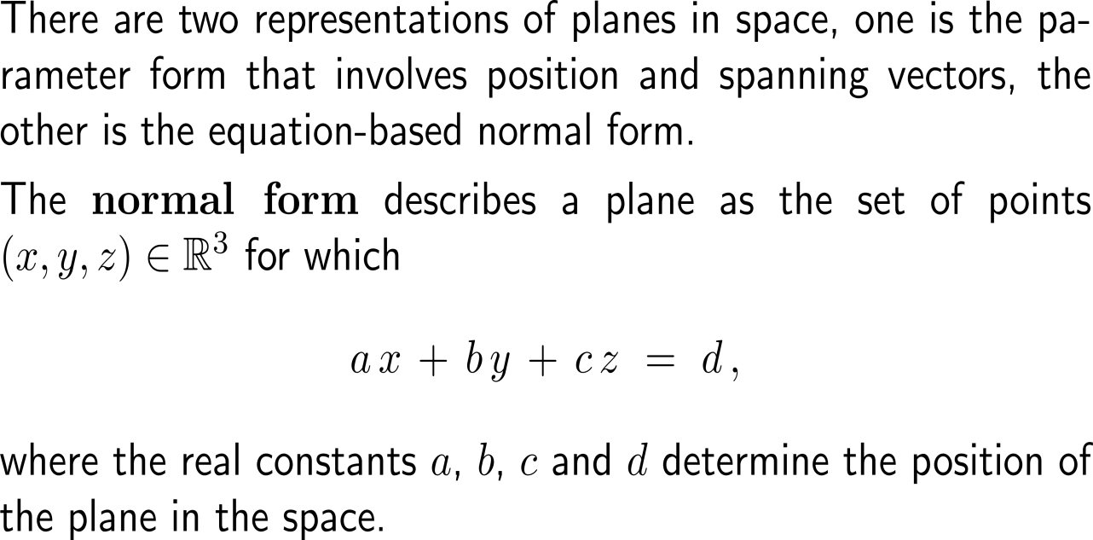
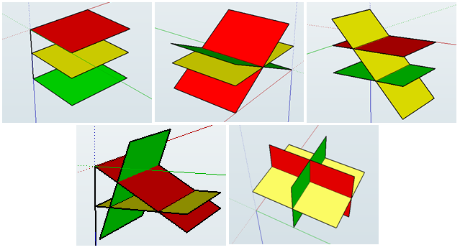
Planes and lines in the (Euclidean) space can be described in terms of a normal form that generalizes the form of a line in the plane (1/ 2)

Slide 3
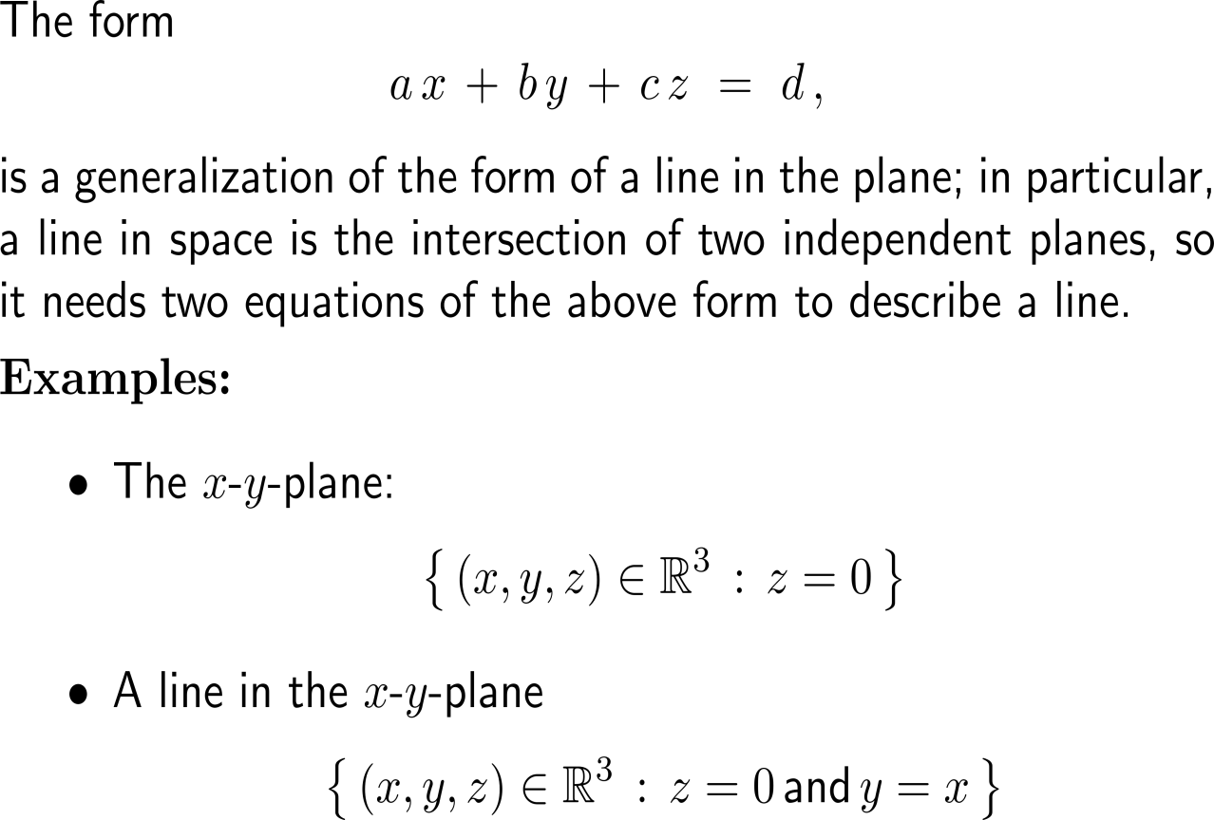
Planes and lines in the (Euclidean) space can be described in terms of a normal form that generalizes the form of a line in the plane (2/ 2)

Slide 4
To solve systems with three variables, we again apply elementary operations to successively eliminate variables (1/ 5)

Slide 5
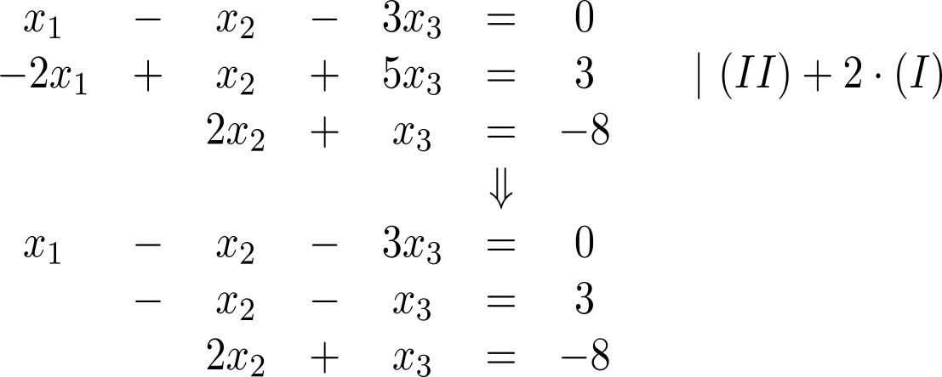
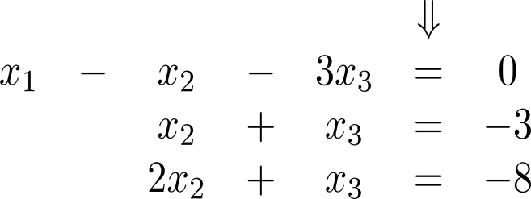
To solve systems with three variables, we again apply elementary operations to successively eliminate variables (2/ 5)

Slide 6
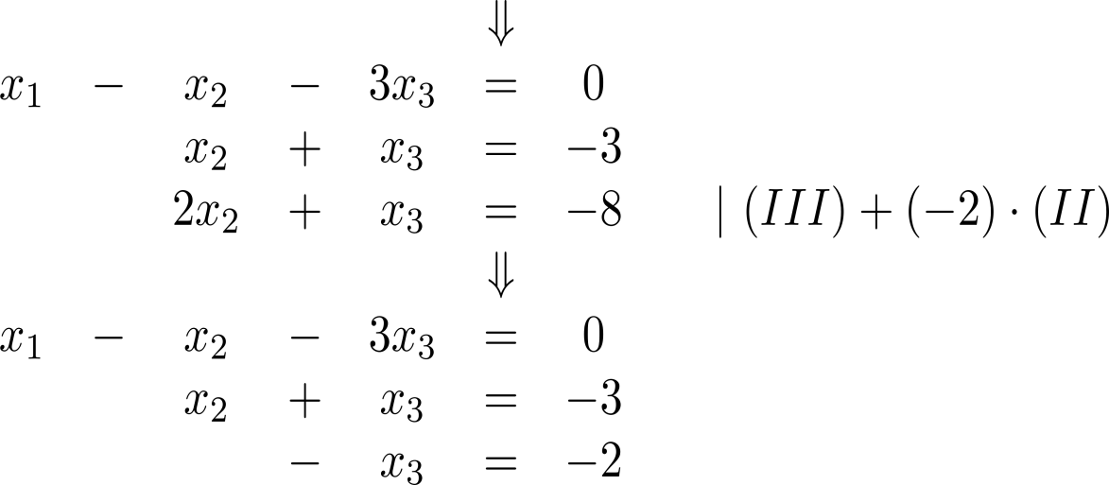
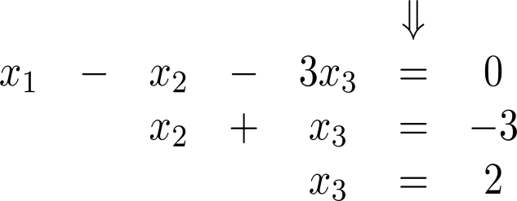
To solve systems with three variables, we again apply elementary operations to successively eliminate variables (3/ 5)
back-substitution

Slide 7
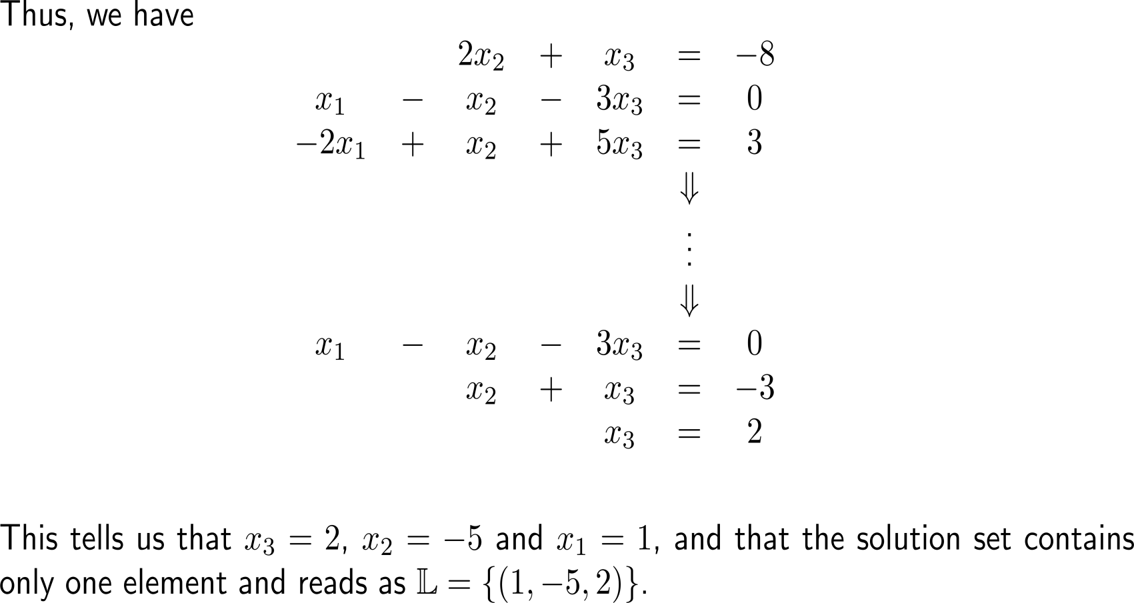
To solve systems with three variables, we again apply elementary operations to successively eliminate variables (4/ 5)
back-substitution

Slide 8
To solve systems with three variables, we again apply elementary operations to successively eliminate variables (5/ 5)

Slide 9
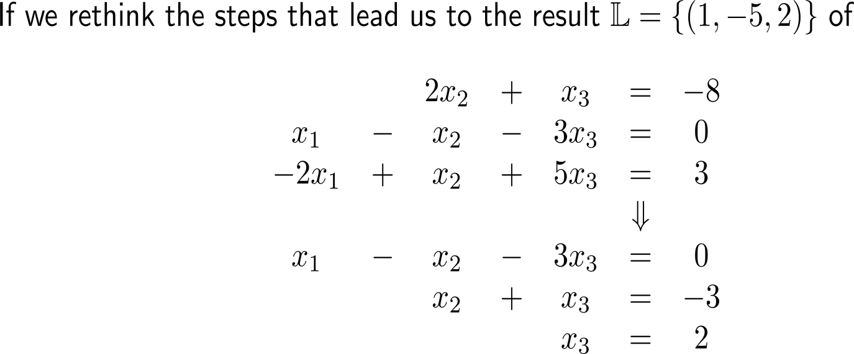
What structural insights do we have obtained so far? (1/ 2)
back-substitution

Slide 10
What structural insights do we have obtained so far? (2/ 2)
back-substitution

Slide 11
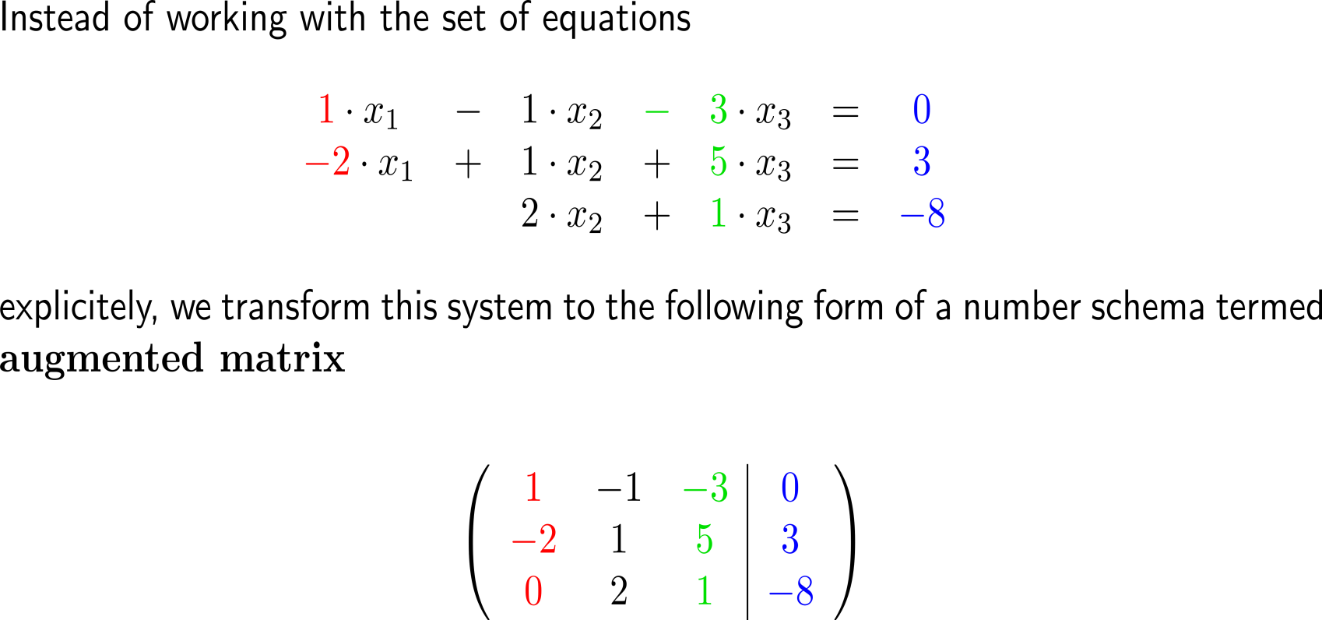
To exploit the fact, that we manipulate the coefficients of the variables only, we introduce the augmented matrix (1/ 2)
columns
rows

Slide 12
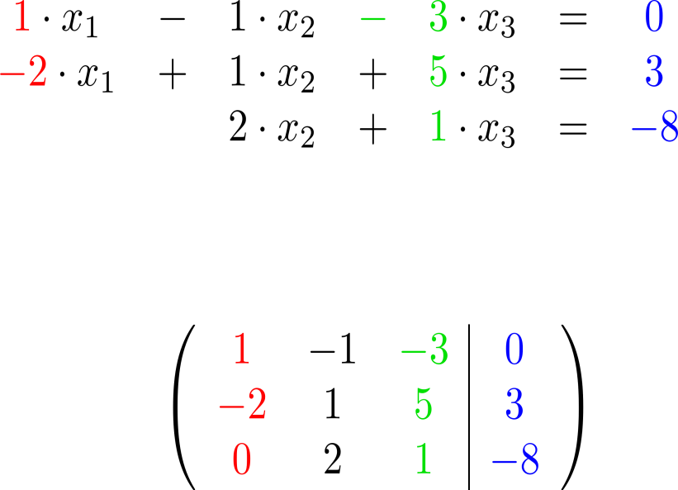
To exploit the fact, that we manipulate the coefficients of the variables only, we introduce the augmented matrix (2/ 2)
columns
rows
numbers correspond to the coefficients of the variables/ unknowns
numbers correspond to the right-hand side entries

Slide 13
What do the numbers in the augmented matrix stand for?

Slide 14
Exercise: Determine the augmented matrix

Slide 15
Instead of the system of equations we now work with its augmented matrix and reduce this until a triangular form is reached (1/ 4)

Slide 16
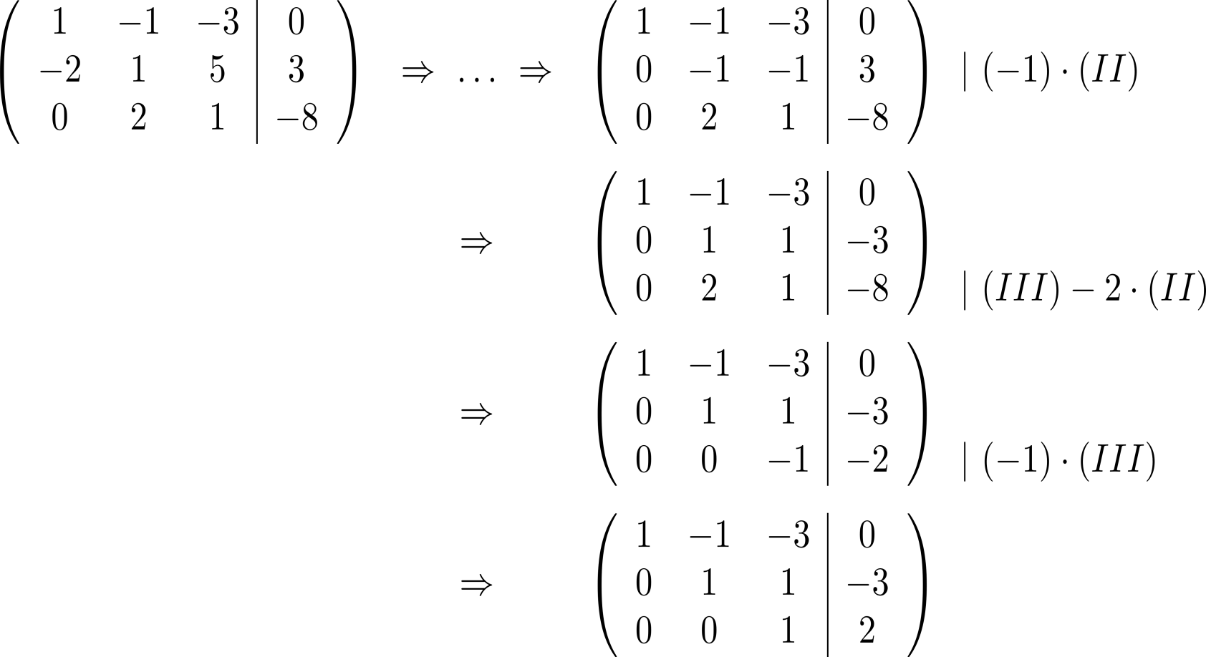
Instead of the system of equations we now work with its augmented matrix and reduce this until a triangular form is reached (2/ 4)

Slide 17
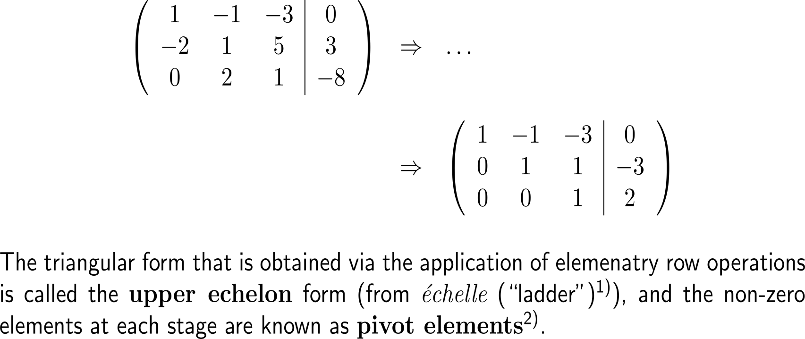
Instead of the system of equations we now work with its augmented matrix and reduce this until a triangular form is reached (3/ 4)
pivot
element
upper echelon
form

Slide 18
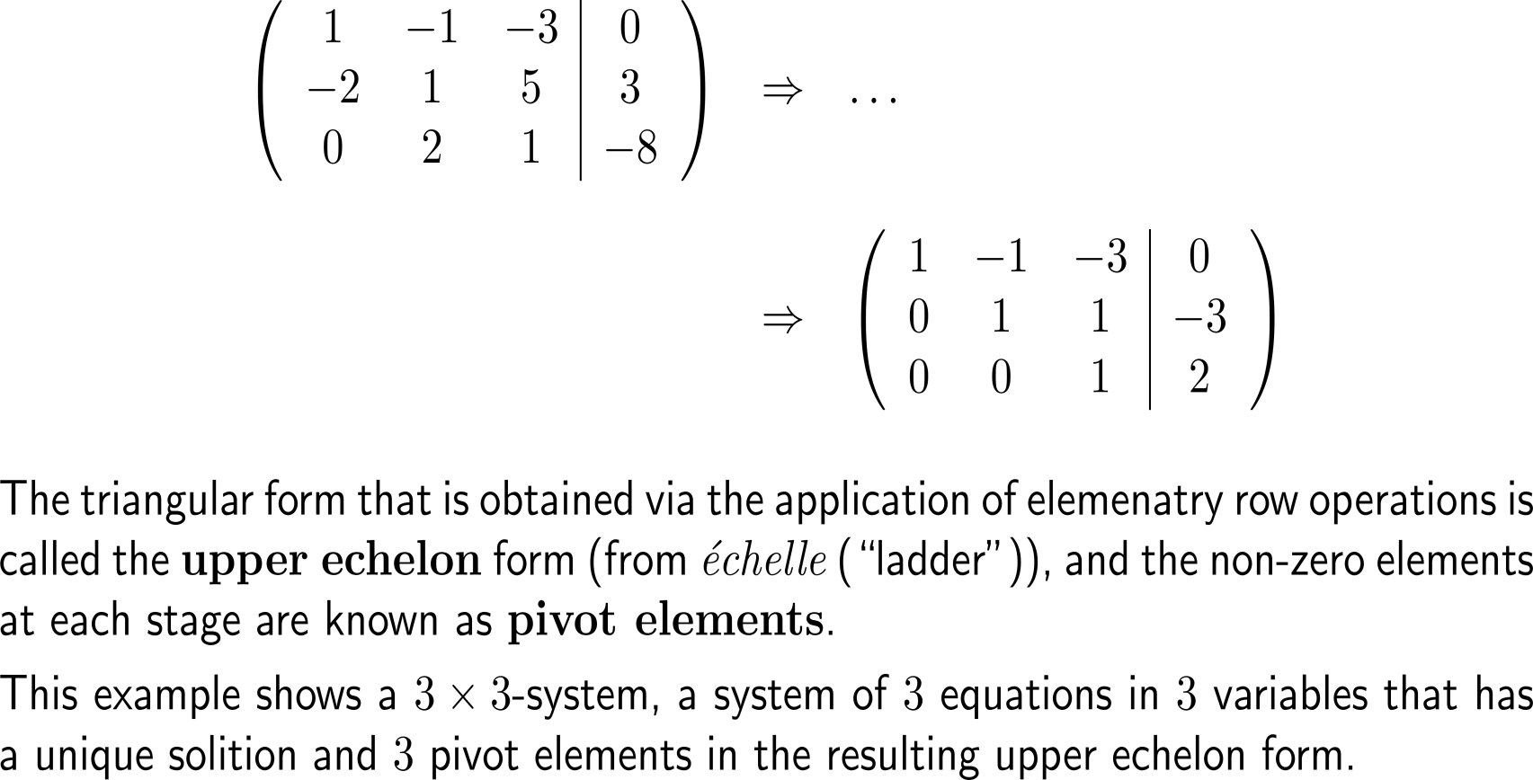
Instead of the system of equations we now work with its augmented matrix and reduce this until a triangular form is reached (3/ 4)
pivot
element
upper echelon
form

Slide 19
Example: The structure of the solution set

Slide 20
Example: The structure of the solution set
pivot elements
free variable

Slide 21
Example: The structure of the solution set
pivot elements
free variable

Slide 22
Example: The structure of the solution set

Slide 23
Example: The structure of the solution set
problem

Slide 24
Summary: What do the upper echelon form and the pivot elements tell us?
elementary operations
number of the equation =
row i
Elementary operations:
Type 1: Swap the positions of two equations/ rows in the augmented matrix
Type 2: Multiply an equation/ row by a nonzero number/ scalar.
Type 3: Add to one equation/ row a scalar multiple of another equation/ row.
Note: Elementary operations leave the solution set invariant, i.e. when applied do not change the solution.
a_{i,j}
column j
= number of the unknown

Slide 25
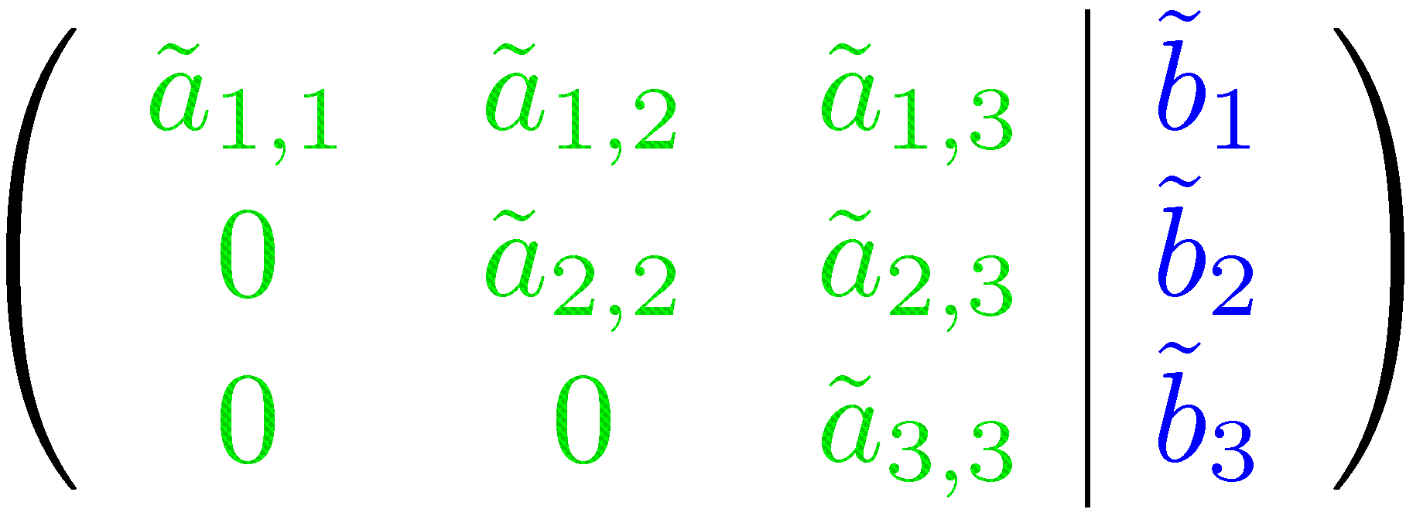
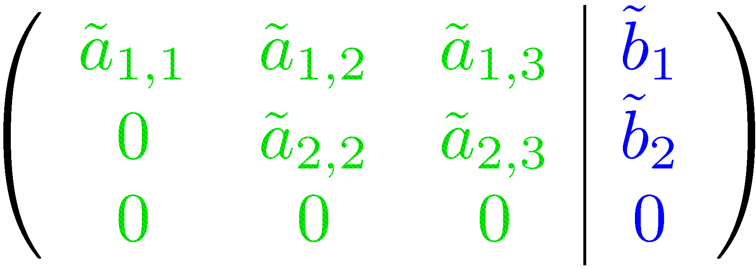
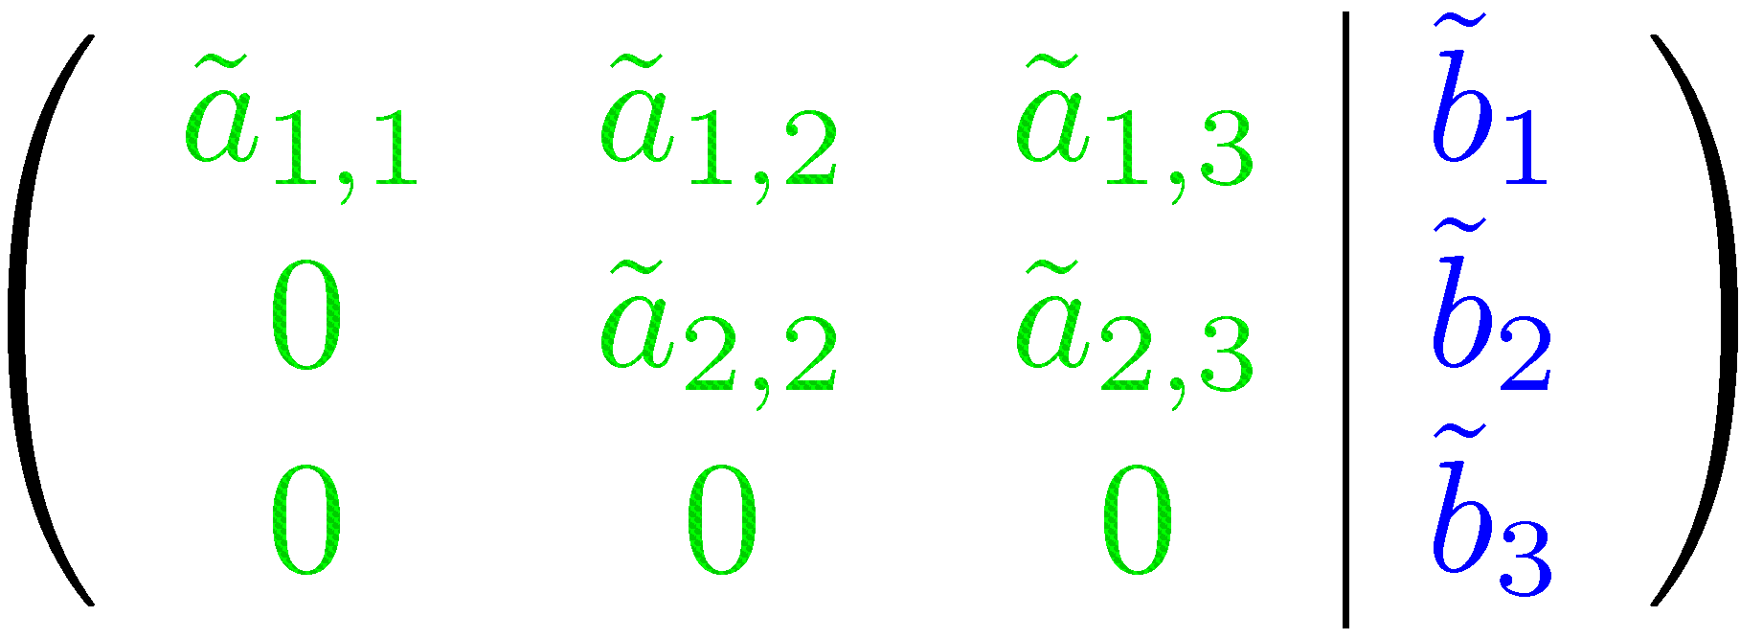
Summary: What do the upper echelon form and the pivot elements tell us?
elementary operations

Slide 26
Summary: What do the upper echelon form and the pivot elements tell us?
number of pivots
= number of unknowns
no additional non zeros on the right hand side
⇒ unique solution
number of pivots
< number of unknowns
no additional non zeros on the right hand side
⇒ free variable required
⇒ infinitely many solutions
additional non zeros on the right hand side
⇒ no solution

Slide 27
Calculus II for Management

