Slide 1
Calculus II for MGMT – Introduction to Vectors & Matrices Determinants
Mathematics for Management
Supplementary Electronic Materials
Determinants
Motivation: The geometry of determinants
General properties &
computation rules

Slide 2
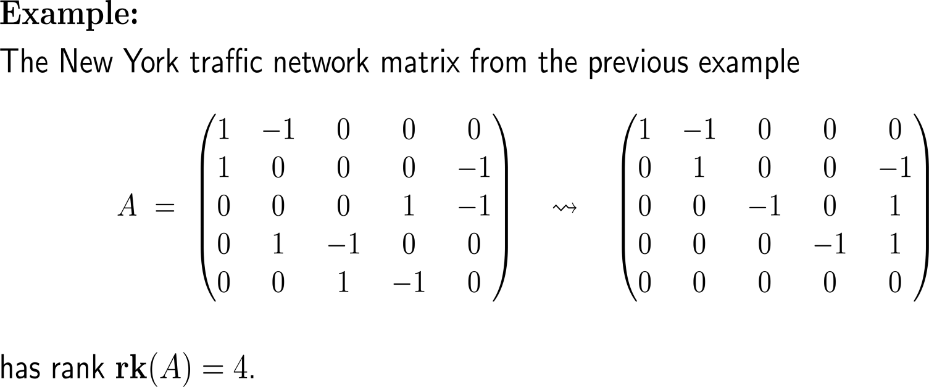
In the last lecture, we already defined the rank of a matrix by means of the number of pivot elements that remain after Gaussian elimination

Slide 3
To establish the general definition of the determinant function we require the notion of linearity

Slide 4
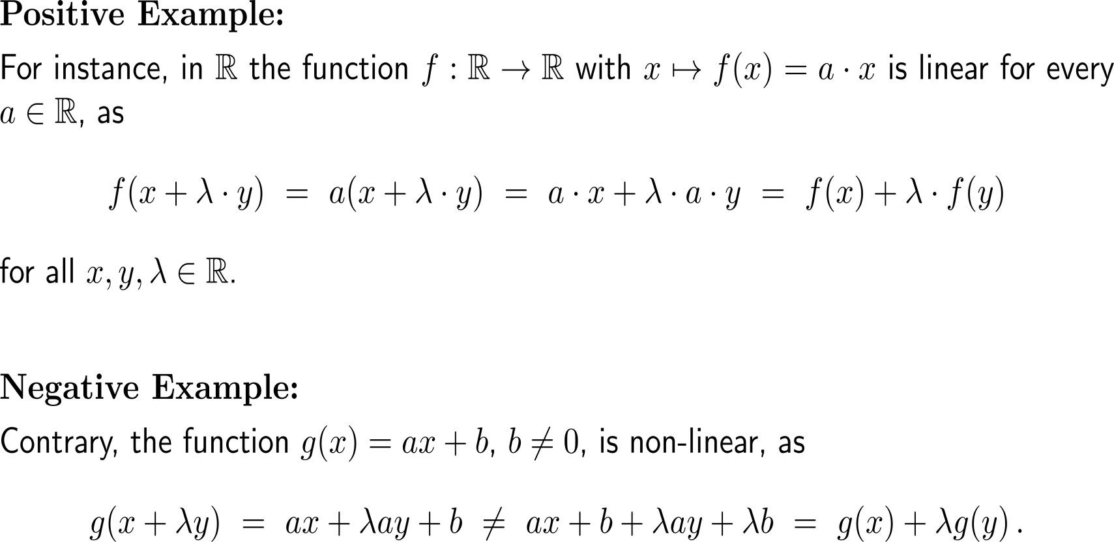
Example: Linear functions

Slide 5
Example: Linear functions

Slide 6
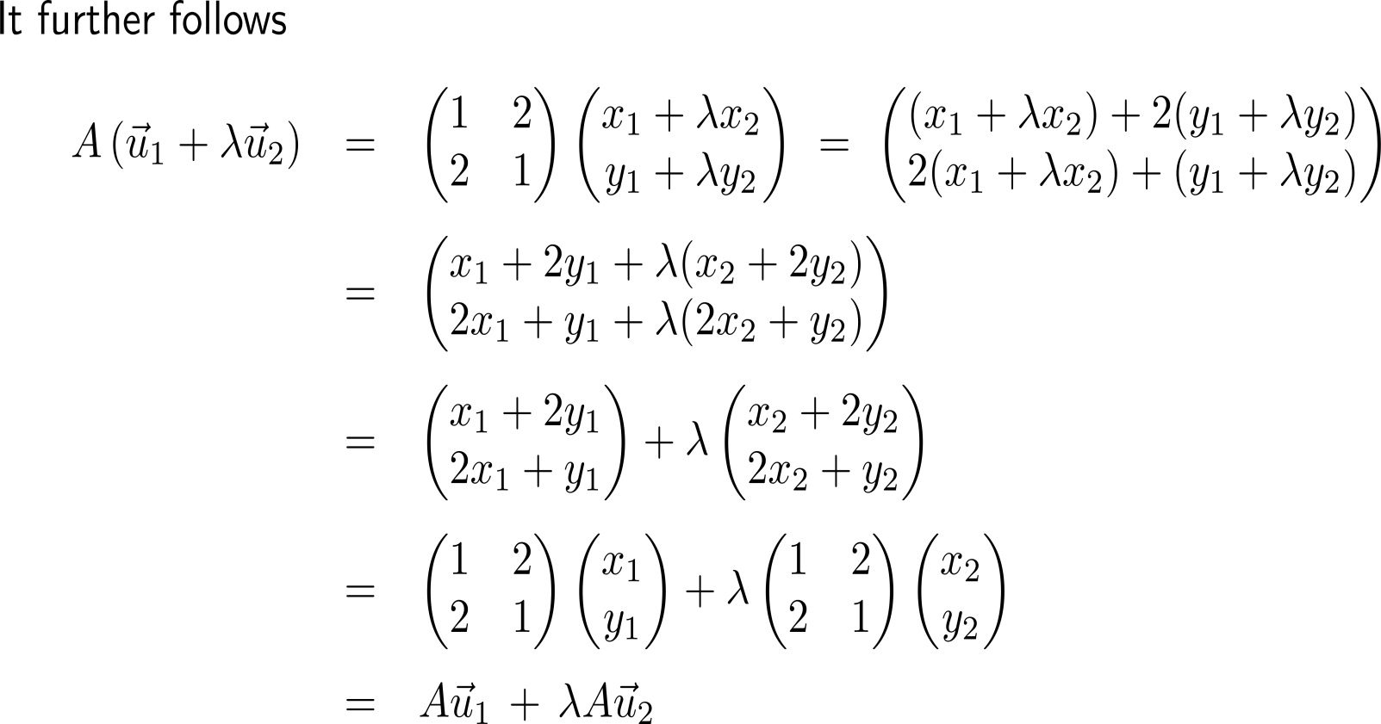
Example: Linear functions

Slide 7
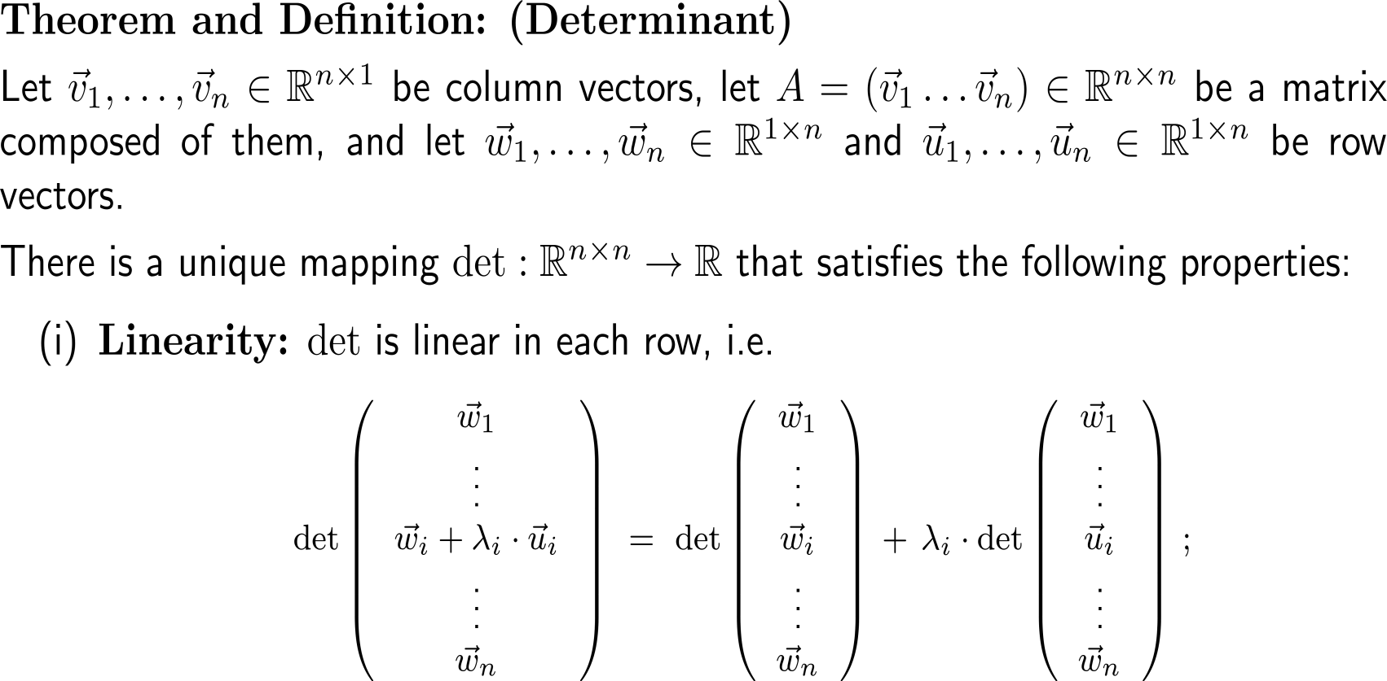
The determinant is a multi-linear form that maps the unit matrix to one and not-full rank matrices to zero (1/ 2)

Slide 8
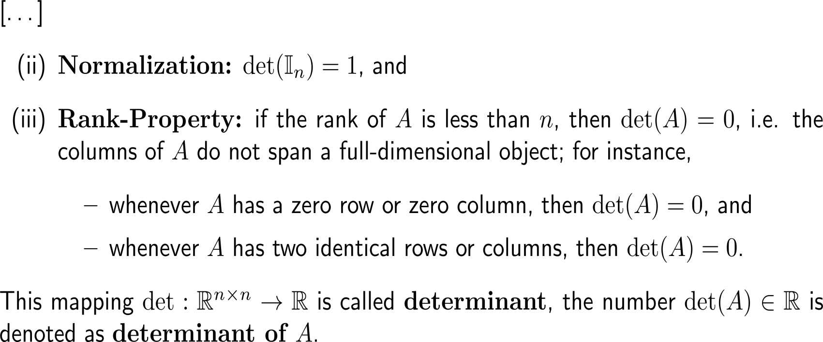
The determinant is a multi-linear form that maps the unit matrix to one and not-full rank matrices to zero (2/ 2)

Slide 9
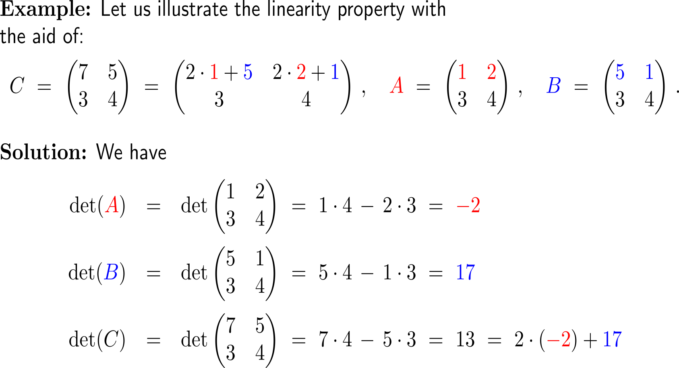
Example: Properties of the determinant

Slide 10
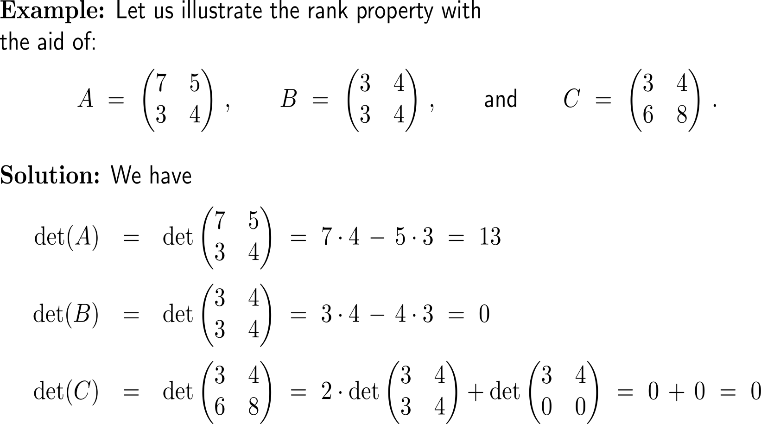
Example: The value of a determinant in 2D

Slide 11
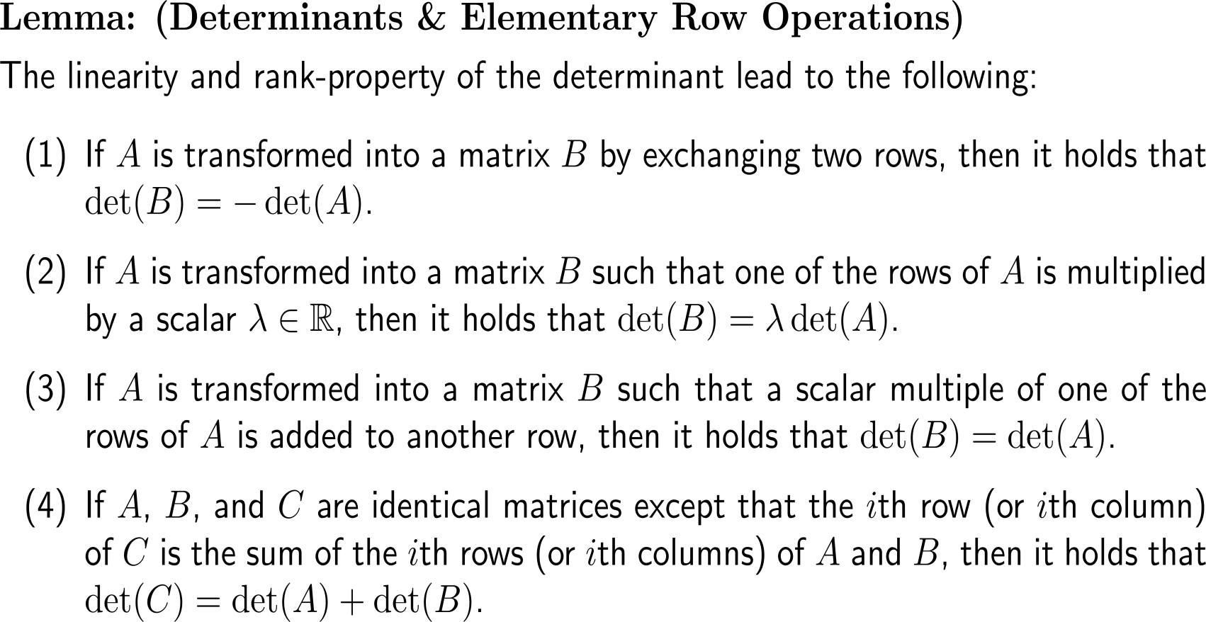
The lemma sheds light on the behavior of determinants on elementary row operations and thus on possibilities to compute the determinant

Slide 12
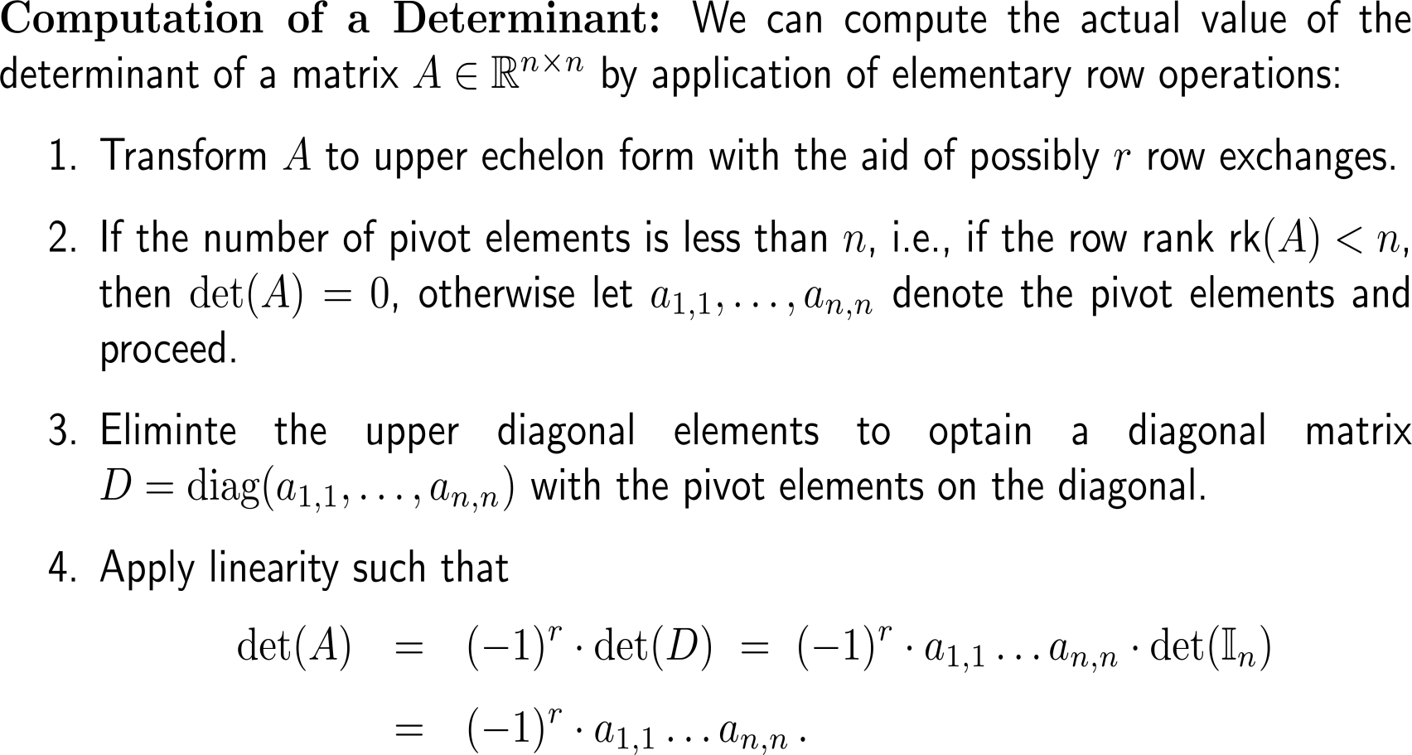
The computation of a determinant boils down to a careful application of Gaussian elimination

Slide 13
Example: Computation of a determinant
| (III) +2 (I)

Slide 14
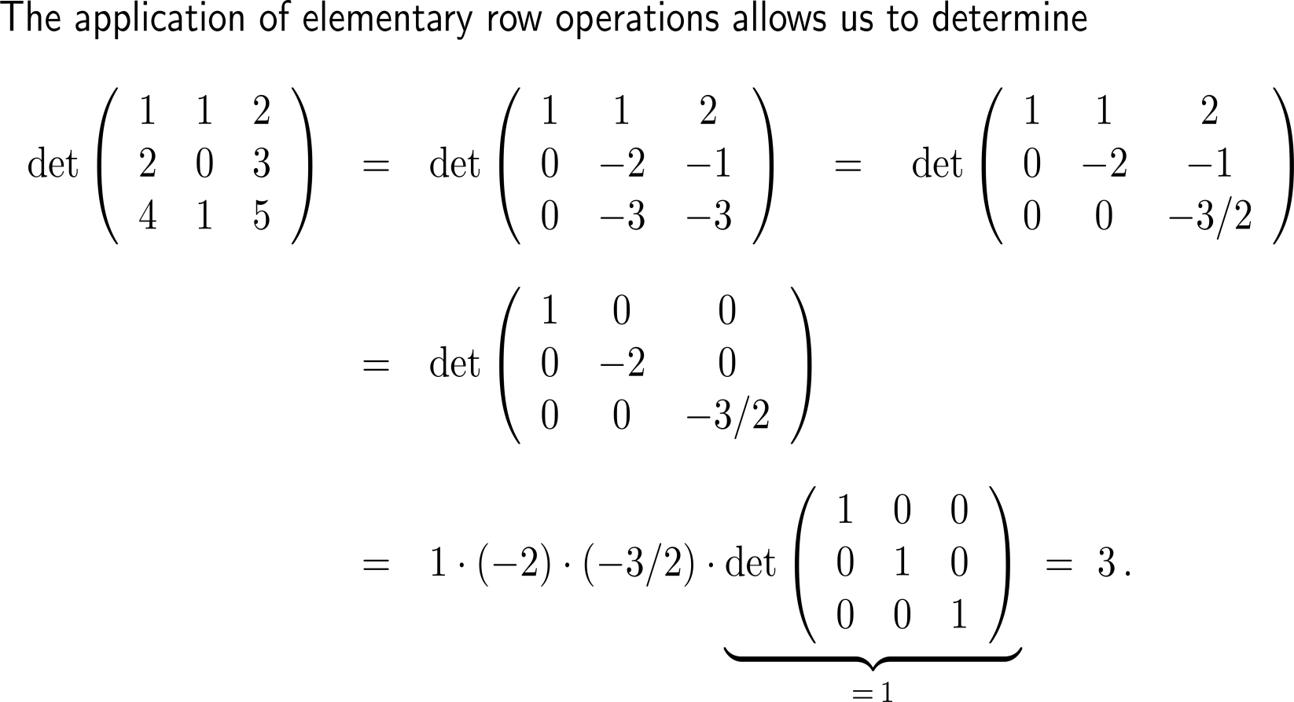
Example: Computation of a determinant
| (II) –2 (I)
| (III) – ³/₂ (II)
| (III) – 4 (I)
| further elementary
row operations
Of course, we get the same result when applying the rule of Sarrus.

Slide 15
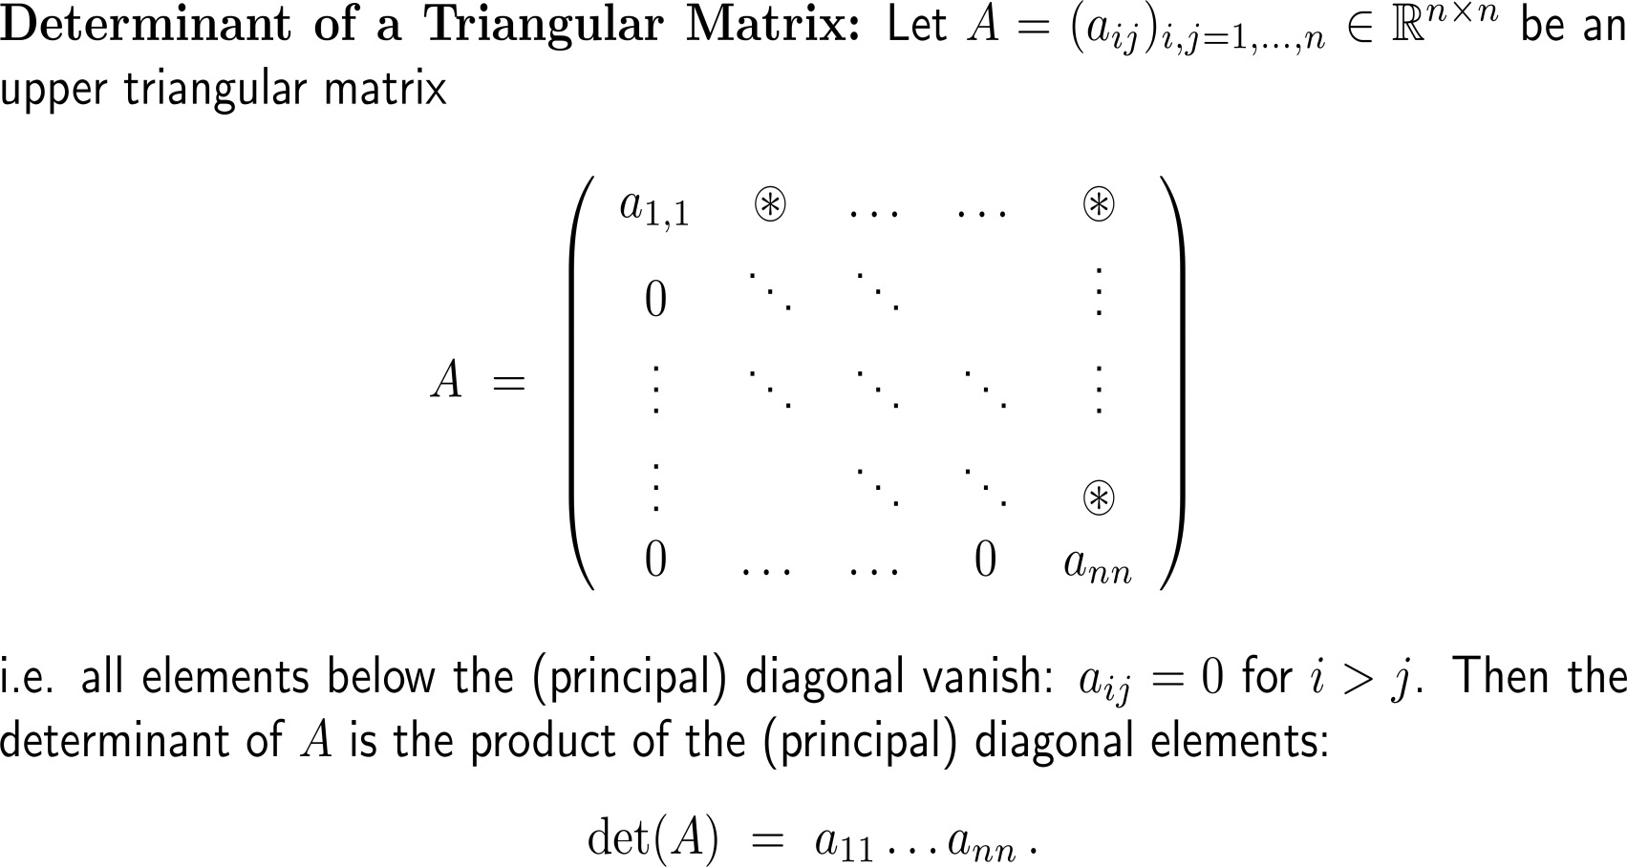
The determinant of a triangular matrix is the product of the diagonal elements

Slide 16
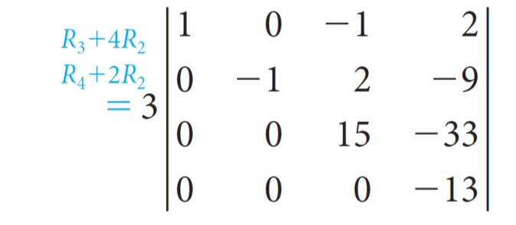
Example: Computation of a determinant
= 3 · 1 · (−1) · 15 · (−13) = 585

Slide 17
Finally, let us study the properties of a matrix whose rows and columns are interchanged: the transposed matrix

Slide 18
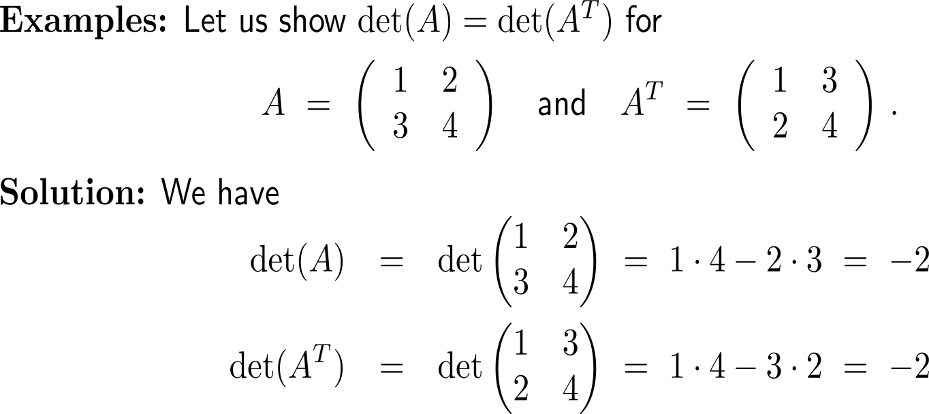
In particular, transposition of a matrix does not change the value of the determinant (1/ 2)

Slide 19
In particular, transposition of a matrix does not change the value of the determinant (2/ 2)

Slide 20
Calculus II for Management

