Slide 1
Calculus II for MGMT – Introduction to Vectors & Matrices Linear Combinations of Vectors
Mathematics for Management
Supplementary Electronic Materials
Vectors & their linear combinations
Vectors & their linear combinations
Scalar-, vector-, and spat-product
Hessian Normal Form

Slide 2
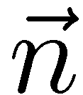
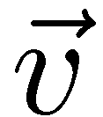
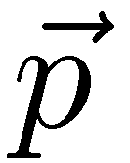
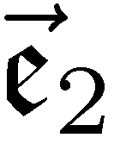
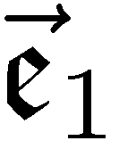
The Hessian normal form (HNF) represents, for instance, a line as a linear system in two variables (1/ 2)

Slide 3
The Hessian normal form (HNF) represents, for instance, a line as a linear system in two variables (2/ 2)

Slide 4
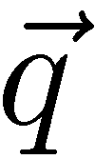
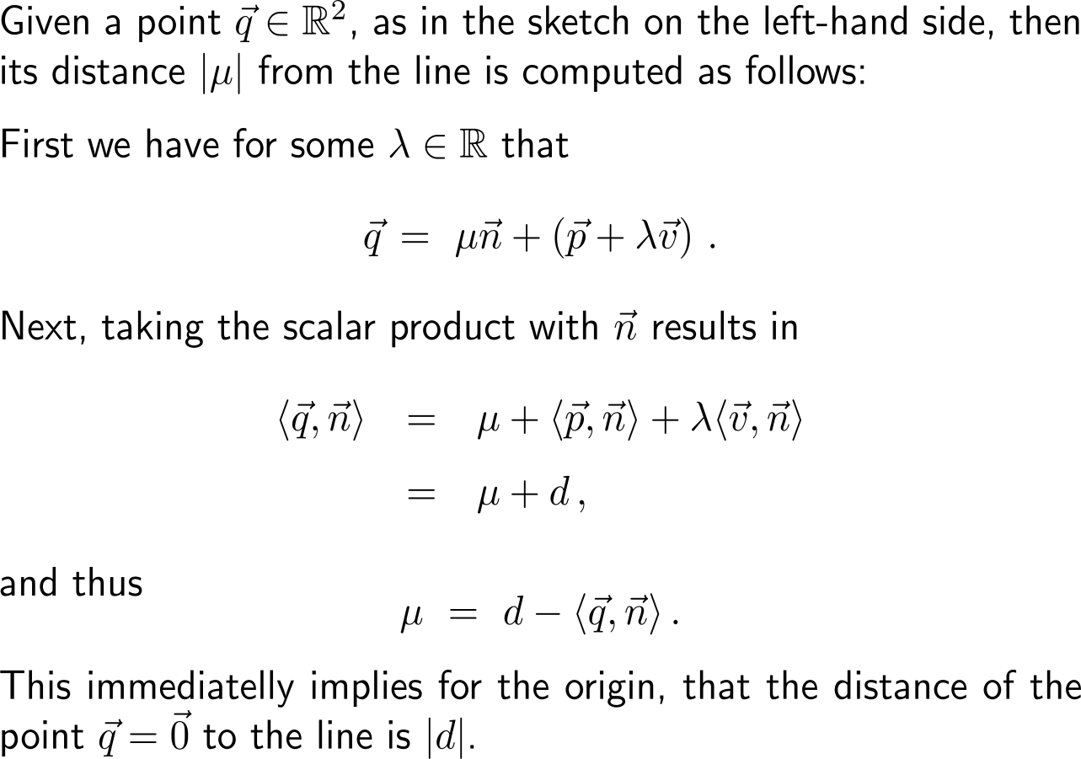
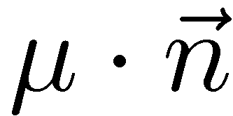
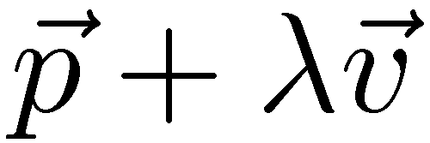
The HNF is a handy tool for determining the distance of a point from a given line (or plane)

Slide 5
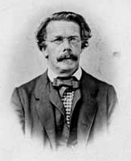
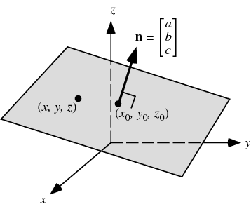
Analogously to our considerations the HNF of a plane in Euclidean 3D space is established
Otto Hesse
(1811 – 1874)

Slide 6
Example: Converting a parameter form into HNF
normal vector to the plane
(7,2,0)^{T}

Slide 7
Example: Converting a parameter form into HNF

Slide 8
The interplay between the parameter and the Hessian normal forms makes solving geometrical questions easy

Slide 9
Calculus II for Management

