Slide 1
Calculus II for MGMT – Introduction to Vectors & Matrices
Matrix Computations
Mathematics for Management
Supplementary Electronic Materials
Matrix Computations
Matrix-matrix computations
  A primer on eigenvalues and eigenvectors
  Inverse matrices

Slide 2
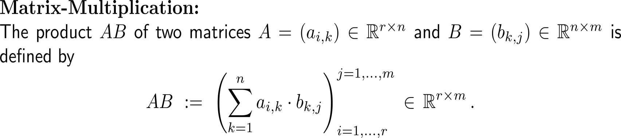
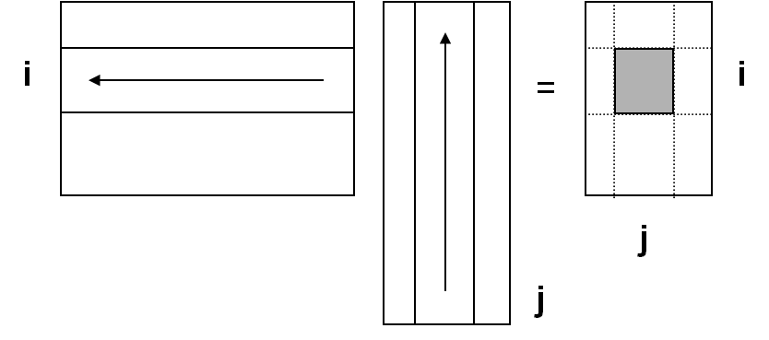
The product of two matrices is defined as multiple application of scalar products: row times column (1/ 3)
lay over each other
multiply
sum

Slide 3
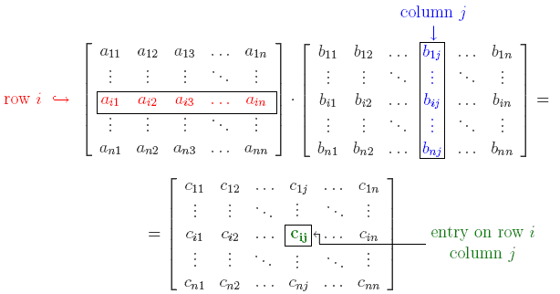
The product of two matrices is defined as multiple application of scalar products: row times column (2/ 3)

Slide 4
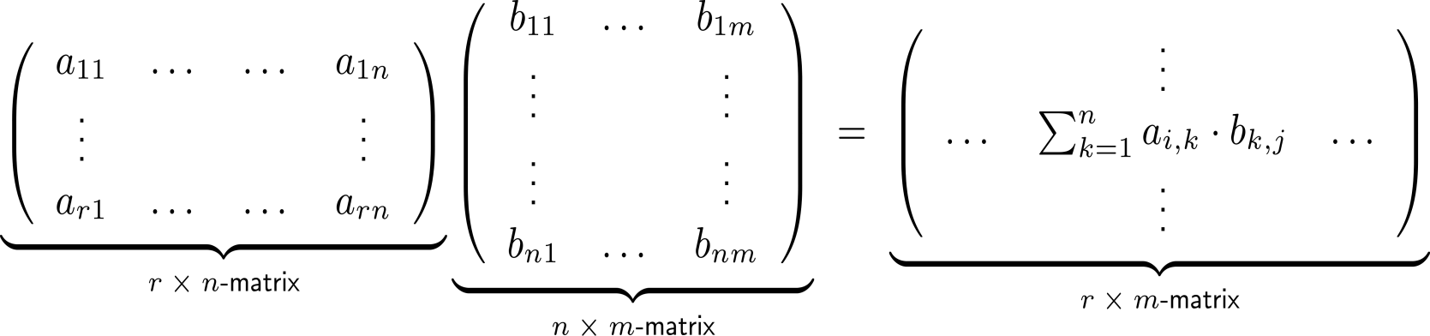
The product of two matrices is defined as multiple application of scalar products: row times column (3/ 3)
lay over each other
multiply
sum

Slide 5

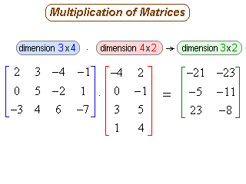
Example:
Matrix-matrix multiplication

Slide 6
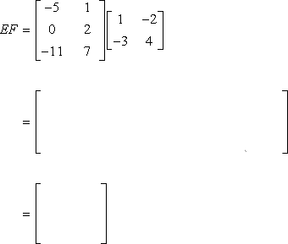
Example:
Matrix-matrix multiplication

Slide 7
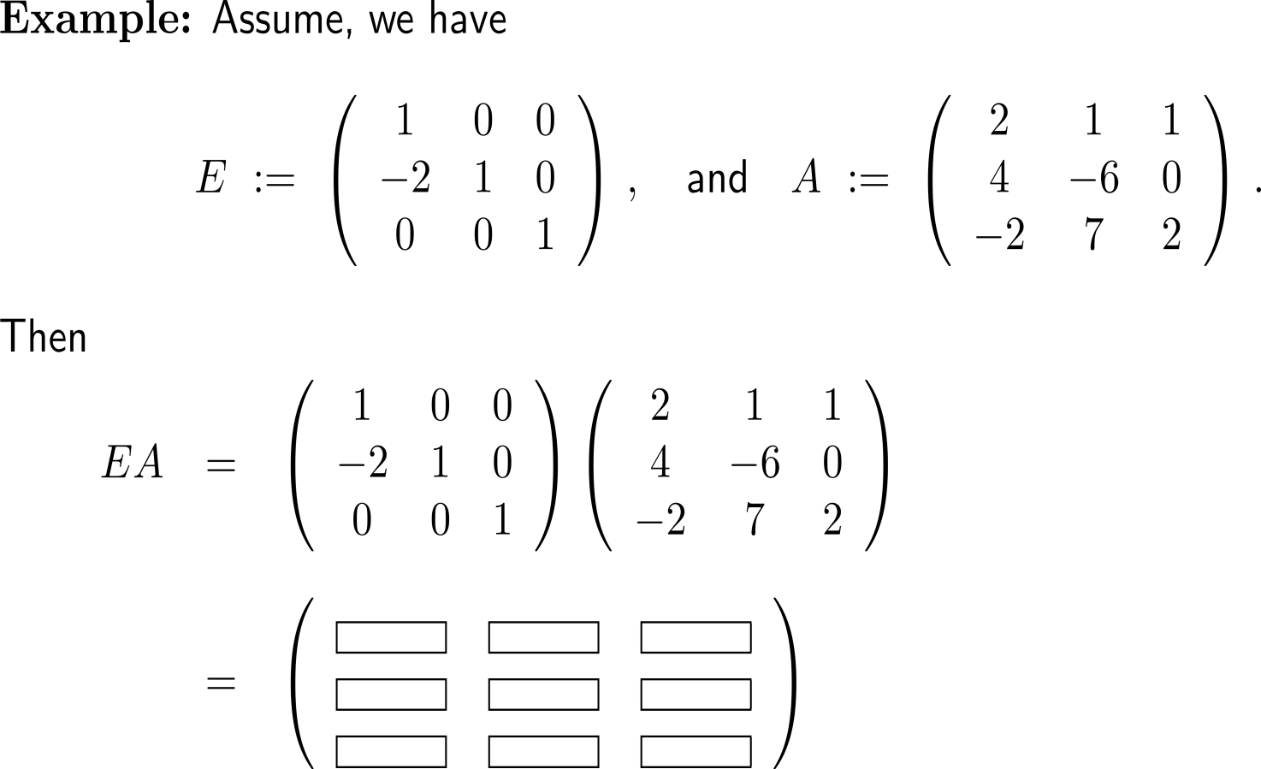
Example:
Matrix-matrix multiplication

Slide 8
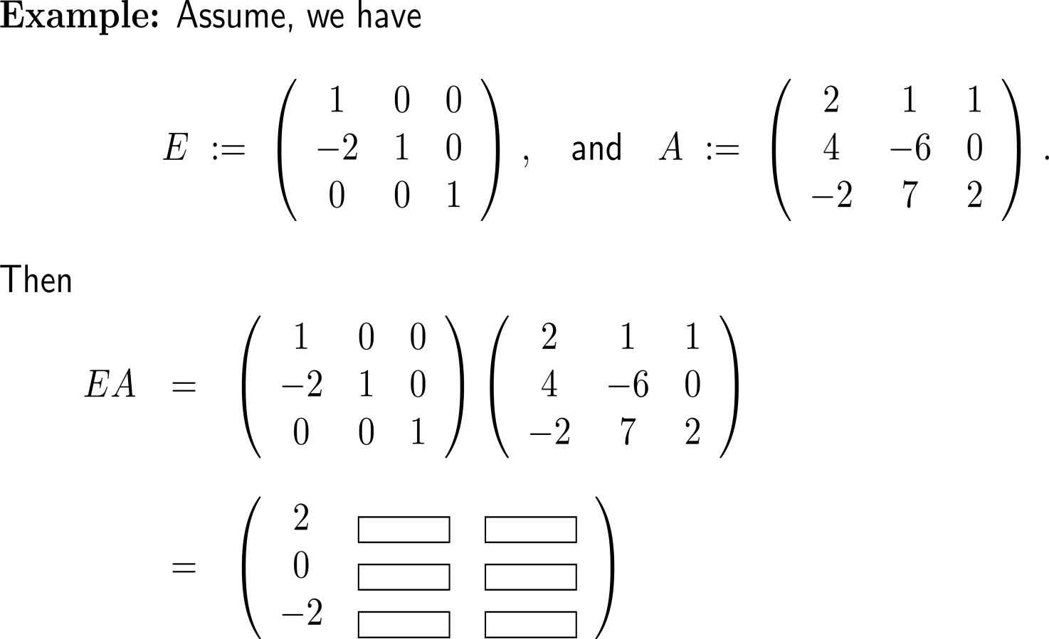
Example:
Matrix-matrix multiplication

Slide 9
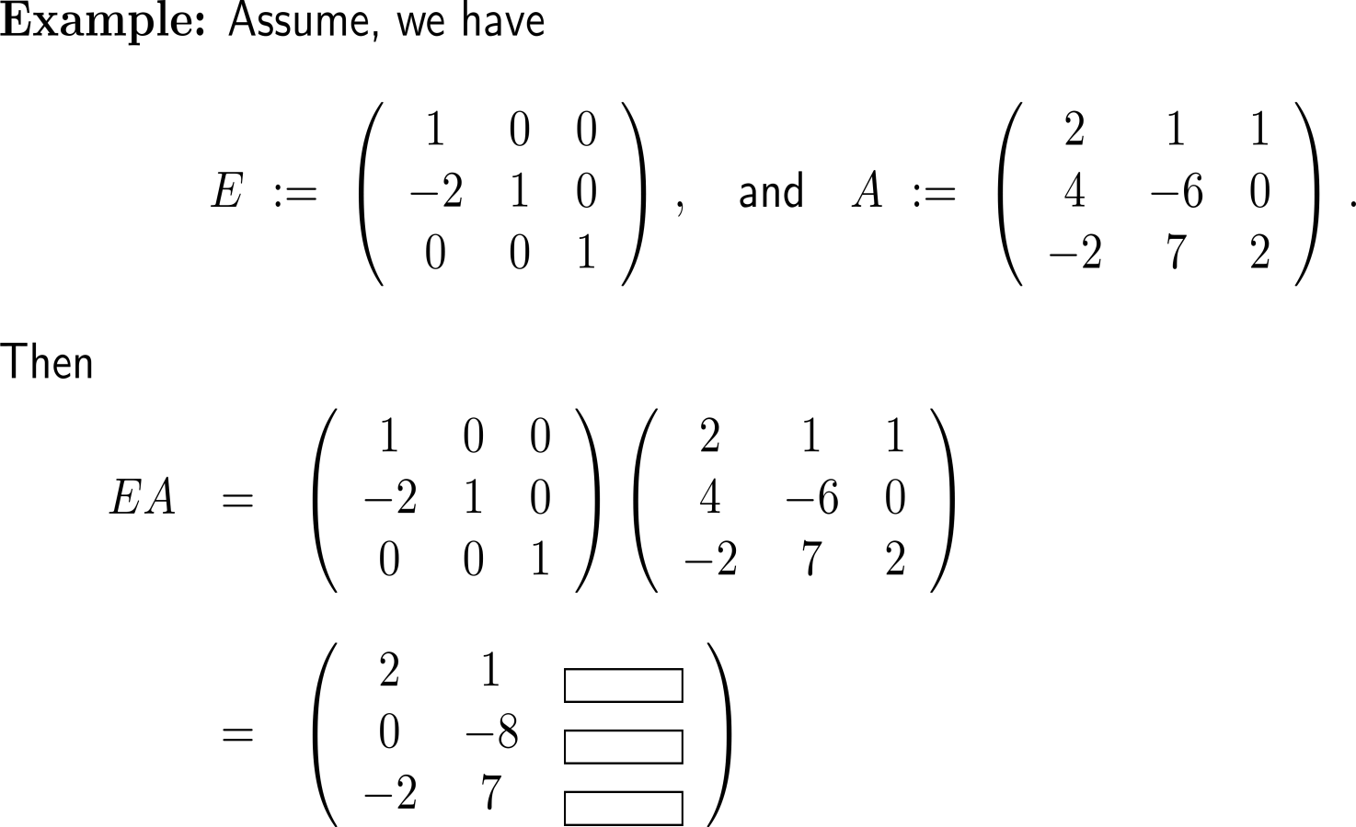
Example:
Matrix-matrix multiplication

Slide 10
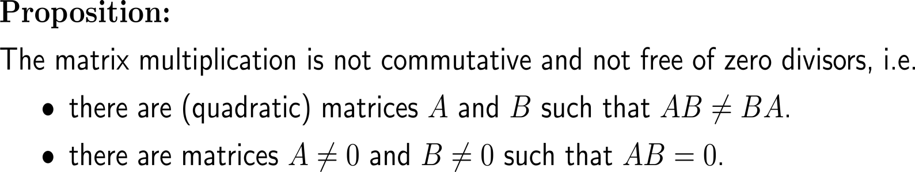
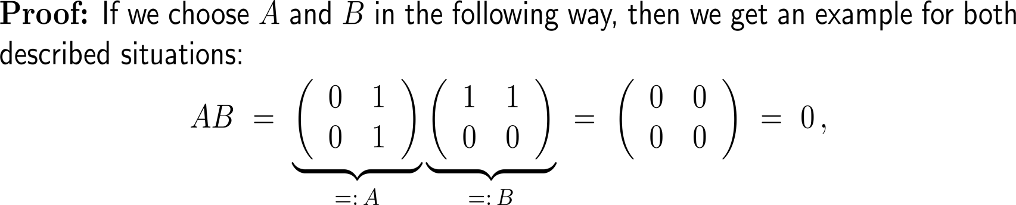
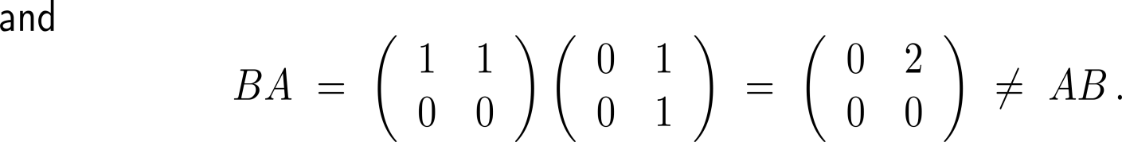
The matrix multiplication is, unlike the multiplication of real numbers, not commutative and not free of zero divisors

Slide 11
Calculus II for Management

