Slide 1
Calculus II for Management
Linear Systems of Equations
week 1
Lecture 1
Lines in the plane & 2D systems of equations
Planes in space & 3D systems of equations

Slide 2
Topics
Lines in the Plane & Systems of Equations with 2 Variables
Planes in Space & Systems of Equations with 3 Variables

Slide 3
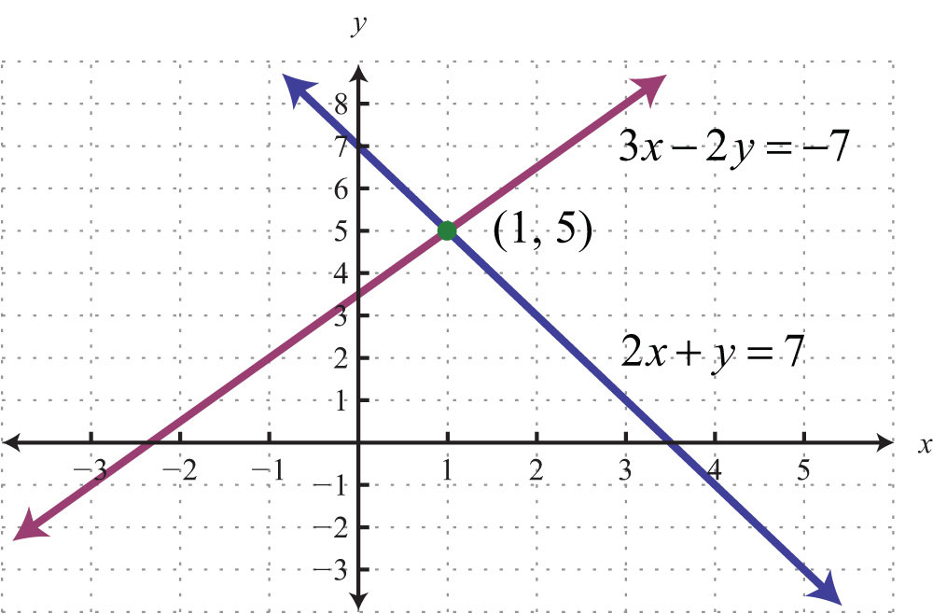
Determining the point of intersection of two lines, i.e. solving a system of two linear equations with two variables (1/ 4)

Slide 4
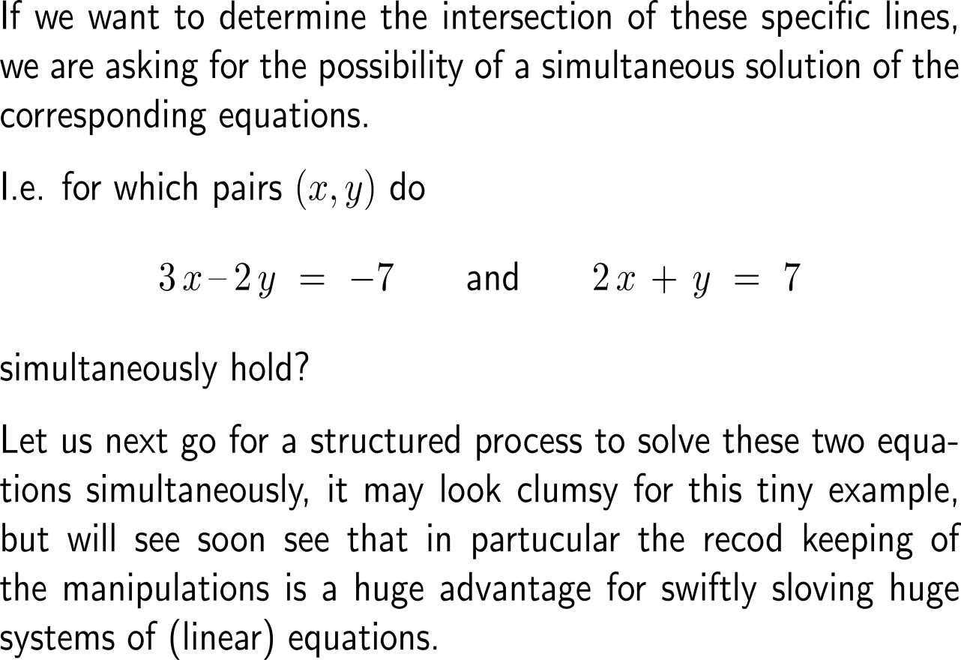
Determining the point of intersection of two lines, i.e. solving a system of two linear equations with two variables (2/ 4)

Slide 5
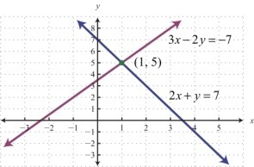
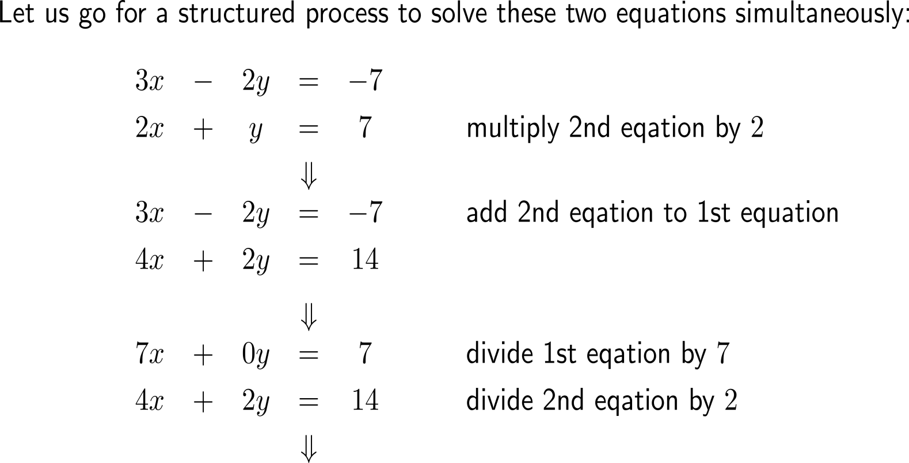
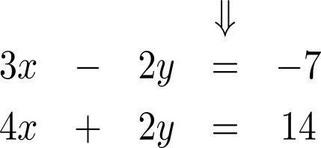
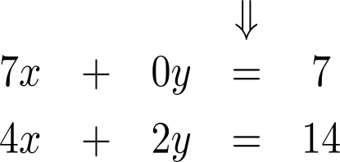
Determining the point of intersection of two lines, i.e. solving a system of two linear equations with two variables (3/ 4)

Slide 6
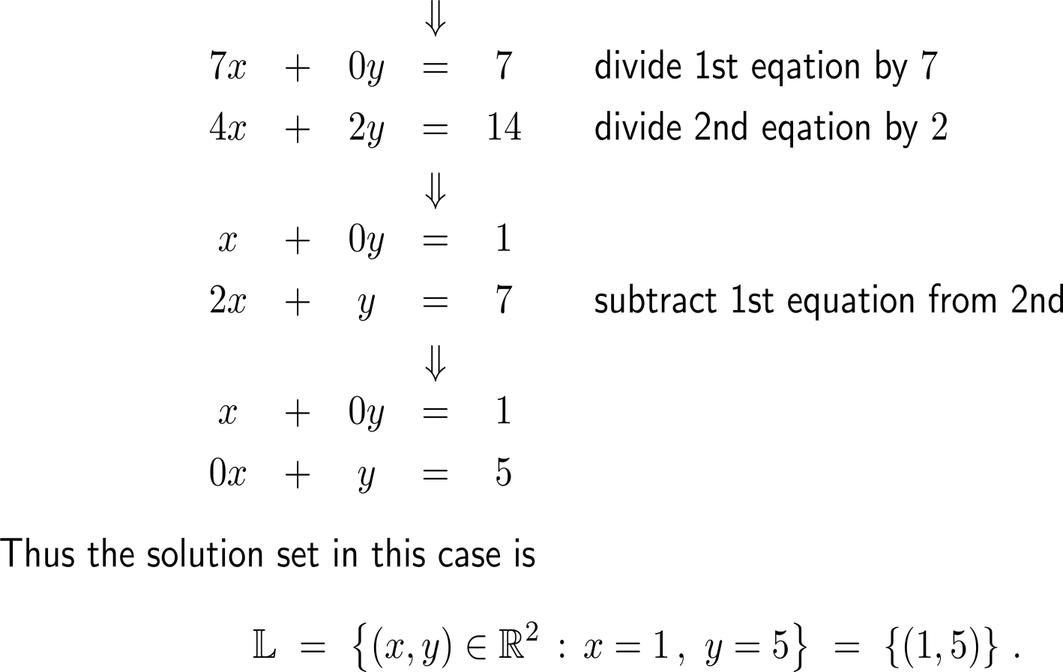
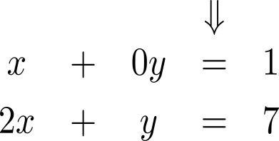
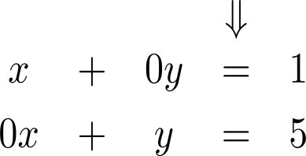
Determining the point of intersection of two lines, i.e. solving a system of two linear equations with two variables (4/ 4)
normalization
of a variable

Slide 7
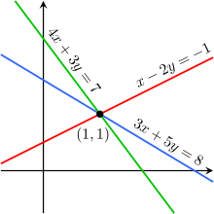
Example: Applying the elimination procedure

Slide 8
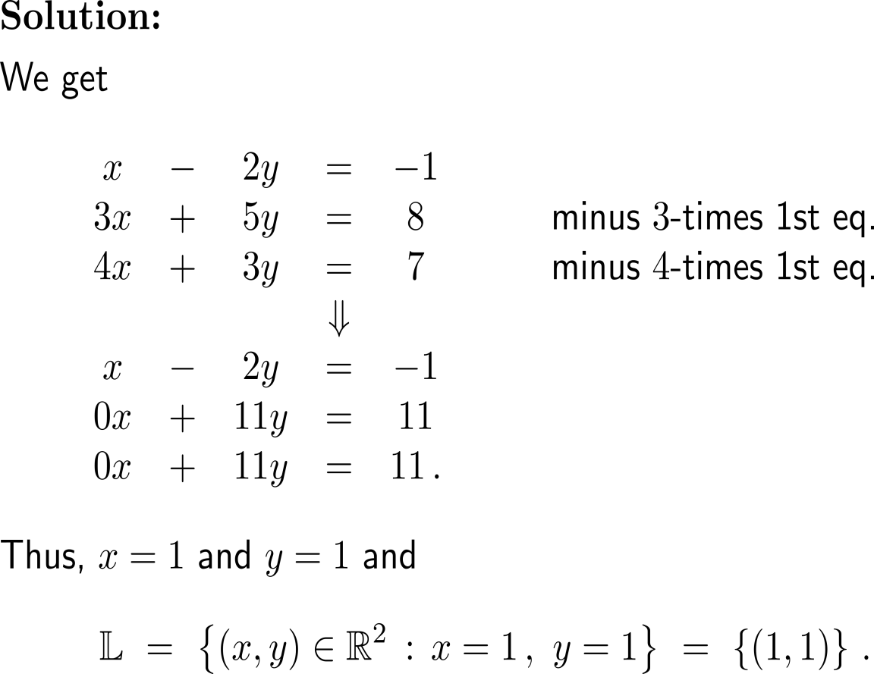
Example: Applying the elimination procedure

Slide 9
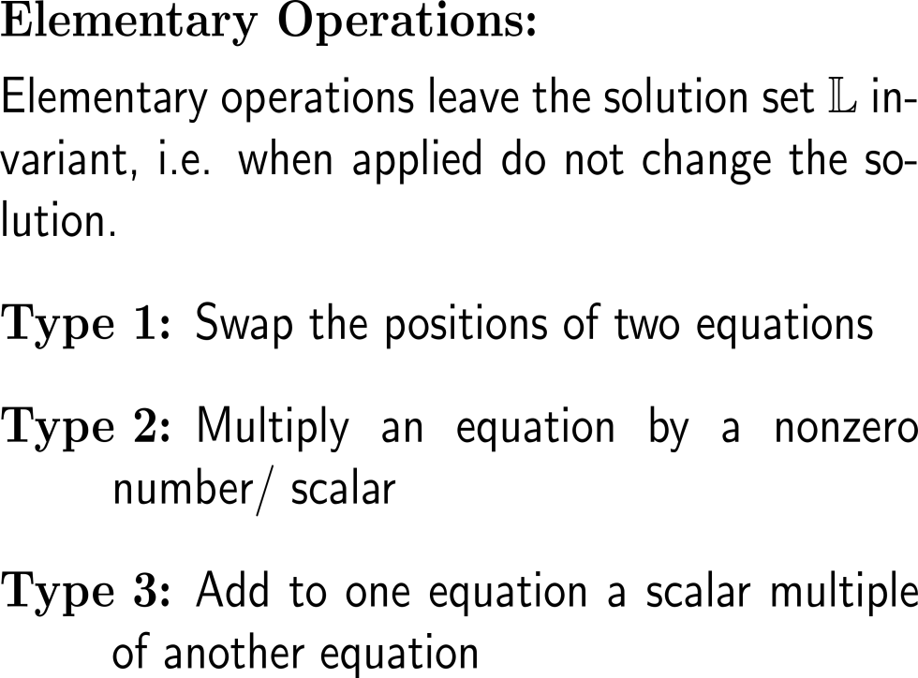
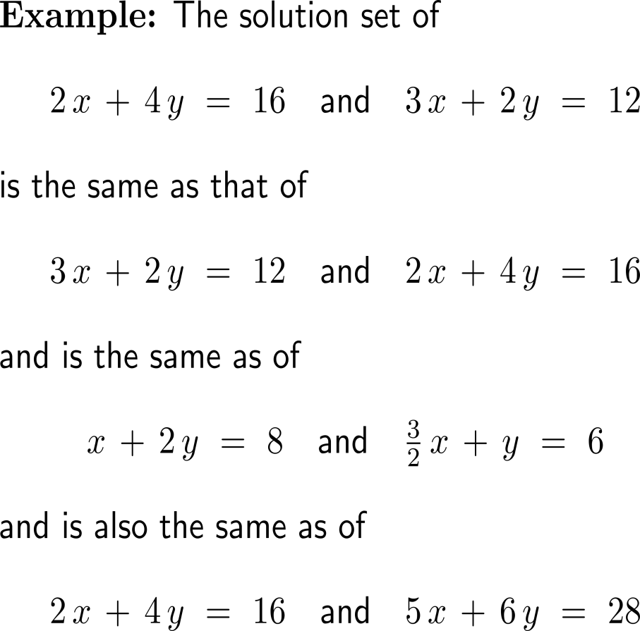
Summary: Elementary operations to gain the upper echelon form
Type 1
Type 2
Type 3

Slide 10
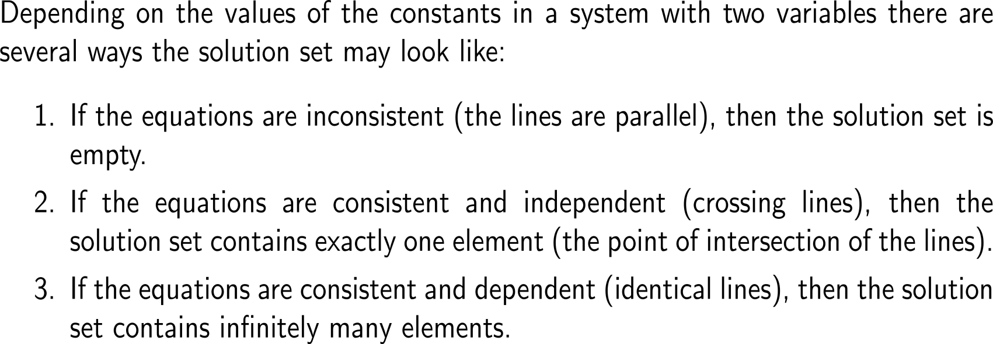
Of course, depending on the mutual position of the two lines there can as well be no or infinitely many points of intersection
consistent
inconsistent
independent
dependent
no solution
(parallel)
one solution
(intersect)
∞ solutions
(identical)

Slide 11
Example: The structure of the solution set

Slide 12
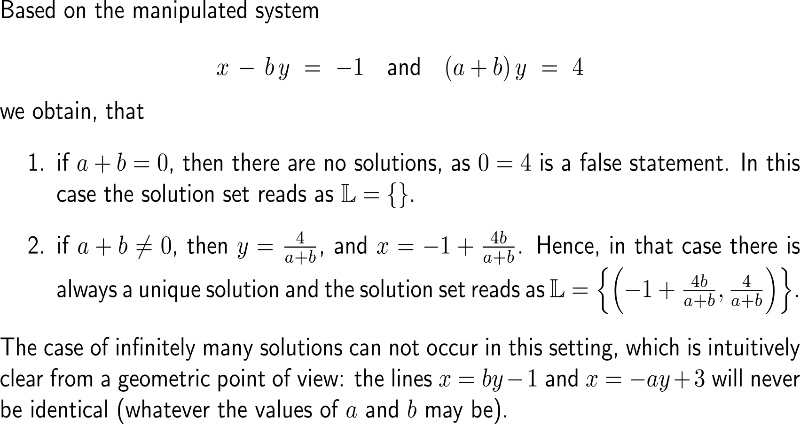
Example: The structure of the solution set
inconsistent
no solution
(parallel)
independent
one solution
(intersect)
dependent
∞ solutions
(identical)

Slide 13
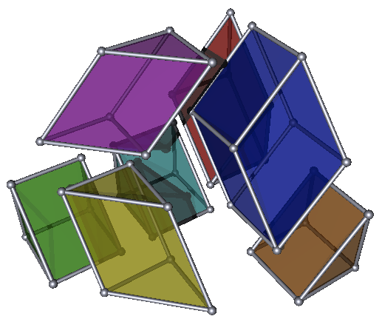
Topics
Lines in the Plane & Systems of Equations with 2 Variables
Planes in Space & Systems of Equations with 3 Variables

Slide 14
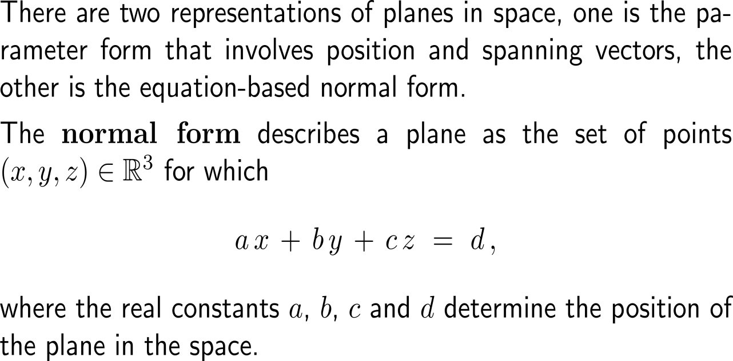
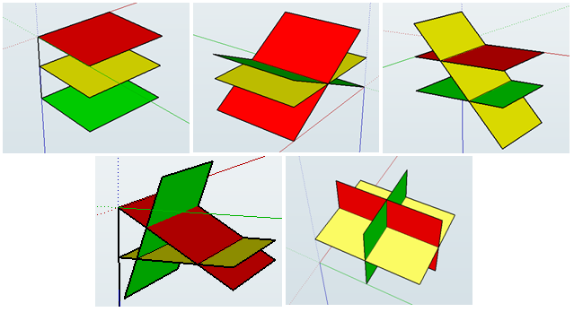
Planes and lines in the (Euclidean) space can be described in terms of a normal form that generalizes the form of a line in the plane (1/ 2)

Slide 15
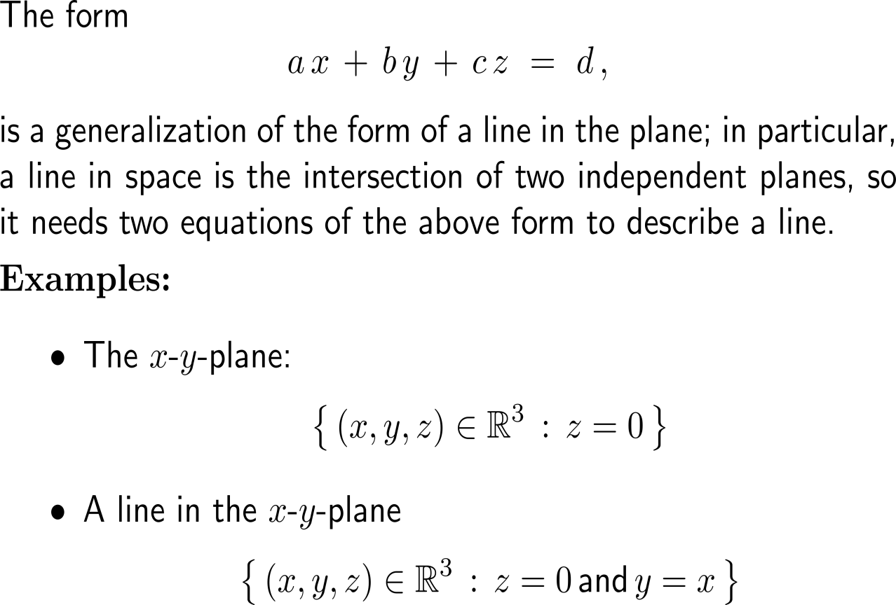
Planes and lines in the (Euclidean) space can be described in terms of a normal form that generalizes the form of a line in the plane (2/ 2)

Slide 16
To solve systems with three variables, we again apply elementary operations to successively eliminate variables (1/ 5)

Slide 17
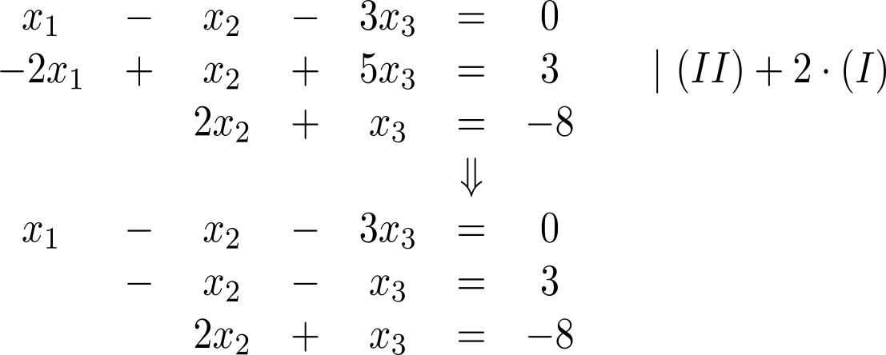
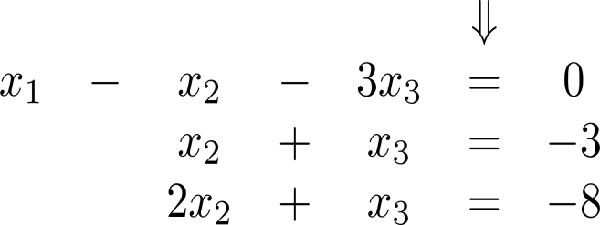
To solve systems with three variables, we again apply elementary operations to successively eliminate variables (2/ 5)

Slide 18
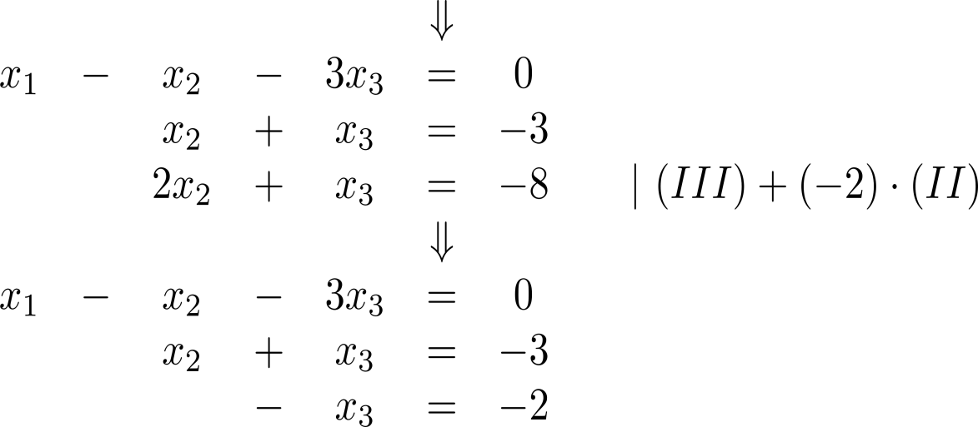
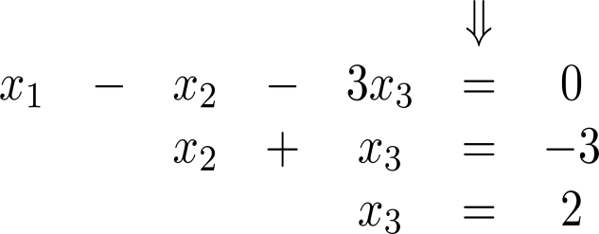
To solve systems with three variables, we again apply elementary operations to successively eliminate variables (3/ 5)
back-substitution

Slide 19
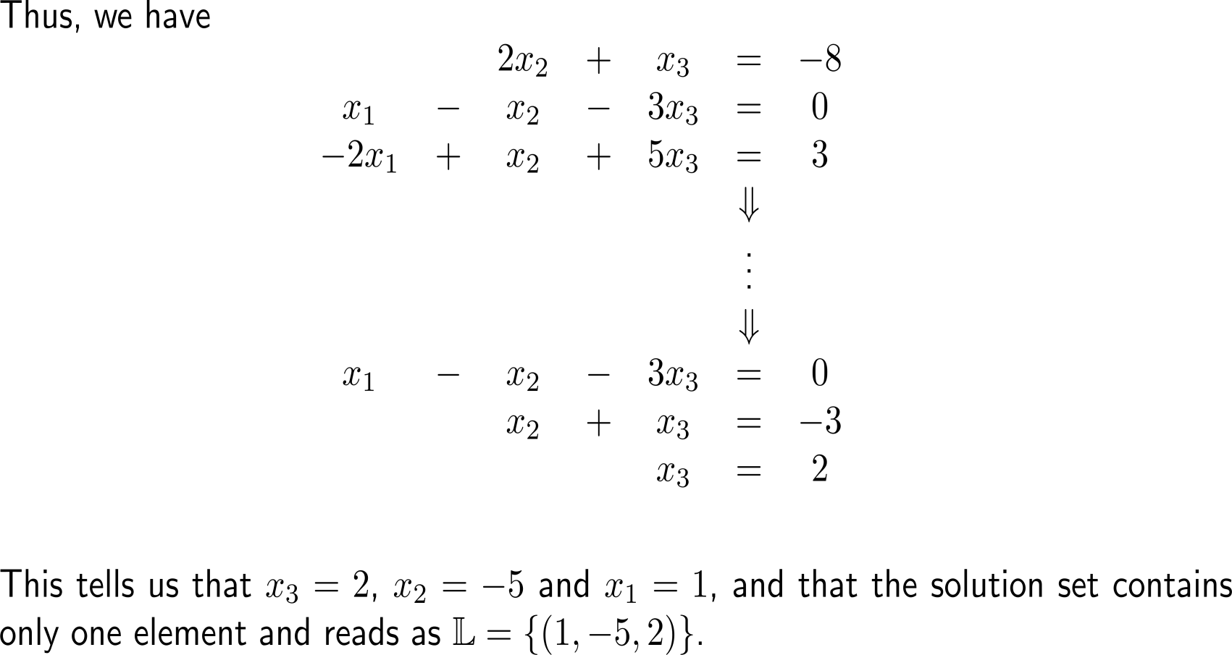
To solve systems with three variables, we again apply elementary operations to successively eliminate variables (4/ 5)
back-substitution

Slide 20
To solve systems with three variables, we again apply elementary operations to successively eliminate variables (5/ 5)

Slide 21
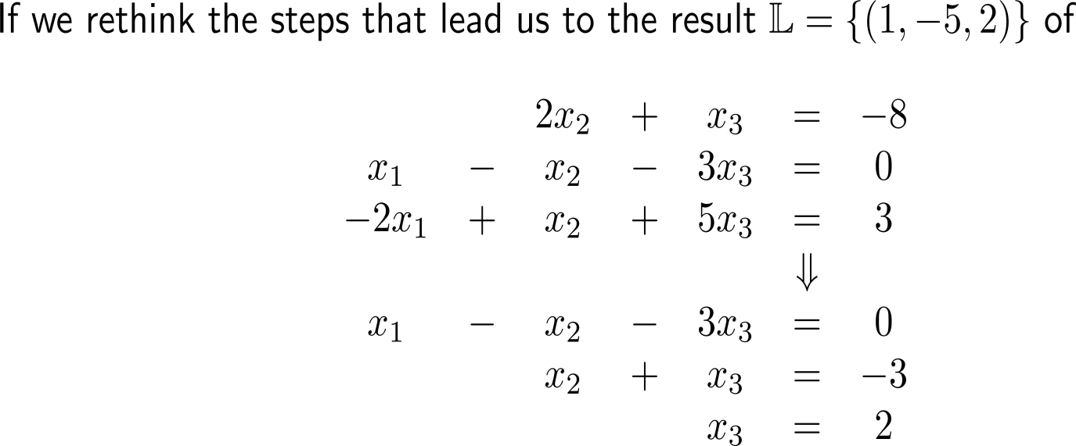
What structural insights do we have obtained so far? (1/ 2)
back-substitution

Slide 22
What structural insights do we have obtained so far? (2/ 2)
back-substitution

Slide 23
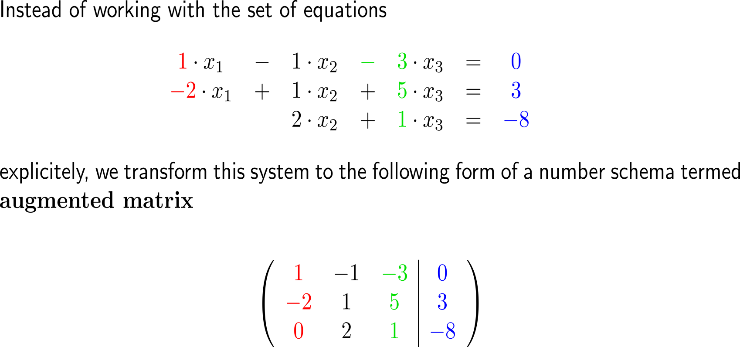
To exploit the fact, that we manipulate the coefficients of the variables only, we introduce the augmented matrix (1/ 2)
columns
rows

Slide 24
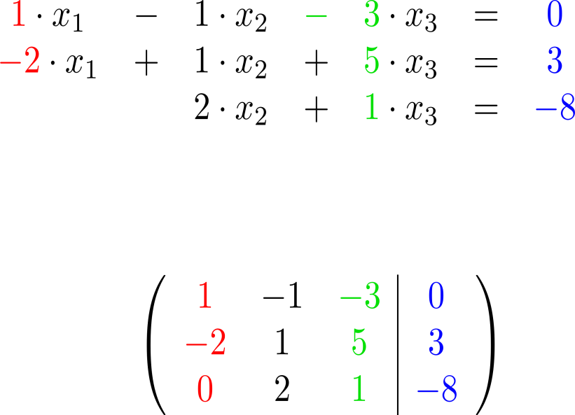
To exploit the fact, that we manipulate the coefficients of the variables only, we introduce the augmented matrix (2/ 2)
columns
rows
numbers correspond to the coefficients of the variables/ unknowns
numbers correspond to the right-hand side entries

Slide 25
What do the numbers in the augmented matrix stand for?

Slide 26
Exercise: Determine the augmented matrix

Slide 27
Instead of the system of equations we now work with its augmented matrix and reduce this until a triangular form is reached (1/ 4)

Slide 28
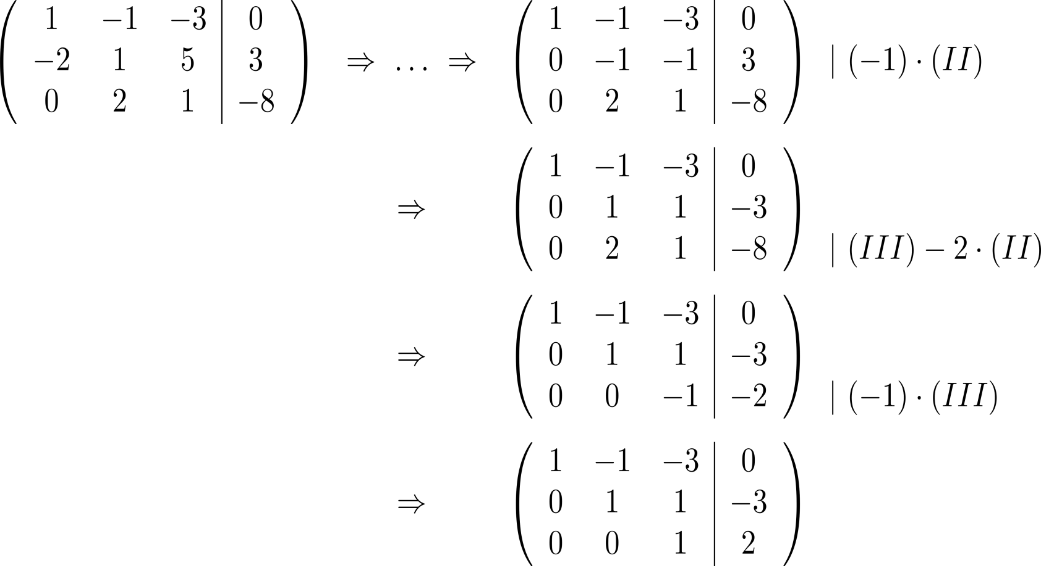
Instead of the system of equations we now work with its augmented matrix and reduce this until a triangular form is reached (2/ 4)

Slide 29
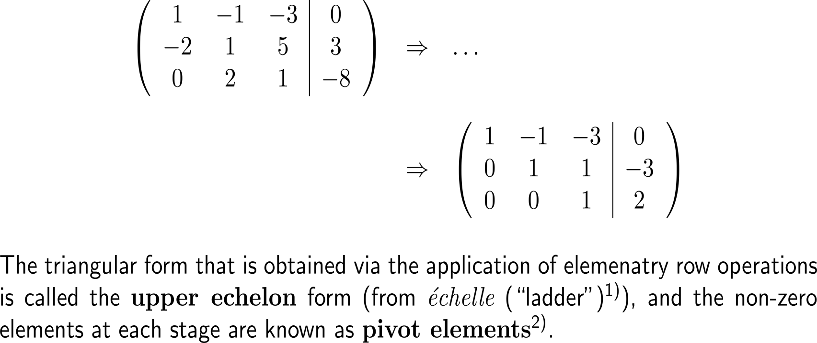
Instead of the system of equations we now work with its augmented matrix and reduce this until a triangular form is reached (3/ 4)
pivot
element
upper echelon
form

Slide 30
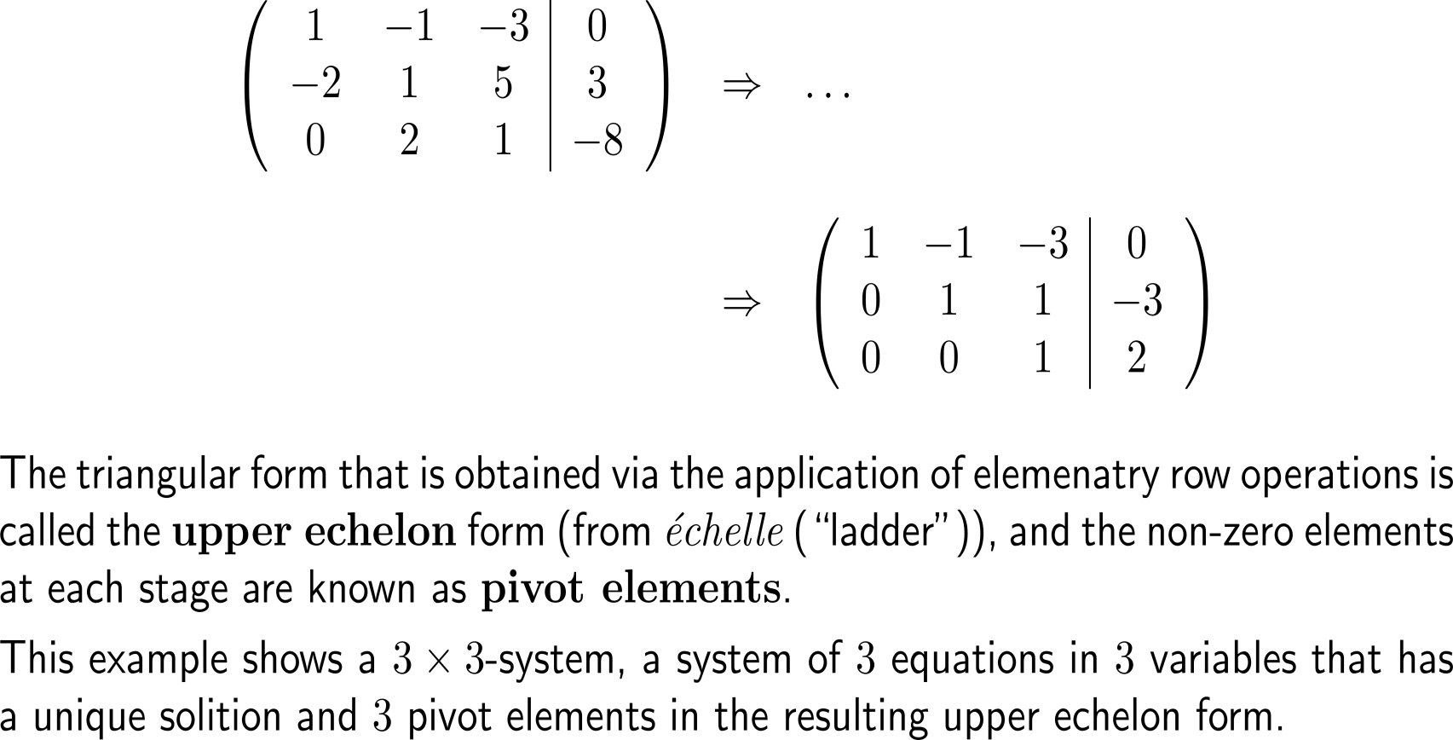
Instead of the system of equations we now work with its augmented matrix and reduce this until a triangular form is reached (3/ 4)
pivot
element
upper echelon
form

Slide 31
Example: The structure of the solution set

Slide 32
Example: The structure of the solution set
pivot elements
free variable

Slide 33
Example: The structure of the solution set
pivot elements
free variable

Slide 34
Example: The structure of the solution set

Slide 35
Example: The structure of the solution set
problem

Slide 36
Summary: What do the upper echelon form and the pivot elements tell us?
elementary operations
number of the equation =
row i
Elementary operations:
Type 1: Swap the positions of two equations/ rows in the augmented matrix
Type 2: Multiply an equation/ row by a nonzero number/ scalar.
Type 3: Add to one equation/ row a scalar multiple of another equation/ row.
Note: Elementary operations leave the solution set invariant, i.e. when applied do not change the solution.
a_{i,j}
column j
= number of the unknown

Slide 37
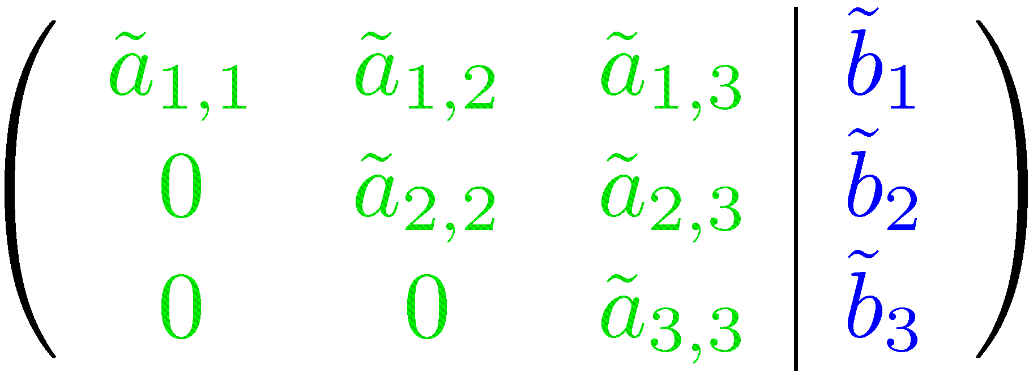
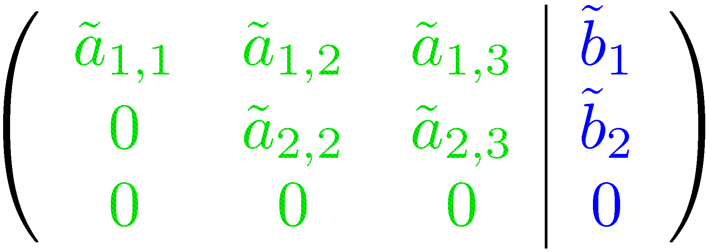
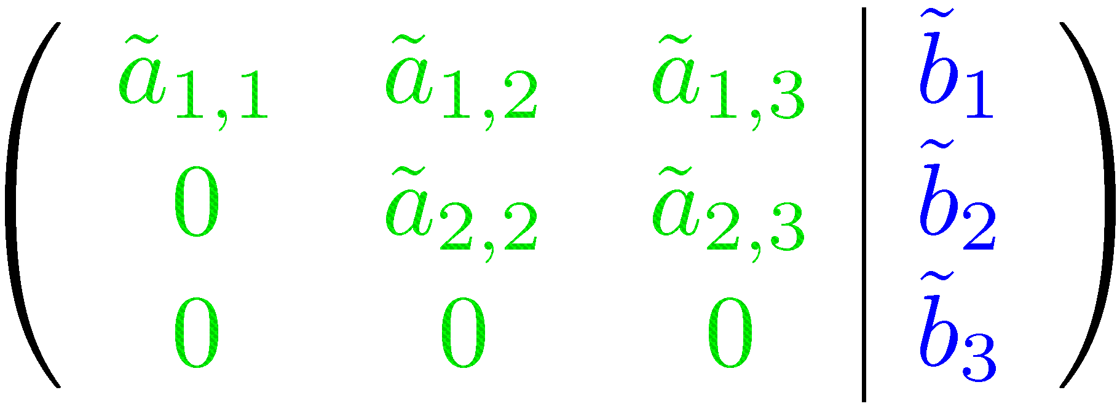
Summary: What do the upper echelon form and the pivot elements tell us?
elementary operations

Slide 38
Summary: What do the upper echelon form and the pivot elements tell us?
number of pivots
= number of unknowns
no additional non zeros on the right hand side
⇒ unique solution
number of pivots
< number of unknowns
no additional non zeros on the right hand side
⇒ free variable required
⇒ infinitely many solutions
additional non zeros on the right hand side
⇒ no solution

Slide 39
Further Worked-Out Exercises:
Calculus II for Management
Topics
Gaussian elimination
Upper echelon form, rank, matrix-column multiplication

Slide 40
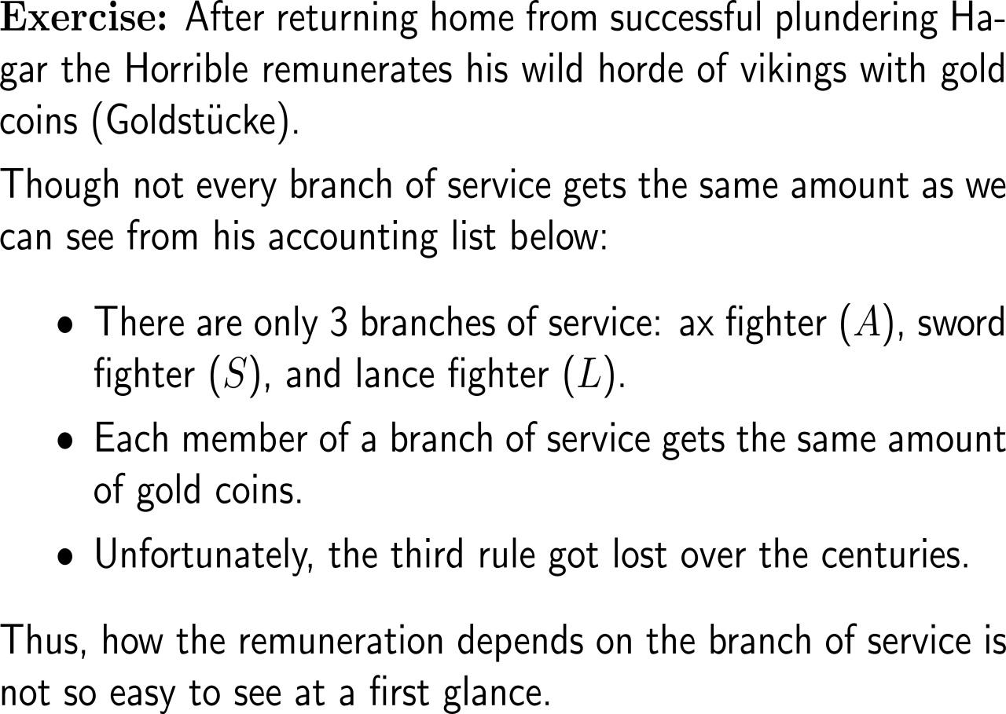
Exercise

Slide 41
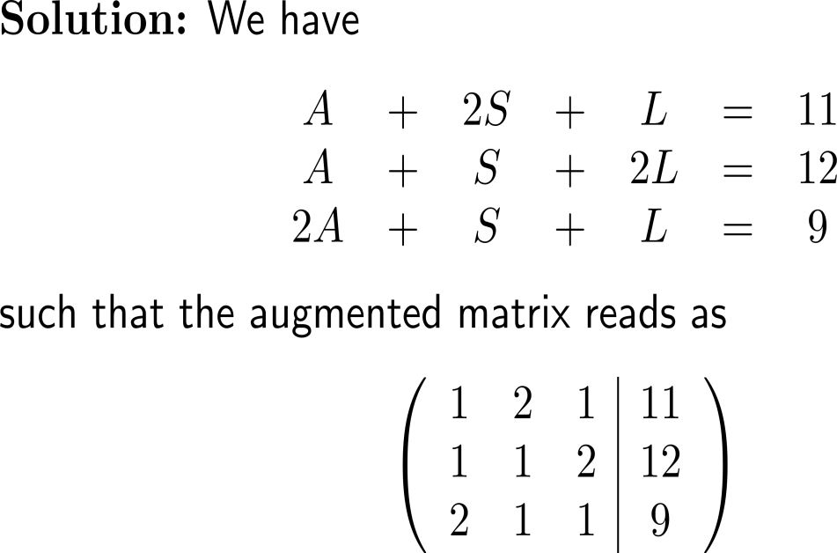
Exercise

Slide 42
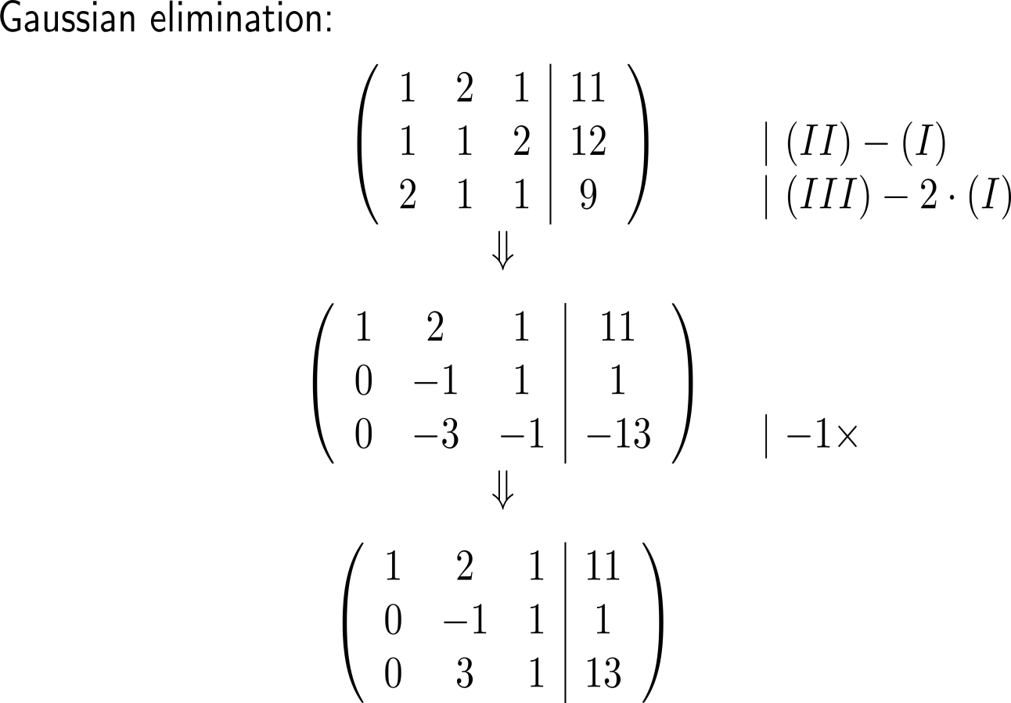
Exercise
Goal:
Generate zeros below the pivot elements

Slide 43
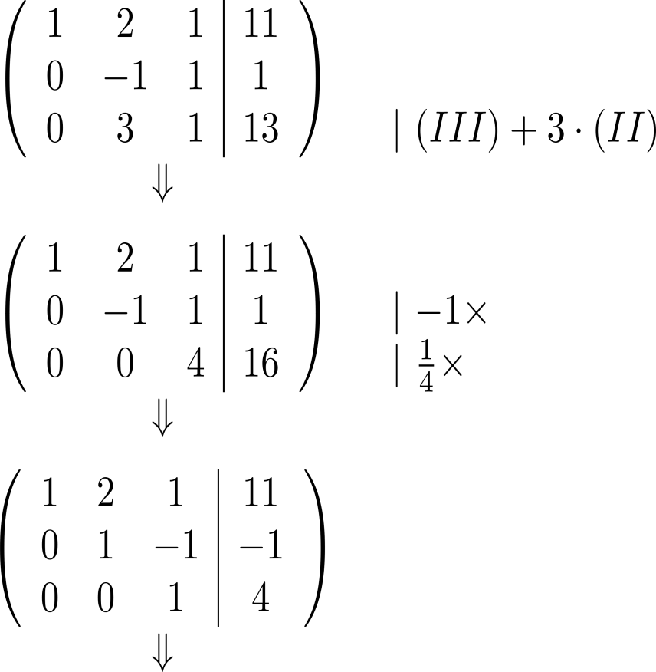
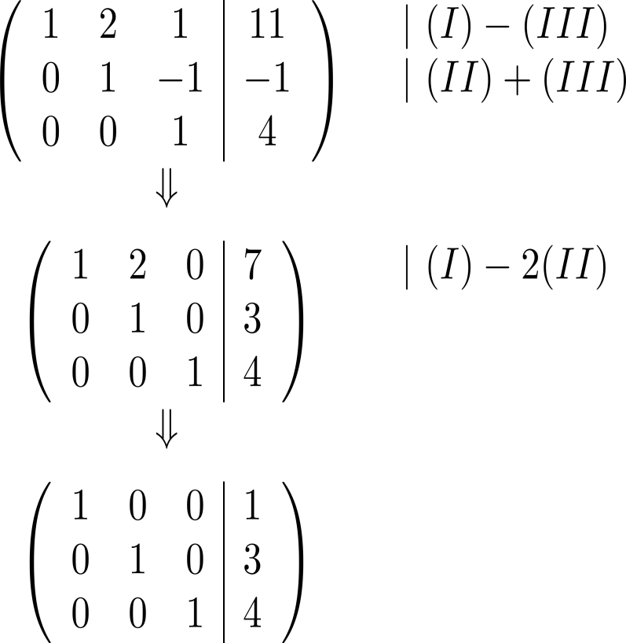
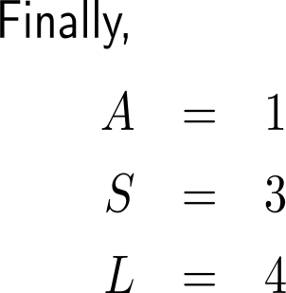
Exercise

Slide 44
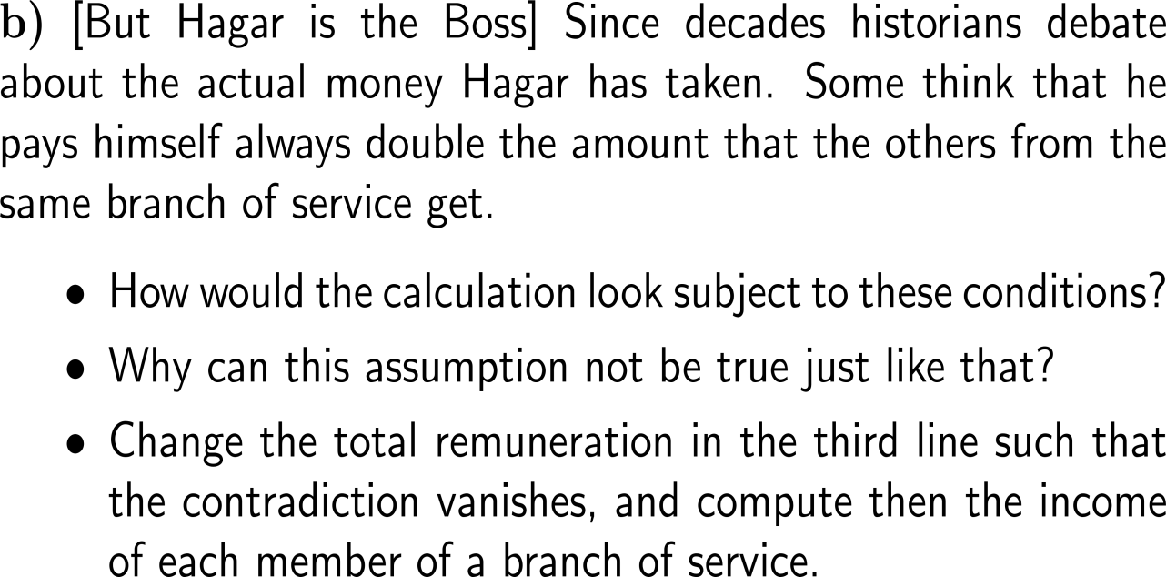
Exercise
Hagar is the boss

Slide 45
Exercise

Slide 46
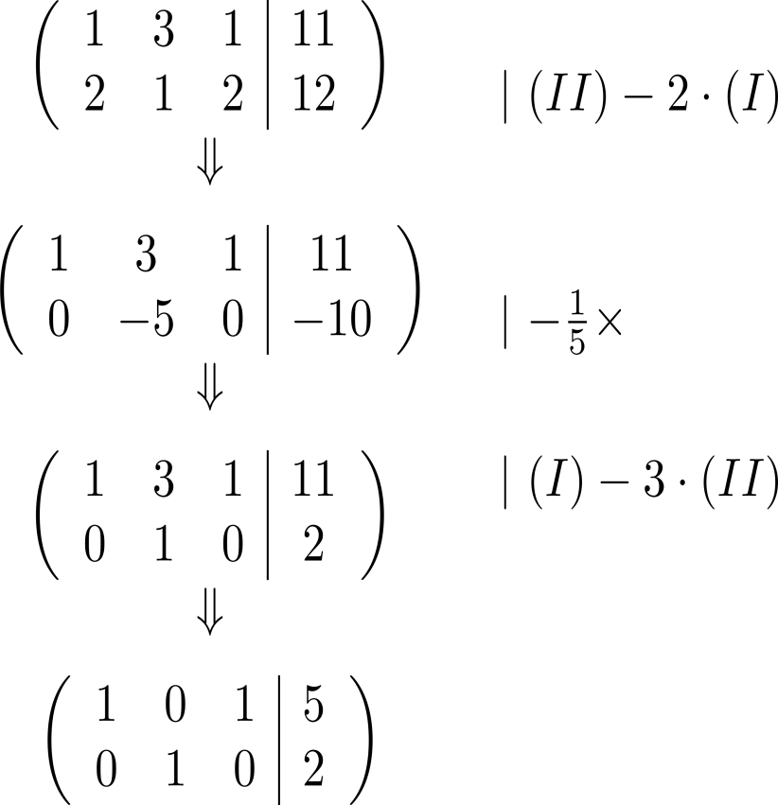
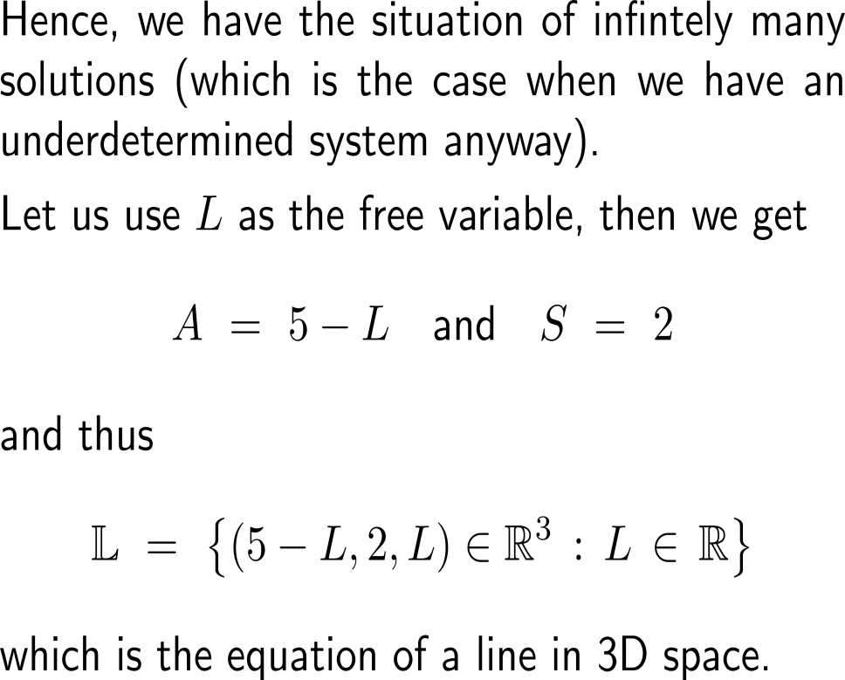
Exercise

Slide 47
Exercise

Slide 48
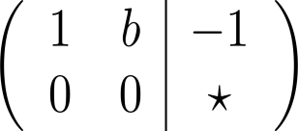
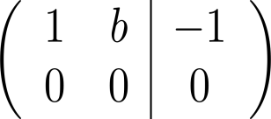
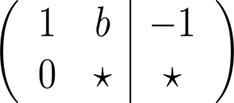
Exercise
no solution:
a ≠ -5 & ab = 2
∞ many solutions:
a = -5 & ab = 2
unique solution:
ab ≠ 2

Slide 49
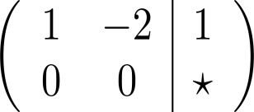
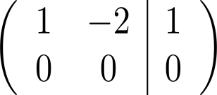
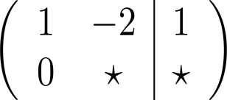
Exercise
no solution:
a ≠ 5 & b = 2a
∞ many solutions:
a = 5 & b = -2a
unique solution:
b ≠ -2a

Slide 50
Exercise

Slide 51
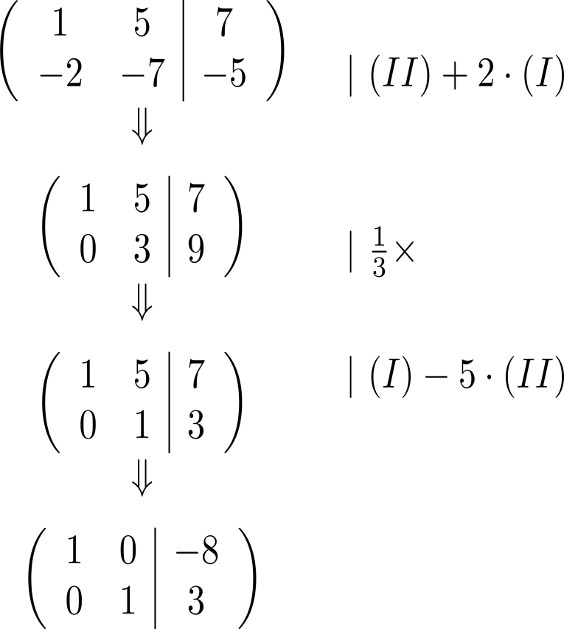
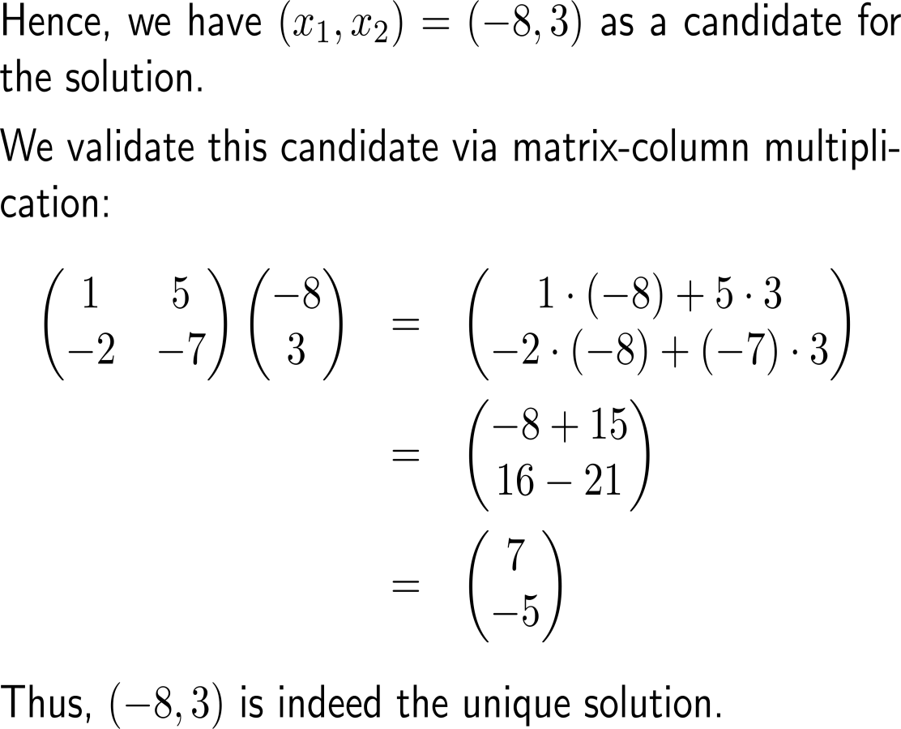
Exercise
a)

Slide 52
Exercise
b)

Slide 53
Exercise

Slide 54
Calculus II for Management

