Slide 1
Calculus II for Management
Determinants
week 2
Lecture 2
  N-Variable systems of equations & Gaussian Elimination
  Motivation: the geometry of determinants

Slide 2
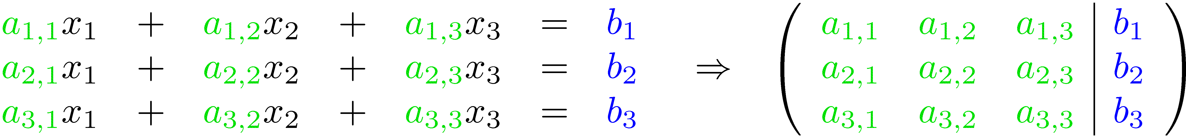
Recap:
What do the upper echelon form and the pivot elements tell us?
elementary operations
number of the equation =
row i
Elementary operations:
Type 1: Swap the positions of two equations/ rows in the augmented matrix
Type 2: Multiply an equation/ row by a nonzero number/ scalar.
Type 3: Add to one equation/ row a scalar multiple of another equation/ row.
Note: Elementary operations leave the solution set invariant, i.e. when applied do not change the solution.
a_{i,j}
column j
= number of the unknown

Slide 3
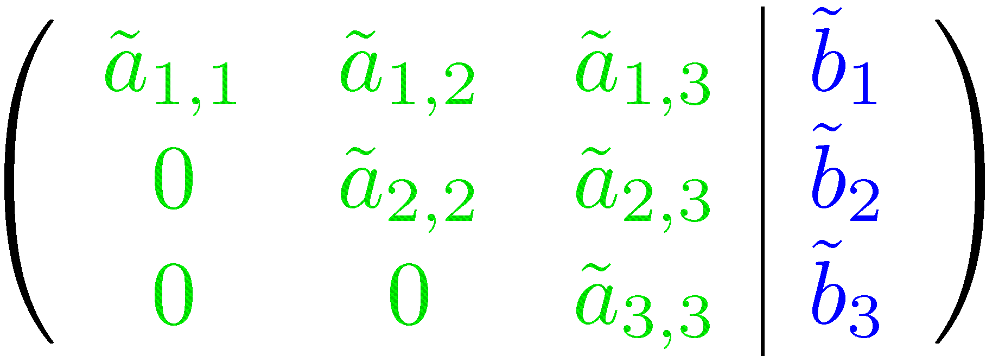
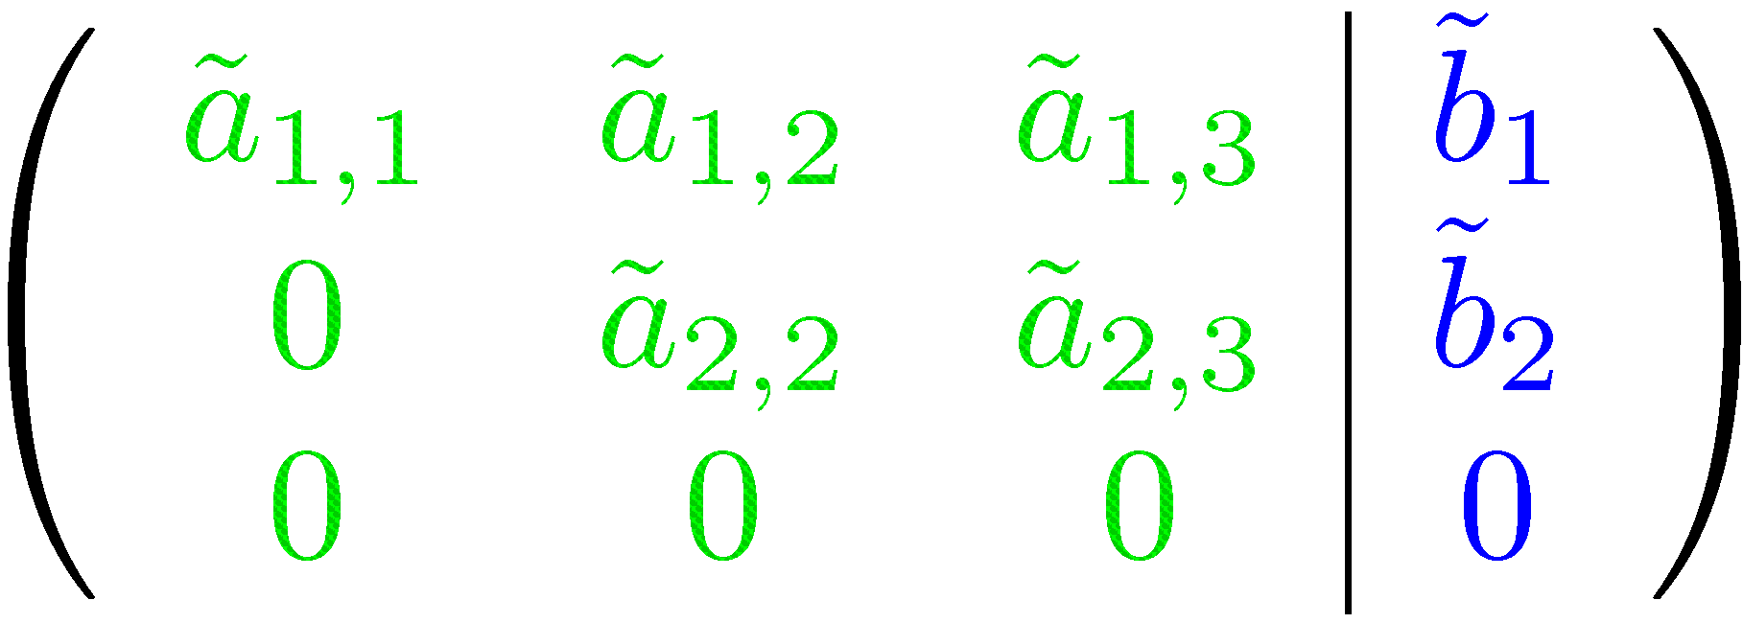
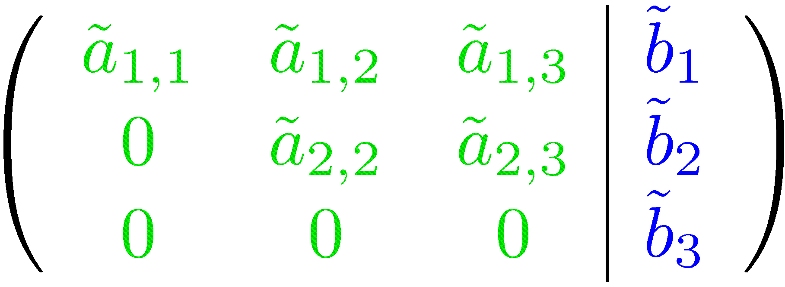
Recap:
What do the upper echelon form and the pivot elements tell us?
elementary operations

Slide 4
Recap:
What do the upper echelon form and the pivot elements tell us?
number of pivots
= number of unknowns
no additional non zeros on the right hand side
⇒ unique solution
number of pivots
< number of unknowns
no additional non zeros on the right hand side
⇒ free variable required
⇒ infinitely many solutions
additional non zeros on the right hand side
⇒ no solution

Slide 5
Topics
  N-Variable Systems of Equations & Gaussian Elimination
  Motivation: The Geometry of Determinants

Slide 6
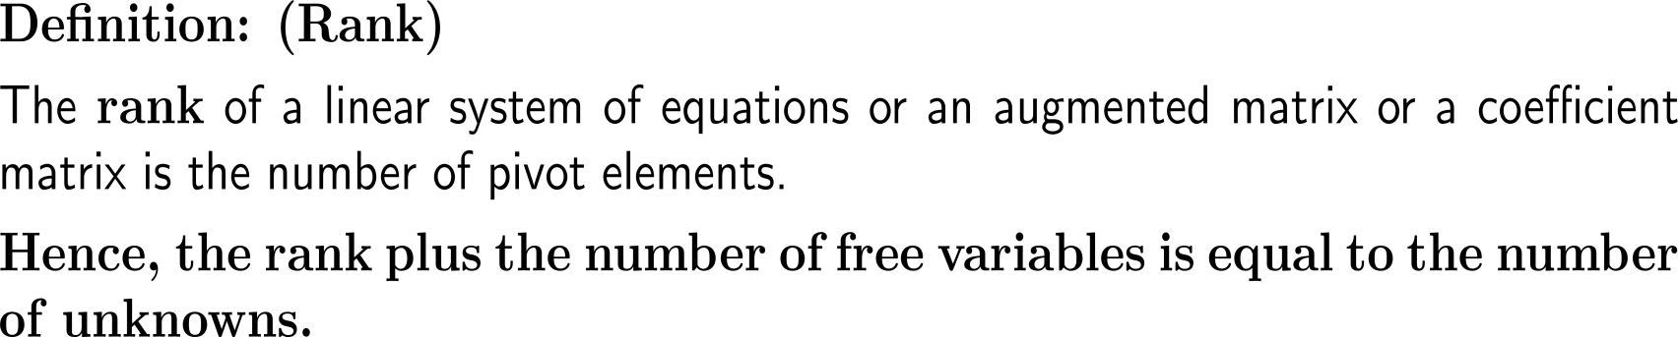
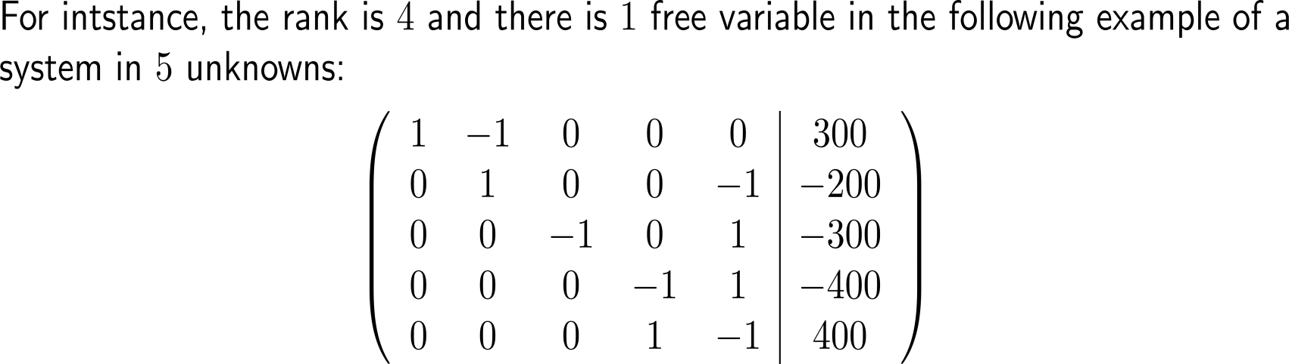
The rank of a linear system/ an augmented coefficient matrix is the number of pivot elements

Slide 7
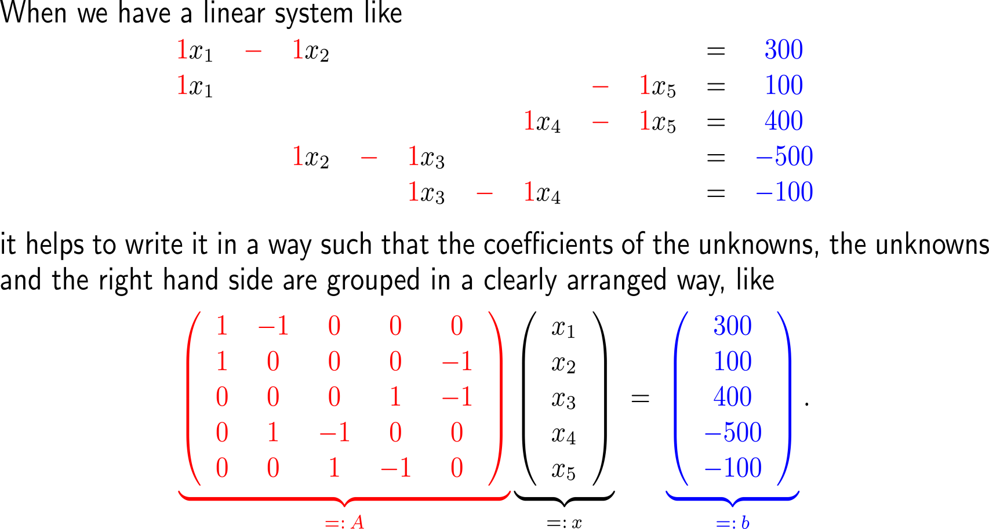
Often it is convenient to write a linear system in the form Ax = b that allows the immediate determination of the augmented matrix (A | b)

Slide 8
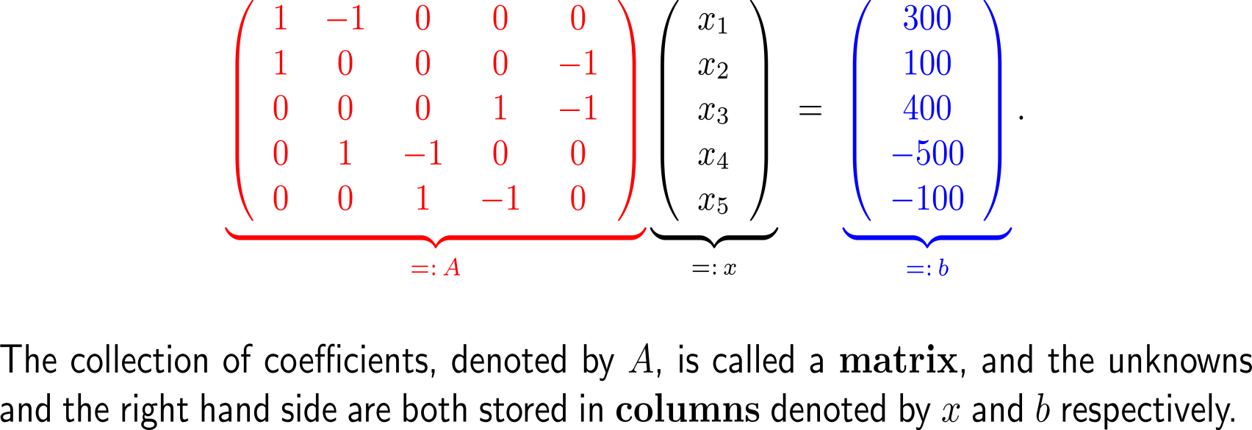
Often it is convenient to write a linear system in the form Ax = b that allows the immediate determination of the augmented matrix (A | b)

Slide 9
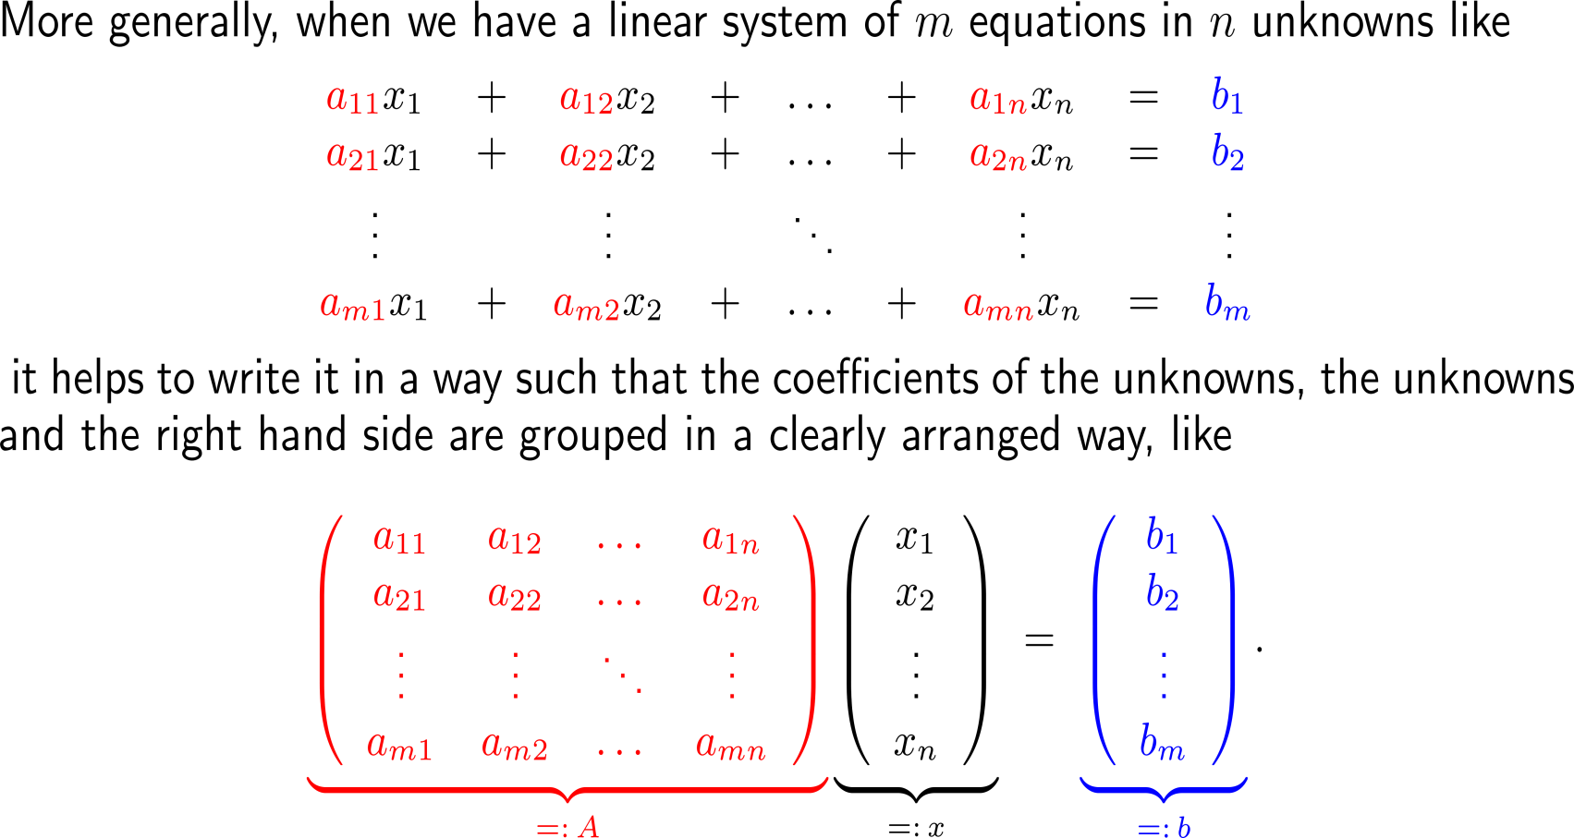
This matrix-column interpretation of a linear system of equation is possible for arbitrary numbers of equations and unknowns, …

Slide 10
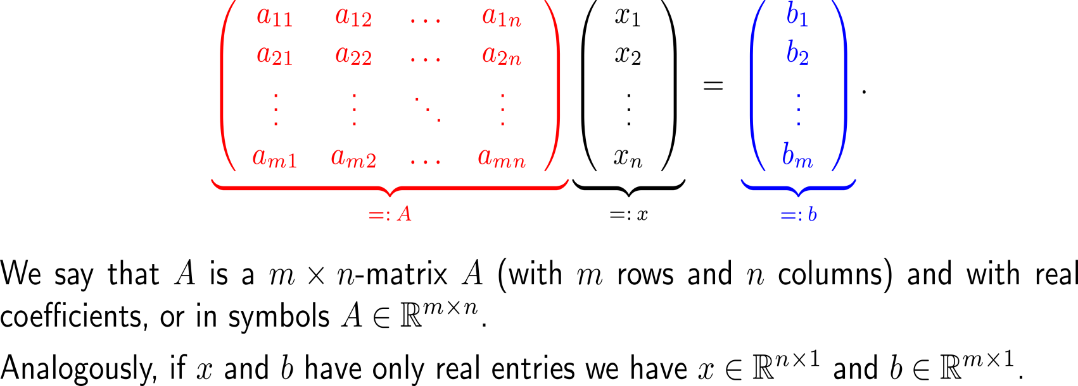
This matrix-column interpretation of a linear system of equation is possible for arbitrary numbers of equations and unknowns, …

Slide 11
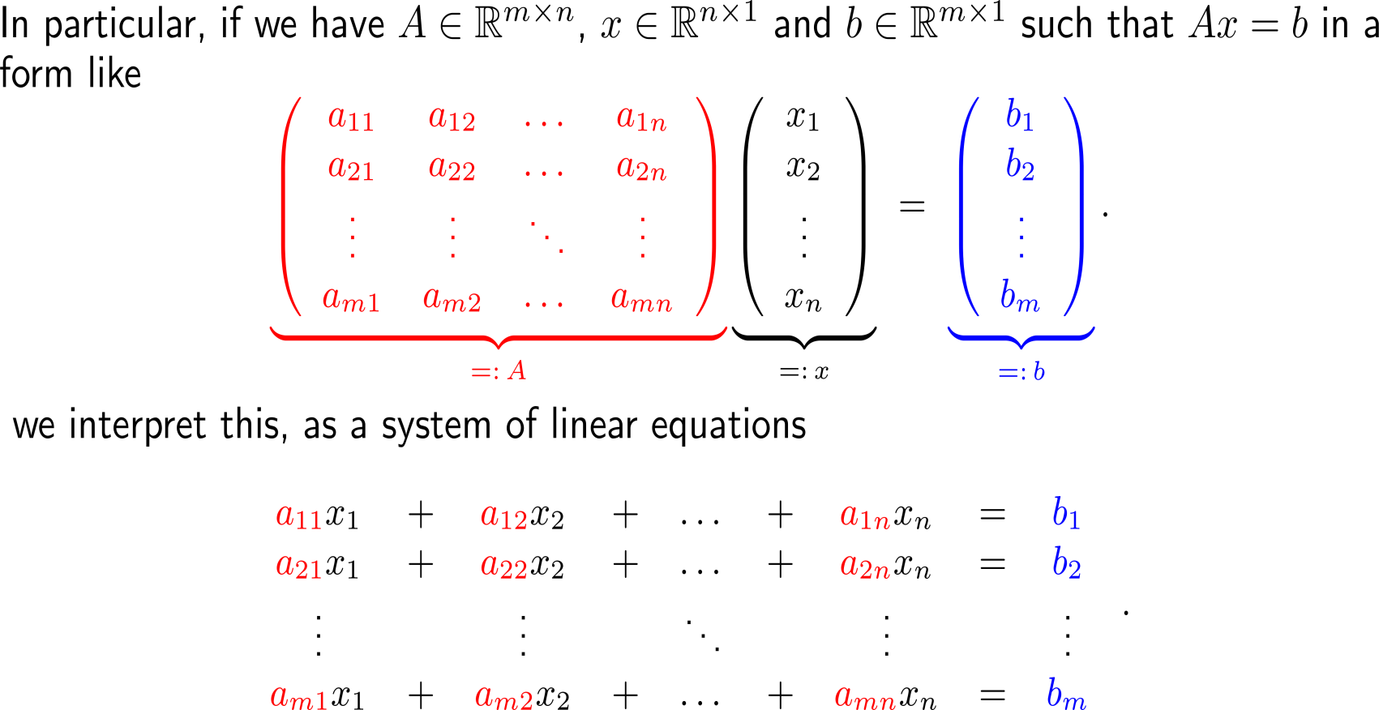
… in particular, given a matrix-column system, we interpret this as a system of linear equations

Slide 12
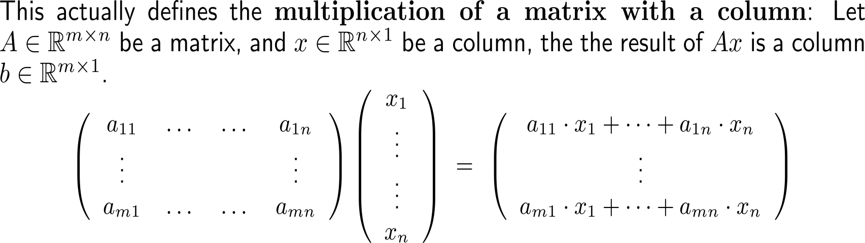
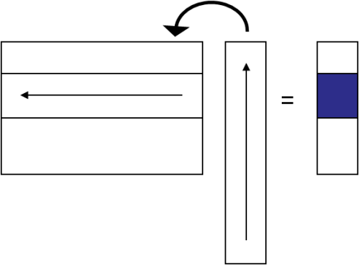
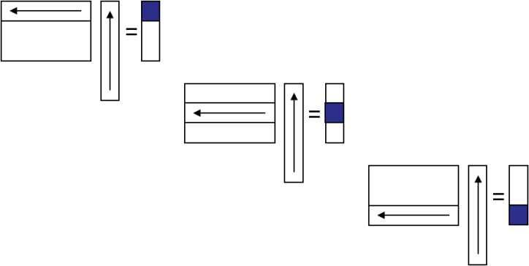
The multiplication of a matrix with a column is easily visualized in terms of overlaying, multiplication and summation of scalars
Illustratively, the computation of Ax follows these steps:

Slide 13
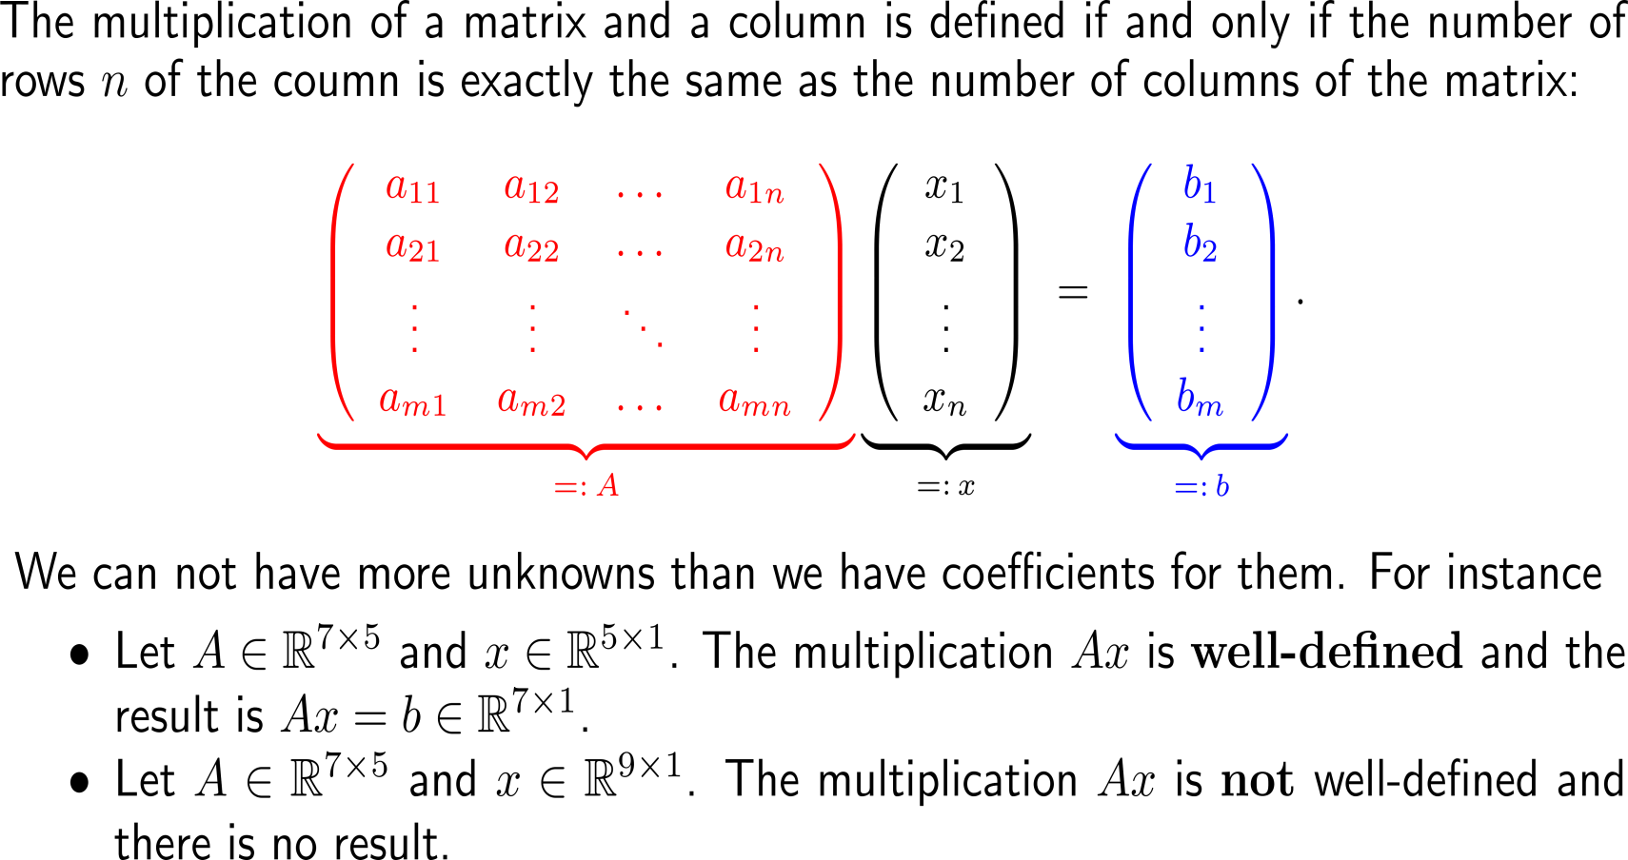
Note: Only the multiplication of a (m x n)-matrix with an n-column is well-defined

Slide 14
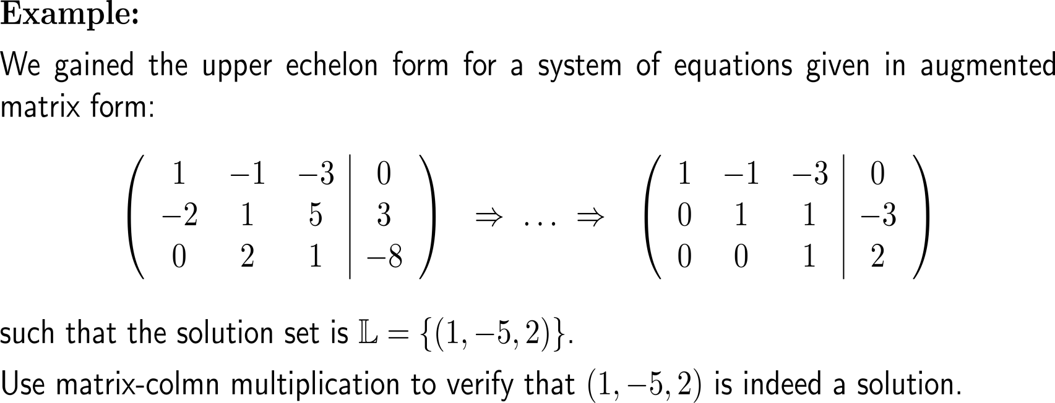
Example:
Matrix-column multiplication to check a solution

Slide 15
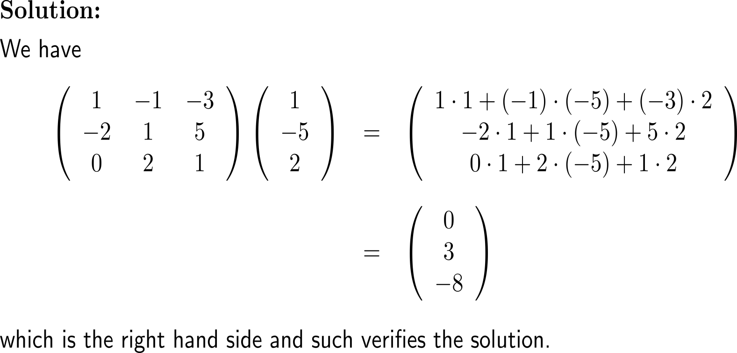
Example:
Matrix-column multiplication to check a solution

Slide 16
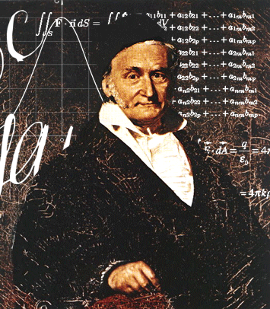
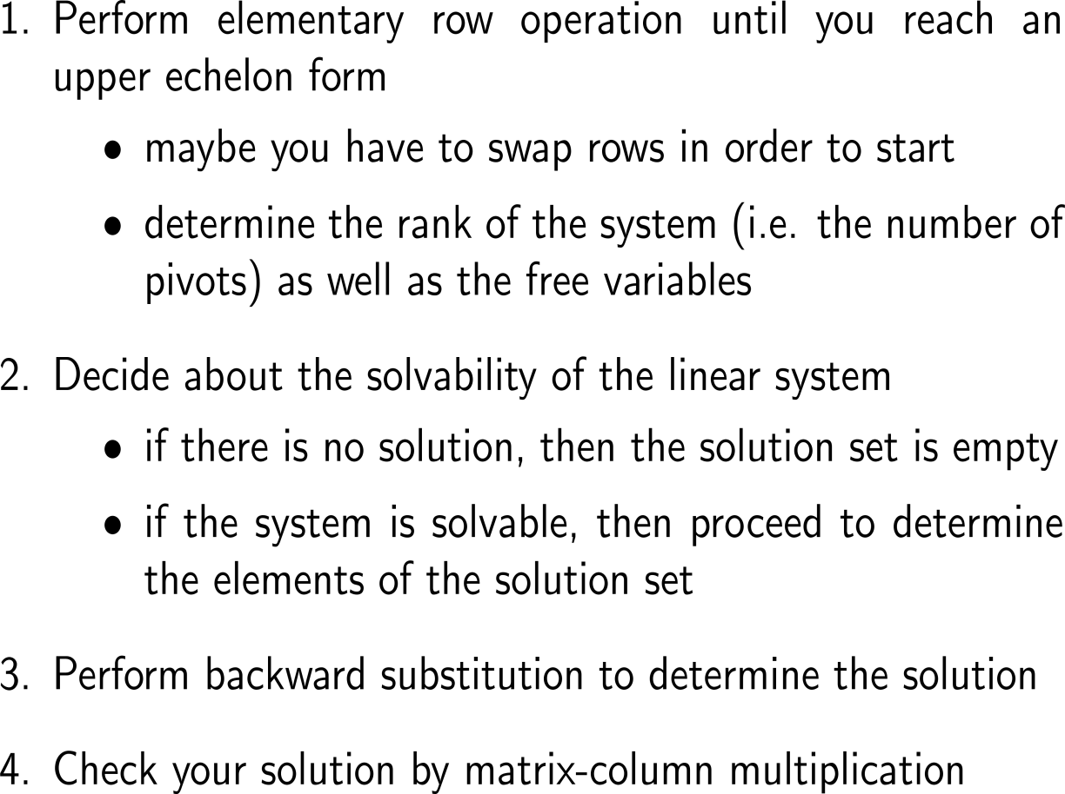
Summary:
Gaussian Elimination in a nutshell

Slide 17
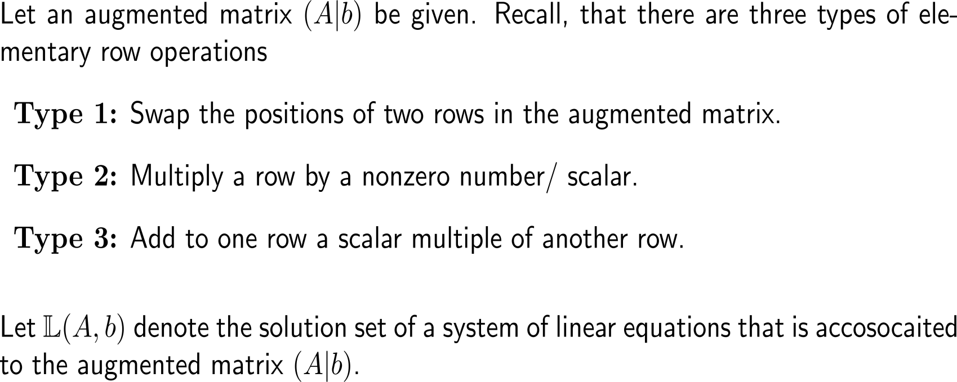
Based on elementary row operations …

Slide 18
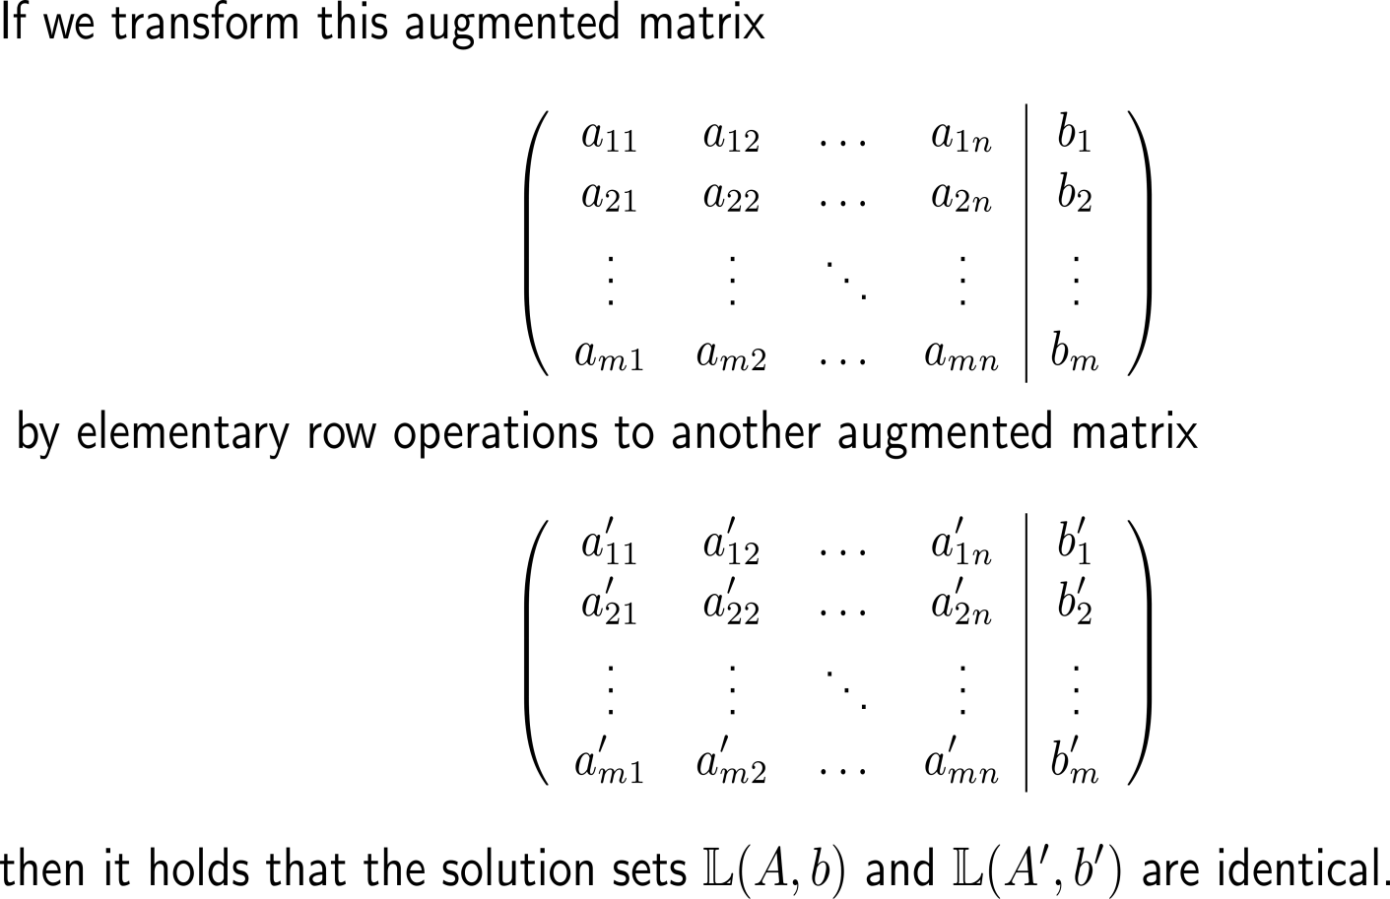
… we know that these do not alter the solution set of a linear system of equations (1/ 2)

Slide 19
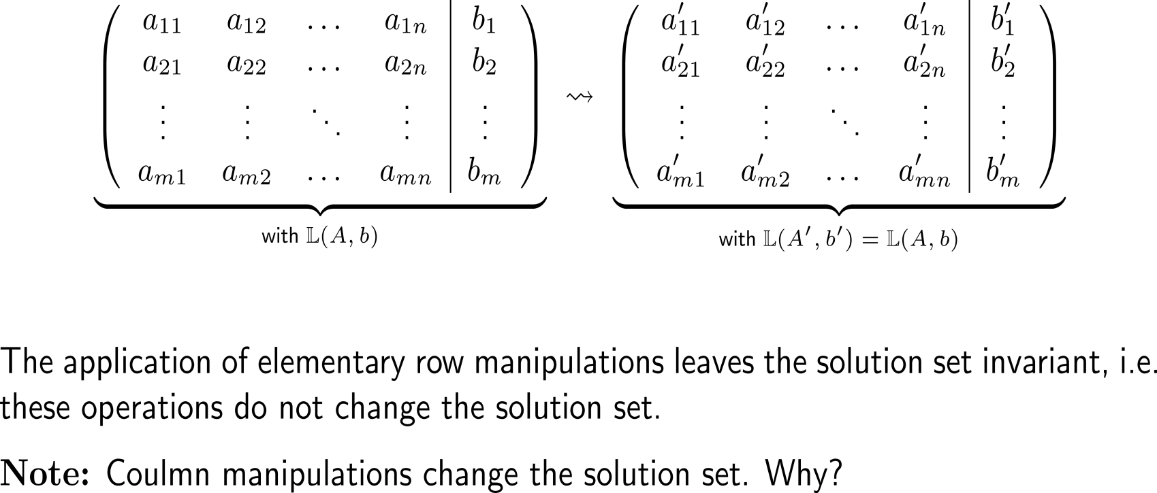
… we know that these do not alter the solution set of a linear system of equations (2/ 2)

Slide 20
Topics
  N-Variable Systems of Equations & Gaussian Elimination
  Motivation: The Geometry of Determinants
To ease learning by means of examples, we will use several notions, like vectors and matrices rather intuitively in this lecture, and provide the underlying concepts in strict rigor in the next lecture.

Slide 21
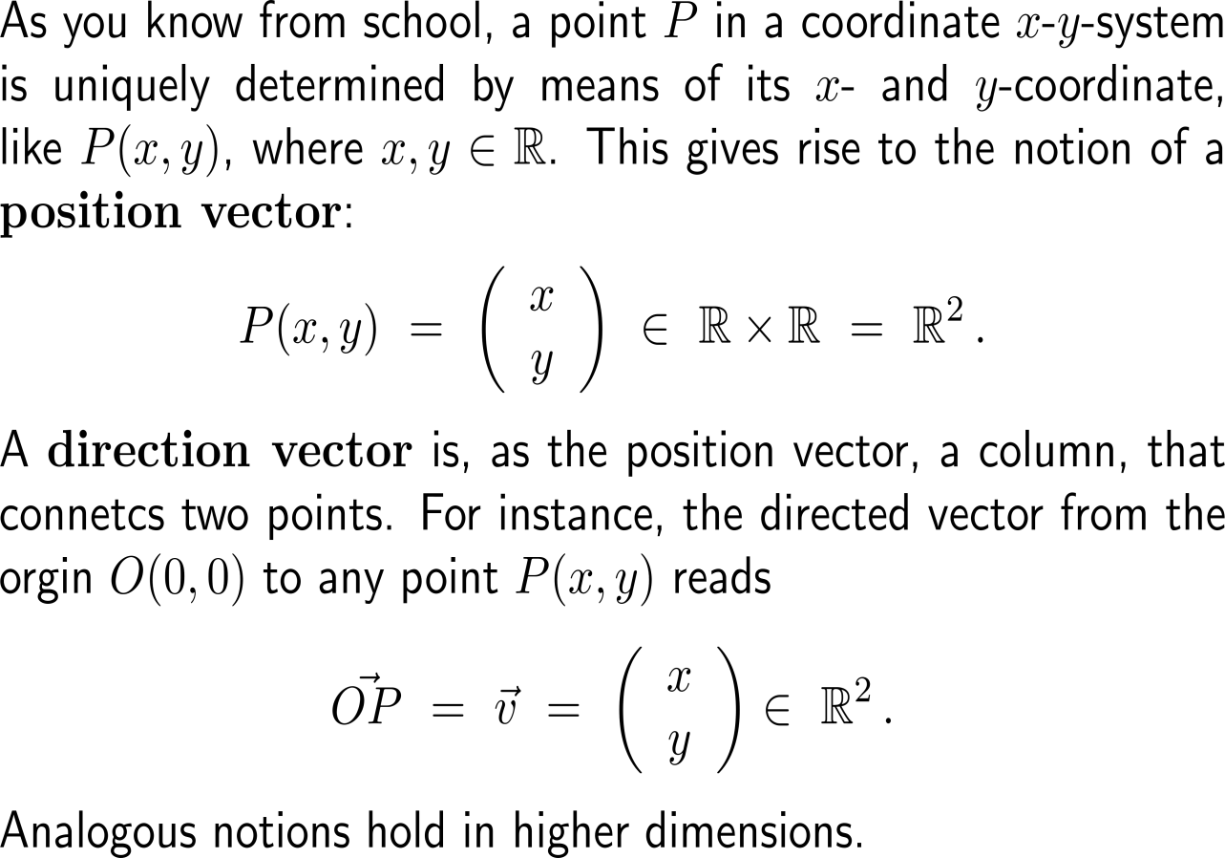

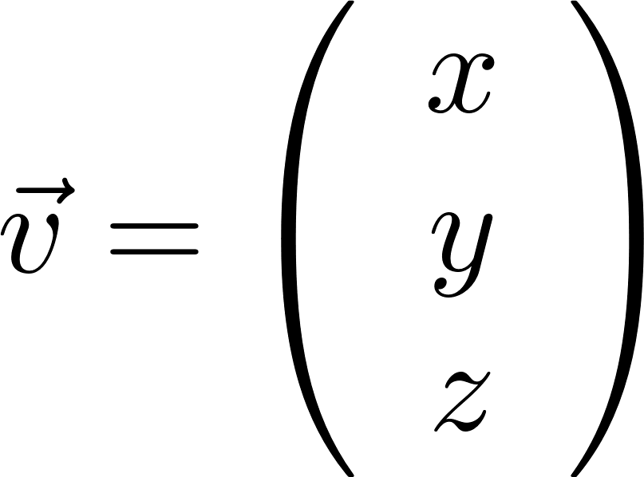
To have a vocabulary that allows us to express geometric quantities, let us recall the notions of position and direction vectors (1/ 2)
y-axis
P
O
x-axis
origin of the coordinate system
z-axis
y-axis
P
O
x-axis
origin of the coordinate system

Slide 22
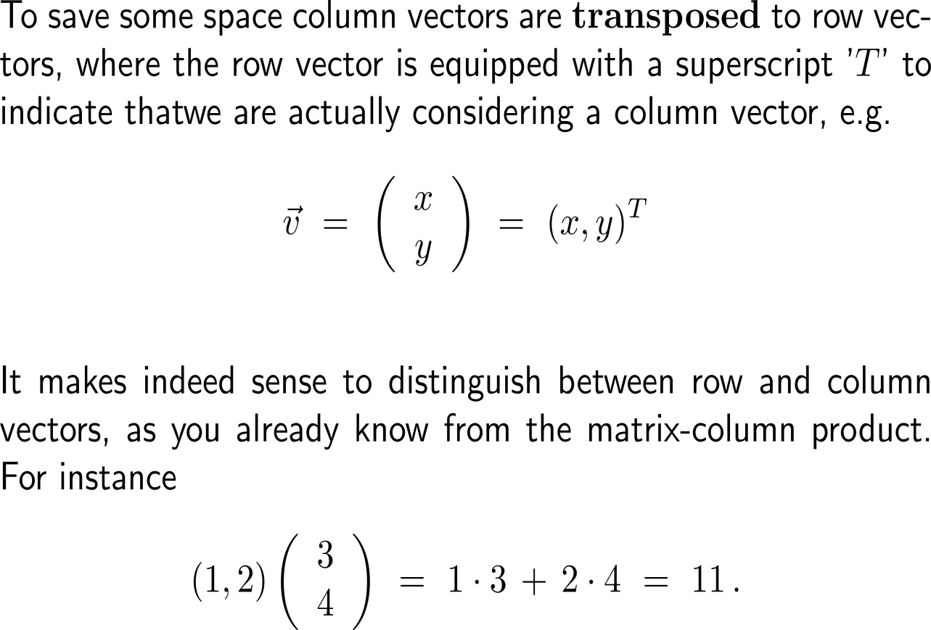


To have a vocabulary that allows us to express geometric quantities, let us recall the notions of position and direction vectors (2/ 2)
y-axis
P
O
x-axis
origin of the coordinate system
z-axis
y-axis
P
O
x-axis
origin of the coordinate system

Slide 23

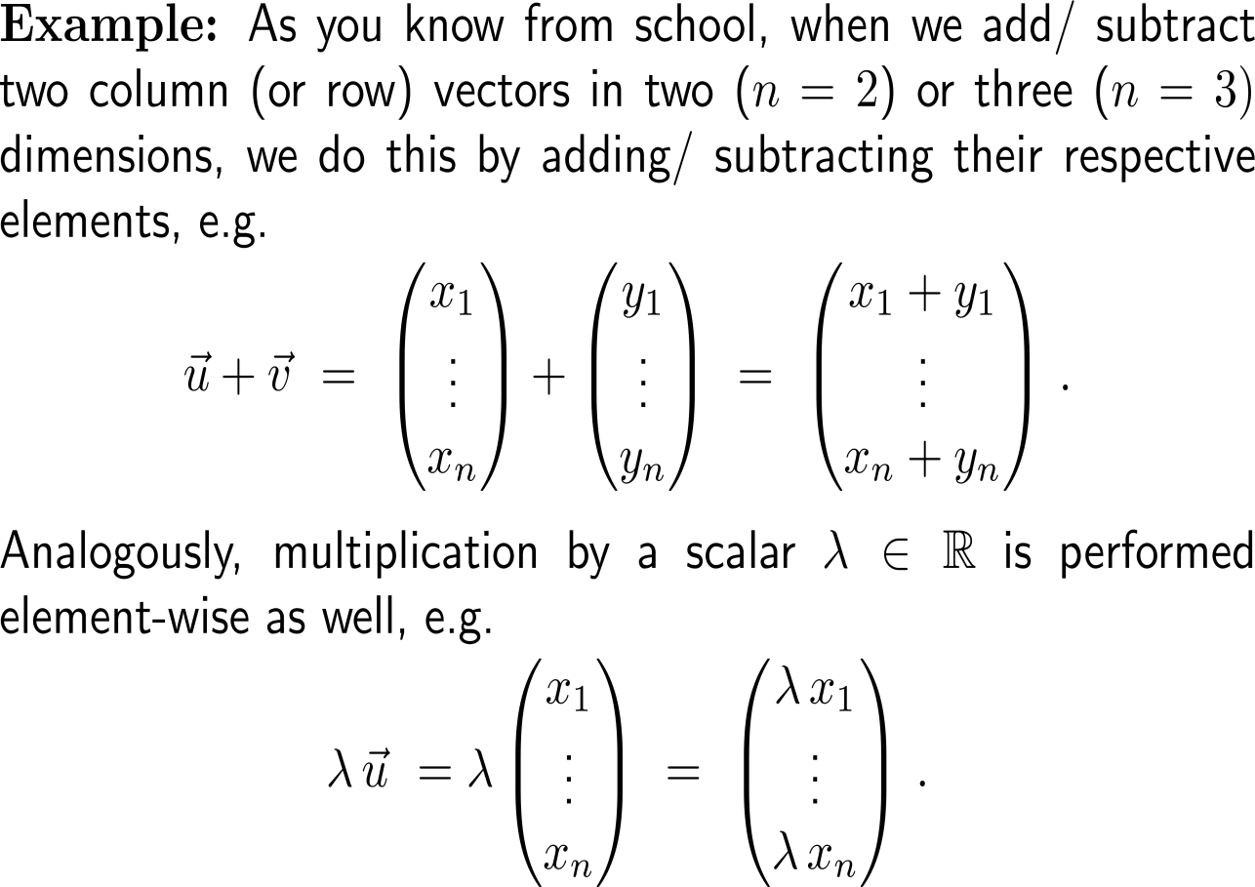



Addition of two vectors and multiplication by a scalar are performed element-wise

Slide 24
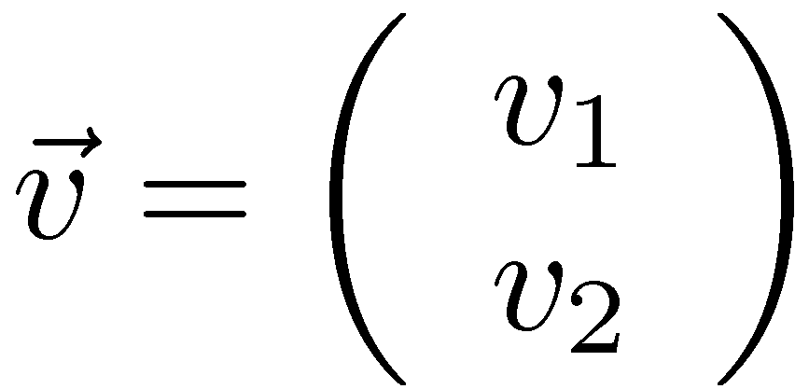

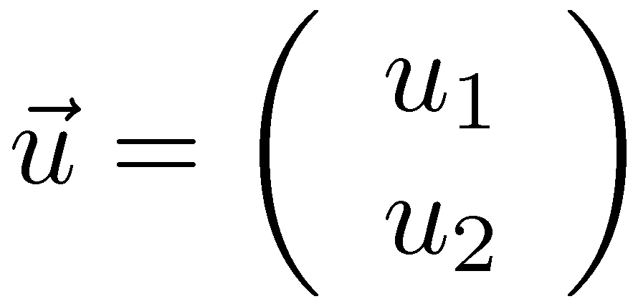
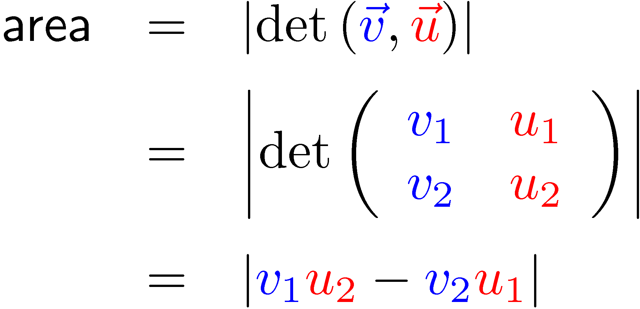
Geometrically, in 2D and 3D, we are introducing a new function – the determinant – to measure areas and volumes

Slide 25
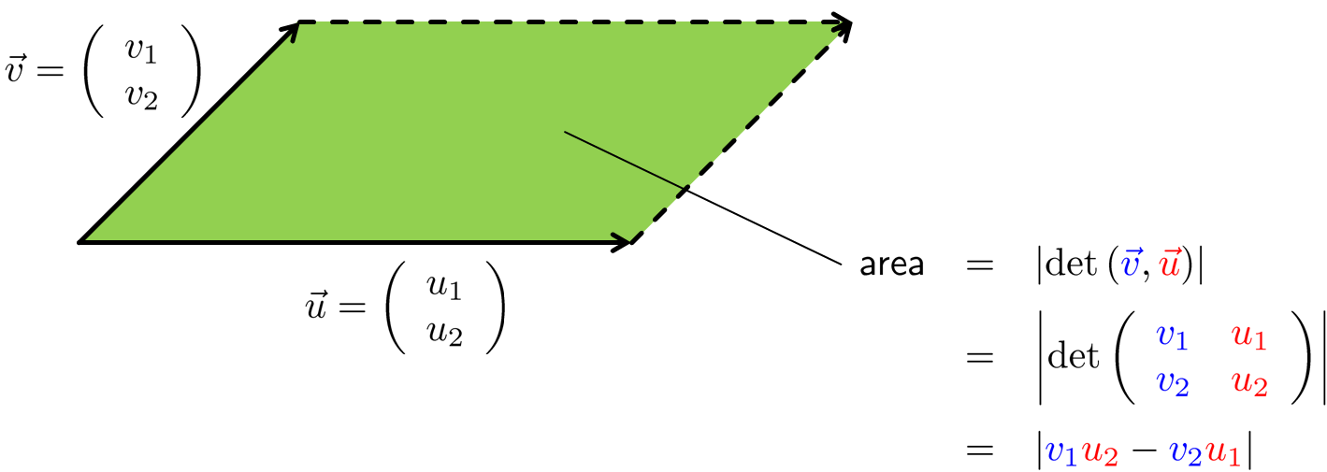
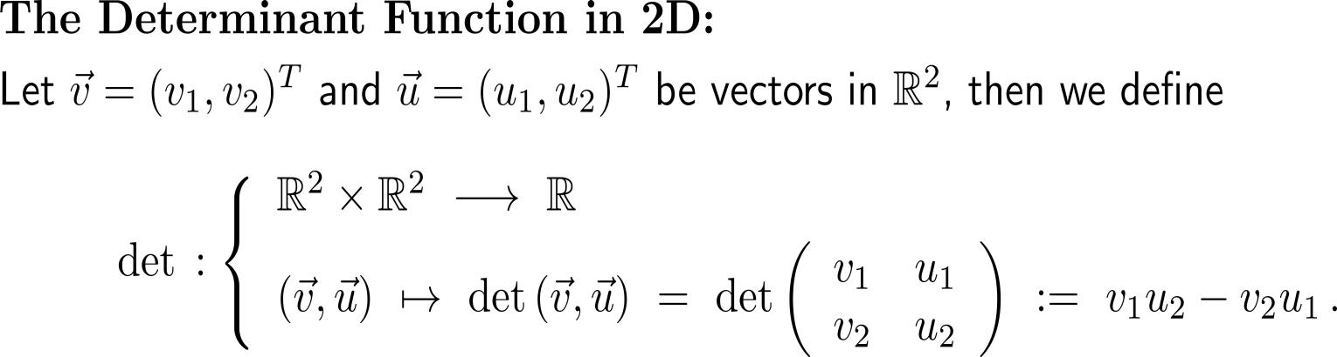
Definition:
The determinant function in 2D

Slide 26
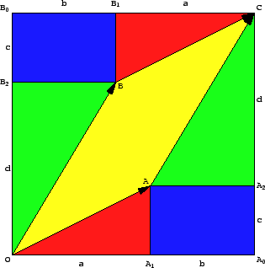
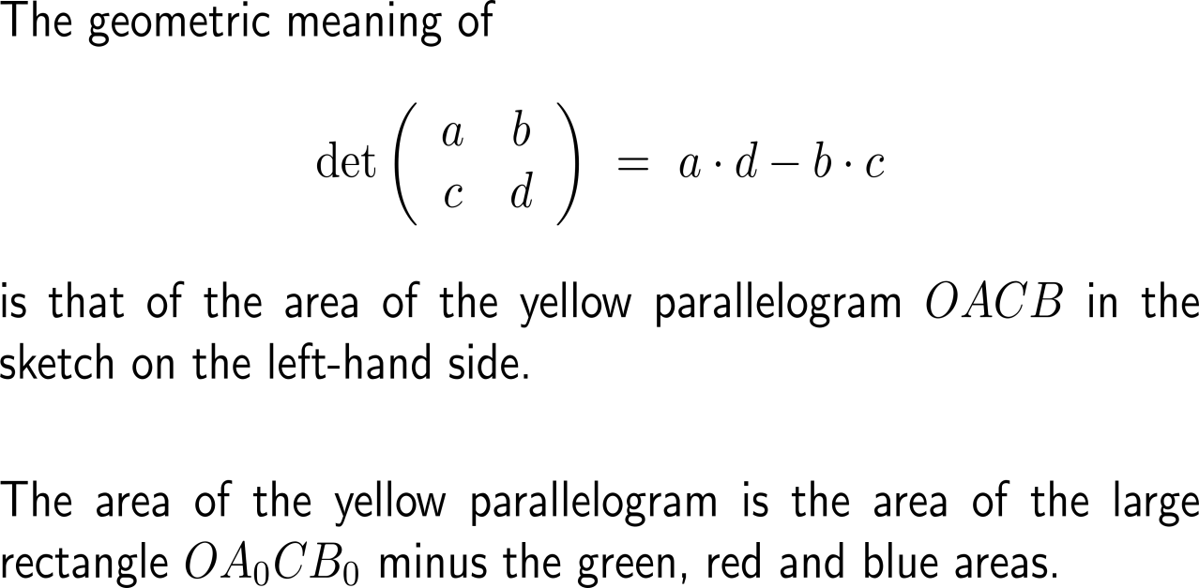
Geometrically, we can straightforwardly connect the value of a determinant with the area of the parallelogram spanned by its input vectors (1/ 2)
http://www.mat.univie.ac.at/~kriegl/Skripten/Math4Ilak1/node13.html

Slide 27
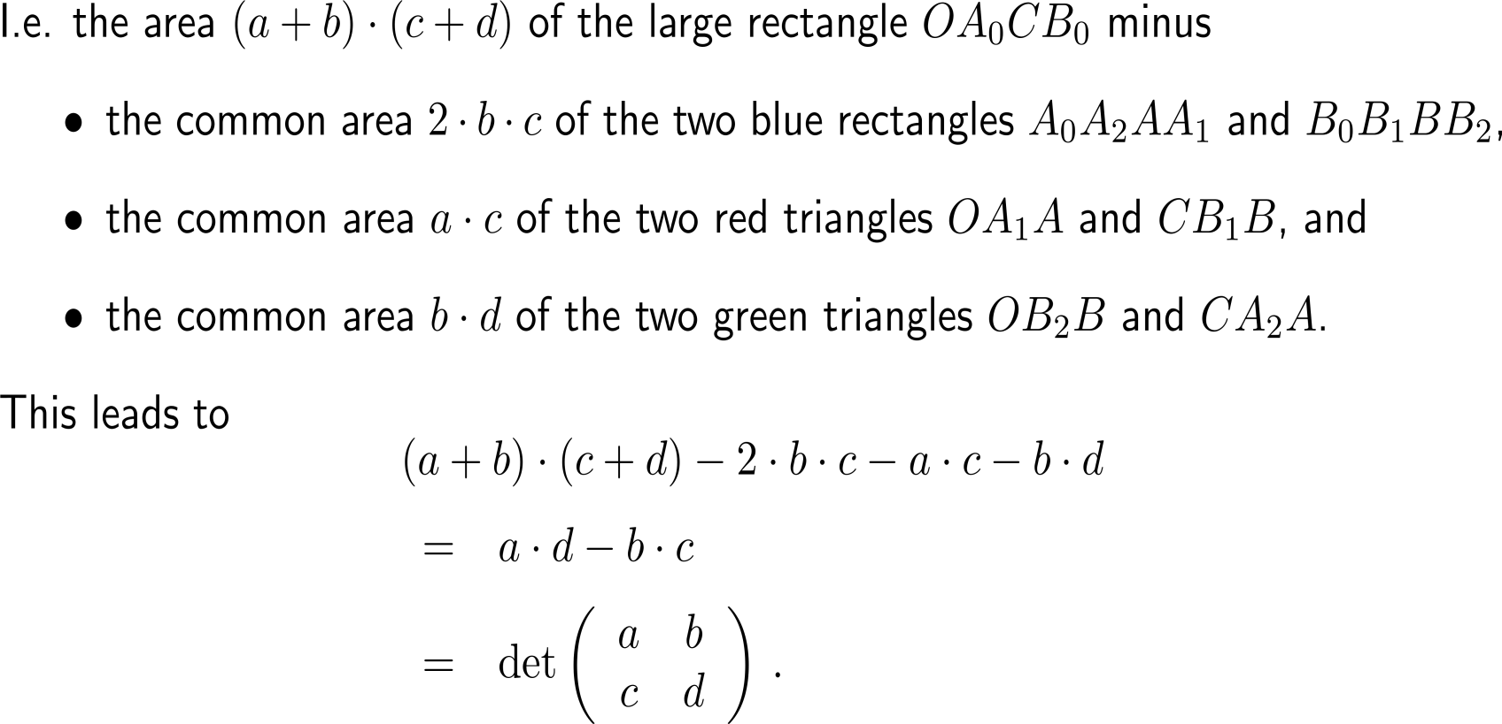
Geometrically, we can straightforwardly connect the value of a determinant with the area of the parallelogram spanned by its input vectors (1/ 2)

Slide 28
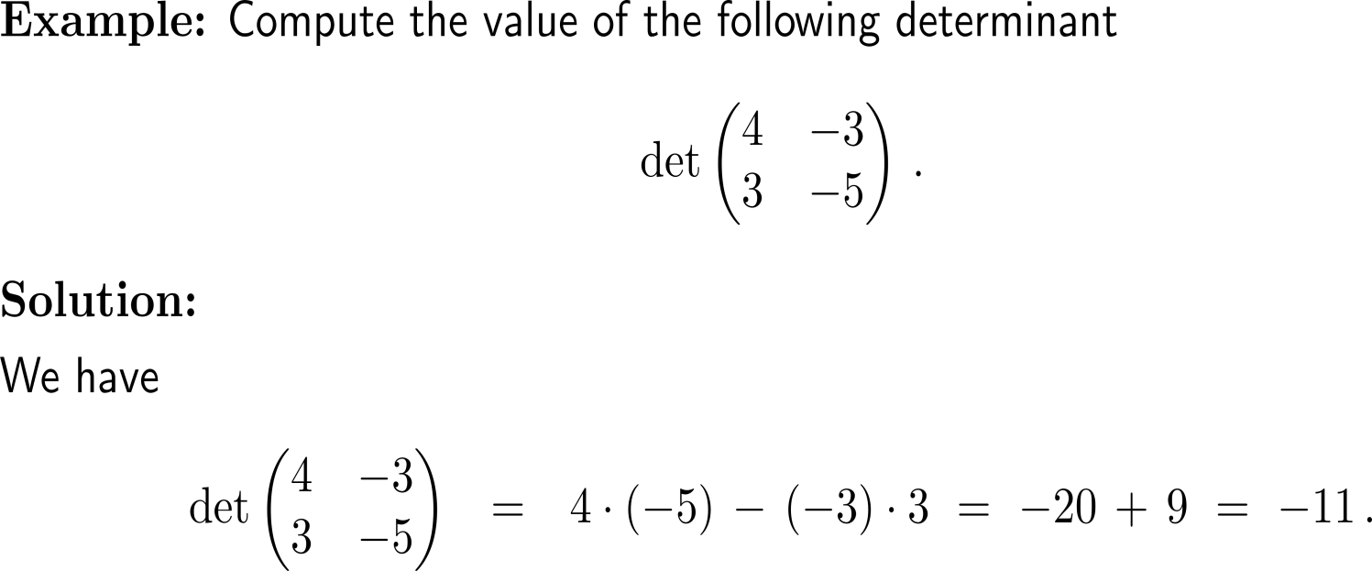
Example:
The value of a determinant in 2D

Slide 29
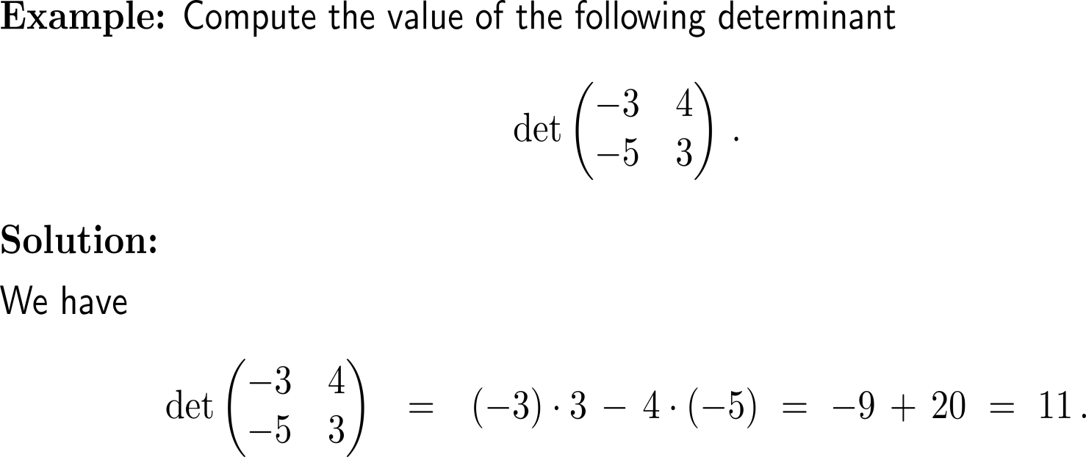
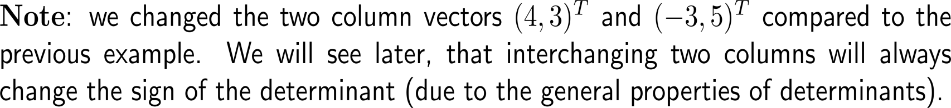
Example:
The value of a determinant in 2D

Slide 30
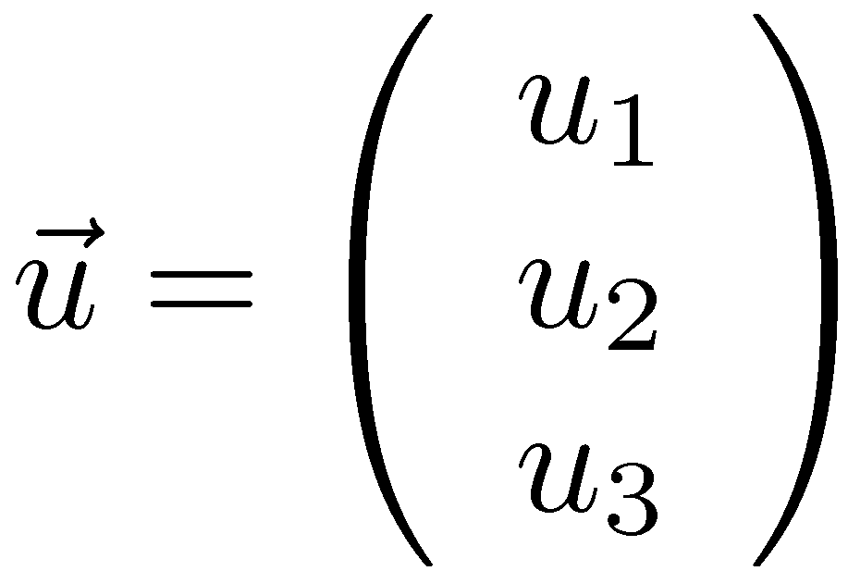
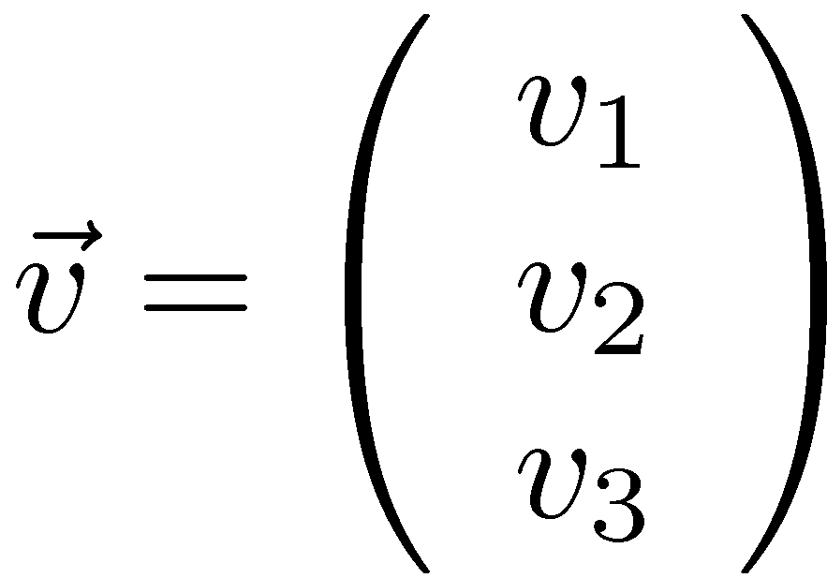
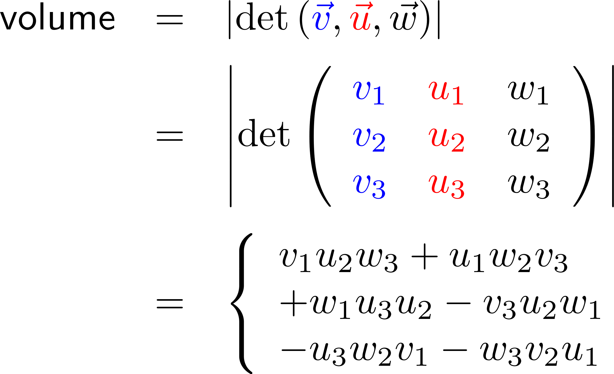
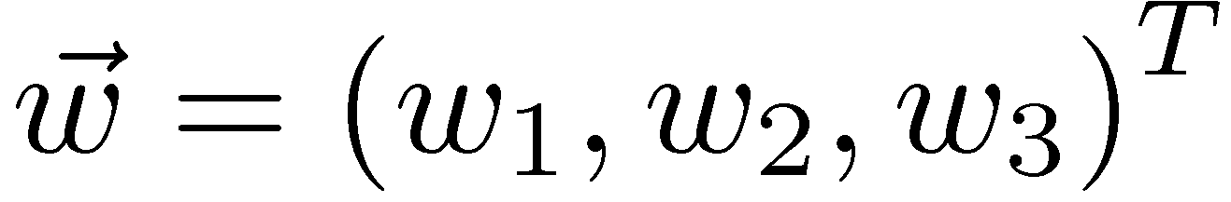
As in 2D the determinant in 3D can be connected with the volume of a spat spanned by three vectors

Slide 31
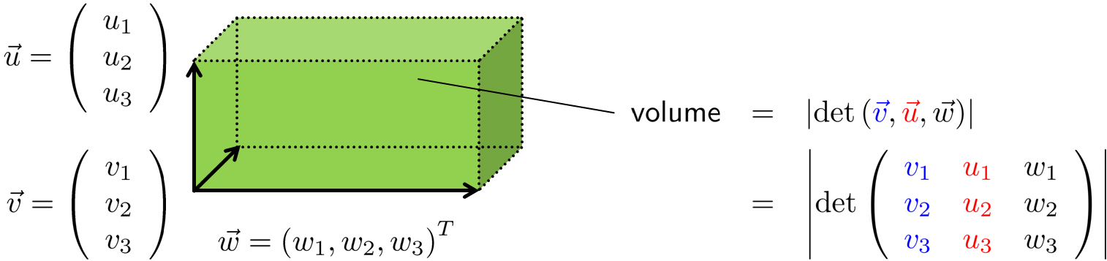
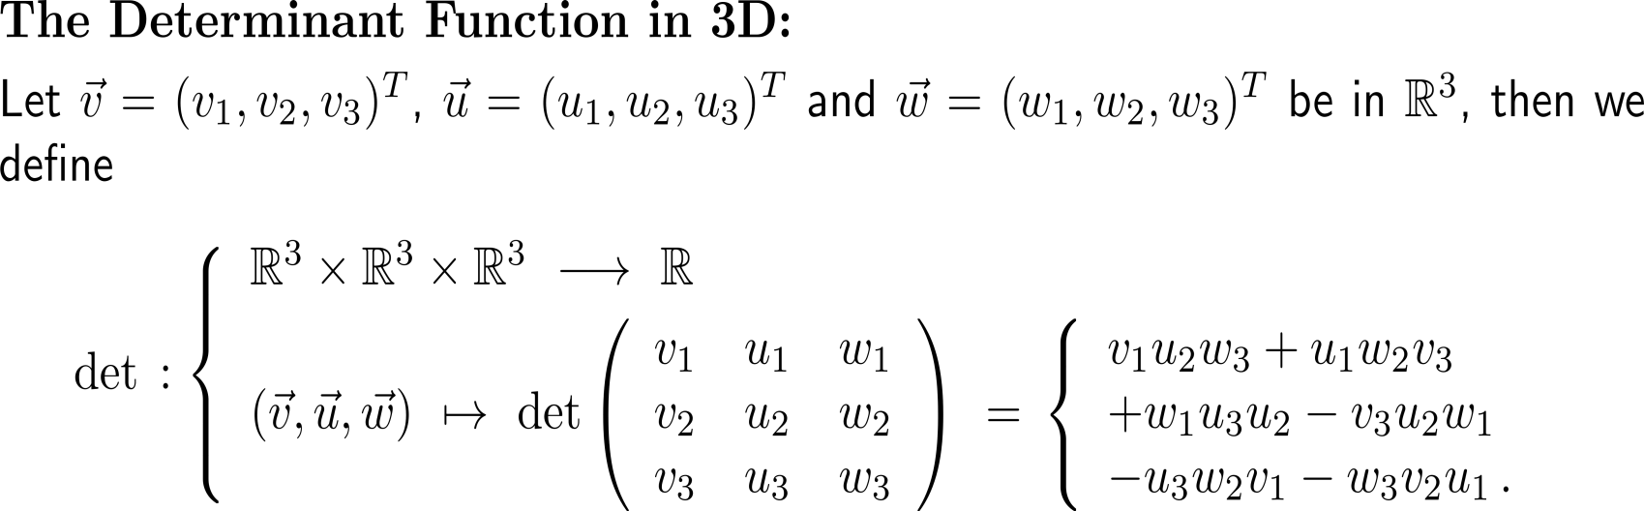
Definition:
The determinant function in 3D

Slide 32
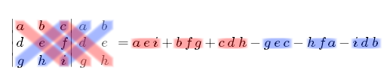
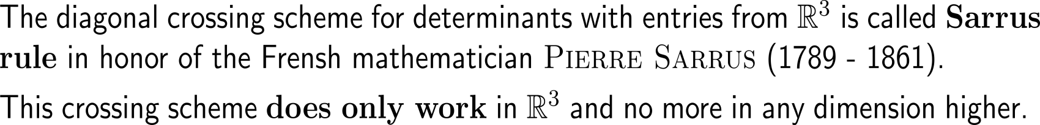
Only, in 2D and 3D can the determinate be computed by utilizing a diagonal crossing scheme

Slide 33

In 3D this diagonal crossing scheme (Sarrus’ rule) requires that the first two columns are attached at the end of the determinant

Slide 34
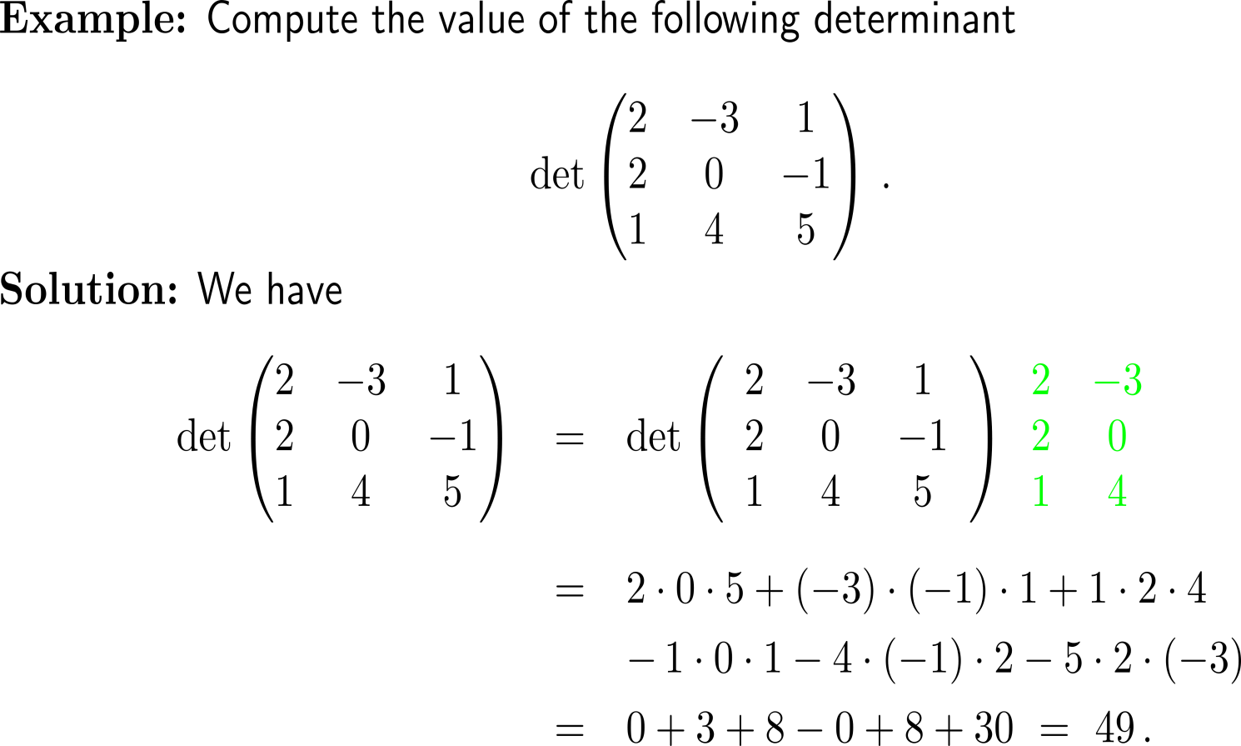
Example:
The value of a determinant in 3D
+
-

Slide 35
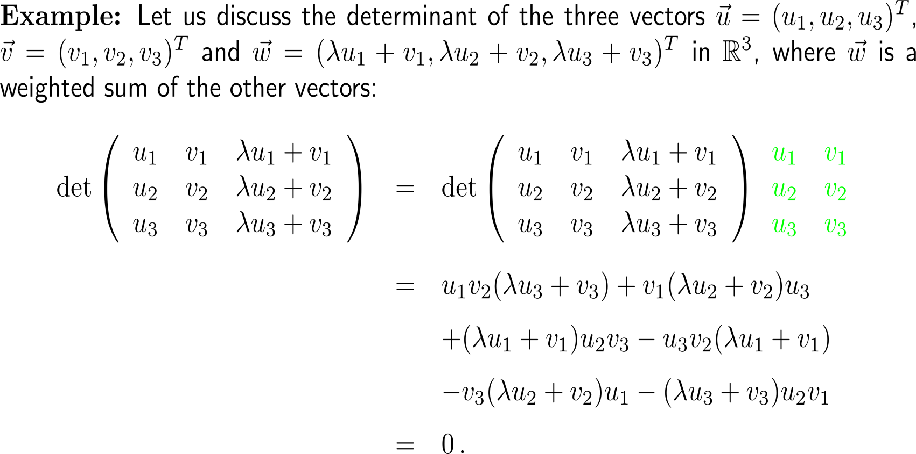
Example:
The value of a determinant in 3D

Slide 36
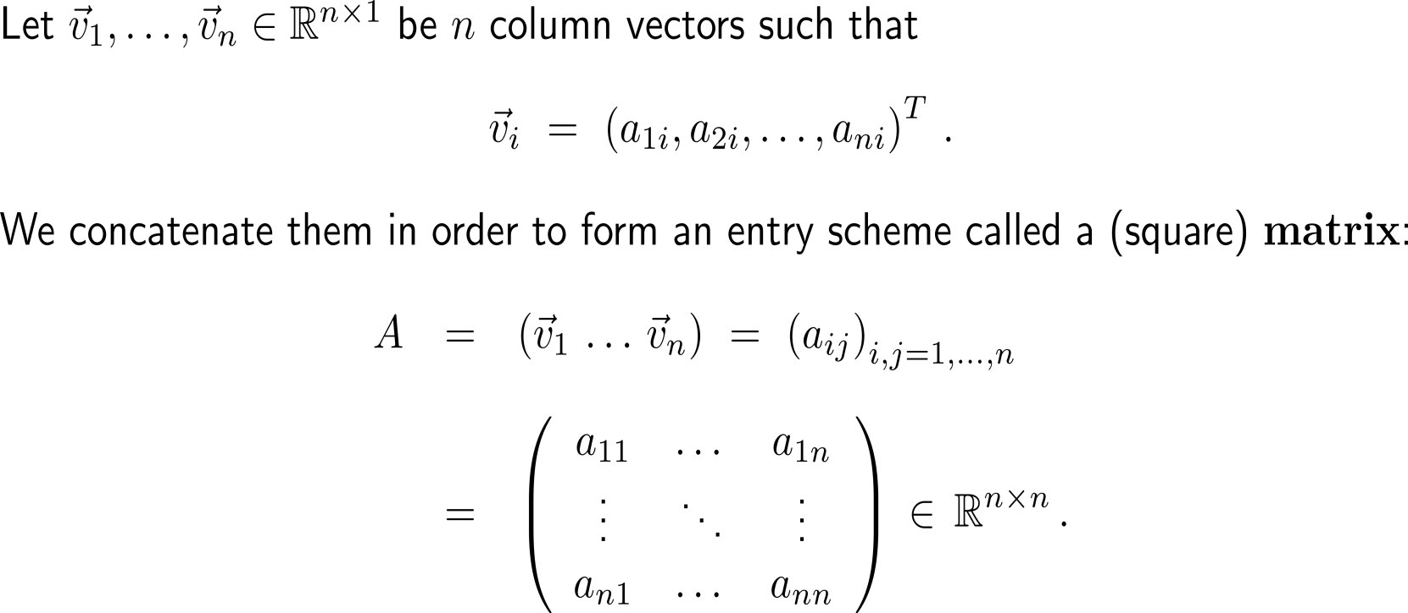
For convenience, we group vectors in special entry schemas that we call matrices (like in the case of linear systems)
rows
columns

Slide 37
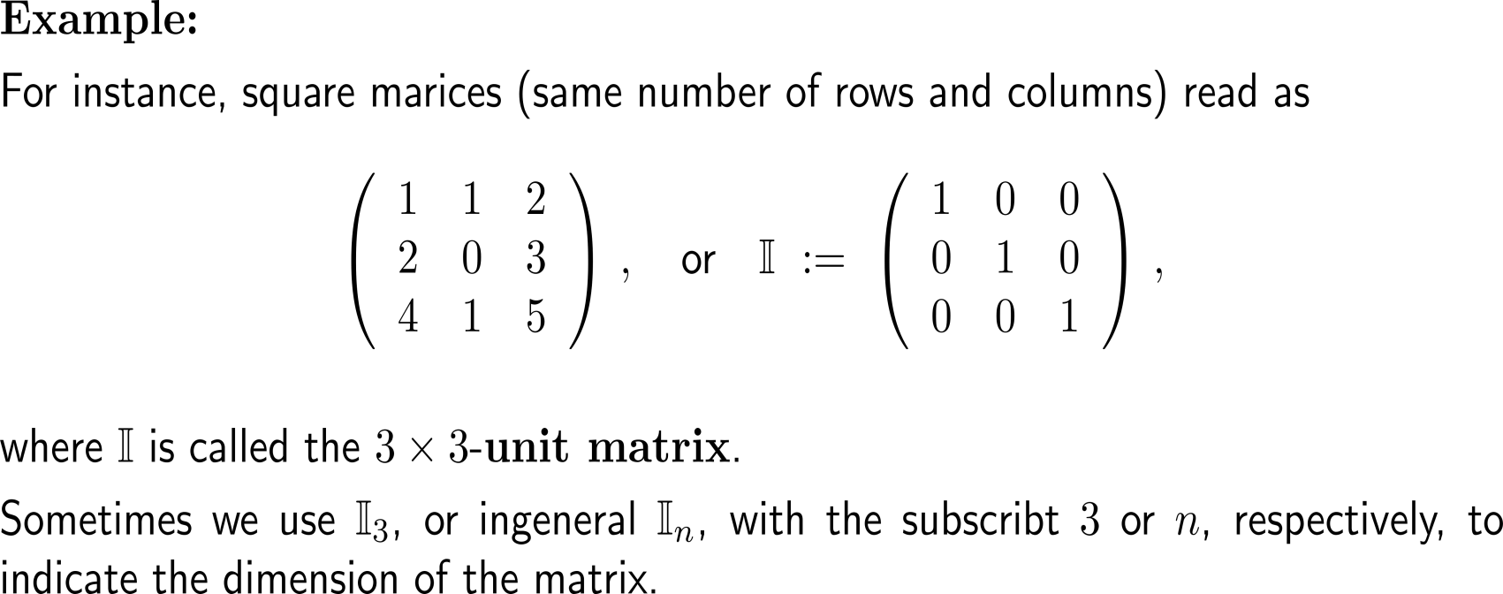
Example:
Some matrices

Slide 38
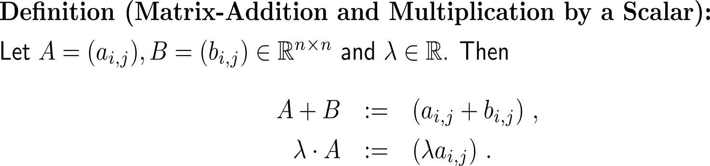
Some first properties of matrices

Slide 39

Example:
Addition and scalar multiplication of a square matrix

Slide 40


Further Worked-Out Exercises:
Calculus II for Management
Topics
  Determinants in 2D and 3D

Slide 41


Exercise

Slide 42


Exercise
y
C
B
1
A
O
1
x

Slide 43

Exercise
y
C
B
1
A
O
1
x

Slide 44



Exercise

Slide 45



Exercise

Slide 46



Exercise

Slide 47

Exercise

Slide 48


Exercise

Slide 49

Exercise

Slide 50
Calculus II for Management

