Slide 1
Calculus II for Management
Improper Integrals
week 6
Lecture 6
A primer on eigenvalues and eigenvectors
The improper integral
Application of improper integrals
Survival & renewal in perpetuity
Population of an urban area

Slide 2
Recap: A short reflection about what we have achieved so far (1/ 2)

Slide 3
Recap: A short reflection about what we have achieved so far (2/ 2)

Slide 4
Topics
A Primer on Eigenvalues and Eigenvectors
The Improper Integral
Application of Improper Integrals
Survival & Renewal in Perpetuity
Population of an Urban Area

Slide 5
The eigenvectors of a (square) matrix are those vectors that, mapped to a multiple of themselves by multiplication with the matrix

Slide 6
This defining property of an eigenvector leads to a linear system …

Slide 7
… that can be solved by Gaussian elimination

Slide 8
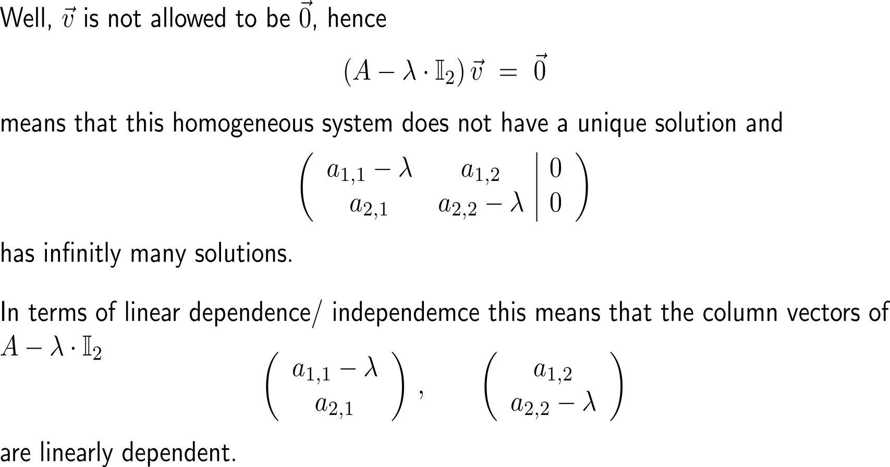
The eigenvalue that corresponds to an eigenvector is the specific value that generates linearly dependent columns in the coefficient matrix …

Slide 9
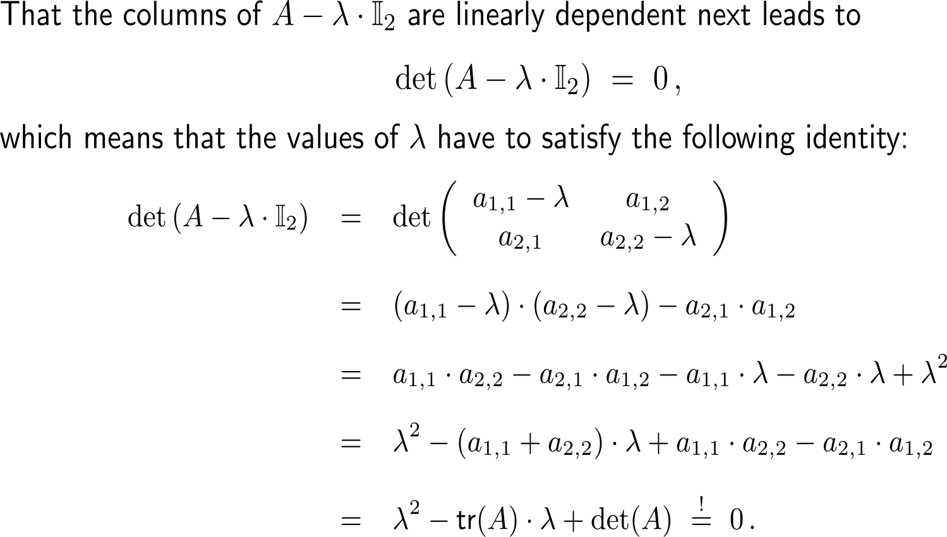
… or, stated differently, that leads to a vanishing determinant of the coefficient matrix (1/ 2)

Slide 10
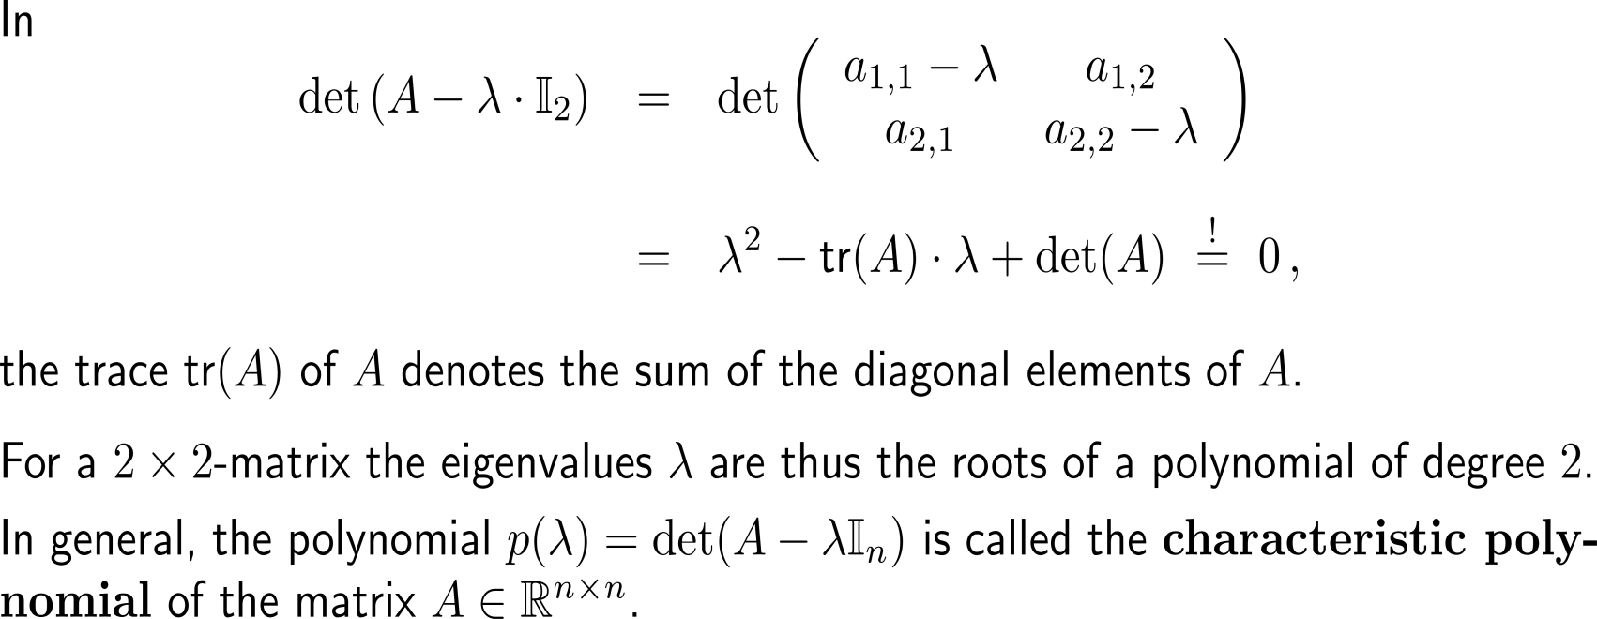
… or, stated differently, that leads to a vanishing determinant of the coefficient matrix (2/ 2)

Slide 11
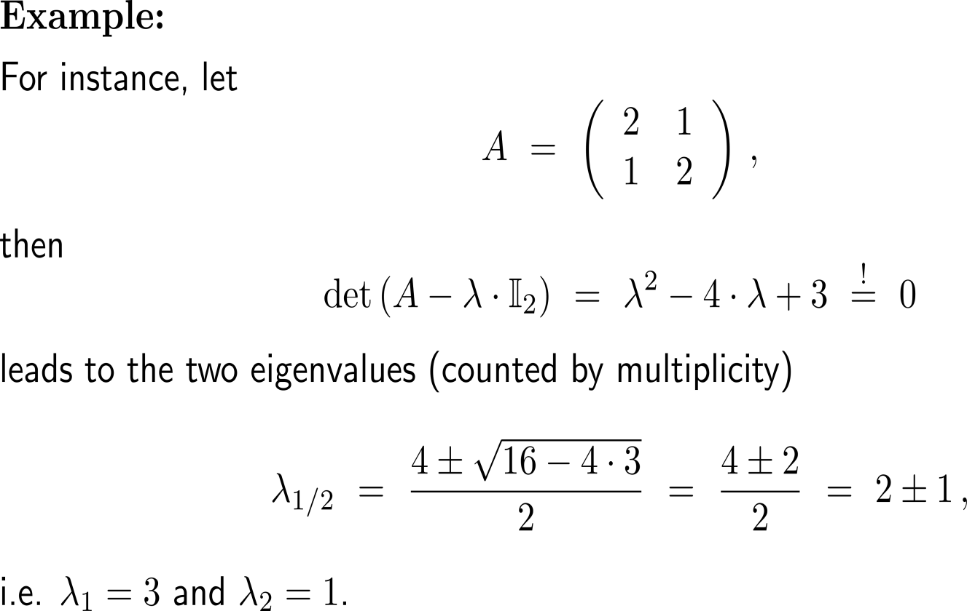
Example: Determining the eigenvalues & eigenvectors of a 2x2-matrix

Slide 12
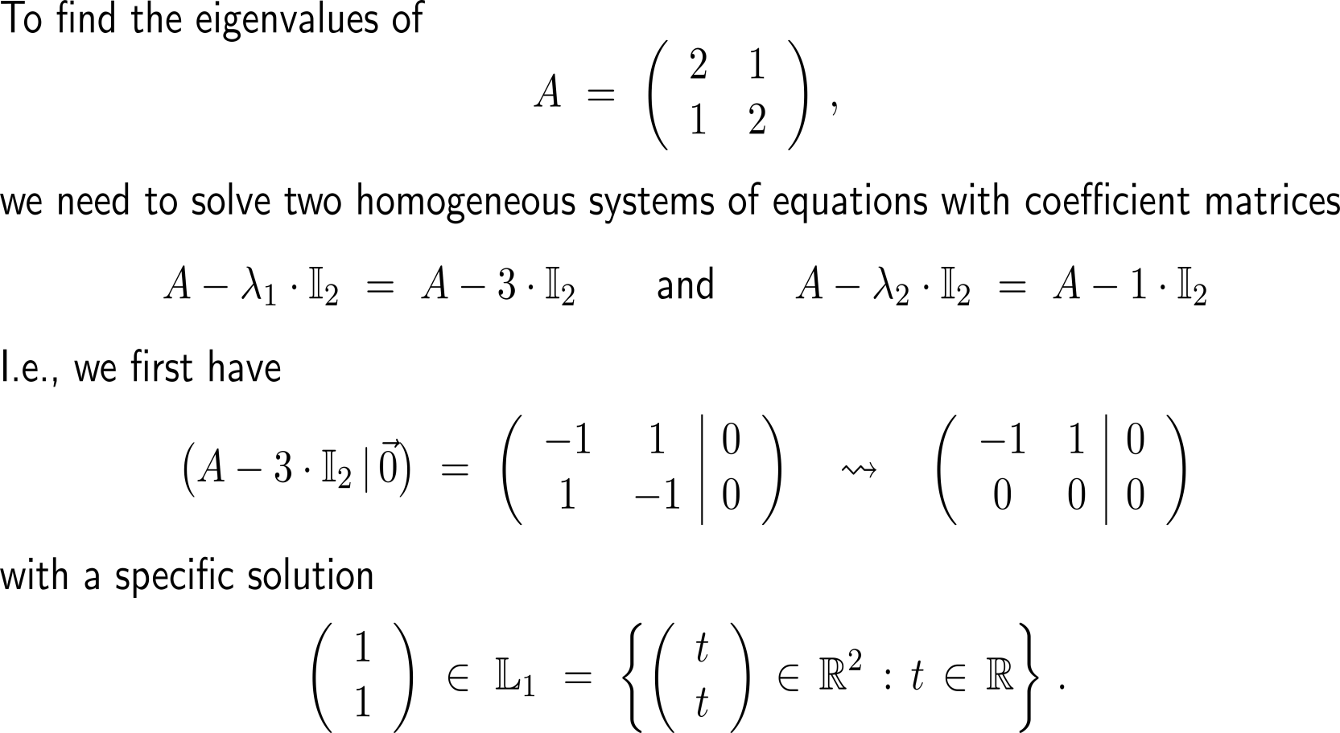
Example: Determining the eigenvalues & eigenvectors of a 2x2-matrix

Slide 13
Example: Determining the eigenvalues & eigenvectors of a 2x2-matrix

Slide 14
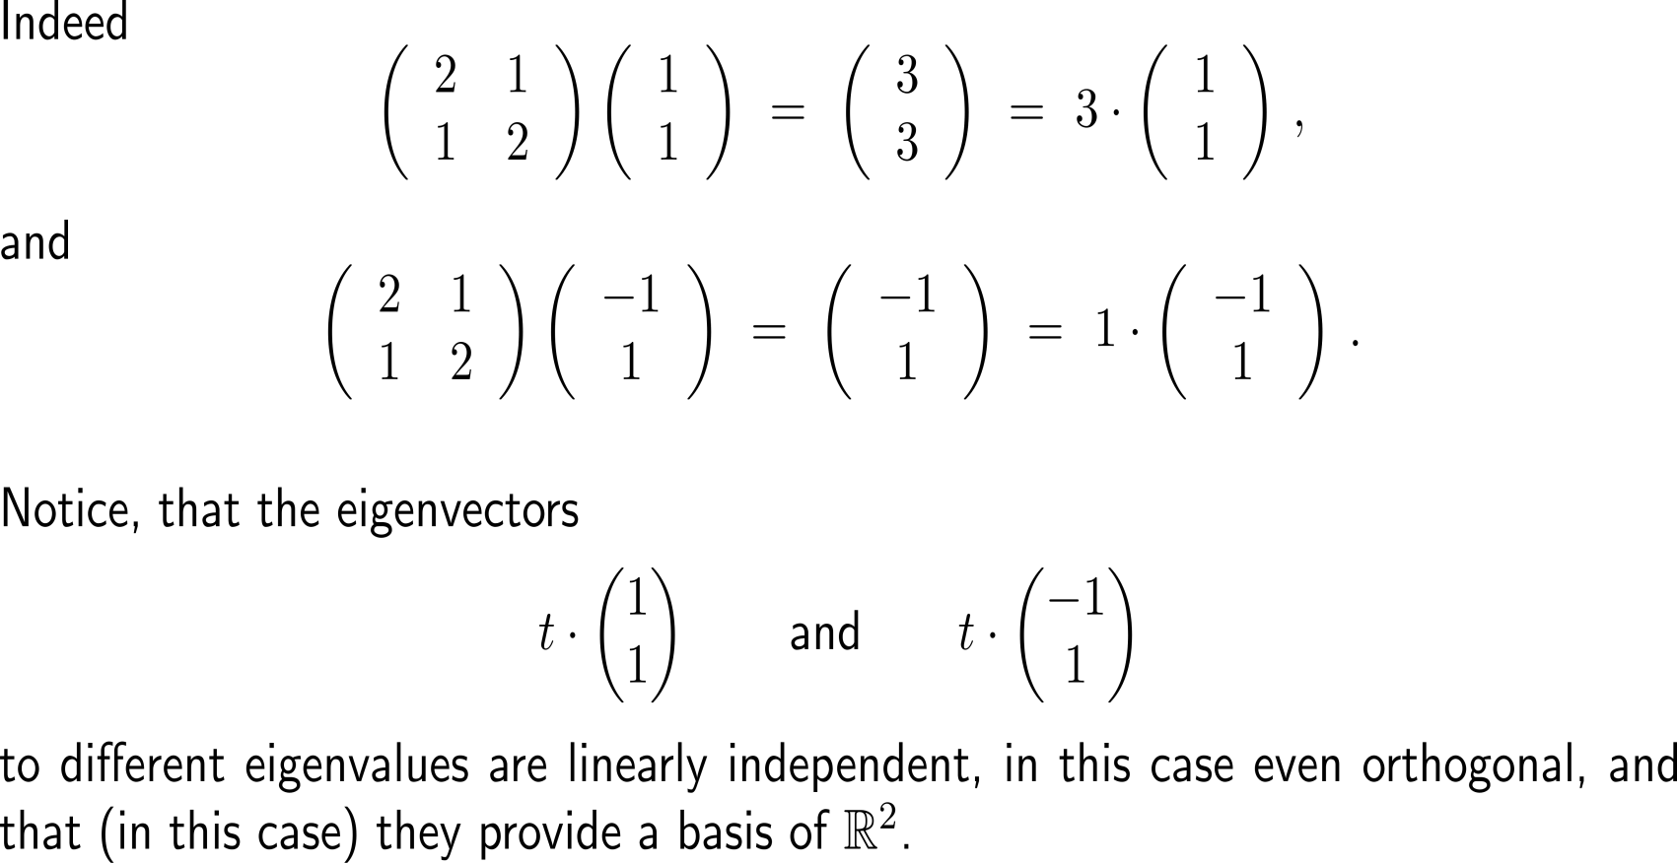
Example: Determining the eigenvalues & eigenvectors of a 2x2-matrix

Slide 15
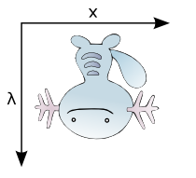
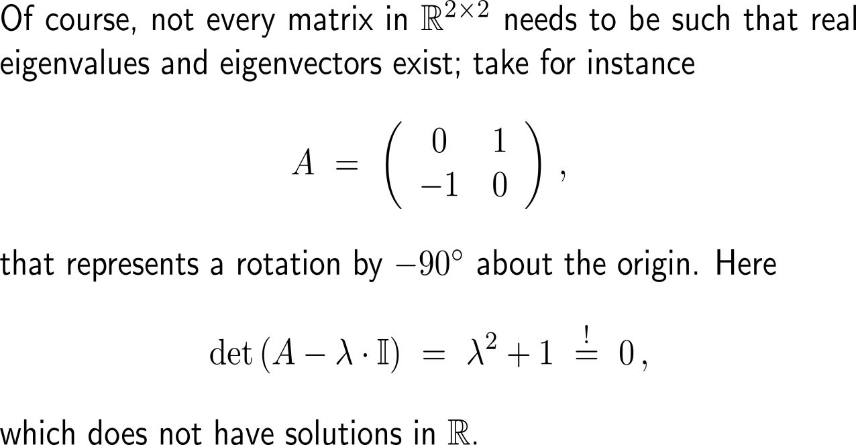
Note, not every matrix needs to have (real) eigenvales and eigenvectors
A

Slide 16
Topics
A Primer on Eigenvalues and Eigenvectors
The Improper Integral
Application of Improper Integrals
Survival & Renewal in Perpetuity
Population of an Urban Area

Slide 17
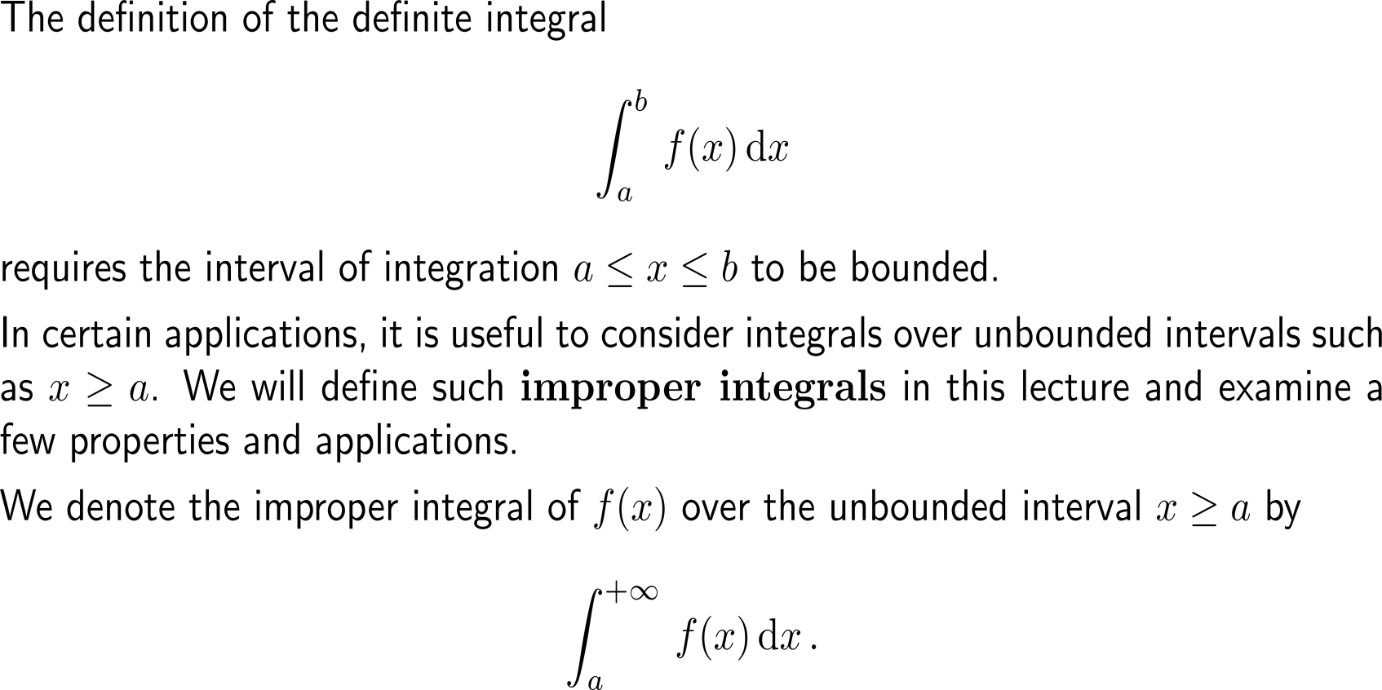
An integral is called an improper integral if one or both of its boundaries tend to infinity (1/ 3)

Slide 18
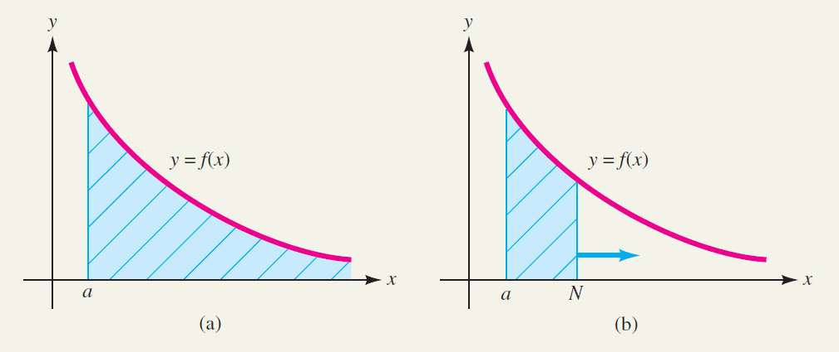
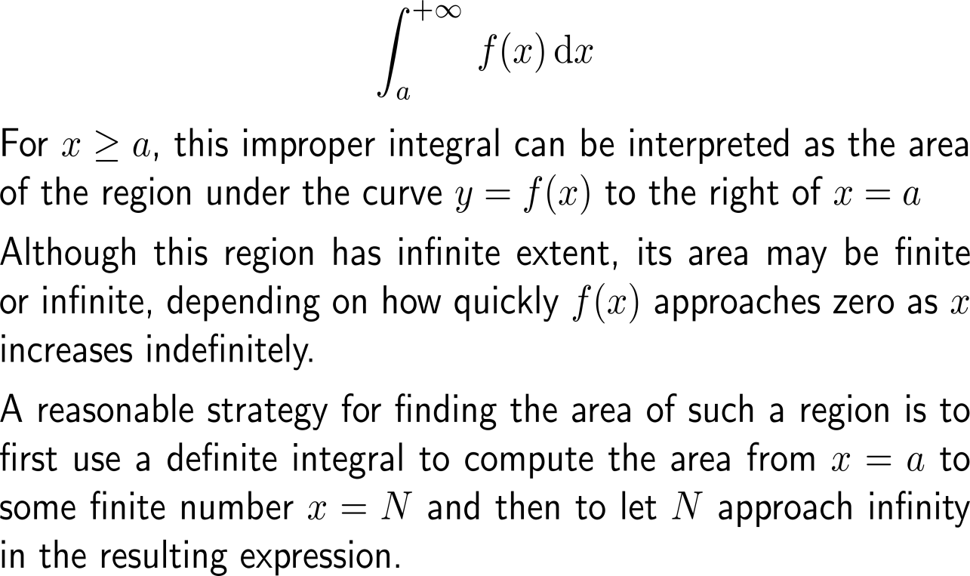
An integral is called an improper integral if one or both of its boundaries tend to infinity (2/ 3)

Slide 19
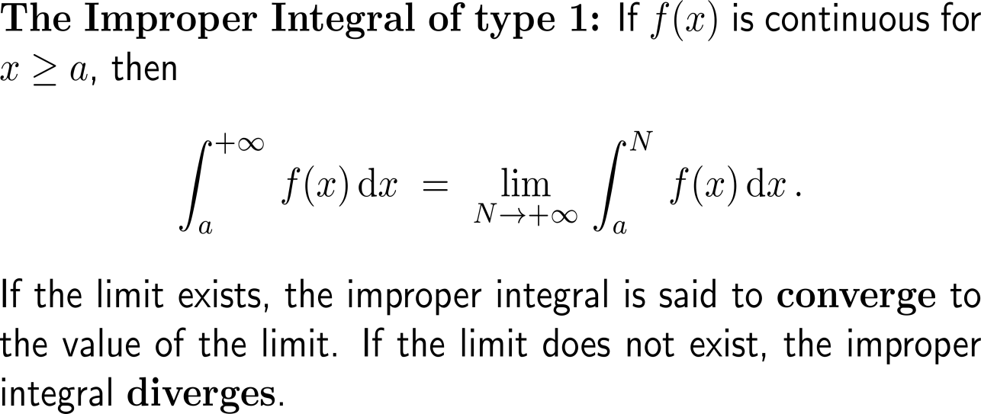
An integral is called an improper integral (of type 1) if one or both of its boundaries tend to infinity (3/ 3)

Slide 20
Example: Evaluating an improper integral
step 2: limit
step 1: definite integral

Slide 21
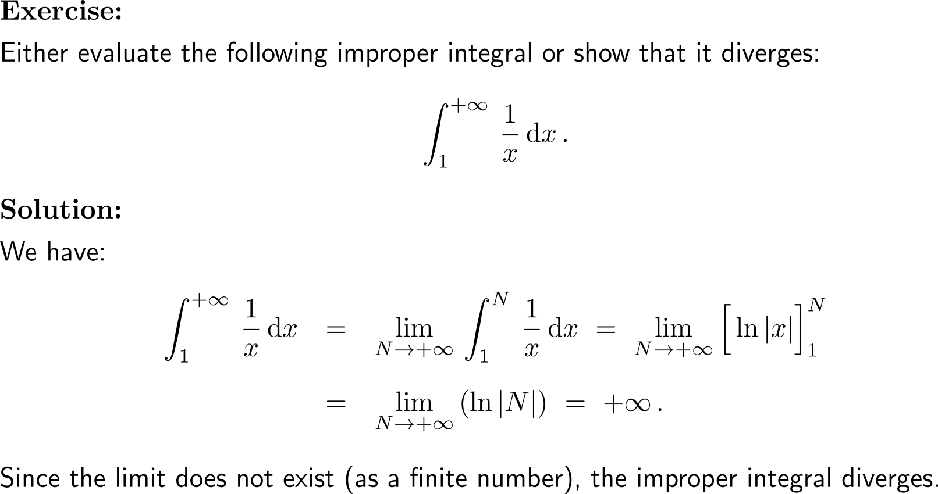
Example: Evaluating an improper integral

Slide 22
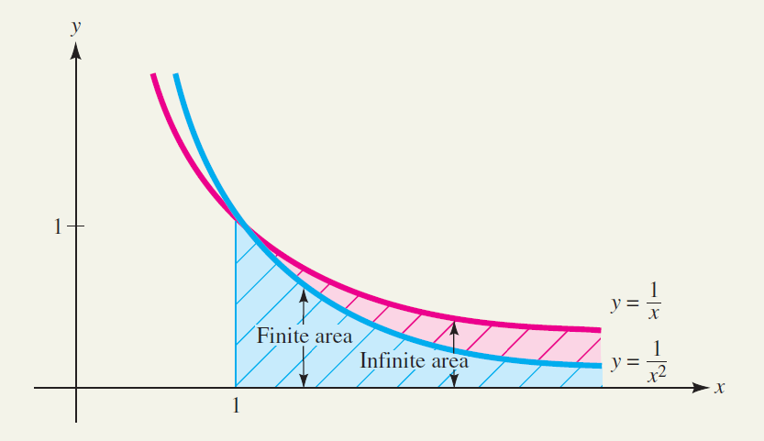
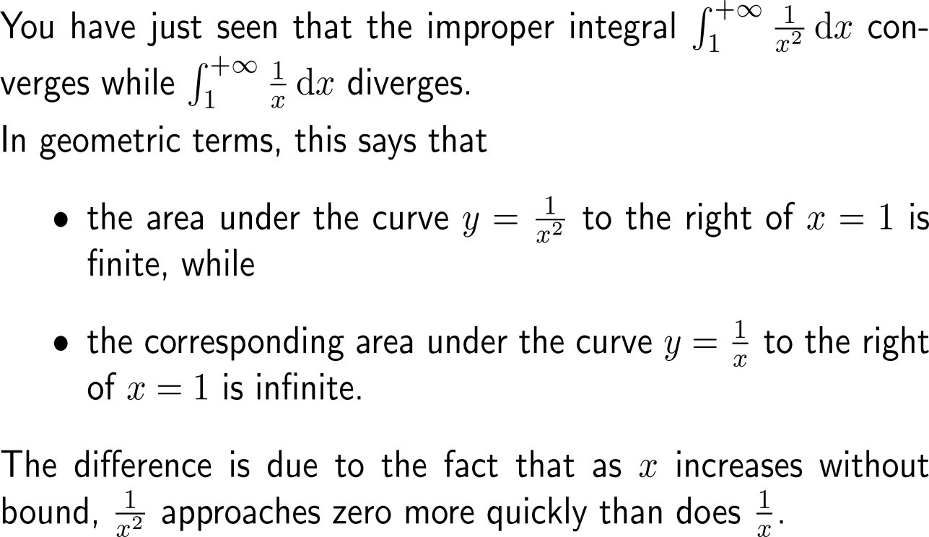
Summary: Convergence and divergence of improper integrals

Slide 23
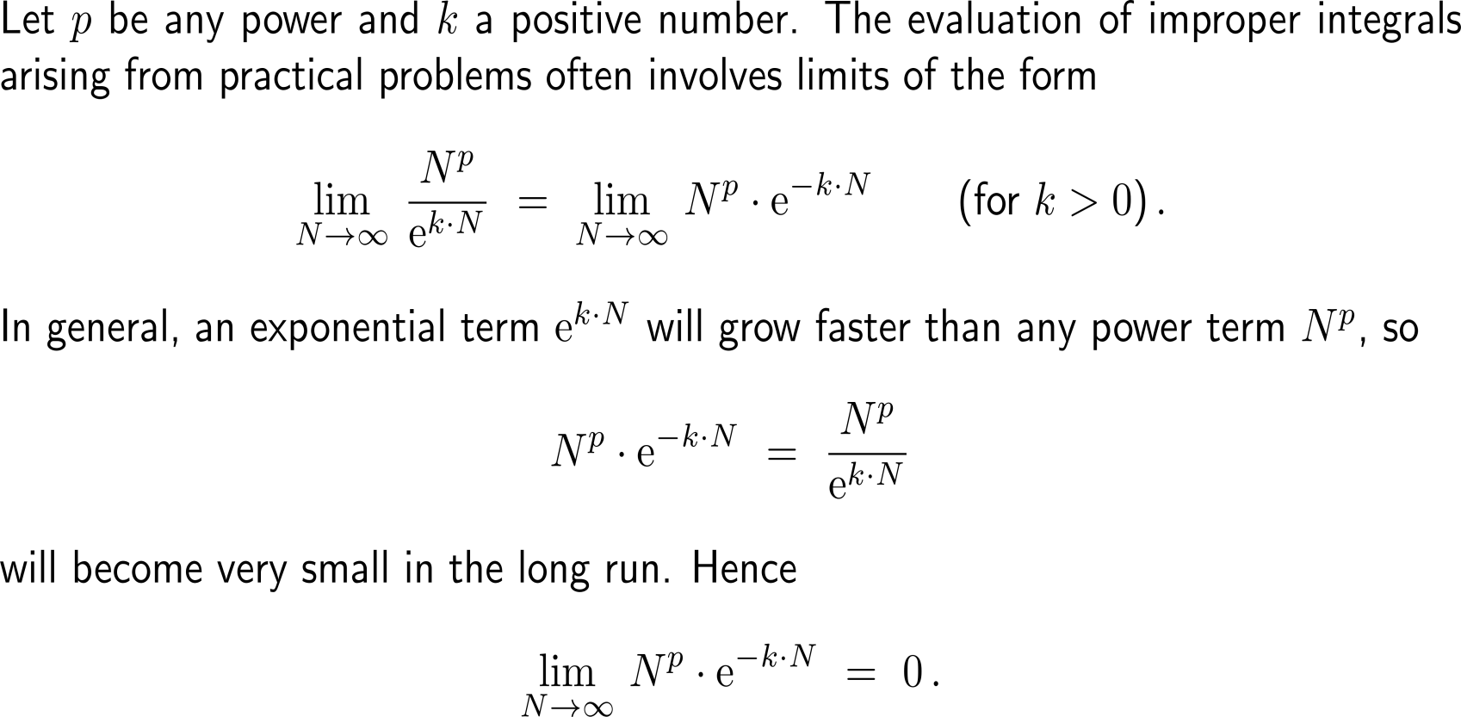
Recall: The exponential function grows faster than any power/ polynomial function

Slide 24
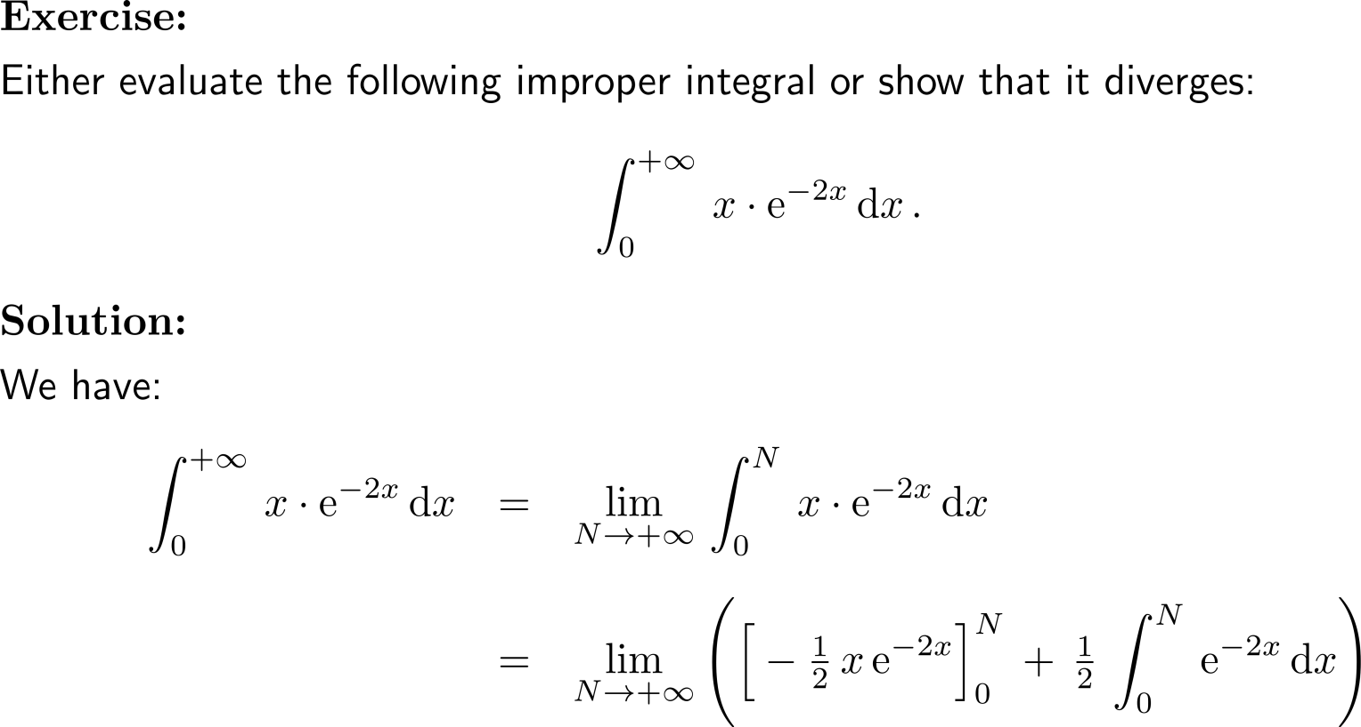
Example: Evaluating an improper integral using integration by parts
u = x
dv = e^{-2x} dx

Slide 25
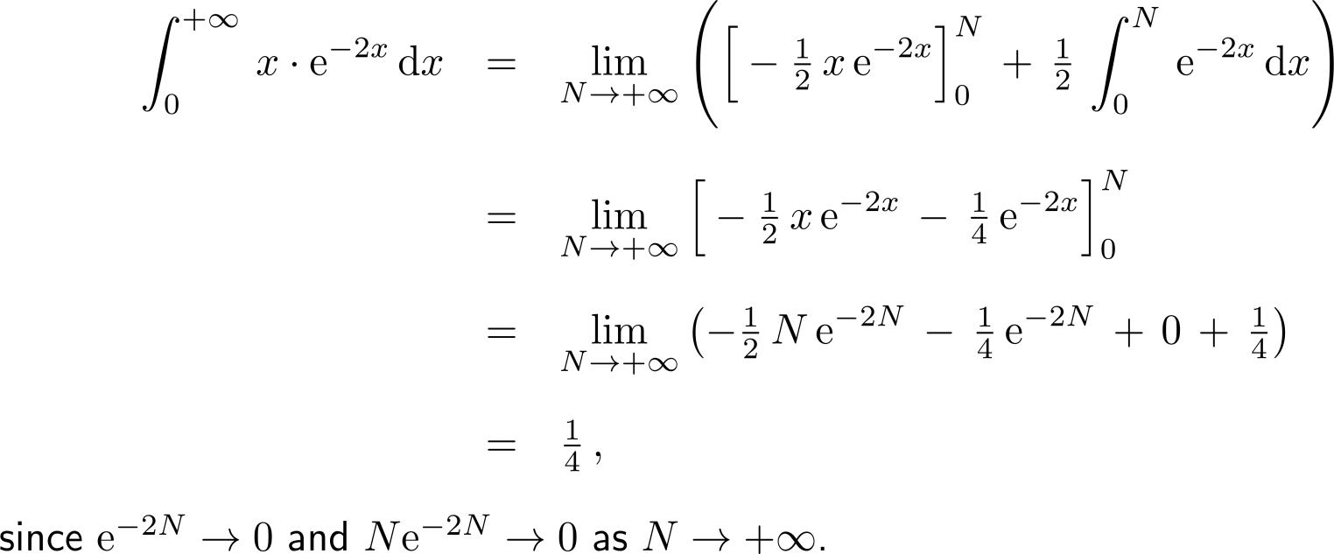
Example: Evaluating an improper integral using integration by parts

Slide 26
Besides improper integrals with an upper integration boundary of +∞ there are improper integrals with a lower integration boundary of -∞ …

Slide 27
… as well as those with both boundaries of integration tending towards infinity (double improper integrals)

Slide 28
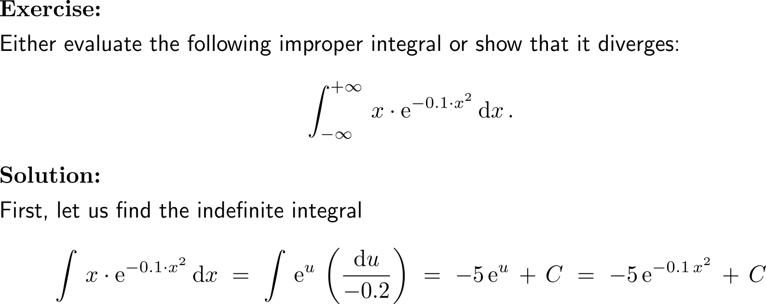
Example: Evaluating a double improper integral
substitution:
u = – 0.1 x²
du = – 0.2 x dx

Slide 29
Example: Evaluating a double improper integral

Slide 30
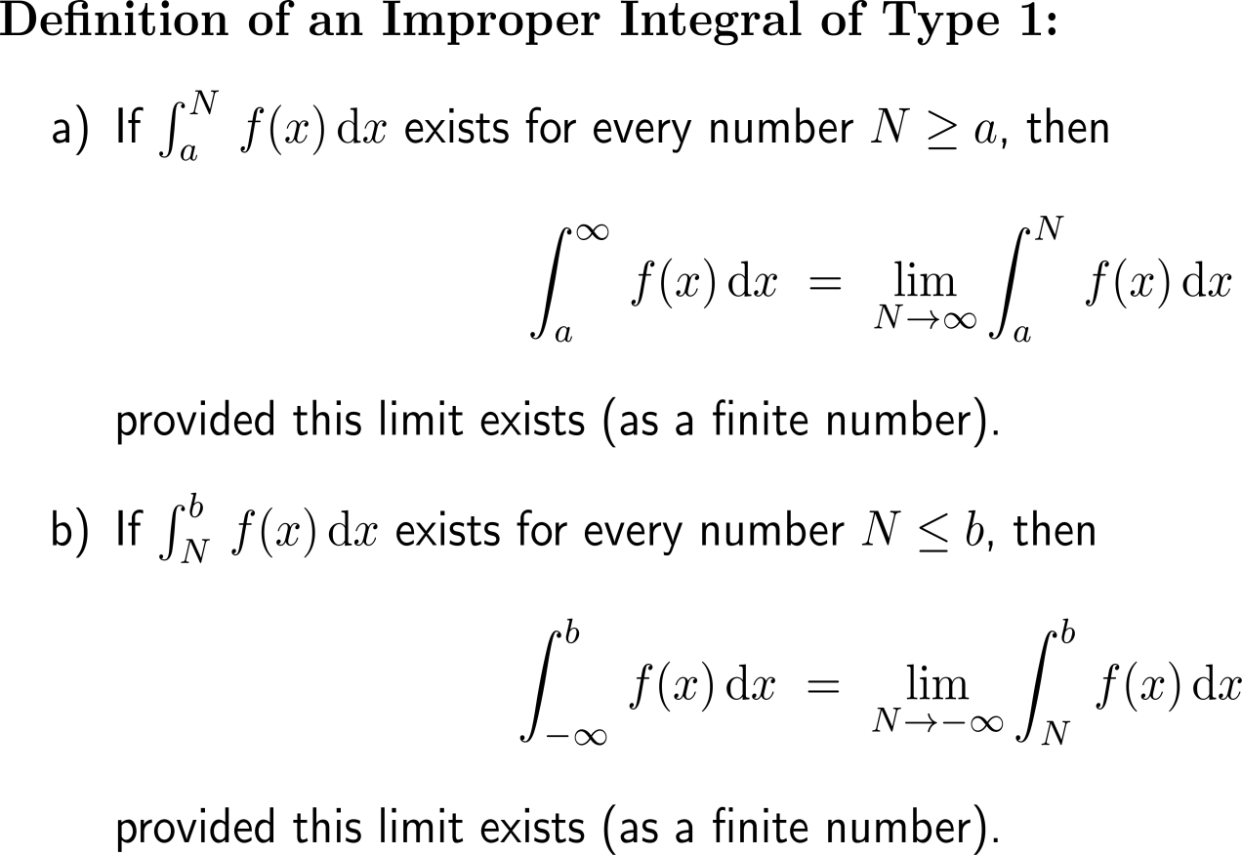
Improper integrals of type 1 summarize definite integrals that have an infinite upper or lower bound (1/ 2)
Summary Improper Integral of Type 1

Slide 31
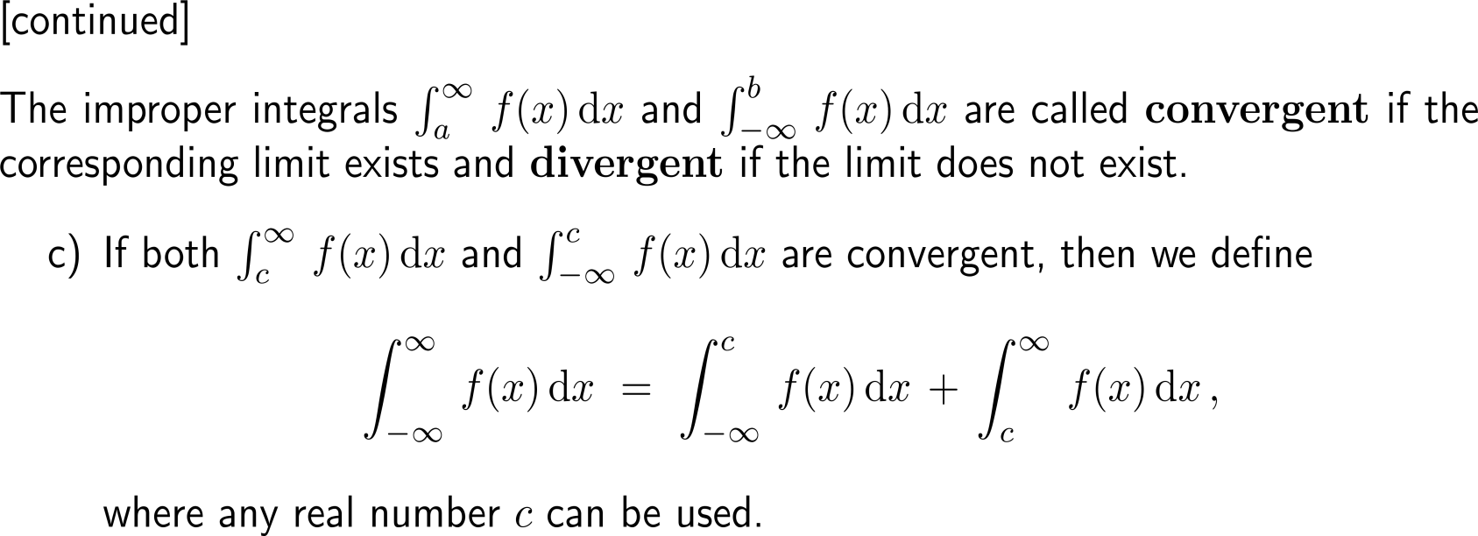
Improper integrals of type 1 summarize definite integrals that have an infinite upper or lower bound (2/ 2)
Summary Improper Integral of Type 1

Slide 32
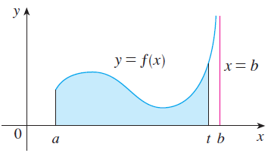
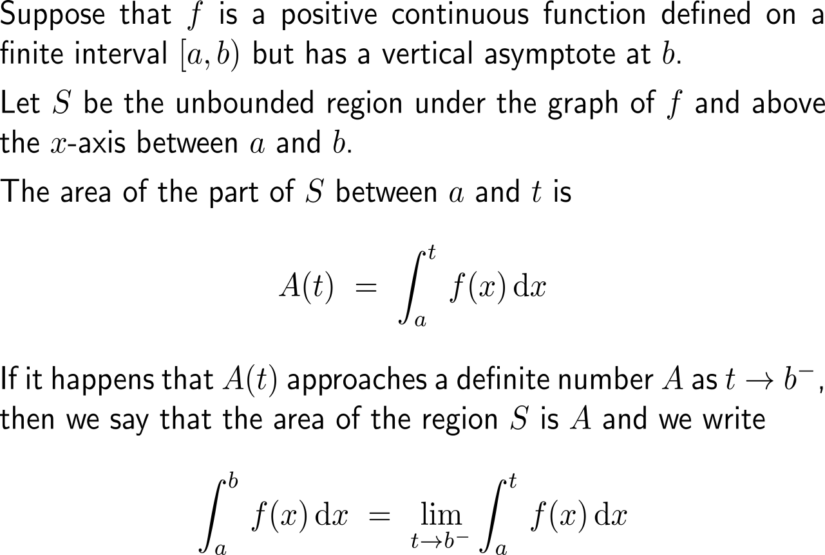
Improper integrals of type 2 are essentially infinite limts

Slide 33
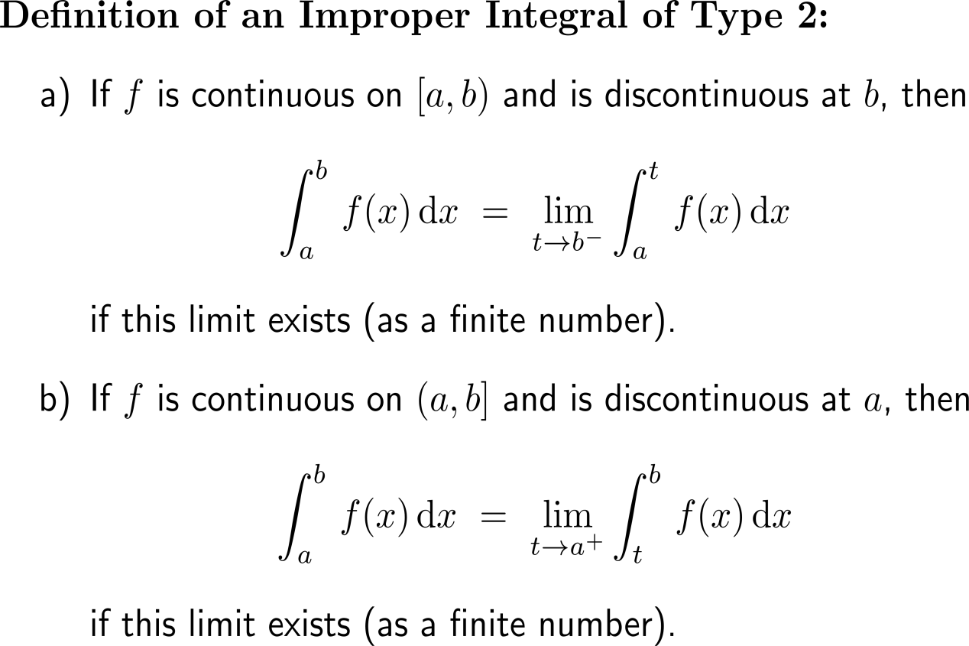
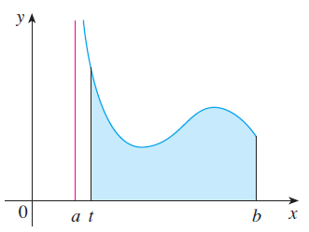
Improper integrals of type 2 summarize definite integrals that have an infinite discontinuity as upper or lower bound (1/ 2)

Slide 34
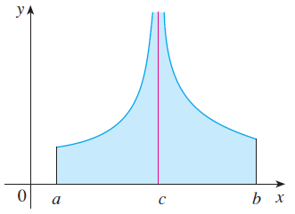
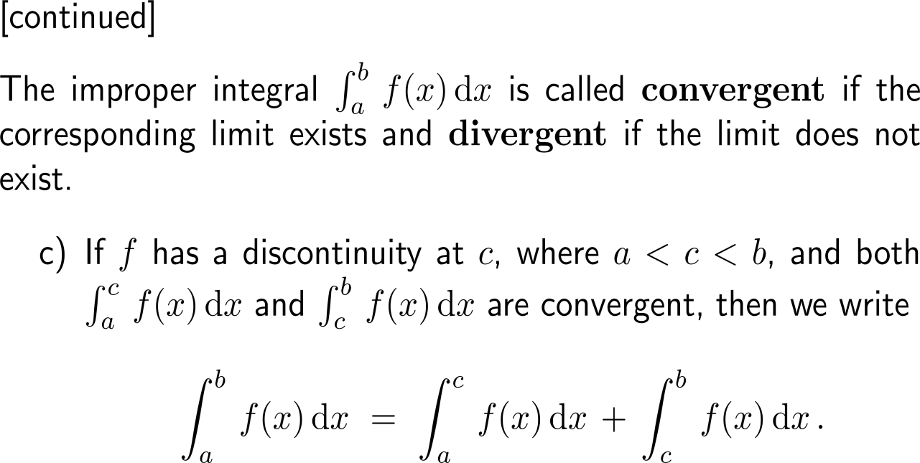
Improper integrals of type 2 summarize definite integrals that have an infinite discontinuity as upper or lower bound (2/ 2)

Slide 35
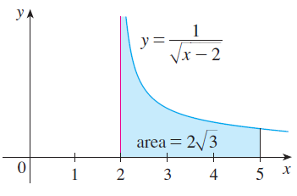
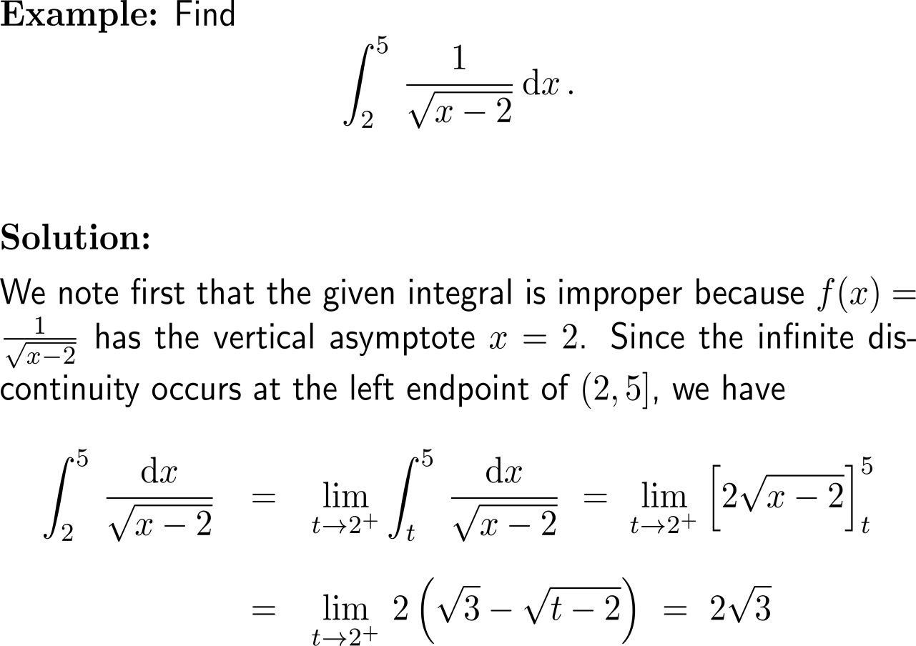
Example: Improper integrals of type 2

Slide 36
Example: Improper integrals of type 2

Slide 37
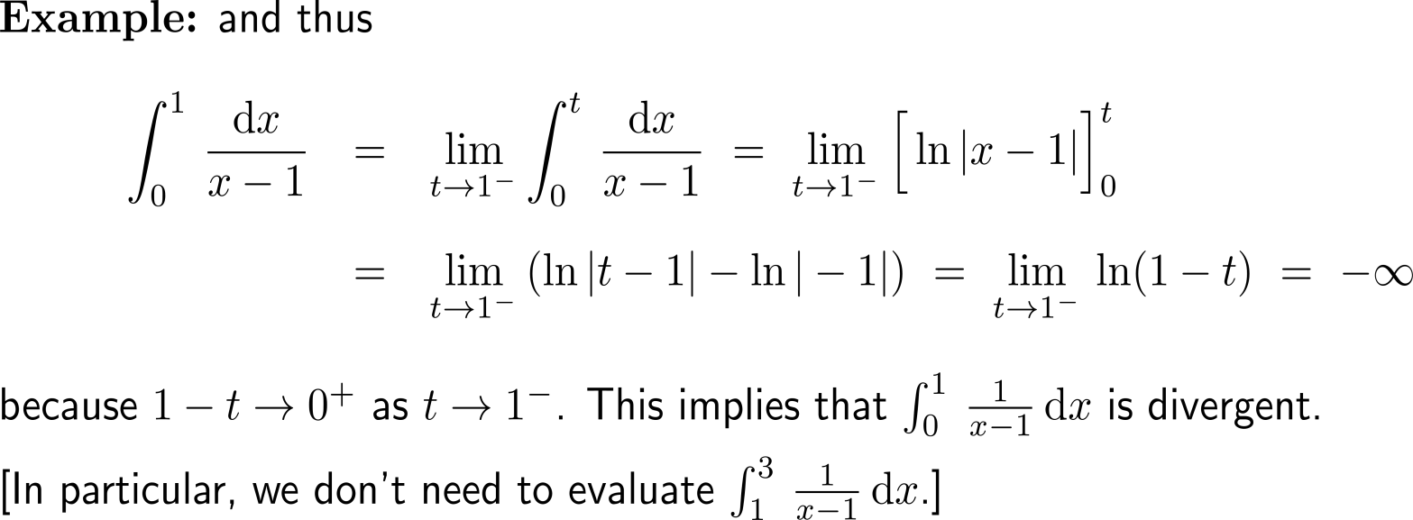
Example: Improper integrals of type 2
!

Slide 38
Topics
A Primer on Eigenvalues and Eigenvectors
The Improper Integral
Application of Improper Integrals
Survival & Renewal in Perpetuity
Population of an Urban Area

Slide 39
Example: Finding the present value of an income flow

Slide 40
Example: Finding the present value of an income flow

Slide 41
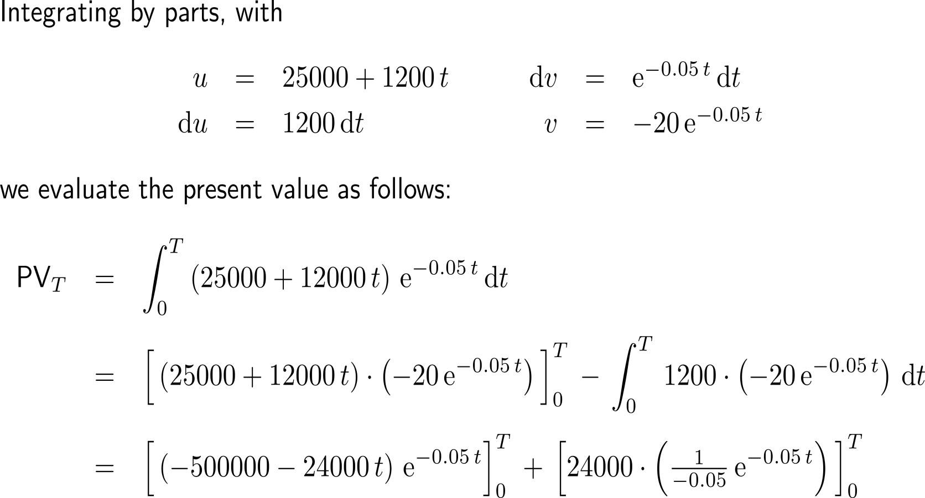
Example: Finding the present value of an income flow

Slide 42
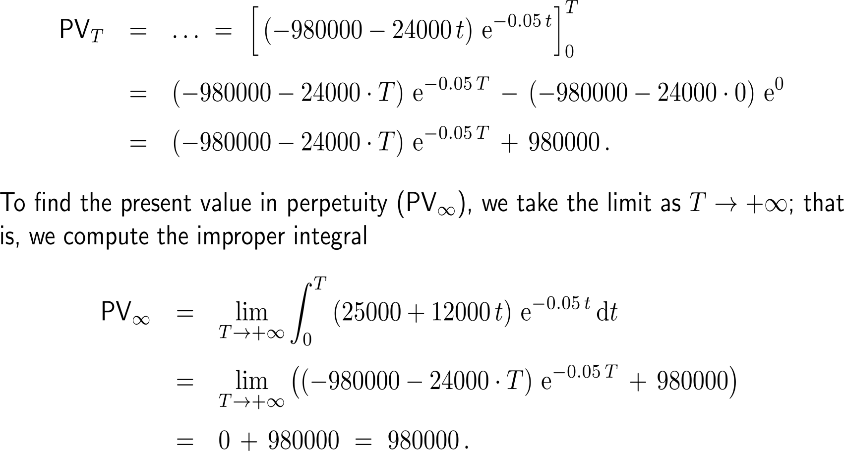
Example: Finding the present value of an income flow

Slide 43
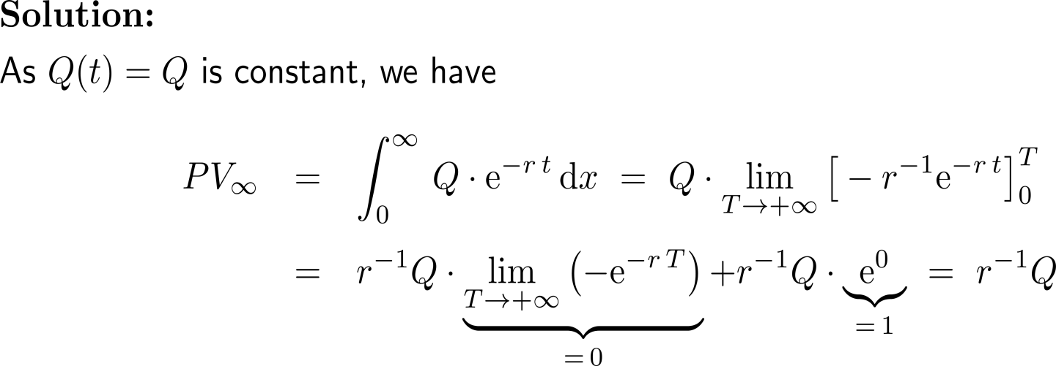
Example: Present value
10 minutes
self/ group work
please, upload your solutions to the chat

Slide 44
Topics
A Primer on Eigenvalues and Eigenvectors
The Improper Integral
Application of Improper Integrals
Survival & Renewal in Perpetuity
Population of an Urban Area

Slide 45
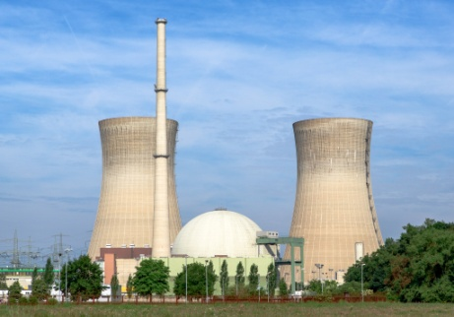
Example: Eventual accumulation of nuclear waste

Slide 46
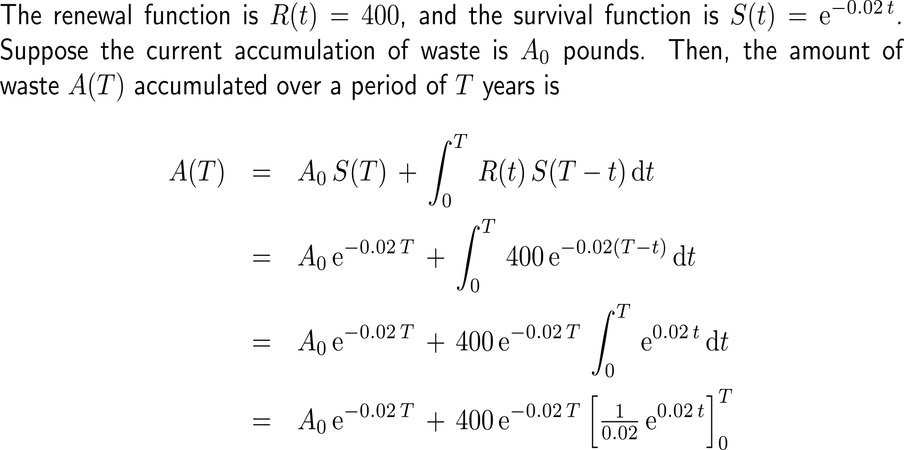
Example: Eventual accumulation of nuclear waste

Slide 47
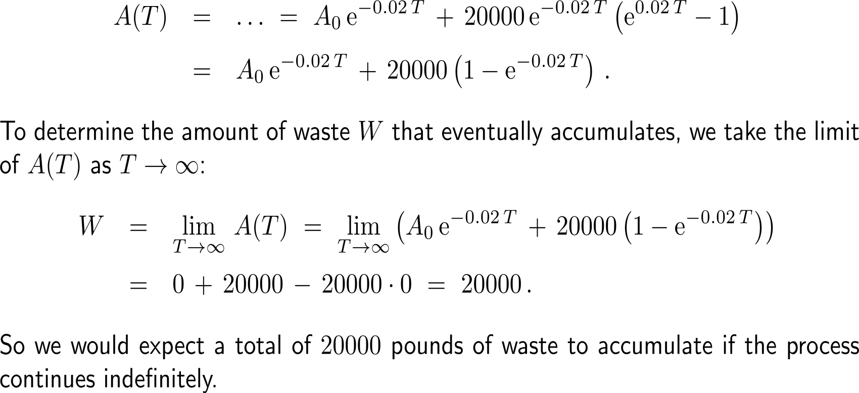
Example: Eventual accumulation of nuclear waste

Slide 48
Topics
A Primer on Eigenvalues and Eigenvectors
The Improper Integral
Application of Improper Integrals
Survival & Renewal in Perpetuity
Population of an Urban Area

Slide 49
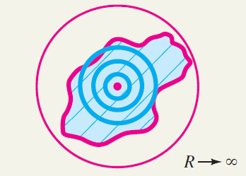
Let us view the population of an urban area (the city together with its commuter belt) in terms of an improper integral

Slide 50
Example: Estimating the population of an urban area

Slide 51
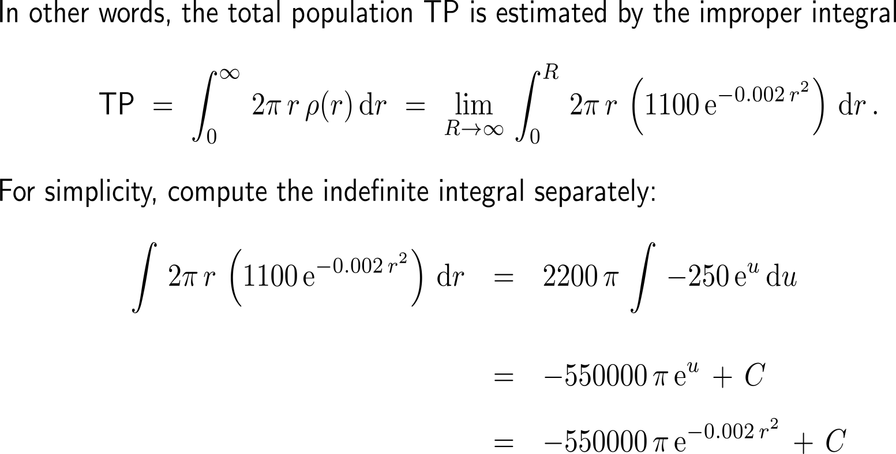
Example: Estimating the population of an urban area
substitution:
u = – 0.002 r²
du = – 0.004 r dr
r dr = -250 du

Slide 52
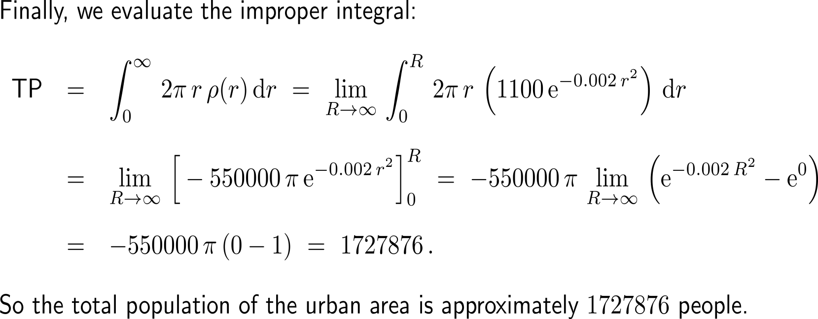
Example: Estimating the population of an urban area

Slide 53
Further Worked-Out Exercises:
Calculus II for Management
Topics
Eigenvalues and eigenvectors
Improper integrals

Slide 54
Exercise

Slide 55
Exercise

Slide 56
Exercise

Slide 57
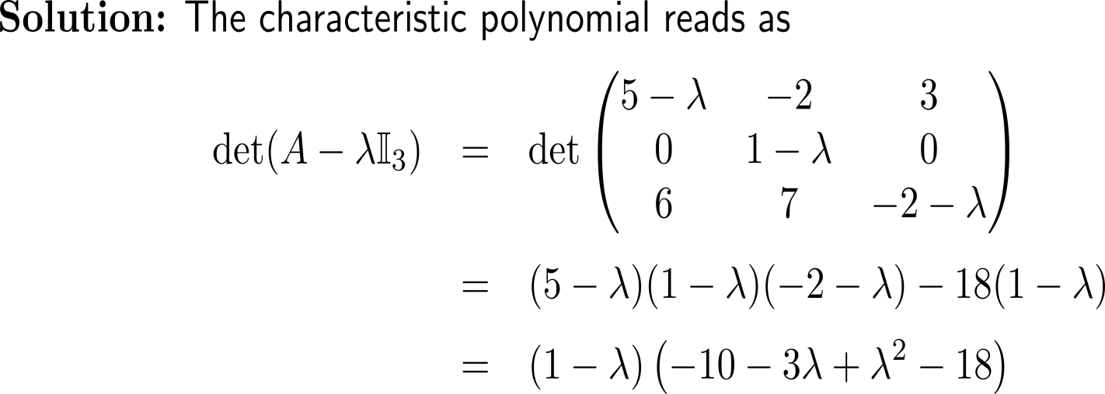
Exercise

Slide 58
Exercise

Slide 59
Exercise

Slide 60
Exercise

Slide 61
Exercise

Slide 62
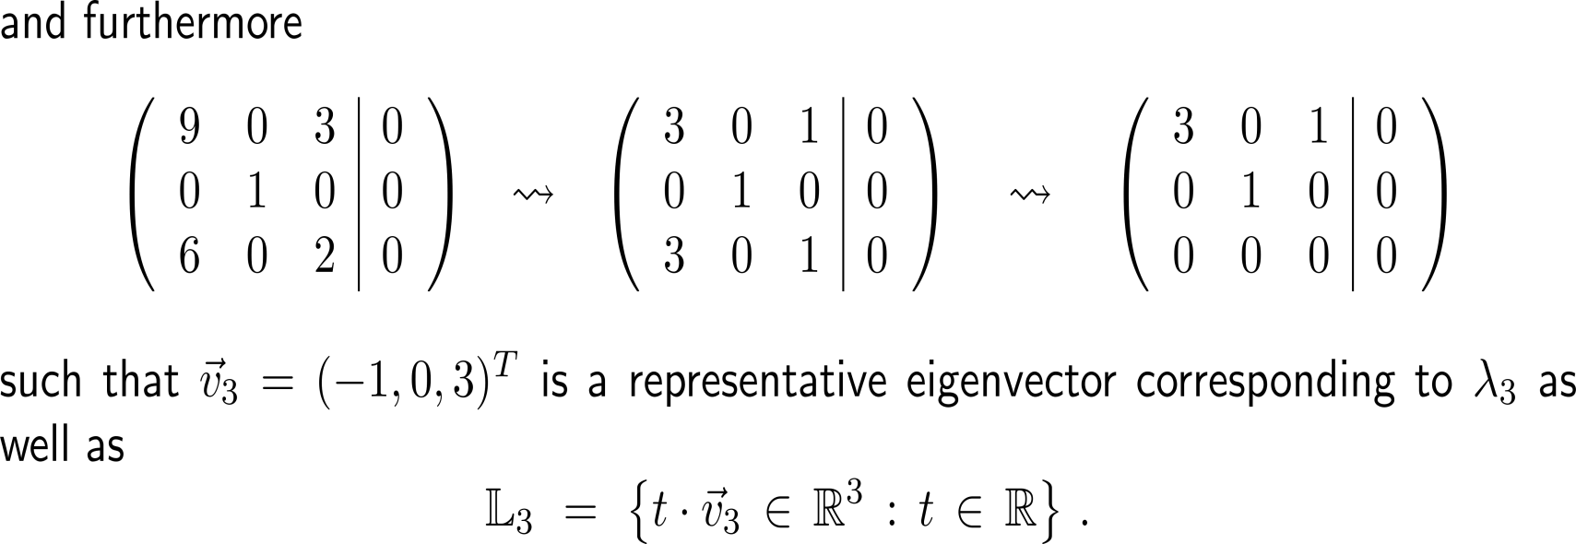
Exercise

Slide 63
Exercise

Slide 64
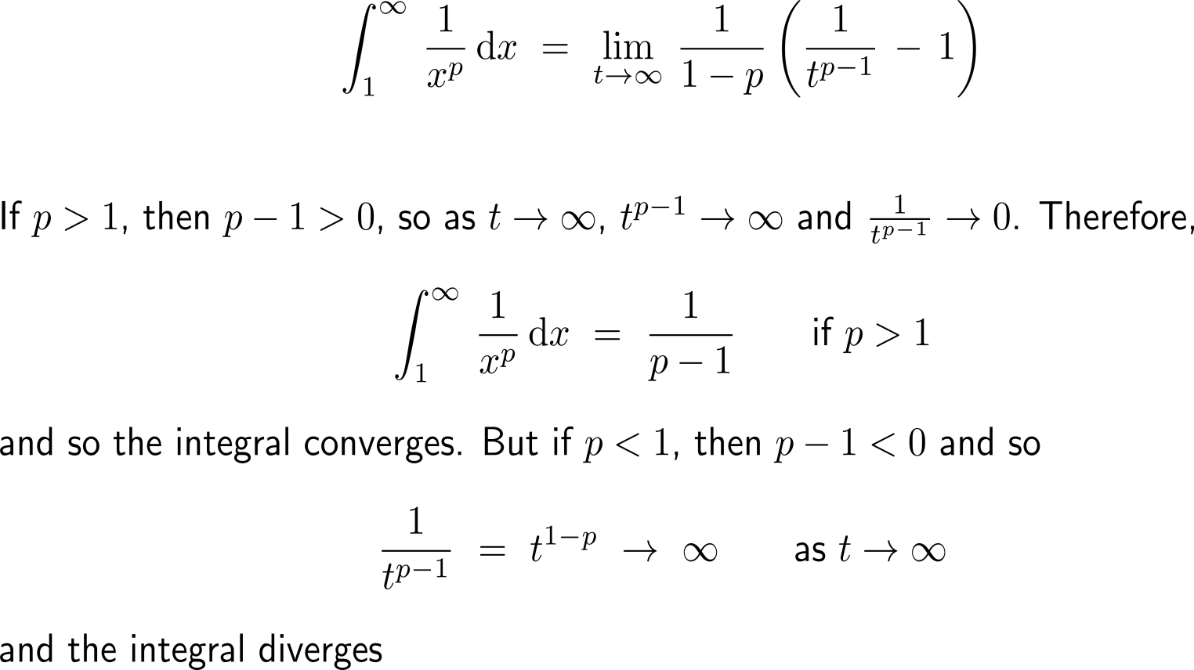
Exercise

Slide 65
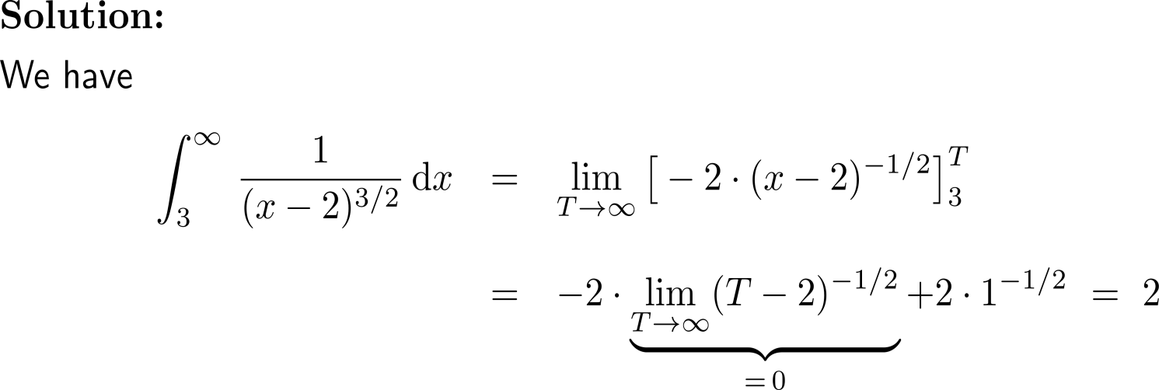
Exercise
10 minutes
self/ group work
please, upload your solutions to the chat

Slide 66
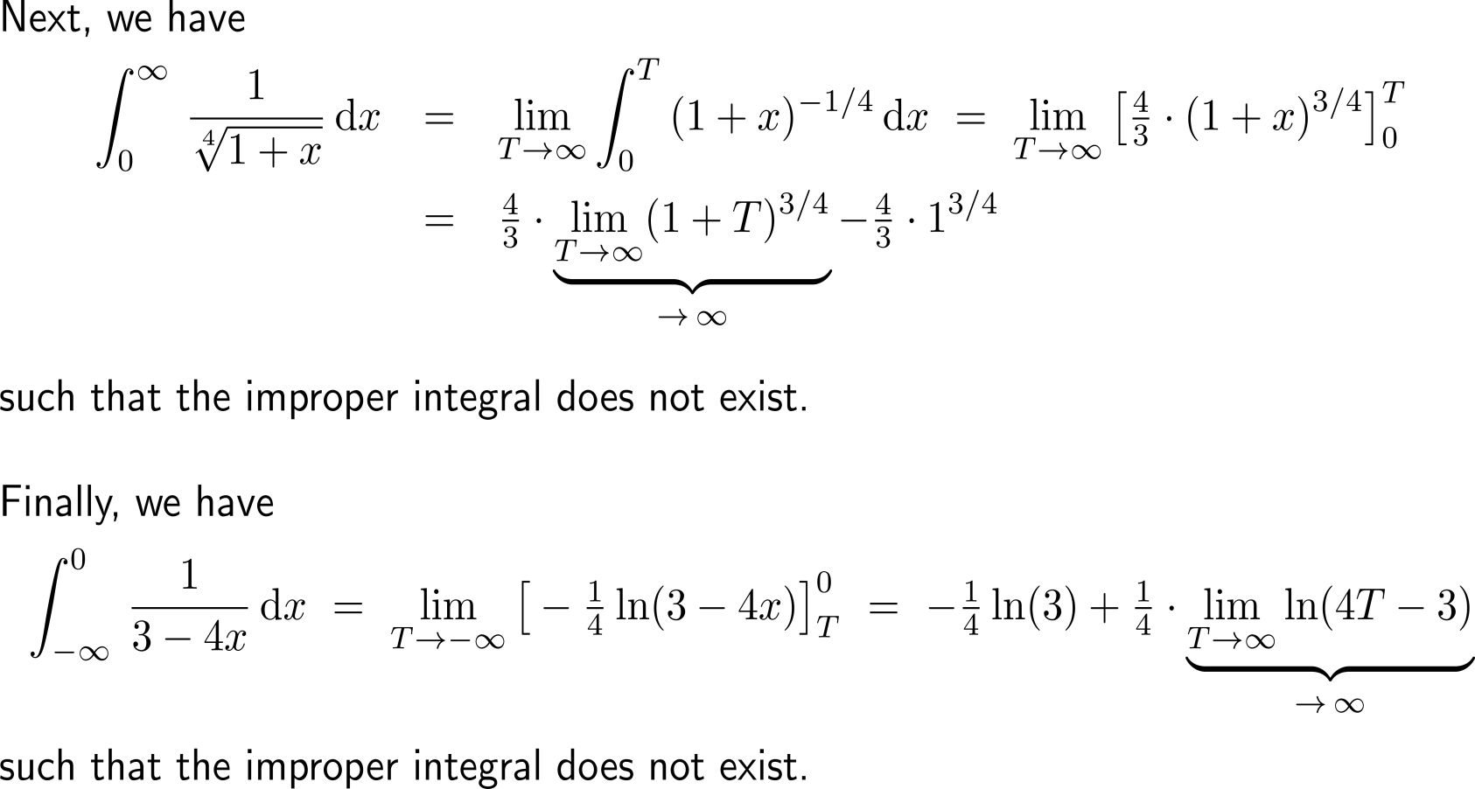
Exercise

Slide 67
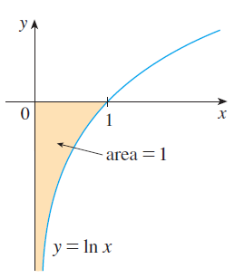
Exercise

Slide 68
Exercise

Slide 69
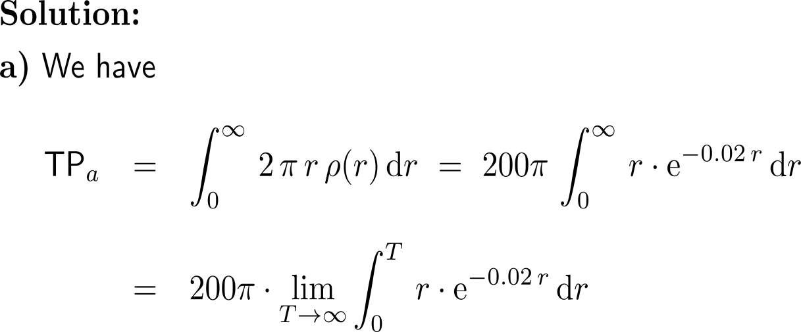
Exercise
10 minutes
self/ group work
please, upload your solutions to the chat

Slide 70
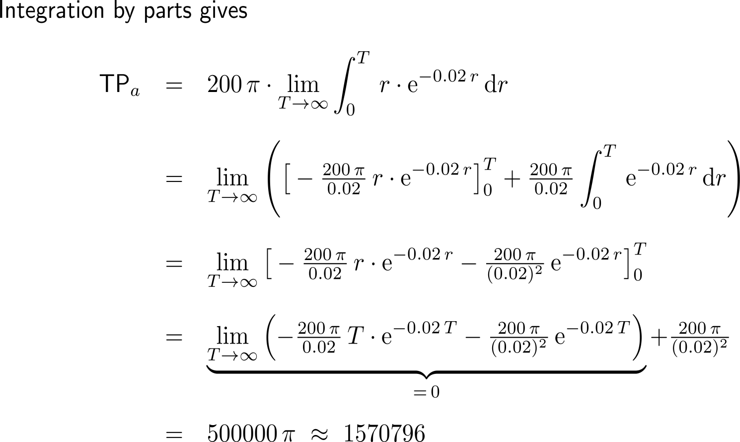
Exercise

Slide 71
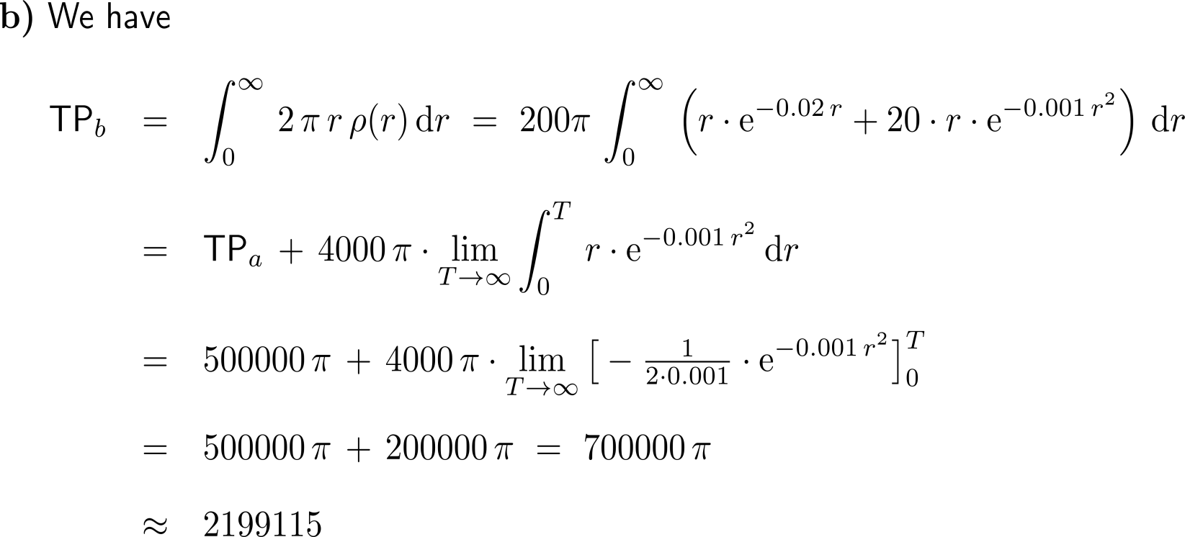
Exercise

Slide 72
Calculus II for Management

