Slide 1
Calculus II for Management
Partial Derivatives and Optimizing Functions of Two Variables
week 10
Lecture 10
  Partial derivatives in economics
  The Chain Rule
  Optimizing functions of two variables
  The Second Partials Test

Slide 2
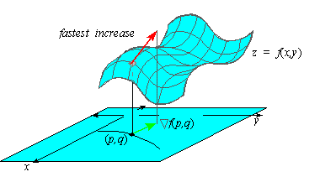
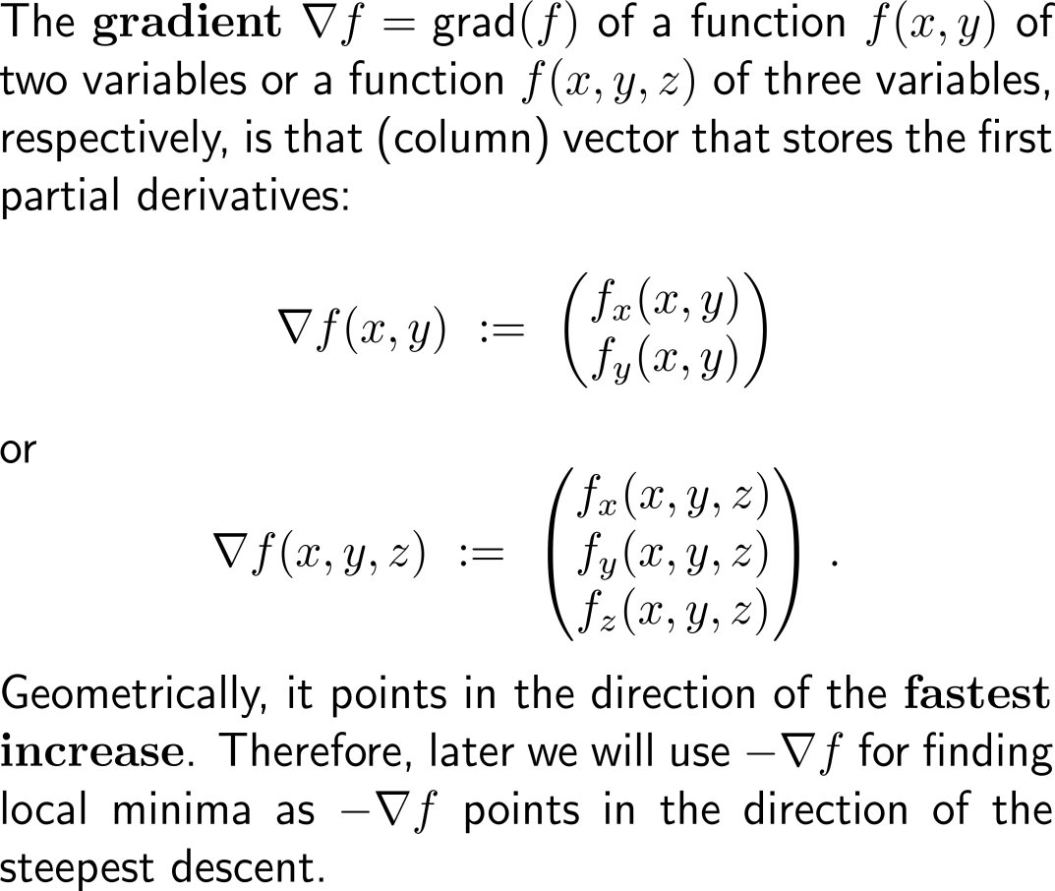
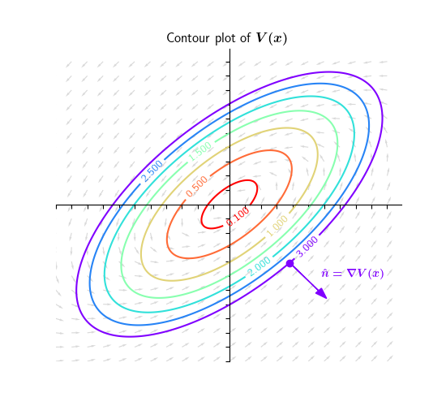
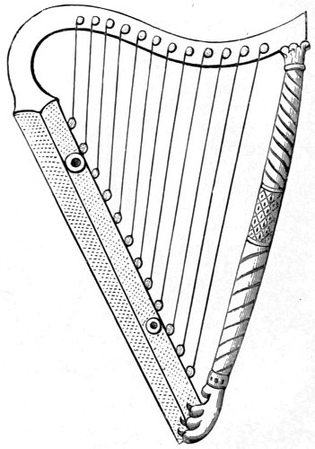
The gradient is that (column) vector that stores the first partial derivatives and points in the direction of the fastest increase …

Slide 3
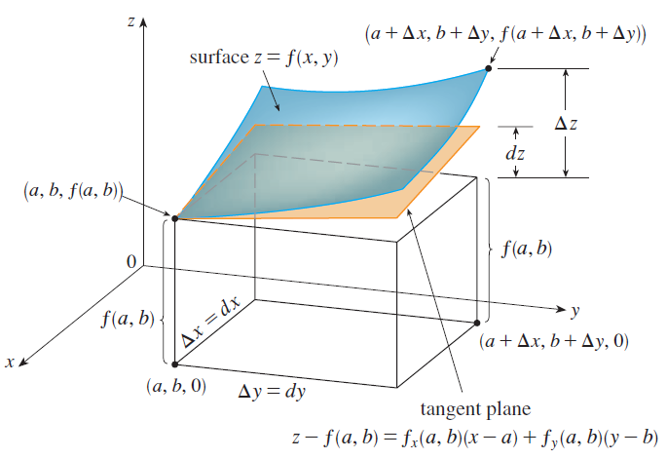
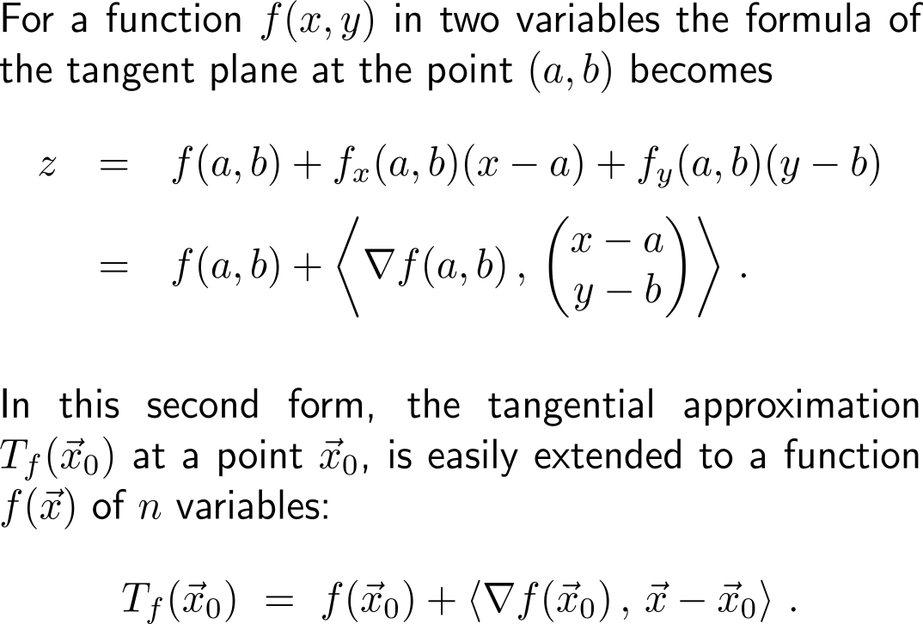
… and can be used to give the tangent plane with the help of a scalar product

Slide 4
Topics
  Applications of Partial Derivatives in Economics: Marginal Analysis
  The Chain Rule for Partial Derivatives
  Optimizing Functions of Two Variables
  2nd-Order Partial Derivatives & the Second Partials Test

Slide 5
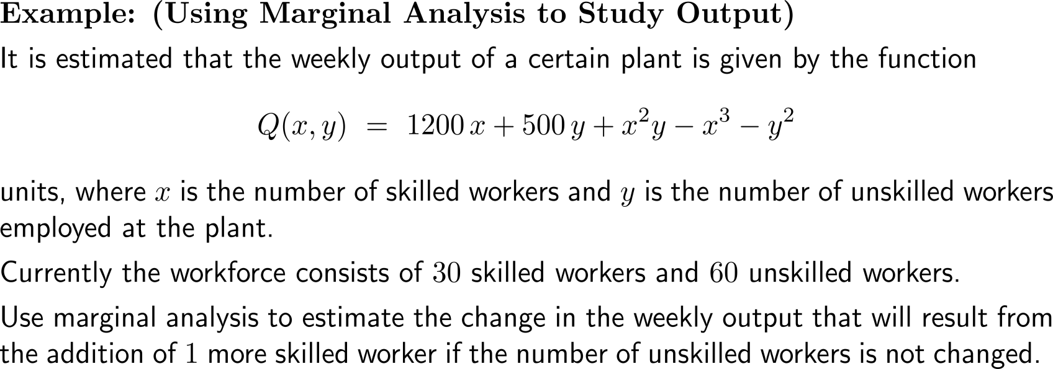
One of the applications of partial derivatives in economics is marginal analysis

Slide 6
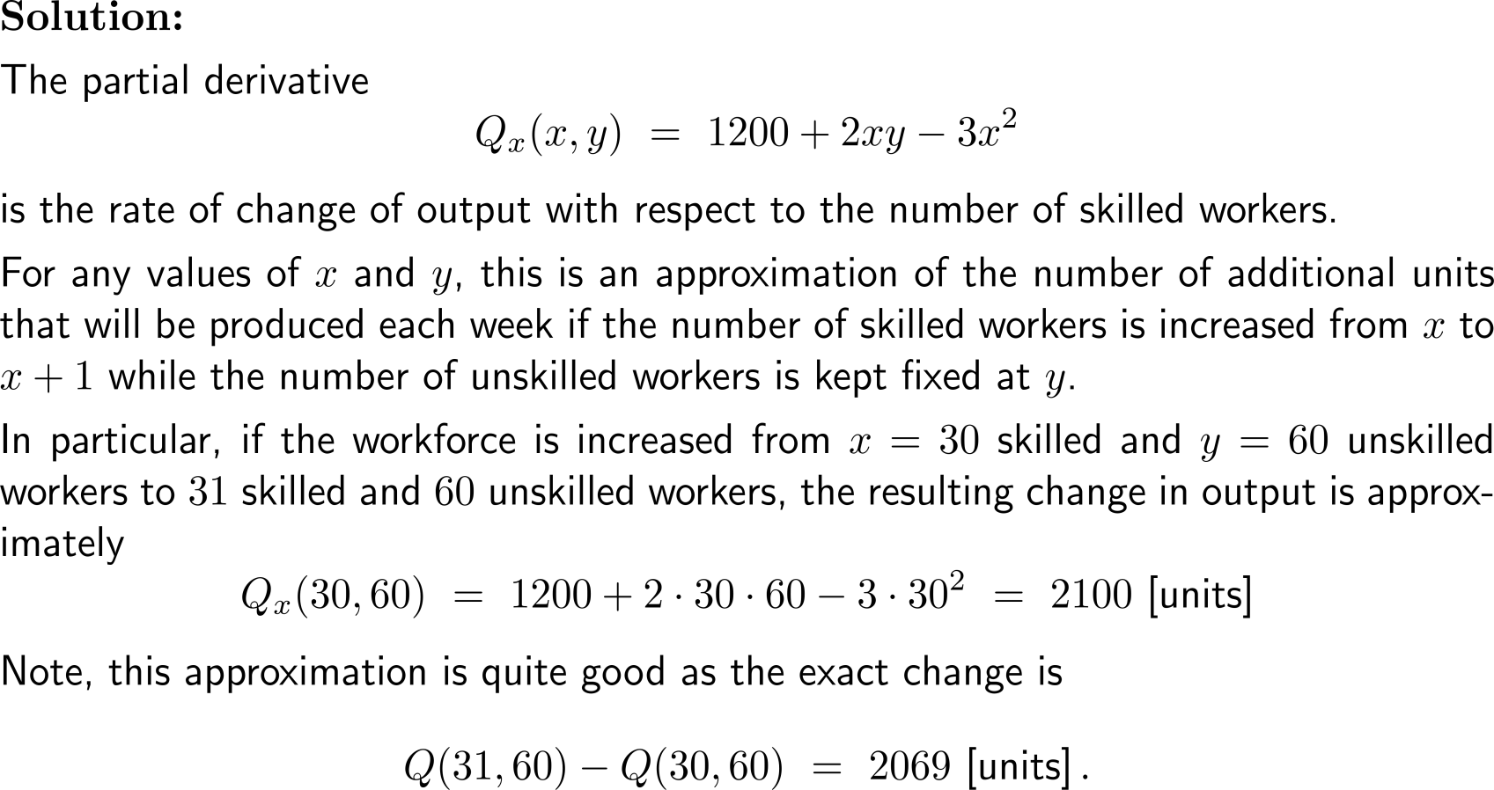
Example:
Using marginal analysis to study output

Slide 7
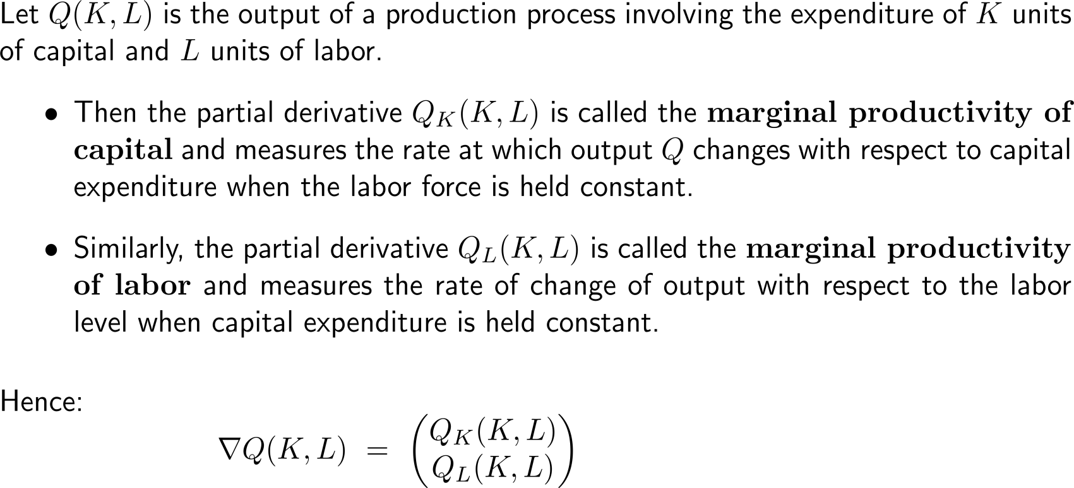
Applications of marginal analysis include the study of marginal productivity of capital and marginal productivity of labor
marginal productivity of capital
marginal productivity of labor

Slide 8
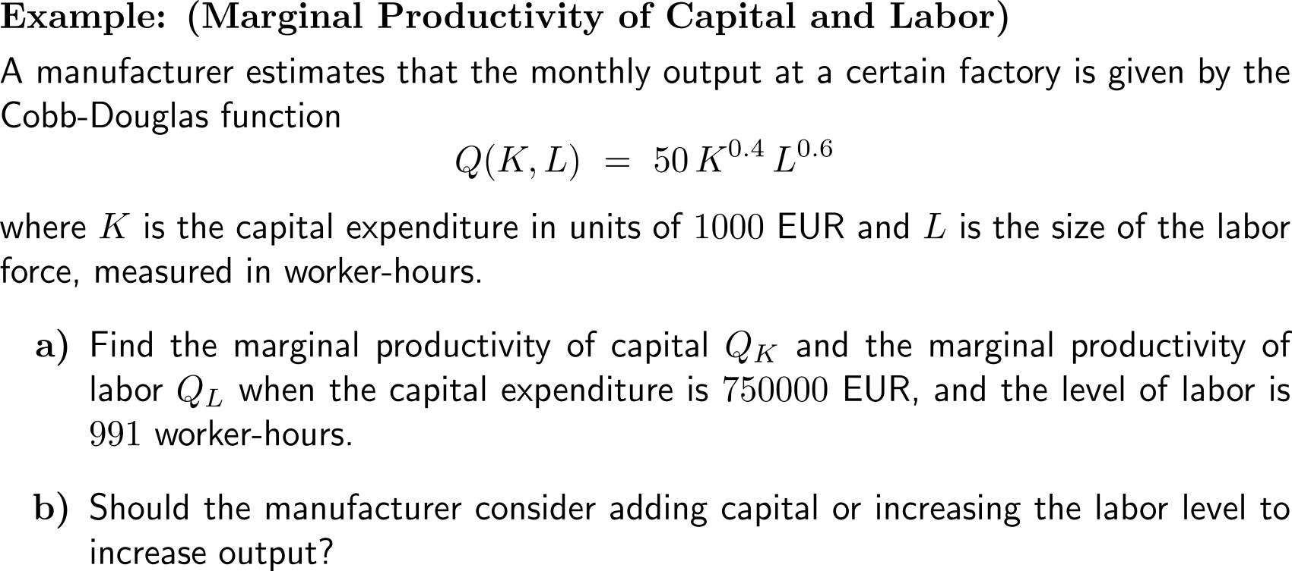
Example:
Marginal productivity of capital and labor

Slide 9
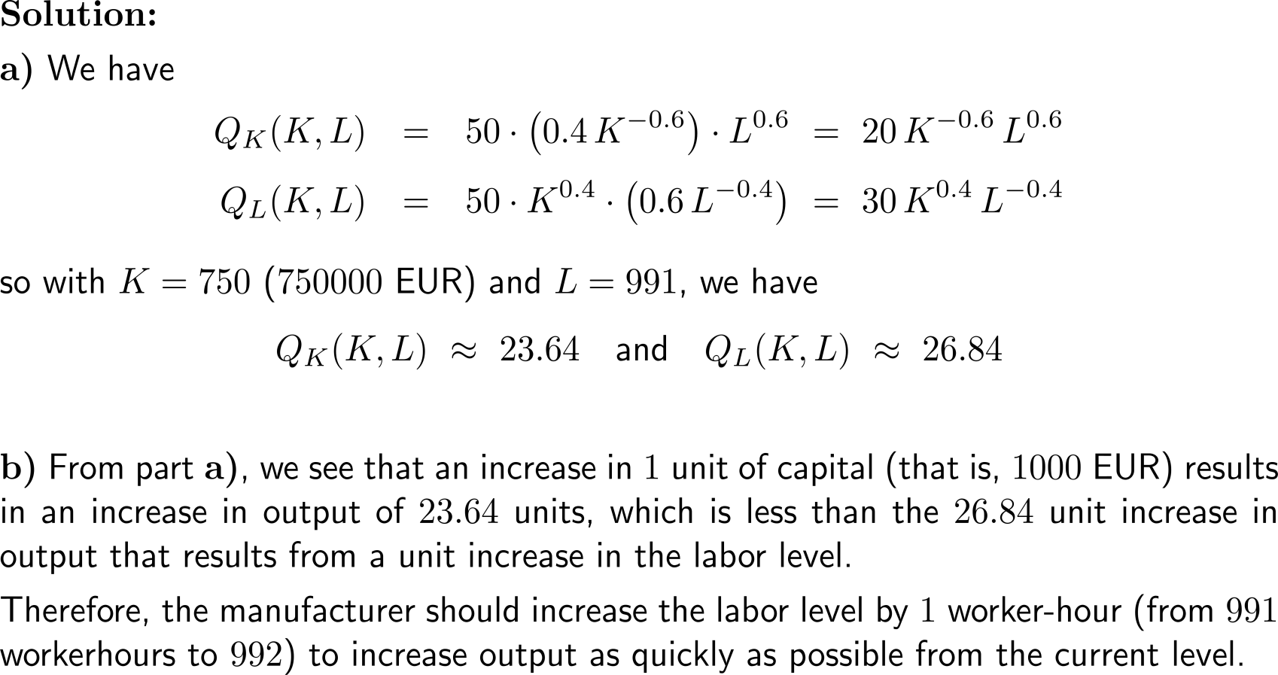
Example:
Marginal productivity of capital and labor

Slide 10
Topics
  Applications of Partial Derivatives in Economics: Marginal Analysis
  The Chain Rule for Partial Derivatives
  Optimizing Functions of Two Variables
  2nd-Order Partial Derivatives & the Second Partials Test

Slide 11
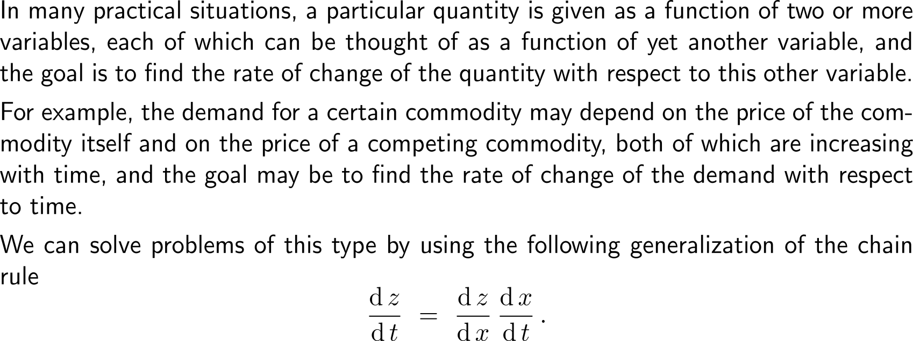
The chain rule for functions in one variable …

Slide 12
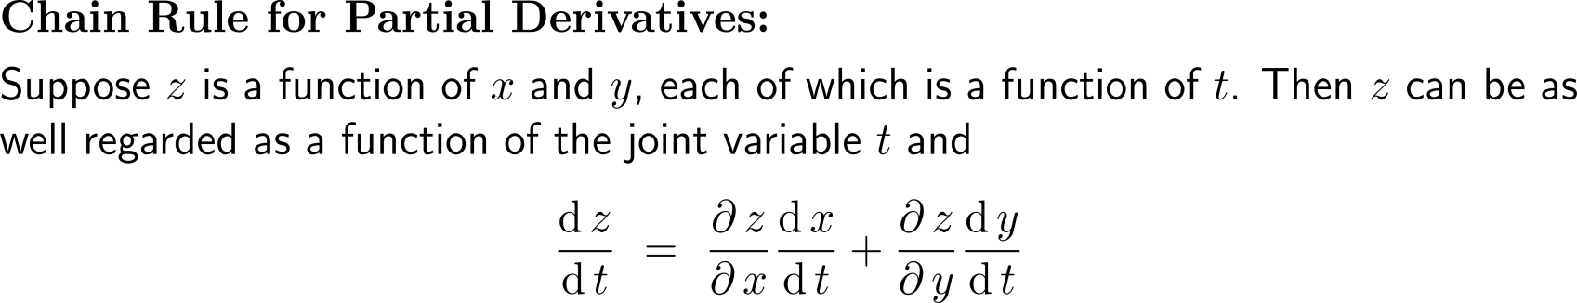
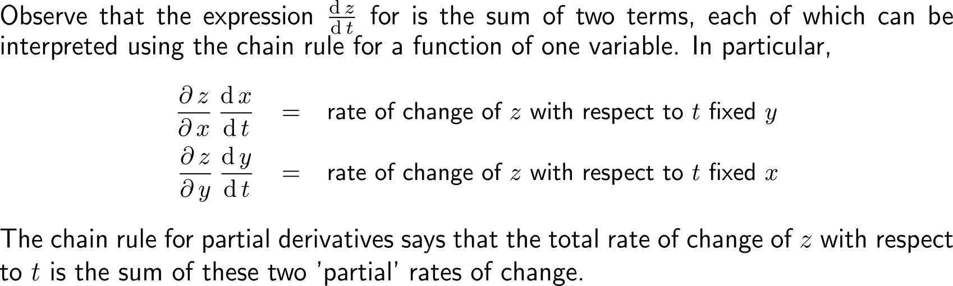
… is extended straightforward to a chain rule for functions of several variables by virtue of a joint variable

Slide 13
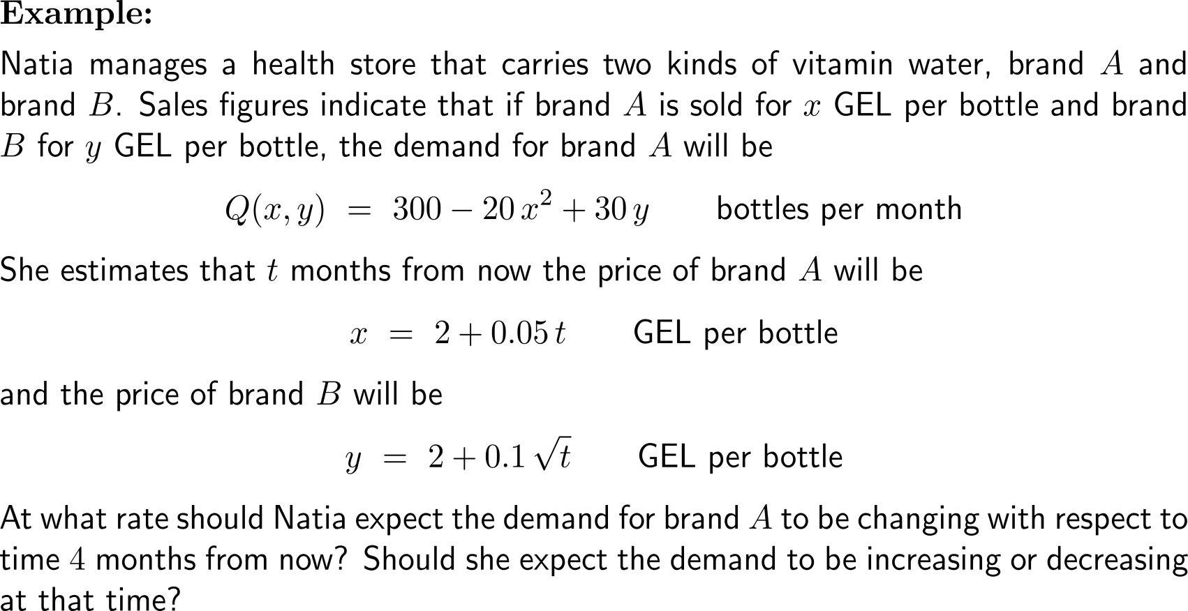
Example:
Using the Chain Rule to compute a demand rate

Slide 14
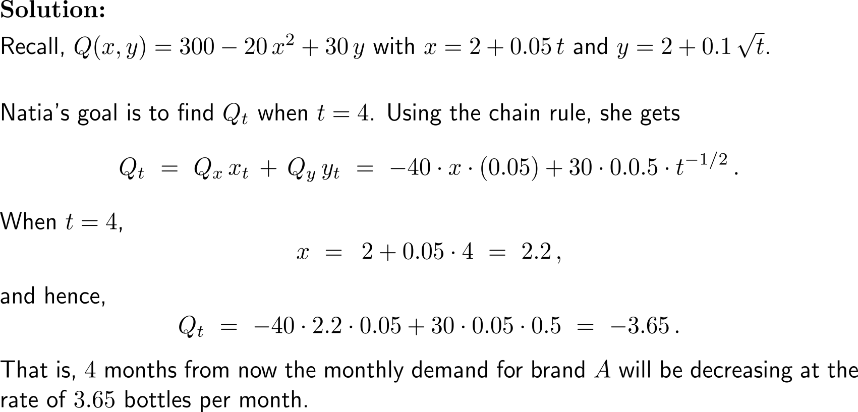
Example:
Using the Chain Rule to compute a demand rate

Slide 15
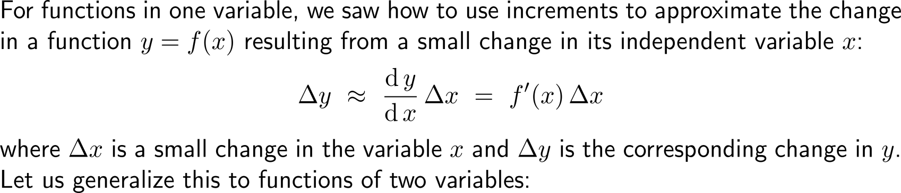
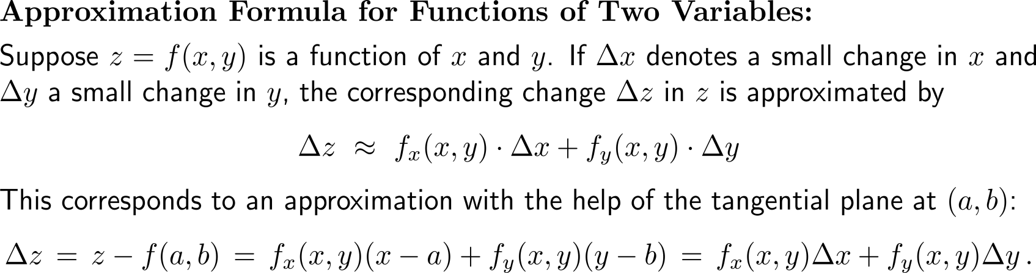
For a function of several variables, the tangential plane can be used to measure the effects of small changes in the variables

Slide 16
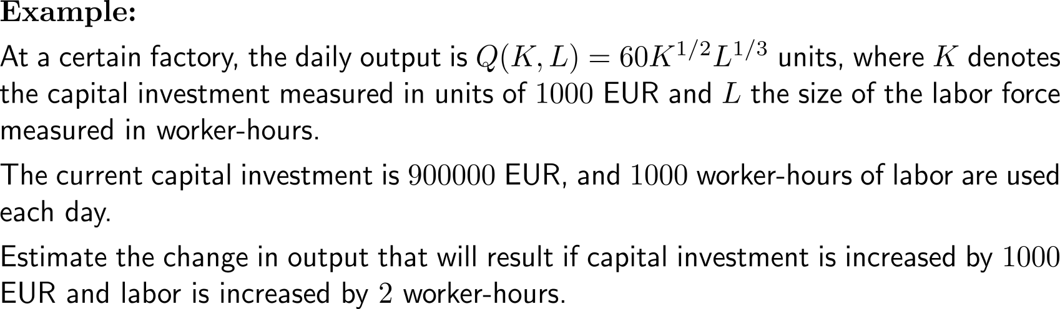
Example:
Incremental approximation of factory outputs

Slide 17
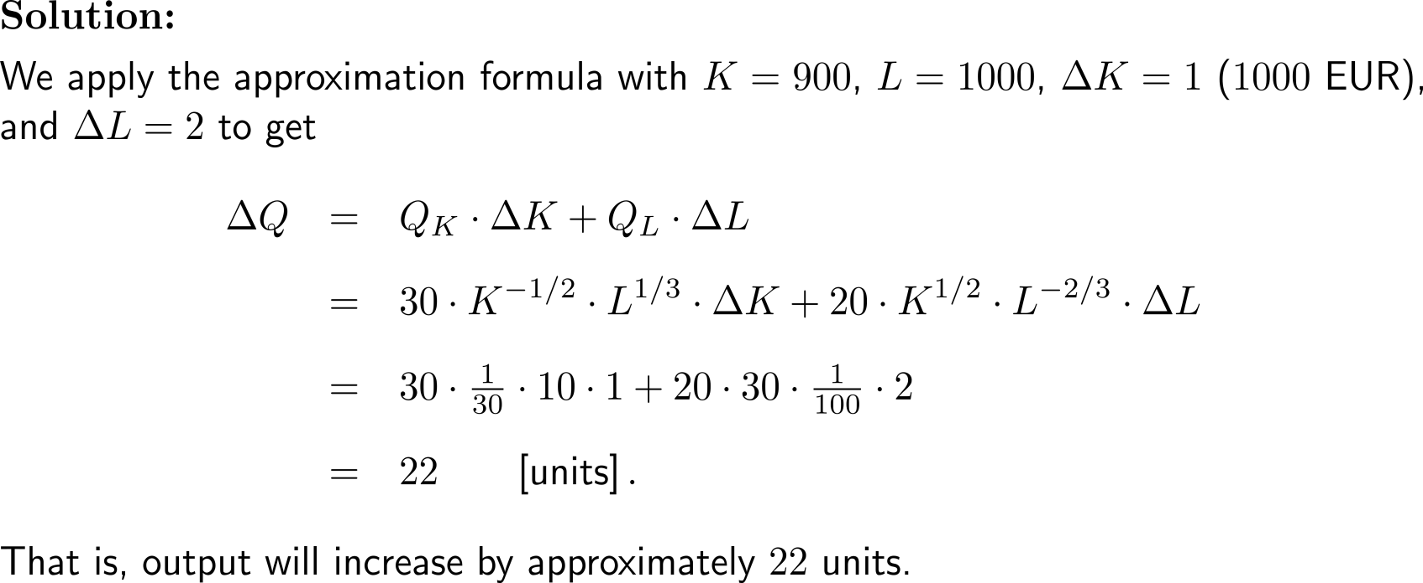
Example:
Incremental approximation of factory outputs

Slide 18
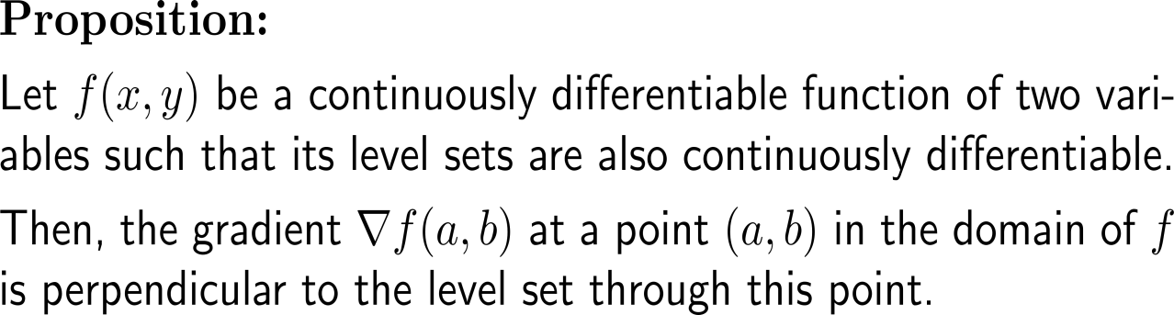
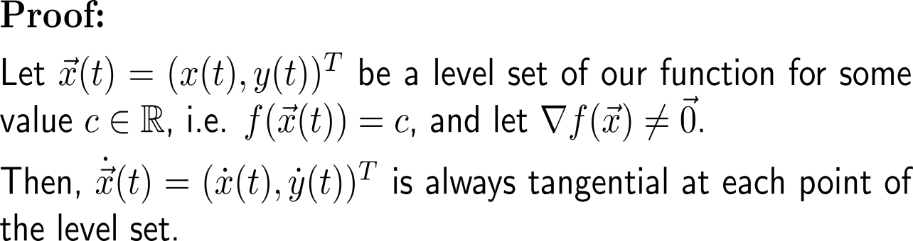

The gradient at a point is perpendicular to the level set through this point (1/ 2)

Slide 19
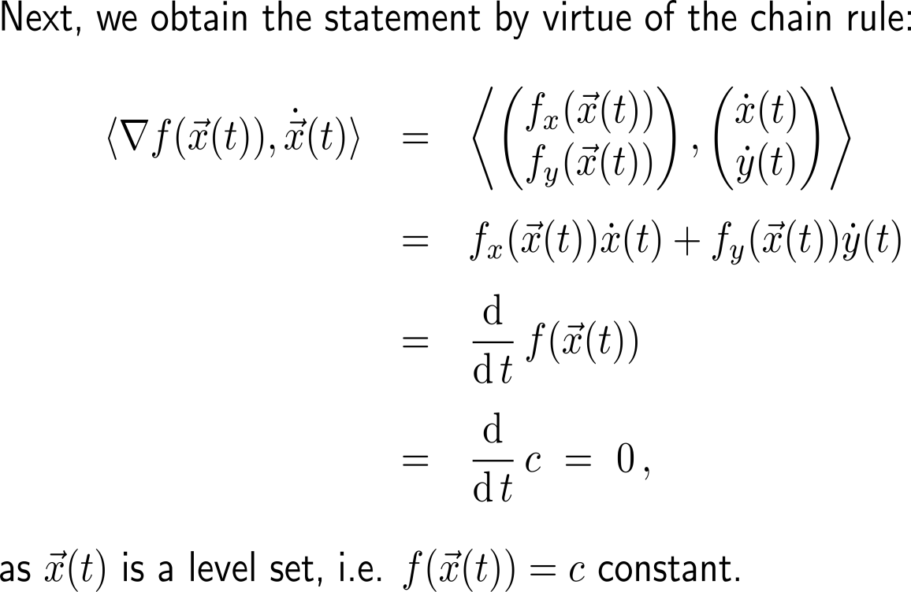
The gradient at a point is perpendicular to the level set through this point (2/ 2)

Slide 20
Topics
  Applications of Partial Derivatives in Economics: Marginal Analysis
  The Chain Rule for Partial Derivatives
  Optimizing Functions of Two Variables
  2nd-Order Partial Derivatives & the Second Partials Test

Slide 21
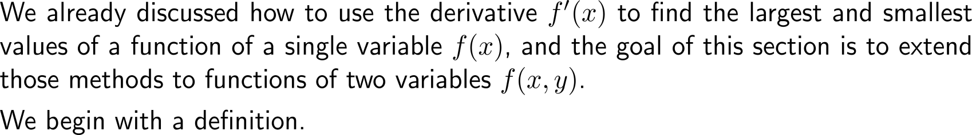
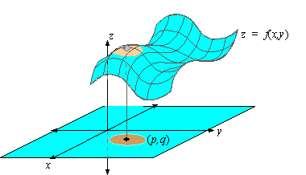
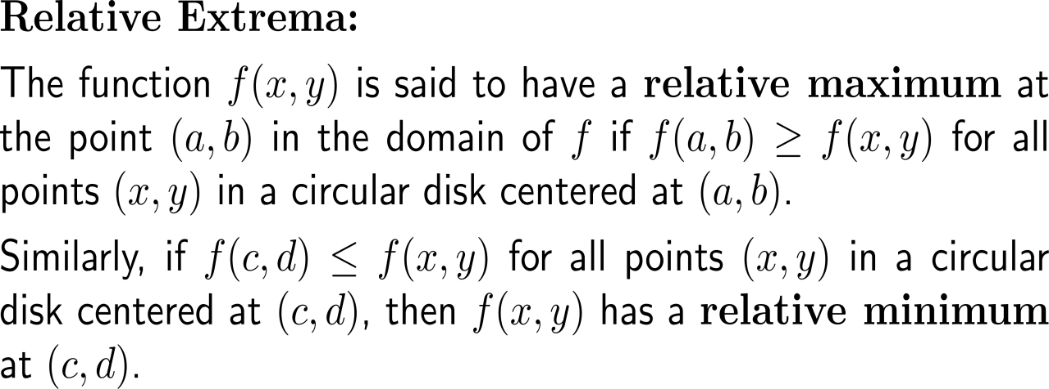
Relative maxima (relative minima) are given as local peaks (local valleys) on the function surface (1/ 2)

Slide 22
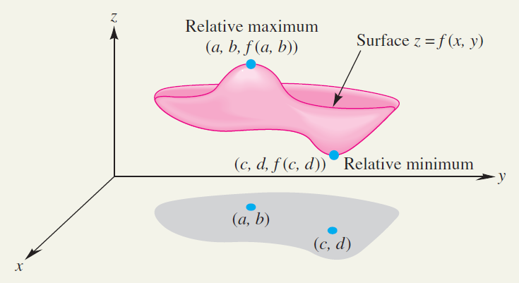
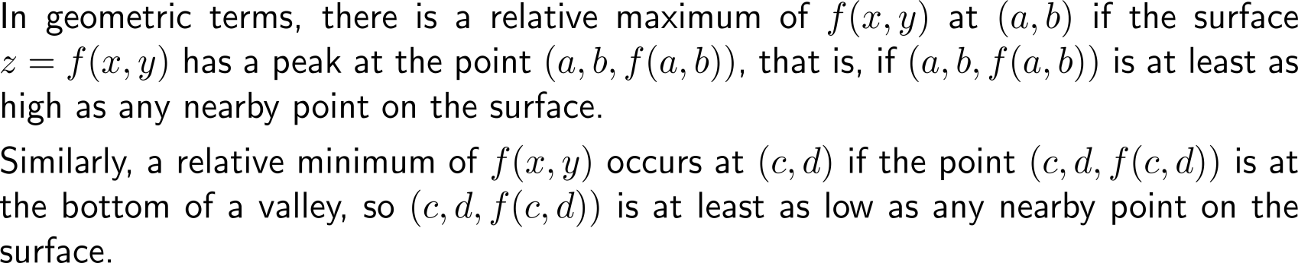
Relative maxima (relative minima) are given as local peaks (local valleys) on the function surface (2/ 2)

Slide 23
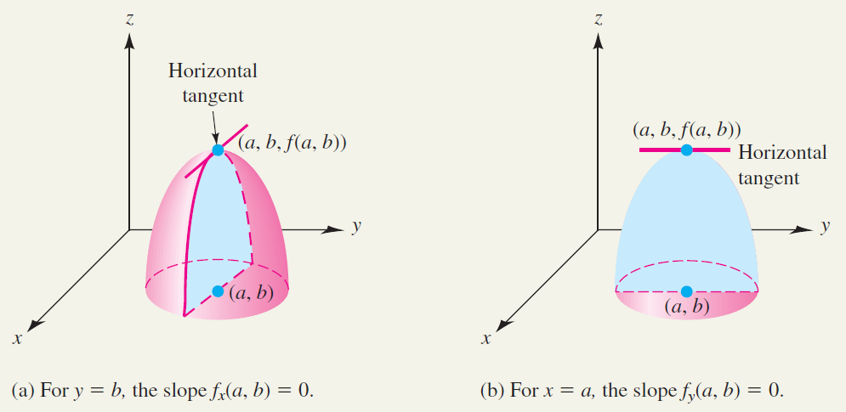
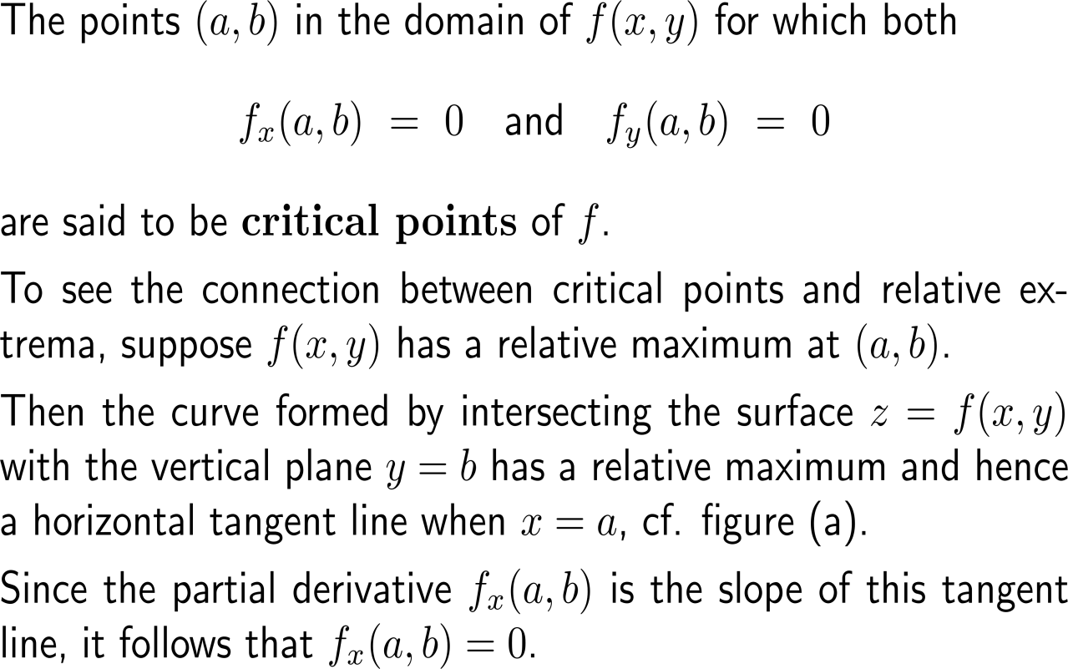
As for functions of one variable, critical points for functions of two variables play an important role in the study of relative maxima and minima (1/ 2)

Slide 24
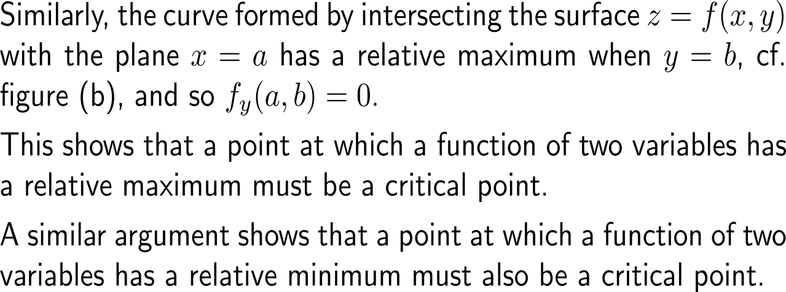
As for functions of one variable, critical points for functions of two variables play an important role in the study of relative maxima and minima (2/ 2)

Slide 25
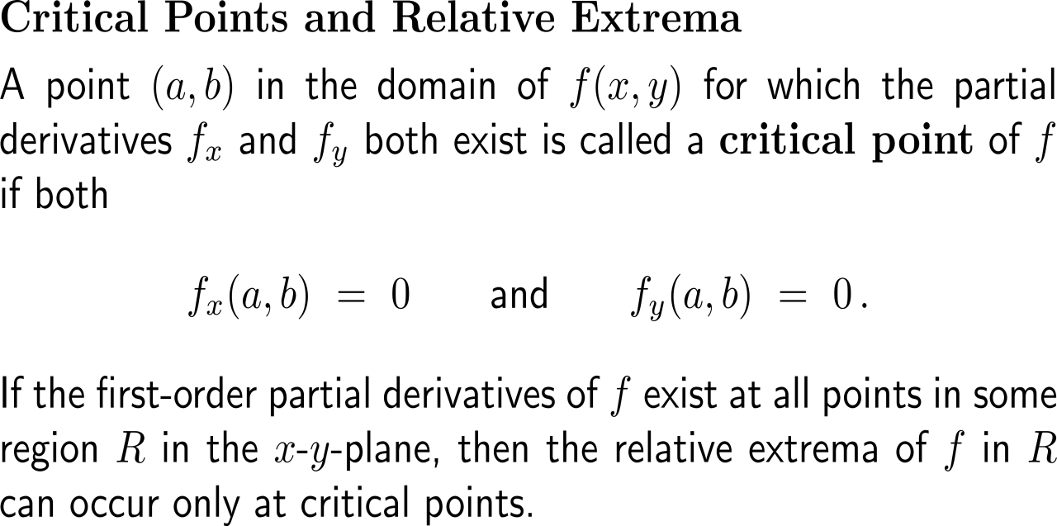
If the first-order partial derivatives exist for all points in some region, then relative extrema can occur there only at critical points

Slide 26
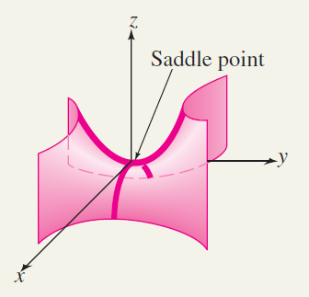
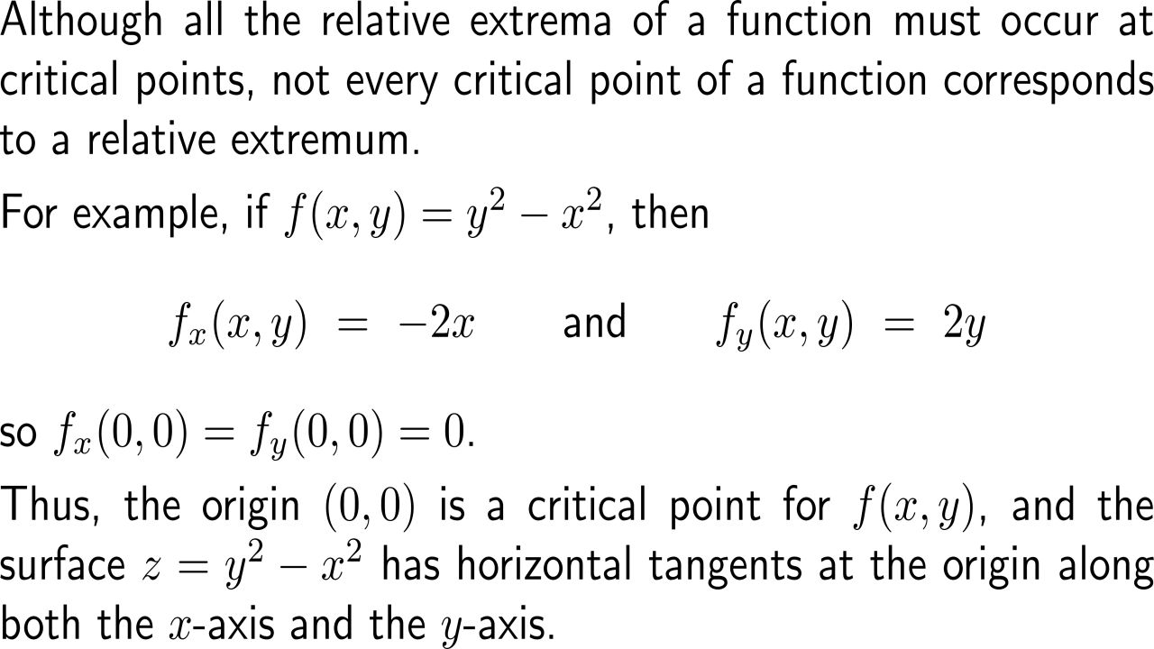
A saddle point is a critical point that is not a relative maximum or relative minimum (1/ 3)

Slide 27
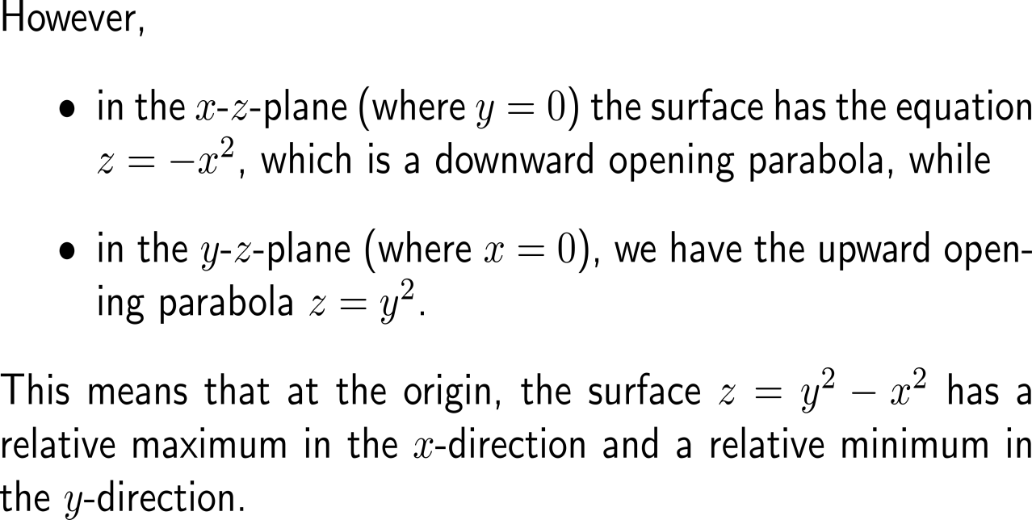
A saddle point is a critical point that is not a relative maximum or relative minimum (2/ 3)

Slide 28
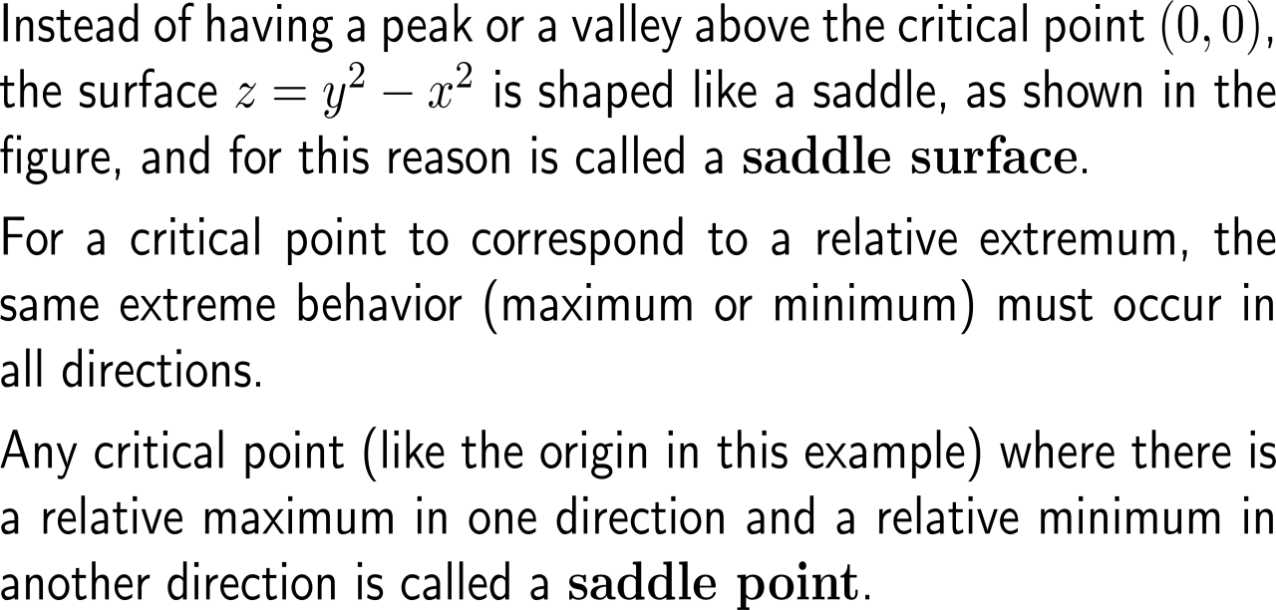
A saddle point is a critical point that is not a relative maximum or relative minimum (3/ 3)

Slide 29
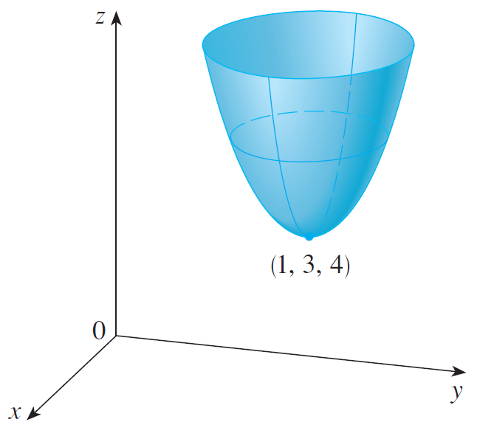
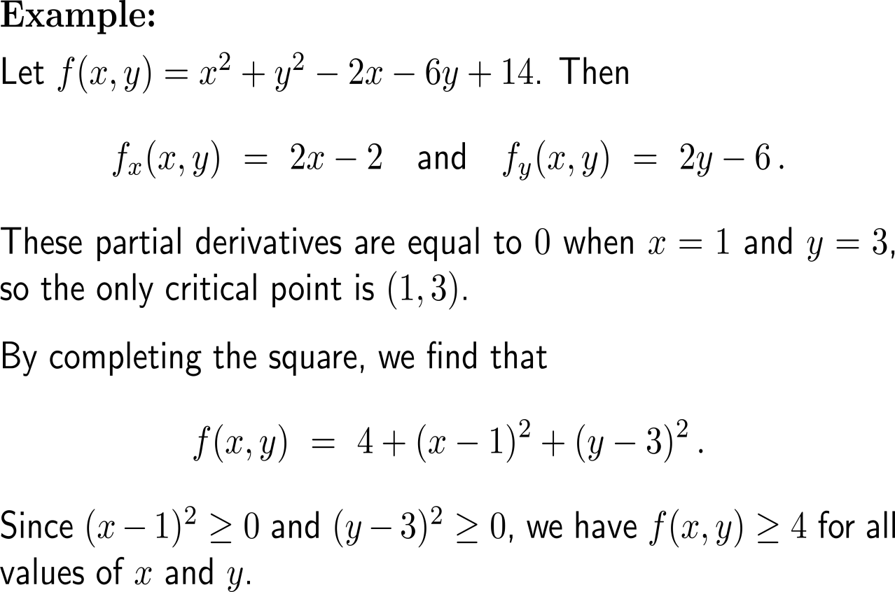
Example:
Critical points

Slide 30
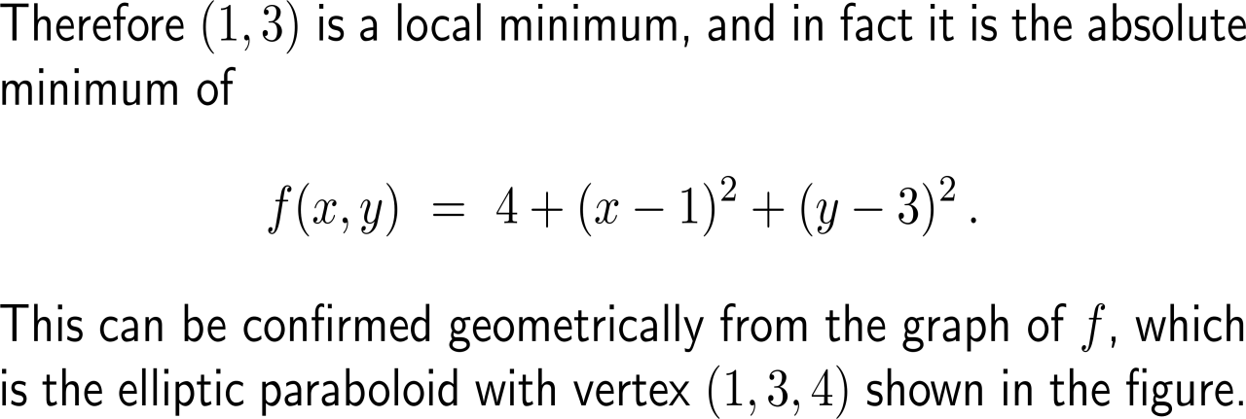
Example:
Critical points

Slide 31
Topics
  Applications of Partial Derivatives in Economics: Marginal Analysis
  The Chain Rule for Partial Derivatives
  Optimizing Functions of Two Variables
  2nd-Order Partial Derivatives & the Second Partials Test

Slide 32
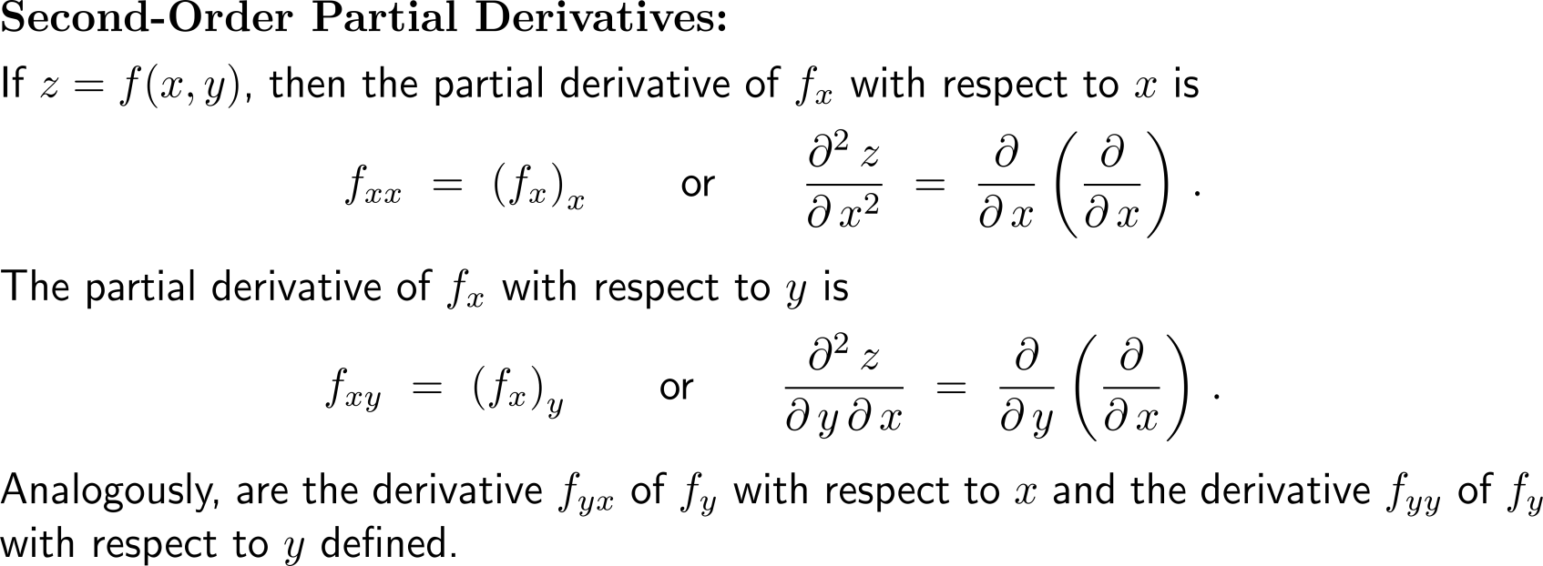
Differentiating twice leads to second-order partial derivatives

Slide 33
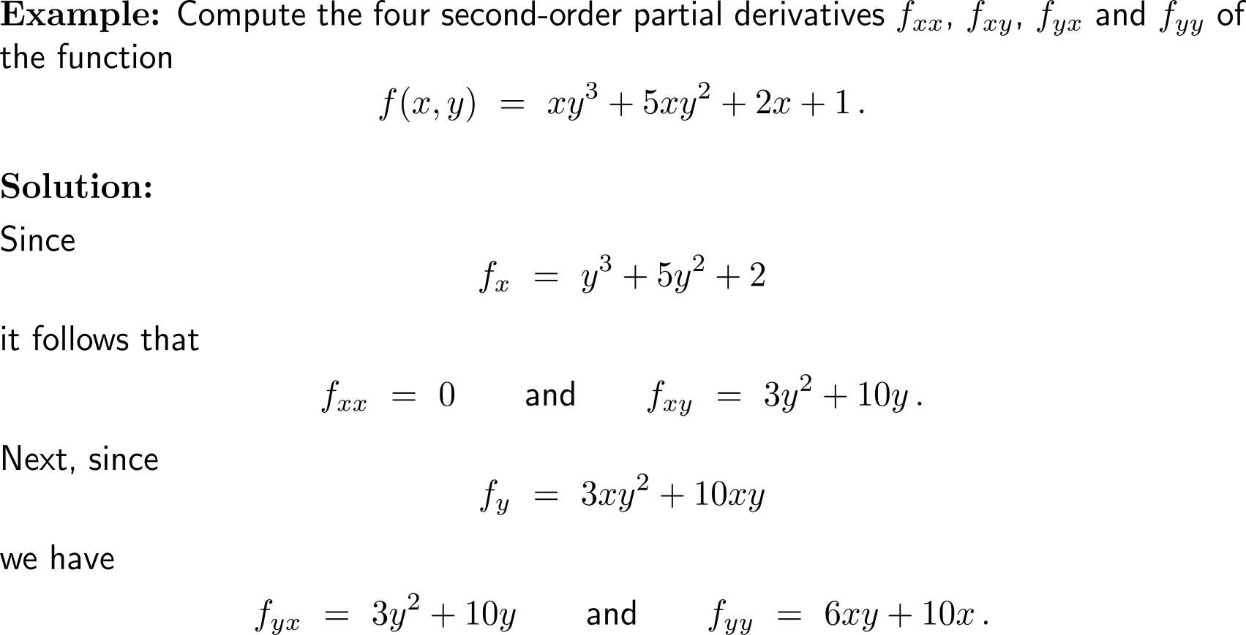
Example:
Computing 2nd-order partial derivatives

Slide 34
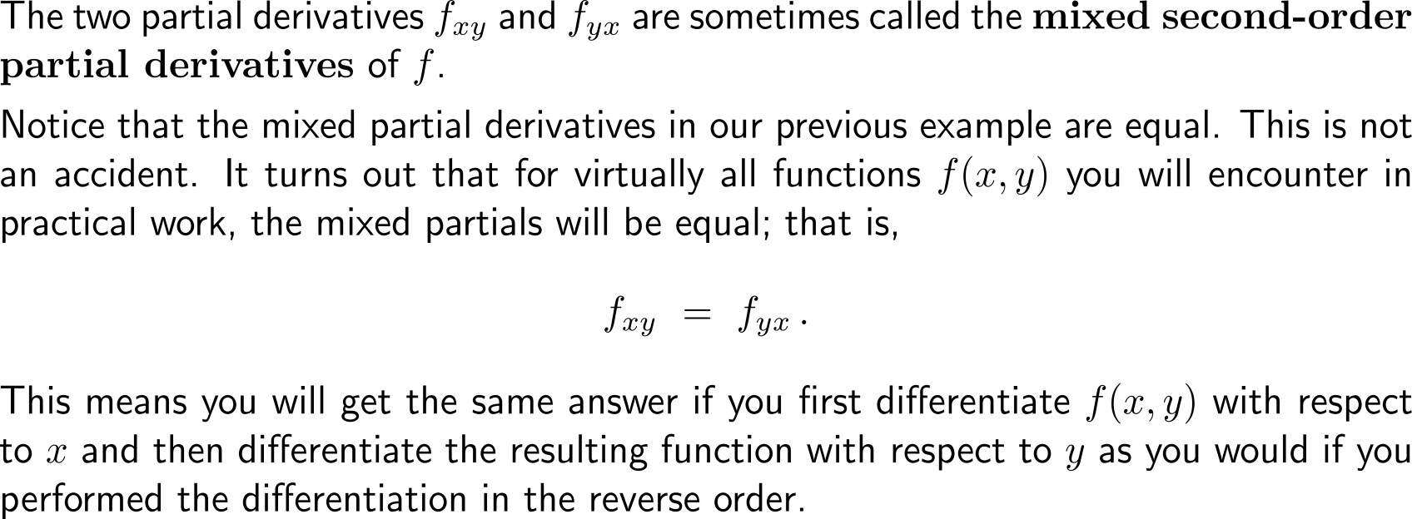
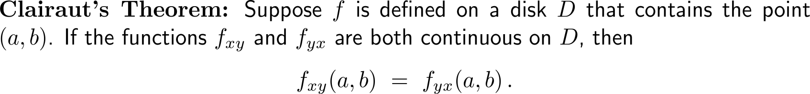
Under very mild assumptions (Clairaut’s theorem) it holds that the values of the mixed second-order partial derivatives are equal

Slide 35
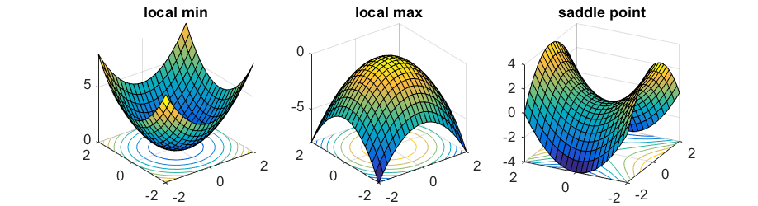
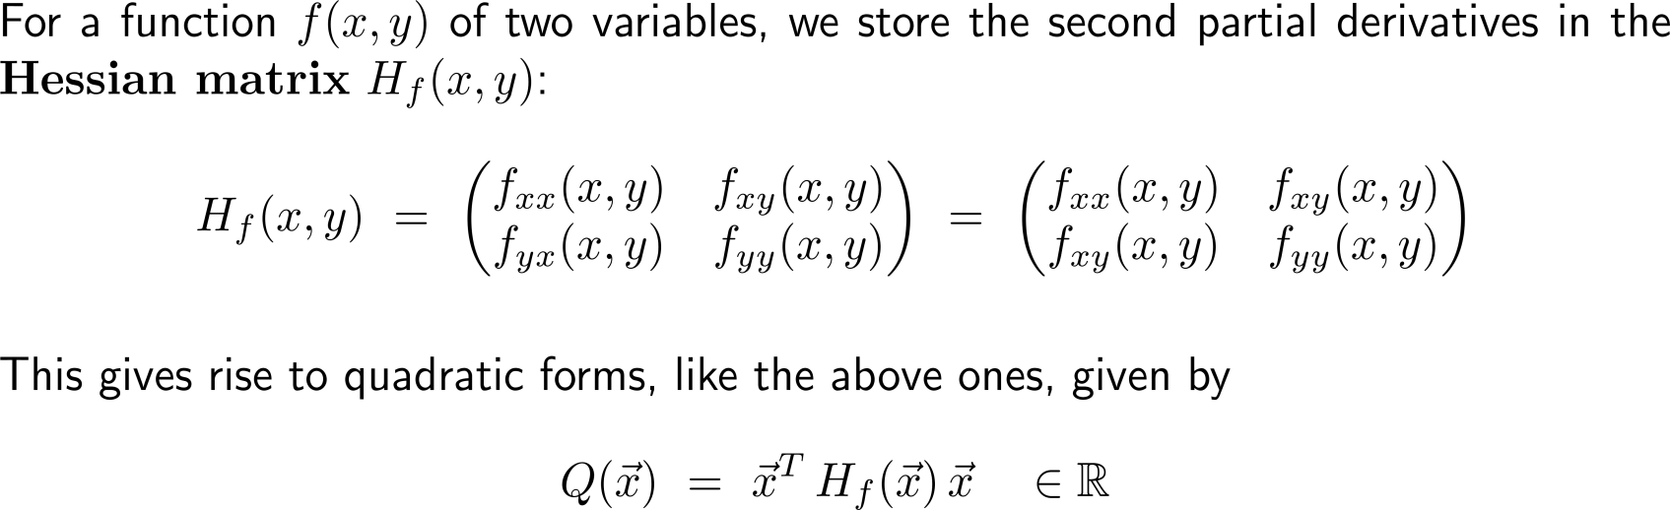
The second partial derivatives are stored in the Hessian matrix
Clairaut’s Theorem

Slide 36
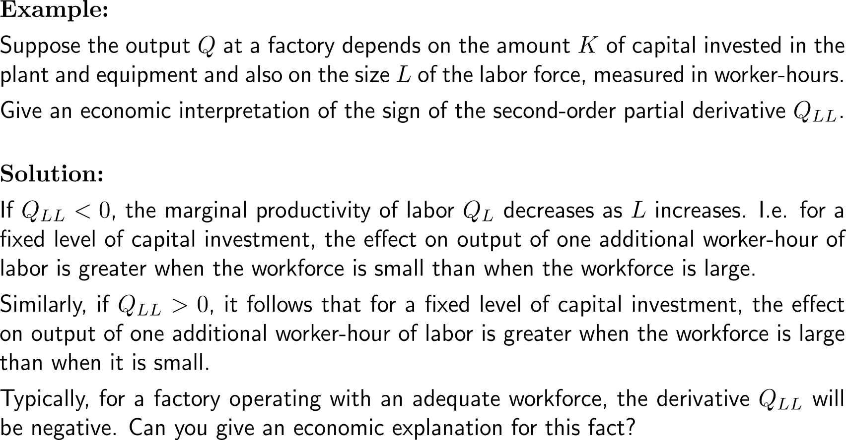
Example:
Interpreting a 2nd-order partial derivative

Slide 37
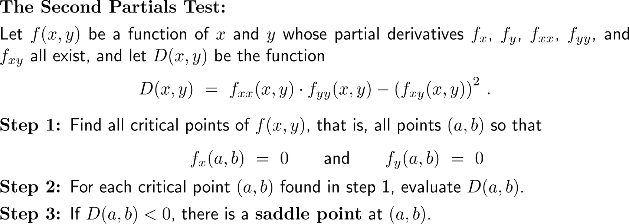
The Second Partials Test allows a classification of critical points as saddle points, relative maxima and relative minima (1/ 2)
…

Slide 38
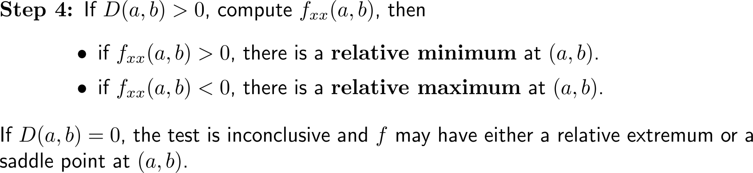

The Second Partials Test allows a classification of critical points as saddle points, relative maxima and relative minima (2/ 2)
sign of D | sign of f_{xx} | behavior at (a, b)
– |  | saddle point
+ | + | relative minimum
+ | – | relative maximum

Slide 39
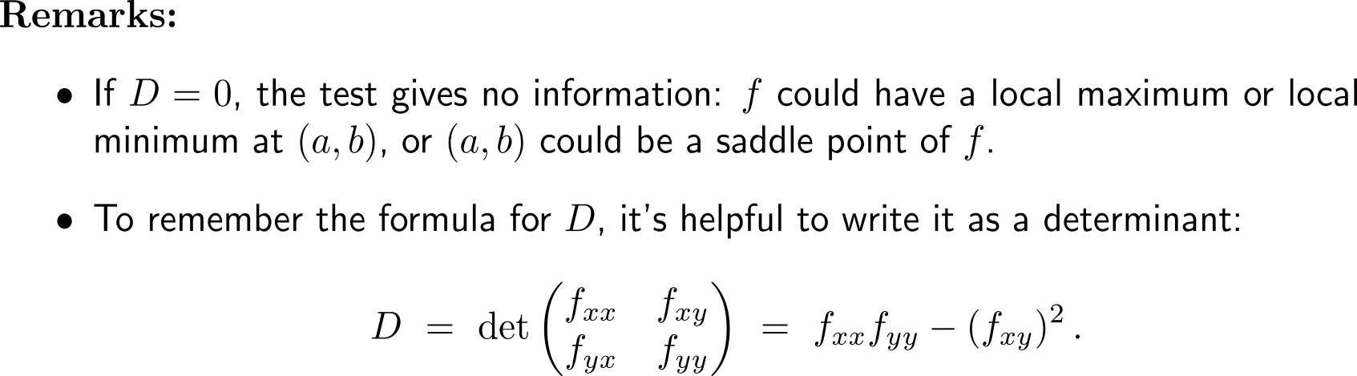
Some remarks on the Second Partials Test

Slide 40
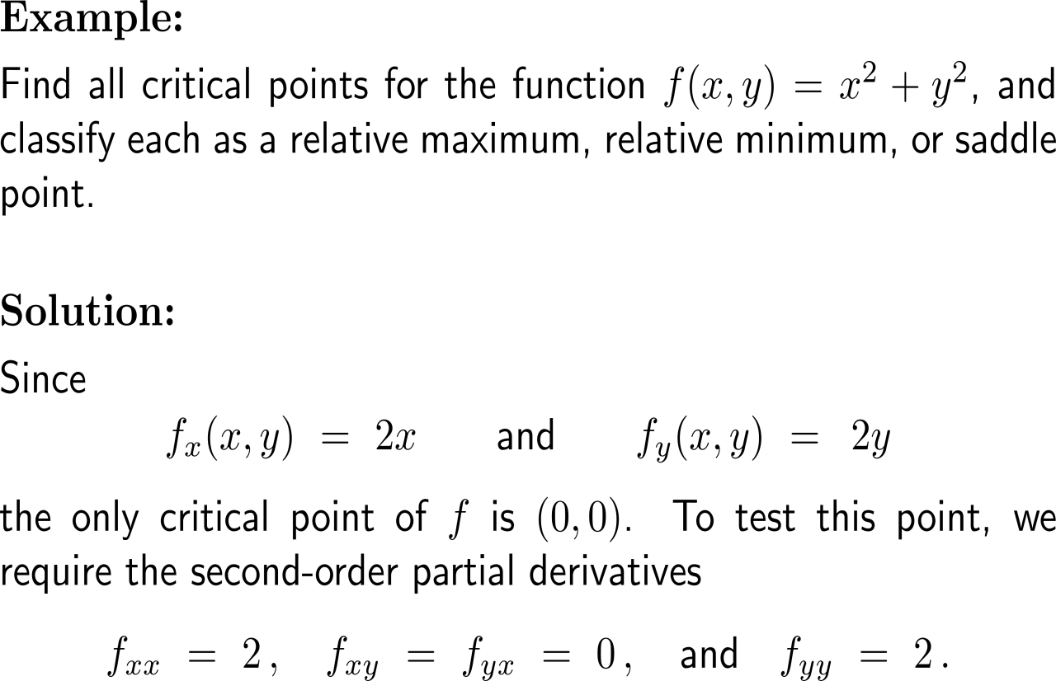


Example:
Classifying critical points
sign of D | sign of f_{xx} | behavior at (a, b)
– |  | saddle point
+ | + | relative minimum
+ | – | relative maximum

Slide 41

Example:
Classifying critical points
sign of D | sign of f_{xx} | behavior at (a, b)
– |  | saddle point
+ | + | relative minimum
+ | – | relative maximum

Slide 42


Example:
Classifying critical points

Slide 43




Example:
Classifying critical points
Graph and contour lines for the monkey saddle function
f(x,y) = x³ – 3xy² + 16

Slide 44



Example:
Finding the optimal location of a warehouse
locations of main targets A, B, and C and warehouse W.

Slide 45

Example:
Finding the optimal location of a warehouse

Slide 46

Example:
Finding the optimal location of a warehouse

Slide 47


As in the case of functions with one variable, maxima, minima, or saddle points can be determined by quadratic approximations (1/ 2)

Slide 48

As in the case of functions with one variable, maxima, minima, or saddle points can be determined by quadratic approximations (2/ 2)

Slide 49

Procedure to determine relative maxima, minima, and saddle points

Slide 50

Example:
Application of the Eigenvalue Test

Slide 51

Example:
Application of the Eigenvalue Test

Slide 52

Example:
Application of the Eigenvalue Test

Slide 53


Central Exercises:
Calculus II for Management
Topics
  Chain rule
  Optimizing functions of two variables
  2nd-order partial derivatives & the second partials test

Slide 54


Exercise:
Application of the Chain Rule
The curve C with
x = sin(2t),
y = cos(t).

Slide 55


Exercise:
Classifying critical points

Slide 56

Exercise:
Classifying critical points
critical point (a, b) | sign of D(a, b) | sign of f_{xx}(a, b) | behavior at (a, b)
(0, 0) | – |  | saddle point
(-1, -1) | + | + | relative minimum
(1, 1) | + | + | relative minimum

Slide 57


Exercise:
Classifying critical points
Besides a graph of f, the figure shows a contour map of the function f.
The level curves near the relative minima (-1, -1) and (1, 1) are oval in shape and indicate that as we move away from (-1, -1) or (1, 1) in any direction the values of f are increasing.
The level curves near (0, 0), on the other hand, resemble hyperbolas. They reveal that as we move away from the origin (where the value of f is 1), the values of f decrease in some directions but increase in other directions.
Thus the contour map suggests the presence of a saddle point at (0, 0).

Slide 58


Exercise:
Classifying critical points
10 minutes
self/ group work
please, upload your solutions to the chat

Slide 59

Exercise:
Classifying critical points
critical point (a, b) | sign of D(a, b) | sign of f_{xx}(a, b) | behavior at (a, b)
(0, 0) | – |  | saddle point
(2, -2) | + | + | relative minimum

Slide 60


Exercise:
Maximizing profit

Slide 61

Exercise:
Maximizing profit

Slide 62

Exercise:
Maximizing profit

Slide 63

Exercise:
Maximizing profit

Slide 64



Exercise:
Finding the maximal volume

Slide 65


Exercise:
Finding the maximal volume

Slide 66

Exercise:
Finding the maximal volume

Slide 67
Calculus II for Management

