Slide 1
Calculus II for Management
Double Integrals
week 13
Lecture 13
Double integrals over a rectangular region
Double integrals over non-rectangular regions
Applications

Slide 2
Topics
Double Integrals over a Rectangular Region
Double Integrals over Non-Rectangular Regions
Applications

Slide 3
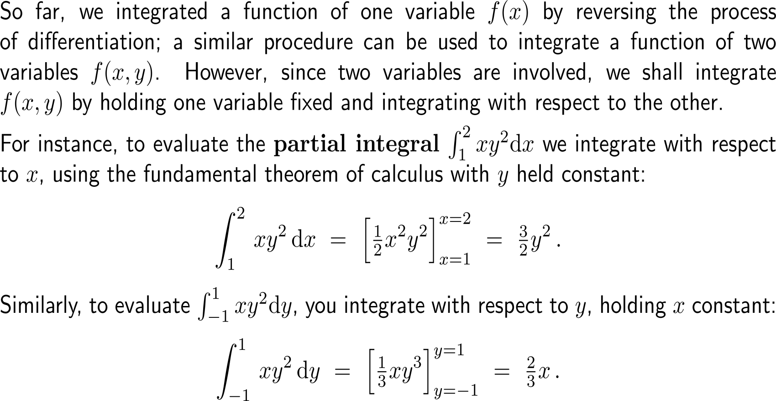
When we deal with integrand functions of several variables we need to be clear on which variable we need to use for integration

Slide 4
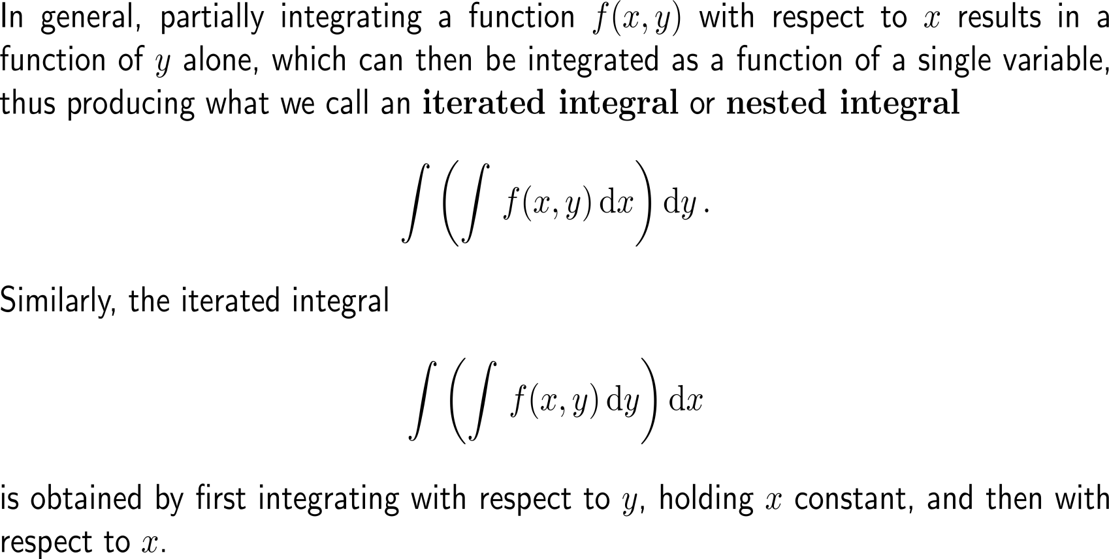
Successive integration w.r.t. the involved variables leads to iterated integrals or nested integrals …

Slide 5
… that are solved by first integrating w.r.t. one variable and then w.r.t. the other variable

Slide 6
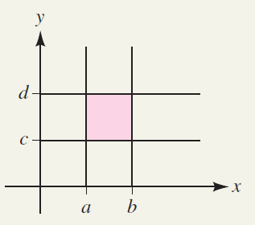
For a double integral over a rectangular region the order of integration is irrelevant (this statement is often called Fubini’s Theorem)

Slide 7
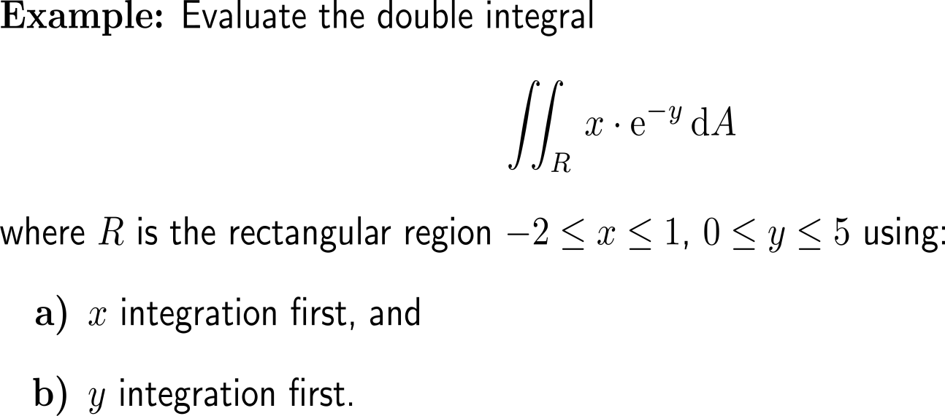
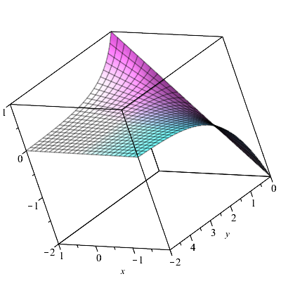
Example: Evaluating a double integral

Slide 8
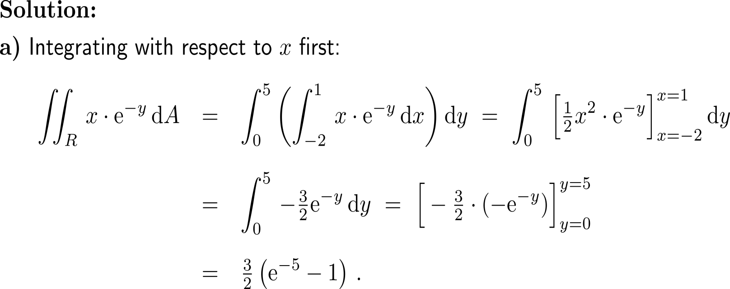
Example: Evaluating a double integral

Slide 9
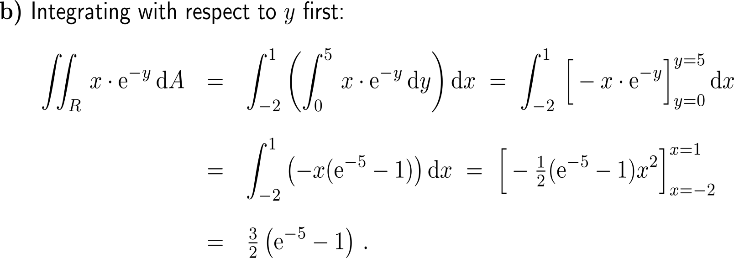
Example: Evaluating a double integral

Slide 10
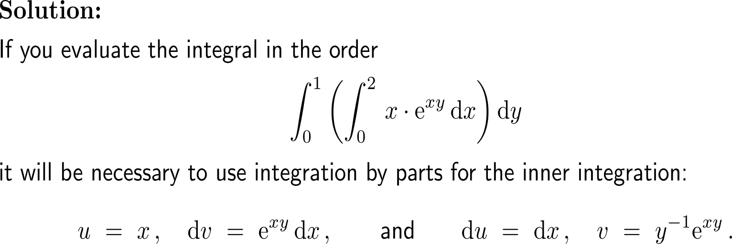
Example: Evaluating a double integral

Slide 11
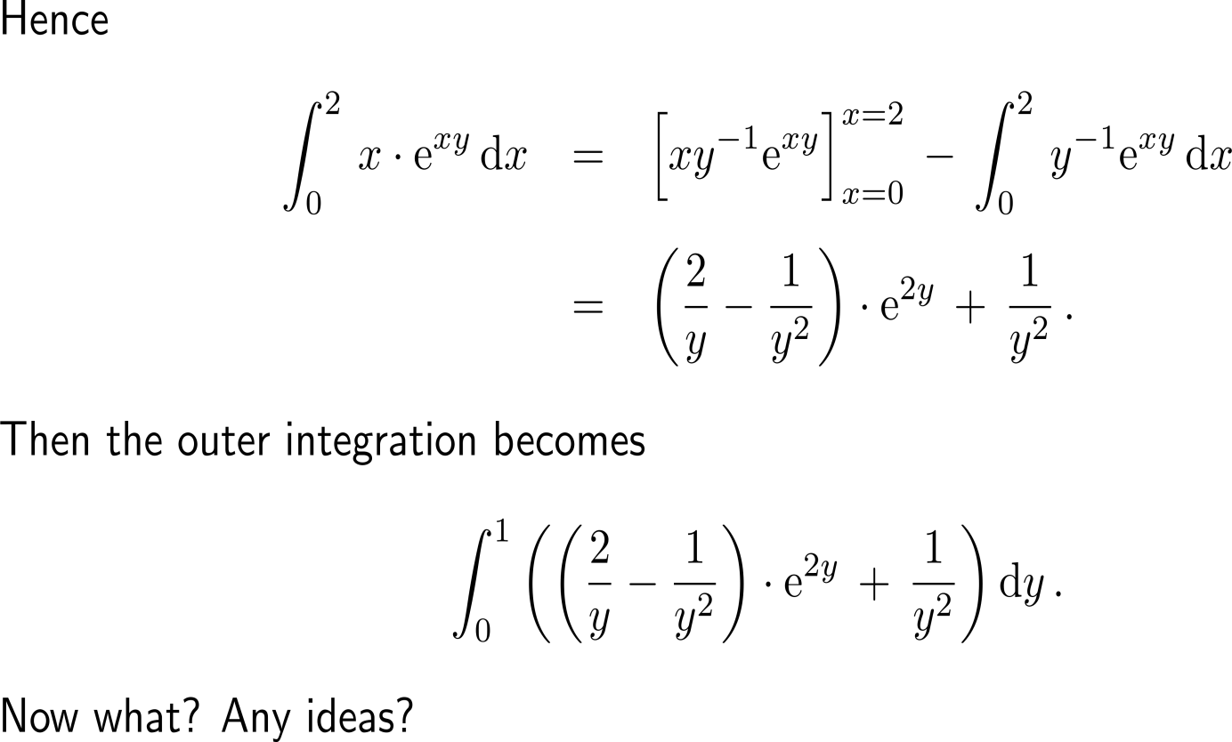
Example: Evaluating a double integral

Slide 12
Example: Evaluating a double integral

Slide 13
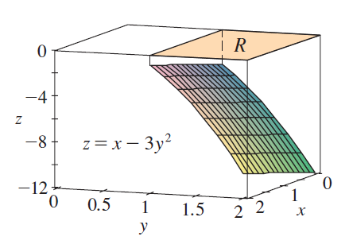
Example: Evaluating a double integral over an rectangular region
10 minutes
self/ group work
please, upload your solutions to the chat

Slide 14
Topics
Double Integrals over a Rectangular Region
Double Integrals over Non-Rectangular Regions
Applications

Slide 15
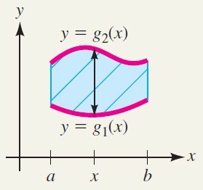
If the region of integration is bounded above and below by a function in x then we can use vertical cross sections to express the region (1/ 2)

Slide 16
If the region of integration is bounded above and below by a function in x then we can use vertical cross sections to express the region (2/ 2)
Vertical cross section

Slide 17
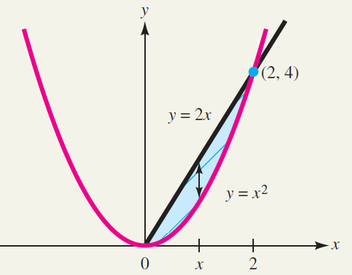
Example: Describing a region by vertical cross sections

Slide 18
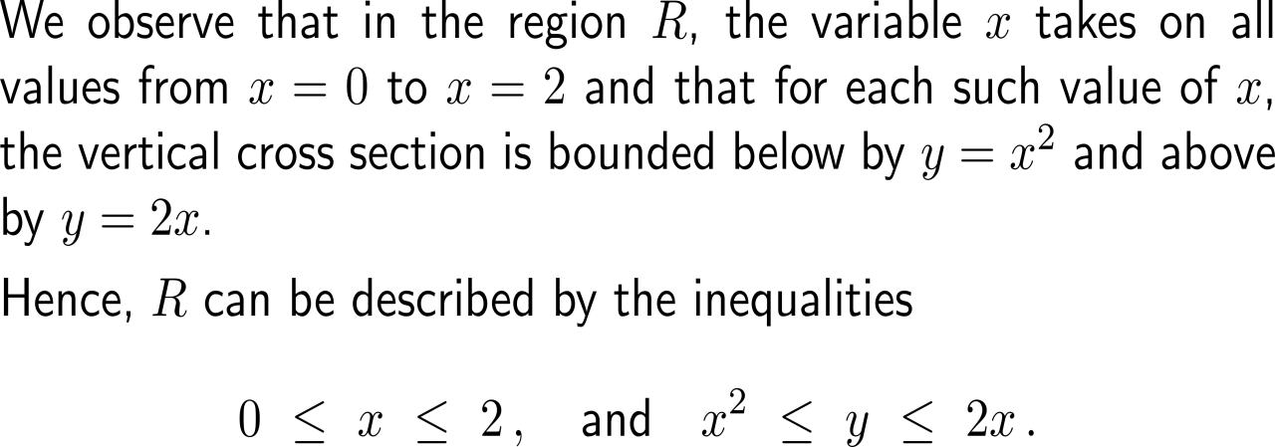
Example: Describing a region by vertical cross sections

Slide 19
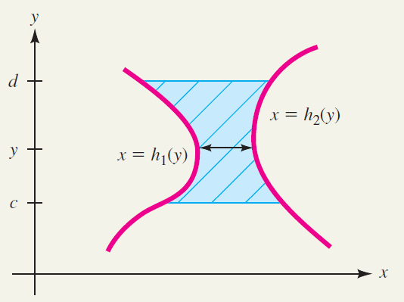
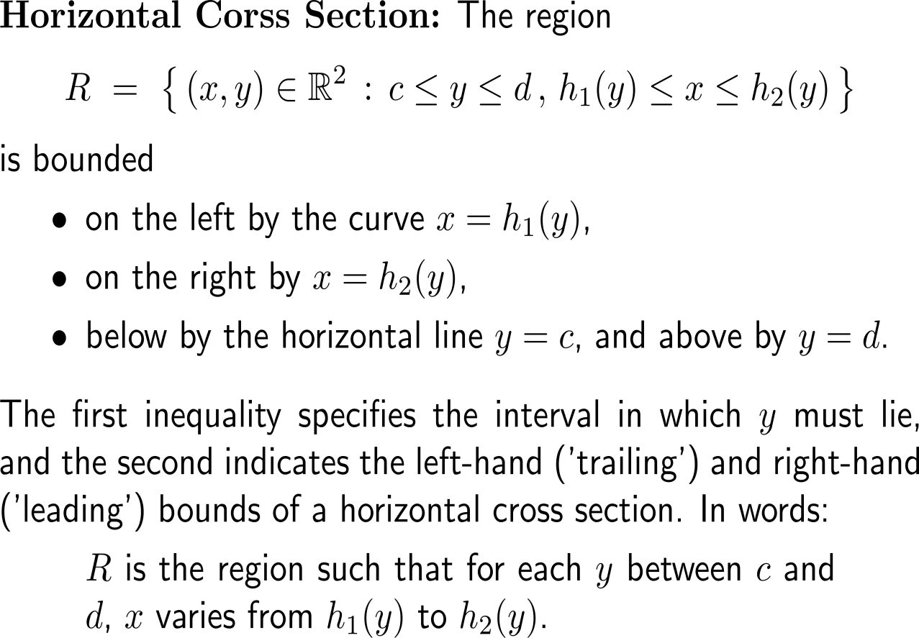
If the region of integration is bounded from the right and left by a function in y then we can use horizontal cross sections to express the region

Slide 20
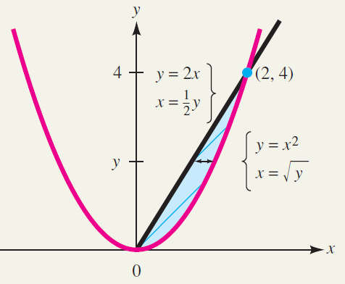
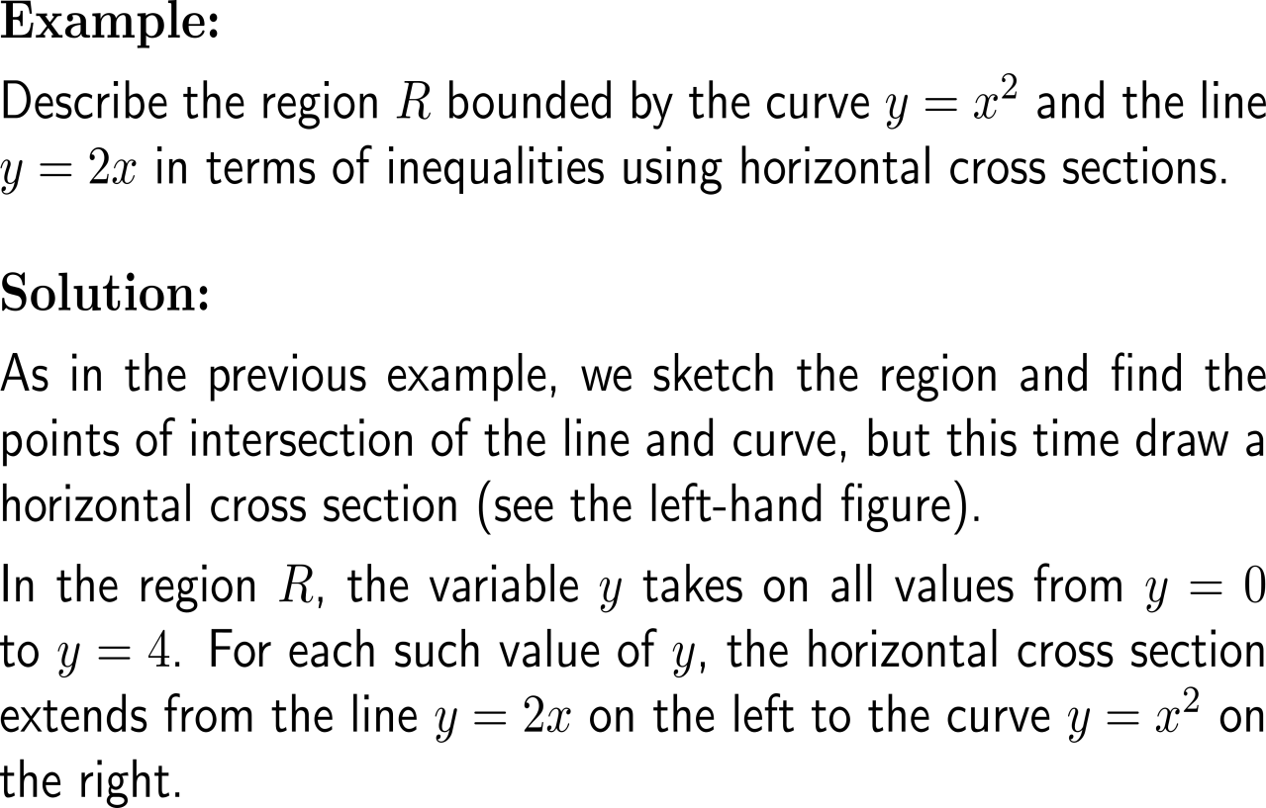
Example: Describing a region by horizontal cross sections

Slide 21
Example: Describing a region by horizontal cross sections

Slide 22
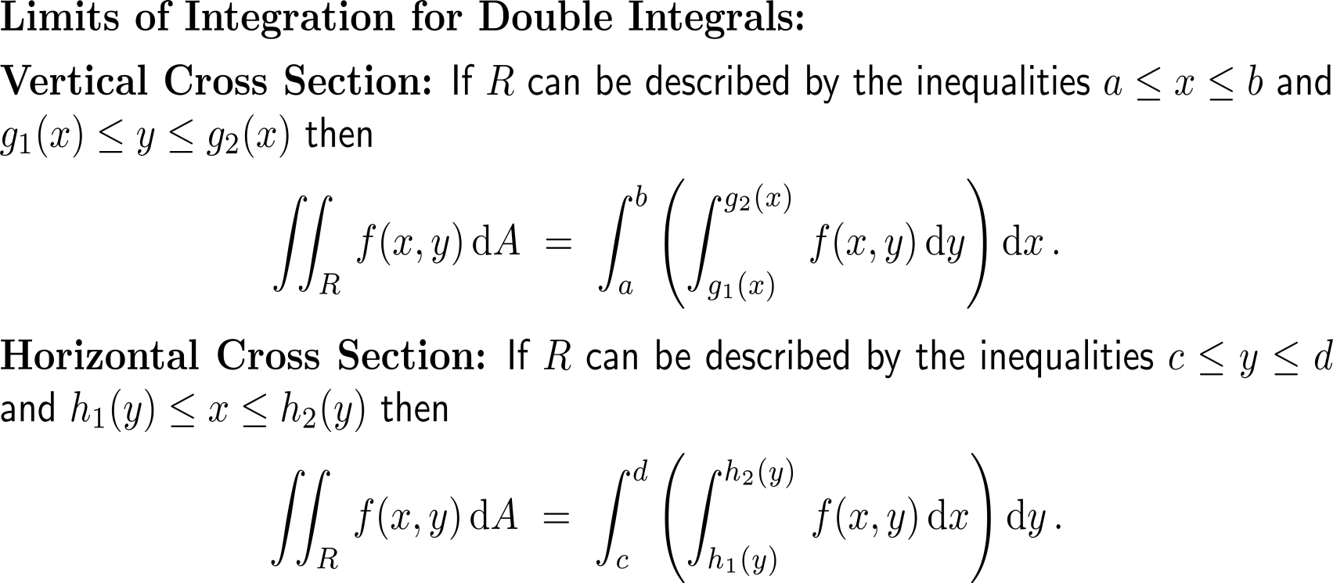
Summary: Vertical and horizontal cross sections and the integrals they lead to

Slide 23
When being free to choose the order of integration, always go for that which results in the easier to handle integrals

Slide 24
Example: Evaluating a double integral over a region

Slide 25
Example: Evaluating a double integral over a region

Slide 26
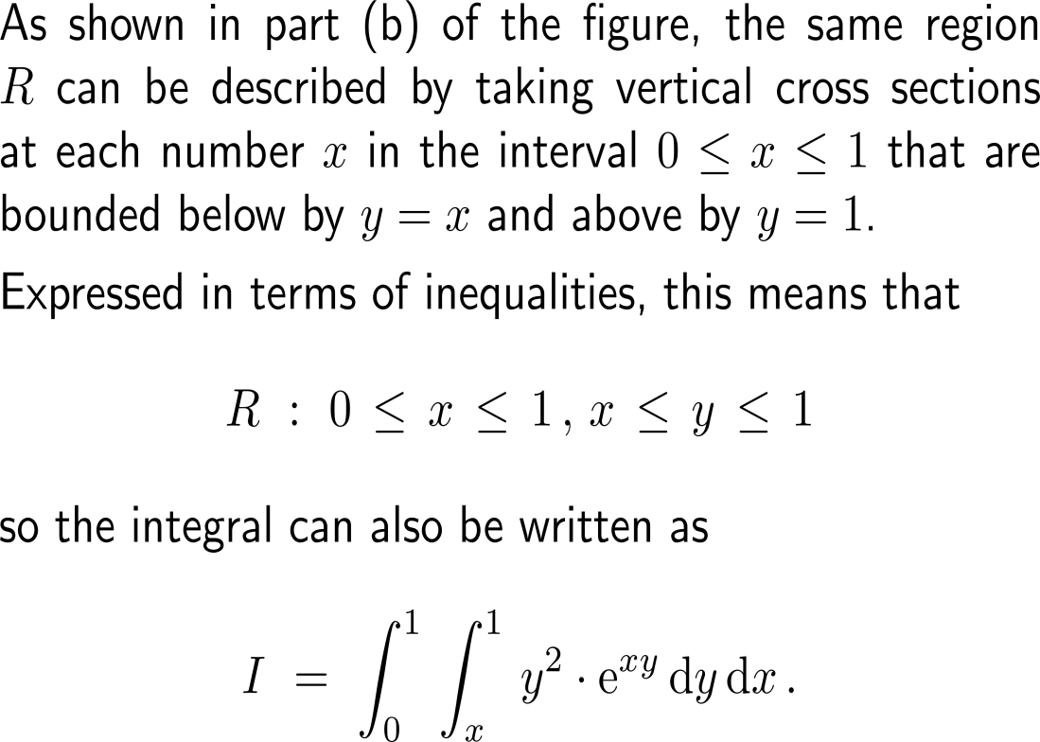
Example: Evaluating a double integral over a region

Slide 27
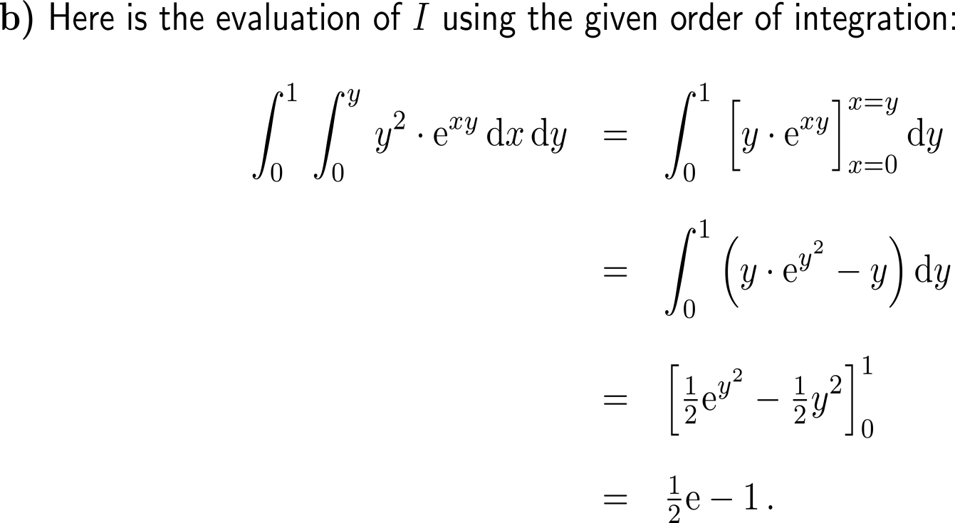
Example: Evaluating a double integral over a region

Slide 28
Topics
Double Integrals over a Rectangular Region
Double Integrals over Non-Rectangular Regions
Applications
Area
Volume
Average value
Population size

Slide 29
Application: Area of a region in the plane (1/ 2)
area
volume
av. value
population

Slide 30
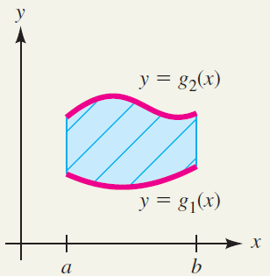
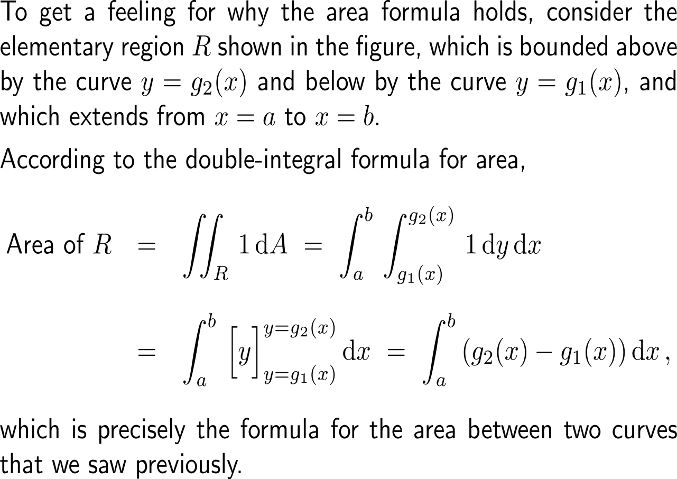
Application: Area of a region in the plane (2/ 2)

Slide 31
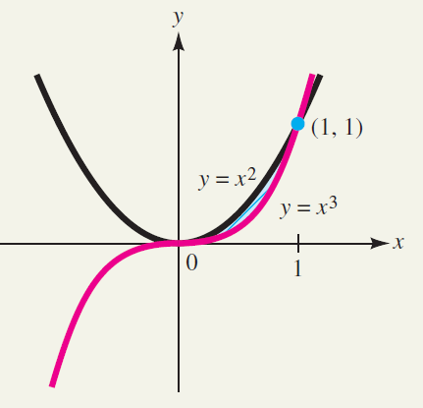
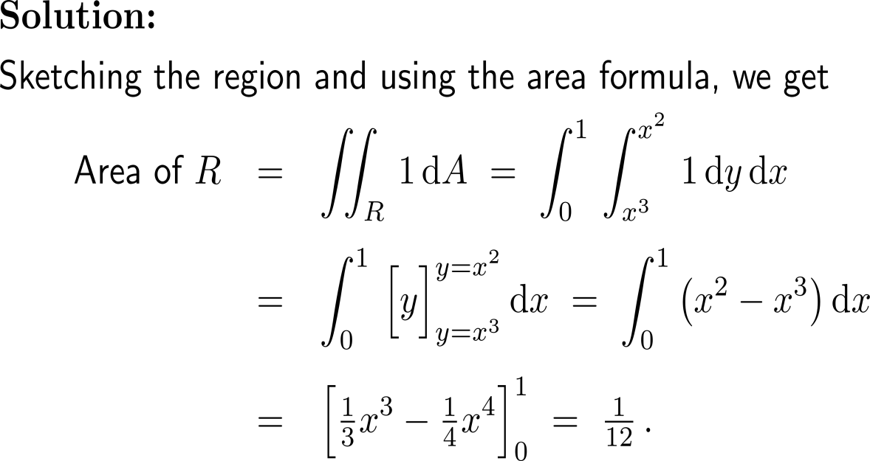
Example: Finding an area using a double integral

Slide 32
Application: Volume as a double integral
area
volume
av. value
population

Slide 33
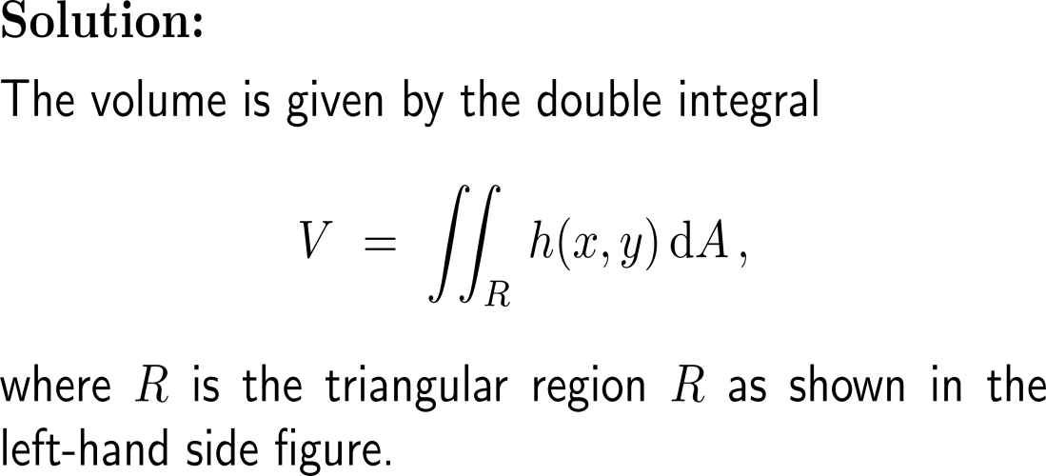
Example: Finding the volume of a biomass using a double integral

Slide 34
Example: Finding the volume of a biomass using a double integral

Slide 35
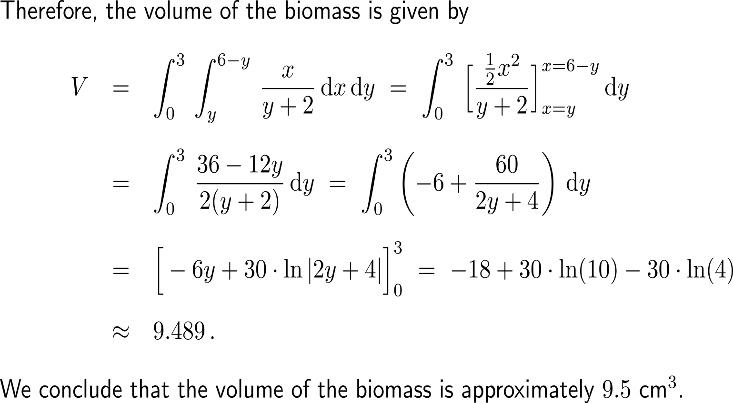
Example: Finding the volume of a biomass using a double integral

Slide 36
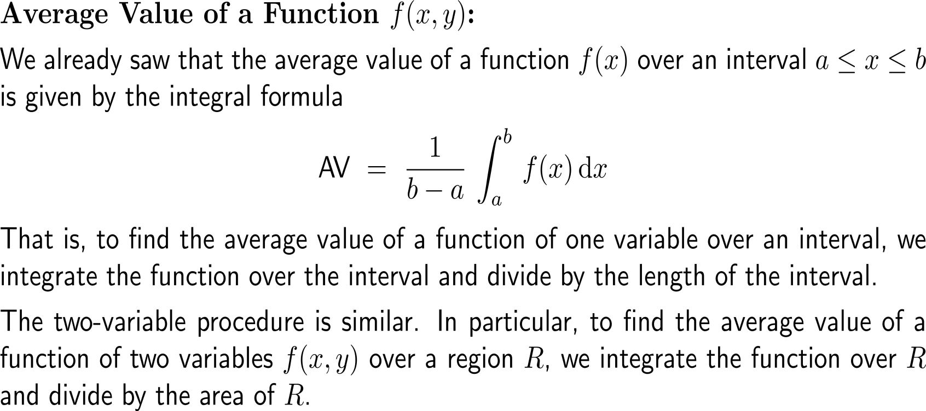
Application: Average value of a function (1/ 2)
area
volume
av. value
population

Slide 37
Application: Average value of a function (2/ 2)

Slide 38
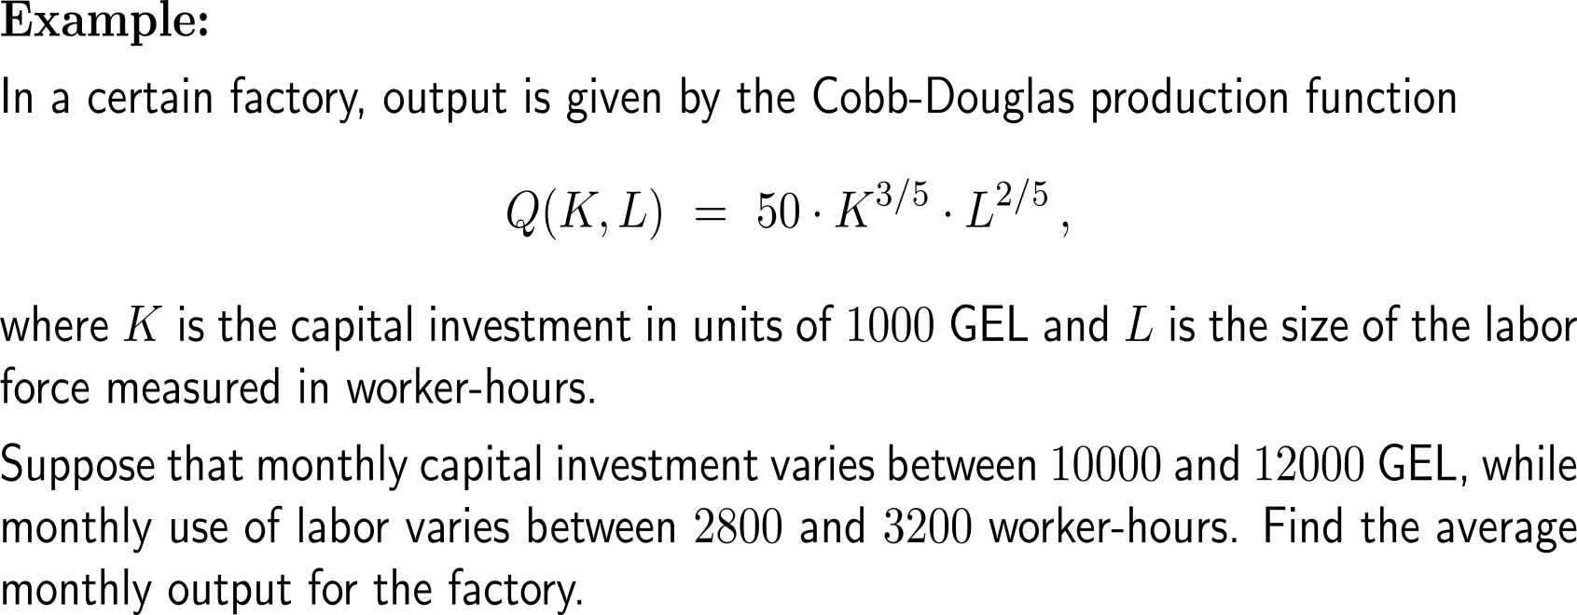
Example: Calculating the average monthly output

Slide 39
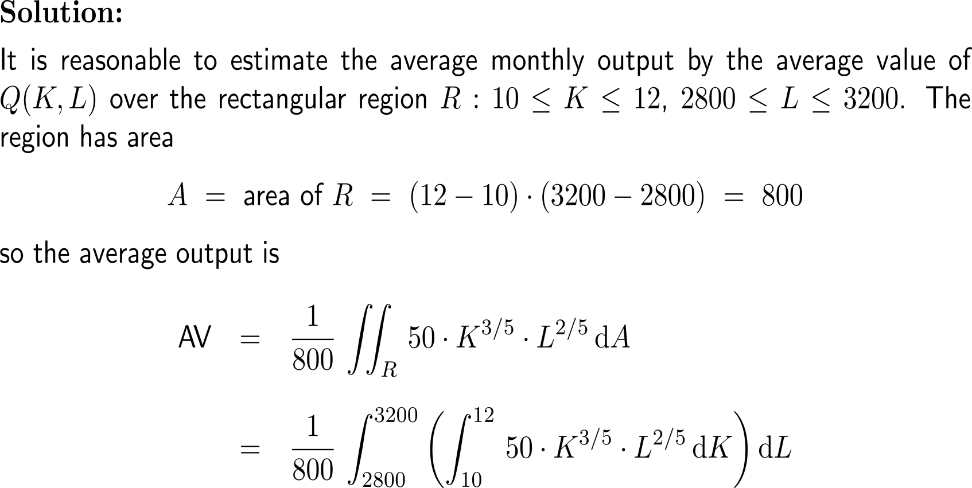
Example: Calculating the average monthly output

Slide 40
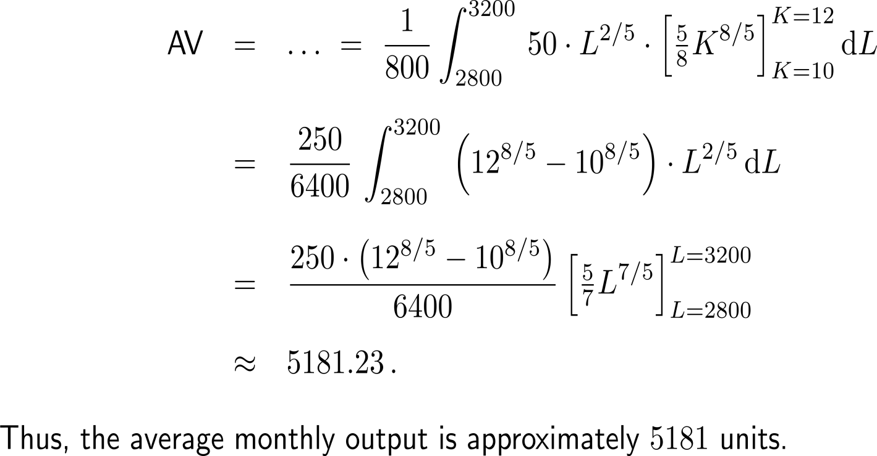
Example: Calculating the average monthly output

Slide 41
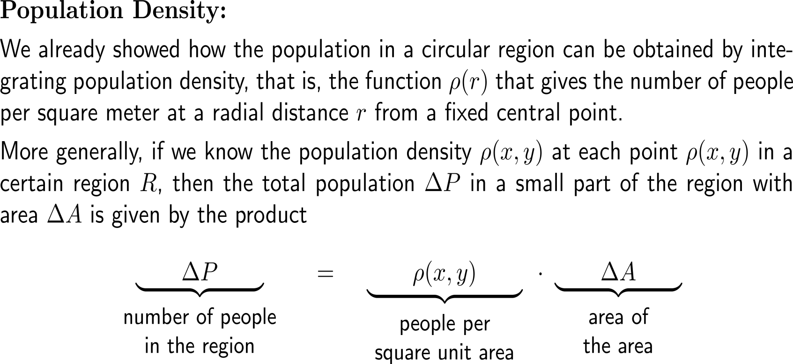
Application: Population density (1/ 2)
area
volume
av. value
population

Slide 42
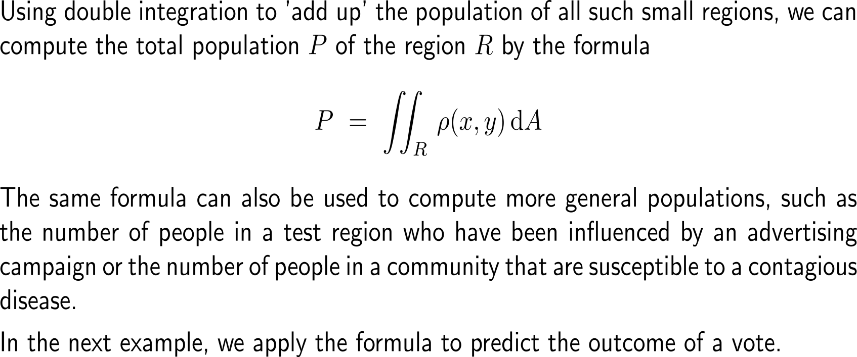
Application: Population density (2/ 2)

Slide 43
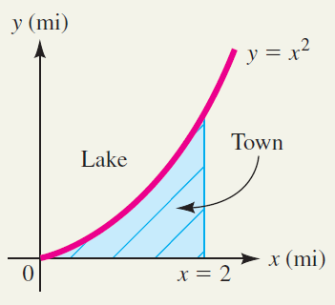
Example: Finding an area using a double integral

Slide 44
Example: Finding an area using a double integral

Slide 45
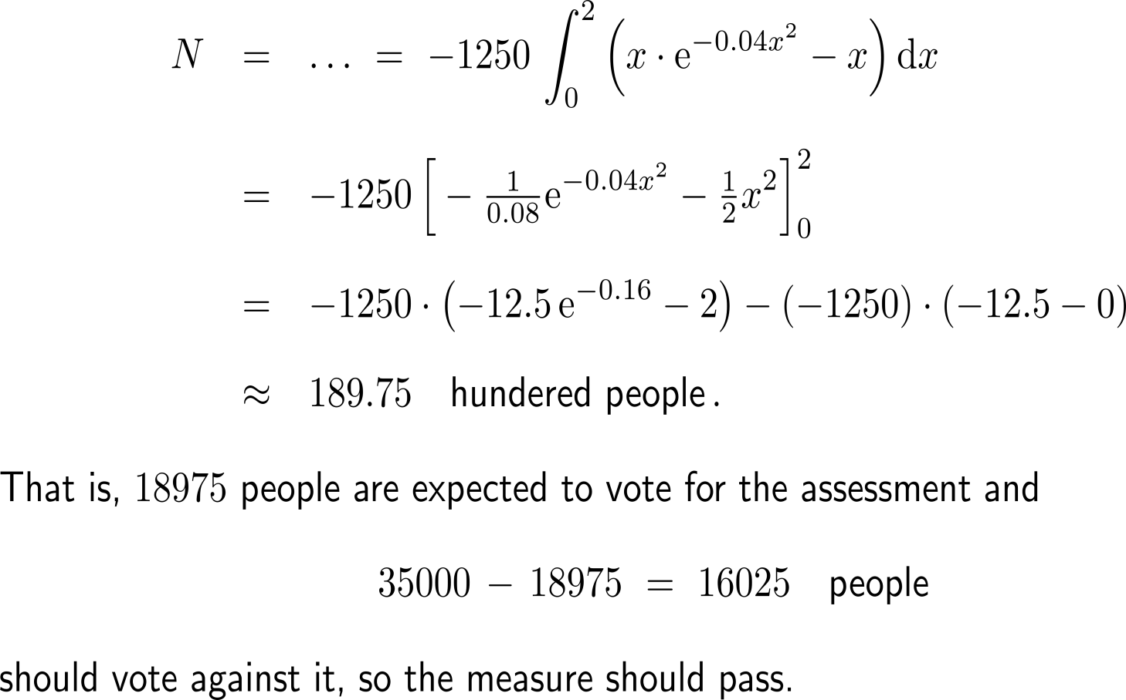
Example: Finding an area using a double integral

Slide 46
Further Worked-Out Exercises:
Calculus II for Management
Topics
Double integrals over rectangular regions
Double integrals over non-rectangular regions

Slide 47
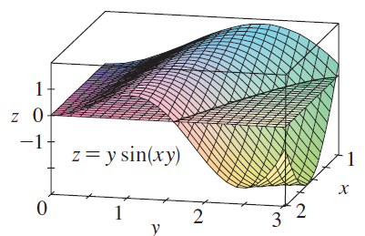
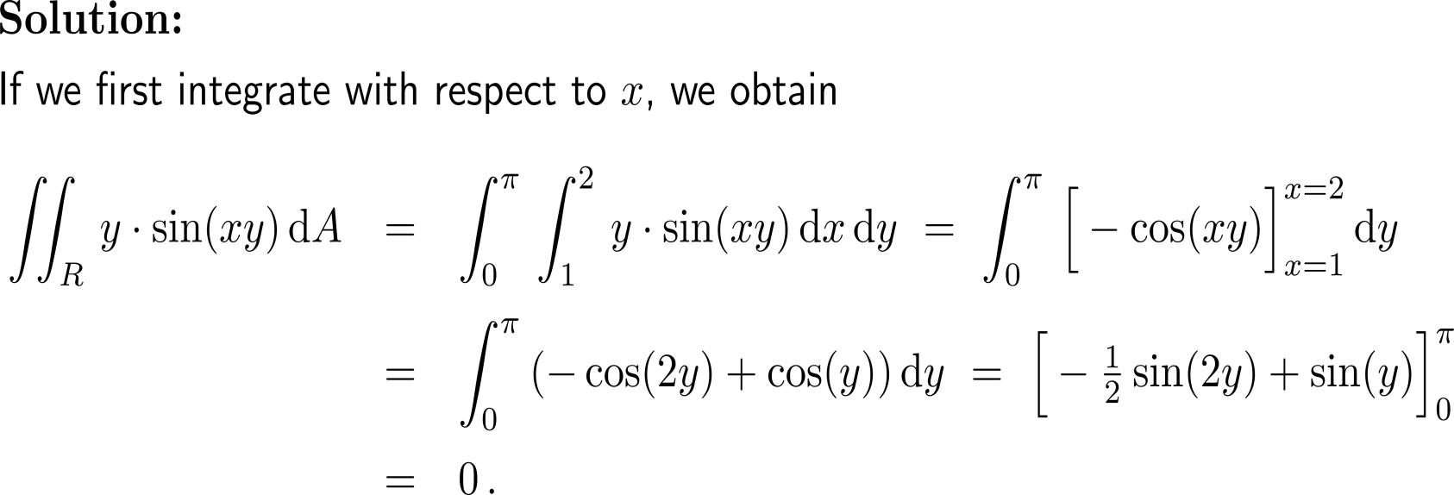
Exercise

Slide 48
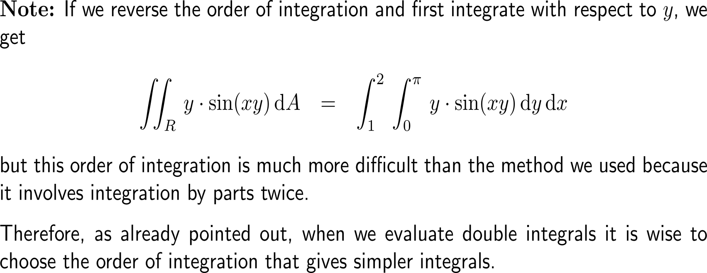
Note: Always take that order of integration that is most easy to evaluate

Slide 49
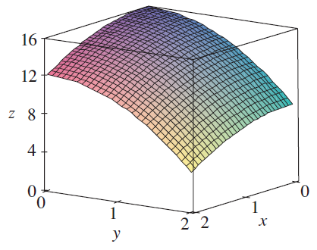
Exercise

Slide 50
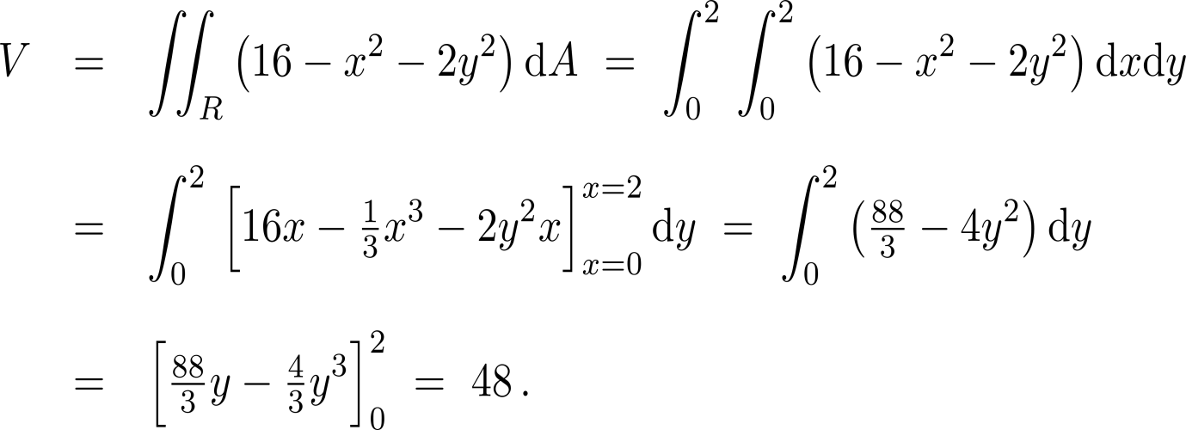
Exercise

Slide 51
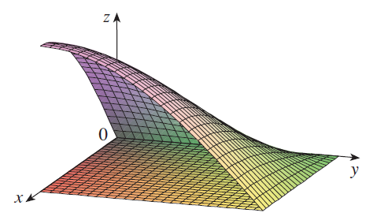
Exercise

Slide 52
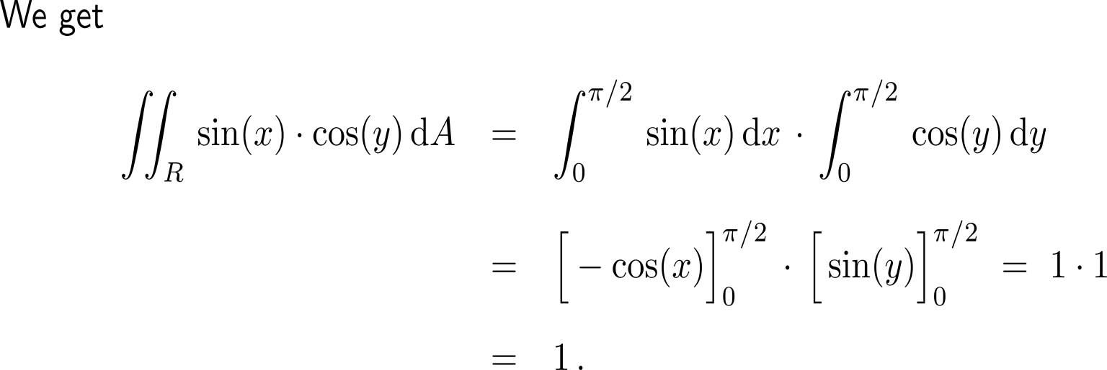
Exercise

Slide 53
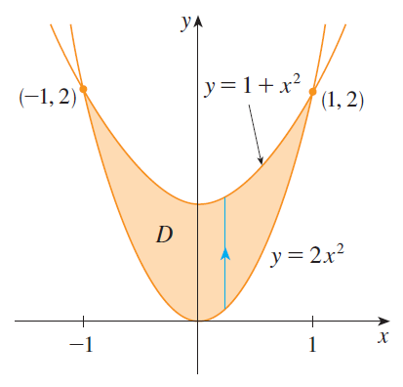
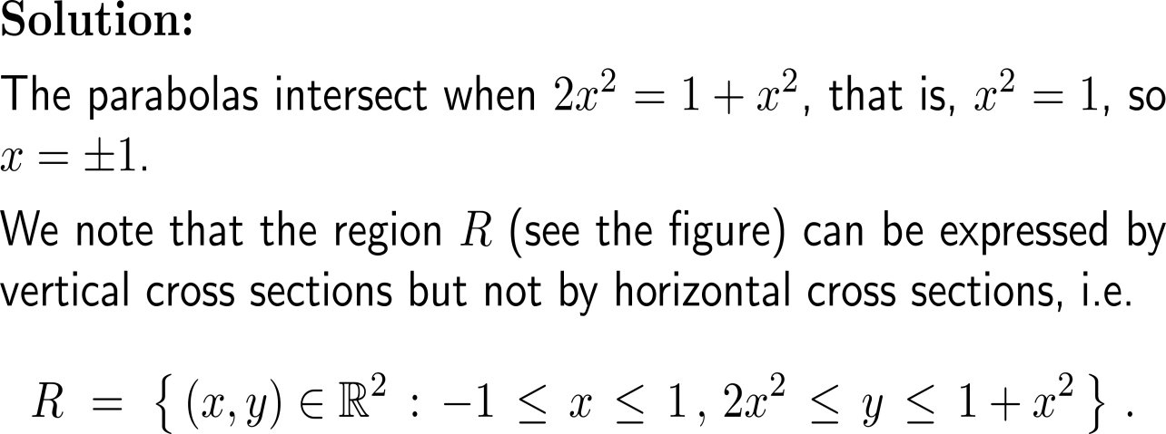
Exercise

Slide 54
Exercise

Slide 55
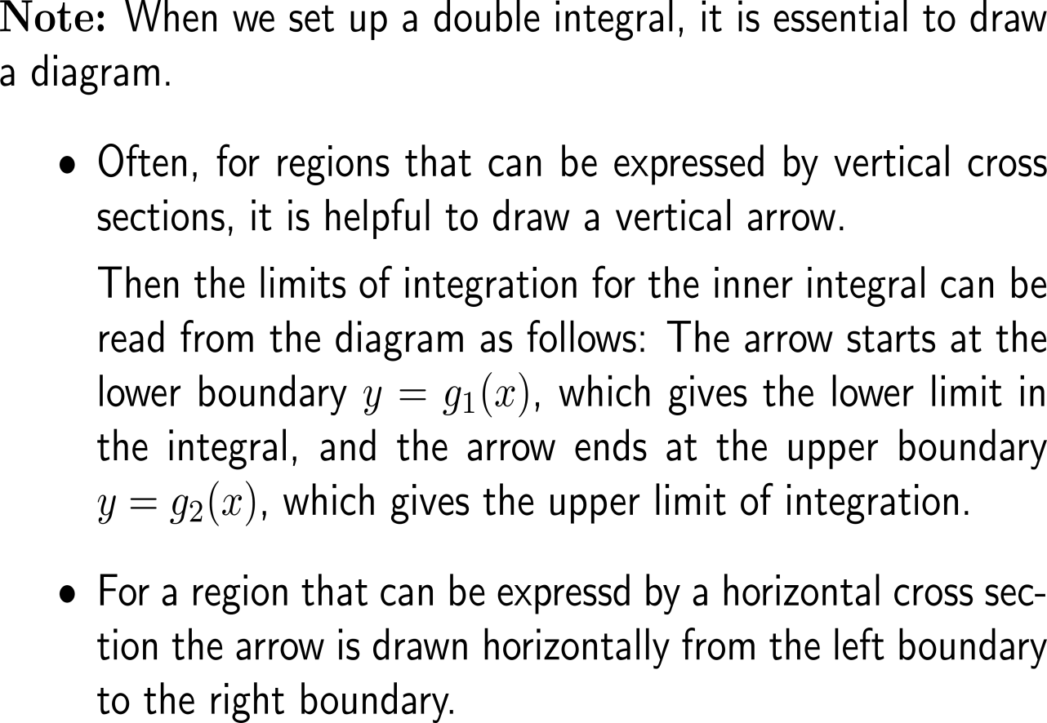
Note: Always take that order of integration that is most easy to evaluate

Slide 56
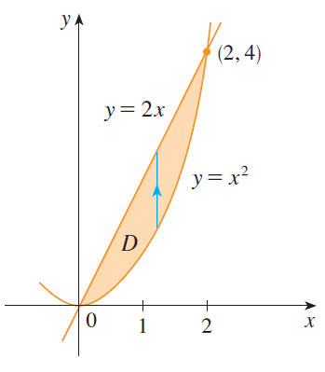
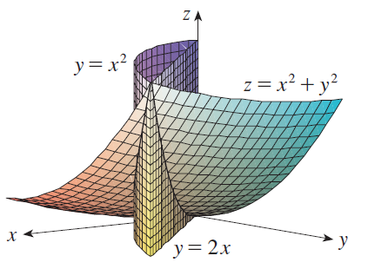
Exercise
The solid whose volume we intend to calculate: It lies above the xy-plane, below the paraboloid z = x² + y², and between the plane y = 2x and the parabolic cylinder y = x².

Slide 57
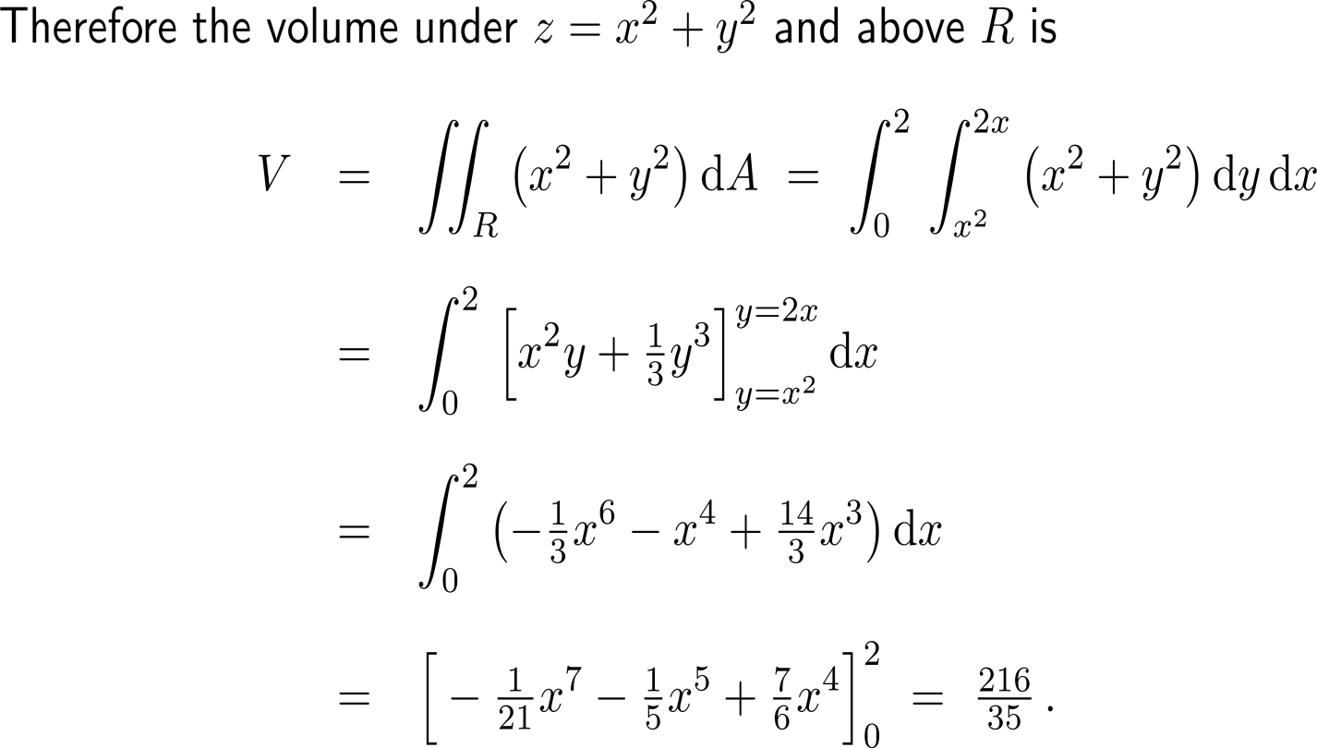
Exercise

Slide 58
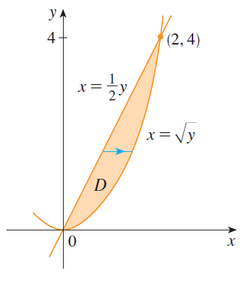
Exercise

Slide 59
Exercise

Slide 60
Exercise

Slide 61
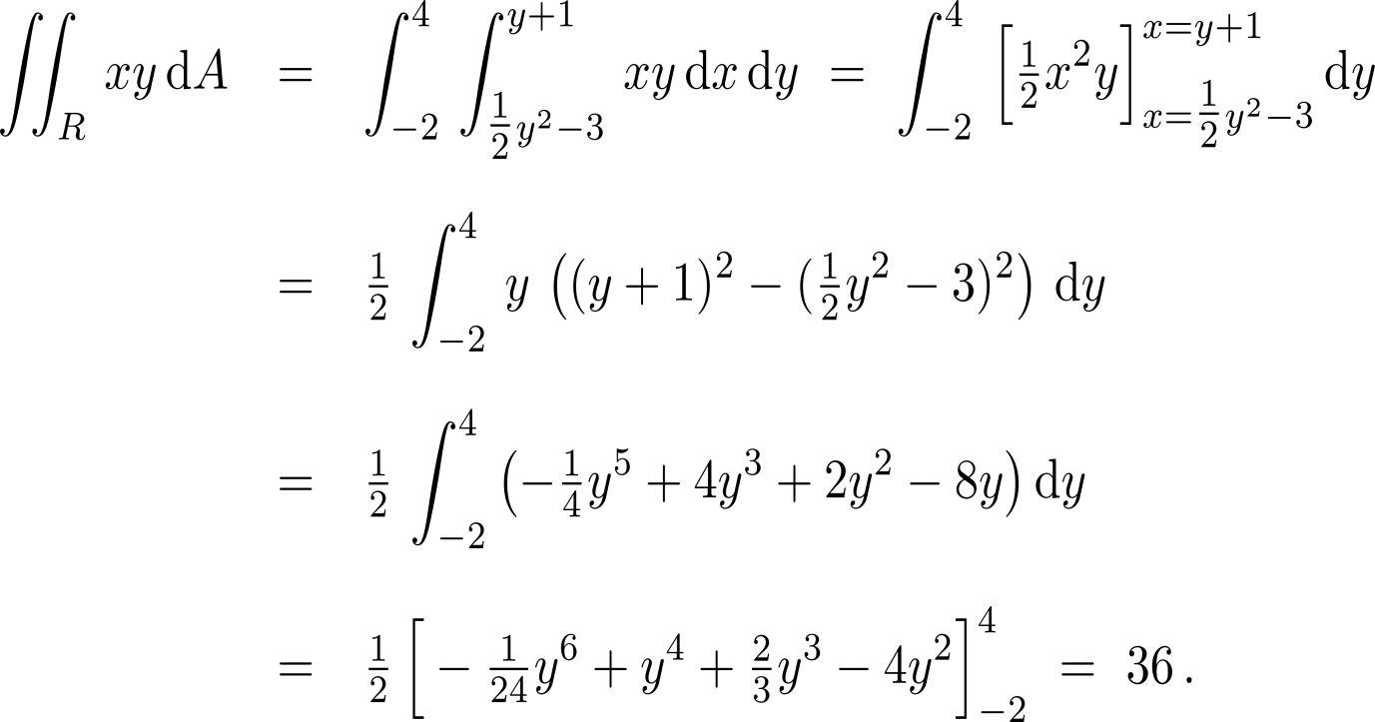
Exercise

Slide 62
Calculus II for Management

