Slide 1
Calculus II for Management
Recap of the Course & Preparation for the Final Exam
week 15
Lecture 15
  Essential theorems and connections between concepts
  Examples

Slide 2
What did we cover during this semester?
Introduction to
Vectors & Matrices
Advanced Topics in
1D Integration
Functions in Several Variables
& Optimization
Double Integrals & Applications
 |  | Topics
1 |  | Linear systems of equations (lines in the plane, planes in space, and their equations)
2 |  | Gaussian Elimination & Determinants I (N-variable systems, geometry of determinants)
3 |  | Determinants II (properties & computation rules), vectors & linear combinations
4 |  | Scalar-product, vector product, and matrix-matrix multiplication
5 |  | Introduction to Ordinary Differential Equations
6 |  | Improper integrals
7 |  | Numerical integration
8 |  | Continuous probability
9 |  | Functions of several variables
10 |  | Partial derivatives and optimizing functions of two variables
11 |  | The method of Least-Squares
12 |  | Constrained optimization: the method of Lagrange multipliers
13 |  | Double integrals
14 |  | Applications of double integrals
15 |  | Review and preparation for the final exam

Slide 3
Topics
  Recap: Introduction to Vectors and Matrices
  Recap: Advanced Topics in Integration
  Recap: Functions in Several Variables & Optimization
  Recap: Double Integrals & Applications

Slide 4
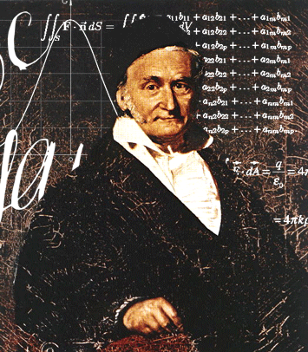
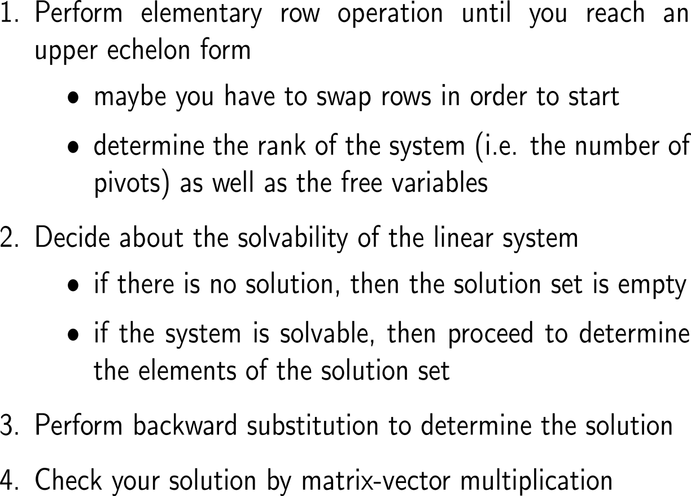
Summary:
Gaussian Elimination in a nutshell

Slide 5
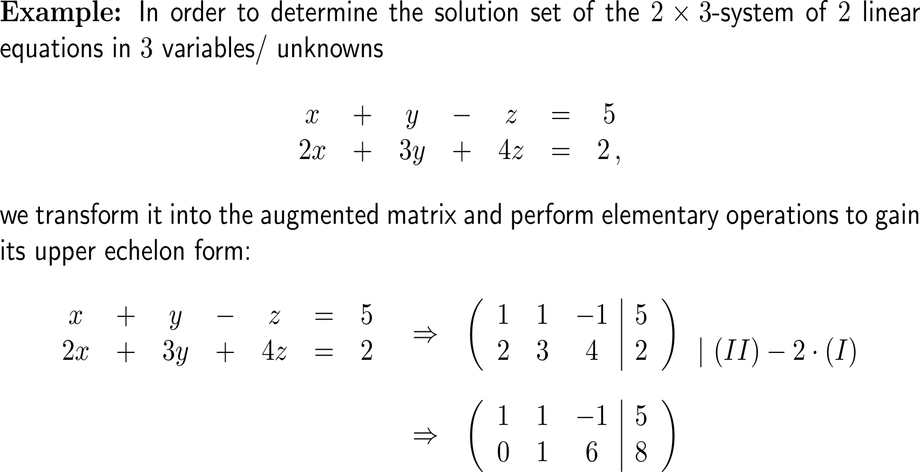
Example:
Application of Gaussian elimination & the structure of the solution set

Slide 6
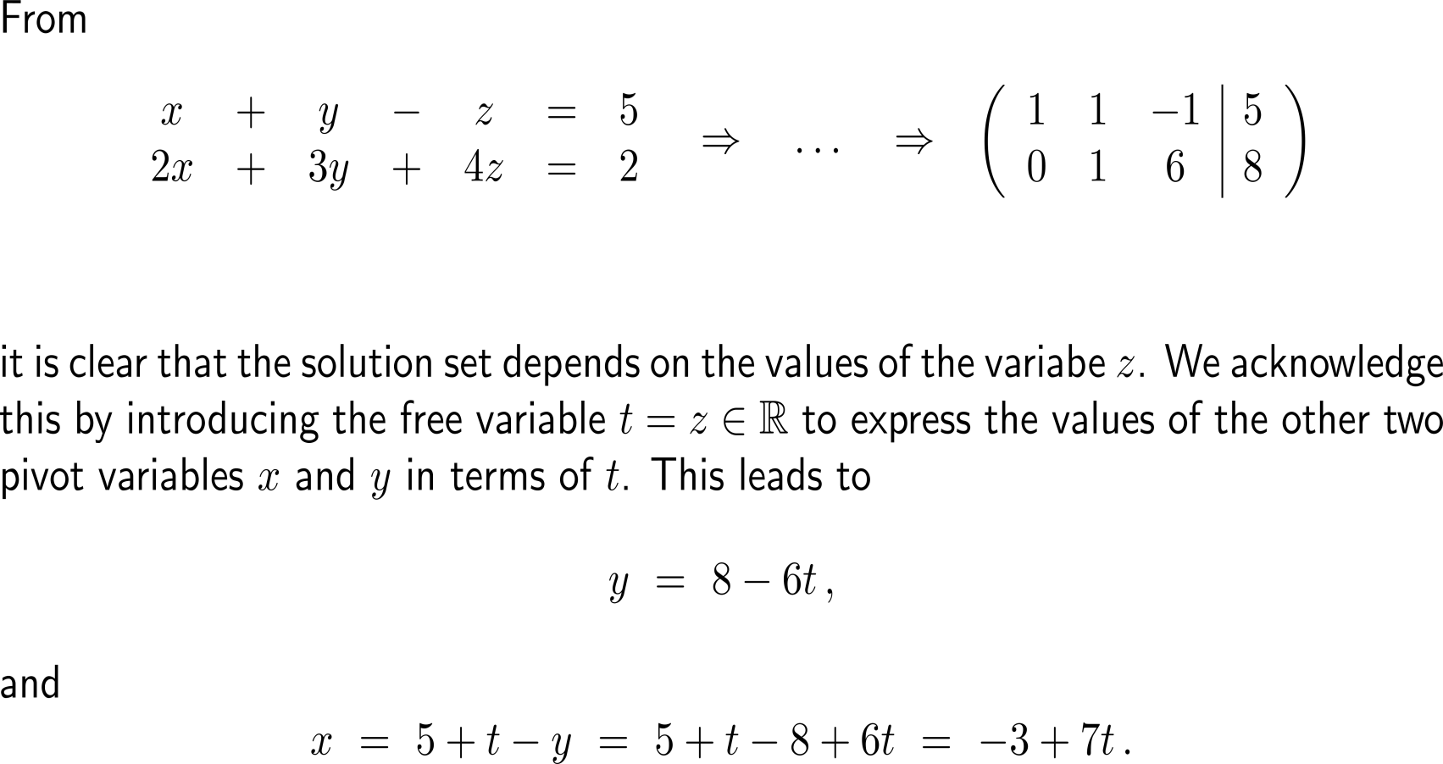
Example:
Application of Gaussian elimination & the structure of the solution set
pivot elements
free variable

Slide 7
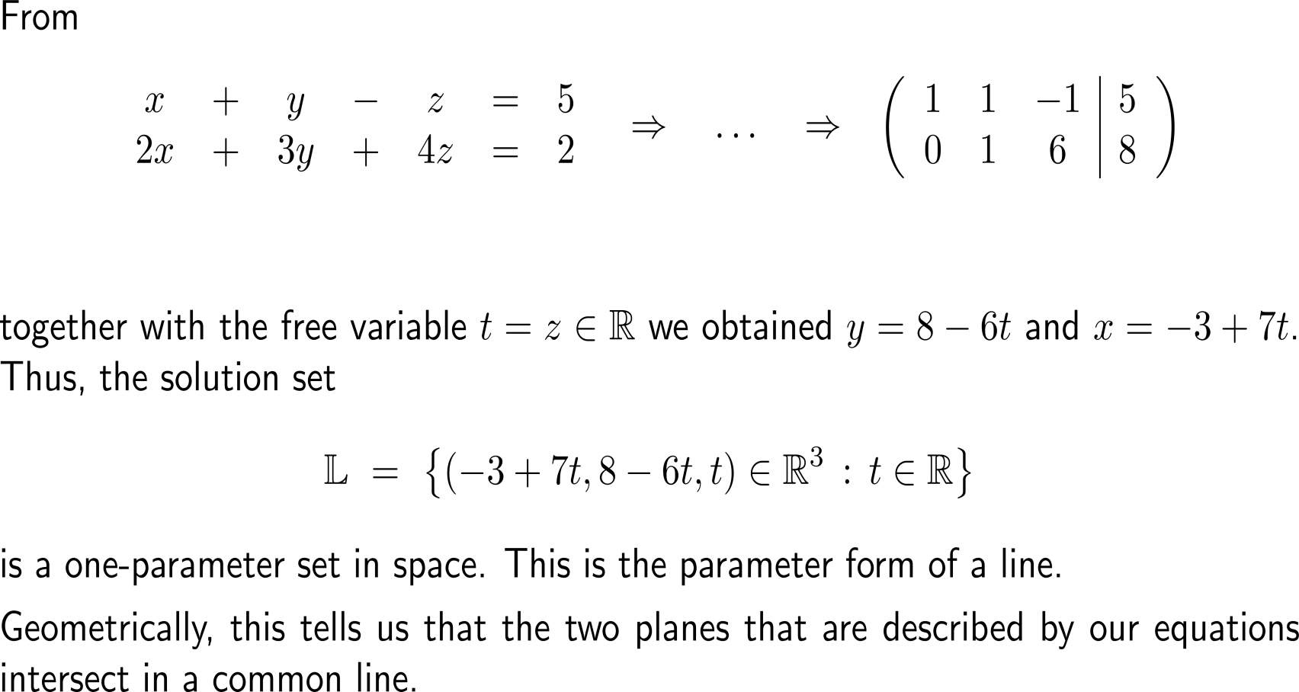
Example:
Application of Gaussian elimination & the structure of the solution set
pivot elements
free variable

Slide 8
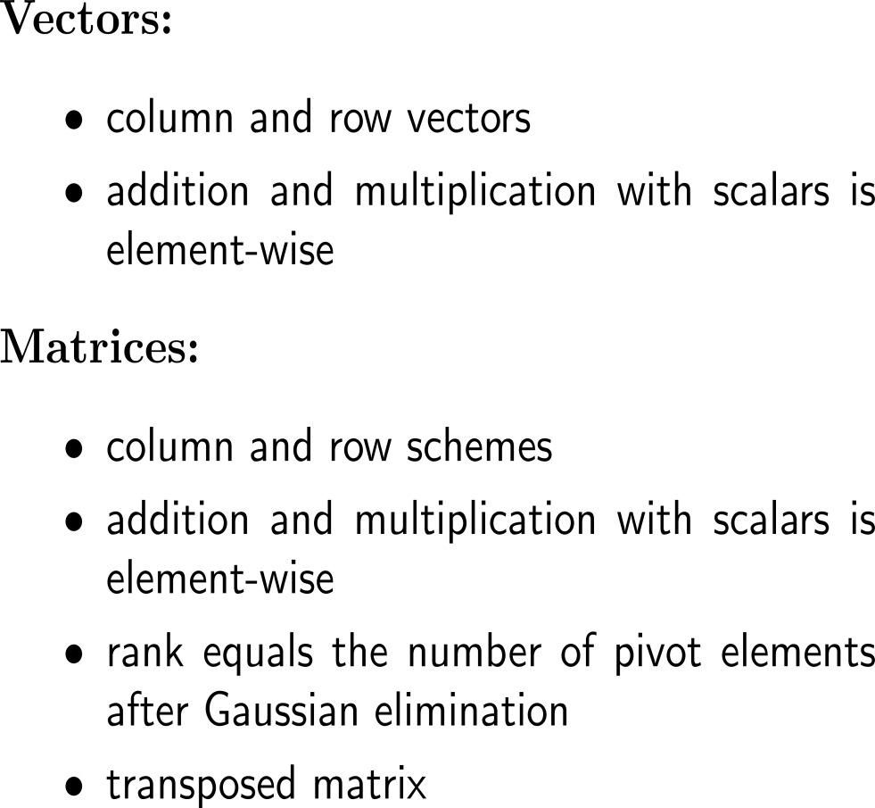
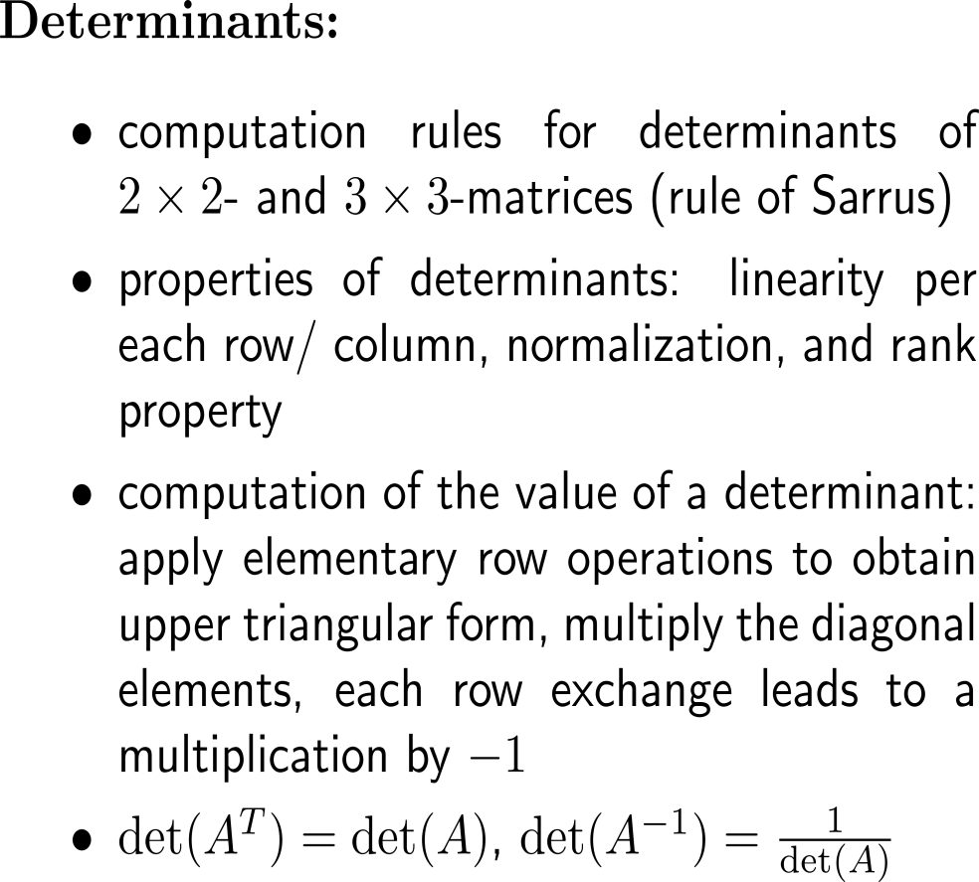
Summary:
Vector & matrix algebra

Slide 9
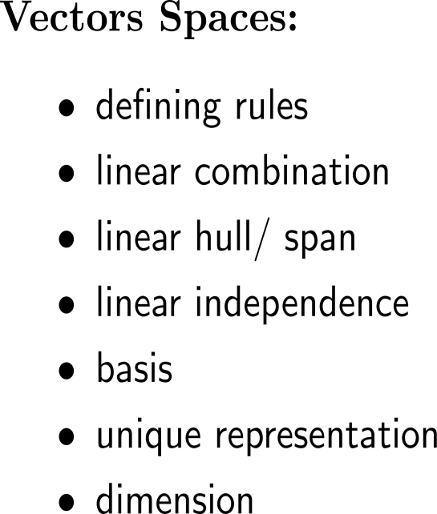
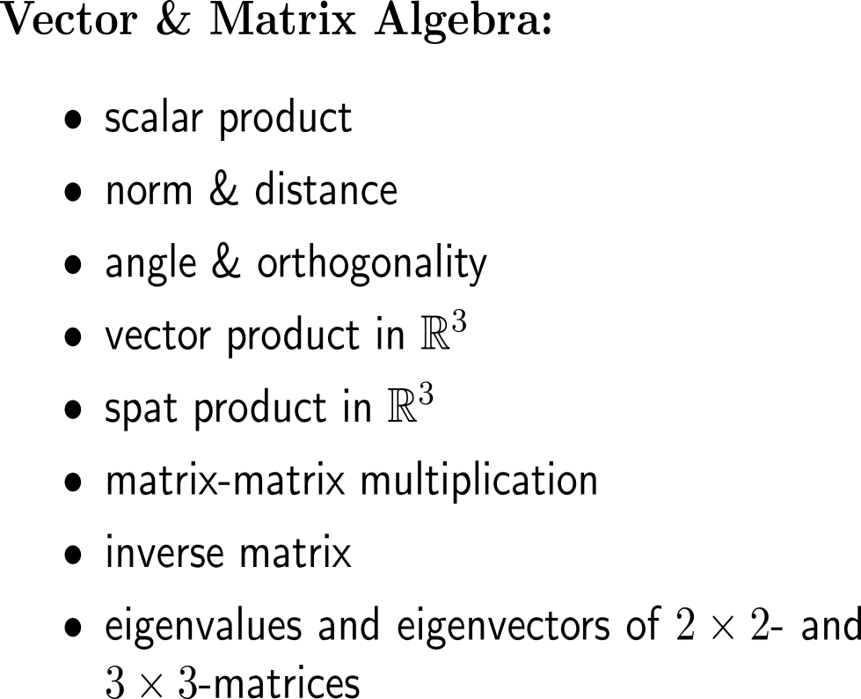
Summary:
Vector & matrix algebra

Slide 10
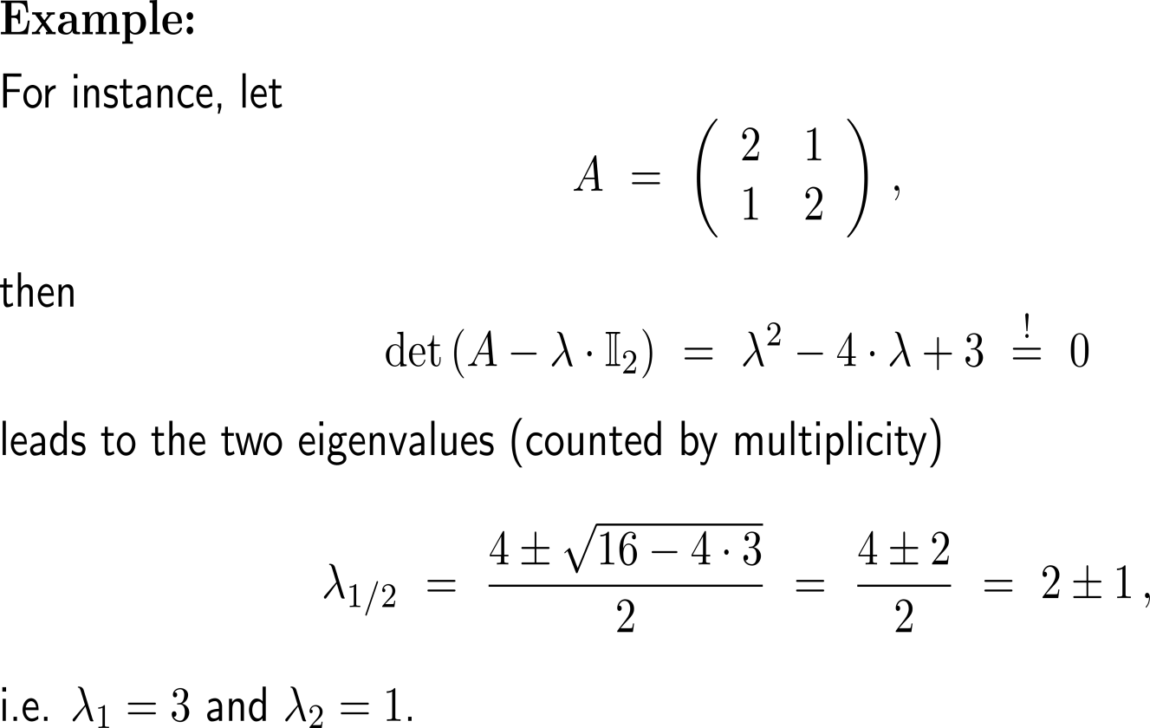
Example:
Determining the eigenvalues & eigenvectors of a 2x2-matrix

Slide 11
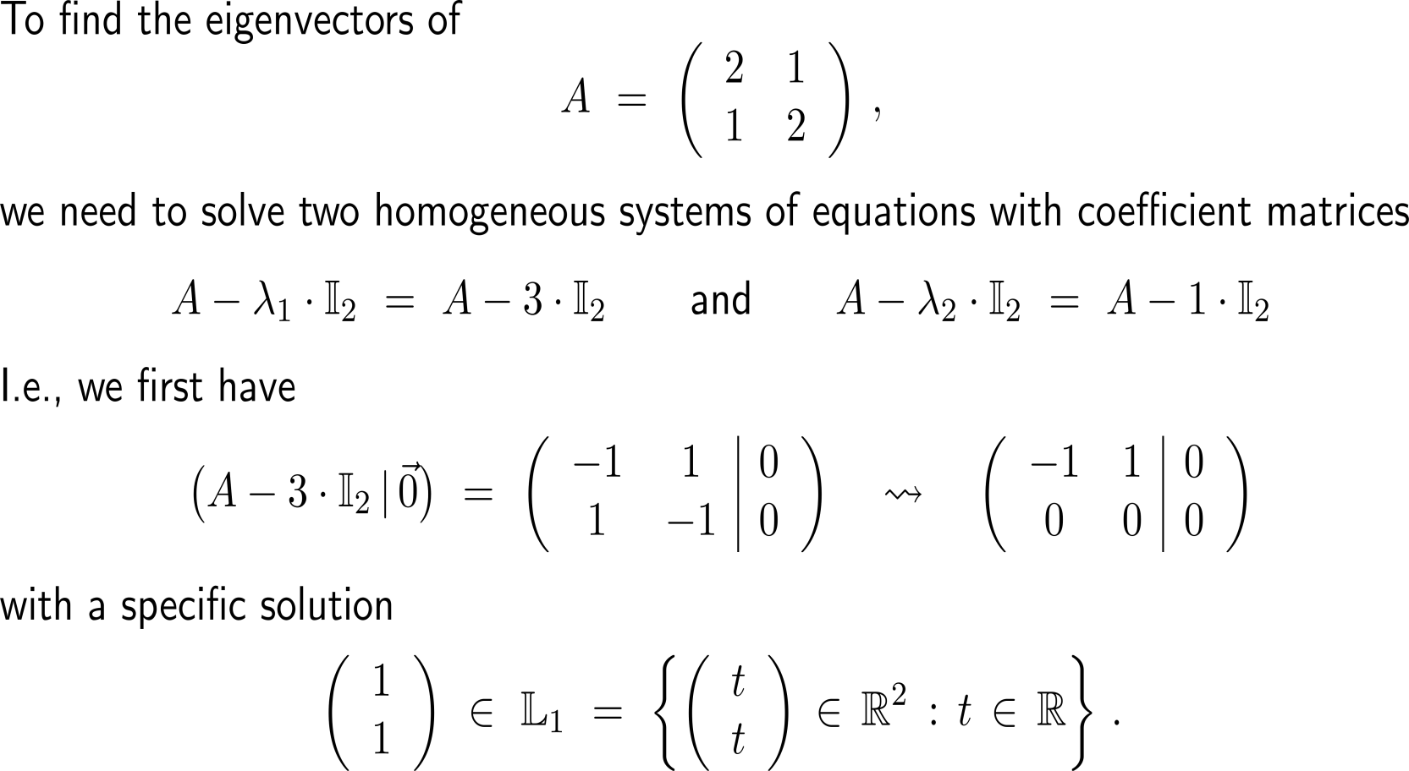
Example:
Determining the eigenvalues & eigenvectors of a 2x2-matrix

Slide 12
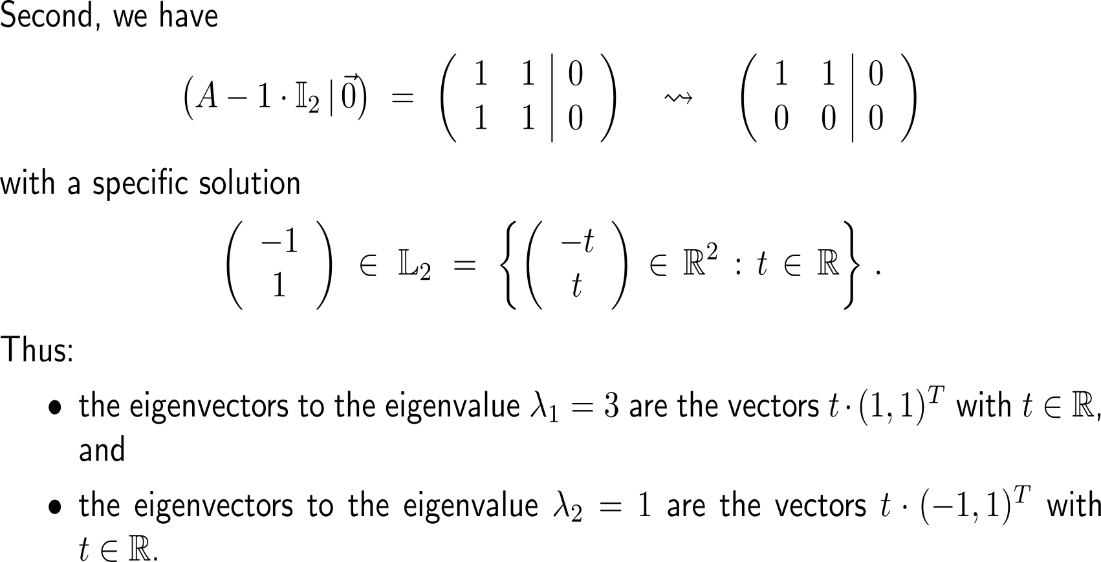
Example:
Determining the eigenvalues & eigenvectors of a 2x2-matrix

Slide 13
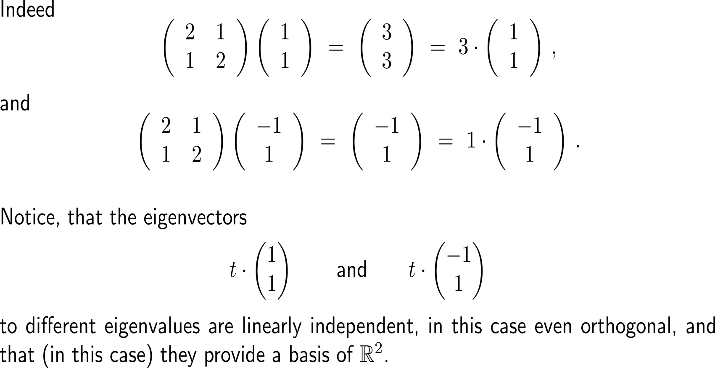
Example:
Determining the eigenvalues & eigenvectors of a 2x2-matrix

Slide 14
Topics
  Recap: Introduction to Vectors and Matrices
  Recap: Advanced Topics in Integration
  Recap: Functions in Several Variables & Optimization
  Recap: Double Integrals & Applications

Slide 15
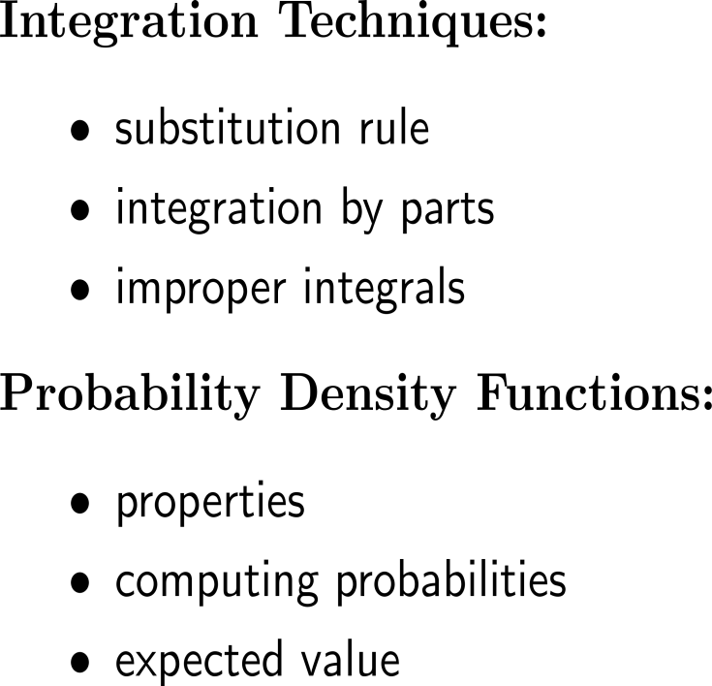
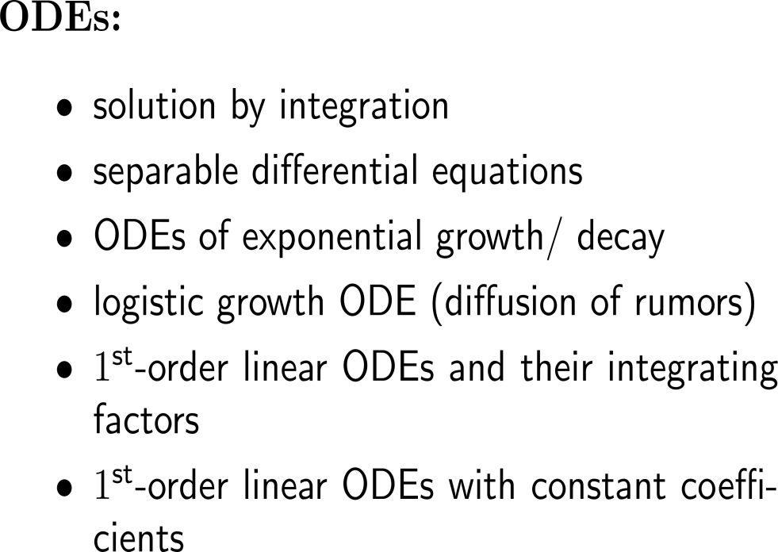
Summary:
Advanced Topics in 1D Integration

Slide 16
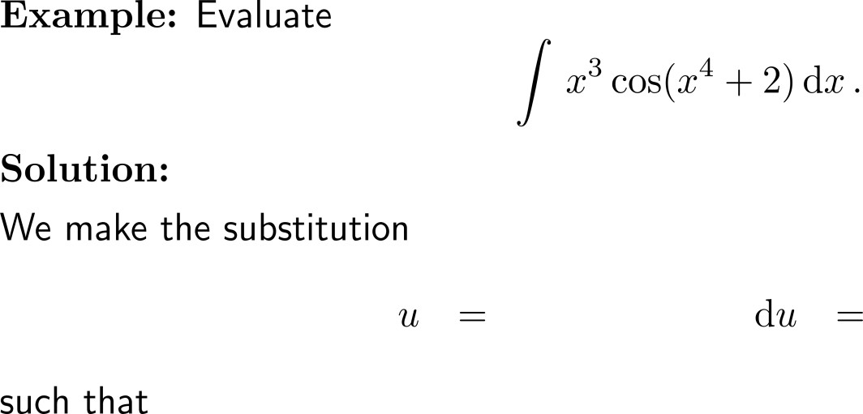


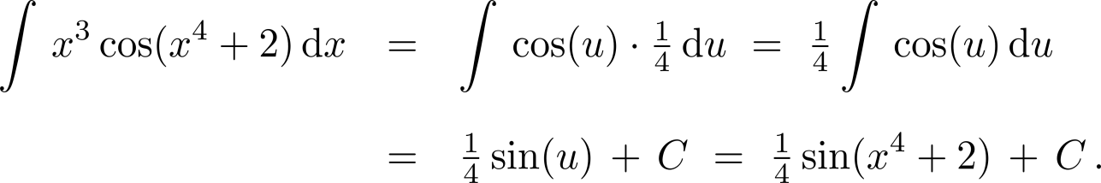
Example:
Substitution Rule

Slide 17

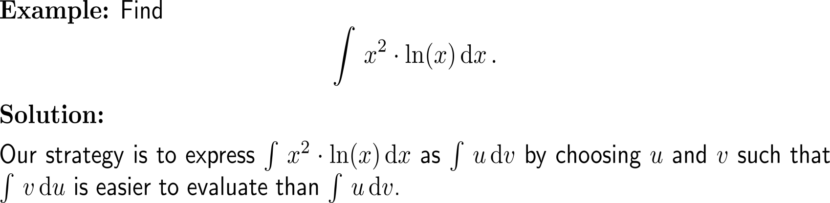
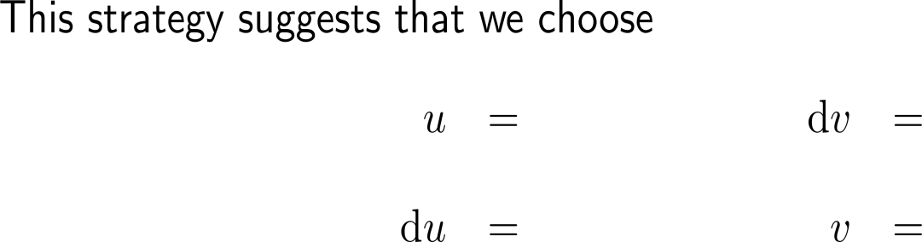




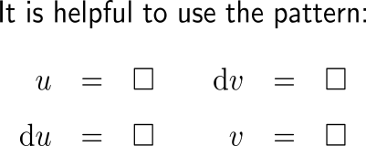
Example:
Application of integration by parts

Slide 18
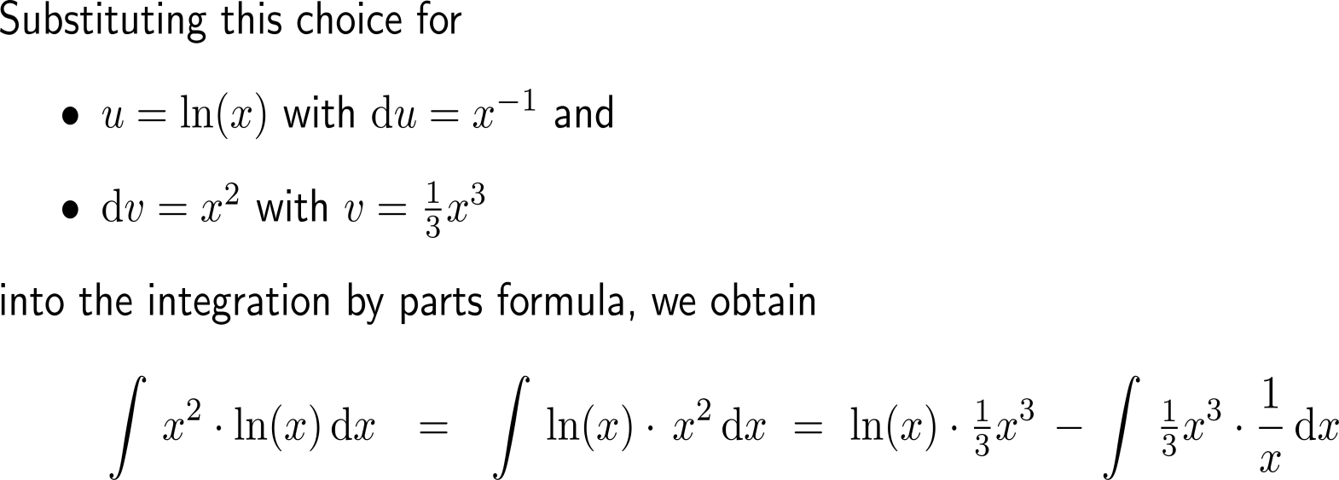
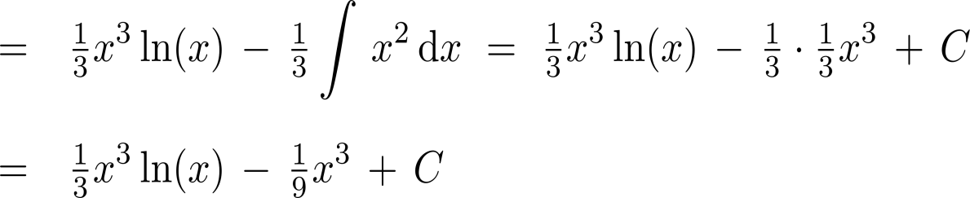
Example:
Application of integration by parts
u
dv
u
v
v
du

Slide 19
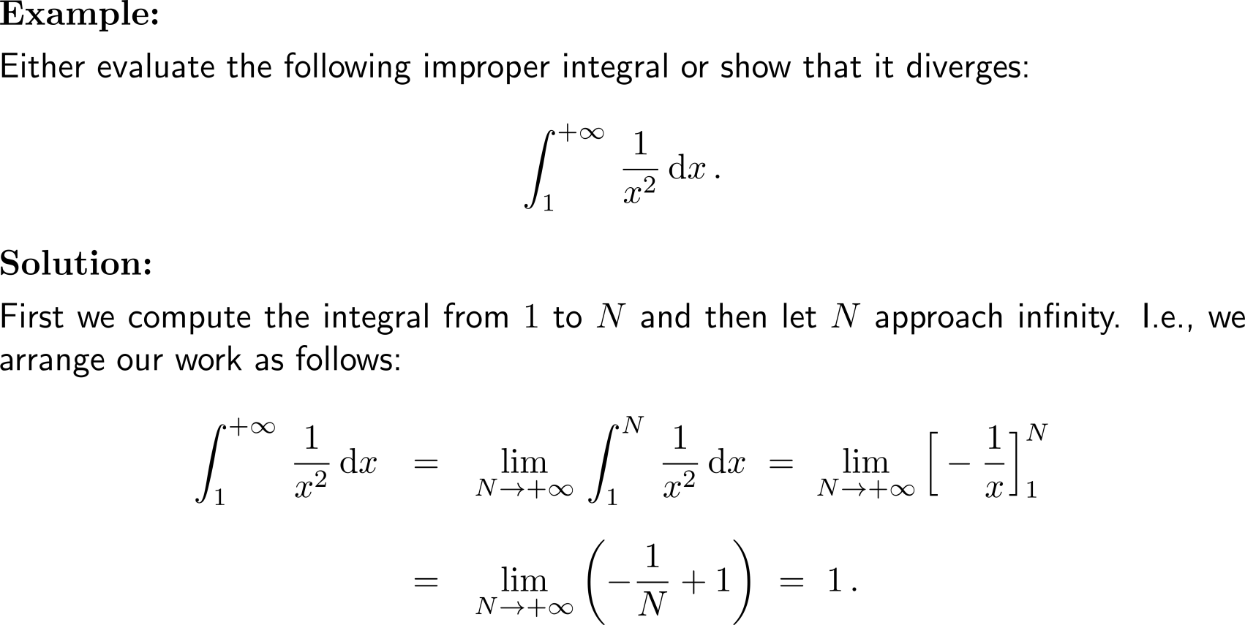
Example:
Evaluating an improper integral
step 2: limit
step 1: definite integral

Slide 20
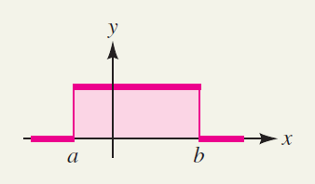
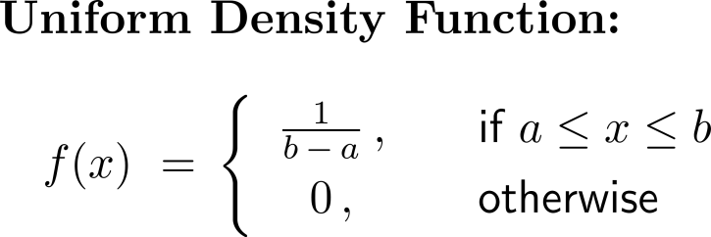
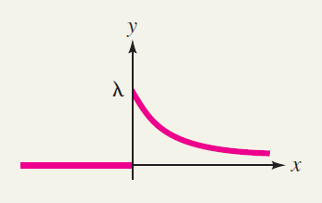
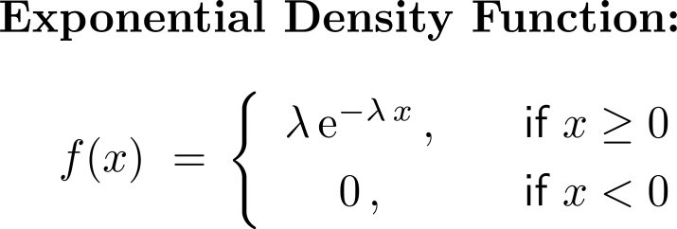
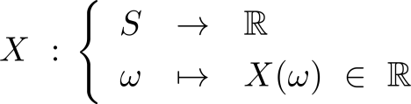
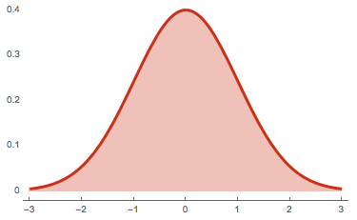
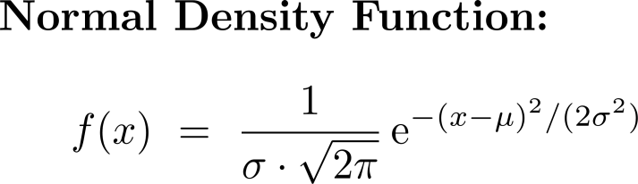
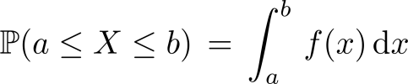
Summary:
Density functions and their connection to probabilities
Sample Space
S
E
Cont. Random Variable
Probability

Slide 21
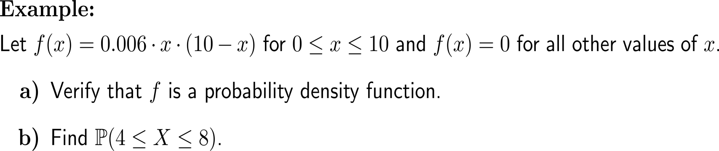
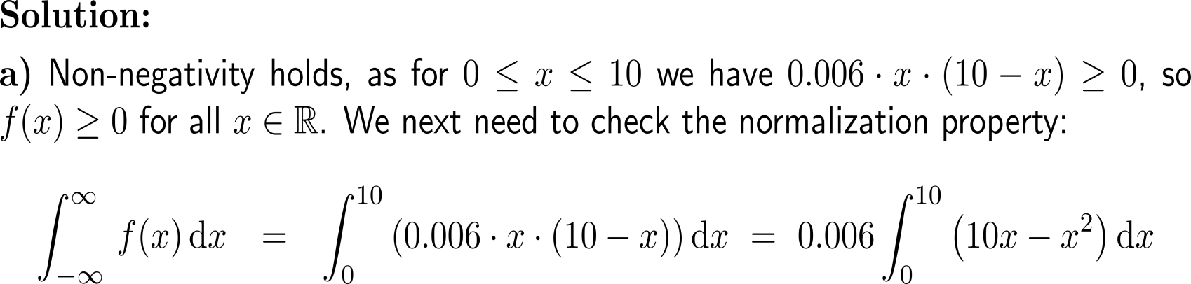
Example
Non-Negativity
Normalization

Slide 22
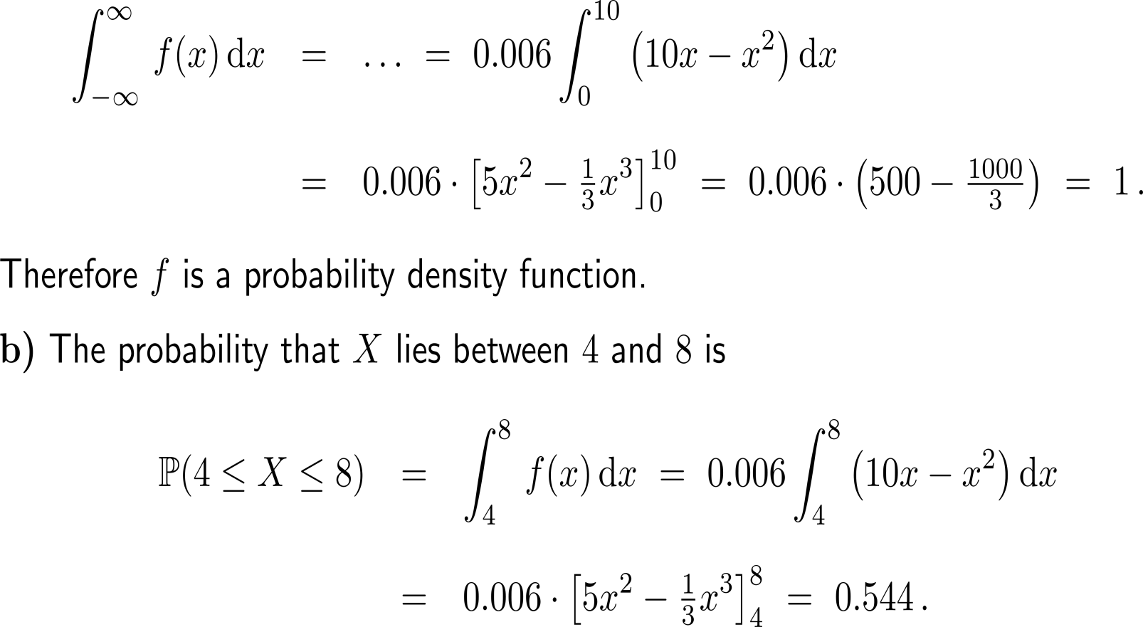
Example

Slide 23
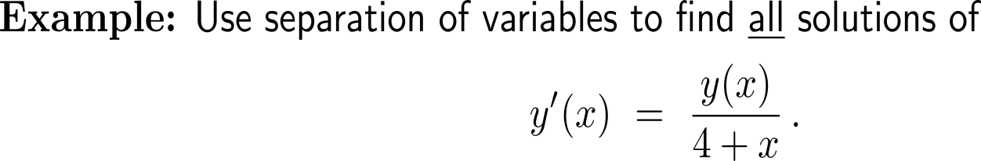
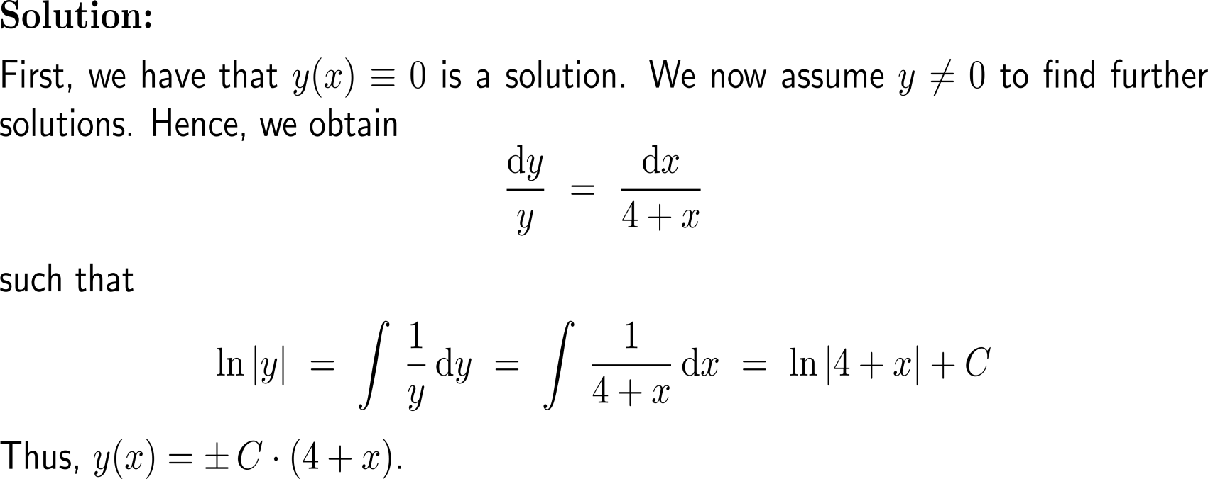
Example:
Separable ODEs

Slide 24
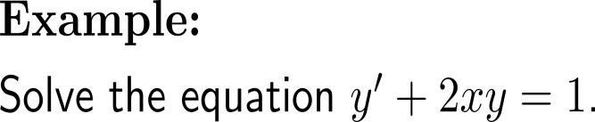
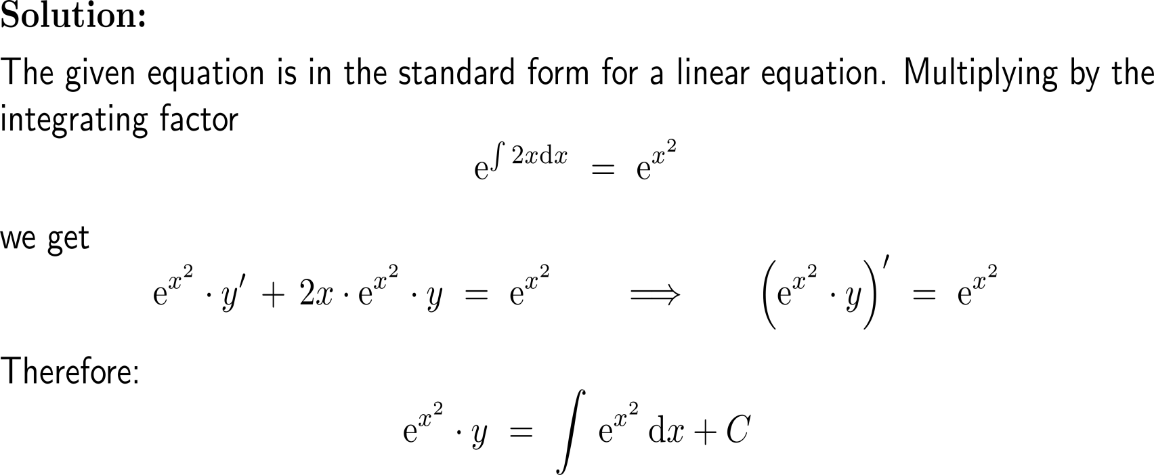
Example:
Linear ODEs and integrating factors

Slide 25
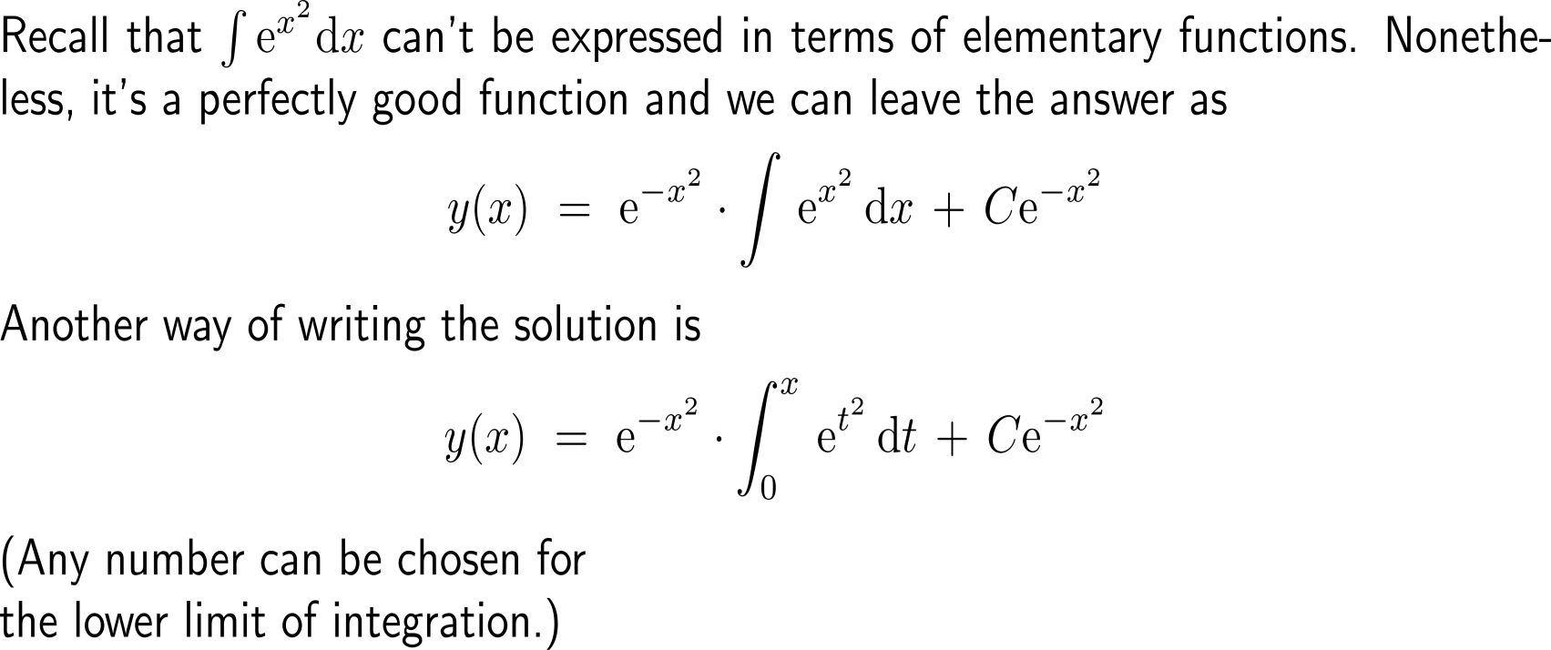
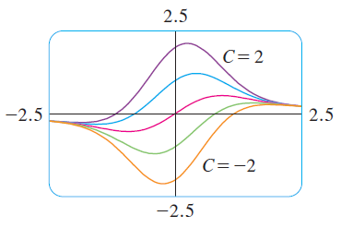
Example:
Linear ODEs and integrating factors
Even though the solutions are expressed in terms of an integral, they can still be graphed by a computer algebra system

Slide 26
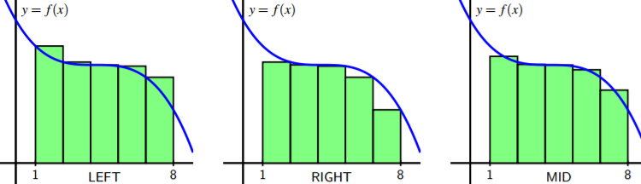
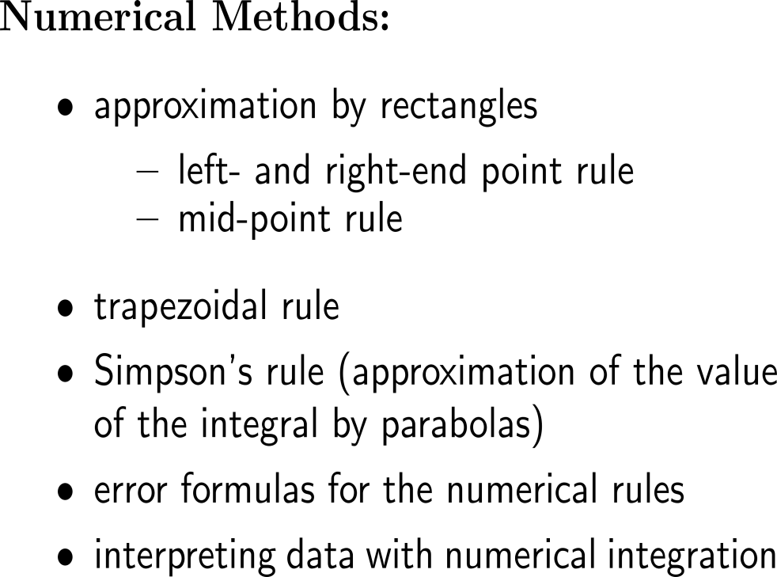
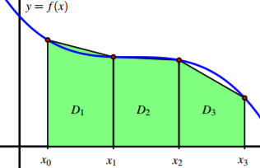
Summary:
Introduction to Numerical Integration

Slide 27
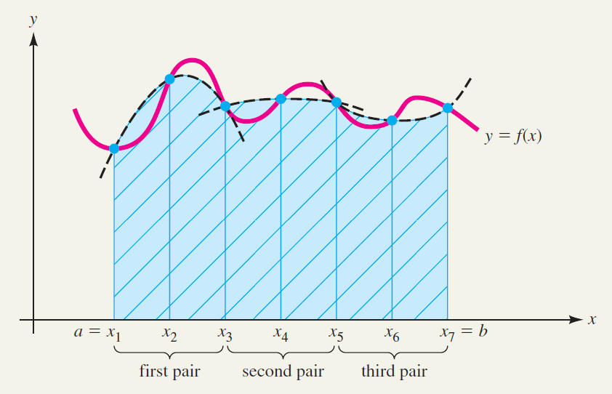
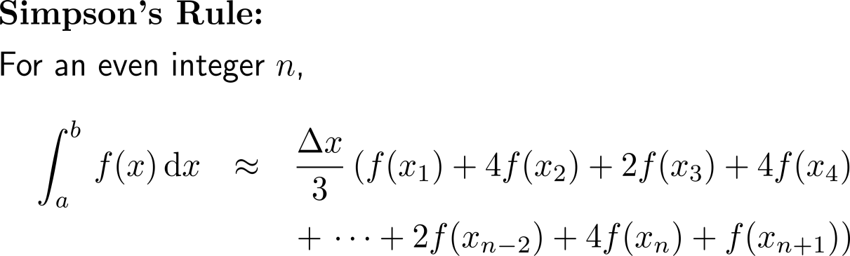
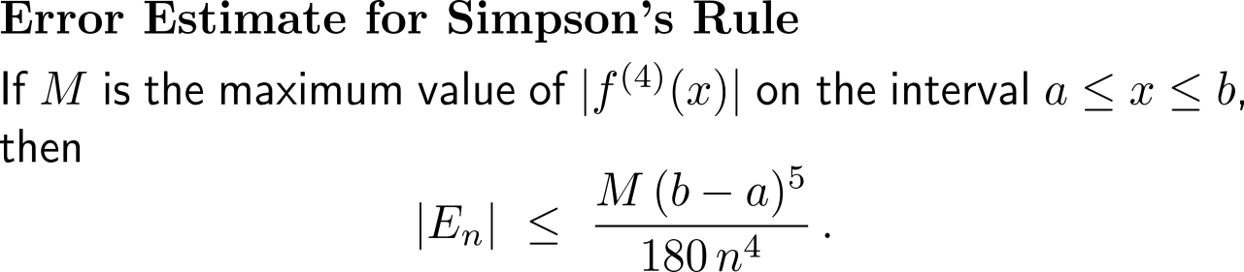
For instance, Simpson’s rule uses the evaluation of the function at the start/ end point of the subintervals times a weighting factor

Slide 28
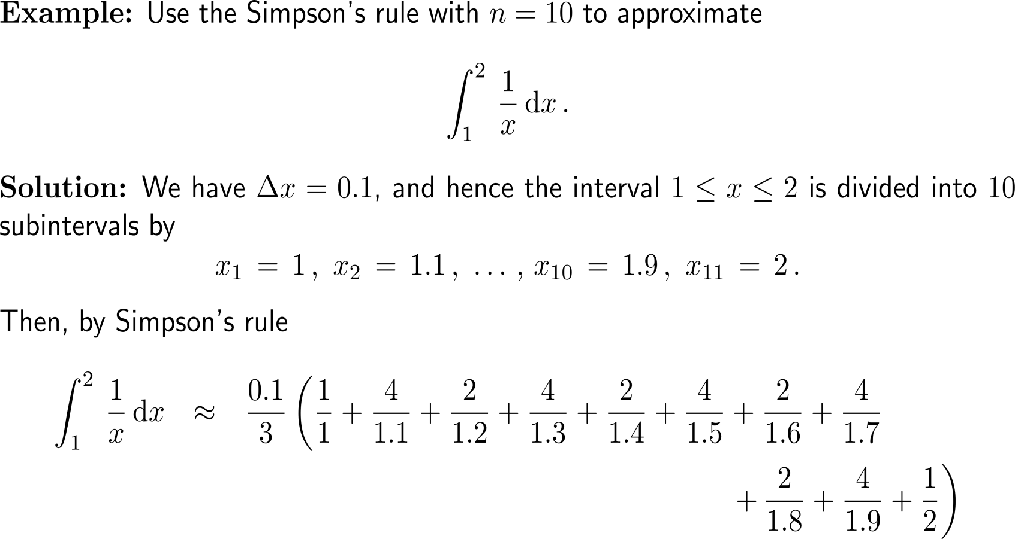
Example:
Application of Simpson’s Rule

Slide 29
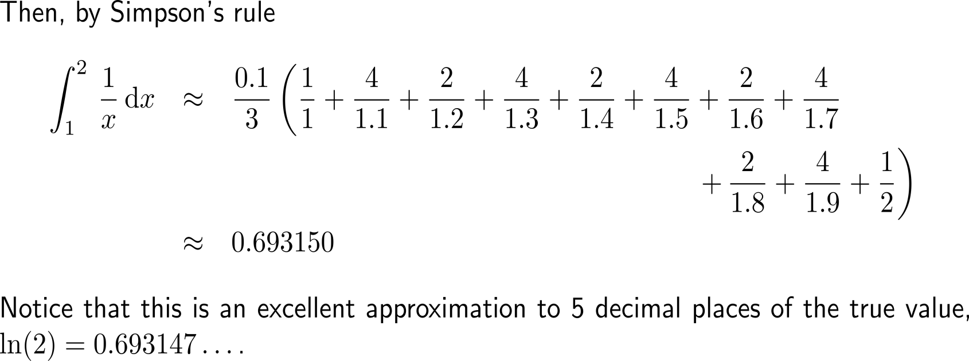
Example:
Application of Simpson’s Rule

Slide 30
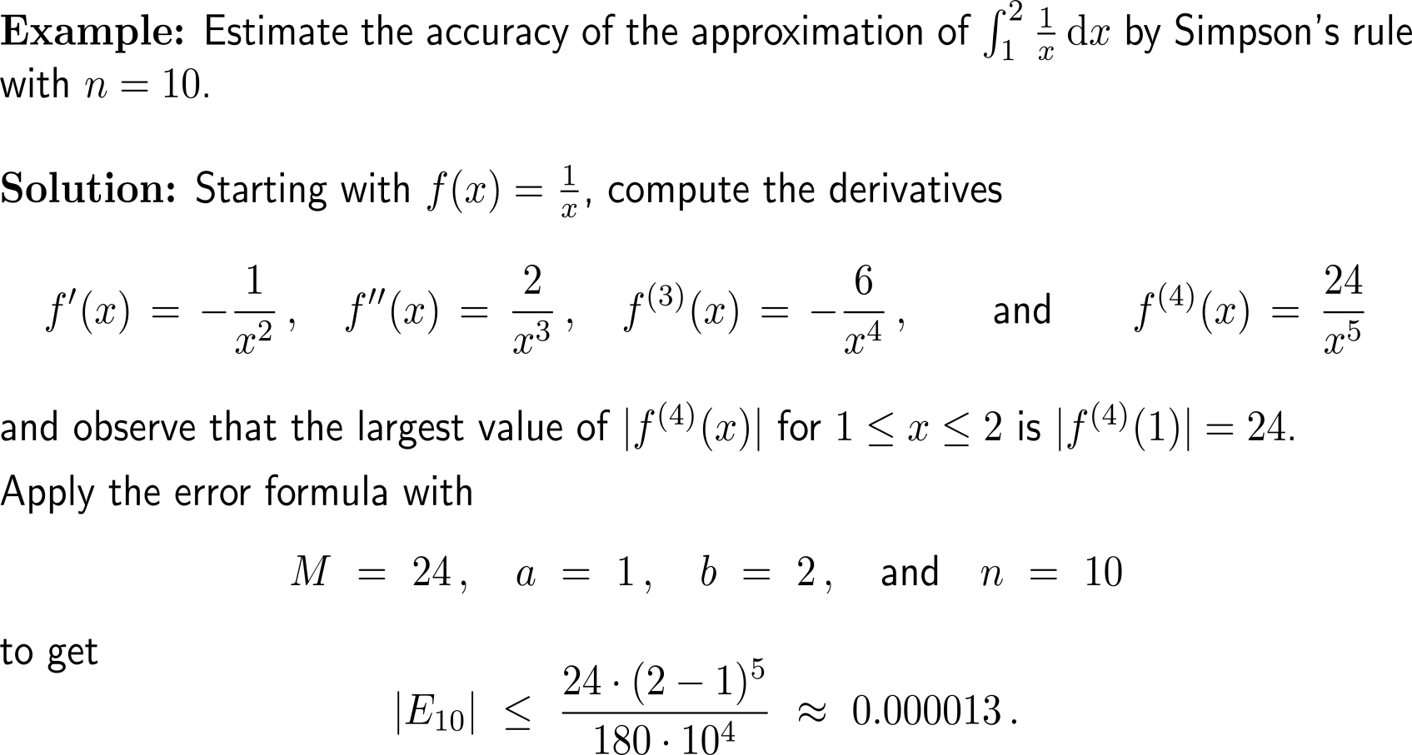
Example:
Using error estimates for Simpson’s Rule

Slide 31
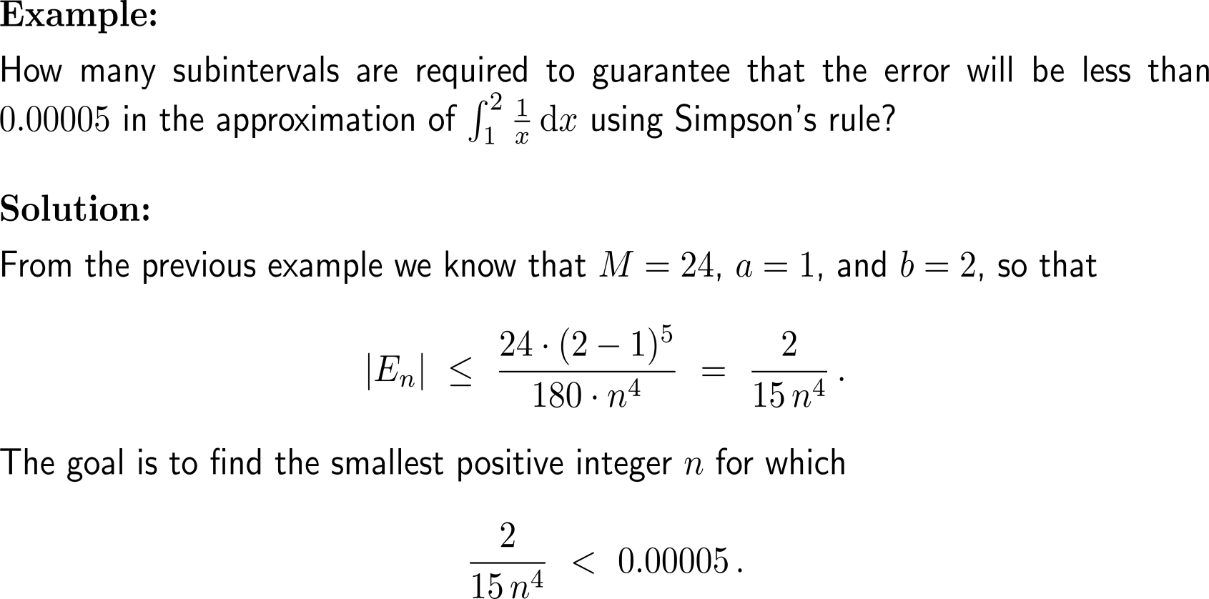
Example:
Ensuring a certain level of accuracy

Slide 32

Example:
Ensuring a certain level of accuracy

Slide 33
Topics
  Recap: Introduction to Vectors and Matrices
  Recap: Advanced Topics in Integration
  Recap: Functions in Several Variables & Optimization
  Recap: Double Integrals & Applications

Slide 34


Summary:
Functions in Several Variables & Optimization

Slide 35


Example:
Application of the Chain Rule
The curve C with
x = sin(2t),
y = cos(t).

Slide 36


Example

Slide 37


Example

Slide 38


Example

Slide 39

Example

Slide 40


Example
(0, 2)
(1, 1)
y = – 0.5 x + 2
(0, 0)
(4, 0)

Slide 41


Example

Slide 42

Example
(0, 2)
y = – 0.5 x + 2
(0, 0)
(4, 0)

Slide 43
Example
(0, 2)
y = – 0.5 x + 2
(0, 0)
(4, 0)
(x, y) | (0, 0) | (1.5, 1.25) | (1, 1) | (0, 2) | (4, 0)
f(x, y) | 0 | 0.875 | 1 | 2 | 4

Slide 44



Example:
Method of Lagrange multipliers

Slide 45

Example:
Method of Lagrange multipliers

Slide 46


Example:
Determining a least-square line

Slide 47

Example:
Determining a least-square line

Slide 48


Example:
Determining a least-square line

Slide 49
Topics
  Recap: Introduction to Vectors and Matrices
  Recap: Advanced Topics in Integration
  Recap: Functions in Several Variables & Optimization
  Recap: Double Integrals & Applications

Slide 50


Summary:
Double Integrals

Slide 51


Example:
Evaluating a double integral

Slide 52

Example:
Evaluating a double integral

Slide 53

Example:
Evaluating a double integral

Slide 54

Example:
Evaluating a double integral over a region

Slide 55



Example:
Evaluating a double integral over a region

Slide 56

Example:
Evaluating a double integral over a region

Slide 57

Example:
Evaluating a double integral over a region

Slide 58

As we don’t have a homework assignment sheet, here’s the final comic for this semester.
Questions & Remarks?

Slide 59

Happy Semester Beak
and
Good Luck for the Finals

Slide 60
Calculus II for Management

